Slide 1
DEVOPS CAPSTONE · END-TO-END DELIVERY
ClinicDesk
A clinic appointments app — built, tested, scanned,
and deployed by pipeline, not by hand.
commit → test → scan → publish → GitOps → cluster → observe
github.com/Datman701/devops_capstone
Terraform · Kubernetes · Helm · GitHub Actions · ArgoCD · Prometheus · Grafana

Slide 2
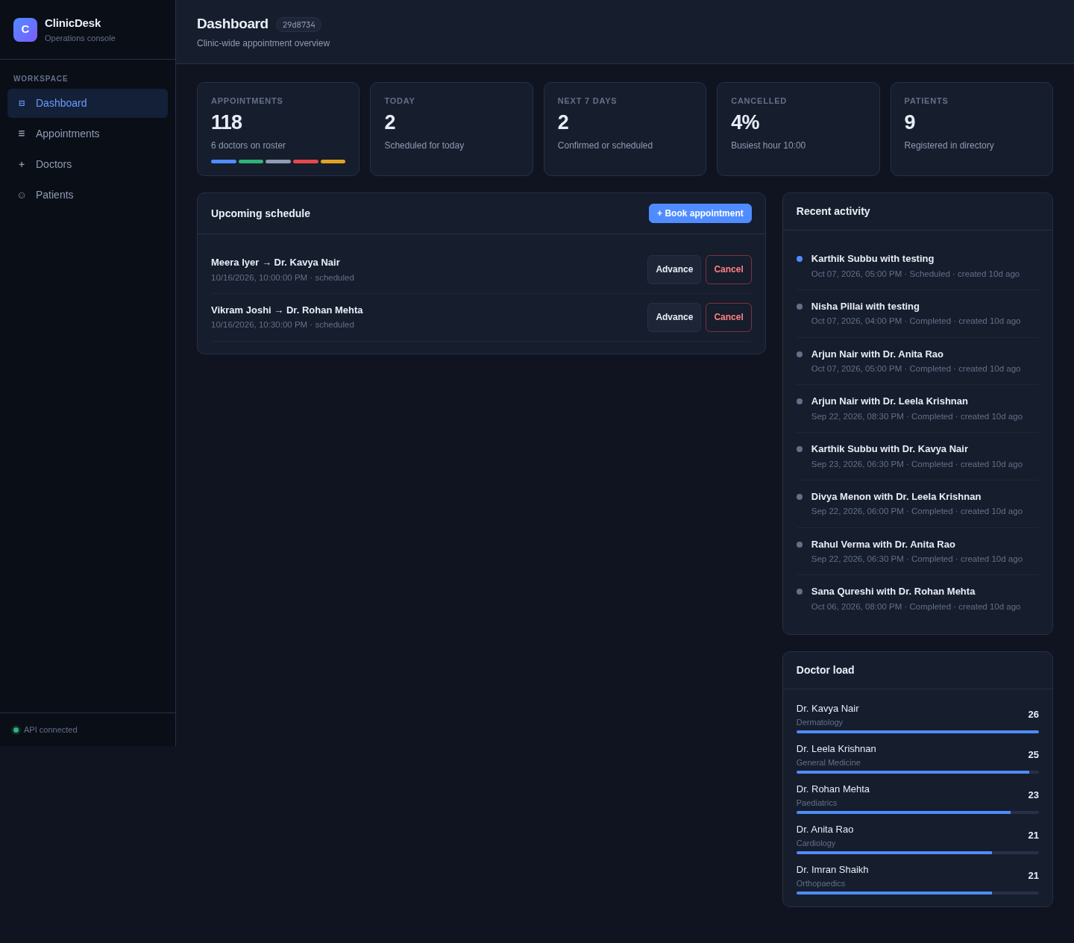
01 · THE PRODUCT
One small app, one serious pipeline
ClinicDesk manages doctors, patients, and appointment bookings. It is deliberately small — the real deliverable is everything around it: automated builds, security scans, infrastructure, deployment, and observability.
Frontend
React + Vite, served by nginx
Backend
FastAPI · Python 3.12 · REST API + /metrics
Database
PostgreSQL 16 with persistent storage
github.com/Datman701/devops_capstone
02

Slide 3
02 · ARCHITECTURE
Every step is automated
A commit travels a fully automated path from developer to a measured, running container.
Dev
commit
GitHub
repository
Actions
test · scan · build
GHCR
SHA-tagged image
ArgoCD
GitOps sync
Kubernetes
kind · EKS
Metrics
Prometheus · Grafana
Gated by design
Nothing reaches the cluster unless it passes tests and the security scan.
Reproducible
The chart deploys the same SHA-tagged images that CI published.
github.com/Datman701/devops_capstone
03

Slide 4
03 · STACK
Tools chosen for automation, not novelty
APP
CONTAINERS
CI / CD
REGISTRY
FastAPI · React
Docker
GitHub Actions
GHCR
PostgreSQL 16
multi-stage builds
gated jobs
commit-SHA tags
INFRA
RUNTIME
GITOPS
METRICS
Terraform
Kubernetes
ArgoCD
Prometheus
AWS VPC + EKS
+ Helm chart
declarative sync
+ Grafana
github.com/Datman701/devops_capstone
04

Slide 5
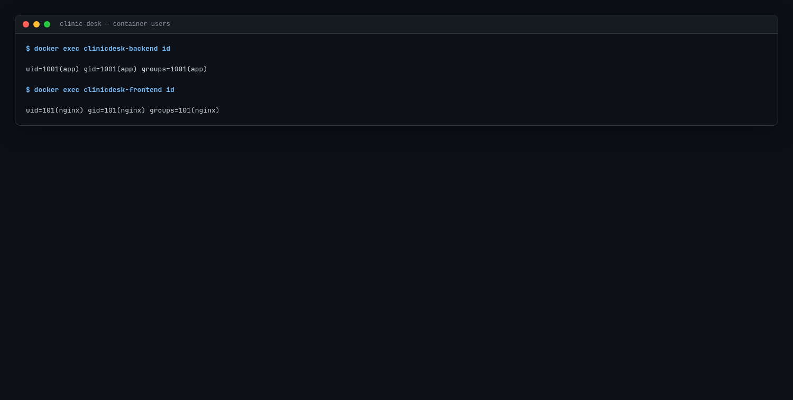
04 · CONTAINERS
Small images, least privilege
Reviewed Dockerfiles that ship only what runs.
Multi-stage builds
Compilers and build tools never reach the runtime image.
Non-root runtime
Backend runs as uid 1001, frontend as uid 101.
Pinned bases + health checks
Predictable builds and probe-ready containers.
github.com/Datman701/devops_capstone
05

Slide 6
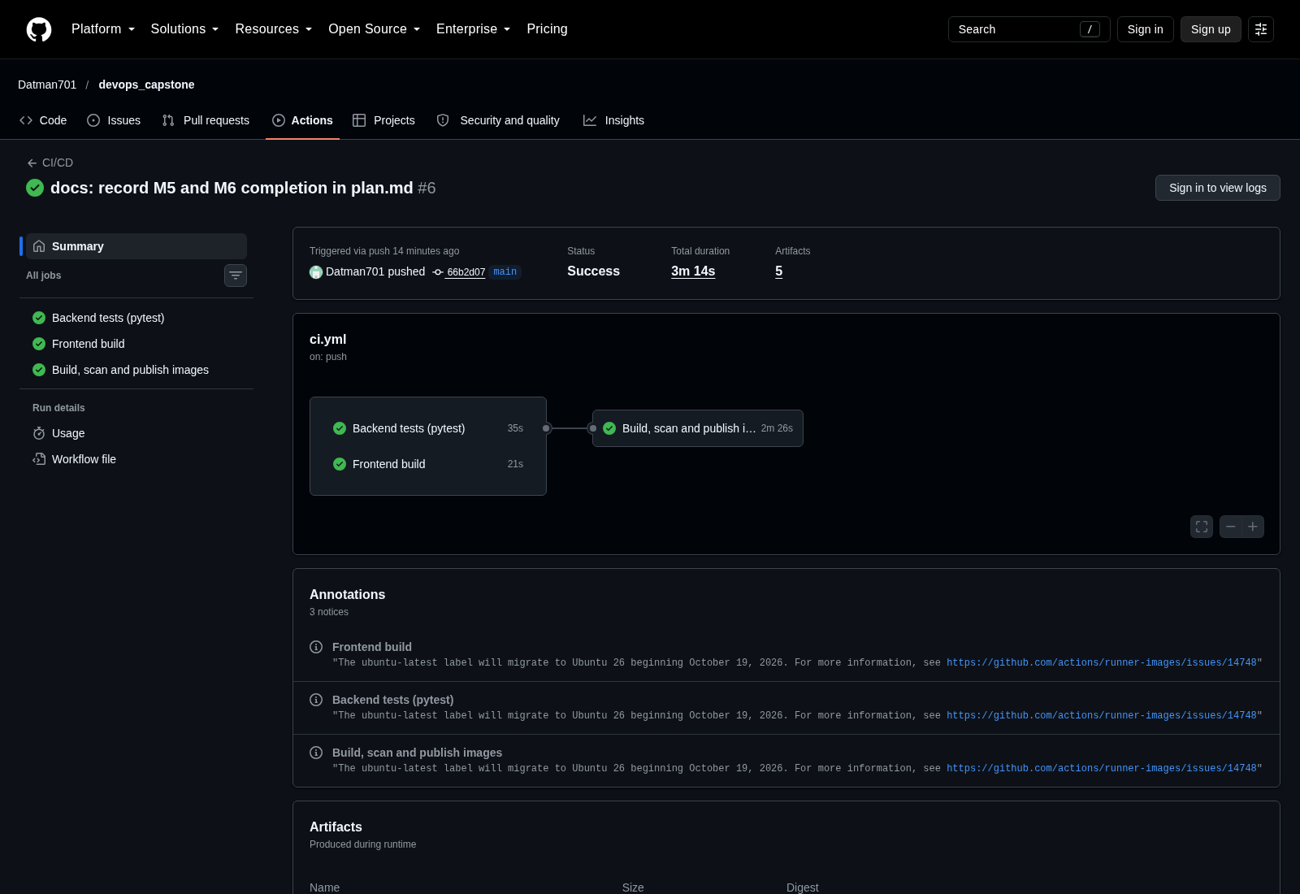
05 · CI / CD
Three gated jobs, one green path
Every push runs the same pipeline; each job blocks the next.
backend-test
85 pytest tests plus ruff lint must pass first.
frontend-build
Production bundle is built and checked.
docker
Images are built and pushed to GHCR.
SHA-tagged, never :latest
Each image carries its commit SHA for traceability.
github.com/Datman701/devops_capstone
06

Slide 7
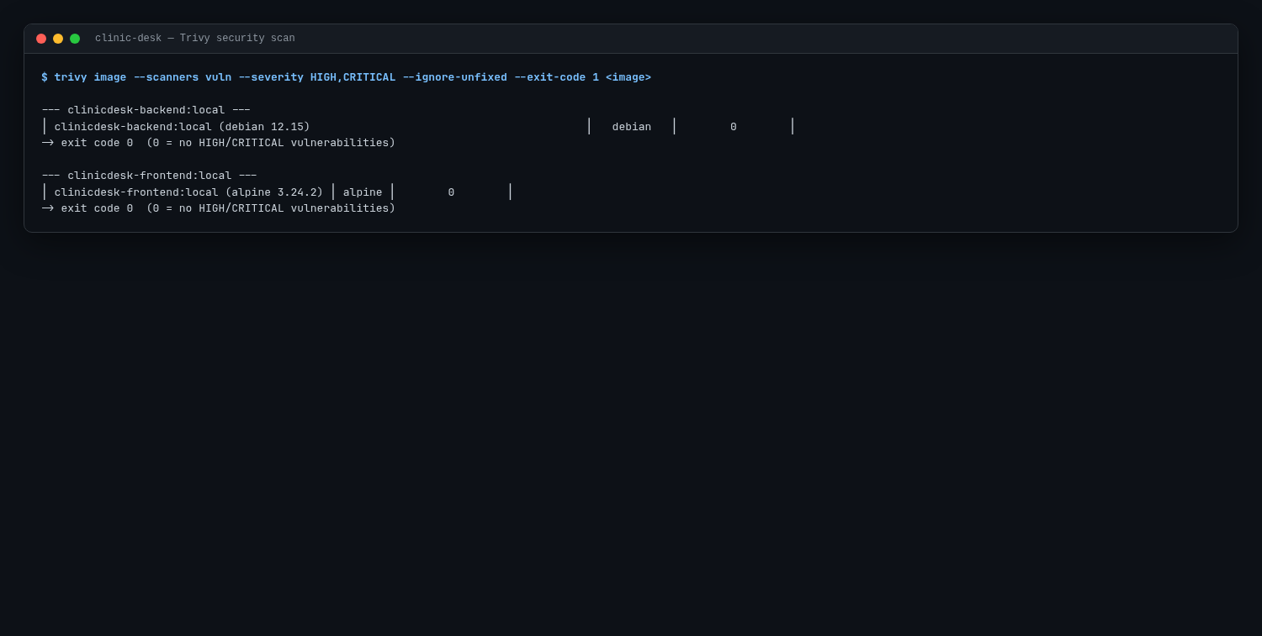
06 · SECURITY
Security is a gate, not an afterthought
Trivy runs inside CI, before anything is published.
Scanned in the pipeline
Both images are scanned for known vulnerabilities.
Fail on HIGH / CRITICAL
A serious finding stops the build and the publish.
Clean result shipped
The released images report 0 HIGH / 0 CRITICAL.
github.com/Datman701/devops_capstone
07

Slide 8
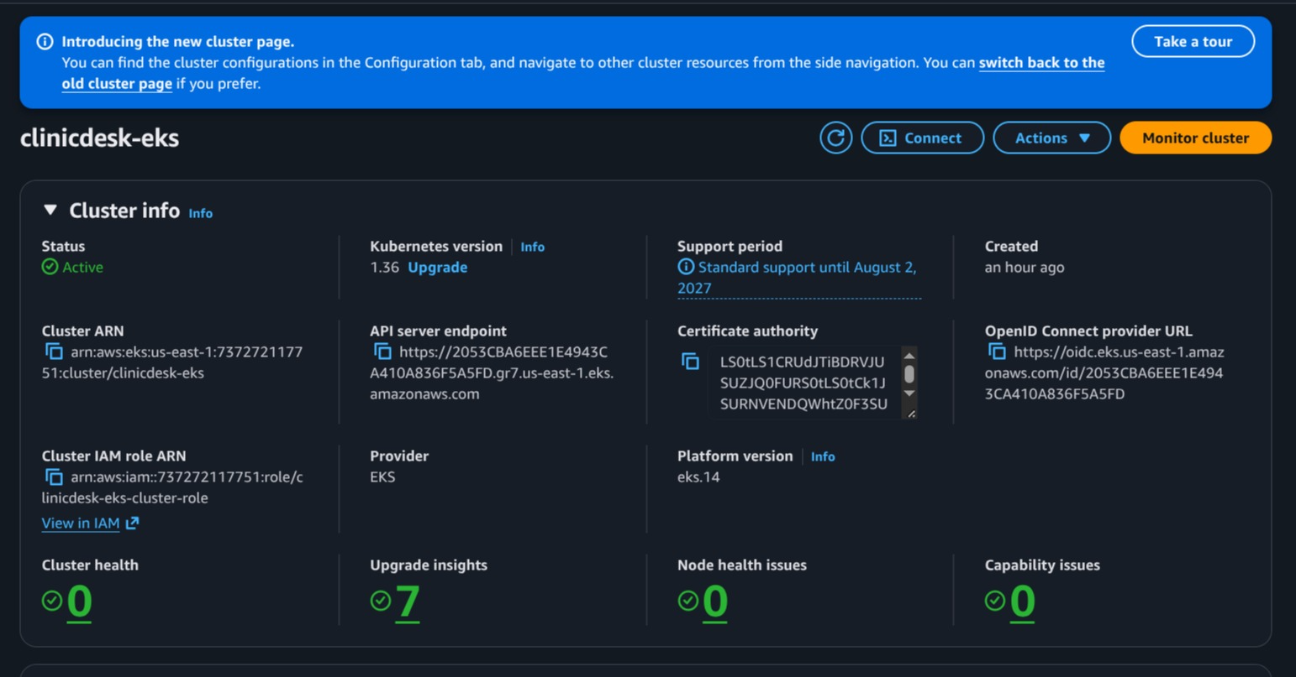
07 · INFRASTRUCTURE AS CODE
Infrastructure defined once, in code
Terraform builds and tears down the AWS foundation.
Networking
VPC with 2 public + 2 private subnets and an Internet Gateway.
Compute
Amazon EKS 1.36 with a managed worker node group.
27 resources, one plan
Provisioned by terraform apply, removed by destroy.
github.com/Datman701/devops_capstone
08

Slide 9
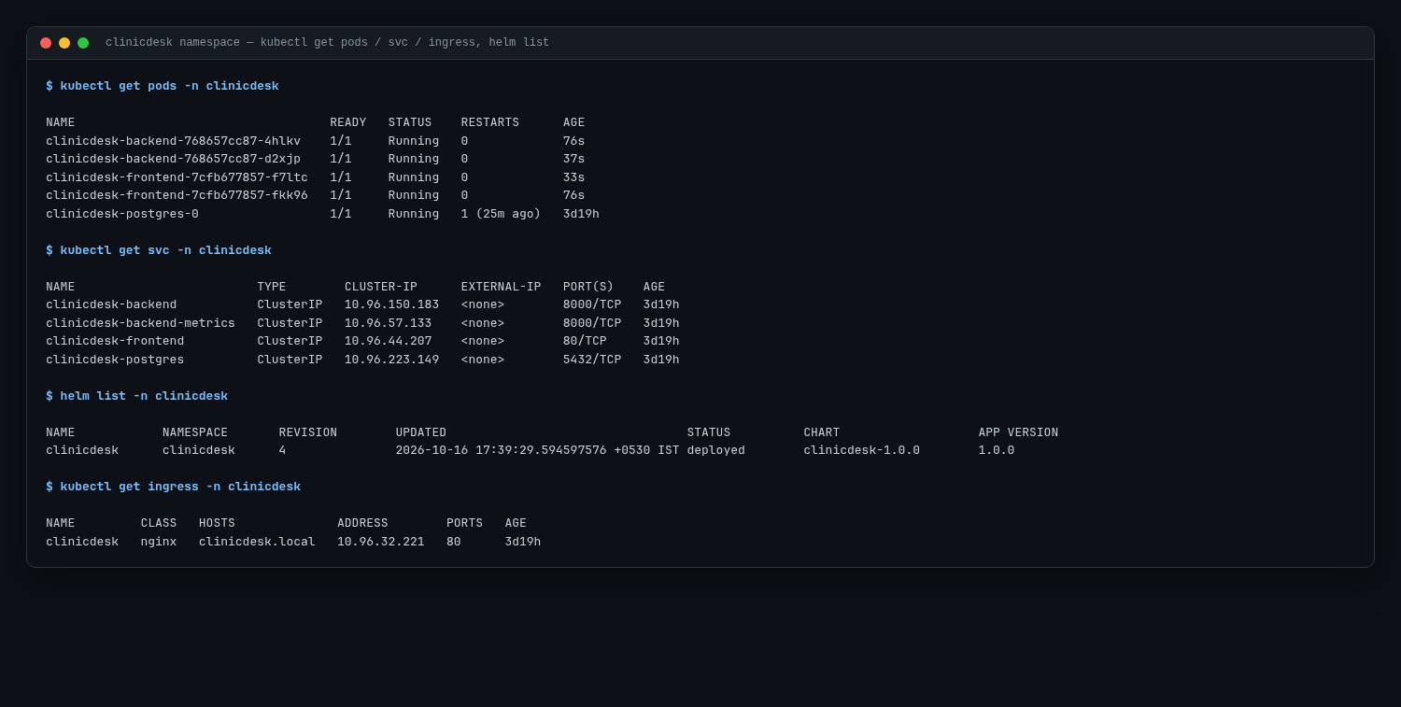
08 · KUBERNETES
Declarative deploys that roll, not break
One Helm chart describes the whole application.
A chart, not a script
Frontend, backend and PostgreSQL defined as templates.
5 pods running
Two backend, two frontend, one database replica.
Zero-downtime updates
Rolling updates with maxUnavailable 0, ClusterIP services, nginx Ingress.
github.com/Datman701/devops_capstone
09

Slide 10
09 · GITOPS
Git is the single source of truth
Git repo
helm chart + manifests
(versioned, reviewable)
ArgoCD
watches the repo,
reconciles the cluster
Kubernetes
desired state applied
continuously
● Synced · Healthy
Declarative, versioned, auditable
The desired cluster state lives in Git alongside the code.
Self-correcting
Drift is detected and reconciled automatically; rollback is a git revert.
github.com/Datman701/devops_capstone
10

Slide 11
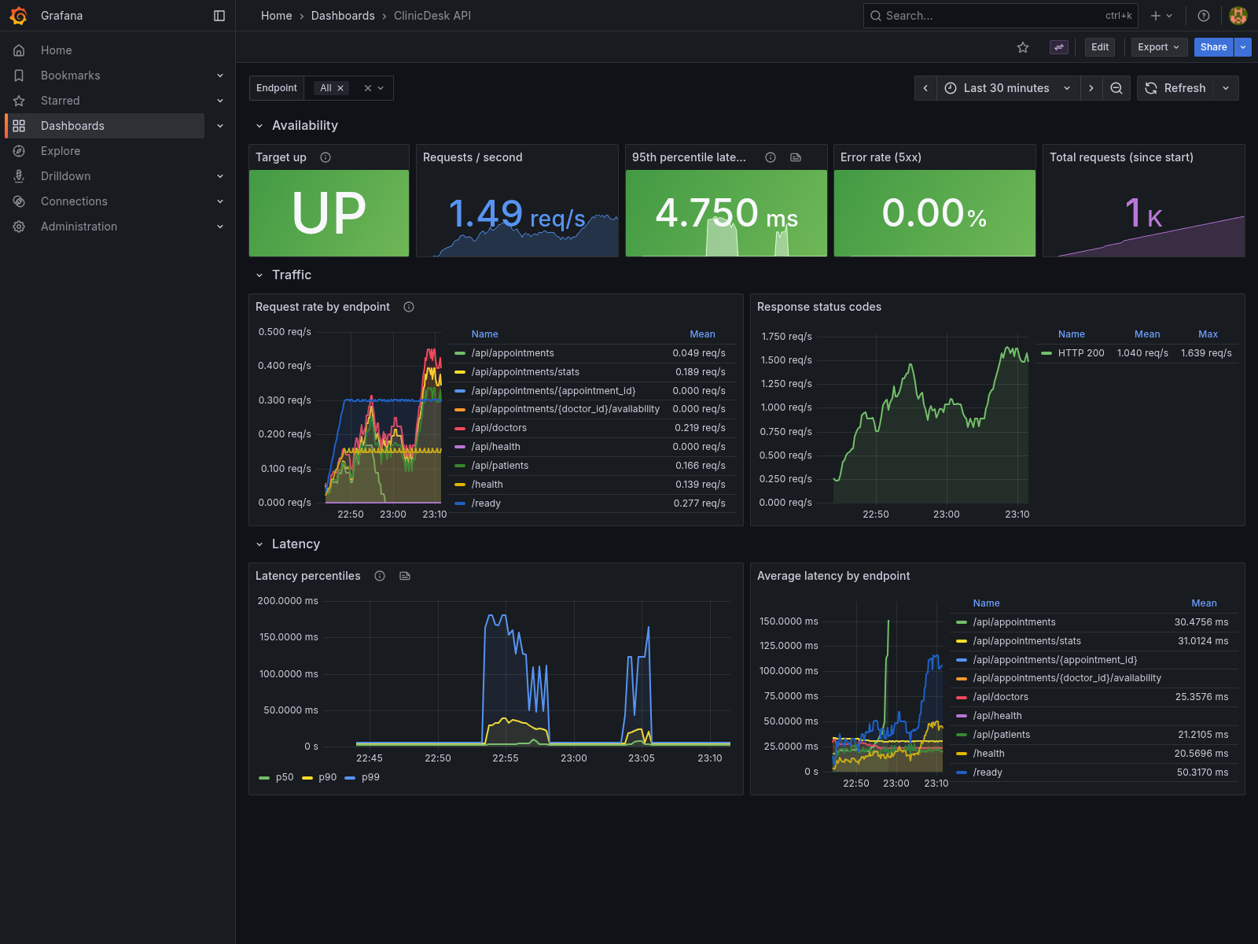
10 · OBSERVABILITY
If it runs, it is measured
Metrics close the loop from request to container.
Prometheus scraping
The API exposes /metrics; target clinicdesk-api reports UP.
Grafana dashboard
Nine live panels covering throughput, latency, errors, DB and resources.
Proves the pipeline
Dashboards read the same instance CI deployed.
github.com/Datman701/devops_capstone
11

Slide 12
11 · RESULTS
Proof, not promises
85
0
5
27
9
tests passing
HIGH / CRITICAL
pods running
Terraform resources
Grafana panels
The running app displays its own commit SHA — live proof that source, CI, registry, and cluster agree.
github.com/Datman701/devops_capstone
github.com/Datman701/devops_capstone
12

