Slide 1
DS2 Praktikumsaufgabe
Davit Chichua

Slide 2
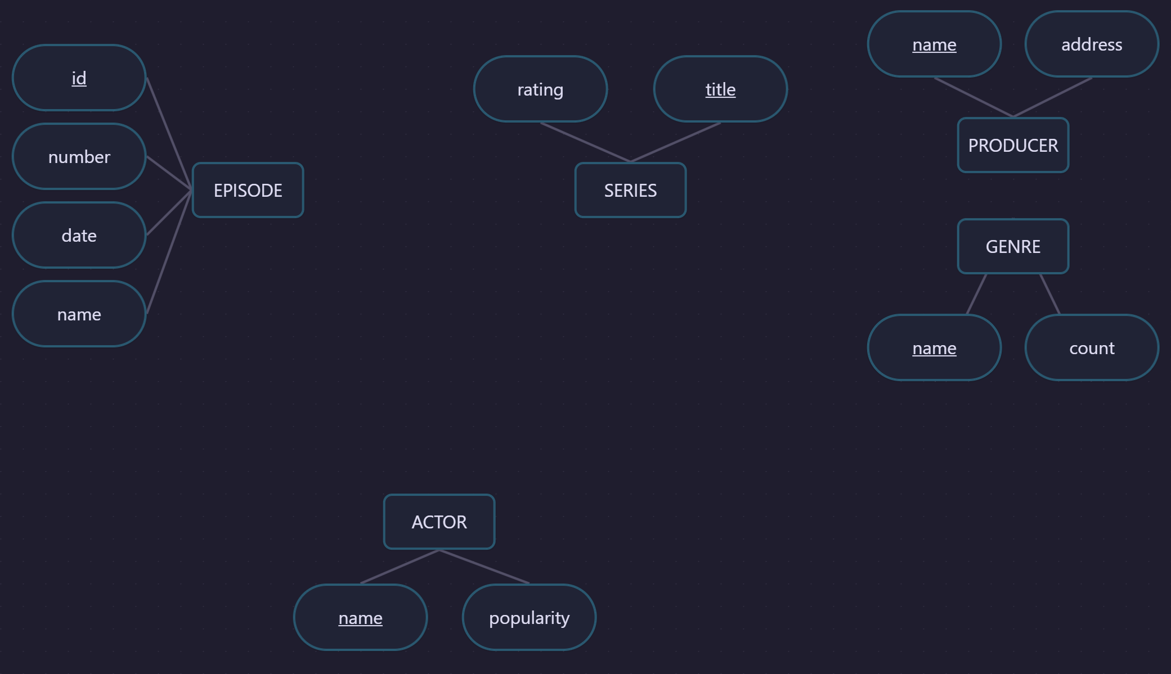

Slide 3
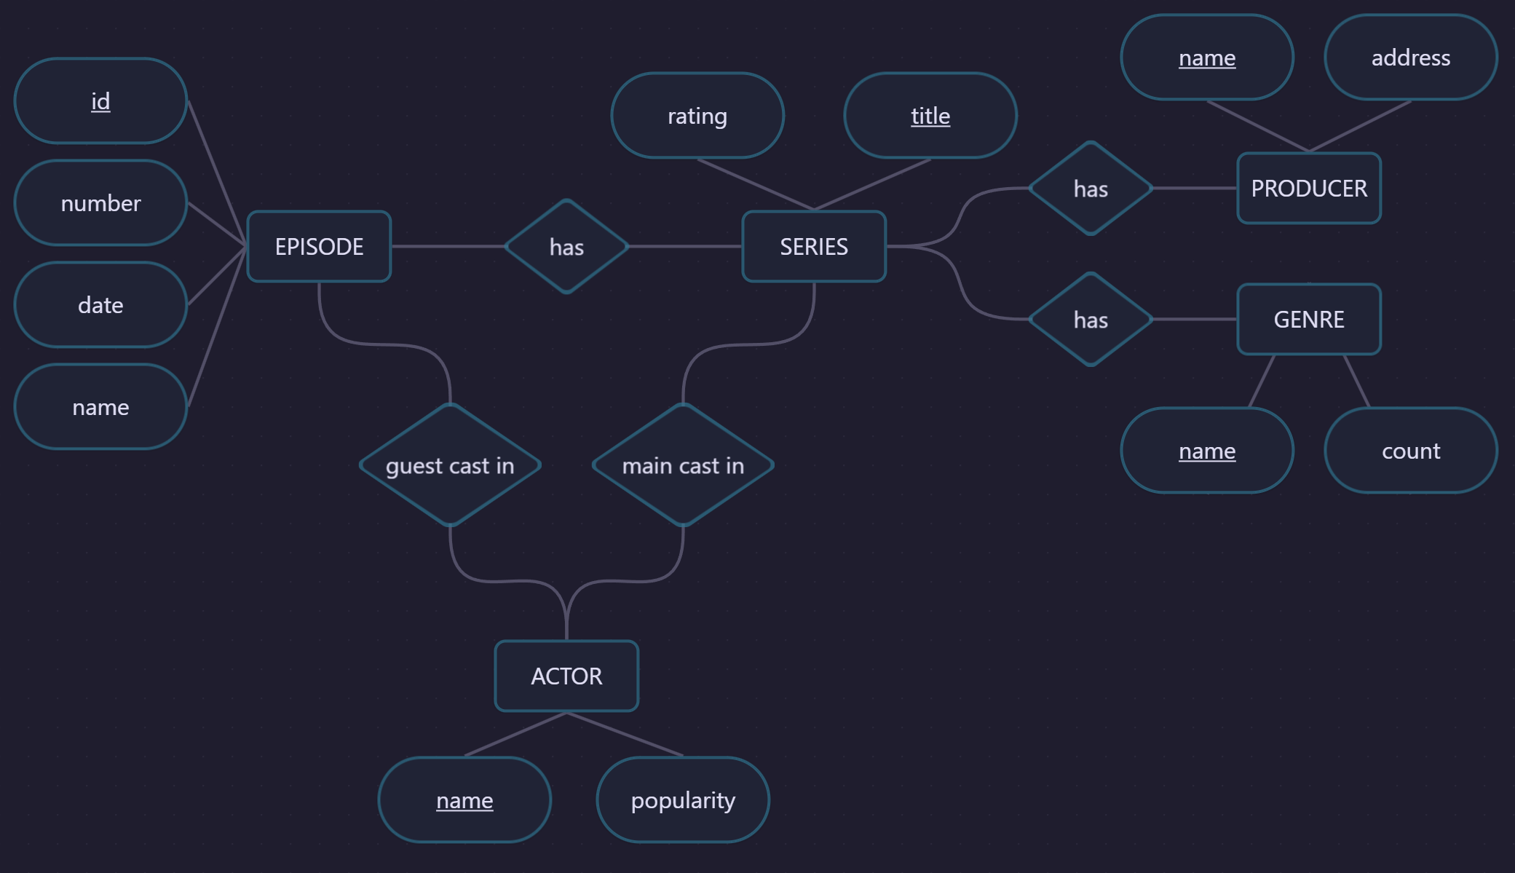

Slide 4
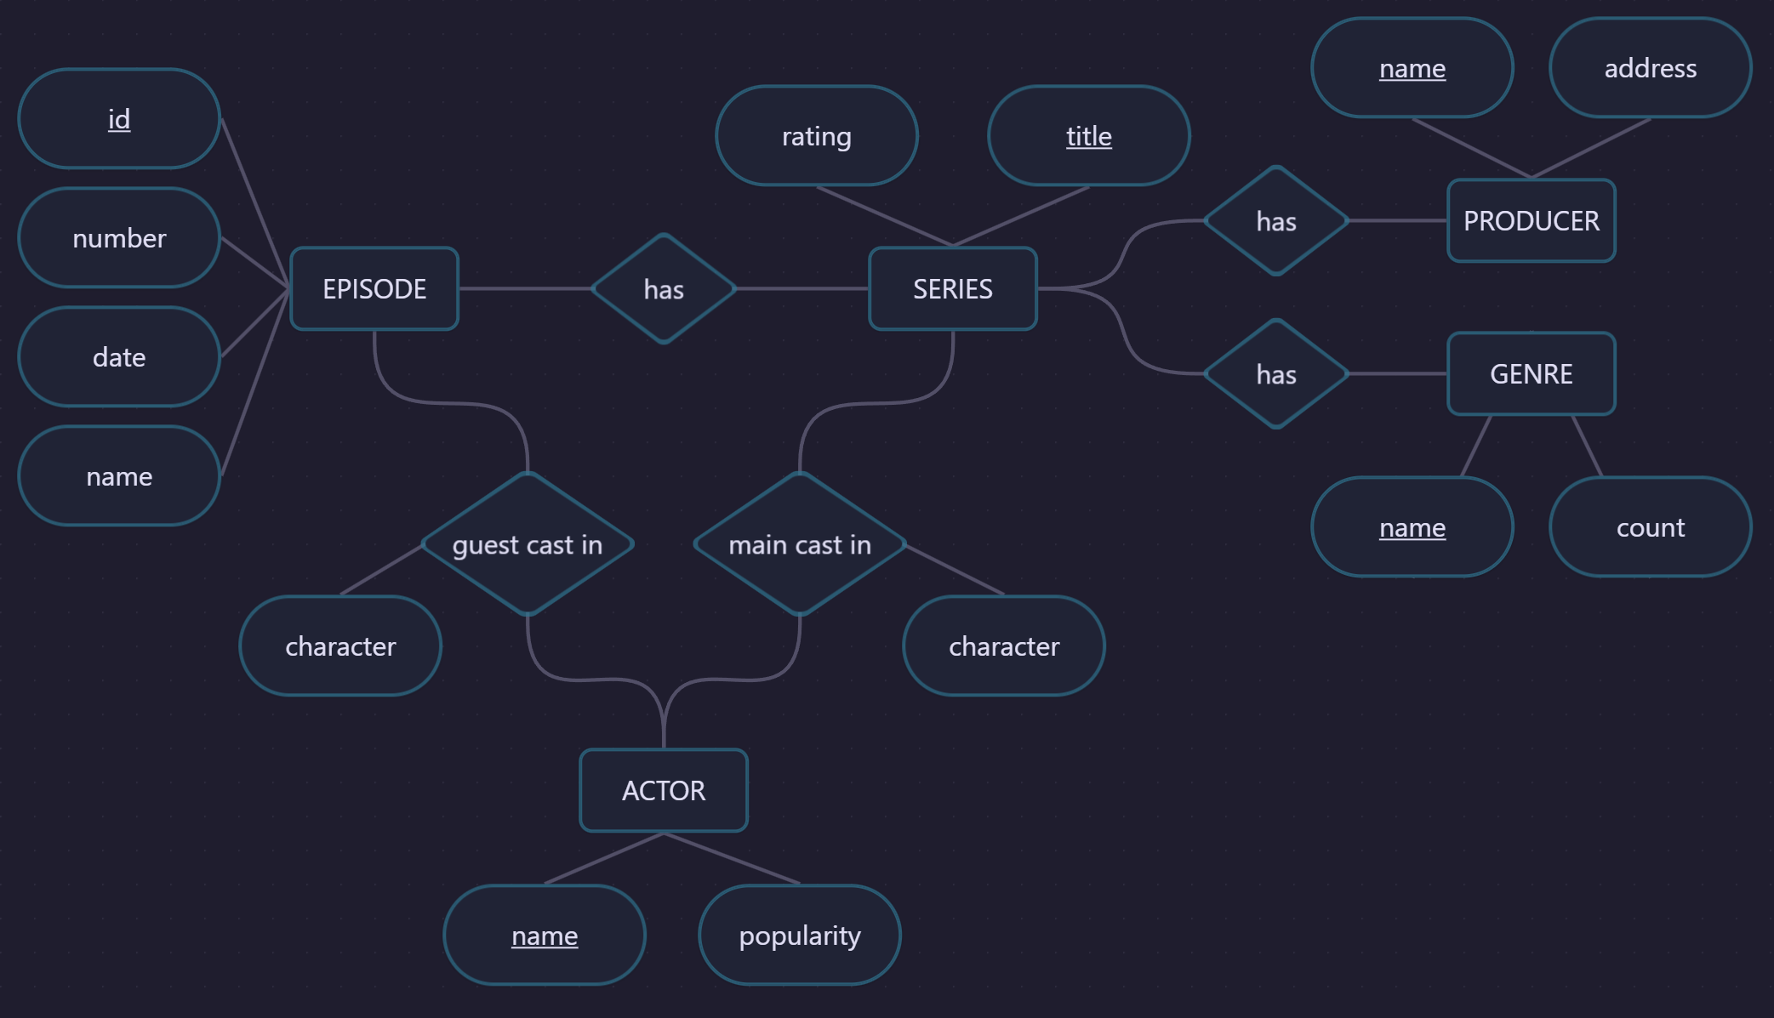

Slide 5
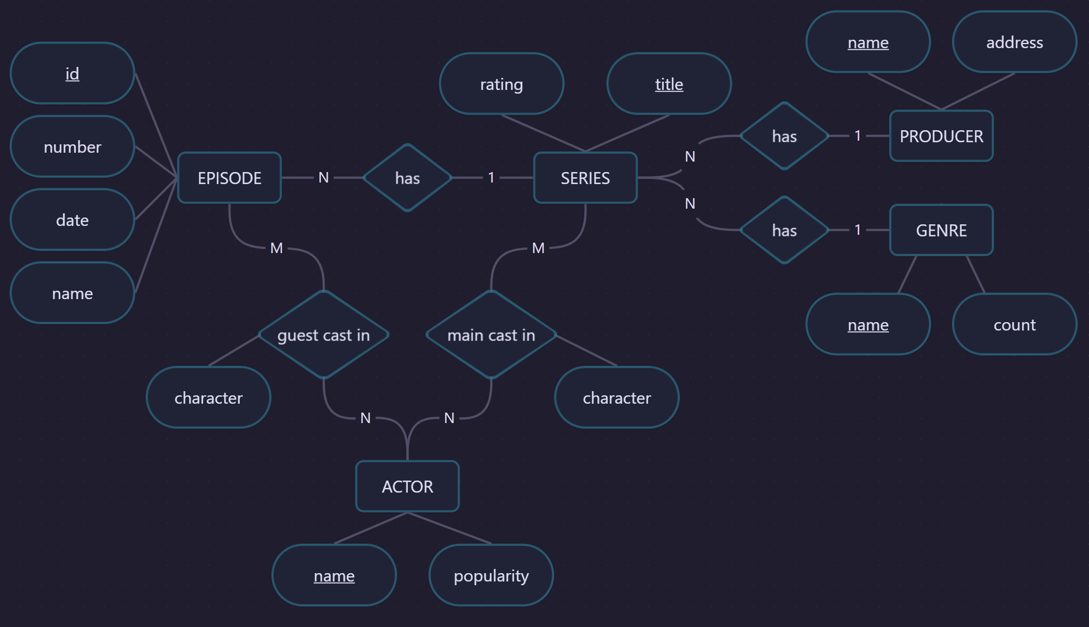

Slide 6
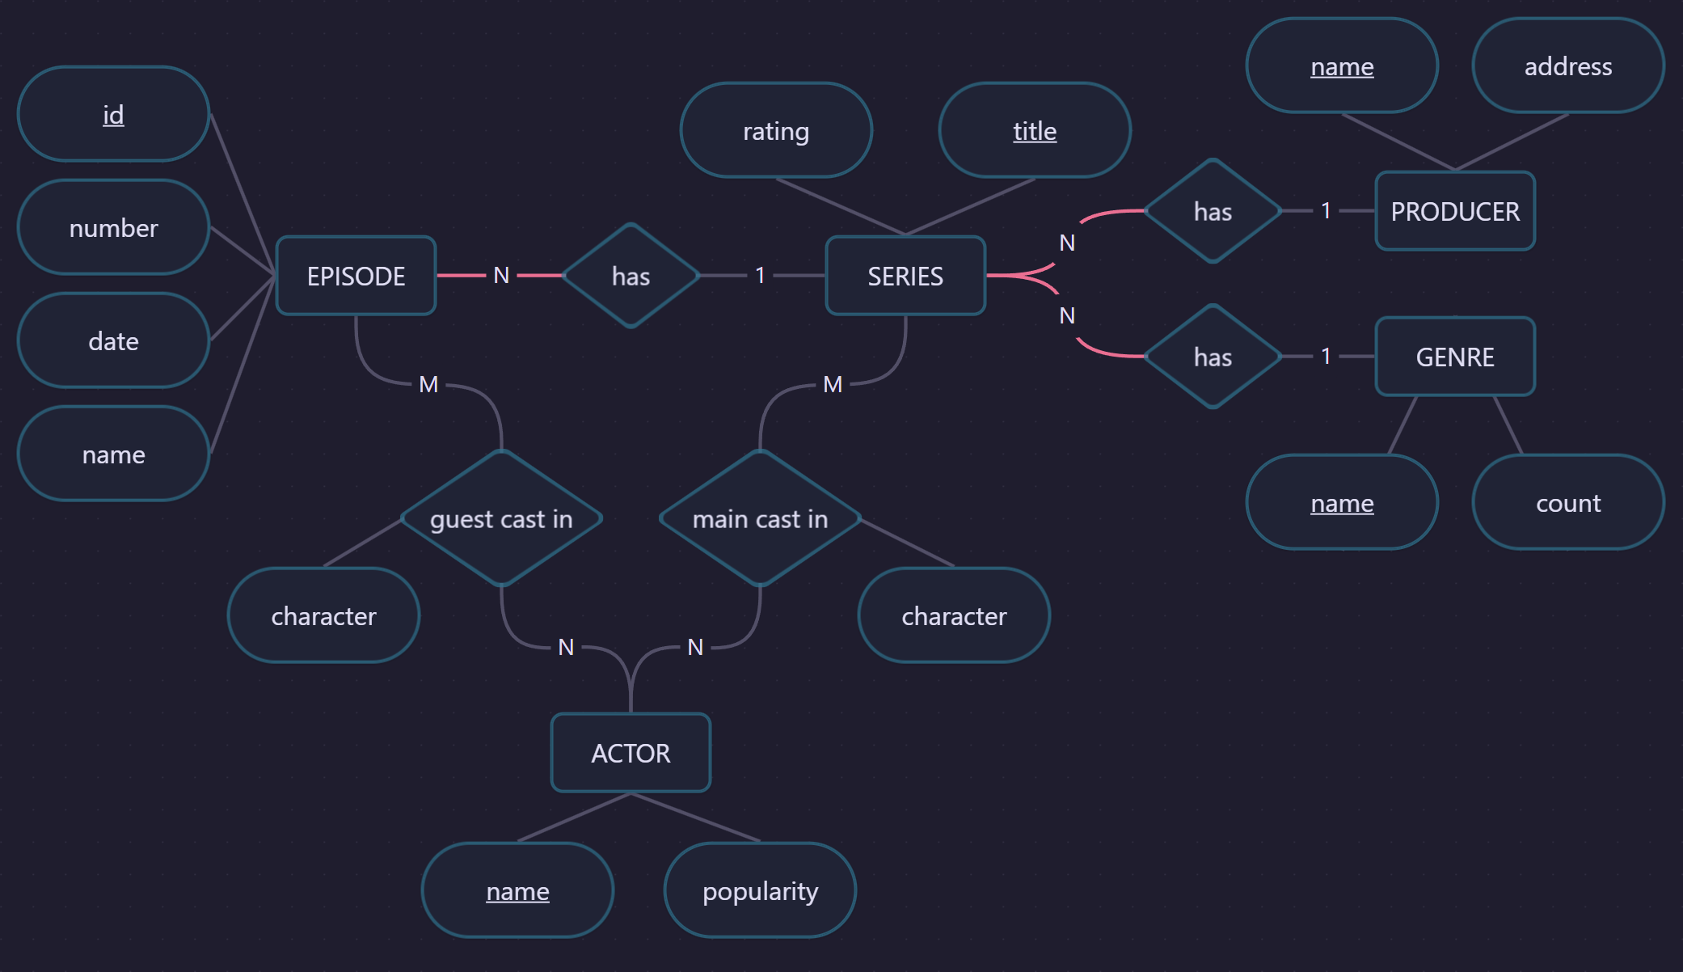

Slide 7
PRODUCER
name
address
GENRE
name
count
ACTOR
name
popularity

Slide 8
SERIES
title
rating
producer → PRODUCER(name)
genre → GENRE(name)
PRODUCER
name
address
GENRE
name
count
ACTOR
name
popularity

Slide 9
EPISODE
id
number
date
name
series → SERIES(title)
SERIES
title
rating
producer → PRODUCER(name)
genre → GENRE(name)
PRODUCER
name
address
GENRE
name
count
ACTOR
name
popularity

Slide 10
EPISODE
id
number
date
name
series → SERIES(title)
SERIES
title
rating
producer → PRODUCER(name)
genre → GENRE(name)
PRODUCER
name
address
GENRE
name
count
ACTOR_EPISODE
actor → ACTOR(name)
episode → EPISODE(id)
character
ACTOR_SERIES
actor → ACTOR(name)
series → SERIES(title)
character
ACTOR
name
popularity
„character“ ist nicht alleine Schlüssel weil:
Charaktere aus verschiedenen Episoden/Serien können denselben Namen haben
Schauspielerwechsel bei Fortsetzung

Slide 11
ACTOR
name
popularity
GENRE
name
count
PRODUCER
name
address
ACTOR_SERIES
actor → ACTOR(name)
series → SERIES(title)
character
EPISODE
id
number
date
name
series → SERIES(title)
SERIES
title
rating
producer → PRODUCER(name)
genre → GENRE(name)
ACTOR_EPISODE
actor → ACTOR(name)
episode → EPISODE(id)
character

Slide 12
ACTOR
name
popularity
GENRE
name
count
PRODUCER
name
address
ACTOR_SERIES
id
actor → ACTOR(name)
series → SERIES(title)
character
EPISODE
id
number
date
name
series → SERIES(title)
SERIES
title
rating
producer → PRODUCER(name)
genre → GENRE(name)
ACTOR_EPISODE
id
actor → ACTOR(name)
episode → EPISODE(id)
character

Slide 13
ACTOR
id
name
popularity
GENRE
id
name
count
PRODUCER
id
name
address
ACTOR_SERIES
id
actor → ACTOR(id)
series → SERIES(id)
character
EPISODE
id
number
date
name
series → SERIES(id)
SERIES
id
title
rating
producer → PRODUCER(id)
genre → GENRE(id)
ACTOR_EPISODE
id
actor → ACTOR(id)
episode → EPISODE(id)
character

