Slide 1



Telegram Chatbot
Astana IT University
Educational Practice project
Damir Temirgaliyev SE-2016

Slide 2
Introduction
Purpose. The purpose of the project is to create a simple Telegram bot that can react to different types of messages in private and public chats. In addition, it has some chat management functions, such as kicking a member of the chat and deleting a message.
Main idea. The main idea of the bot is that it can receive messages from users and react to them according to their type. For example, the bot will answer audio messages and video messages in two different ways. Also, it has two modes in which the bot can operate. The mode is chosen by the users, and every user will have different modes according to their choice.
Software. PyCharm IDE, Python PL

Slide 3
Gantt Chart

Slide 4

Functions
Two modes
Reply to messages (photo, video, audio, long messages)
Chat Management commands (delete message, kick user)

Slide 5
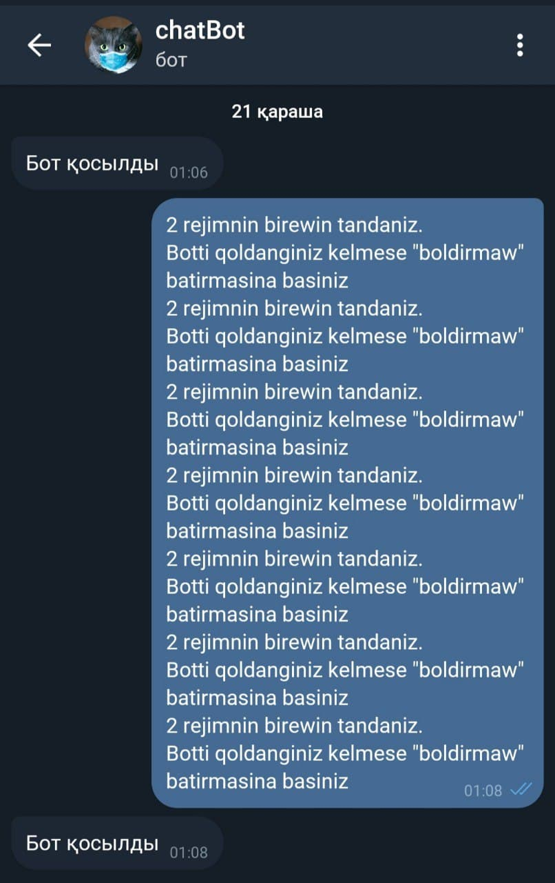
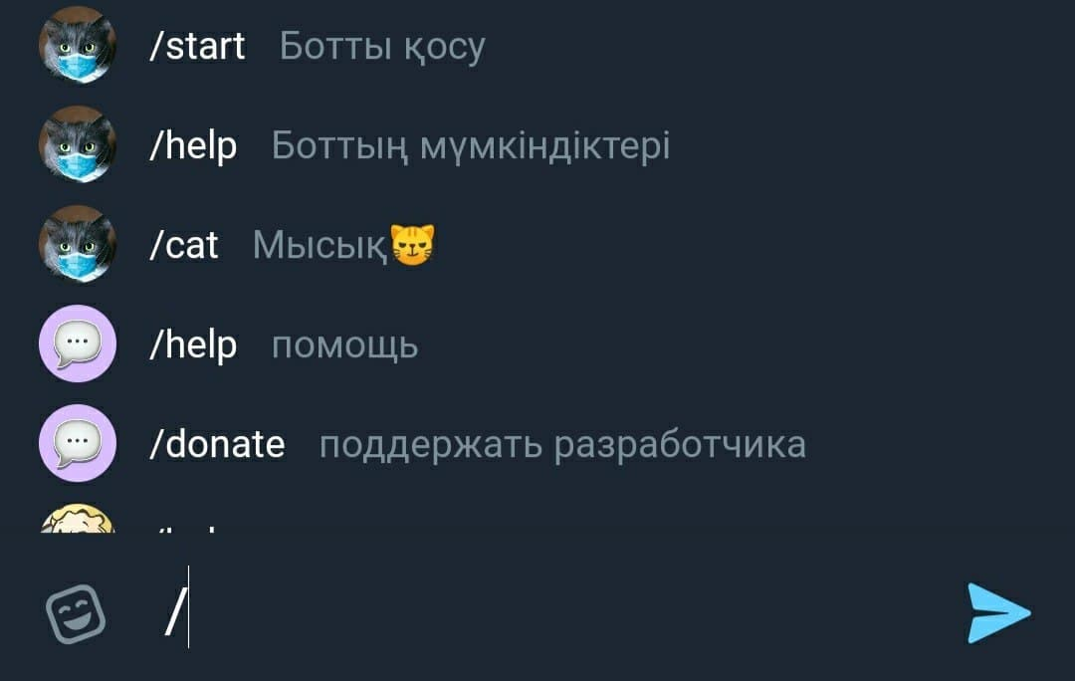
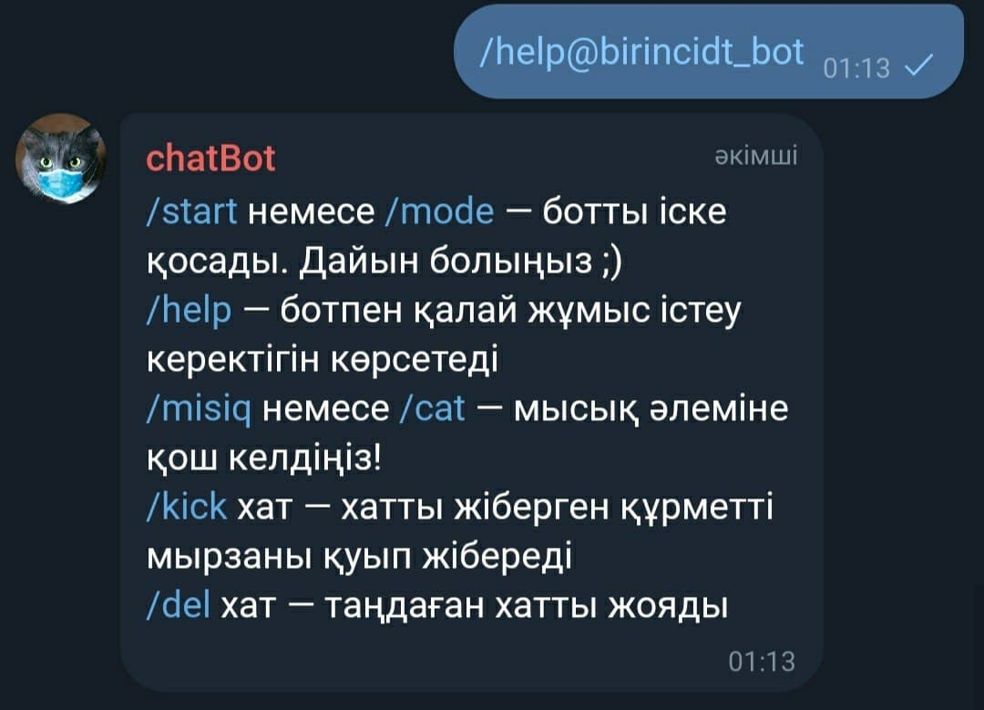
Basic bot abilities
Not all, but the main commands are shown in the commands list
The bot sends notification message to the admin, when it starts
When sending /help command It sends list of the commands that the bot can handle

Slide 6
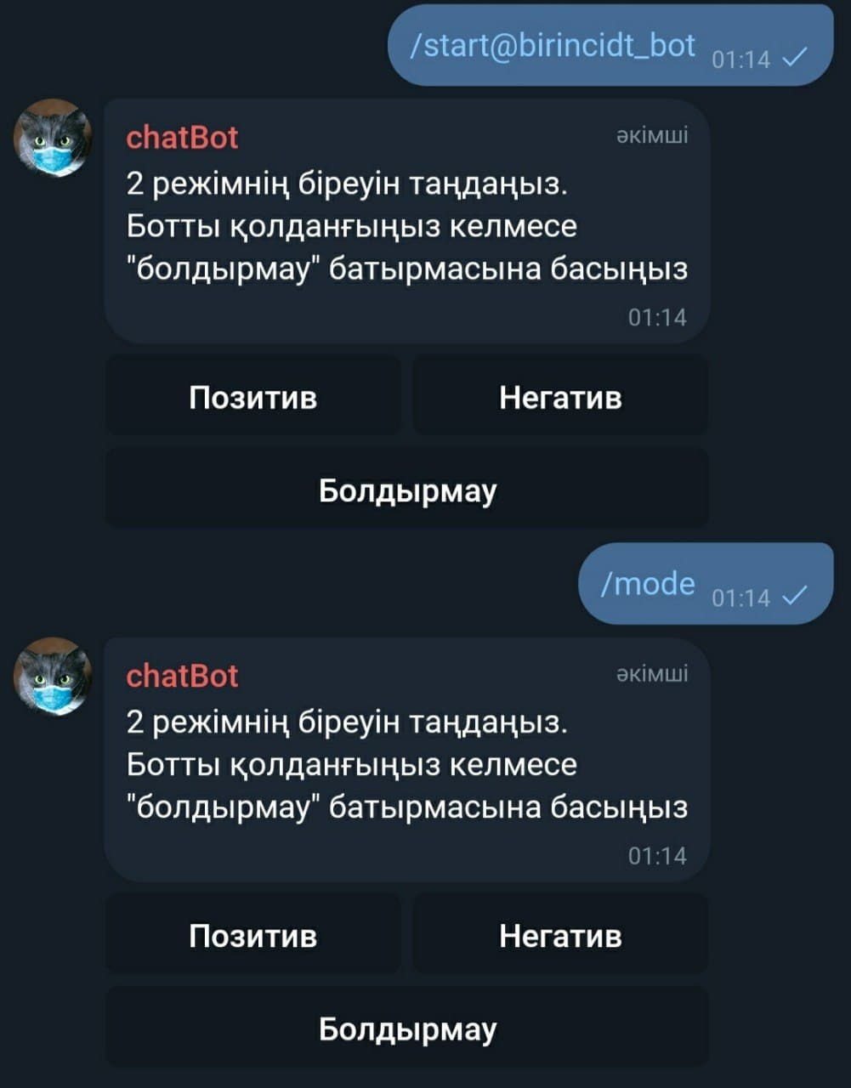
/start and /mode commands start the bot

Slide 7
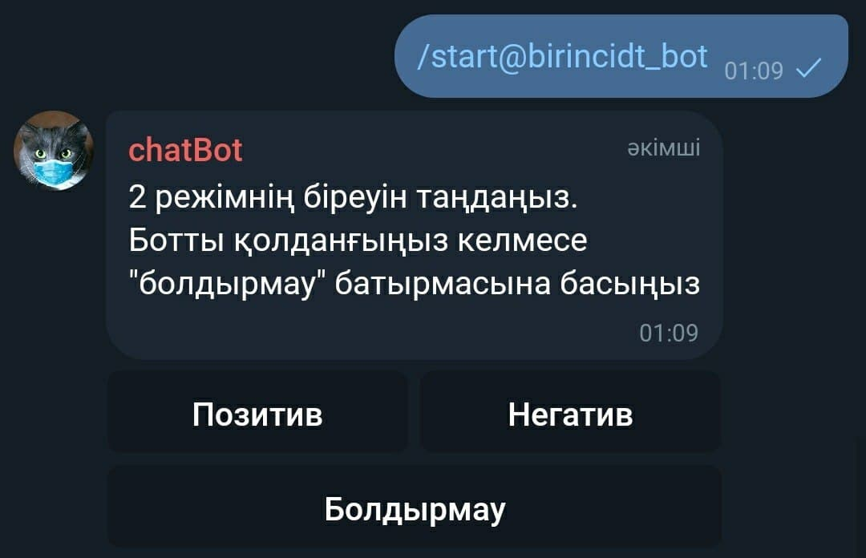
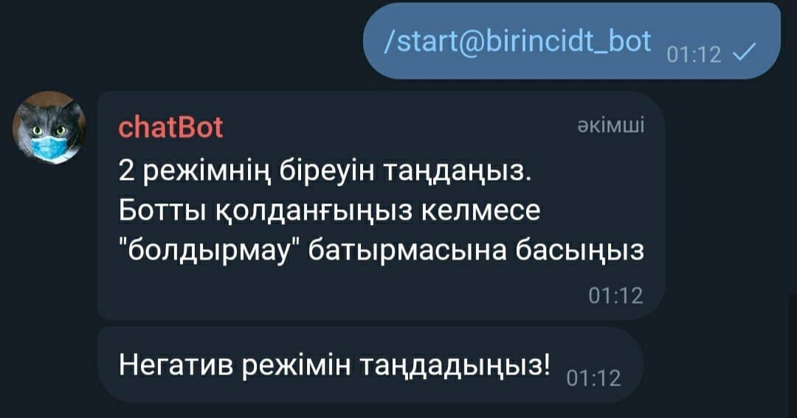
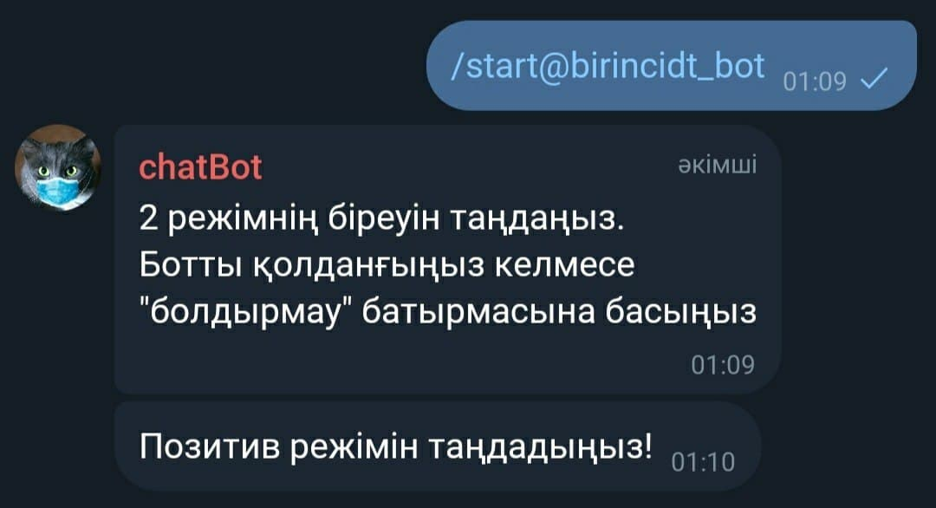
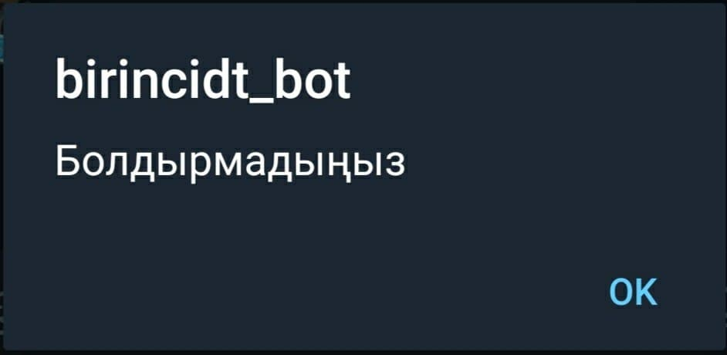
Positive and Negative modes
A user can press one of the buttons and change the mode
It will not make any changes if a user presses cancel button.
An alert message is called after pressing the button

Slide 8
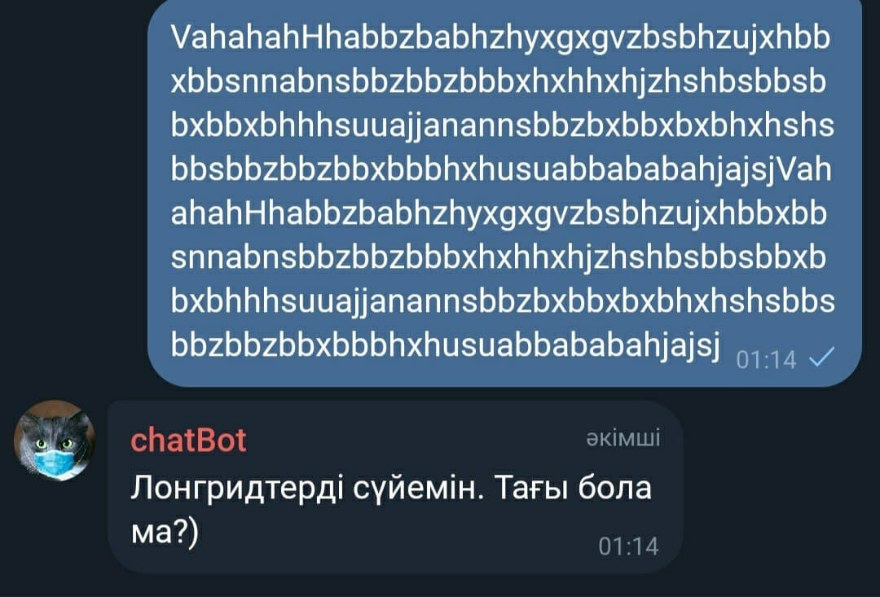
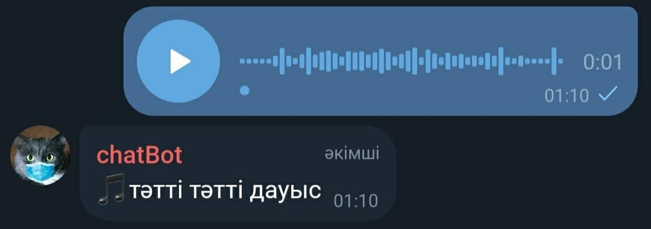
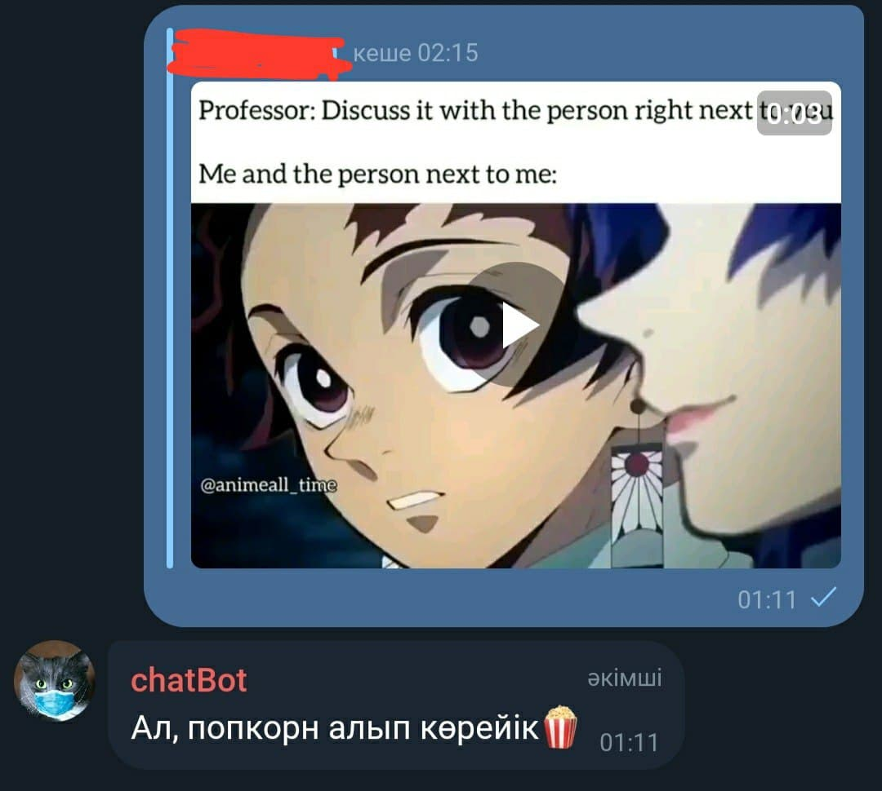
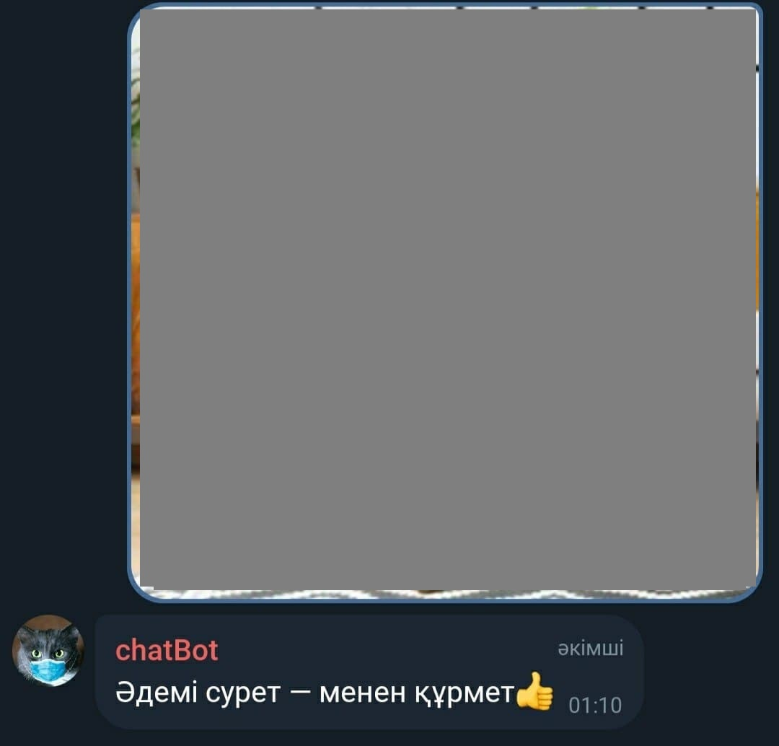
Positive mode

Slide 9
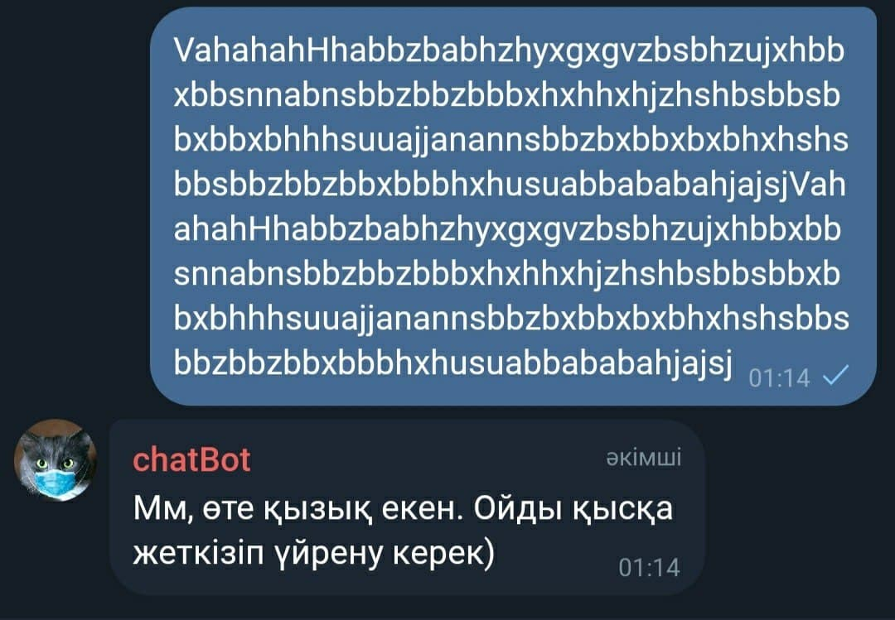
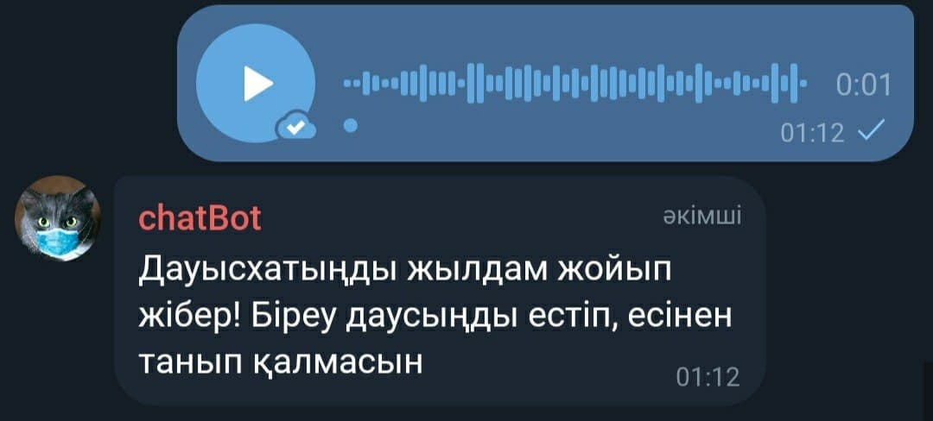
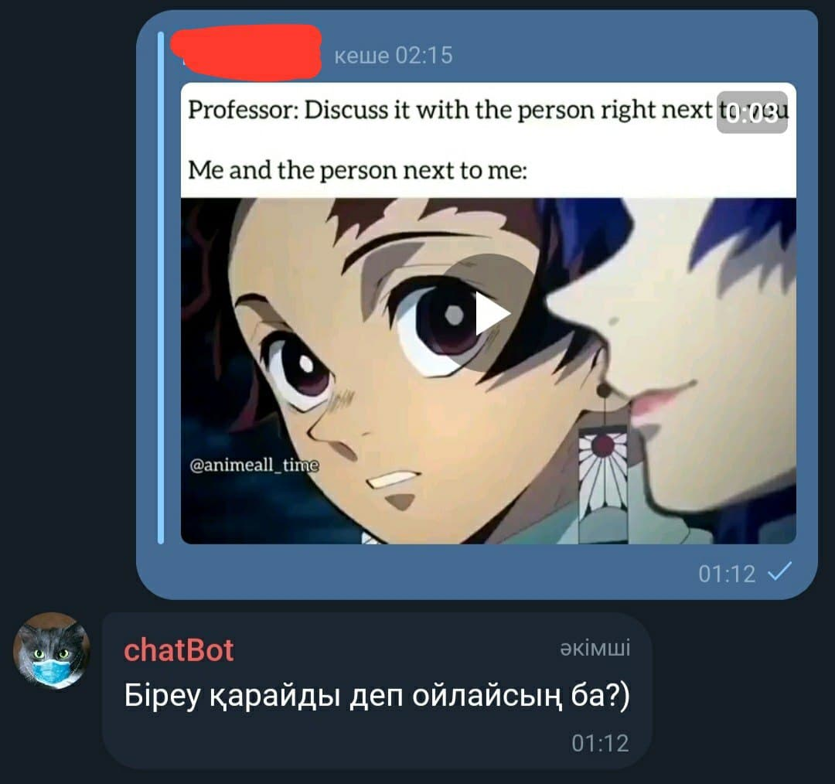
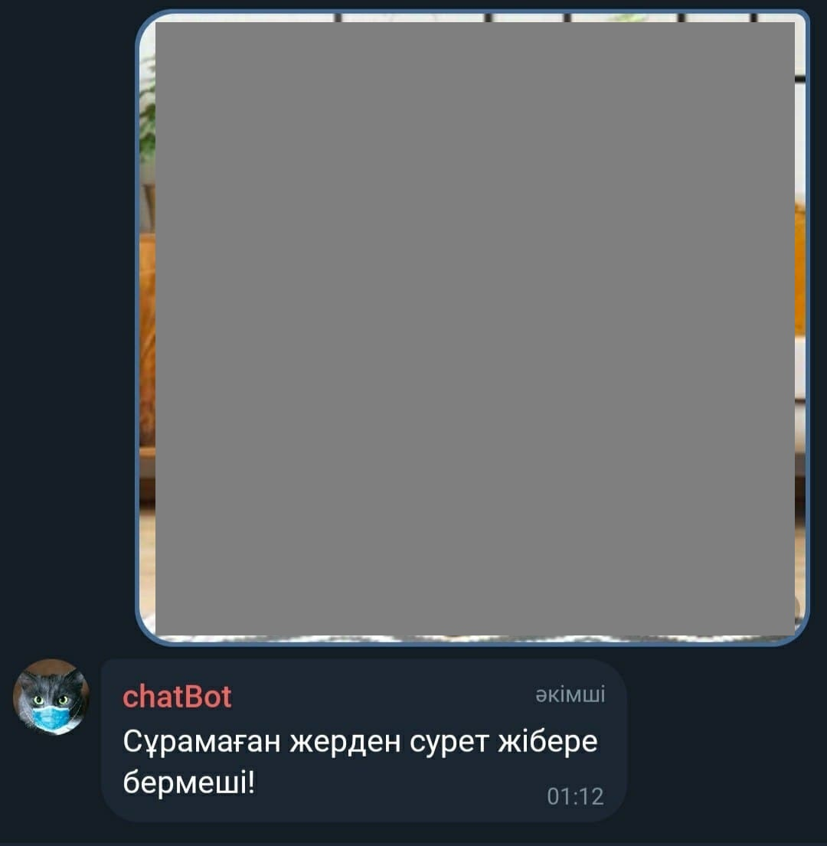
Negative mode

Slide 10
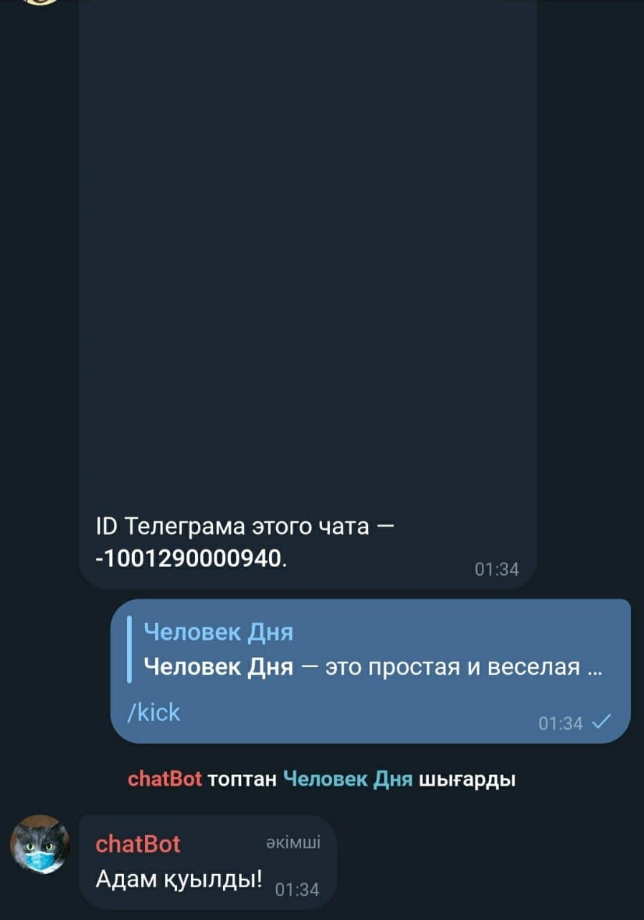
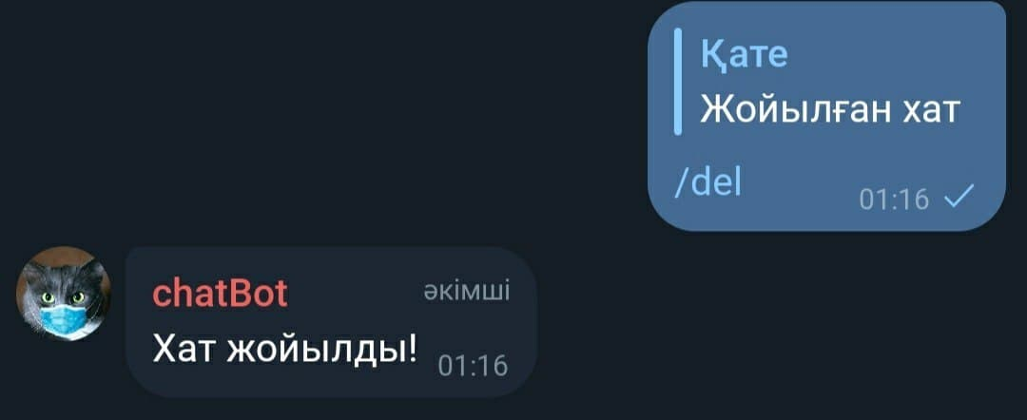
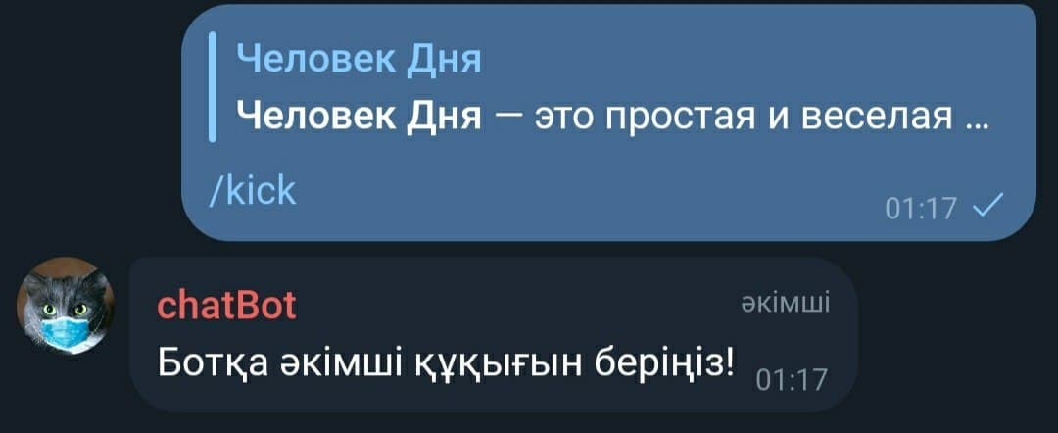
Chat management
Deleting a message with /del command
/kick — kicks the chosen user
/del — deletes the chosen message
The commands won’t work if the bot has no admin rights
Kick command in action

Slide 11
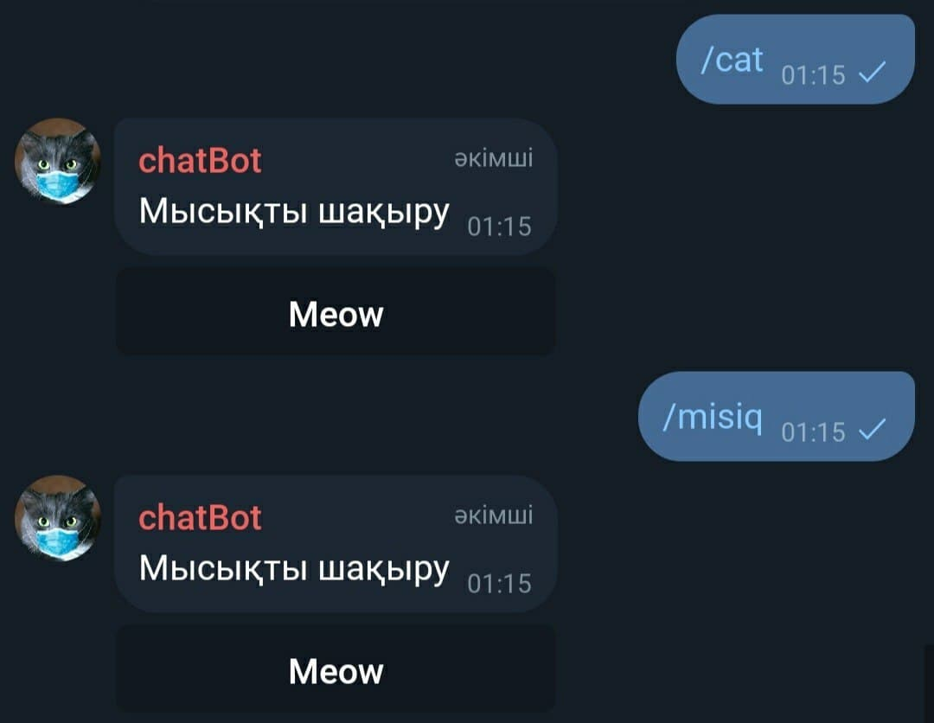
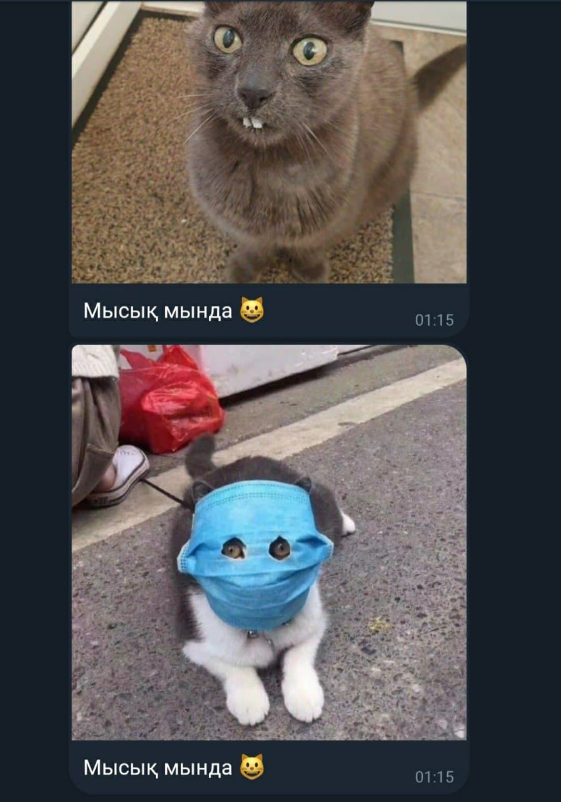
/cat and /misiq commands
A special function, for people that had a hard day. Sends a button, by pressing which a random cat picture is sent. Then, a user's mimimimeter goes off scale, and the bad mood disappears because everybody loves cats

