Slide 1



“Easy Writers” Creative Writing App
Dan Trinh
CIS 4280
Spring 2021

Slide 2
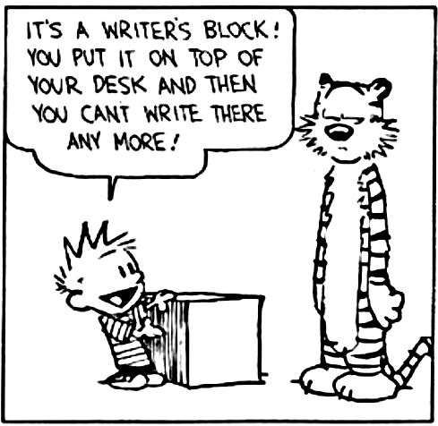
Motivation
Encountered freewriting in past creativity classes and English classes.
Freewriting: Process of writing whatever comes to mind without stopping for a short period of time.
Encourages the flow of creativity.
Prevents judging an idea too early.
Thus, freewriting helps break writer’s block.
Notes:
So, what was the motivation for this app?
Well, for one, I needed an alternative to divert from my tendency to browse (and get trapped on) Reddit whenever I open my phone.
So I thought that if I enjoy improv, why not build something based around creativity?
I then remembered the idea of freewriting, which is something that I’ve always come across in various creativity and English classes and enjoyed.
Freewriting is essentially the process of writing whatever comes to your mind without stopping for a short period of time.
By doing this, you encourage the flow of novel ideas and prevent yourself from judging an idea too early.
So, it’s a short and sweet way to help you get over writer’s block, or even just a way to have a bit of fun in a few minutes’ time.

Slide 3
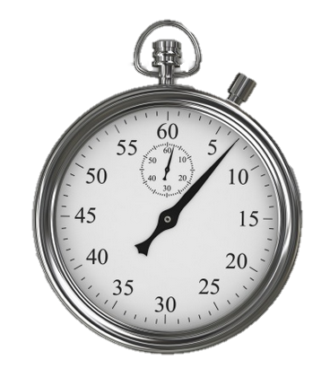
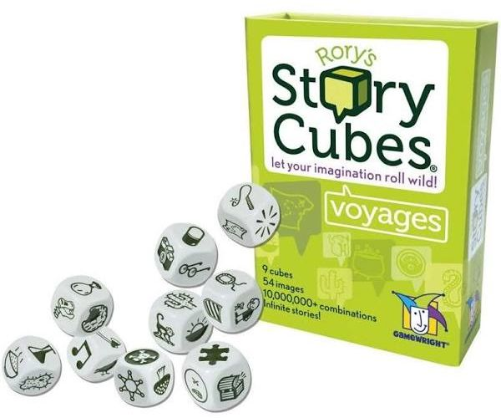

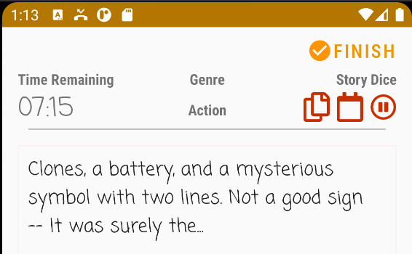
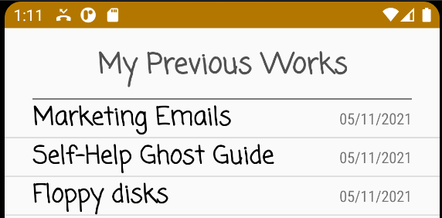
Design
Freewriting with some twists!
A countdown timer presides over a free write session.
Story cubes offer visual aids to assist with writing.
Inspired by Rory’s Story Cubes.
A genre option helps prompt the user in a direction.
History Function
A completed freewrite is saved in an internal database.
The user can view their previously made free writes.
Demo time!
Notes:
So my take on free writing has a few twists to it, as you’ll see in the demo shortly.
To keep the free write short, there’s a countdown timer that keeps you writing and helps applies pressure to suppress your inner critic as you do so.
In addition, there are provided story cubes which offer visual aids that assist with writing.
These are based on a board game called Rory’s Story Cubes, in which you roll a set of dice with pictures on it and try to tell a story based on it afterwards.
Then there’s a genre option which further assists in creating a story.
Meanwhile, all free writes that the user creates are saved into a database, which they can view later.
So without further ado, let’s get to the demo!!

Slide 4
Implementation - MVC
6 Activities (with accompanying view)
Main Menu Activity
Configuration Activity
Free Write Session Activity
Session Over Activity
Freewrite List Activity
Freewrite Detail Activity
Main Menu
Configure Free Write
Free Write
Free Write Over
Freewrite List
Freewrite Detail
2 Models
Freewrite Model
Freewrite Session Manager
Notes:
The first aspect of implementation to discuss is MVC -- the app was created following the MVC pattern.
There are six activities in total… { }.
Supporting those six activities are a Freewrite model, which keeps track of the freewrite and
then a Session Manager, which keeps track of user configuration and a countdown timer, for when a session is started.

Slide 5
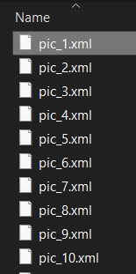
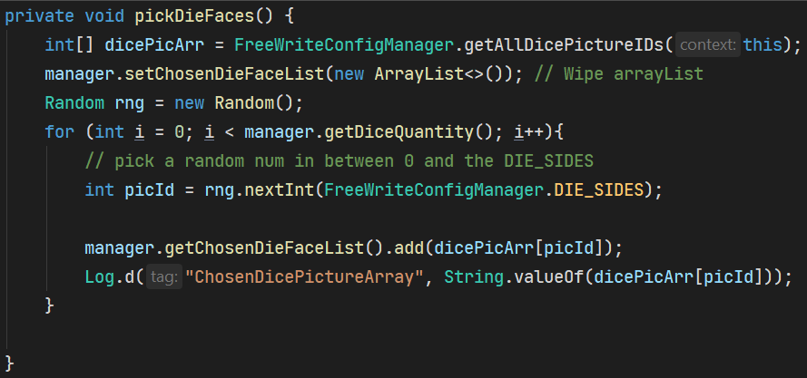
Implementation – Story Dice
A collection of FontAwesome icons in .xml, obtained from Github: “fa5ad-free” by Dariusz Iwanoczko.
https://github.com/diwanoczko/fa5ad-free
Used bulk rename utility to rename all pictures pic_{num}.xml
How story dice are chosen in Config Activity:
Has a for-loop calling context.getResources.getIdentifier( “pic_” + i+1, “drawable”, “package_name”); to the drawable’s resource ID based on filename.
For-loop picks a random number in between 0 and number of pictures
The picture is added to a list of chosen dice faces
Notes:
Next to discuss is how the story dice were achieved.
The icons, which are part of the free Font Awesome package, were obtained from the Github of Dariusz Iwanoczko.
Dariusz took the time to convert those icons all into .xml files, which simply had to be dragged and dropped into the drawables folder.
To be able to randomly select pics, I needed a way to loop through all of the pictures reliably, so I used a program called bulk rename utility to rename all the pictures to pic followed by a number.
Then, to choose the dice before starting a free write session, the code does the following:
Has a for-loop calling context.getResources,getIdentifier(“pic_” + i, “drawable”, “package_name”); to get a collection containing a resource Id of each picture.
Then, a for loop picks a random number in between 0 and the number of pictures, a hard-coded constant.
Then, the picture is added to a list of chosen dice faces.

Slide 6
Implementation – Databases
A SQLite Database is created and accessed through the following:
FreeWriteDatabaseHelper.java – Creates and updates the database schema
FreeWriteDAO.java - Object to access the database and CRUD data.
Freewrites are stored in a table with the following attributes:
ID | Date | Title | Genre | Story Pics | Filepath | Duration | Favorite
Story Pics (string)
Ex: “pic_11,pic_17,pic_79,pic_89,”
Split into filenames which are used to fetch its respective resourceId.
Filepath (string)
Ex: “freewrite_1620768981976.txt”
Refers to the .txt file in which the free write is saved.
Notes:
There’s not many places to discuss error handling since the user is limited to fixed inputs, aside from the free write, but anything can be written there.
The majority of error handling occurs in the free write over session, after the free write ends. There are two main places to handle that could become troublesome, left unchecked…
When the user presses BACK, rather than taking them to the free write session again, we want to take them to the main menu rather than having them go to free write session again.
Let’s take a look at this code that executes when the user presses BACK. Instead of finish(), the activity starts a new intent to go to the main activity.
However, the key here is this flag Intent.FLAG_ACTIVITY_CLEAR_TOP – it clears the activity stack and returns us to the existing instance of the main menu.

Slide 7
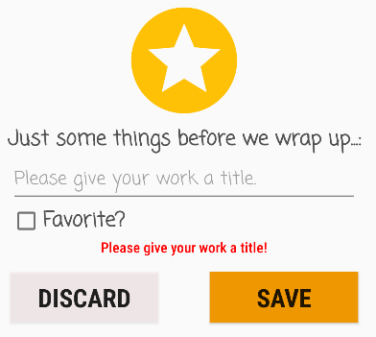
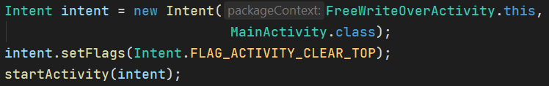
Implementation – Error Handling
When the user presses BACK after the freewrite session ends, this takes them to the main menu rather than the freewrite.
The user cannot save a free write unless they enter in a title.
MainActivity
FreeWriteOverActivity
FreeWriteActivity
FreeWriteConfigActivity
MainActivity
The intent clears the activity stack, and resumes the existing instance of MainActivity.
An error message pops up telling the user to title the work.
Notes:
There’s not many places to discuss error handling since the user is limited to fixed inputs, aside from the free write, but anything can be written there.
The majority of error handling occurs in the free write over session, after the free write ends. There are two main places to handle that could become troublesome, left unchecked…
When the user presses BACK, rather than taking them to the free write session again, we want to take them to the main menu rather than having them go to free write session again.
Let’s take a look at this code that executes when the user presses BACK. Instead of finish(), the activity starts a new intent to go to the main activity.
However, the key here is this flag Intent.FLAG_ACTIVITY_CLEAR_TOP – it clears the activity stack and returns us to the existing instance of the main menu.

Slide 8
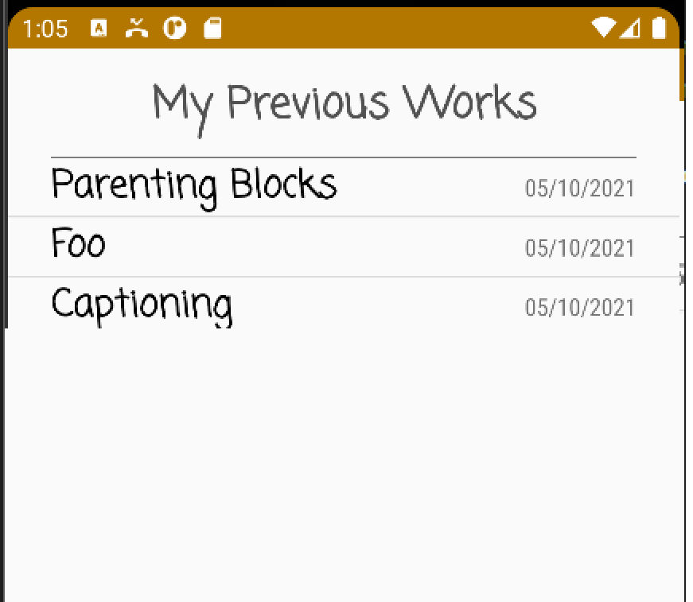
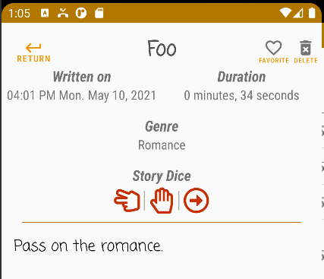
Implementation - Fragments
The Freewrite List Activity and Freewrite Detail Activity employ fragments in master-detail design pattern.
Adapted from Band Database app in ZyBooks Chapter 5.
Master
Detail
FreeWrite ListActivity.java
FreeWrite ListFragment.java
FreeWrite DetailActivity .java
FreeWrite List Fragment .java
The list activity use a list fragment to show a list of items.
The detail activity has a fragment to display details.
Notes:
Fragments are utilized similar to the Band Database app as described in ZyBooks Chapter 5.
They follow the master-detail design pattern in which an activity uses a fragment to display its views.
This increases the modularity of the app and allows them to be reused for a master-detail view, so that’s one thing I plan to do in the future.
On the topic of the future… let’s discuss that.

Slide 9
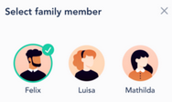
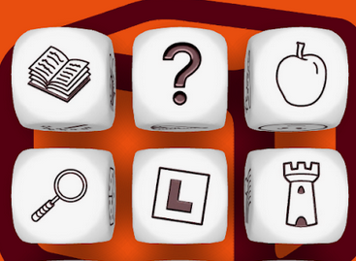


Future Work
Multiple Users
Dice Rolling Activity
Exporting and Sharing Free Writes
Select Writer
The user can define multiple profiles that keep track of their own free writes.
The user has more agency over what sort of visual aids they get before they write.
The user can export to expand upon elsewhere. They can also share them with friends and family.
Notes:
For future work, there are three areas I want to focus on.
One is to support having multiple users at any given time on the app through profiles.
Another is a dice rolling activity so the user can simulate actually tossing a story dice and getting a visual aid from that.
Lastly is the ability to export and share free writes, so the user can share with their friends and family or back it up on Google Drive.

Slide 10
References (and many thanks to)
ZyBooks.
Chapter 5, Band Database App.
Chapter 7, Timer App.
Dr. Shi’s Lecture Code
File Read / Write Utility
StarBuzz SQLite Database
Github
Stack Overflow
Oracle Java Docs
Google Android Developer Docs.
Notes:
Special thanks to the following!

