Slide 1
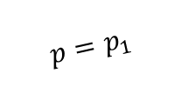

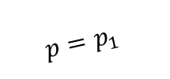
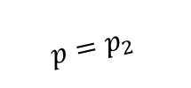

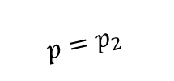

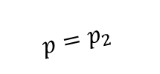

$$p=p_{1}$$
$$p=p_{1}$$
$$p=p_{2}$$
$$p=p_{2}$$
$$p=p_{2}$$
result
$$1$$
state space
fractions
state space
$$0$$
step:
0 starting point
1 seed initial conditions
2 find new attractors
3 match attractors
4 compute basins
$$p_{1}$$
$$p_{2}$$

