Slide 1
submitted to ms. Neeshu Chaudhary by
Name | Enrolment No.
Datt Bhatt | 23BT04D166
Dev Bhavsar | 23BT04D167
Hiral Chhatrapati | 23BT04D168
Pranita Bhatt | 23BT04D190

Slide 2
Basic File manager
OS project

Slide 3
File manager
A file manager, also known as a file management system or file explorer, is a software application or utility that provides a graphical user interface (GUI) for users to perform various file and folder-related tasks on a computer.
These tasks typically include organizing, viewing, creating, copying, moving, deleting, and searching for files and folders. File managers are an integral part of modern operating systems and serve as a user-friendly way to interact with the file system.

Slide 4
Project information
We have created a basic file manger without GUI
It has three operation
Find File in a directory
Create File in a directory
Delete File of a directory

Slide 5
Code information
The code is written in python language
We haved used libraries like
os: It provides functions and methods to interact with the file system, manage directories and paths, and perform various system-related tasks.
datetime: It provides classes for working with dates and times.
subprocess: It is used to interact with the operating system's command-line interface and execute external processes or commands.

Slide 6
Code explained
In the code there are total 3 function on which are used to search,create and delete
The are as follows:
search() Function: Prompts the user to select a search option (name, extension, date, or size) and then calls the corresponding search function.
creation() Function: It allows users to create a new file with a specified name and extension, providing an option to open it in Notepad for editing, and handles file existence and creation errors.
delete() Function: It allows user to delete file

Slide 7
Code with its specific operation function with output

Slide 8
Search() function
search() function uses os library
search() function has an initial directory and user defined directory in which it searches the file
It has 4 function which are used to search a file with different categories.
They are as follows:
search_by_name(): it searches a file with name to search (e.g., 'dash' or 'cat').
search_by_extension(): it searches a file with file extension (e.g., .pdf, .docx)
search_by_date(): it has two option to search the file by date as follows:
on the date: the date on the file is created (e.g., 'YYYY-MM-DD‘)
between dates: the date beteween start date (e.g., 'YYYY-MM-DD‘) to end date (e.g., 'YYYY-MM-DD‘).
search_by_size(): it searches a file with file size (e.g., '1000kb' or '1mb').

Slide 9
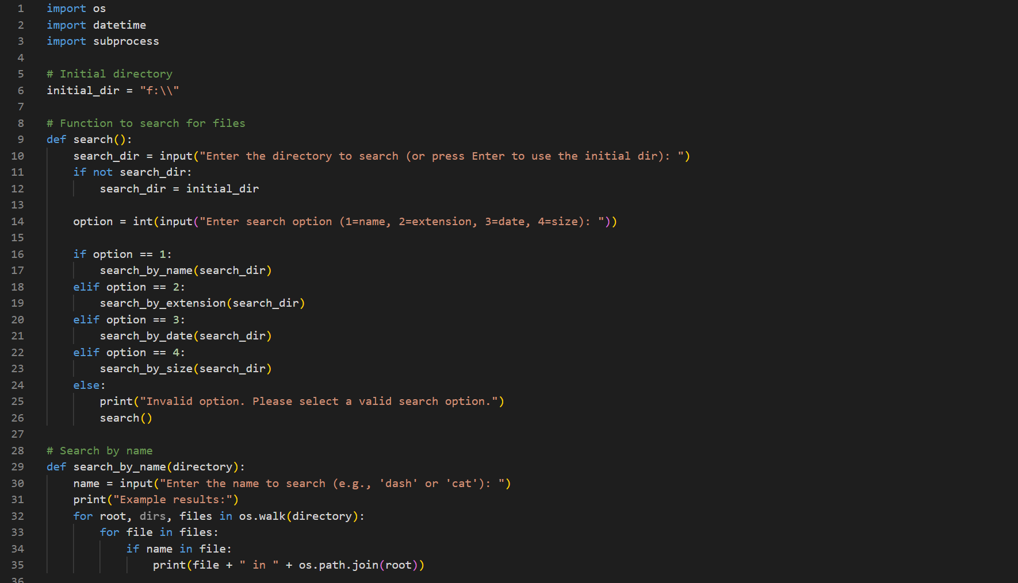

Slide 10
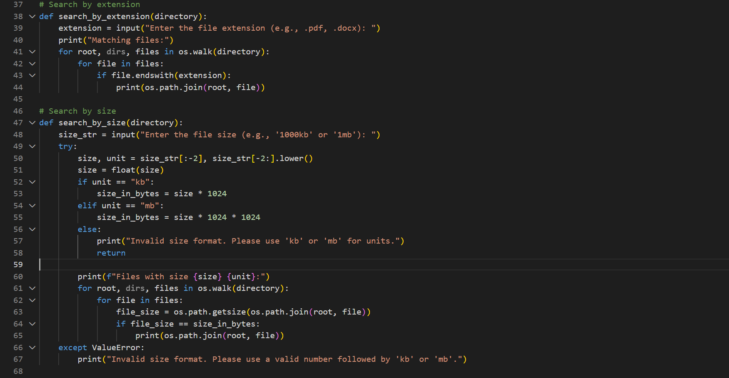

Slide 11
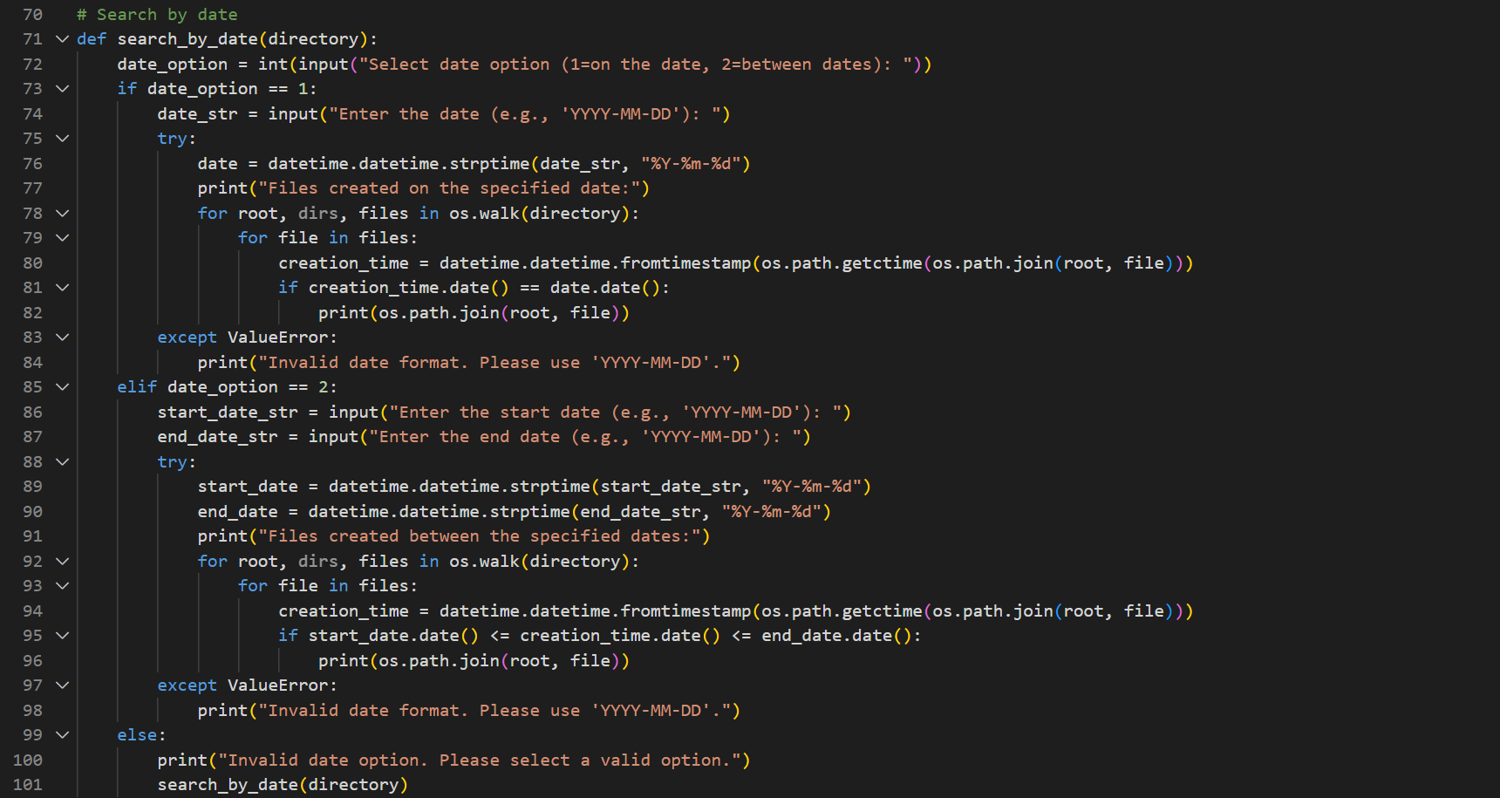

Slide 12
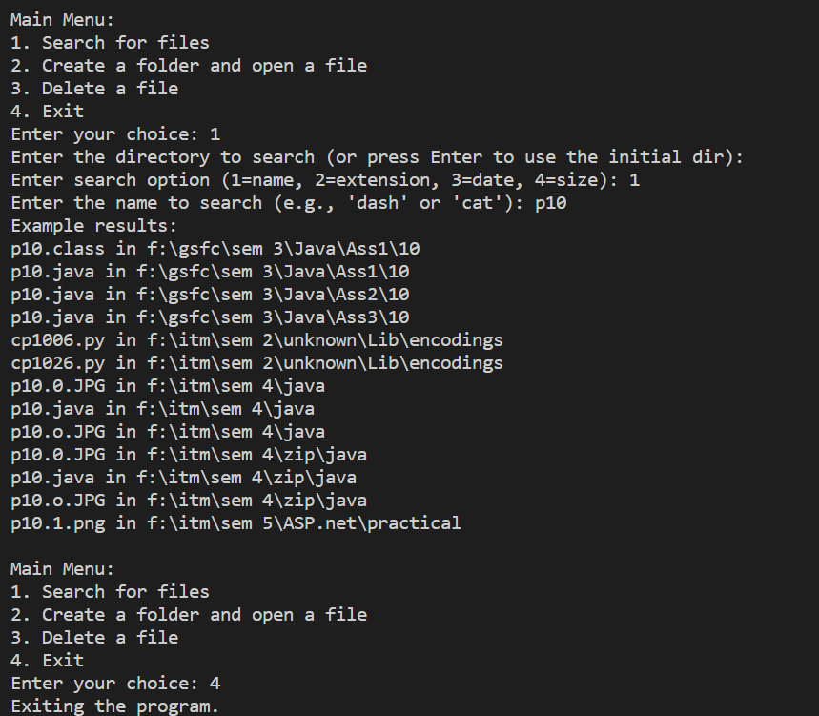
Output for search()FUNCTION

Slide 13
Creation() function
creation() function uses os and subprocess library
creation() function has an initial directory and user defined directory in which it opens existing file and if not exist it creates and run the file with subprocess library

Slide 14
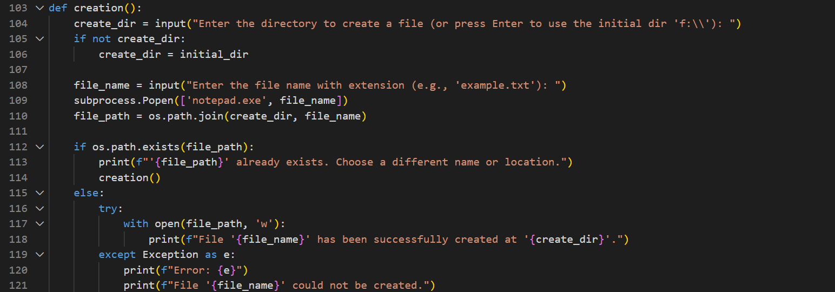

Slide 15
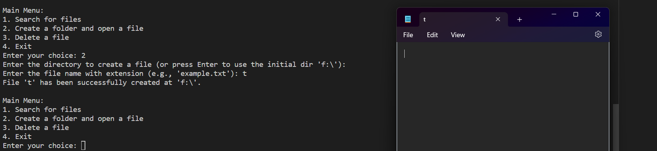
OUTPUT FOR CREATION()

Slide 16
DELETE() function
delete() function us os library
It deletes the file with the path given, if exist or if direct name given it find file in directory the code is running only

Slide 17
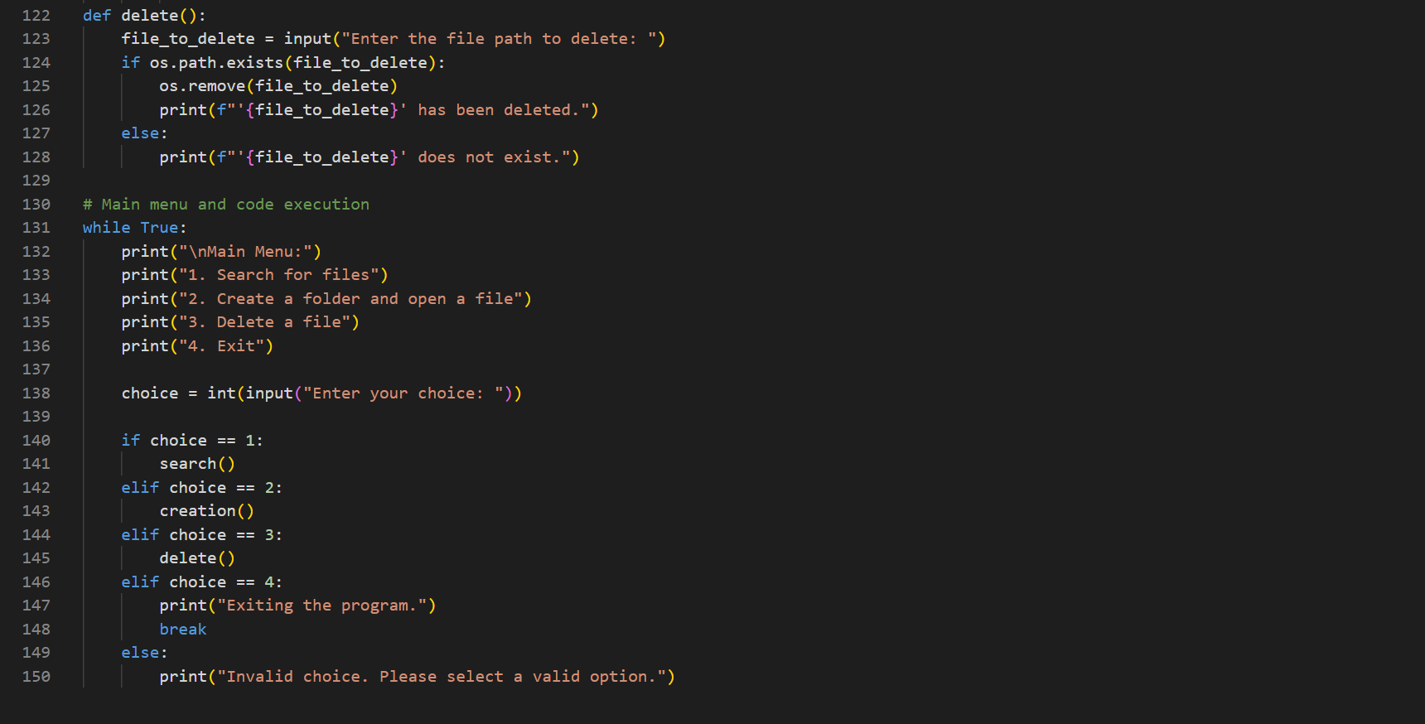

Slide 18
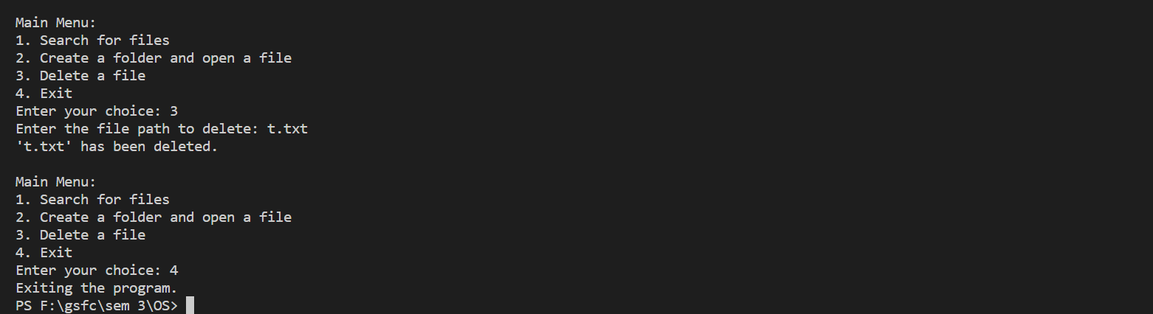
OUTPUT FOR delete()

Slide 19
Improvements possible
The code can be displayed with GUI module
There can be more search type
There can be other file types can be opened or created (like .docx,.pdf
The deletion can be done with file name only for all the directory and subdirectory

Slide 20
Thank you

