Slide 1
Smart Water Distribution and Leakage Detection
T2
IoT · MQTT · Node-RED · Machine Learning · Closed-loop control
Team 2 | B.Tech CSE, Semester 7 | IoT Mini-Project
Notes:
Introduce the team and the project in one sentence: an IoT system that monitors a water network, detects leaks, sensor faults and cyber-attacks with machine learning, and reacts automatically.

Slide 2
Three things go wrong in a water network
L
S
C
Leaks
Sensor faults
Cyber-attacks
Water escapes: flow rises and pressure falls. Wastes water and money.
A sensor reports nonsense, e.g. −12 bar. Control decisions become unsafe.
Someone manipulates valves or pumps remotely through the control system.
Goal: detect which one is happening, then alert and act automatically: slow pumps, isolate the section, flag the sensor or lock the controller.
Notes:
The problem statement asks for leak detection, classification of type or severity, and a control action. We go further and distinguish leaks from sensor faults and cyber-attacks, because each needs a different response.

Slide 3
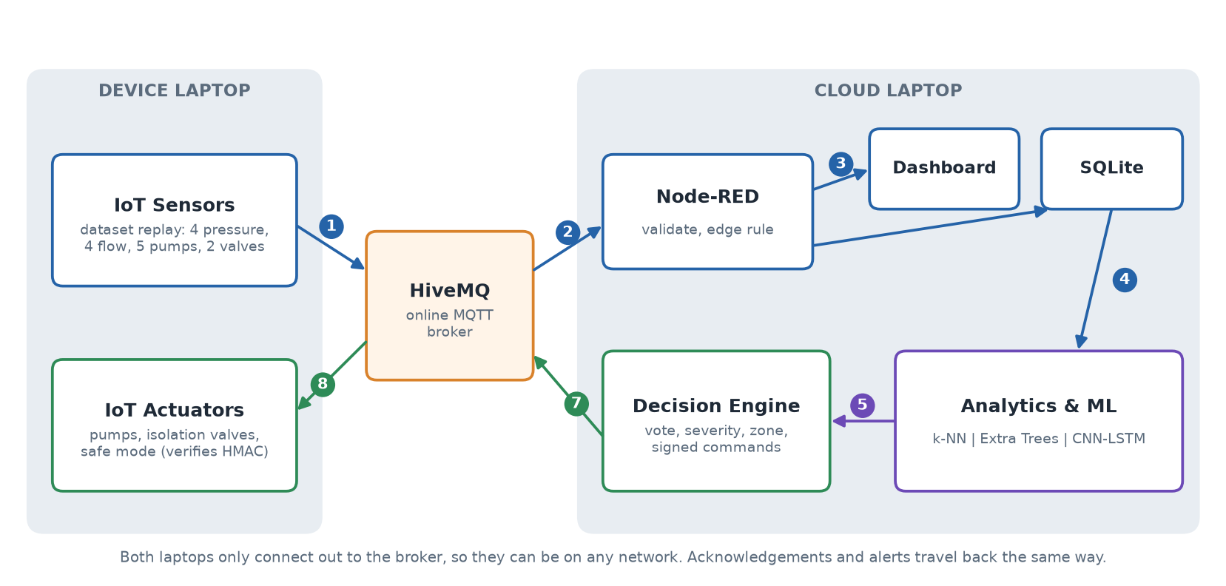
Architecture on two laptops
Notes:
Walk through the numbered arrows: 1 the device publishes readings, 2 HiveMQ delivers them to Node-RED, 3 Node-RED stores them in SQLite and updates the dashboard, 4 the engine reads SQLite, 5 ML classifies and the engine decides, 7 a signed command goes back through HiveMQ, 8 the actuators act and acknowledge.

Slide 4
Two laptops that only talk through HiveMQ
Device laptop
Cloud laptop
Replays the real sensor recordings
Executes commands: pumps, valves, safe mode
Verifies every command's signature
Shows the cloud's alerts and results
Needs only Python and internet
Node-RED flows and dashboard
SQLite database
3 ML models and decision engine
Signs commands, measures KPIs
Corrects for the clock difference
MQTT
broker.hivemq.com
~412 ms
best round trip
Notes:
Neither laptop knows the other's address. Both connect out to the public HiveMQ broker, which routes messages by topic, so the laptops can be on different networks. All topics start with a random project id so our traffic doesn't mix with other users. The engine pings the device every 5 seconds to measure the clock difference between the laptops.

Slide 5
Real testbed data: WDSEventDB
25,165
15
9
4
readings
signals per reading
recordings
classes
Recording | Event
Clean | Normal operation only
Leakage 1-3 | Normal operation, then a leak
Sensor failure 1, 23, 45, 67 | Pressure sensors fail (P1, P2, P3, P4)
Cyber-attack 1-4 | Valve 2 forced to ~100 %, pump 1 slowed
Notes:
Signals: 4 pressure, 4 flow, 5 pump drives, 2 valves. The dataset's 0/1 label combined with the folder name gives four classes: normal, leak, sensor fault, cyber-attack. There is no tank-level sensor in the dataset.

Slide 6
The life of one sensor reading
1
2
3
4
5
7
8
Publish
Validate
Store
Read
Classify
Command
Act
device → HiveMQ
Node-RED edge rule
SQLite + dashboard
engine polls DB
ML + vote
signed, via HiveMQ
device acks
~1 s
~1.1 s
~1.6 s
detection after a leak starts
command → acknowledgement
sensor reading → actuator ack
Notes:
Follow one reading end to end. Timings were measured over the real HiveMQ broker with both programs on one laptop. Command to acknowledgement includes a 300 ms simulated actuator delay. Real two-laptop numbers depend on the internet connection.

Slide 7
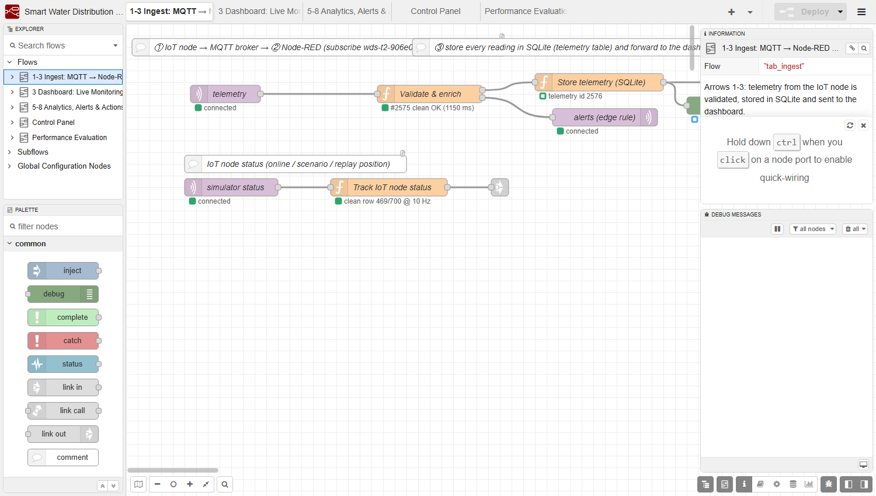
Node-RED: integration and edge processing
5 flow tabs, 141 nodes
Validates every reading against physical limits
Raises an edge alert before any ML
Writes all 5 SQLite tables
Signs dashboard commands (HMAC)
Serves the dashboard and an incident-report CSV
Notes:
Node-RED is the integration layer. It talks to SQLite through Node's built-in node:sqlite module, so nothing needs compiling. The ingest flow: MQTT in, validate and enrich, store, then forward to the dashboard.

Slide 8
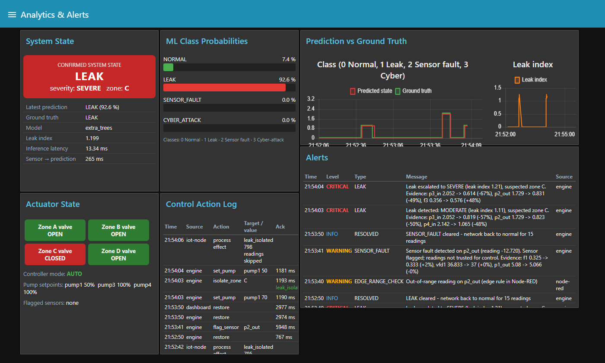
Dashboard during a severe leak
Notes:
This is the Analytics page during LeakEvent1: the state card shows a severe leak in zone C, the zone C valve is closed, pump 1 is at 50 %, and each alert says why, e.g. P3 −57 %, P2 −50 %. Other pages: Live Monitoring, Control Panel and Performance.

Slide 9
Turning readings into features
53 features per reading
A fair train/test split
15 raw signals
Rolling mean and spread (10 readings)
Change from the 60-reading mean
Change since the previous reading
Hydraulic indicators: head loss, outflow, pump efficiency
Blocks of 60 consecutive readings
30 % of each class's blocks held out
No near-duplicate readings on both sides
Balanced class weights for rare faults
Label is the target, never an input
Notes:
Features look only backwards in time, so the online engine computes exactly what the model saw in training. A random row split would leak near-identical neighbours into the test set; block splitting avoids that. We also checked that faking or removing the label column changes no prediction.

Slide 10
Choosing the best model in each family
Traditional: k-NN (0.970)
Ensemble: Extra Trees (0.996)
Deep learning: CNN-LSTM (0.950)
Naive Bayes fails because its independence assumption doesn't hold: a signal and its rolling mean are strongly correlated.
Notes:
We trained nine candidates from the three families in the architecture and kept the best of each by macro F1, which weights rare classes equally. CNN-LSTM's lead over the MLP is within training variation, but it learns from the time sequence directly and is the fastest at inference.

Slide 11
Extra Trees is the default; all three run live
0.996
0.06 %
0.8 ms
macro F1 (Extra Trees)
false alarms on normal data
CNN-LSTM latency per reading
 | k-NN | Extra Trees | CNN-LSTM
Accuracy | 0.989 | 0.999 | 0.985
Leak recall | 0.923 | 0.991 | 0.987
False alarms | 0.34 % | 0.06 % | 1.57 %
Training time | 0.04 s | 0.25 s | 11.8 s
Notes:
Extra Trees has the best accuracy and fewest false alarms, so it runs by default. The dashboard can switch to k-NN or CNN-LSTM live for comparison. Latency includes feature computation; CNN-LSTM skips it and is the fastest.

Slide 12
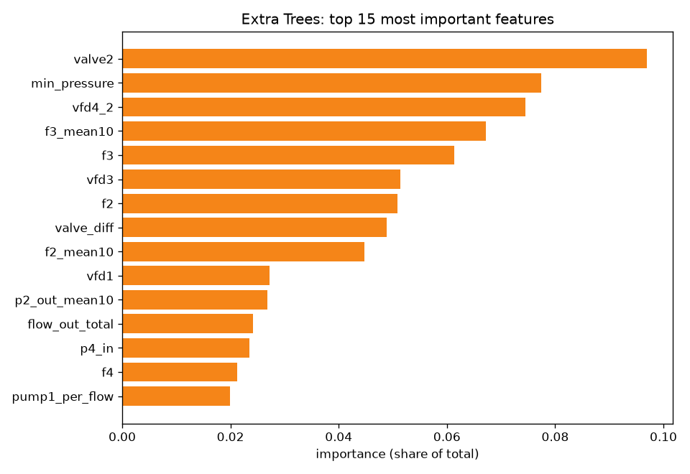
Does the model cheat? We checked
Pump and valve settings rank high, and valves open when the leaks begin. So we retrained without all 9 pump and valve features:
0.996
0.989
with all features
pressure and flow only
The models detect events from the physical measurements, not from the recordings' settings.
Notes:
Valve 2 ranks first because the cyber-attacks force it open. In the leak recordings both analog valves also open further when the leak begins, so we worried about shortcut learning. Without any pump or valve feature, macro F1 only drops from 0.996 to 0.989 and leak recall stays at 0.989.

Slide 13
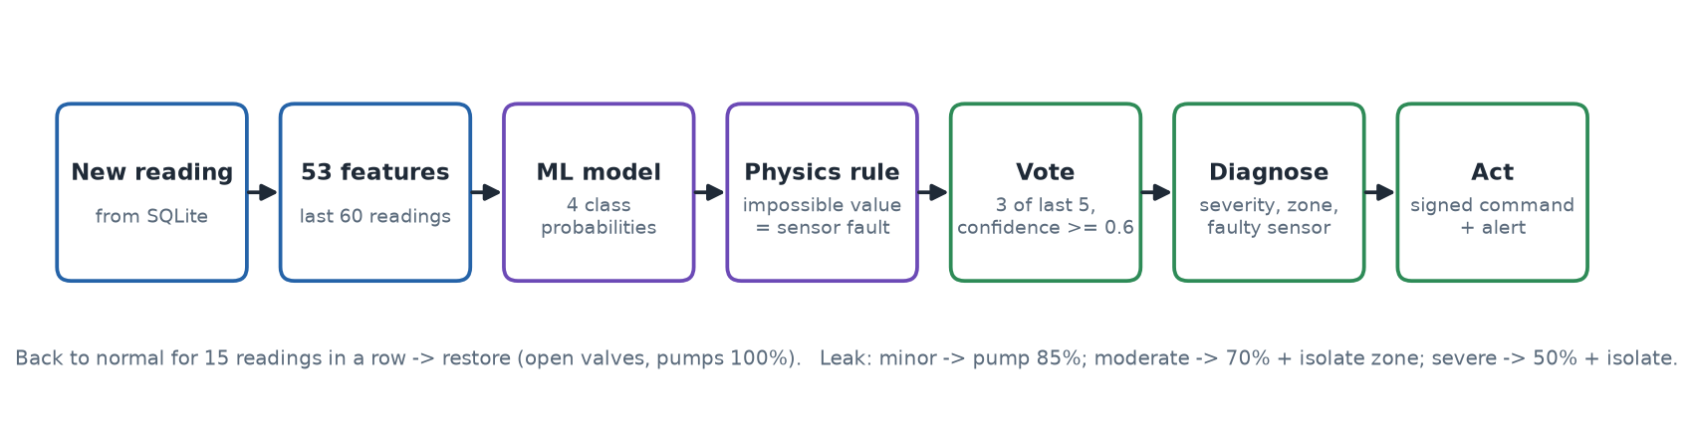
From prediction to action
Event | Action
Leak: minor / moderate / severe | Pump 1 to 85 / 70 / 50 %; isolate the zone from moderate up
Sensor fault | Flag the sensor; no hydraulic action
Cyber-attack | Controller to safe mode
Normal for 15 readings | Restore valves and pumps
Notes:
Voting (3 of the last 5 predictions) plus a 15-reading hold-off before restore gives hysteresis, so valves don't switch back and forth on noise. Severity comes from a leak index learned from the data; the zone is where flow rose and pressure fell most. Auto mode off means the engine only recommends actions.

Slide 14
Advanced: forged commands are rejected
On a public broker anyone could send "close valve". Every command is signed with HMAC-SHA256 and checked by the device.
X
No signature
Rejected
X
Guessed key
Rejected
X
Tampered command
Rejected
X
Replayed command
Rejected
X
10 minutes old
Rejected
OK
Genuine command
Accepted
Also: explainable alerts, clock-offset correction, live model switching, scenario injection, edge rule, incident-report CSV.
Notes:
Demo: run tools/attack_demo.py unsigned or replay; the device window prints SECURITY REJECTED and the dashboard raises a FORGED_COMMAND alert. The signature covers id, time, action, target and value. Replay protection: the device remembers executed command ids and rejects commands older than 5 minutes.

Slide 15
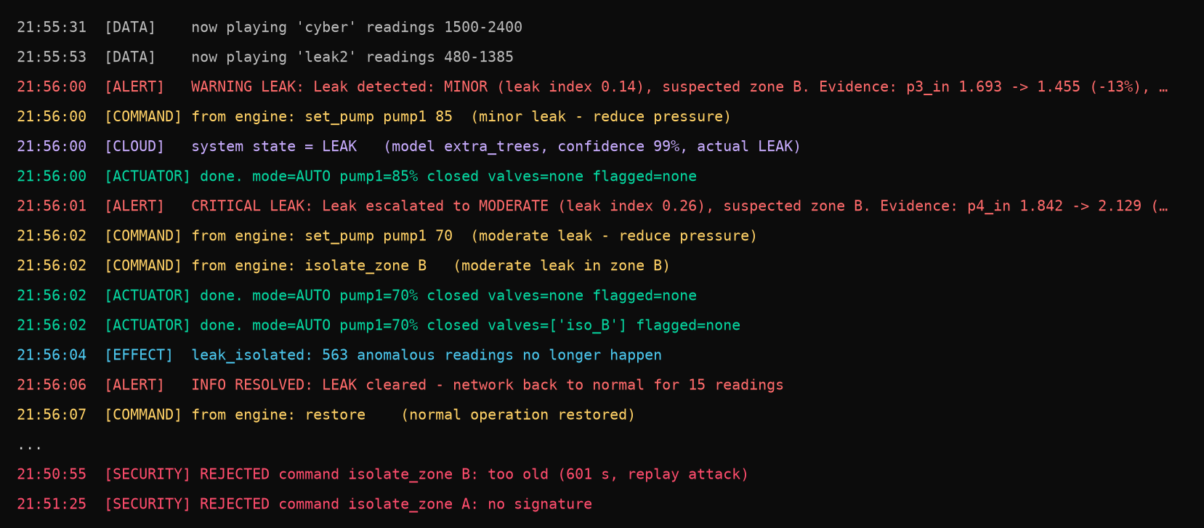
Closed loop over the real HiveMQ broker
12 / 12
3 / 1
~1.6 s
events detected, none missed
leaks contained / attacks blocked
sensor reading → actuator ack
Notes:
Measured at 10 readings per second with both programs on one laptop, through the real broker, with the device clock shifted by 7 s on purpose; the engine measured 6,985 ms and corrected it. One brief false sensor-fault event occurred. The console is the device laptop's real output: alert, commands, actuators, leak contained, restore, and rejected forged commands.

Slide 16
Limitations and next steps
Limitations
Next steps
Recorded data can't react to valves, so effects are approximated
Live accuracy is optimistic: recordings were used in training
One testbed; leak location is a heuristic
Public broker: telemetry is unsigned and unencrypted
Couple to a hydraulic simulator (EPANET/WNTR) or real sensors
Private broker with TLS; sign telemetry too
Unsupervised detection of unseen event types
Train on more networks; learn leak location
Notes:
Be upfront about these: examiners respond well to honest limits. The fair accuracy figure is the held-out test set, not the live dashboard.

Slide 17
Live demo
T2
Leak 1 → detect, isolate zone C, contain, restore
Sensor fault → flag sensor, no valve action
Cyber-attack → safe mode · Forged command → rejected
Notes:
Switch to the dashboard and the device laptop. Order: Leak 1 (wait about 18 s), Sensor fault P2, Cyber-attack (about 22 s), then tools/attack_demo.py unsigned. Keep both screens visible.

