Slide 1


Microplastic Pollution
Prediction🌍

Slide 2

Learning Objectives
Predict microplastic concentration levels in oceanic/river environments.
Analyze the influence of environmental and anthropogenic (human) factors.
Develop a data-driven model to support early warning systems and policy decisions.
Visualize spatial patterns of pollution for better awareness.
GOAL
Source :
www.freepik.com/

Slide 3
Tools and Technology used
Programming Language: Python
Libraries: Pandas, NumPy, Matplotlib, Scikit-learn
Development Environment: Jupyter Notebook / Google Colab
Techniques: Data Preprocessing, Feature Engineering, Machine Learning Models (Regression/Classification)
Visualization: Graphs & plots for analysis and prediction results

Slide 4
Methodology
Approach:
Step 1: Data cleaning and preprocessing (handling missing values, normalization).
Step 2: Exploratory Data Analysis (correlation heatmaps, geographical plots).
Step 3: Feature selection using importance scores.
Step 4: Train ML models (Random Forest, Linear Regression, XGBoost).
Step 5: Model evaluation using RMSE, R² score.
Step 6: Interactive User input-based predictions and insights.

Slide 5
Methodology
Algorithms Used:
Used Linear Regression to predict microplastic concentration.
Chosen for its simplicity and effectiveness with continuous data.
Helps understand the linear impact of each feature on pollution levels.
Evaluated using R² score and RMSE for accuracy and performance

Slide 6
Problem Statement:
Brief Overview:
Microplastic pollution poses a significant environmental threat, contaminating water bodies and soil and affecting marine life and even the air. These microscopic plastic particles originate from industrial waste, synthetic textiles, personal care products, and plastic degradation, impacting ecosystems and human health. The challenge lies in predicting microplastic pollution levels under various environmental conditions, taking into account factors such as water pH, temperature, salinity, industrial activity, and population density. Traditional monitoring methods are time-consuming and resource-intensive, making real-time prediction crucial for effective mitigation strategies.

Slide 7
Problem Statement:
Key Objectives:
Predict microplastic concentration levels in oceanic/river environments.
Analyze the influence of environmental and anthropogenic (human) factors.
Develop a data-driven model to support early warning systems and policy decisions.
Visualize spatial patterns of pollution for better awareness.

Slide 8
Solution:
A machine learning–based predictive model that estimates microplastic concentration in water bodies.
Uses environmental features (Latitude, Longitude, Water Temperature, Salinity, Depth) and human activity factors (Population Density, Industrial Activity).
Helps identify high-risk pollution zones and supports early intervention by environmental agencies.
Provides data-driven insights for policymakers, researchers, and conservationists to reduce microplastic impact.

Slide 9
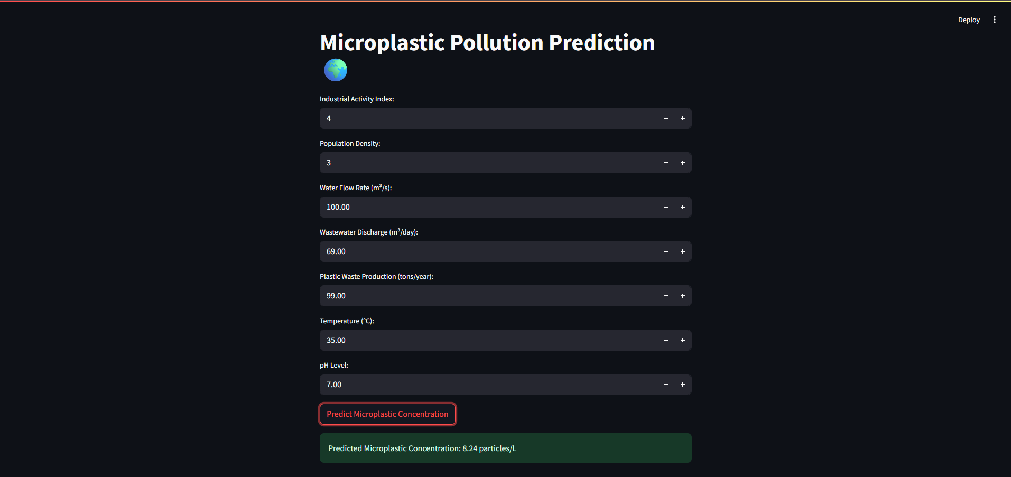
Screenshot of Output:

Slide 10
Conclusion:
Summary:
This case study focused on predicting microplastic pollution levels using environmental and human activity data. A Linear Regression model was applied for its simplicity and effectiveness in handling continuous variables, achieving good accuracy through R² and RMSE evaluation. The model successfully identified key pollution factors and hotspots, proving useful for environmental monitoring and decision-making.
Future Work:
Incorporate satellite image data for better geographical prediction.
Include time-series analysis to observe pollution trends over time.
Extend the model to predict the impact on marine species and ecosystems.
Collaborate with environmental agencies for real-time data integration.

Slide 11


GitHub Repository Link of a project
https://github.com/Dattaguru27/MICROPLASTIC-POLLUTION-PREDICTION

Slide 12
Thank You
Notes:
Thank You !!

