Slide 1

BRACT’S, Vishwakarma Institute of Information Technology, Pune-48
Intelligent Crop Health Advisor with Disease Diagnosis & Chatbot Integration
Name | Roll No | PRN
Kedar Kolase | 382013 | 22310297
Dattaraj Jadhav | 382002 | 22310028
Anurag Mhaske | 382003 | 22310033
Sairaj Magdum | 382012 | 22310273

Slide 2
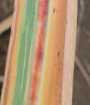
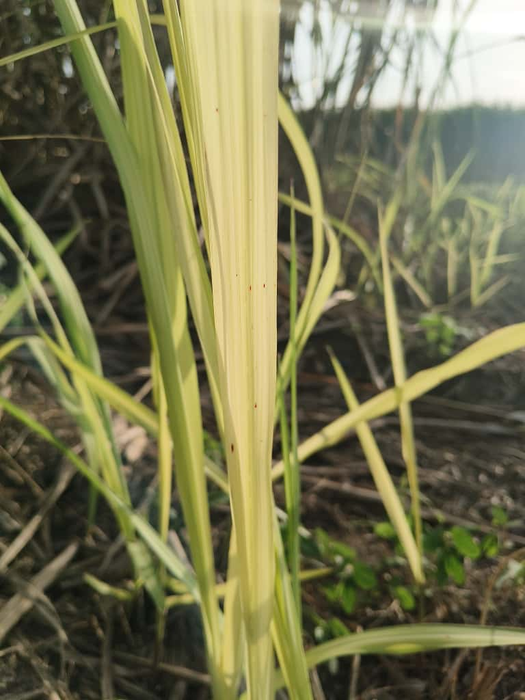
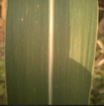
Dataset & EDA
BRACT’S, Vishwakarma Institute of Information Technology, Pune-48
Source of Dataset
Primary Source: Collected from local sugarcane plantations (Custom dataset using field photography)
PlantVillage dataset
Sample Data
Total Images: Approximately 1,000 images collected
from field photography
Target Categories (3 classes):
Red Root Disease
White Leaf Disease
Healthy/Normal Leaves
Red Rot | White Leaf | Normal Leaf
EDA Highlights:-
Dataset is moderately imbalanced across disease categories
Visible variations in texture, color spots, lesions
Preprocessing applied:
1.Image resizing (224 × 224 pixels) 2.Noise reduction 3.Normalization
Kaggle link - https://doi.org/10.34740/KAGGLE/DSV/13931305

Slide 3
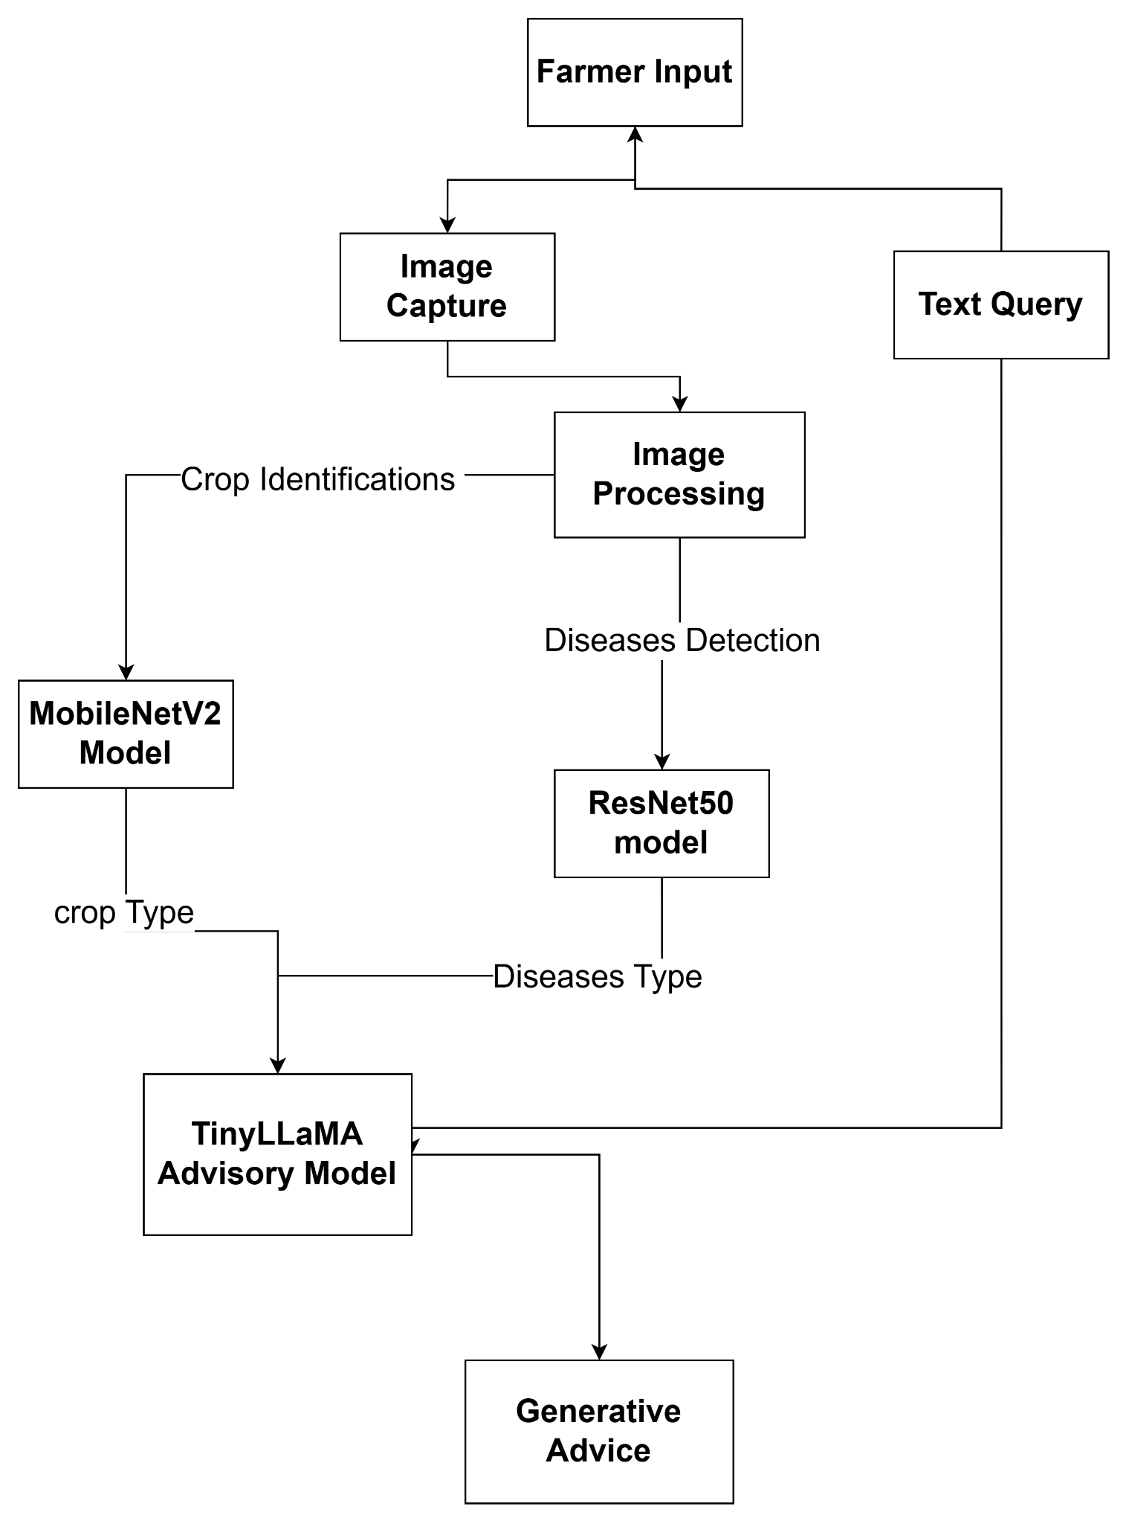
BRACT’S, Vishwakarma Institute of Information Technology, Pune-48
Architecture / Methodology
1. Data Preparation
Collect sugarcane leaf images (Healthy, Red Rot, White Leaf).
Expert labeling for accuracy.
Resize & normalize images (224×224).
Apply augmentation (rotate, flip, zoom, brightness).
2. Crop Identification Model
MobileNetV2 with transfer learning (ImageNet).
Fine-tuned on crop datasets.Outputs: crop type + confidence.
3. Disease Detection Model
ResNet50 for fine-grained leaf disease classification.
Trained on PlantVillage + custom images.
4. Context Fusion
Combine crop type + disease type + metadata.
Prepare structured input for LLM.
Ollama
(Gemma3)
5. Advice Generation (LLM)
Ollama fine-tuned on agricultural knowledge.
Generates treatment steps, prevention, and care plans.
Architecture Diagram

Slide 4
BRACT’S, Vishwakarma Institute of Information Technology, Pune-48
Key Innovations :
1.Custom Sugarcane Disease Dataset
Built using real-field images → more realistic, India-specific, and directly applicable to farmers.
2.Hybrid AI System (Vision + NLP)
Combines CNN-based disease classification with a chatbot for step-by-step advisory.
3.Context-Aware Recommendations
Advice adapts based on detected disease, severity patterns, and commonly used local treatments.
What Makes Our Solution Unique :
1.Farmer-Friendly Workflow: Simple 3-step process: Upload → Diagnose → Get Cure.
2.Practical & Easy to Use: Works with minimal input; suitable for low-resource rural environments.
3.Complete Plant Health Assistant: Provides diagnosis, treatment steps, and prevention — not just predictions

Slide 5
BRACT’S, Vishwakarma Institute of Information Technology, Pune-48
Conclusion
Built an intelligent crop advisory system that integrates CNN-based sugarcane disease detection with an NLP-driven chatbot.
System accurately identifies major sugarcane diseases and provides clear, actionable treatment and prevention guidance.
Solution reduces farmers’ dependency on agricultural experts and helps prevent large-scale crop loss through timely diagnosis.
Future Enhancements
Integrating a multilingual voice assistant to support farmers in local regional languages.
Adding weather-based disease risk prediction to provide early warnings and preventive recommendations.
Deploying the system as a mobile application for wider accessibility and real-world field usage.

Slide 6

BRACT’S, Vishwakarma Institute of Information Technology, Pune-48
Thank you !

