Slide 1

CMR COLLEGE OF ENGINEERING & TECHNOLOGY
Kandlakoya, Medchal, Hyderabad - 501401
Department of Computer Science and Engineering
Blockchain based Portal for Farmers
Name of the student:
V.Datta Sai (20H51A0525) K.Sreehaas (20H51A0567) T.Himesh (20H51A05A7)
Under esteemed guidance of
Guide Name
Ms.K.Jyothi

Slide 2
Outline
Abstract
Introduction
Literature survey
Existing system
- Problems in existing system
Research Objective of Presentation
Problem Definition
Research work
- Proposed system architecture
- Methods
Performance Measure
Results
Conclusion
Future Work
References
Notes:
2

Slide 3
Abstract
Notes:
3

Slide 4
ABSTRACT
Blockchain is a method in which a confirmation of a transaction is kept by means of a crypto-currency. The record is maintained transversely, linking several computers in a peer to peer network. Contracts, transactions, and the records of them define the economic system of a country. They set boundaries and provide security to the assets. Considering the features of blockchain such as immutability and maintaining the footage of transaction details, this paper highlights the usage of blockchain technology with farmer’s portal that keep the footage of selling and buying information of crops.
The proposed solution uses the python as a programming language in integration with the blockchain system that will benefit the farmers or vendors and individuals by preserving the contract of trade. An interface for the farmers is designed using a python programming language in addition with blockchain technology, which is used to store the information related to seller, buyer, selling and buying an item and total value transacted.

Slide 5
INTRODUCTION
Notes:
5

Slide 6
Introduction
Agriculture is the foundation of life, and farmers are the backbone of agriculture. However, farmers often face challenges in getting the proper sale value for their crops. This is due to a number of factors, including lack of transparency in the supply chain, information asymmetry, and unfair pricing practices.
Blockchain technology has the potential to revolutionize the agricultural sector by addressing these challenges. Blockchain is a distributed ledger technology that is immutable, decentralized, and transparent. This means that all transactions recorded on a blockchain are secure, tamper-proof, and accessible to all participants.
This helps the farmers to get the fair price and a transparency is maintained along the whole transaction process. So the farmer gets the correct amount that he should get.
Notes:
6

Slide 7
Literature Survey
Notes:
7

Slide 8
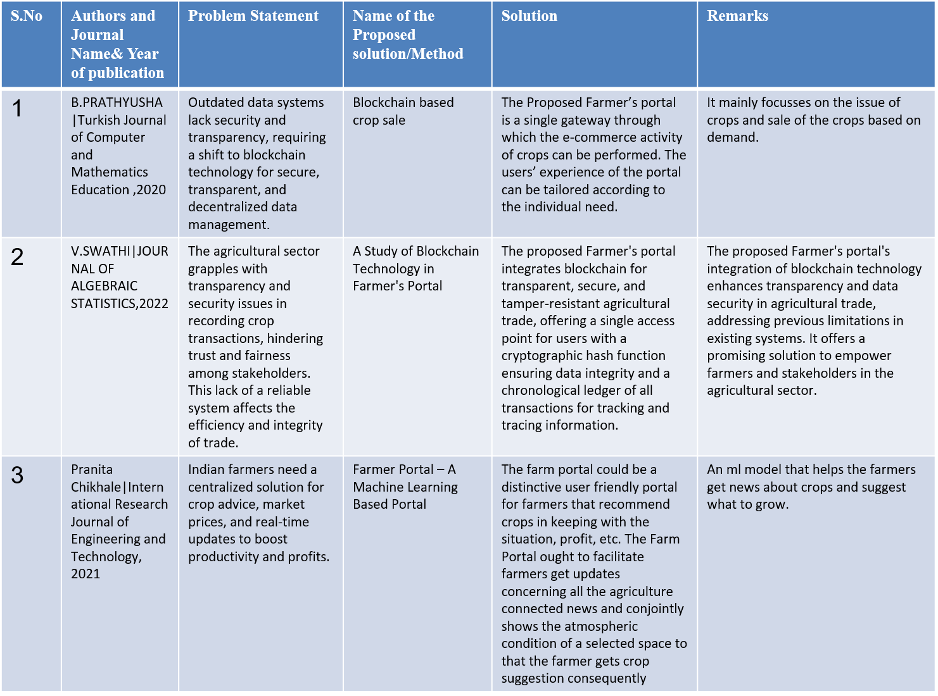
Existing system
Notes:
8

Slide 9
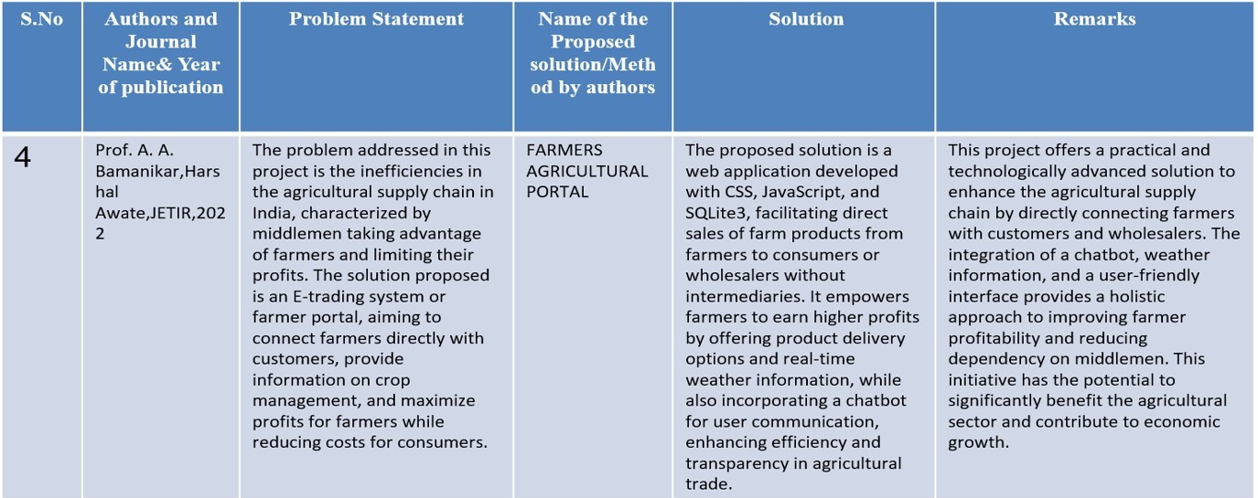
Existing system
Notes:
9

Slide 10
Research Objective
Notes:
10

Slide 11
Research objective
The primary objective of this research is to assess the feasibility and potential impact of integrating blockchain technology with farmer's portals in the Indian agricultural sector. Specifically, our research aims to achieve the following:
Evaluate Technological Viability: Determine the technical feasibility of integrating blockchain technology with existing farmer's portals and assess the compatibility of such a system with the Indian agricultural landscape.
Assess Transparency and Trust: Investigate how the use of blockchain technology enhances transparency, security, and trust within agricultural trade, with a focus on how it can benefit both farmers and other stakeholders.
Examine Efficiency Gains: Analyze the potential efficiency gains in agricultural trade processes, including reduced paperwork, faster transactions, and minimized reliance on intermediaries.
Empower Farmers: Assess the extent to which the proposed blockchain-based system empowers farmers by enabling them to secure fair prices for their crops, access financial services, and take control of their trade transactions.
Analyze Market Impact: Explore the broader economic and market impact of implementing blockchain technology, including its potential to transform the agricultural ecosystem in India.

Slide 12
Problem Definition
Notes:
12

Slide 13
Problem Definition
The general statement of BLOCKCHAIN BASED PORTAL FOR FARMERS is to introduce an online portal for farmers to deal with the issue of demand and sale price of crops which in result ensure crop security to farmers as well as to get fair price of the crop.

Slide 14
Research Work
Notes:
14

Slide 15
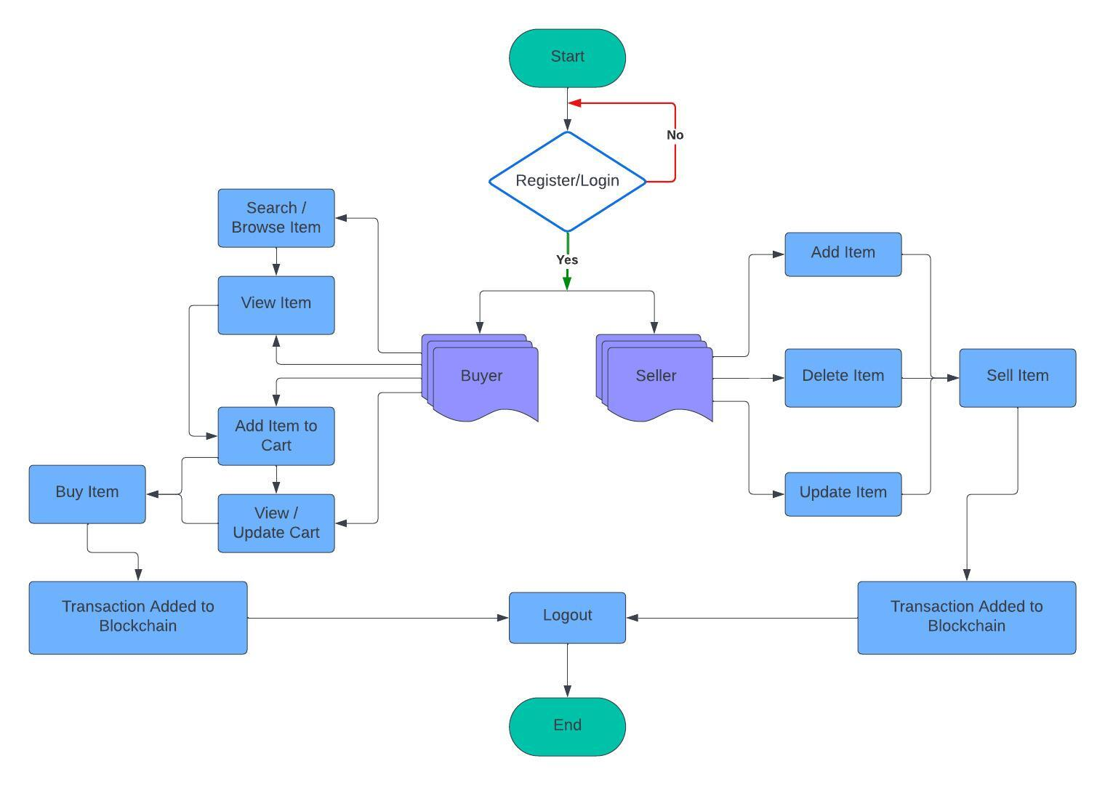
Proposed system architecture

Slide 16
Proposed Methods
The Proposed Farmer’s portal is a single gateway through which the e-commerce activity of crops can be performed. The users’ experience of the portal can be tailored according to the individual need. It is a single access point i.e., everything is in a single place, the only thing needed is single login to approved users.
User : A user can be a buyer or a seller. The seller may be a farmer or a representative of him.
Device : The user can interact through the portal using a computer or a laptop.
Interface : To access the portal, the user needs to register using a sign-up. The registered user logins using the correct credentials. Once the user signs in successfully. The user will have access to the portal/ interface. A user can view available items that are crops and seeds with their price.

Slide 17
Result Analysis
The integration of blockchain technology into the farmer's portal has the potential to significantly benefit the agricultural sector in India. By leveraging the immutable, decentralized, and transaction history features of blockchain, this system aims to enhance transparency and fairness in agricultural transactions. With a user-friendly interface developed in Python, farmers and stakeholders will be able to securely record and access critical information about crop sales, ultimately leading to more equitable and efficient trade practices. This initiative has the potential to empower farmers, vendors, and individuals, improving their access to fair prices and enhancing their overall livelihoods in the agriculture industry.

Slide 18
Conclusion
Blockchain Technology in the field of agriculture can bring revolutionary enhancement in the area of maintaining farmers data securely, ensuring the security of transactions, and sale price of crops. In this project the block chain-based portal is involved in dealing with the issue of demand and sale price of crops which in result ensure crop security to farmers as well as to get fair price of the crop. A farmer can register and sell his crops, recording a transaction on a block chain at a point when buyers commit to buy a farmer's crop. This transaction is capable of recording crop details, the price at which it is committed to buying and quantity of crop purchased. This immutable nature of block chain technology will enable the farmers to get a legitimate price of crop and reduce the cost of operation for selling and buying crops when compared to traditional methods.

Slide 19
Future work
Integration with IoT Devices: Explore the integration of Internet of Things (IoT) devices to provide real-time data on crop conditions and supply chain logistics, enhancing transparency and traceability throughout the farming process.
Smart Contract Automation: Implement smart contracts to automate transaction execution based on predefined conditions, reducing manual intervention and streamlining trading operations for farmers and vendors.
User Experience Enhancements: Continuously improve the user interface and experience based on feedback and usability testing results, ensuring widespread adoption and usability among farmers and stakeholders.
Data Analytics and Insights: Develop data analytics tools within the system to provide valuable insights such as crop price trends and demand forecasts, empowering farmers with informed decision-making capabilities.

Slide 20
References
Hileman, Garrick, and Michel Rauchs. "2017 Global Blockchain Benchmarking Study." Available at SSRN 3040224 (2017).
Yadav,Vinay Surendra, and A. R. Singh. “A Systematic Literature Review of Blockchain Technology in Agriculture.”
Ghosh, Soumalya,A. B. Garg, Sayan Sarcar, PSV S. Sridhar, Ojasvi Maleyvar, and Raveesh Kapoor. "Krishi-Bharati: An Interface for Indian Farmers”. In Proceedings of the 2014 IEEE Students' Technology Symposium, pp. 259-263. IEEE, 2014.
Zhu, Xingxiong, and Dong Wang. "Research on Blockchain Application for E-Commerce, Finance and Energy." In IOP Conference Series: Earth and Environmental Science, vol. 252, no. 4, p. 042126. IOP Publishing, 2019.

Slide 21
Thank You!

