Slide 1
Git and GitHub Introduction
Datta Sai

Slide 2
What is Git?
It is a Distributed Version Control System that helps developers manage and track changes in their codebase.
It is used for:
Tracking Code Changes.
Tracking who made changes.
Coding Collaboration.
What does Git do?
Manage projects with Repositories.
Clone project to work on a local copy.
Control and track changes with Staging and Committing.
Pull the latest version of the project to a local copy.
Push local updates to the main project.
Why Git?
Developers can work together from anywhere.
Developers can see full history of the project.

Slide 3
What is GitHub?
It is a Web-Based Platform for hosting and managing Git repositories.
It is widely used in Software Development, open-source projects.
It makes tools that use Git.
Git Install:
You can download Git from the following website:
https://www.git-scm.com
Using Git with Command Line and GitBash.
Need to Set the Path in Environment Variables.

Slide 4
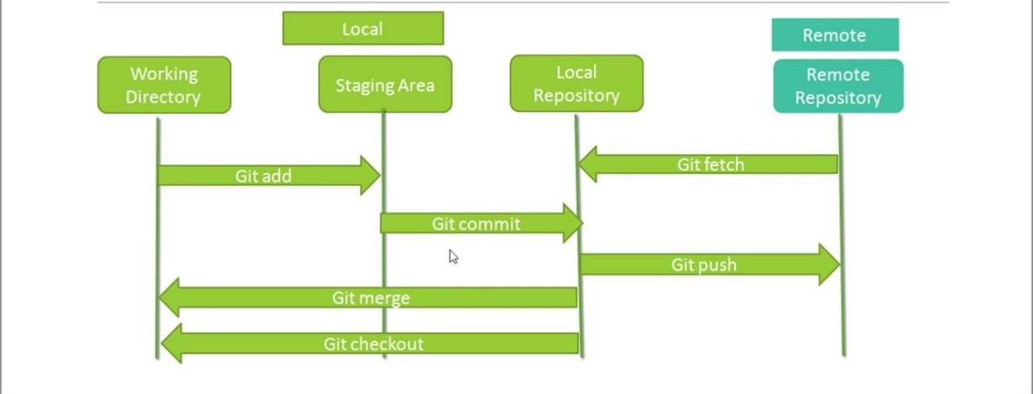
Git Architecture

Slide 5
Working Directory:
This is the Local Machine where files are created, modified or deleted.
It reflects the current state of the files, either tracked or untracked.
2. Staging Area:
It is an intermediate space where changes are prepared before committing them to the local repository.
It ensures that only the changes which want to include in a commit are staged.
3. Local Repository:
It contains a .git folder in the project directory that stores the entire project history, including all the commits and branches.
It stores a complete snapshot of the project at every commit.
4.Remote Repository:
It is a version of the repository hosted on a remote server like GitHub, Bitbucket.

Slide 6
Git Workflow
Modify Files: Changes are made in the Working Directory.
Stage Changes: Use “git add” to add changes to the Staging Area.
Commit Changes: Use “git commit” to save changes to the Local Repository.
Push Changes: Use “git push” to send commits to the Remote Repository.
Pull Updates: Use “git pull” to sync in local repository with updates from remote repository.

Slide 7
Git Commands
1. Git init – It is used to initialize a new Git repository in a directory.
Command - git init
2. Git clone – It is used to create a copy of an existing Git repository. It allows to clone a repository from a remote source (like GitHub).
Command – git clone <repository-url>
3. Git config – It is used Git to allow attribute commits to a specific person, making history of changes more traceable.
Command – git config --global user.name “<Your Name>”
git config --global user.email “<Your Email>”
4. Git status – It provides a summary of the current state of working directory and the staging area, allowing to see which changes are stages and which or not(which are not tracked by Git).
Command – git status
5. Git add – It is used to stage changes in the working directory so that can be included in next commit.
Command – git add <file_name> → Used to add Single File.
git add . → Used to add Multiple Files.

Slide 8
6. Git commit – It records changes in repository. Once the staged changes using “git add” , “git commit” saves those changes to the projects version history.
Command – git commit –m “<commit_message>”
7. Git log – It provides a detailed history of commits in a repository. It is used for reviewing the commit history, tracking changes, author detailes and date.
Command – git log
git log –n 3 → Shows last 3 commits
git log --oneline → Shows each commit in a single line with shortend commit hash and commit message.
8. Git show – It provides a specific commit, including the commit message, author, date, and the changes made in the commit.
Command – git show <commit_hash>
9. Git diff – It is used to show the differences between files or commits. It compares changes between working directory and staging area.
Command – git diff

Slide 9
10. Git push – It is used to upload local repository changes to a remote repository. It allows developers to share their changes with others by pushing commits from local repository to remote repository (like GitHub).
Command – git push <remote_name> <branch_name>
11. Git pull – It is used to update the local repository with the changes from a remote repository. It is a combination of both “git fetch” (which downloads new data from a remote repository) and “git merge” (which integrates those changes in current branch).
Command – git pull <remote_name> <branch_name>
12. Git fetch – It is used to download changes from a remote repository to local machine, without merging changes into working directory or current branch. It allows to get the latest changes from a remote repository.
Command – git fetch <remote_name> <branch_name>
13. Git branch – It is used to manage branches in repository. It helps to create, list, rename, delete branches.
Command – git branch <branch_name> → Used to create a branch
git branch → Used to list all branches
git branch –d <branch_name> → Used to delete a branch
git branch –D <branch_name> → Used to force-delete a branch

Slide 10
14. Git checkout – It is used to switch between branches.
Command – git checkout <branch_name> → Used to switch from one branch to another branch
git checkout –b <new_branch_name> → Used to create a new branch and switches to it
15. Git merge – It is used to combine changes from two branches into a single branch.
Command – git merge <branch_name>

