Slide 1

Churn Analysis & Customer Intelligence
by Dattatreya

Slide 2
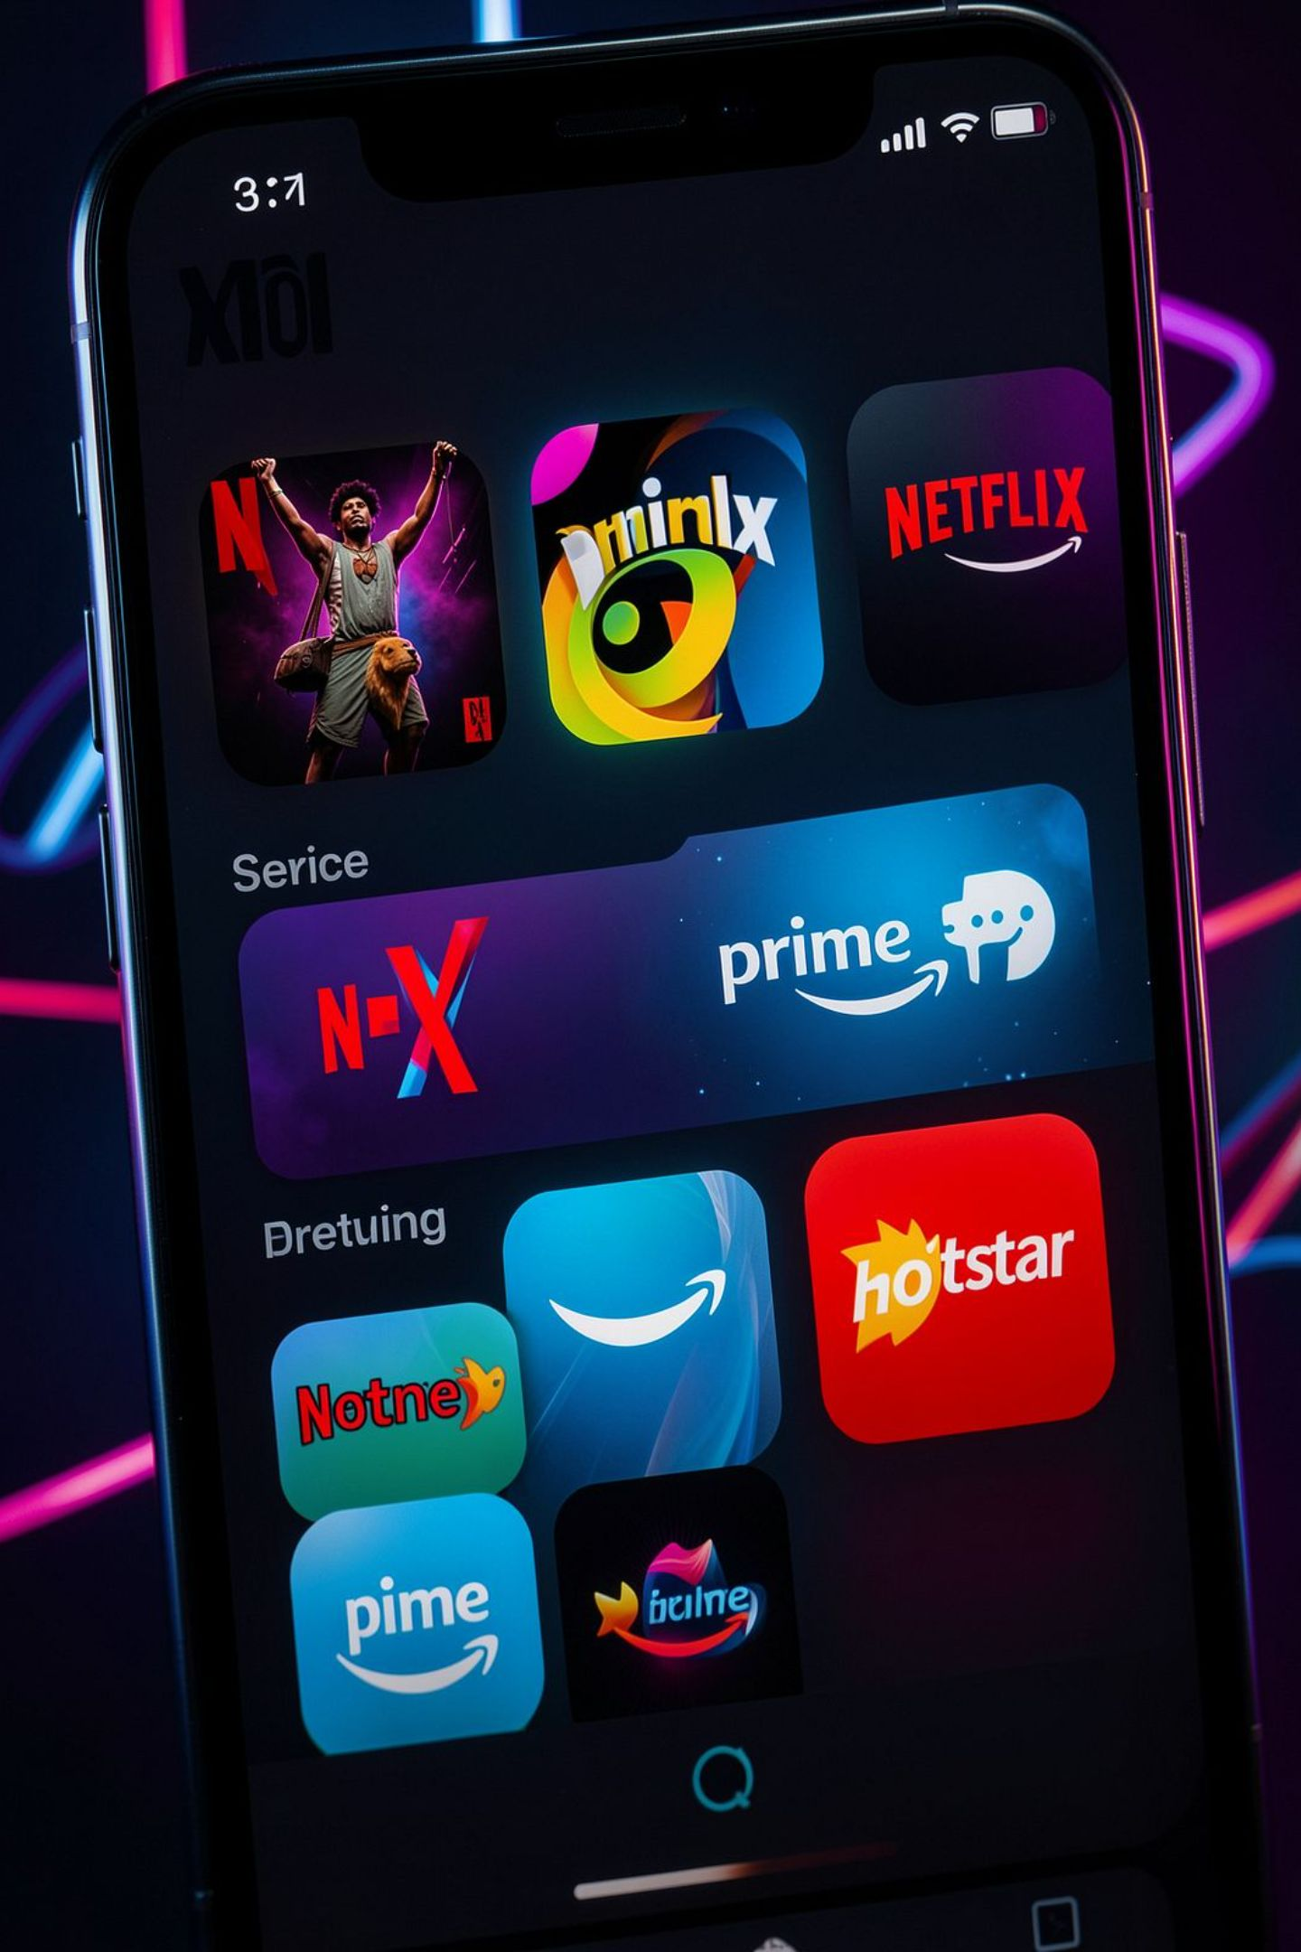
The Business Challenge
OTT Landscape
Your Role
Netflix, Hotstar, Prime — hyper-competitive
Data Analyst identifying high-risk subscribers
Data Sources
Demographics, subscription tiers, support escalations

Slide 3




Core Tech Stack
SQL & Python
Performance Engineering
numpy, pandas, sqlite3
Data cleaning, feature engineering
Visualization
Actionable Insights
matplotlib, seaborn
Business-ready reporting

Slide 4
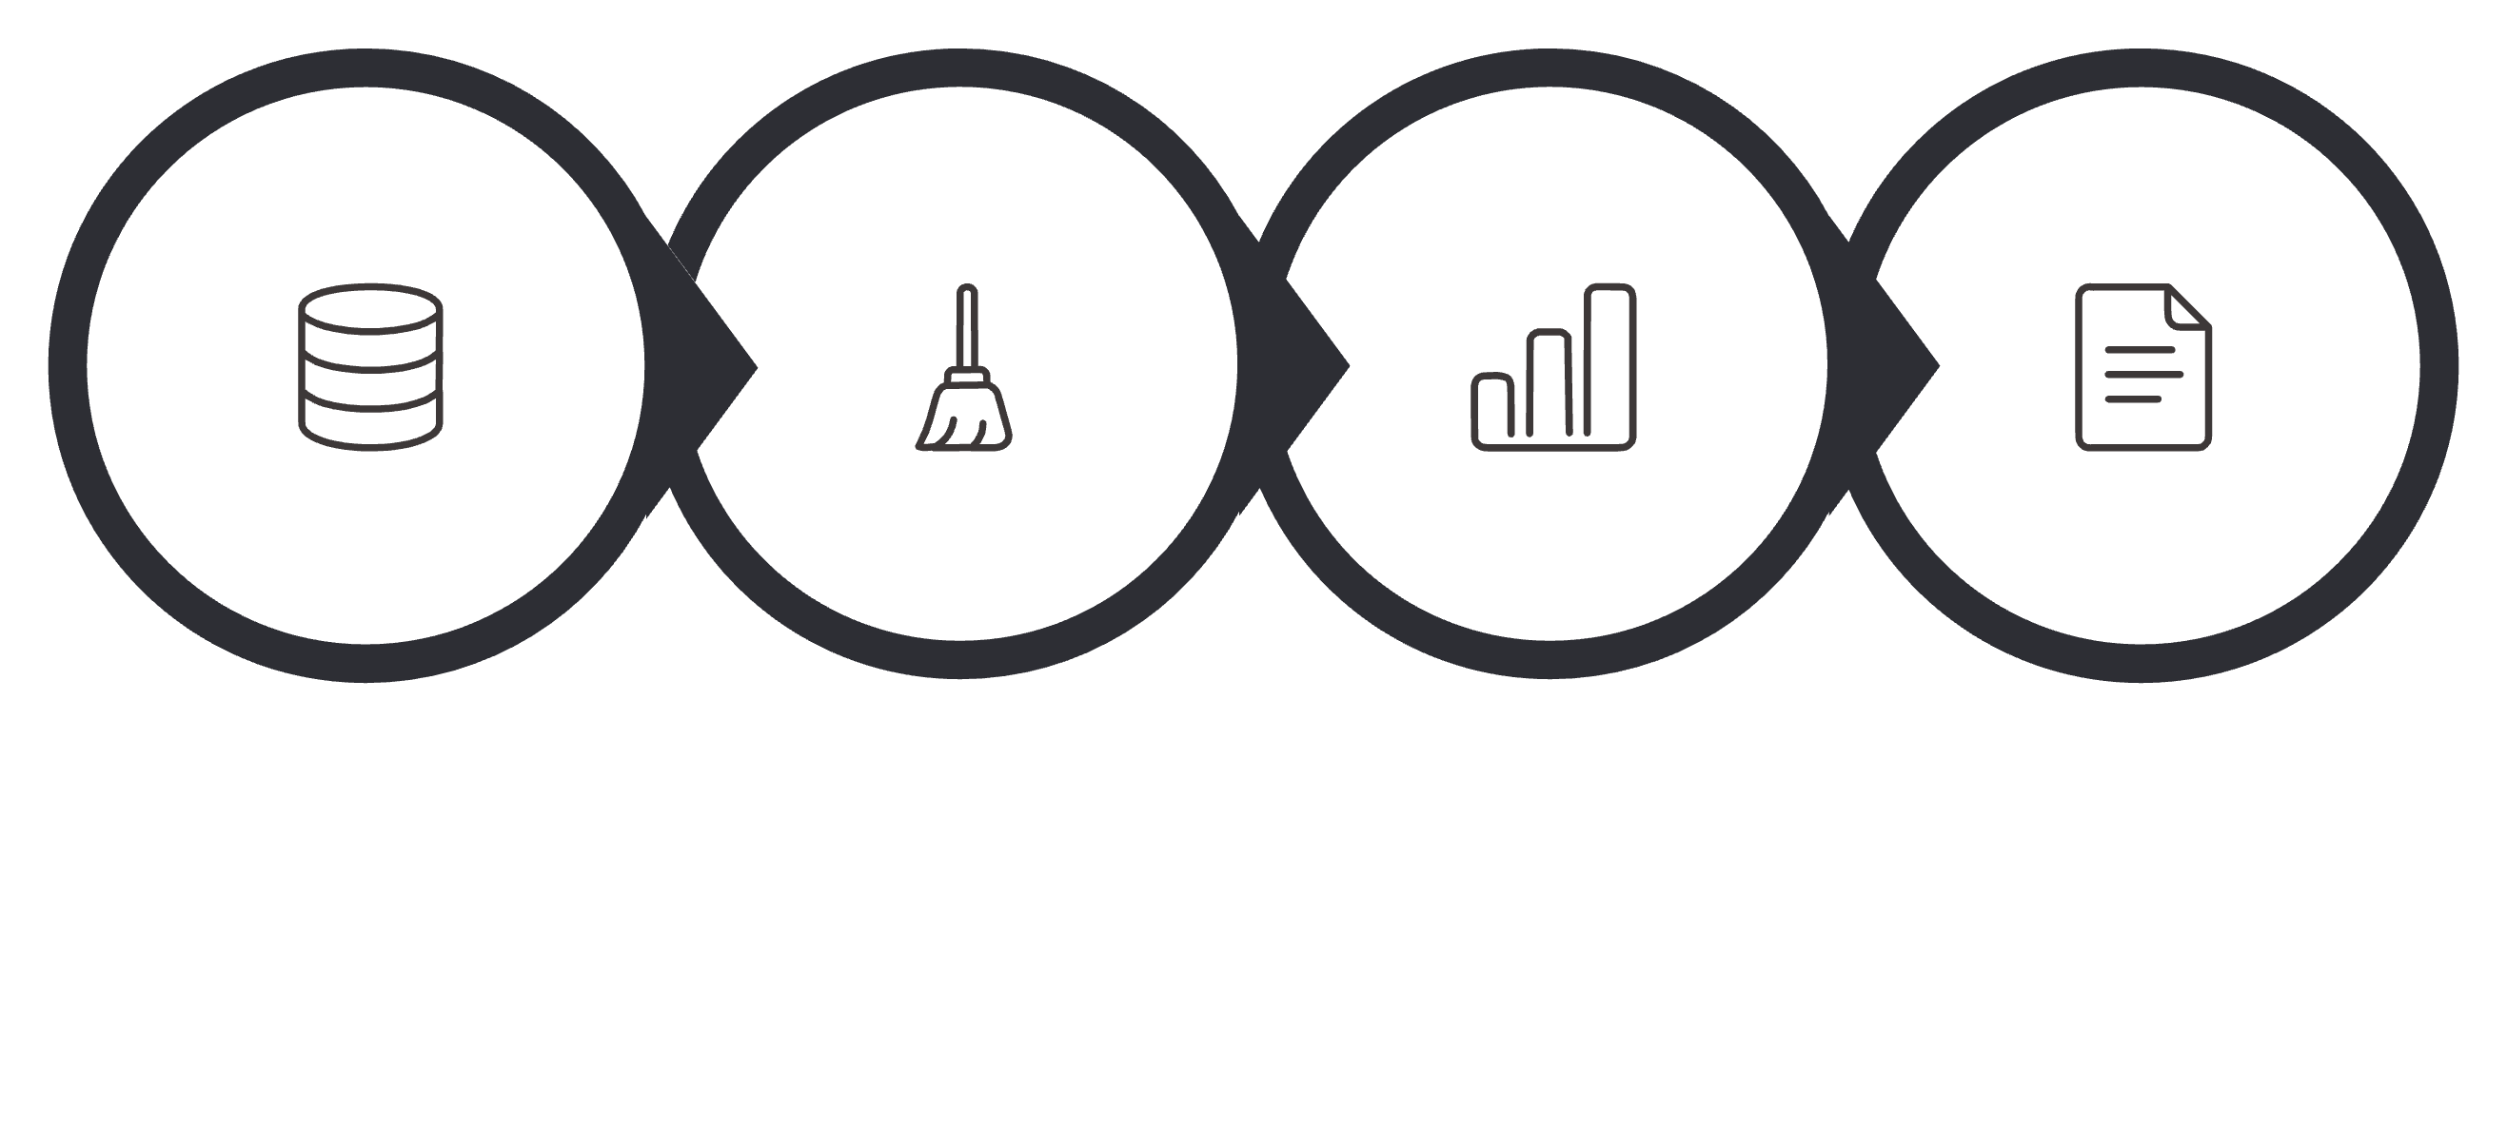
Churn Analysis Roadmap
Connect
Clean
Analyze
Report
End-to-end pipeline from raw data to billion-dollar business insights.

Slide 5
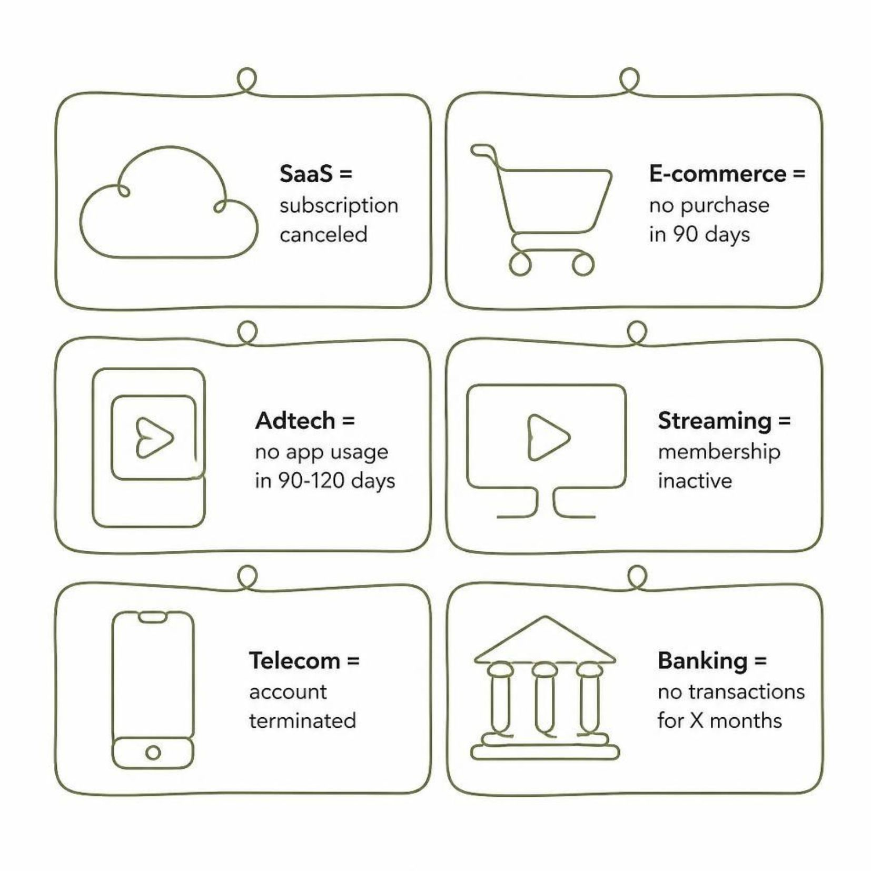
Churn Definition by Business
Churn analysis answers three questions: Who left, Why they left, and When — the danger zone.

Slide 6
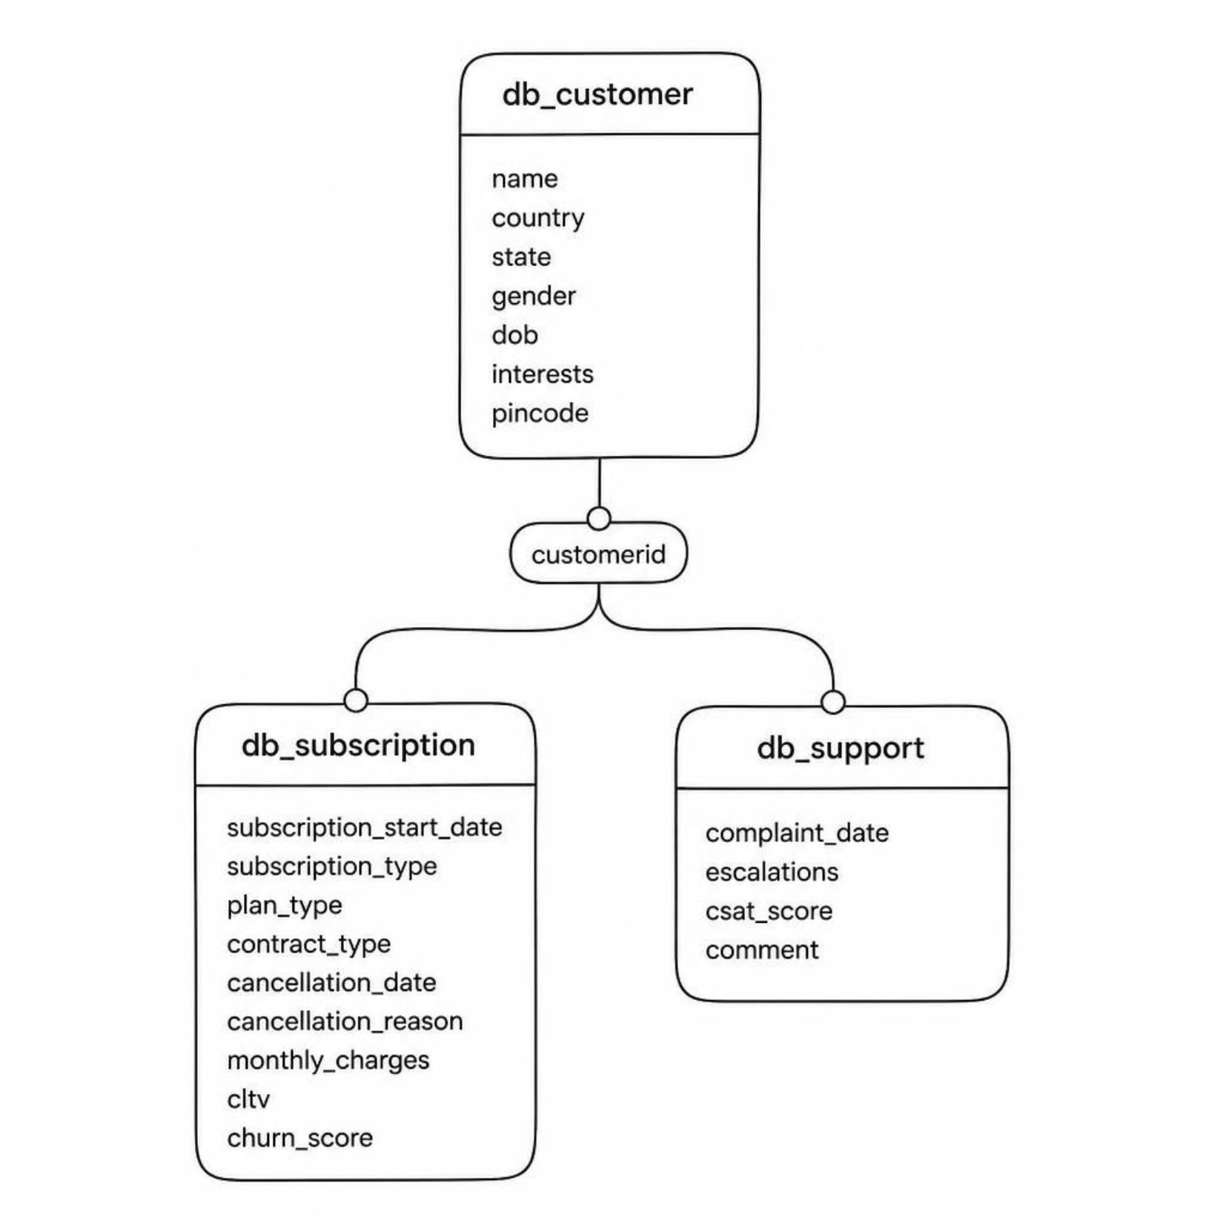

Database Schema
Database: customer_churn
db_customer — demographics & interests
db_subscription — plans, charges, churn_score
db_support — complaints, escalations, CSAT
All three tables linked via customerid

Slide 7
Key KPIs & Formulas
Churn Rate | Churned / Total customers
Retention Rate | 1 − Churn Rate
ARPU | SUM(monthly_charges) / Active customers
Avg Tenure | AVG(DATEDIFF(cancellation_date OR NOW(), start_date))
Revenue at Risk | SUM(monthly_charges) WHERE churn_score > 70
Escalation Rate | SUM(escalations) / COUNT(complaints) × 100

Slide 8
Key Insights
28.6%
55.6%
Churn Rate
Monthly Churn
Retention: 71.4%
vs 8.3% annual
₹18.8
18%
ARPU
Revenue Loss
Avg tenure: 1,451 days
₹74 lost, CLTV: ₹2,047
Most churn: Basic plan, Sep 2024, Karnataka. Low revenue impact — focus on high/med risk cohorts.

Slide 9


Action Items
Investigate Karnataka
Price hikes? Complaints? Tech issues?
Audit Basic Plan
Recent changes in September?
Competitor Check
Users switching — why?
Proactive Outreach
Email, SMS, calls to high/med risk customers

Slide 10
Thank you

