Slide 1
Chatbot
Project By: Project Guide:
Datwani Niyati Dr Jyoti Pareek
Department of Computer Science
Rollwala Computer Center
Gujarat University

Slide 2
Goals and Objective of the Project
The goal of this project is to compare the advantages and disadvantages of both Rule-based and Learning-based chatbot.
Objective is to create a fully functional chatbot:
In Rule-based using Tf-Idf and Cosine Similarity.
In Learning-based using Deep Natural Language Processing.

Slide 3
Applications
Order Food
Domino’s chatbot build new pizza and tracks user order all from Facebook Messenger.
Schedule a Meeting
Meekan - slack bot find times in everyone's calendar to schedule meeting.
Search for & Track Flights
Tracks current flights, wait times, delays.
Search and compare and book flights and hotels based on price and location from Facebook Messenger.

Slide 4
What is Chatbot?
It is an assistant that communicate with us through text messages a virtual companion that integrates into websites , applications or instant messengers and helps entrepreneurs to get closer to customers

Slide 5
Steps in an AI Chatbot Development
Building an AI Chatbot involve 3 steps:
End-user Channel
NLP
Chatbot Development Techniques
End-user Channel
NLP
Chatbot Development Techniques

Slide 6
Steps in an AI Chatbot Development
End-user Channel
This is how our chatbot will talk to our end customer. It can either be a stand-alone app or an integrated one to run on any of the social channels like Facebook,Google- hangouts etc.

Slide 7
Steps in an AI Chatbot Development
Natural Language Processing (NLP)
For building an AI-based Chatbot ,the preprocessing of the textual information is very critical and important.
Main objective of the data preprocessing is to remove data which do not give useful information regarding the class of a document.
Furthermore we also want to remove data that is redundant.
Most widely used data cleaning steps in the textual retrieval tasks are removing of stop words and performing stemming to reduce the vocabulary

Slide 8
Chatbot Development Techniques
Rule based Chatbot
Learning based Chatbot

Slide 9
Methodology of data pre-processing in Chatbot Development
All the special characters are removed.
Stop words are removed.
Porter’s Stemming Algorithm is applied to bring the word in their most basic form.
The word frequency of all the words.
The normalized term frequency of all the words
The inverse document frequency of all the words.
Term Document Frequency inverse document frequency (TF-IDF)

Slide 10
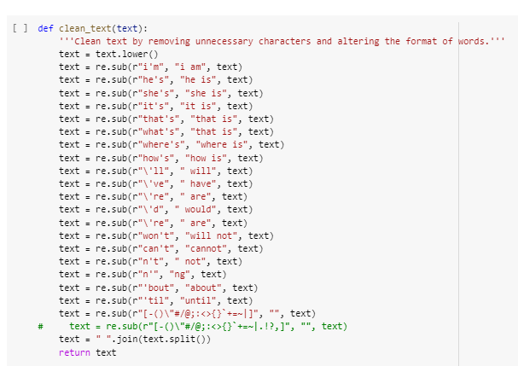
Methodology of data pre-processing in Chatbot Development

Slide 11
Rule based techniques
Rule-based chatbot are pretty straight forward as compared to learning-based chatbots. There are a specific set of rules. If the user query matches any rule, the answer to the query is generated,otherwise the user is notified that the answer to user query doesn’t exist.
One of the advantages of rule-based chatbots is that they always give accurate results.However, on the downside, they do not scale well. To add more responses you have to define new rules.

Slide 12
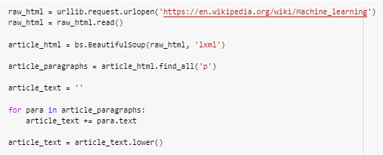
Creating the Corpus
We will use the Wikipedia article on Machine Learning to create our corpus. The following script retrieves the Wikipedia article and extracts all the paragraphs from the article text.

Slide 13
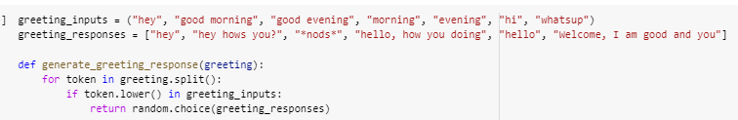
Responding to Greetings
Since we are developing a rule-based chatbot, we need to handle different types of user inputs in a different manner. For instance, for greetings we will define a dedicated function. To handle greetings, we will create two lists: greeting_inputs and greeting_outputs list, if the greeting is found we will randomly choose a response from the greeting_outputs list.

Slide 14

Responding to the User Queries
As we saw earlier, the response will be generated based upon the Cosine Similarity of the vectorized form of the input sentence and the sentences in the corpora.
The following script imports the TFidfVectorizer and the cosine_similarity functions:
Tf(t) = no of time term t appear in a document /total no of document.IDF which means how imp a word is in a document idf(t) = log_e(total no of document/total no of document with term t
It measure the angle between two vector projected in a multi dimensional space the two vectors are array containing the word count of two document.

Slide 15
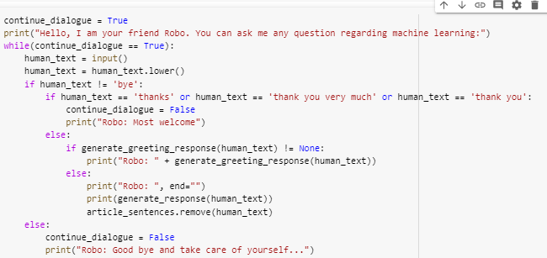
Chatting with the Chatbot

Slide 16
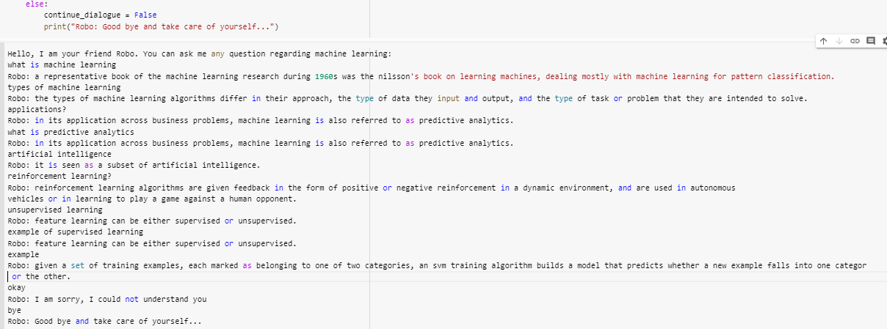
Output

Slide 17
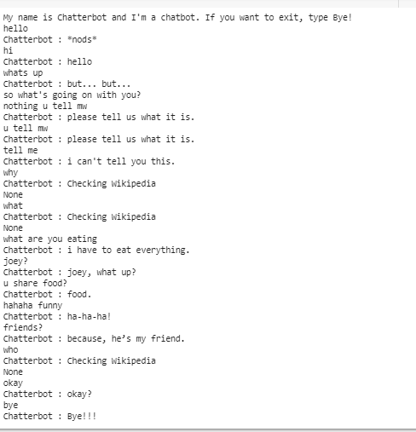
Output
Output with conversational dataset

Slide 18
Learning based Chatbot
Learning based chatbots are the type of chatbots that use machine learning techniques and a dataset to learn to generate a response to user queries. Learning - based chatbots can be further divided into two categories: retrieval-based chatbots and generative based chatbots.
The main advantages of learning-based chatbots is their flexibility to answer a variety of user queries. Though the response might not always be correct,learning-based chatbots are capable to answer to any type of user query.
One of the major drawbacks of these chatbots is that they may need a huge amount of time and data to train.

Slide 19
Dataset Description
Metadata-rich large collection of conversations from raw scripts from popular movies.
The following are found in corpus-
220,579 conversational exchanges between 10,292 pairs of movie characters.
9,035 characters from 617 movies.
304,713 utterances.
Other movie meta-data :
genres, release year, IMDB rating, number of IMDB votes
Data Source:
http://www:cs:cornell:edu/~cristian/Cornell Movie-Dialogs Corpus:html.

Slide 20
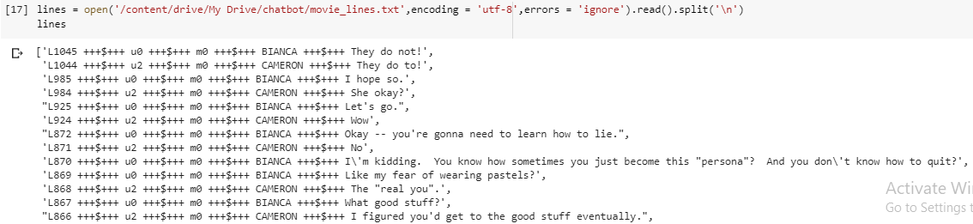
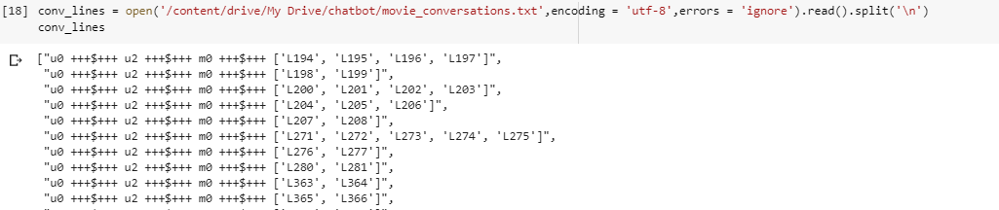
Dataset Description

Slide 21
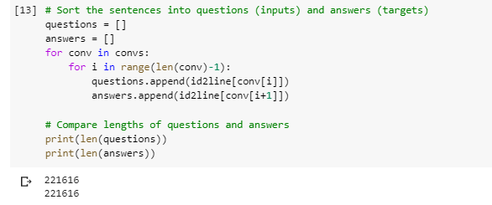
Distribution of Questions and Answers in Dataset

Slide 22
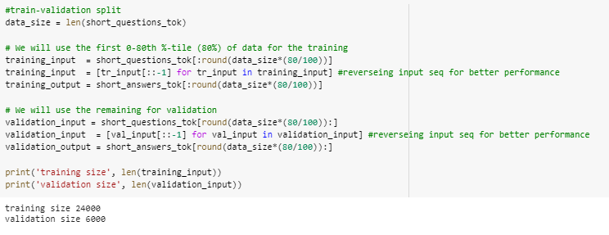
Train-Validation split
Source and target file was splitted for
Training development/validation set
Saved in files for final input pipeline feed.

Slide 23
Recurrent Neural Network
Used for sequential memory
Primarily used in Natural Language Processing
Consists of 3 layers:
Input Layer
Takes input as scalar vector
Applies weight and biases
Hidden Layer
Can have multiple layers
Applies weight
Output is generated using activation function
sigma, tangent
Output Layer

Slide 24
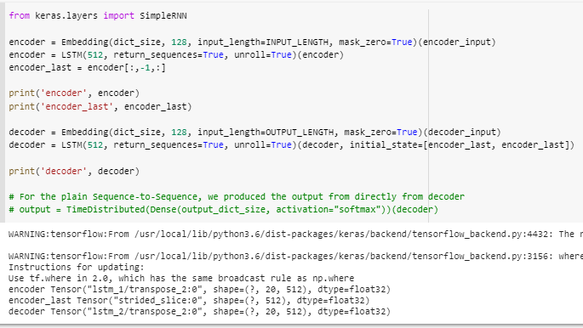
Recurrent Neural Network

Slide 25
Limitation of Recurrent Neural Network
Does not work for most NLP problems.
Too simple architecture to handle complex problems.
Complete sequence may be irrelevant to store.
Sparse tokens in sequence may be relevant.
For long sentence or sequence, RNN may fail and memory may become bottleneck.

Slide 26
Evaluation Measures
Epochs - One epoch is when an Entire dataset is passed forward and backward through the neural network only once.
Batch size - Total number of training examples present in a single batch.
LSTM Cell - A common lstm unit is composed of a cell, an input gate, an output gate, and a forget gate. The cell remembers value over arbitrary time intervals and the three gates regulate the flow of information into and out of the cell.
Notes:
The algorithms leverages the power of adaptive learning rates methods to find individual learning rates for each parameter. It also has advantages of Adagrad [10], which works really well in settings with sparse gradients, but struggles in non-convex optimization of neural networks

Slide 27
Training Hyper Parameter
Parameter name | Value
No. of training sets | 24000
Steps per set | 5ms/steps
No of layers | 12
Cell type | Lstm
Optimizer | adam
Parameter name | Value
Activation | Softmax
Loss | Binary cross entropy
Batch size | 20
Epochs | 1000
Notes:
Binary crossentropy is a loss function used on problems involving yes/no (binary) decisions. For instance, in multi-label problems, where an example can belong to multiple classes at the same time, the model tries to decide for each class whether the example belongs to that class or not.

Slide 28
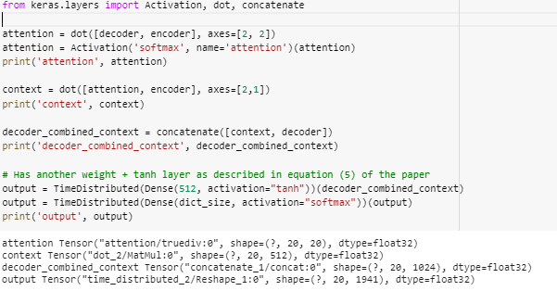
Training Hyper parameter

Slide 29
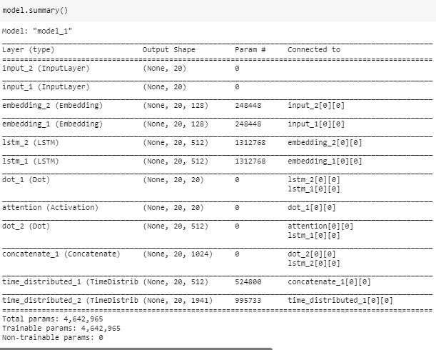
Training Hyper parameter

Slide 30
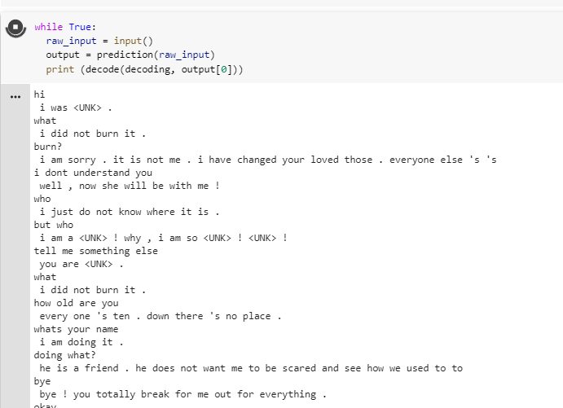
Output
After 100 epochs:

Slide 31
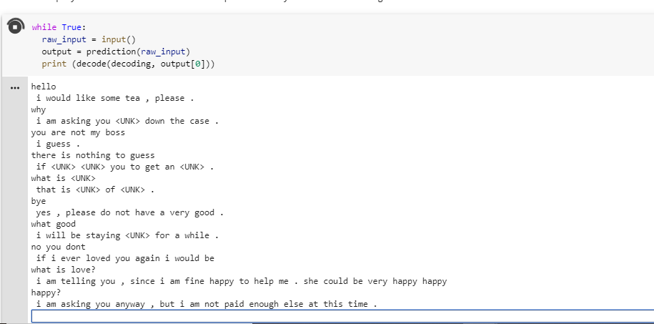
Output
After 500 epochs:

Slide 32
Comparison
Retrieval based model: Trained specifically on some question and their possible answer. It is like a database of question, and their answers are provided to the chatbot. When the question is asked When a question is asked, the bot searches the most relevant answer from the lot and displays the one that is selected. It is different from other AI bots as it cannot generate a new answer to the question.
The rule-based bots can be preferred for a business that deals with straight questions that don’t require much intelligence and customized answers.

Slide 33
Comparison
Generative models: They are better than rule-based chatbots since they can generate a new answer and the replies are different from the previous one. The reason for their better performance is that they take words from the query and generate the answer accordingly.
Business dealing with delivery, tracking, and logistics offer the best application for rule-based chatbots while AI chatbots are ideal for customer issues, where pre-set answers cannot serve the purpose of satisfying the customer.

Slide 34
Challenges
Model Specific:
Generative chatbot treated dialogue generation as deterministic translation problem.
Tuning:
Finding right hyper parameters to optimize the for chat bot or dialogue generation system.
Dataset Specific:
Movie data does not reflect real interaction.
Data quality is not optimum.
Loss of data after cleaning and fewer quality utterance
Many utterance was discarded due to longer length or discrepancy in earlier training.
Number of training utterance was less than required.
Dataset was splitted for training, testing and development.
Test and development dataset was quite larger in comparison to training.
Processing:
Training is a long process demands higher processing power

Slide 35
Discussion
Developing chatbot algorithm from scratch would be better
Requires multiple trial and error before reaching optimal performance for the comprehensive chatbot module.
Better suited as research problem.

Slide 36
References
Deep reinforcement learning for dialogue generation
Authors: Jiwei Li, Will Monroe, Alan Ritter, Michel Galley, Jianfeng Gao, Dan Jurafsky
Recurrent Neural Network
https://github.com/tensorflow/nmt
(seq2seq) Tutorial
https://www.tensorflow.org/tutorials/seq2seq
seq2seq Github Repository
https://github.com/google/seq2seq
Cornell Movie Dialogs Corpus
http://www.cs.cornell.edu/~cristian/Cornell Movie-Dialogs Corpus.html
Rule-based chatbot
https://blog.eduonix.com/internet-of-things/simple-nlp-based-chatbot-python/

Slide 37
References
https://medium:com/swlh/chatbots-of-the-future-86b5bf762bb4
https://chatbotsmagazine:com/to-build-a-successful-chatbot-ask-these-
5-questions-b7fe3776c74c
https://labs:bawi:io/creating-a-conversational-chatbot-using-wit-ai-
6eba3c625f4f
https://www:ipsoft:com/2017/11/20/when-chatbots-fail-virtual-agentsstep-
in/

