Slide 1

Quizcraft Your Intelligent C++ Learning Companion

Slide 2

Introduction
Welcome to QuizCraft, an innovative educational initiative aimed at enhancing the learning experience for computer science students through an engaging and interactive game-based platform. Developed using C++ programming language within the Visual Studio environment, QuizCraft combines game-based learning with real-time code compilation and error checking

Slide 3
Preferred Levels
Beginners
Intermediate
Advanced

Slide 4


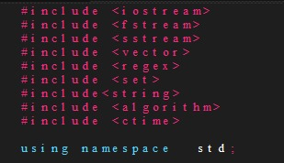

Body of code

Slide 5


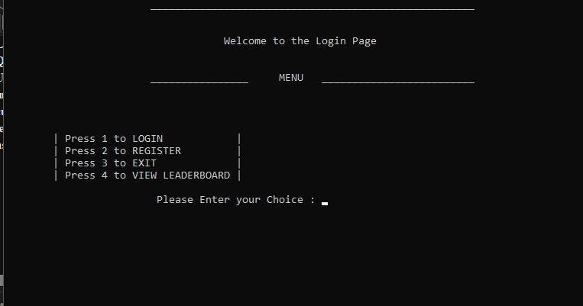


Interface

Slide 6
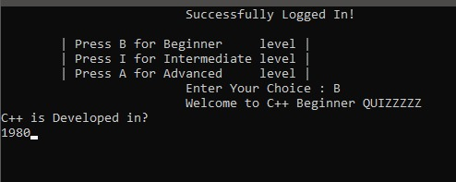
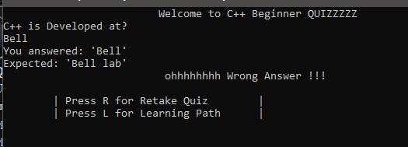
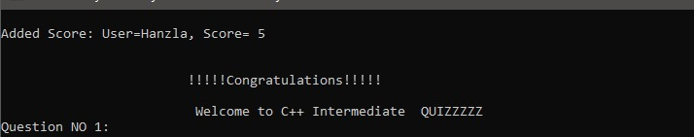
Beginner

Slide 7

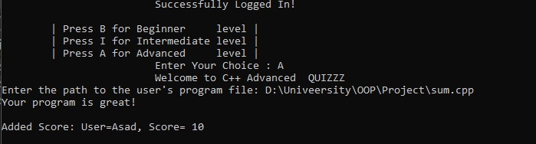
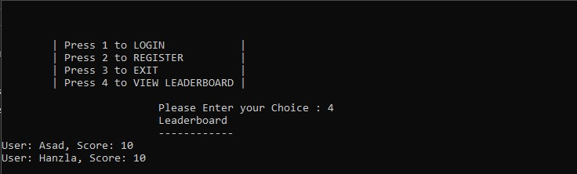
Leaderboard

Slide 8

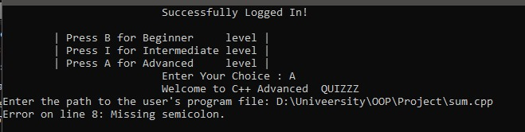
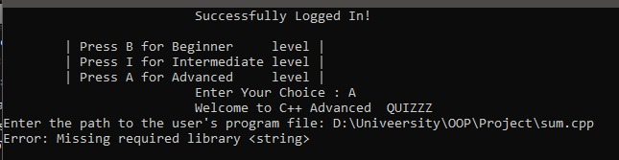
Advanced

Slide 9

Thank you

