Slide 1
Functions
Abylkassymova A.B.

Slide 2
To function or NOT to function
Organize your code into “paragraphs” - capture a complete thought and “name it”
Don’t repeat yourself - make it work once and then reuse it
If something gets too long or complex, break up logical chunks and put those chunks in functions
Make a library of common stuff that you do over and over - perhaps share this with your friends...

Slide 3
So …
Functions provide a means of packaging code to make it easy to find and access.
The code that needs services from the function is named the caller, and it calls upon the function to perform tasks for it
The caller must supply information to the function, and the function returns information to the caller.

Slide 4
The main purpose
The main advantage of having a function – code reusability!
Code reusability is a necessary part of applications to
» Reduce development time
» Reduce programmer error
» Increase application reliability
» Allow entire groups to benefit from the work of one programmer
» Make code easier to understand
» Improve application efficiency

Slide 5
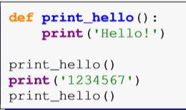

Defining a function
Required!
Functions are deﬁned with the def statement
the function definition
Function’s body
Calling the function
Output

Slide 6
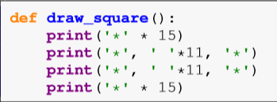
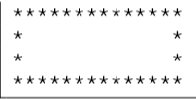
Example
One beneﬁt of this is that if you decide to change the size of the box, you just have to modify the code in the function, whereas if you had copied and pasted the box-drawing code everywhere you needed it, you would have to change all of them.

Slide 7
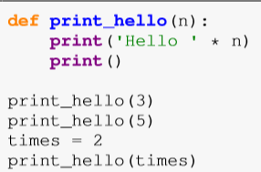

Arguments
We can pass values to functions. Here is an example:
the print_hello function with the value 3, that value gets stored in the variable n.

Slide 8
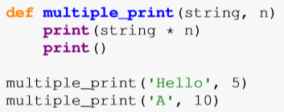

Example
You can pass more than one value to a function:
Two arguments

Slide 9
Return
Values: Any value is acceptable. You can return numbers, such as 1 or 2.5; strings, such as “Hello There!”; or Boolean values, such as True or False.
Variables: The content of any variable works just as well as a direct value. The caller receives whatever data is stored in the variable.
Expressions: Many developers use expressions as a shortcut. For example, you can simply return A + B rather than perform the calculation, place the result in a variable, and then return the variable to the caller. Using the expression is faster and accomplishes the same task.
Results from other functions: You can actually return data from another function as part of the return of your function.

Slide 10
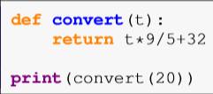
Returning values
Sometimes functions perform calculations and RETURN a result!
Printing is done outside of the function.
The return statement is used to send the result of a function’s calculations back to the caller.

Slide 11
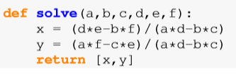
A function can return multiple values as a list
A function that solves the system of equations ax + by = e and cx +dy = f.
Returns both the x and y solutions.
the shortcut for assigning to lists

Slide 12
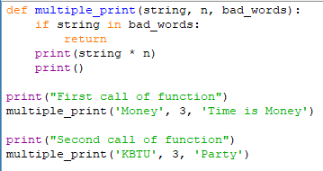

A return statement by itself can be used to end a function early

Slide 13
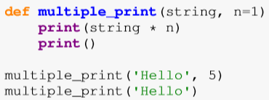

Default arguments
This makes it optional, and if the caller decides not to use it, then it takes the default value.
Default arguments need to come at the end of the function deﬁnition, after all of the non-default arguments.

Slide 14
Keyword arguments
A related concept to default arguments is keyword arguments (But not the same).
Suppose, we have a function:
Fortunatelly, PYTHON allows to do that:
Or EVEN that:
Too many values ☹
The order of the arguments does not matter when you use keyword arguments.

Slide 15
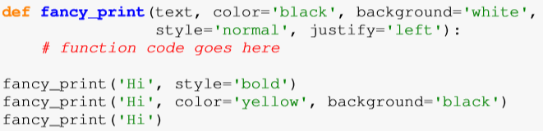
Mixing keyword and default arguments
Give defaults

Slide 16
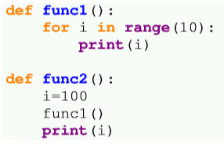
Local variables
The same name
When a variable is deﬁned inside a function, it is local to that function, which means it essentially does not exist outside that function.

Slide 17
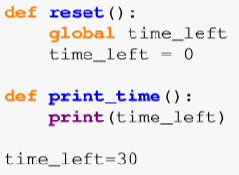
Global Variable
Sometimes you actually do want the same variable to be available to multiple functions.
Such a variable is called a global variable.
You have to be careful using global variables, especially in larger programs!

Slide 18


Comparing function output
Suppose we have a function:
Try this:

Slide 19
Python Anonymous/Lambda Function

Slide 20

What are lambda functions in Python?
A function that is defined without a name.
While normal functions are defined using the def keyword, in Python anonymous functions are defined using the lambda keyword.
Hence, anonymous functions are also called lambda functions.
Syntax:
any number of arguments
only one expression

Slide 21
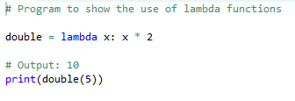

Example of Lambda Function
=
A nameless function for a short period of time.

Slide 22
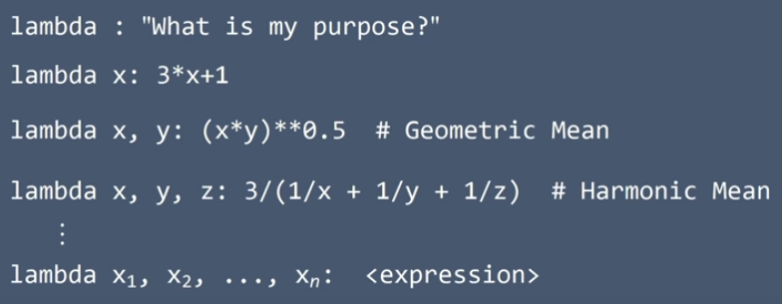

Slide 23

Good example of Lambda
Some list
Looks not very nice….Let’s do some sorting:
So:
A lambda function, that accesses the list; split it by “ ”;
get the last name of citizens, converting all to lowercase (for any case)

Slide 24
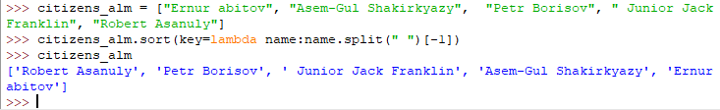
Continue of example
Sorting by first name:
Why do we use lower()???

Slide 25
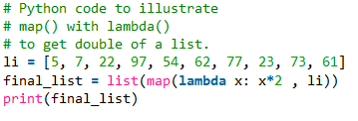

Map + lambda

