Slide 1
Spring 2026 Check-in
Segmentation Model Survey — JABr Condensates
Daniel Chang · C&S BIO 199/197 · PI: Elisa Franco · 2026-04-23
· Winter pipeline left a PC gap: automated 2.04 vs. manual reference 6.32
· Goal this week: survey alternative segmentation models to close the gap
· Dataset: JABr ROI Z-stack (55 slices × 185 × 259, 2-channel fluorescence)

Slide 2
Model Comparison
Same PC formula, same dataset — 4 new models benchmarked
Model
Approach
PC
Runtime
Old Cellpose (2D)
cyto2, slice-by-slice (baseline)
2.04
—
Cellpose 3 ★
cyto3 + denoising + 3D mode
3.33
11 s
StarDist 2D
versatile_fluo, slice-by-slice
1.91
6 s
U-FISH †
ONNX spot detection
3.81
2 s
Nellie
Frangi filter + graph analysis
3.57
14 s
Reference
Manual / ImageJ benchmark
6.32
—
★ Recommended † U-FISH nuclei mask = Otsu threshold, not a trained model — PC likely inflated

Slide 3
Why Cellpose 3?
Three concrete changes over the Winter baseline (PC: 2.04 → 3.33)
1 Denoising
DenoiseModel cyto3 runs on every slice before segmentation — suppresses shot noise, sharpens condensate boundaries. Important: PC intensities always computed from raw pixels. Denoising only guides boundary placement.
2 3D mode
do_3D=True processes XY, XZ, and YZ planes simultaneously and merges gradient flows before drawing boundaries. Old pipeline: 55 independent 2D slices → inconsistent boundaries per condensate → hurts intensity ratio.
3 cyto3 vs cyto2
cyto3 trained on a larger, more diverse dataset. Better at small, dim, and irregularly shaped objects. 3D mode is likely the single largest contributor to the PC improvement.
All models still fall short of reference PC = 6.32 — gap is due to condensate segmentation sensitivity. Small boundary errors have an outsized effect on intensity ratios.

Slide 4
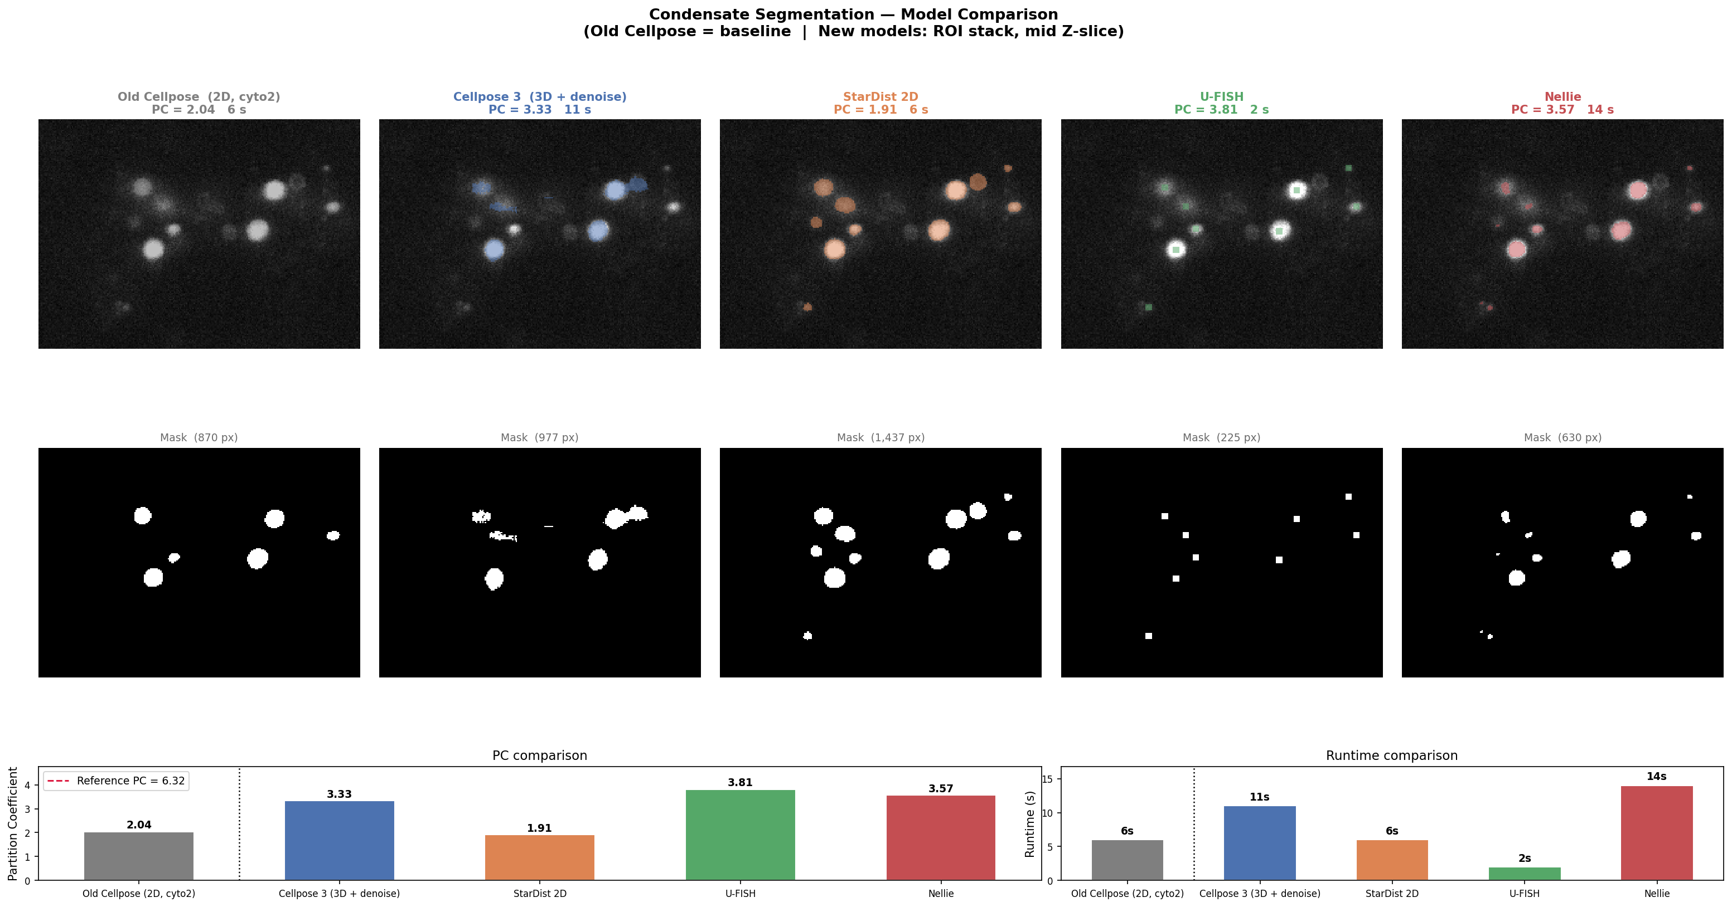
Segmentation Output — Side-by-Side
Mid-Z slice, all models

Slide 5
Caveats — Apples-to-Apples Problem
PC values are not fully comparable across models
Model
Condensate mask
Nuclei mask
Old Cellpose
Cellpose cyto2 (2D)
Cellpose cyto2 (2D)
Cellpose 3
Cellpose cyto3 (3D)
Cellpose cyto3 (3D)
StarDist 2D
StarDist2D
StarDist2D
U-FISH ⚠
U-FISH spot + disk
Otsu threshold ← different!
Nellie
Frangi + graph
Frangi + graph
Fix: use the same Cellpose 3 nuclear mask for all models and only swap the condensate mask — isolates condensate segmentation as the single variable.

Slide 6
Next Steps
Spring 2026
1
Standardize nuclear mask
Re-run all models using Cellpose 3 nuclei masks → fair PC comparison
2
3D volume estimation
Aggregate masks across Z-slices; compute true voxel volumes per condensate
3
CLI packaging
Replace hardcoded paths in cellpose_pipeline.py with argparse / config file; add docstrings
4
Spring poster / report
Narrative: problem → Winter pipeline → model survey → Cellpose 3 → 3D volume

Slide 7
Reference PC Investigation
2026-04-23 — found a methodological mismatch
Three types of PC
Findings for Sample2_5_1
Nuclear PC
Dilute density anomaly
Condensate vs. dilute, both inside the nucleus. What the pipeline computes.
Sample2_5_1 nuclear dilute density = 104.09 vs. ~70 for all other Sample2_5 entries. If dilute were ~70, reference PC ≈ 9.4, not 6.32. Possible cause: loose manual mask left bright condensate-edge pixels counted as dilute, deflating the reference PC.
Cytoplasmic PC
Condensate vs. dilute, both in the cytoplasm. Not currently computed.
Background subtraction not in pipeline
Reference CSVs apply background subtraction before computing PC. Pipeline does not. Formula: PC = (cond − B) / (dilute − B) Since dilute ≈ background, subtracting B inflates PC disproportionately. Part of the 3.33 → 6.32 gap is methodological, not just segmentation.
Background-subtracted PC
Same formula but a background constant B (outside all cells) subtracted before the ratio. Reference CSVs use this.
Action: confirm background estimation method with lab member → add bg subtraction to pipeline → recompute PC

