Slide 1

CONNECTTEL
CUSTOMER CHURN PREDICTION
Notes:
Introduction

Slide 2
BACKGROUND
,
ConnectTel is a leading telecommunications company at the forefront of innovation and connectivity solutions with a strong presence in the global market, ConnectTel has established itself as a trusted provider of reliable voice, data, and Internet services Offering a comprehensive range of telecommunications solutions, including mobile networks, broadband connections, and enterprise solutions, ConnectTel caters to both individual and corporate customers, they are committed to providing exceptional customer service and cutting edge technology ConnectTel ensures seamless communication experiences for millions of users worldwide Through strategic partnerships and a customer centric approach,
ConnectTel continues to revolutionize the telecom industry, empowering individuals and businesses to stay connected and thrive in the digital.
CONNECTTEL
CUSTOMER CHURN PREDICTION

Slide 3
ConnectTel Telecom Company faces the pressing need to address customer churn, which poses a significant threat to its business sustainability and growth. The company's current customer retention strategies lack precision and effectiveness, resulting in the loss of valuable customers to competitors.
OBJECTIVES/PROBLEM STATEMENT

Slide 4
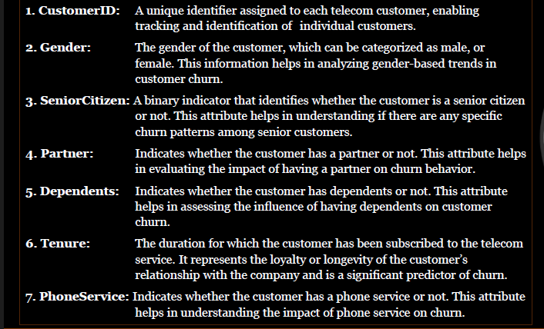
Data Dictionary

Slide 5
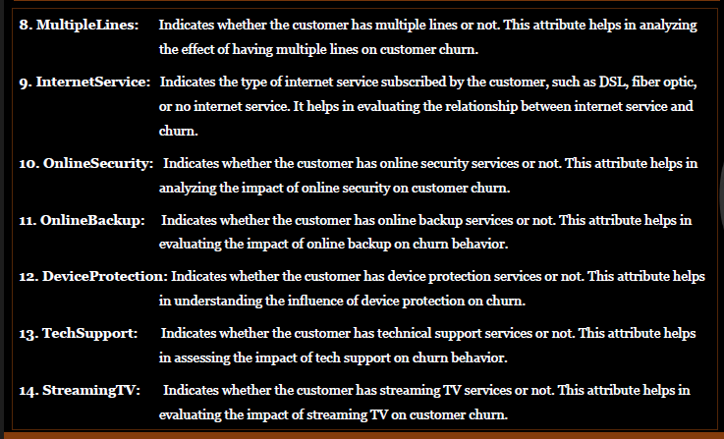
Data Dictionary

Slide 6
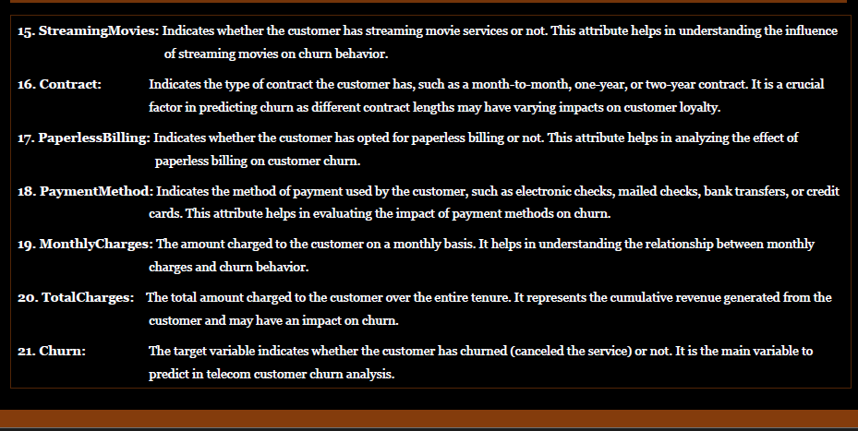
Data Dictionary

Slide 7
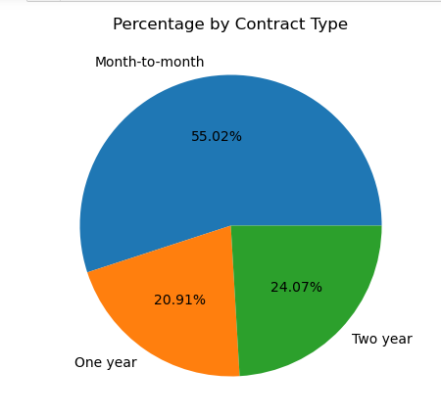
VISUALIZATION OF KEY FEATURES
Observations:
Most of the customers are subscribed to a Month-to-Month contract with 55.02%, followed by Two-year contract type having 24.07% and the least contract type is the One Year with 20.91%

Slide 8
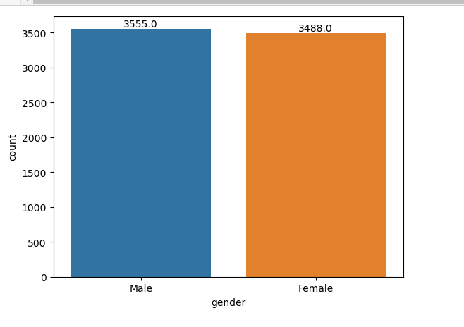
VISUALIZATION OF KEY FEATURES
Observations:
There are 3555 Males against 3488 Females who patronize the company

Slide 9
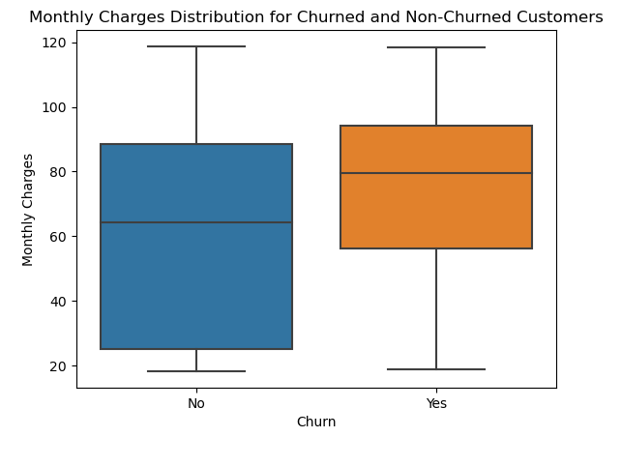
VISUALIZATION OF KEY FEATURES
Observation:
The median Value for the customers who have churned is higher, which indicates that they have higher monthly charges compared to that of those who has not churned

Slide 10
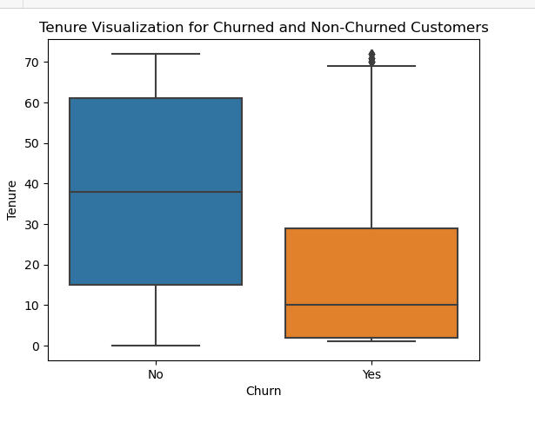
VISUALIZATION OF KEY FEATURES
Observation:
We can notice that there are some outliers, meaning there are customers who had a relatively short stay before churning. So, we need to investigate factors that caused that.

Slide 11
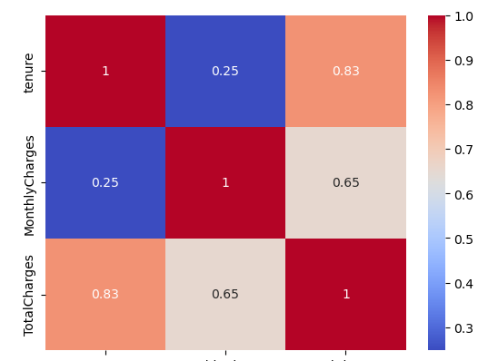
VISUALIZATION OF KEY FEATURES
Observation:
This heat map shows there is a very high correlation between Tenure and Total Charges and also Monthly Charges has a high positive Correlation with Total Charges. In all they all have a positive correlation with each other.

Slide 12
Evaluation Models
I will use four different Evaluation Models to build a churn Detection system
Logistic Regression Model
Random Forest Model
Decision Tree Model
SGD Classifier Model

Slide 13
Evaluation Models
From the four Evaluation Models above Logistic Regression Model has better Metric results . This is because the goal is to predict customer churn. In that case, it is best to prioritize the model with higher recall, F1 score, and AUC-ROC. These metrics are particularly important for identifying customers who have churned accurately. These metrics help to identify customers who have churned accurately and minimize false negatives.:
Accuracy: 0.8088026502602934
Precision: 0.6270491803278688
Recall: 0.5795454545454546
F1-score: 0.6023622047244095
AUC-ROC: 0.7323594780613708

Slide 14
INSIGHTS
The Business should be more concerned with the False Negative(FN) Results, because it wrongly predicts that the customers have not churned whereas they have churned, thereby reducing the ability of Customer Retention

Slide 15

THANK YOU
Thank you
16
Proprietary content. © Great Learning. All Rights Reserved. Unauthorized use or distribution prohibited.

