Slide 1
Introduction to Risk Tag Analysis in Smart Contracts
David Alonge

Slide 2
Introduction
Purpose of the Analysis
This analysis explores the frequency and correlation of key risk tags in smart contracts, aiming to identify common vulnerabilities and the relationships between different risk factors.
Importance of Smart Contract Risk Management
With the growing reliance on smart contracts in blockchain applications, managing security risks is crucial. This analysis provides insights that can inform best practices in contract design and vulnerability mitigation.
Key Questions Addressed
Which risk tags are most frequently observed in the dataset?
Are there surprising trends in the occurrence of certain risks?
How are different risk tags correlated, and what does this reveal about potential risk clusters?

Slide 3
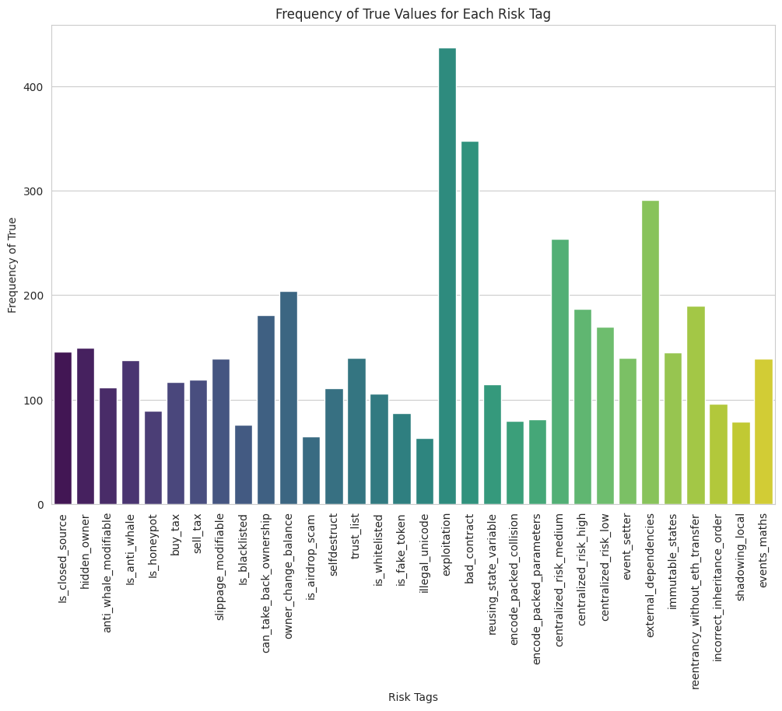
Top 3 Most Frequent Risk Tags:
Exploitation: 437 occurrences
Bad Contract: 348 occurrences
Centralized Risk (Medium): 254 occurrences
Key Insight:
High frequency of exploitation and centralized risk tags suggests companies need to prioritize these vulnerabilities.
Implication:
Companies typically handle these risks by implementing security audits, decentralized control structures, and regular contract updates.

Slide 4
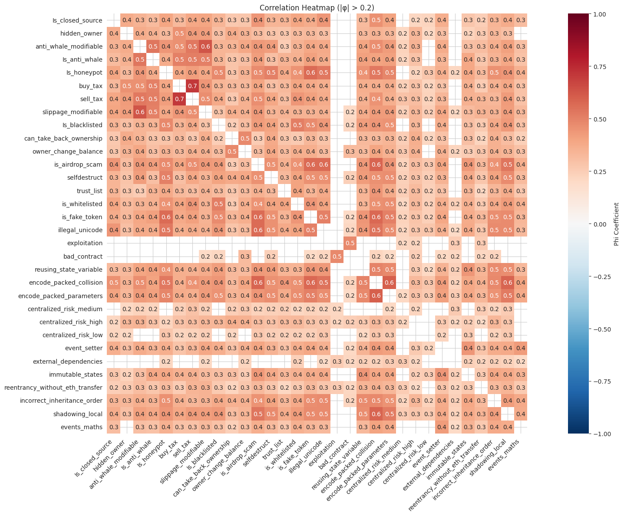
Most Correlated Risk Tag Pairs:
Buy Tax and Sell Tax: Correlation = 0.71
Anti-Whale Modifiable and Slippage Modifiable: Correlation = 0.63
Encode Packed Collision and Encode Packed Parameters: Correlation = 0.60
Interpretation:
Tax correlations: Buy and sell tax correlations suggest pricing manipulation risks.
Anti-Whale and Slippage: Correlation may point to patterns in volume-based control mechanisms.
Encoding correlations: Repeated encoding issues highlight potential for programming vulnerabilities.

Slide 5
Surprising Findings
Unexpected Frequency Tags:
Is Honeypot and Fake Token are less frequent but still show high correlations with each other and other risks.
Reasoning: Is Honeypot and Fake Token correlations likely arise from manipulation strategies used in scams, despite their lower frequency.
Industry Context: Literature suggests these tags are complex to detect, contributing to their infrequency but strong correlations when present.

