Slide 1
Concept of Test-Driven Development (TDD)

Slide 2



Slide 3
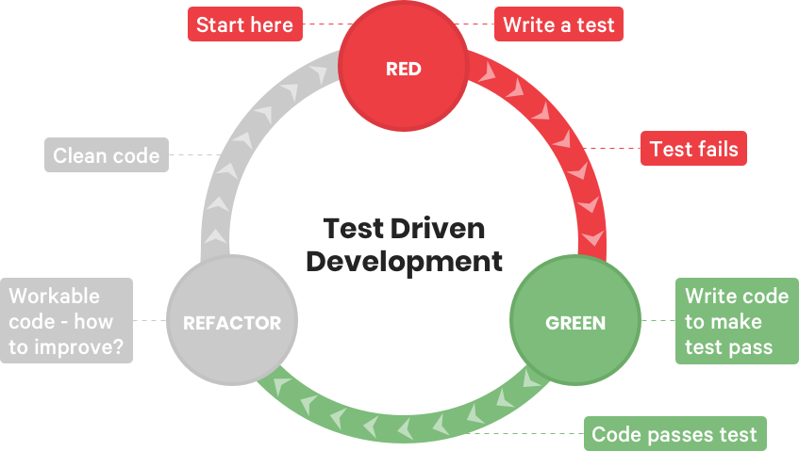

Slide 4
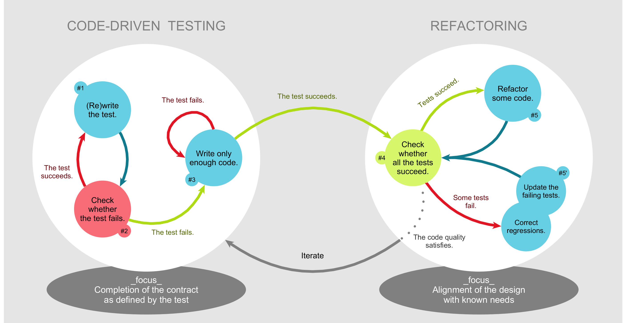

Slide 5
What are the advantages of TDD approach ?
It can lead to simple, elegant, modular code.
It can help developers find defects and bugs earlier than they otherwise would. It’s a common belief that a bug is cheaper to fix the earlier you find it.
The tests can serve as a kind of live documentation and make the code much easier to understand.
It’s easier to maintain and refactor code, your own and other programmer’s code.
It can speed up development in the long-term.
It can encourage developers to think from an end user point-of-view.

