Slide 1
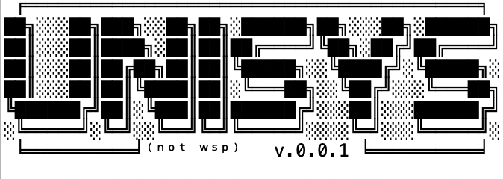
OOP Final Project
Completed by:
Khlebokazov Danila
Kozhakhmetov Dauren
Tugelbai Ansar

Slide 2

WHAT IS WORKING?
Creation of Users by Admin
Each user has its own menu with actions
User can: create/view/join organizations, view news
Student can: add/drop courses, view transcript/schedule/
journal
Manager can: create/view/delete -> faculties/courses/lessons/news, assign teachers for courses, and make schedule for students
Teacher can: put marks/attendance
/attestation, view own courses, view schedule
Librarian can: give/add/delete books
Message System
Organization System

Slide 3

Our Фишка
Requests System - is a system that allows you to manage almost all the actions of our project. Starting with the addition of the course until the issuance of the book to the User. The potential of this system was very large, but unfortunately there was enough time to implement only the addition of the course.
How does it work?
For example, a student by himself cannot add a course. He makes an add request. This Request is sent to the Manager, and the Manager decides to accept or reject this Request. This is one of the many ideas of this system.

Slide 4

WHAT IS NOT WORKING?
Changing Language
Not every method is implemented in demo
Timer for attendance and Online Attendance(Student can’t mark own attendance. Since this is a demo version, various errors may occur. But Danila's team tried very hard)

Slide 5

Pakita better than best)

