Slide 1
Volatility and signal clustering for optimized asset allocation
Seminar: Econometric Models in Financial Applications
Jacob, Frederik og Jamie

Slide 2
Introduction
Data
Clustering
Markowitz regime weight
Dynamic regime weight selection

Slide 3
Data
Data pull from Yahoo and FRED Databases
Assets used
SP500
QQQ
Gold
RealEstate
Features used.
Inflation change from t-1 -> t
Oil return 12 month rolling standard deviation.
SP500 3, 6, and 12 month price momentum
SP500 3 and 6 month volatility
Credit spread, diff in high-yield and investment bond prices
Month-over-month change in credit spread

Slide 4
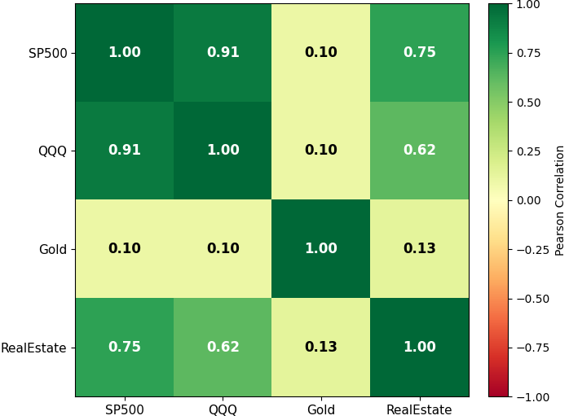
Assets for different regimes
Equity assets are seems strongly positivetly correlatet
Switch into gold, in uncertainty

Slide 5
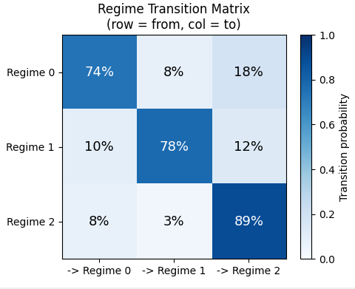
Transition probablities
Transition probablities
Tells us alot about how to which assets to allocate liqiudity.

Slide 6
Trading strategy and backtesting
In sample backtesting from, 2009-2026
Use all data up till time = t-1 to cluster data in each regime
For each regime calculate markowitz weights.
For observation t, calculate distance to nearest cluster, with KNN find similar situations and look at those outcomes, what is our transition matrix.
Bland weights so if they are weighted by probability of which regime the next one are.

Slide 7
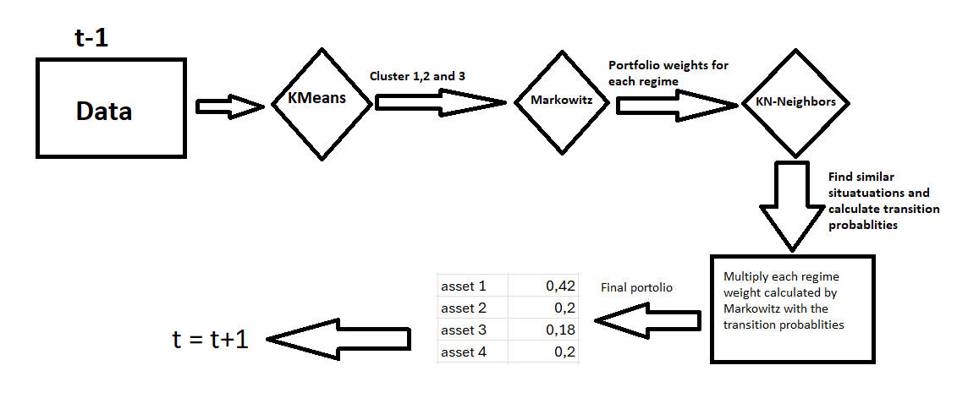
Full model diagram

Slide 8
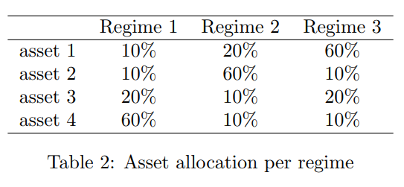
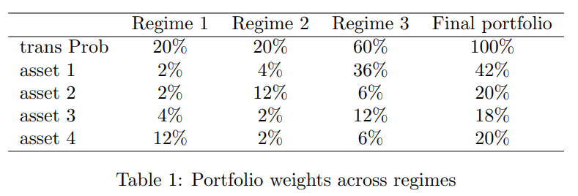
From transition probablity and weight to portfolio
From table 2 multiply asset 1 weight in regime 1 by table 2 transition probablity in regime 1 in this example 0.1*0.2=0.02,
Asset 1 will be allocated 2 procent in this scenario

Slide 9
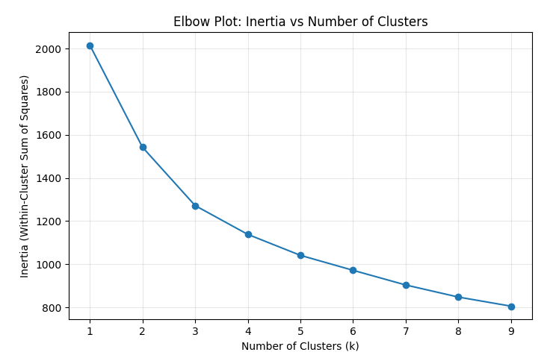
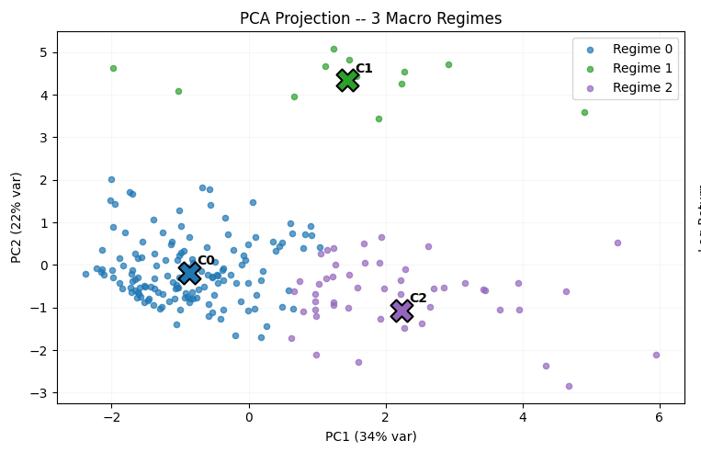
K-Means 1/2

Slide 10
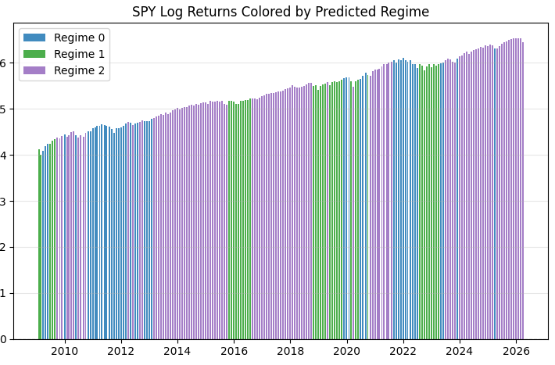
Kmeans 2/2
Captures regimes fairly
well

Slide 11
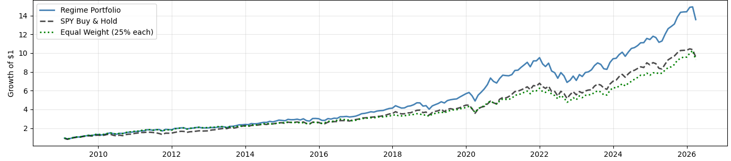
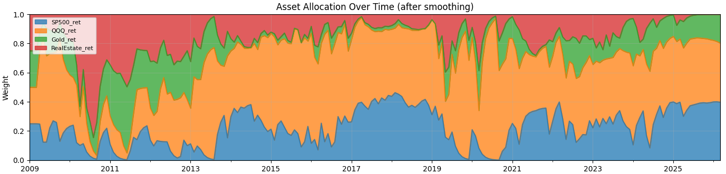
Results 1/2

Slide 12
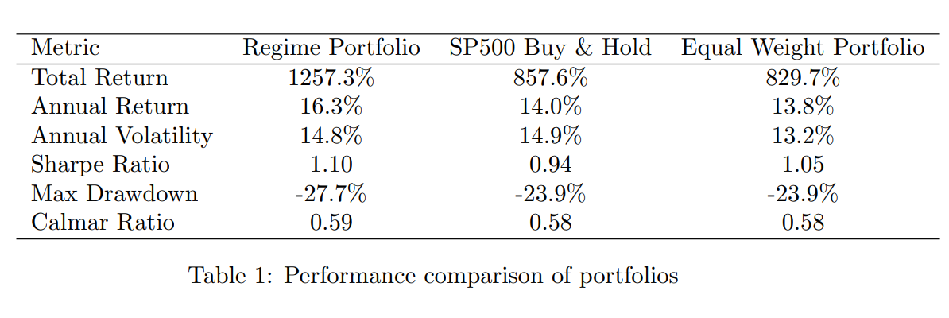
Results 2/2

