Slide 1
Agenda
Start | End | Item
 |  | Core Concepts in Data Mining
 |  | Break
 |  | More R learning & EDA

Slide 2
Lab Questions…
Some of you were wondering about Canvas:
Upload your R script(s) and presentation files following instructions here
https://community.canvaslms.com/t5/Student-Guide/How-do-I-upload-a-file-as-an-assignment-submission-in-Canvas/ta-p/274
For case video presentations, you can add to youtube (unlisted is fine), dropbox or similar and share the URL as a simple text file uploaded to Canvas. We don’t really care where it is hosted or even emailed.
To be successful in a business context, even the most technical people/teams need to present to leadership. Thus the class includes presentations similar to MBA classes and was included in the syllabus shared prior to class.
Your teaching staff will first watch the video, review the scripts and add running commentary in canvas. The final score is then assigned in canvas according to the syllabus description. Once all assignments have been graded the results are “published” so that each individual student can review the grade and commentary.

Slide 3
More Lab Questions…
DataCamp free subscription invitations for 6 months should be in your inbox. Check spam and if not there please reach out over email for a new link.
EDA is the subject of today’s lesson, so that should decrease some of the anxiety regarding the case.
The book is required. You spent thousands on the class, don’t complain about the book cost. Graduate school at HU expects that you study 10-14hrs per class outside of instruction. It was part original syllabus and should have been expected.

Slide 4
Data Mining in this course
Business Analytics – analyzing historical business data with basic math, SME rules, tallies, tables, summary statistics etc
Business Intelligence – what has happened or is happening that can help current business decisions, often done with visuals, powerpoint, dashboards i.e. tableau
Data Mining – includes machine learning (ML) & data science; applies more sophisticated methods to understand and predict business outcomes.
In this class we explore basic analytics, some business intelligence and ML methods in an effort to bring quantitative judgment to bear on business decisions.

Slide 5
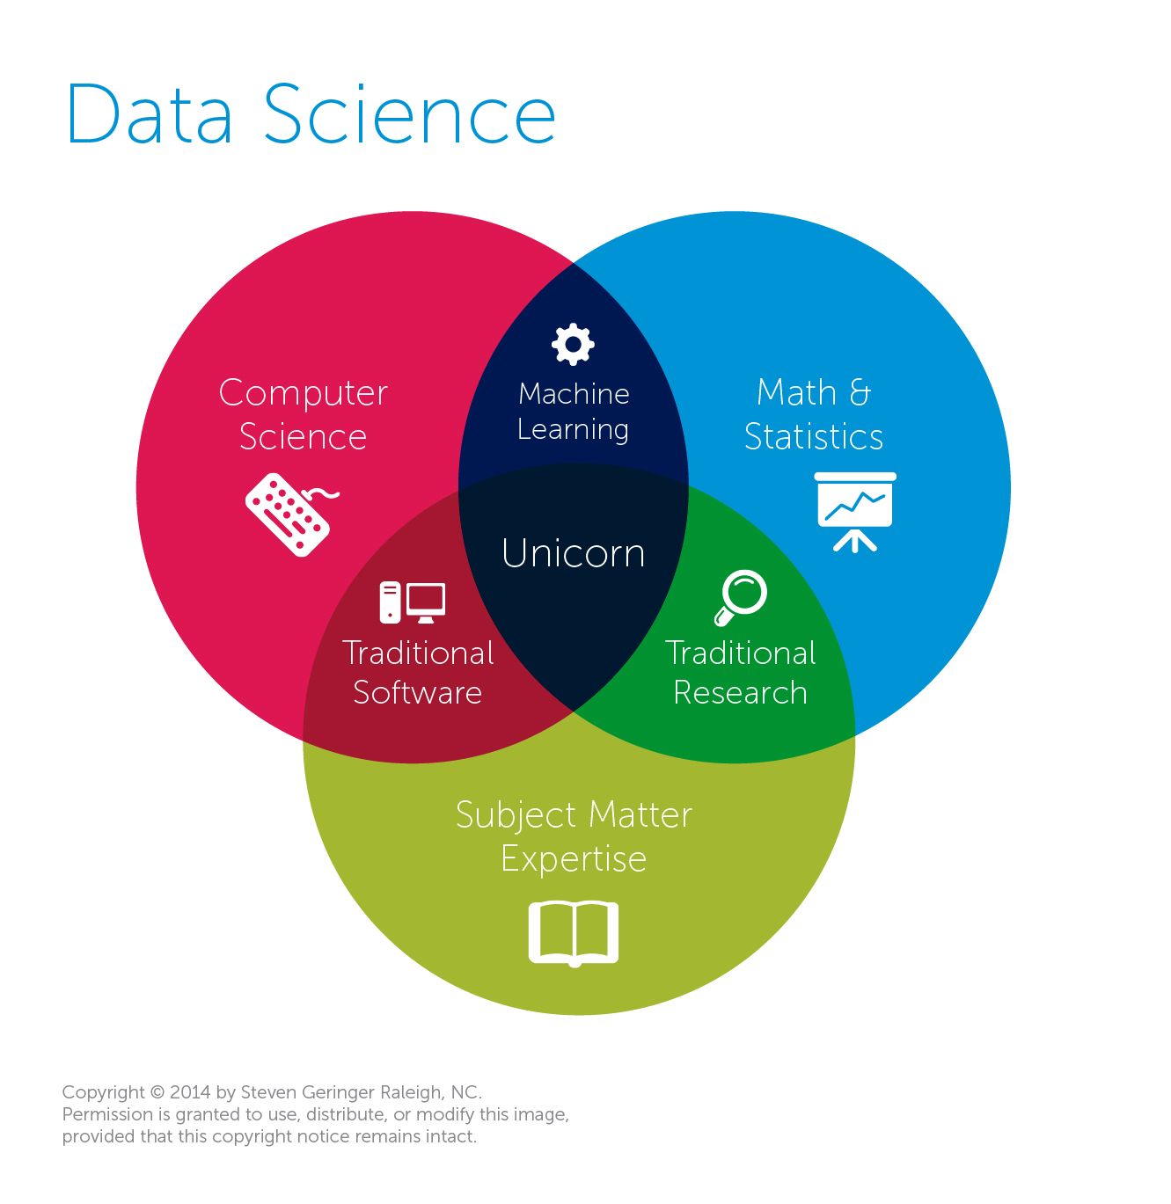
Data Mining & Science is almost always missing business acumen.
Traditional View
Data Science
The study of information with the goal of extracting meaningful insights and creating actionable recommendations.
*often does not require “big data” or extremely exotic approaches to have a business impact
Machine Learning
An outgrowth of artificial intelligence, machine learning is the set of tools, methodologies and techniques allowing a computer to “learn” about a specific situations represented with data.

Slide 6
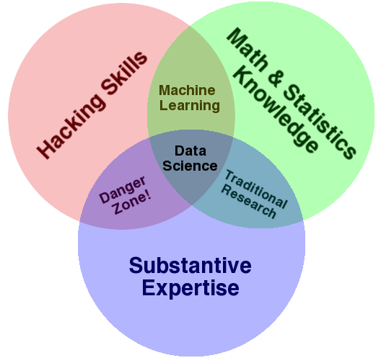
Expertise is not confined to math or CS…but learning business implications.
Another Popular View
Why hacking skills?
Data science takes creativity
Art & Science
A sprinkle of obsessive behavior to explain the data phenomenon
My $0.02
Both diagrams have expertise yet it is often overlooked. Many data scientists are technically sound but lack business acumen or substantive expertise.

Slide 7
Diagnosing & Defining a data mining project
Questions to Ask:
Is this a data mining problem? If so, what data would be helpful?
What is the current state?
What are the possible outcomes of the business scenario?
How will the outcome of the data mining project be used?
What is success for this project?

Slide 8

Pitfalls
Without asking these questions your efforts will:
Have scope-creep or never end!
Be difficult to define success
Be difficult to implement or have a limited impact

Slide 9

Let’s do this for real…
Meet Dale
Runs the analytics group at Busy-ness Corp a large conglomerate that makes, distributes corn dogs.
He looks miserable because senior leaders make his job harder than needed.
Let’s help Dale add some structure to his data mining projects.

Slide 10

Let’s do this for real
Hey Dale, its me…from OfficeSpace.
I read in the WSJ that everyone should be using blockchain. Should we?
Is this a biz analytics, intel or data mining problem?
What is the current state?
What are the possible outcomes of the business scenario?
How will the outcome of the data mining project be used?

Slide 11

Let’s do this for real
Your Daleness, I work in marketing (and apparently hate phones). I want to do a mailing to prospective corndog eaters. Can you identify how many postcards we should send & ROI?
Is this a biz analytics, intel or data mining problem?
What is the current state?
What are the possible outcomes of the business scenario?
How will the outcome of the data mining project be used?

Slide 12

Let’s do this for real
Dale-areno! I think we are getting a lot more calls than usual about defective corn dogs. Can you investigate whether that’s true?
Is this a biz analytics, intel or data mining problem?
What is the current state?
What are the possible outcomes of the business scenario?
How will the outcome of the data mining project be used?

Slide 13

Let’s do this for real
The Notorious DALE, let’s forecast how many of our current corn dog debtors will be delinquent. Is that getting better or worse over time?
Is this a biz analytics, intel or data mining problem?
What is the current state?
What are the possible outcomes of the business scenario?
How will the outcome of the data mining project be used?

Slide 14

Let’s do this for real
The East coast regional corn dog sales are up! I wonder if my region is worse than them.
Is this a biz analytics, intel or data mining problem?
What is the current state?
What are the possible outcomes of the business scenario?
How will the outcome of the data mining project be used?

Slide 15

Let’s do this for real
Despite that idiot in marketing selling defective dogs, we need a new warehouse in the East region. Which zip code should we build it in to support a strong workforce?
Is this a biz analytics, intel or data mining problem?
What is the current state?
What are the possible outcomes of the business scenario?
How will the outcome of the data mining project be used?

Slide 16


Let’s call Dale to tell him what we learned.
https://www.motionelements.com/stock-video-3902092-successful-black-businessman

Slide 17
Types of Problems
Retrospective
Descriptive
Data Science
Predictive
Supervised Learning
Classification
Binary
Multi-Class
Continuous
Forecasting
Unsupervised Learning
Associative System

Slide 18
Types of Problems
Retrospective
Descriptive
Data Science
Predictive
Supervised Learning
Classification
Binary
Multi-Class
Continuous
Forecasting
Unsupervised Learning
Associative System
How did we do last quarter?
Usually point in time and standalone information not summary.

Slide 19
Types of Problems
Retrospective
Descriptive
Data Science
Predictive
Supervised Learning
Classification
Binary
Multi-Class
Continuous
Forecasting
Unsupervised Learning
Associative System
What is the average number of donuts served each morning?
Retrospective but can be summary and/or in comparison to other data.

Slide 20
Types of Problems
Retrospective
Descriptive
Data Science
Predictive
Supervised Learning
Classification
Binary
Multi-Class
Continuous
Forecasting
Unsupervised Learning
Associative System
Ask yourself is there an outcome variable that we want to predict.
Will the next person that calls accept the credit card offer?
The outcome is 1 = yes, 0=no

Slide 21
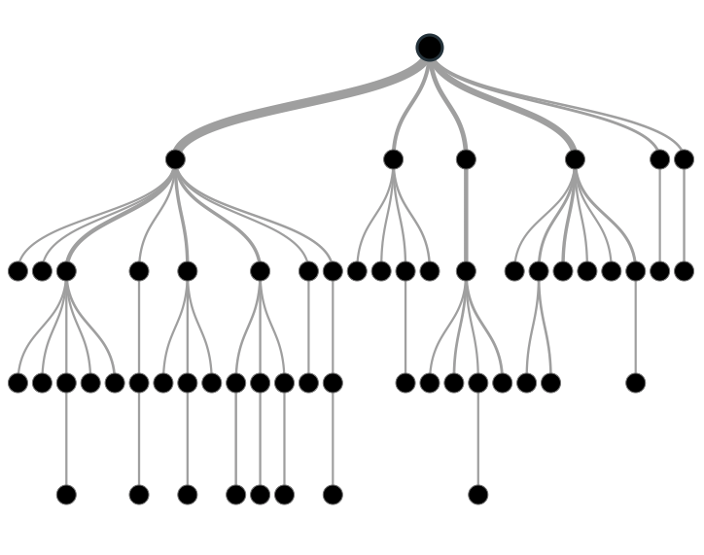

Supervised Learning: Classification & Prediction
Inferring a function from labeled data.
“Learn from telling”, “Look at my data and I will tell you what to predict”
Data Setup
Method
Business Examples
Application
Marketing-Will a customer buy yes or no? How much will a customer spend?
Operations- Will an applicant default? When will a machine break?
Flat “Excel” file. Each row is a record or observation. Each column is an attribute of the record.
One column is the outcome, y or target attribute.
Modeling e.g. K-NN, linear regression, decision tree, random forest etc.
Use the model to make predictions for the target label on the new data.

Slide 22
Types of Problems
Retrospective
Descriptive
Data Science
Predictive
Supervised Learning
Classification
Binary
Multi-Class
Continuous
Forecasting
Unsupervised Learning
Associative System
Ask yourself is there an outcome variable that we want to predict.
Will the next person that calls accept the credit card offer?
The outcome is 1 = yes, 0=no, they will accept.

Slide 23
Types of Problems
Retrospective
Descriptive
Data Science
Predictive
Supervised Learning
Classification
Binary
Multi-Class
Continuous
Forecasting
Unsupervised Learning
Associative System
Ask yourself is there an outcome variable that we want to predict.
Will the next patron purchase ProductA, ProductB or ProductC?
The outcome is one of three classes, A, B, C.

Slide 24
Types of Problems
Retrospective
Descriptive
Data Science
Predictive
Supervised Learning
Classification
Binary
Multi-Class
Continuous
Forecasting
Unsupervised Learning
Associative System
Ask yourself is there an outcome variable that we want to predict.
How many ice cream cones will we sell on an 85 degree, Saturday?
(the outcome is a continuous 0 to some number of cones)

Slide 25
Types of Problems
Retrospective
Descriptive
Data Science
Predictive
Supervised Learning
Classification
Binary
Multi-Class
Continuous
Forecasting
Unsupervised Learning
Associative System
Ask yourself is there an outcome variable that we want to predict.
How much corn meal will we need for our corn dogs this month?
(there is an outcome, and the data is time related)

Slide 26
Types of Problems
Retrospective
Descriptive
Data Science
Predictive
Supervised Learning
Classification
Binary
Multi-Class
Continuous
Forecasting
Unsupervised Learning
Associative System
Ask yourself is there an outcome variable that we want to predict.
Can our customer data base be grouped in some meaningful way?
(there is no clear outcome to predict, we can observe and explore the clusters within the customer db)

Slide 27
Unsupervised Learning: Find meaningful groups
Trying to find hidden structure in unlabelled data.
“Learn from observing”, “Look at my data and tell me about it”
Data Setup
Method
Business Examples
Application
Marketing-Find customer segments for specific marketing campaigns.
Operations-Identify locations for cell towers based on population density and area characteristics.
Text Analysis- Topic modeling of articles
Flat “Excel” file. Each row is a record or observation. Each column is an attribute of the record.
Clustering e.g. K-Means, Hierarchical Clustering etc
In new data find the customers/observations that most likely are part of a particular cluster.

Slide 28
Types of Problems
Retrospective
Descriptive
Data Science
Predictive
Supervised Learning
Classification
Binary
Multi-Class
Continuous
Forecasting
Unsupervised Learning
Associative System
Ask yourself is there an outcome variable that we want to predict.
What should we offer customers that bought the corn dog?
(There is not really a distinct outcome, only observed data similar to the unsupervised example. Should we offer additional dogs, condiments, orange soda, red wine, steak etc. Among all choices, how are items associated based on purchase history?)

Slide 29

Your turn…
Methods
Scenarios
Retrospective
Descriptive
Data Science
Predictive
Supervised Learning
Classification
Binary
Multi-Class
Continuous
Forecasting
Unsupervised Learning
Associative System
Will the Mystics (pro basketball team) win the game?
Binary Classification

Slide 30
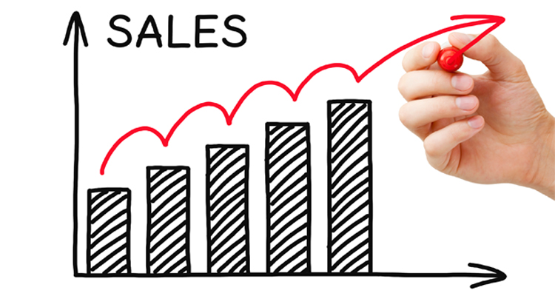
Your turn…
Methods
Scenarios
Retrospective
Descriptive
Data Science
Predictive
Supervised Learning
Classification
Binary
Multi-Class
Continuous
Forecasting
Unsupervised Learning
Associative System
How did same stores sales change year over year?
Descriptive

Slide 31
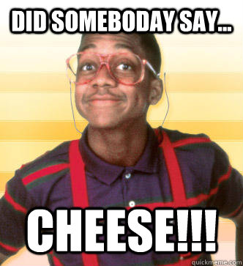
Your turn…
Methods
Scenarios
Retrospective
Descriptive
Data Science
Predictive
Supervised Learning
Classification
Binary
Multi-Class
Continuous
Forecasting
Unsupervised Learning
Associative System
What should we place next to the cheese in the grocery cooler?
Association

Slide 32

Your turn…
Methods
Scenarios
Retrospective
Descriptive
Data Science
Predictive
Supervised Learning
Classification
Binary
Multi-Class
Continuous
Forecasting
Unsupervised Learning
Associative System
How many patients should we expect in the urgent care tomorrow?
Predictive>Continuous

Slide 33

Your turn…
Methods
Scenarios
Retrospective
Descriptive
Data Science
Predictive
Supervised Learning
Classification
Binary
Multi-Class
Continuous
Forecasting
Unsupervised Learning
Associative System
How many runs will the Chennai SuperKings make?
Continuous

Slide 34

Your turn…
Methods
Scenarios
Retrospective
Descriptive
Data Science
Predictive
Supervised Learning
Classification
Binary
Multi-Class
Continuous
Forecasting
Unsupervised Learning
Associative System
What are our customer personas and how are they similar by account attribute?
Unsupervised

Slide 35
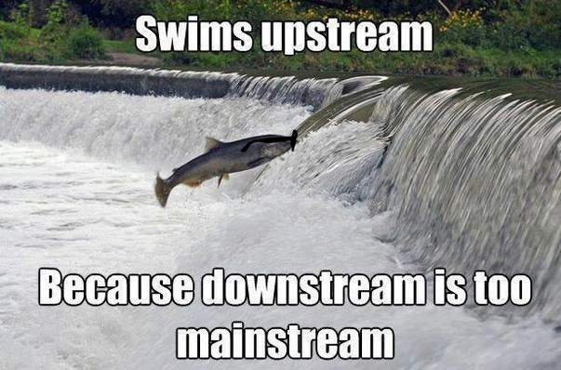
Your turn…
Methods
Scenarios
Retrospective
Descriptive
Data Science
Predictive
Supervised Learning
Classification
Binary
Multi-Class
Continuous
Forecasting
Unsupervised Learning
Associative System
How many fish did each vessel catch yesterday?
Retrospective/Descriptive

Slide 36
Quiz!
Is there a target variable in unsupervised learning?
True or False? Data Science is defined as the study of information with the goal of extracting meaningful insights and creating actionable recommendations.
Data scientists need what type of skills?
What is an example of a supervised learning business question?
Name three data attributes would you need for that example.

Slide 37
Agenda
Start | End | Item
 |  | Core Concepts in Data Mining
 |  | Break
 |  | More R learning & EDA

Slide 38

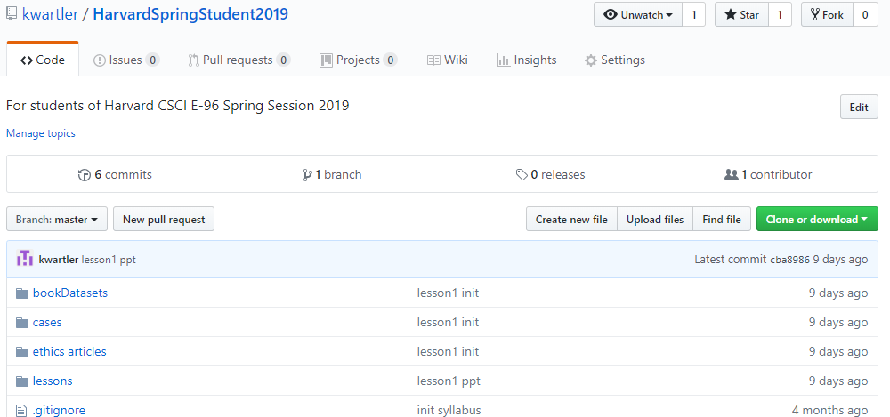
Perform a Git Pull to get the scripts & data
https://github.com/kwartler/Harvard_DataMining_Business_Student
If you have git software, when do a “git pull” in Rstudio.
Alternatively you can download a zip of the repo on github.com but this can be cumbersome with file updates.

Slide 39
Let’s Practice!
Open:
A_Functions_EDA_Viz.R
read.csv
dim()
table()
indexing
subset()
sample()
as.matrix()
barplot()
ggplot()
Bokeh::figure()
Open the second script, get familiar with libraries, reading data, functions applied to objects & making visuals.

Slide 40

What is ggplot?
The first layer is to define a ggplot, with screenTime as the data. The aesthetics (aes) define that information should be colored by each character. However, there is no other information at this point.
ggplot(screenTime, aes(colour=screenTime$character))
ggplot is a “grammar of graphics” package. It works by adding layers with an “+” to construct a visual.

Slide 41
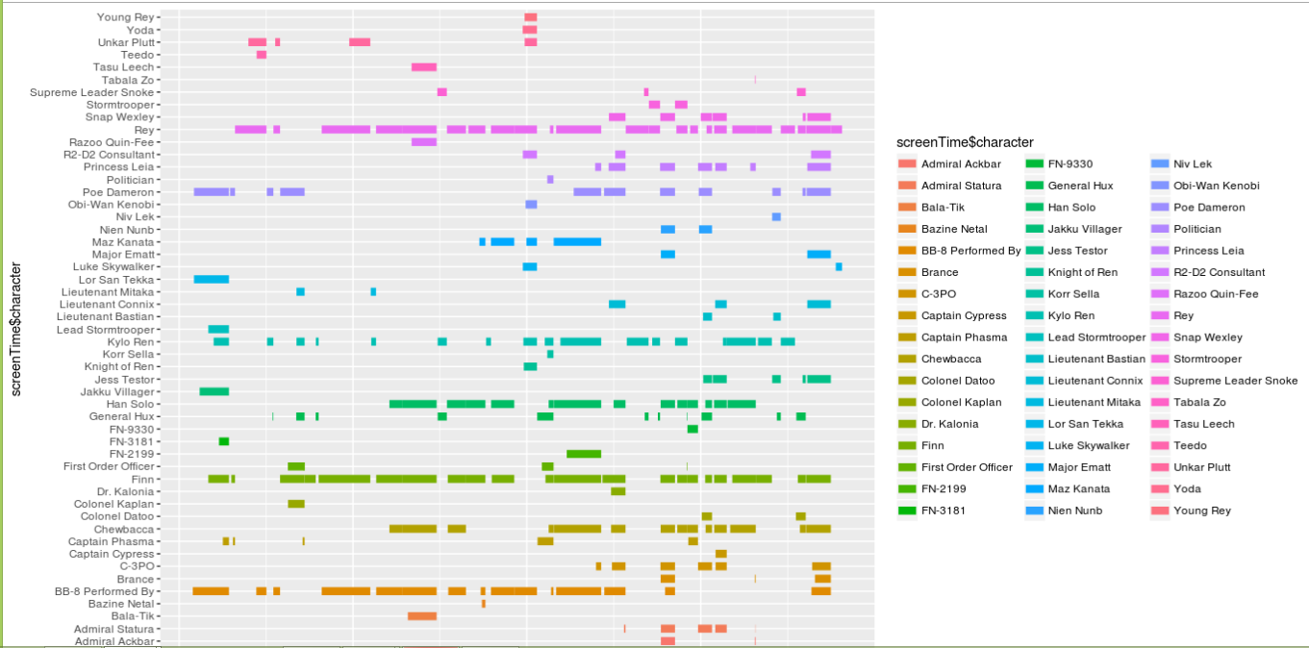
Understanding ggplot…
The second layer adds a line segment for each character and defines the size of each.
ggplot(screenTime, aes(colour=screenTime$character)) +
geom_segment(aes(x=screenTime$start, xend=screenTime$end,y=screenTime$character, yend=screenTime$character),size=3)

Slide 42
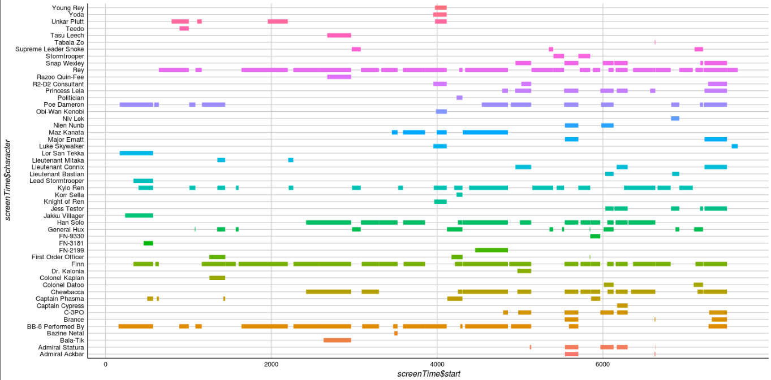
Understanding ggplot…
The third layer changes the background, axis & colors. The fourth layer removes the legend which is redundant in this context.
ggplot(screenTime, aes(colour=screenTime$character)) +
geom_segment(aes(x=screenTime$start, xend=screenTime$end,y=screenTime$character, yend=screenTime$character),size=3) + theme_gdocs() + theme(legend.position="none")

Slide 43
Data Exploration (EDA)
Data sets are typically large, complex & messy
Need to review the data to help refine the task
Use techniques of Reduction and Visualization

Slide 44
Exploring Data: Sampling to Save Time
Data mining typically deals with huge databases
For piloting/prototyping, algorithms and models are typically applied to a sample from a database, to produce statistically-valid results
Once you develop and select a final model, you use it to “score” (predict values or classes for) the observations in the larger database
Caveats – unbalanced data needs “over sampling”
Insurance no claim (99%) vs claim (1%)
Credit Card Transactions (99+% no fraud) vs (<1% fraud)
If your modeling is unbalanced, the book has an example of oversampling

Slide 45
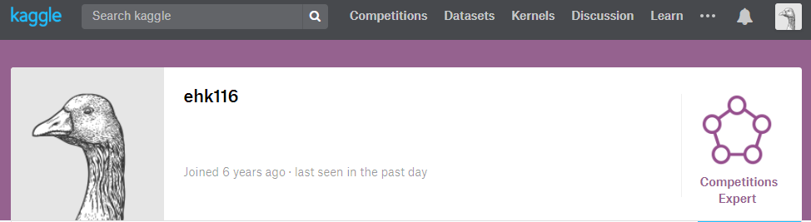
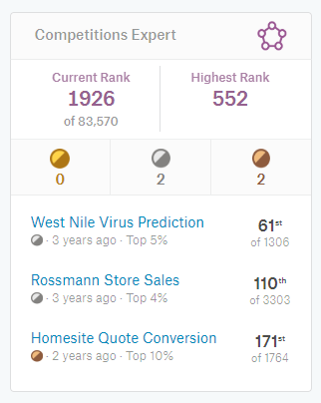
What’s the value of good EDA?
Asked to predict the presence of West Nile Virus in Chicago mosquitos traps.

Slide 46

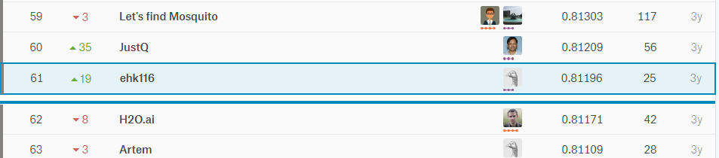
EDA let me realize a flaw!
Simple EDA by year would show that West Nile was 2x in 2012
After fitting an algorithm, I merely doubled predictions if they were within 2012 for the test set. Not great DS but an easy way to move up the leaderboard.

Slide 47
Let’s Practice
Open B_EDA work.R:
Lots of basic R options
str()
dim()
class()
head()
nlevels()
summary()
cor()
unique()
mean()
colSums()
is.na()
Specific packages make life easier
library(DataExplorer)
plot_str()
plot_missing()
plot_histogram()
plot_density()
plot_scatterplot()
library(radiant.data)
On this script you will fill in the object, vector and information into the code scaffold. Then spend 5-10min exploring the data with radiant.data

Slide 48
Let’s Practice on geospatial data!
Open:
C_geospatial.R
read.csv
ggplot()
Google maps with ggmap
leaflet()
Open the third file, explore geospatial information.

Slide 49



Common R Object Types - Vectors
Objects in R can be various forms and even made to be “custom” types.
Numeric/Integer
Factors (Distinct Classes)
as.factor(c('MALE','FEMALE','FEMALE'))
Cardinality
2
1
10
12
3.47
82
MALE
FEMALE
FEMALE
Unordered
c(1,10,12,3.47)
[1] MALE FEMALE FEMALE
Levels: FEMALE MALE
High
Med
Low
as.factor(c(‘High',‘Med',‘Low'))
Cardinality
3
Ordinal
Boolean
STRING (just text)
TRUE
TRUE
FALSE
TRUE
FALSE
c('MALE','FEMALE','FEMALE')
c(T, T, F, T, F)
c(TRUE,TRUE, FALSE, TRUE,FALSE)
c(T,TRUE, F, TRUE,FALSE)
[1] "MALE" "FEMALE" "FEMALE"
In R, a vector can be numeric, Boolean (T/F), factors, or contain strings.
Notes:
Ordinal – is there an order to the factor, how does that factor level relate to other levels
Cardinality – number of distinct factor levels, the number of elements in a set

Slide 50
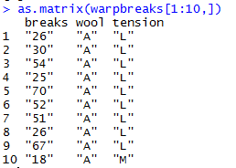
More Complex Common R Object Types - Matrix
Matrices are 2 dimensional data (rows/columns). Each column must be the same type.
RowID | breaks | wool | tension
1 | 26 | A | L
2 | 30 | A | L
3 | 54 | A | L
4 | 25 | A | L
5 | 70 | A | L
6 | 52 | A | L
7 | 51 | A | L
8 | 26 | A | L
9 | 67 | A | L
10 | 18 | A | M
All strings
Matrices are organized into rows and columns. In R, the row names are not actually a vector of the matrix but are an attribute of the matrix. In excel you would need a standalone vector to capture that information.

Slide 51
More Complex Common R Object Types – List
Lists are multi-dimensional objects that can contain different data types of different lengths.
ListA
single value
Single data frame or matrix
single vector
Nested list
Nested data frame
Nested matrix
Lists are useful for data organization but can be complex and difficult to navigate to get specific information.

Slide 52
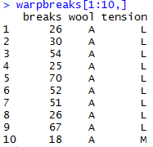
More Complex Common R Object Types – Data Frame
Data Frames are like 2 dimensional data objects but can have mixed data types.
A data frame is actually a named list but with equal length elements. Being a list lets it contain mixed data types.
RowID | breaks | wool | tension
1 | 26 | A | L
2 | 30 | A | L
3 | 54 | A | L
4 | 25 | A | L
5 | 70 | A | L
6 | 52 | A | L
7 | 51 | A | L
8 | 26 | A | L
9 | 67 | A | L
10 | 18 | A | M
Integers
Factor
Factor
Data frames are used often because they can hold different types of vectors, but can be switched back and forth with as.matrix() and as.data.frame(). Remember that the vector classes could change!!

Slide 53
Data Structure for Analysis & Modeling
Often the 1st Column is a unique identifier but the identifier could also be a row attribute (not actually a vector)
name | mfr | type | calories | protein | fat | sodium | fiber | carbo | sugars | potass | vitamins | shelf | weight | cups | rating
100%_Bran | N | C | 70 | 4 | 1 | 130 | 10 | 5 | 6 | 280 | 25 | 3 | 1 | 0.33 | 68.40297
100%_Natural_Bran | Q | C | 120 | 3 | 5 | 15 | 2 | 8 | 8 | 135 | 0 | 3 | 1 | 1 | 33.98368
All-Bran | K | C | 70 | 4 | 1 | 260 | 9 | 7 | 5 | 320 | 25 | 3 | 1 | 0.33 | 59.42551
All-Bran_with_Extra_Fiber | K | C | 50 | 4 | 0 | 140 | 14 | 8 | 0 | 330 | 25 | 3 | 1 | 0.5 | 93.70491
Almond_Delight | R | C | 110 | 2 | 2 | 200 | 1 | 14 | 8 |  | 25 | 3 | 1 | 0.75 | 34.38484
Apple_Cinnamon_Cheerios | G | C | 110 | 2 | 2 | 180 | 1.5 | 10.5 | 10 | 70 | 25 | 1 | 1 | 0.75 | 29.50954
Apple_Jacks | K | C | 110 | 2 | 0 | 125 | 1 | 11 | 14 | 30 | 25 | 2 | 1 | 1 | 33.17409
Basic_4 | G | C | 130 | 3 | 2 | 210 | 2 | 18 | 8 | 100 | 25 | 3 | 1.33 | 0.75 | 37.03856
Bran_Chex | R | C | 90 | 2 | 1 | 200 | 4 | 15 | 6 | 125 | 25 | 1 | 1 | 0.67 | 49.12025
Bran_Flakes | P | C | 90 | 3 | 0 | 210 | 5 | 13 | 5 | 190 | 25 | 3 | 1 | 0.67 | 53.31381
Cap'n'Crunch | Q | C | 120 | 1 | 2 | 220 | 0 | 12 | 12 | 35 | 25 | 2 | 1 | 0.75 | 18.04285
Generally we will use data frames to avoid complexity but you will be exposed to other data types.

Slide 54
Data Structure for Analysis & Modeling
Informative features are usually independent & do not lend information to other rows (auto-correlation). Can be called informative columns, independent variables, or features.
Remember in a DF, these can be mixed with decimals, integers, factors, strings, T/F.
name | mfr | type | calories | protein | fat | sodium | fiber | carbo | sugars | potass | vitamins | shelf | weight | cups | rating
100%_Bran | N | C | 70 | 4 | 1 | 130 | 10 | 5 | 6 | 280 | 25 | 3 | 1 | 0.33 | 68.40297
100%_Natural_Bran | Q | C | 120 | 3 | 5 | 15 | 2 | 8 | 8 | 135 | 0 | 3 | 1 | 1 | 33.98368
All-Bran | K | C | 70 | 4 | 1 | 260 | 9 | 7 | 5 | 320 | 25 | 3 | 1 | 0.33 | 59.42551
All-Bran_with_Extra_Fiber | K | C | 50 | 4 | 0 | 140 | 14 | 8 | 0 | 330 | 25 | 3 | 1 | 0.5 | 93.70491
Almond_Delight | R | C | 110 | 2 | 2 | 200 | 1 | 14 | 8 |  | 25 | 3 | 1 | 0.75 | 34.38484
Apple_Cinnamon_Cheerios | G | C | 110 | 2 | 2 | 180 | 1.5 | 10.5 | 10 | 70 | 25 | 1 | 1 | 0.75 | 29.50954
Apple_Jacks | K | C | 110 | 2 | 0 | 125 | 1 | 11 | 14 | 30 | 25 | 2 | 1 | 1 | 33.17409
Basic_4 | G | C | 130 | 3 | 2 | 210 | 2 | 18 | 8 | 100 | 25 | 3 | 1.33 | 0.75 | 37.03856
Bran_Chex | R | C | 90 | 2 | 1 | 200 | 4 | 15 | 6 | 125 | 25 | 1 | 1 | 0.67 | 49.12025
Bran_Flakes | P | C | 90 | 3 | 0 | 210 | 5 | 13 | 5 | 190 | 25 | 3 | 1 | 0.67 | 53.31381
Cap'n'Crunch | Q | C | 120 | 1 | 2 | 220 | 0 | 12 | 12 | 35 | 25 | 2 | 1 | 0.75 | 18.04285
Generally we will use data frames to avoid complexity but you will be exposed to other data types.

Slide 55
Data Structure for Analysis & Modeling
If we are doing supervised learning, there is a dependent variable.
This is the outcome and is “dependent” on the informative columns. An analysis with this vector can be binary, classification, or predictive.
name | mfr | type | calories | protein | fat | sodium | fiber | carbo | sugars | potass | vitamins | shelf | weight | cups | rating
100%_Bran | N | C | 70 | 4 | 1 | 130 | 10 | 5 | 6 | 280 | 25 | 3 | 1 | 0.33 | 68.40297
100%_Natural_Bran | Q | C | 120 | 3 | 5 | 15 | 2 | 8 | 8 | 135 | 0 | 3 | 1 | 1 | 33.98368
All-Bran | K | C | 70 | 4 | 1 | 260 | 9 | 7 | 5 | 320 | 25 | 3 | 1 | 0.33 | 59.42551
All-Bran_with_Extra_Fiber | K | C | 50 | 4 | 0 | 140 | 14 | 8 | 0 | 330 | 25 | 3 | 1 | 0.5 | 93.70491
Almond_Delight | R | C | 110 | 2 | 2 | 200 | 1 | 14 | 8 |  | 25 | 3 | 1 | 0.75 | 34.38484
Apple_Cinnamon_Cheerios | G | C | 110 | 2 | 2 | 180 | 1.5 | 10.5 | 10 | 70 | 25 | 1 | 1 | 0.75 | 29.50954
Apple_Jacks | K | C | 110 | 2 | 0 | 125 | 1 | 11 | 14 | 30 | 25 | 2 | 1 | 1 | 33.17409
Basic_4 | G | C | 130 | 3 | 2 | 210 | 2 | 18 | 8 | 100 | 25 | 3 | 1.33 | 0.75 | 37.03856
Bran_Chex | R | C | 90 | 2 | 1 | 200 | 4 | 15 | 6 | 125 | 25 | 1 | 1 | 0.67 | 49.12025
Bran_Flakes | P | C | 90 | 3 | 0 | 210 | 5 | 13 | 5 | 190 | 25 | 3 | 1 | 0.67 | 53.31381
Cap'n'Crunch | Q | C | 120 | 1 | 2 | 220 | 0 | 12 | 12 | 35 | 25 | 2 | 1 | 0.75 | 18.04285
Generally we will use data frames to avoid complexity but you will be exposed to other data types.

Slide 56
When should you use a specific data type?
Number of Dimensions >1
No
Yes
Use a Vector
Data Types >1
No
Yes
Matrix or Array
Data Frame or List
Most analyses start with a data frame, and change classes as needed.

Slide 57
Let’s Practice!
Open D_R objects.R:
c() to combine values into a vector
as.matrix() to create a matrix object
data.frame()
as.list()
List elements by index
List elements by name
Skip depending on time!

Slide 58
Housekeeping , Reading & Homework
Now that the cohort has a level foundation of R knowledge, the real fun begins…applications in a real business scenario!
Homework suggestions…check the syllabus
Start Case2 in code or with Radiant.Data!
Read Chapter 3
Ask questions publicly on Piazza

