Slide 1
Visit Scotland
Dave Bradshaw

Slide 2
Introduction
Visit Scotland work with various partners to help realise the potential of tourism assets in Scotland.
We want to look at various categorical data to find information about the tourists who use these assets
  What activities
  What types of location
  How do they reach destinations
  What are the key demographics
  What accommodation types are most popular and where
  What counties of Scotland receive the most visits

Slide 3
Data
The data used for this is all generated through surveys
  Accommodation providers across Scotland
  Those who took overnight trips
  Those who took part in a designated tourism activity
Data runs from 2013 to 2019 bar accommodation data which is 2011 to 2021.

Slide 4
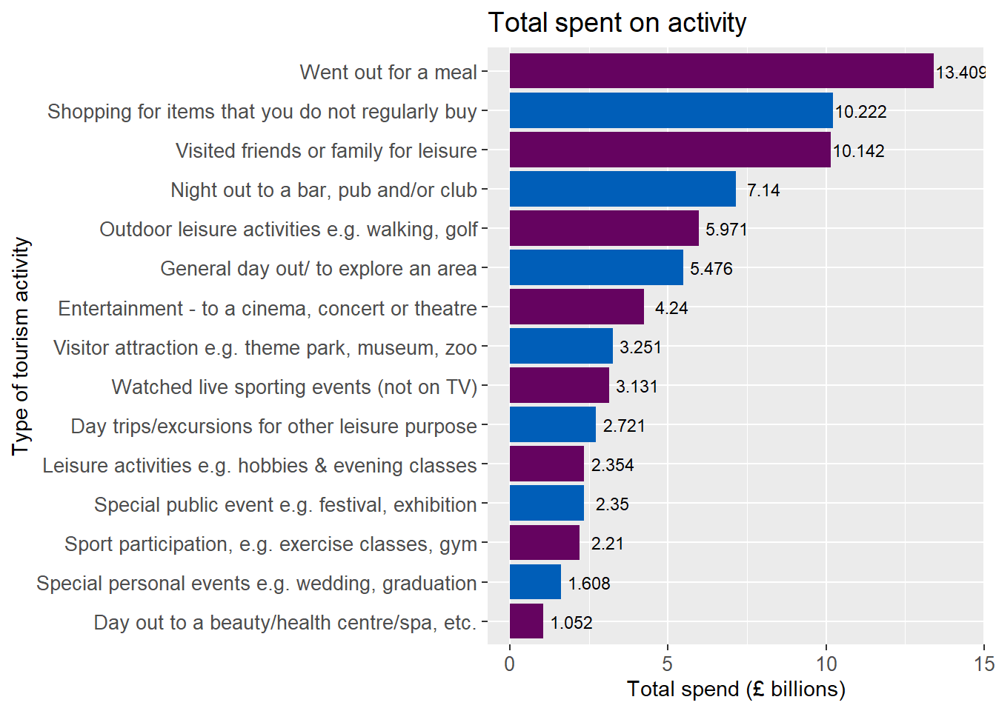
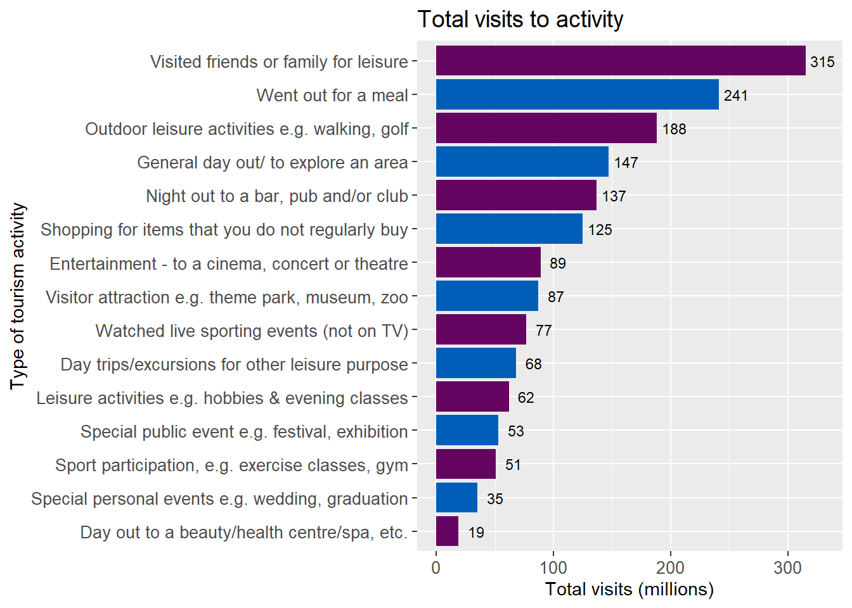
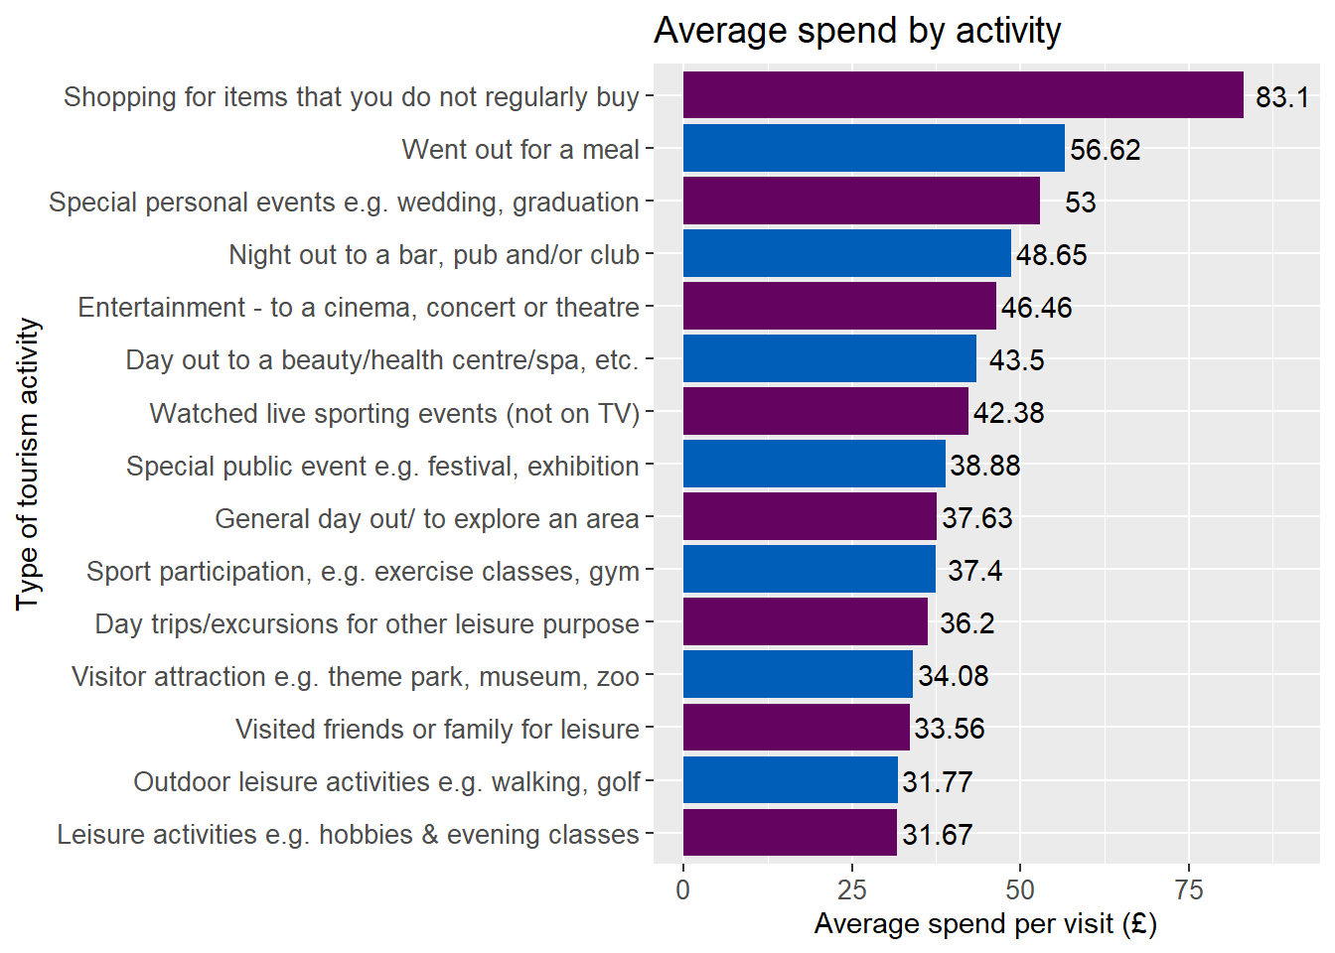
Activities
Most income in generated from people going out for a meal
The reason for the most visits is to see friends and family
Trying to popularise activities with low visits and a high average spend could help generate a lot of income for the tourism industry.

Slide 5
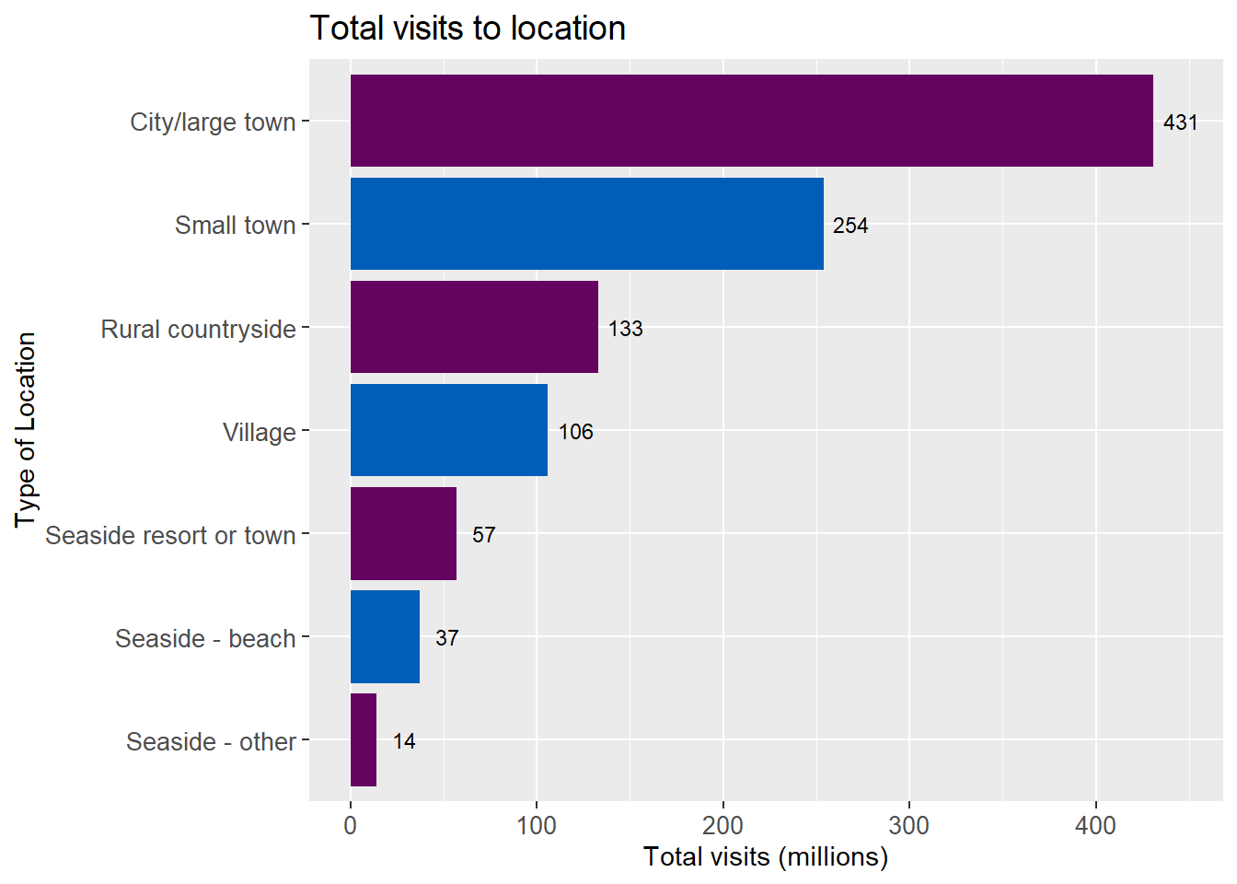
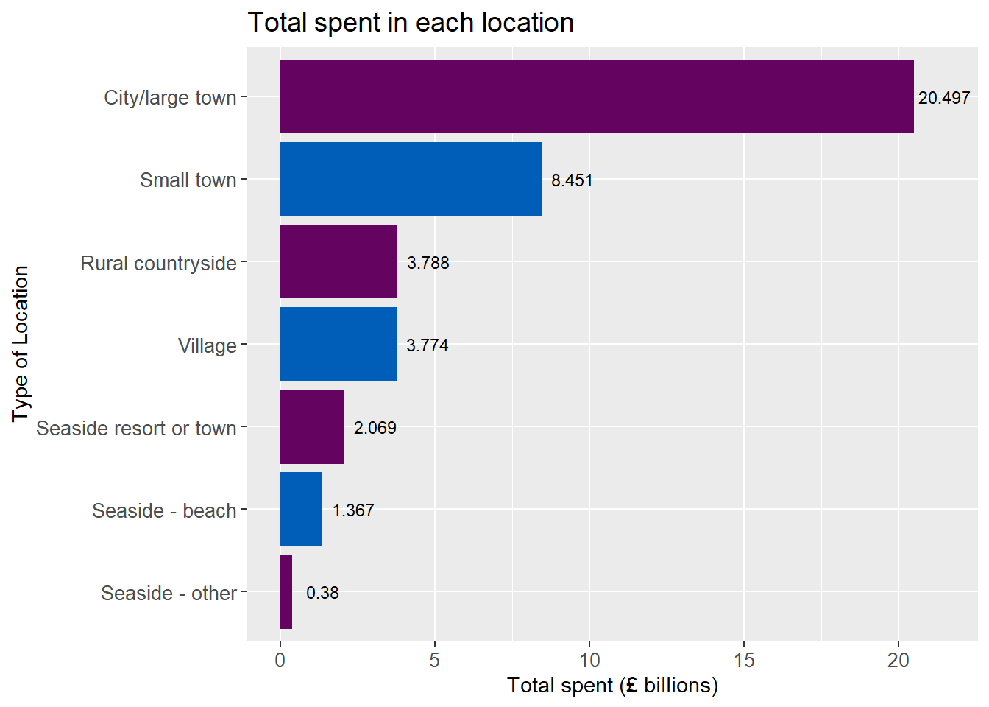
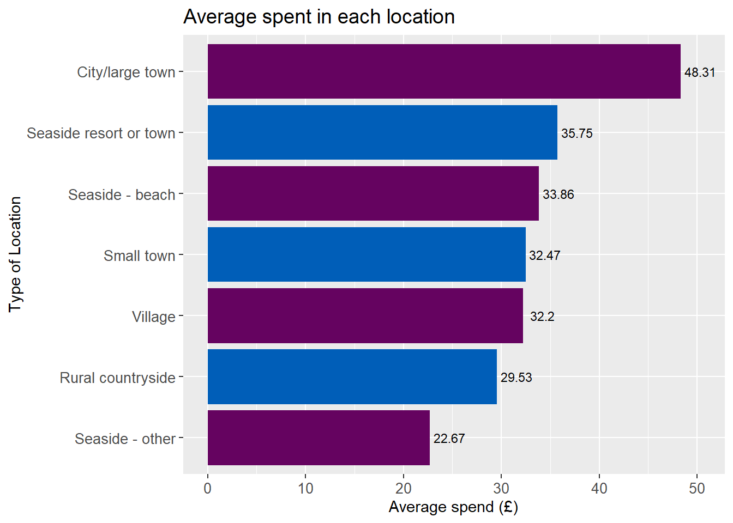
Locations
The most popular type of location to visit is cities and large towns.
  Most people for visiting family and friends
  Likely wide selection of tourism activities

Slide 6
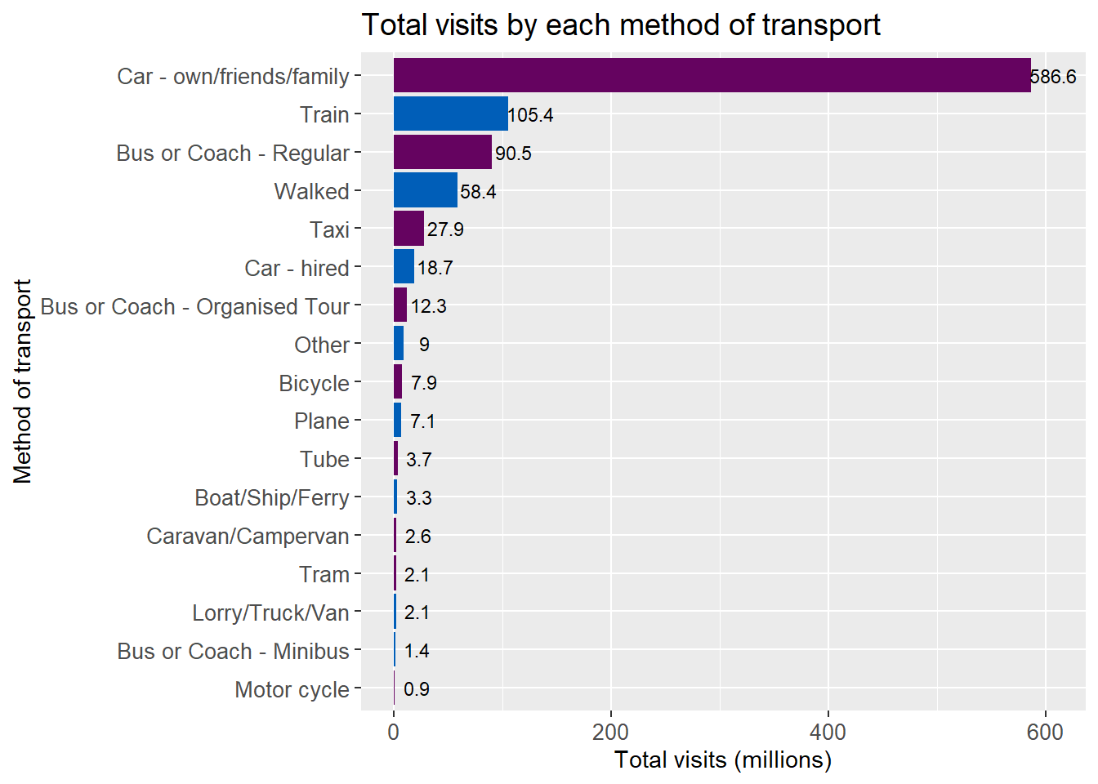
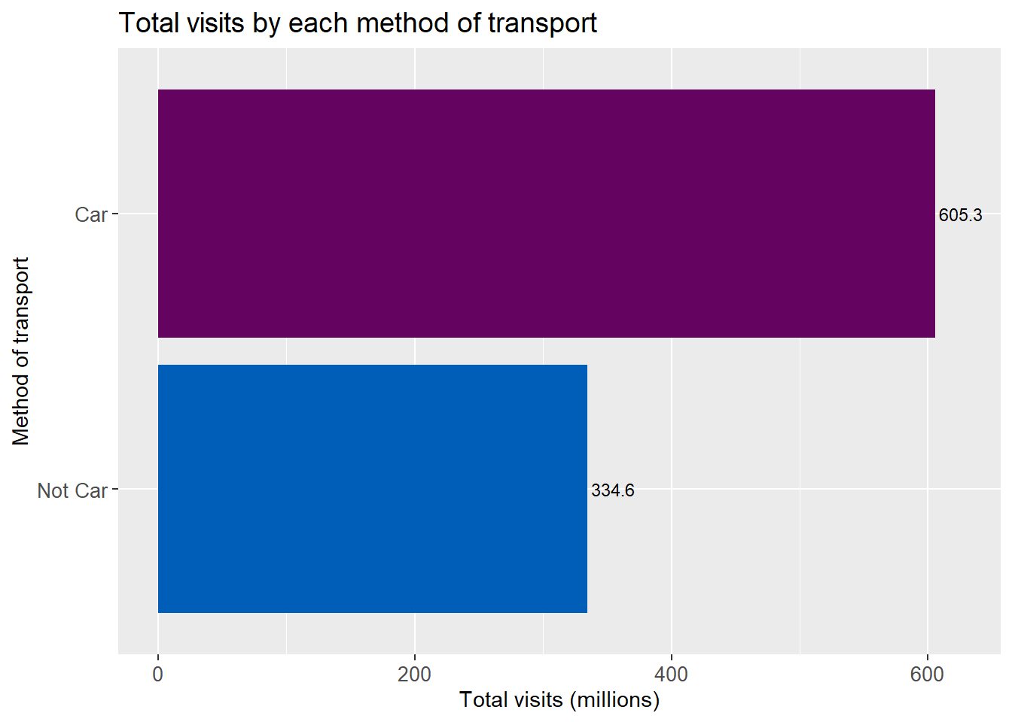
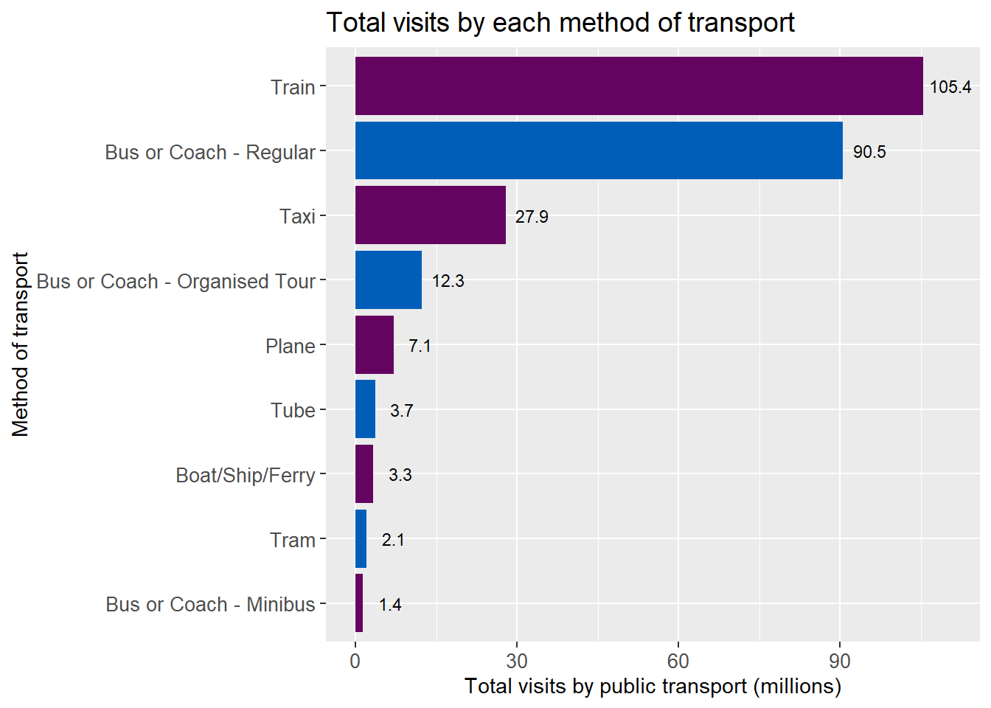
Transport
Car is by far the most popular from of transport to reach tourist activities
Positive for locations without good public transport links
Partnerships for certain locations with public transport providers by be able to produce mutually beneficial results

Slide 7
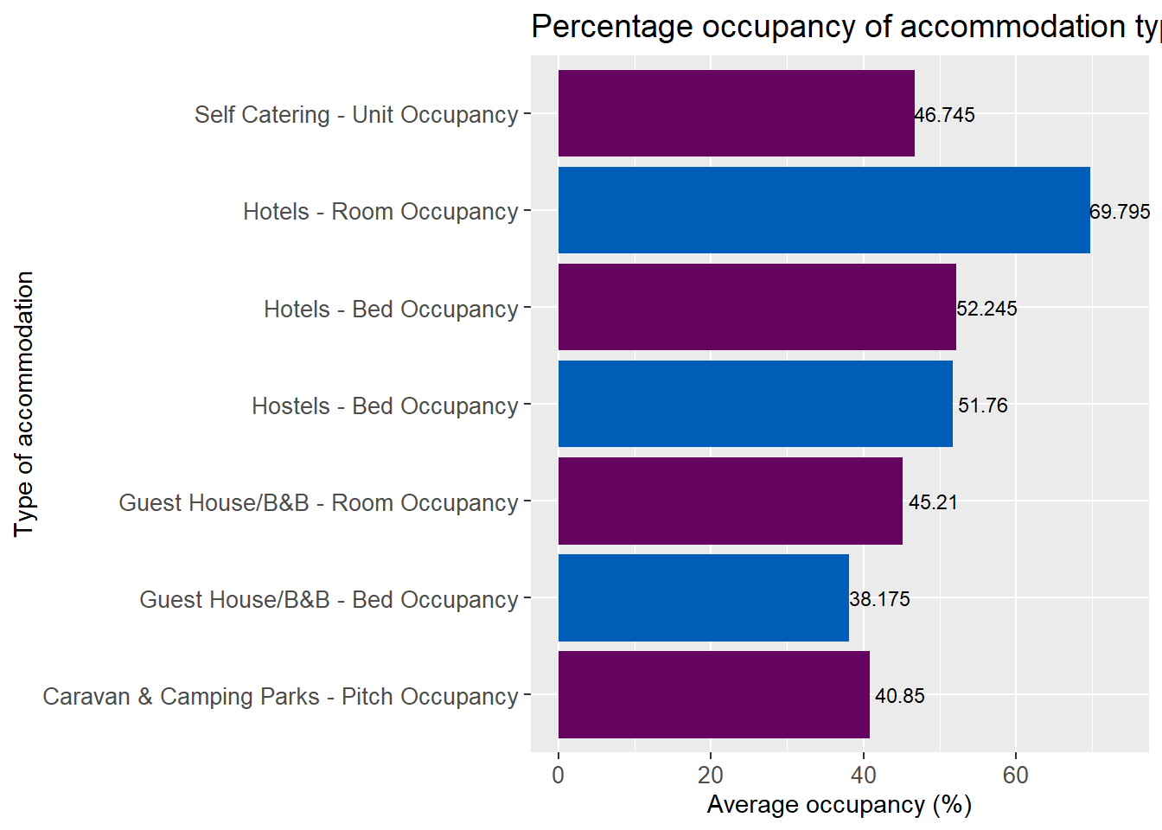
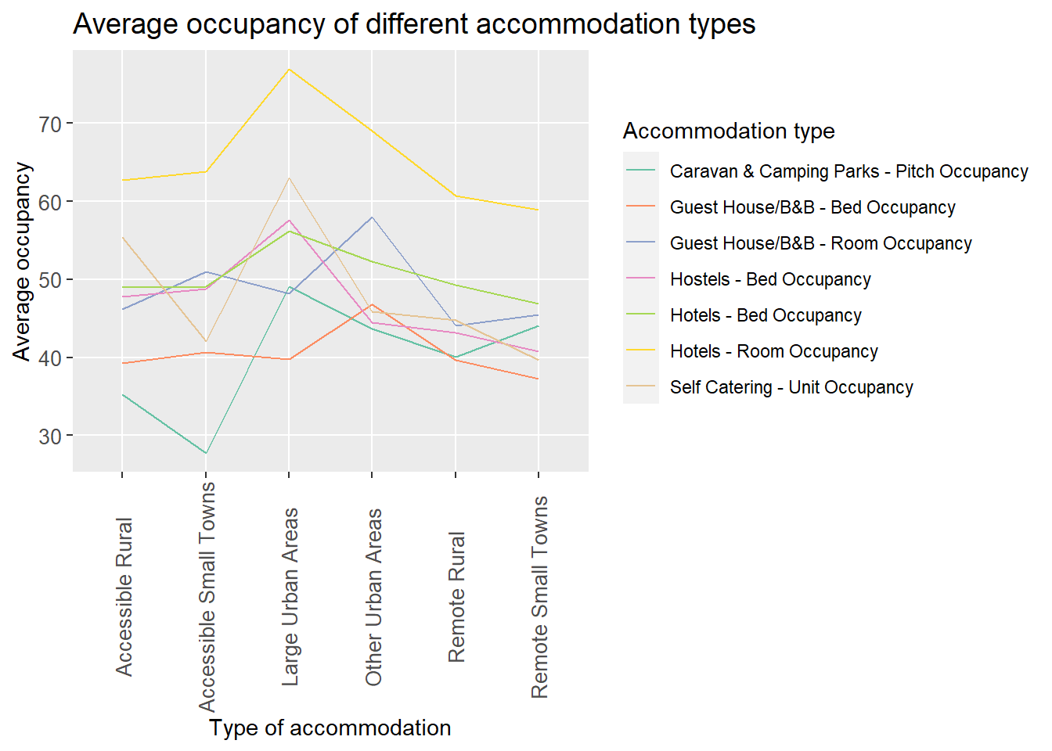
Accommodation
Hotels are the most popular type of accommodation overall and in all designated locations
Popularity varies by the location
Useful information for Visit Scotland when supporting new enterprises

Slide 8
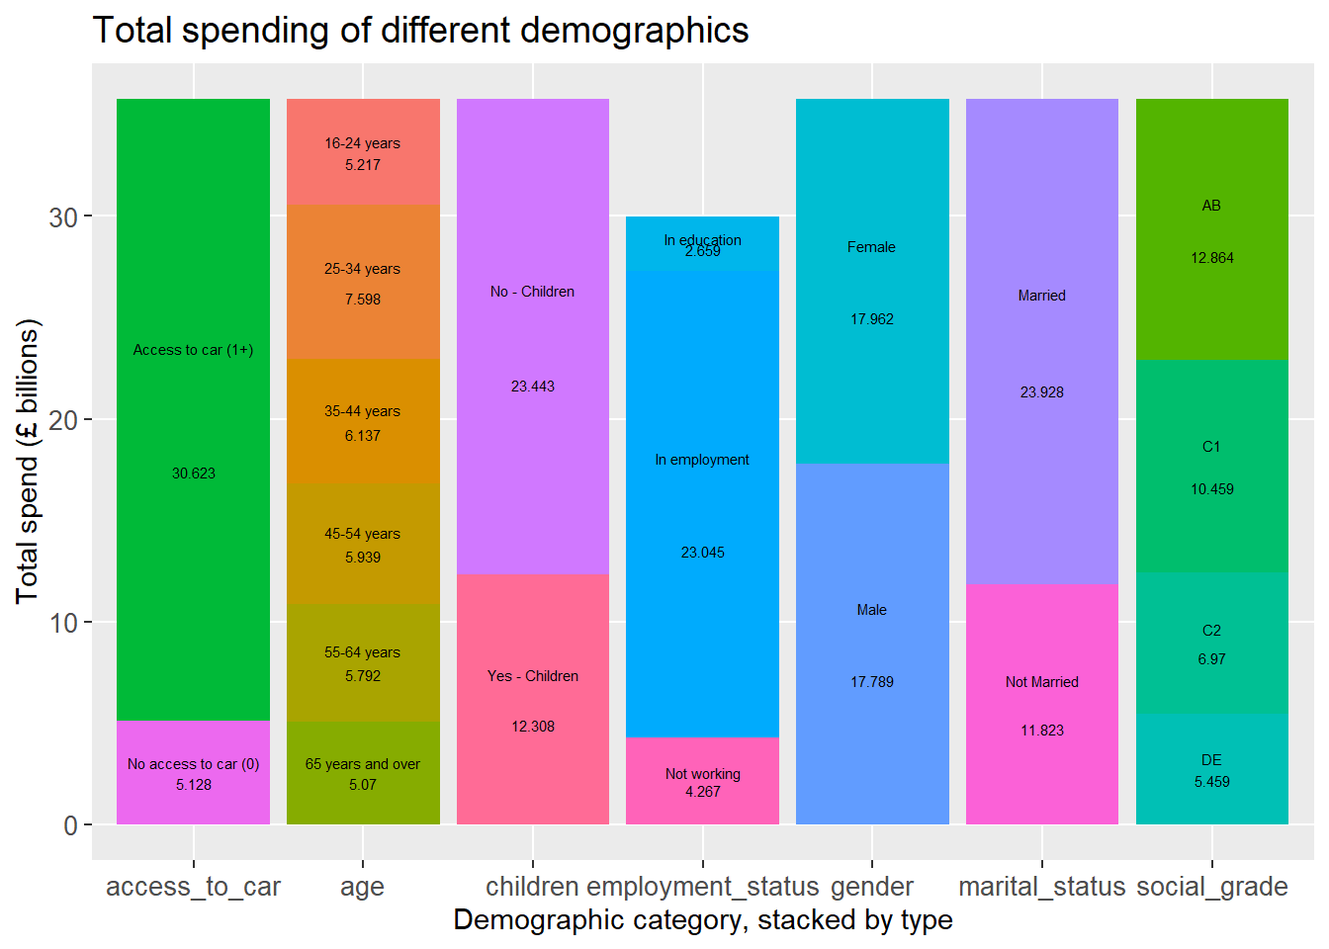
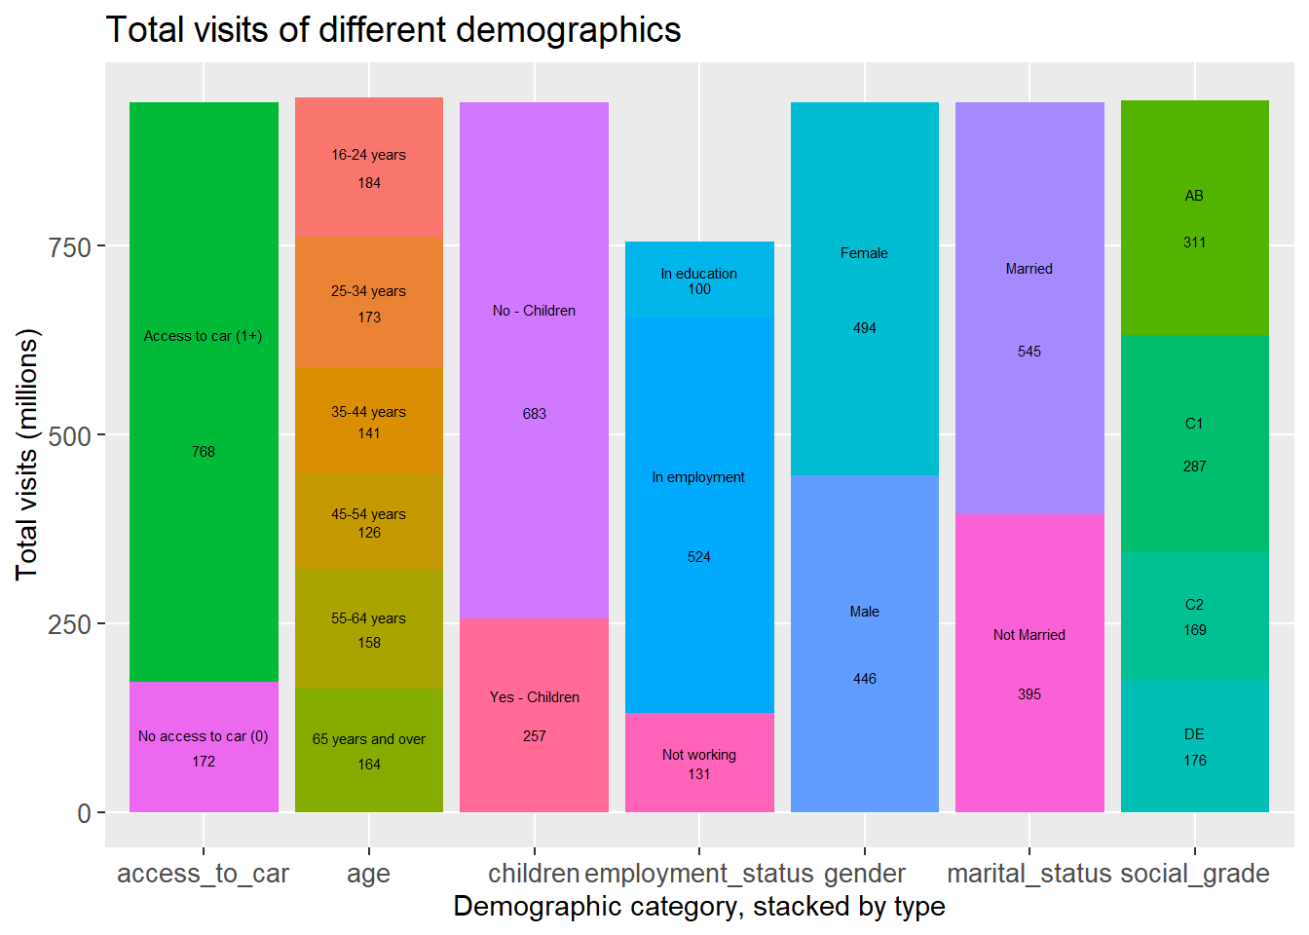
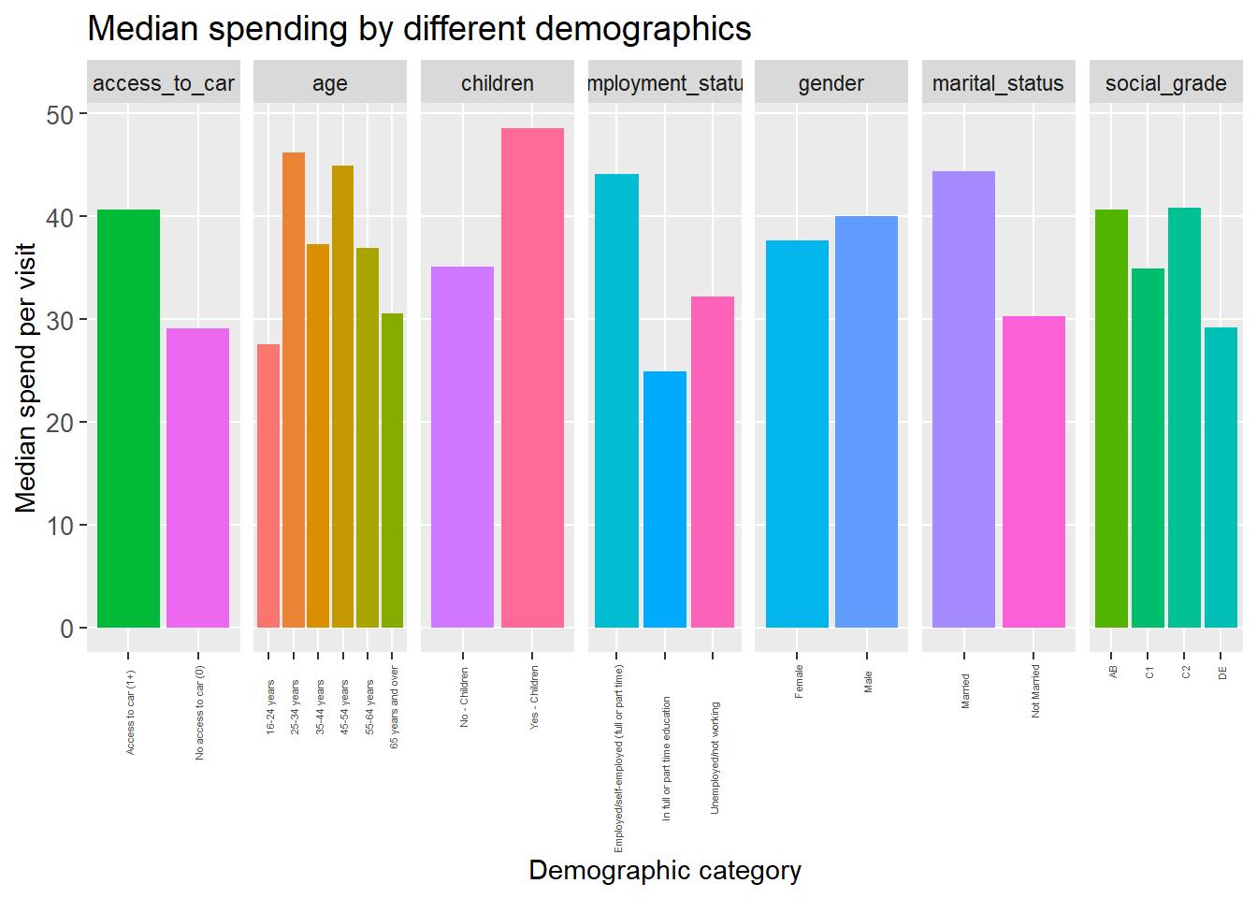
Demographics
Total spending and visits vary across different demographics
Useful for targeted advertising

Slide 9
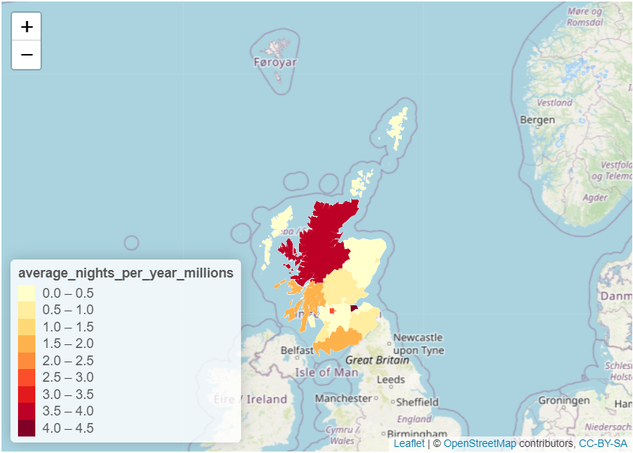
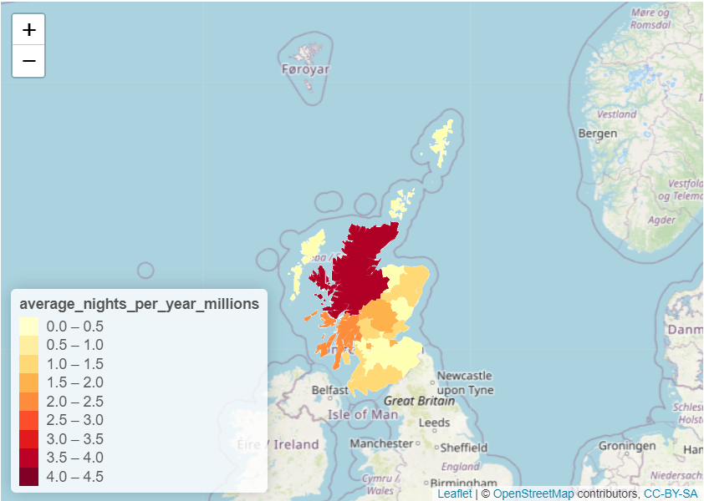
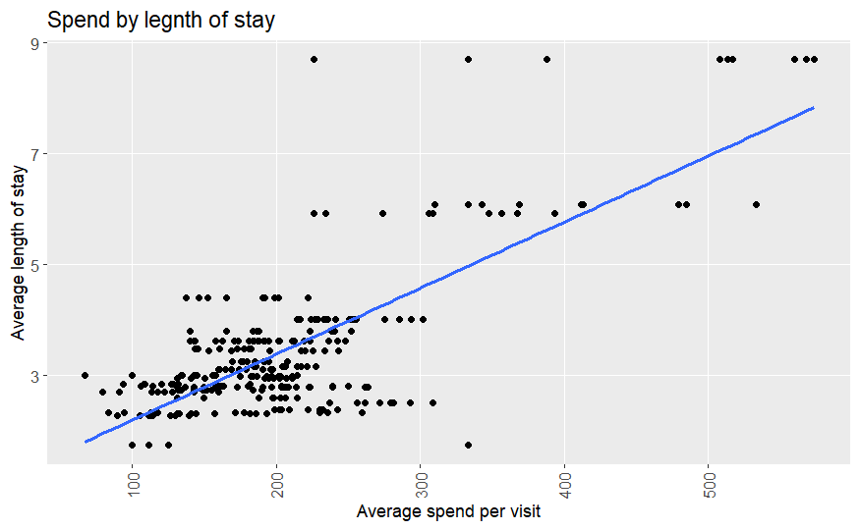
Regional tourism
Some changes in popularity of different areas.
Similar total visit numbers but those from England tend to stay for longer and therefore spend more money.
      Visitors from England Visitors from Scotland

Slide 10
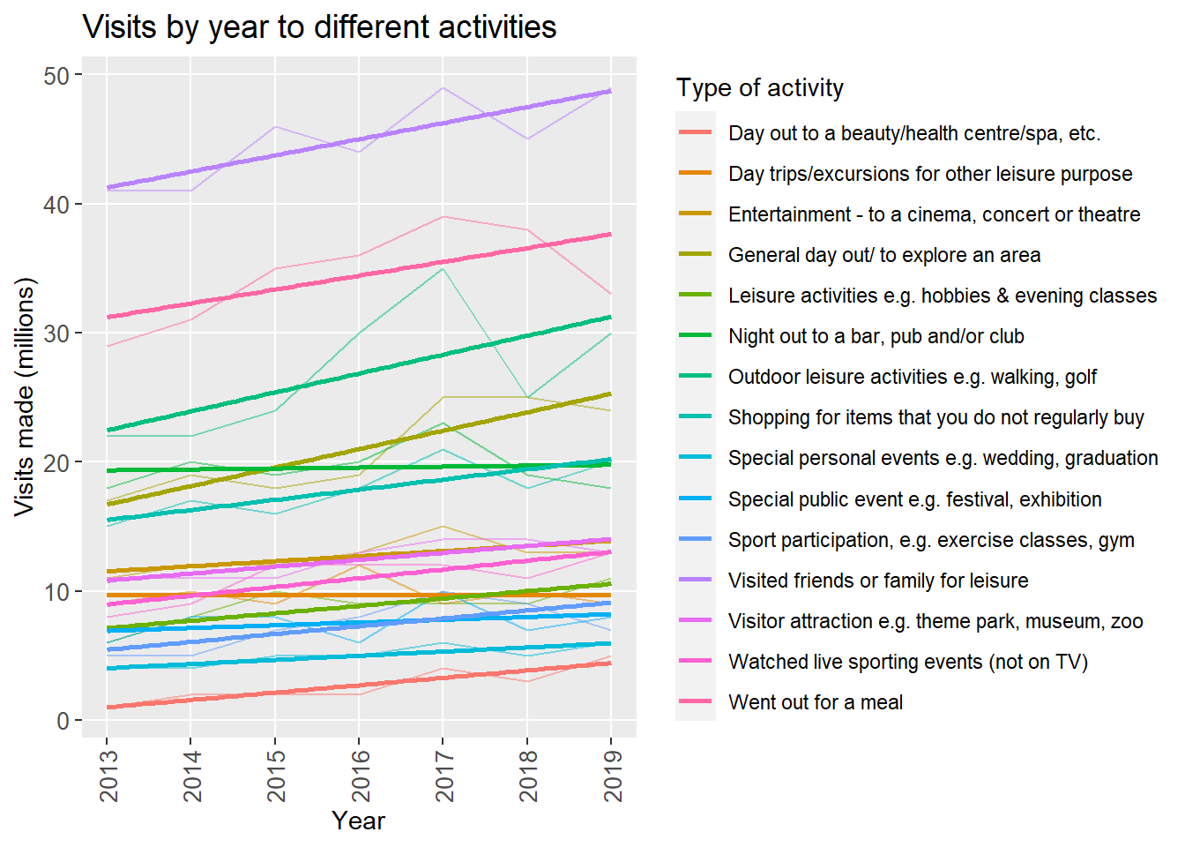
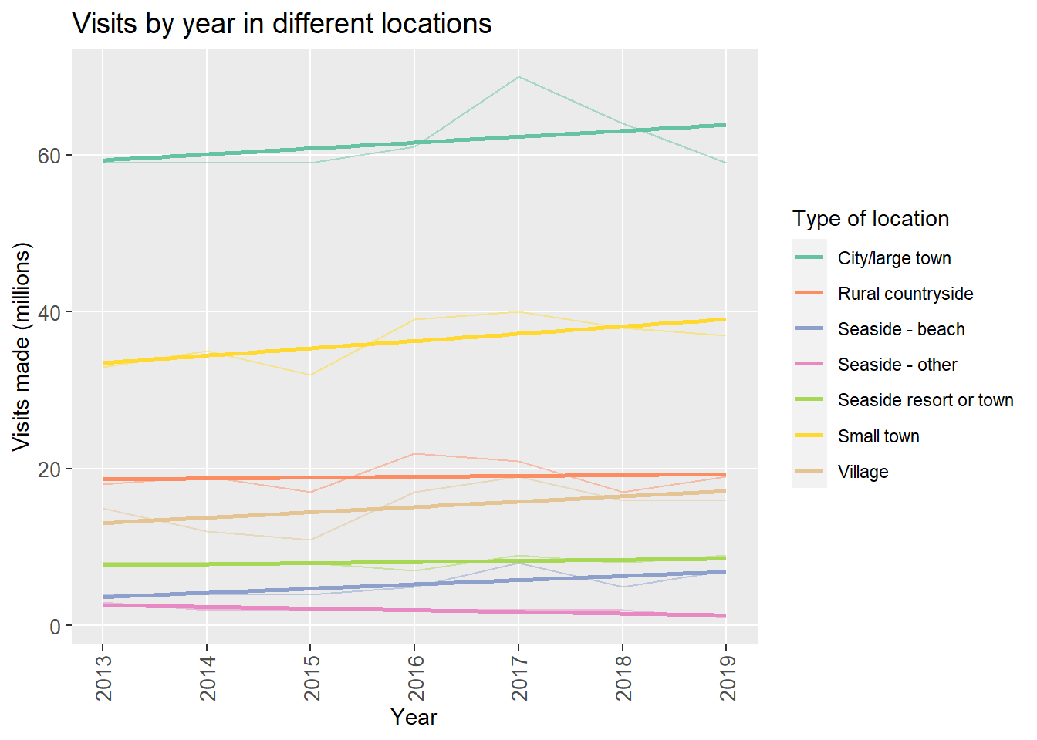
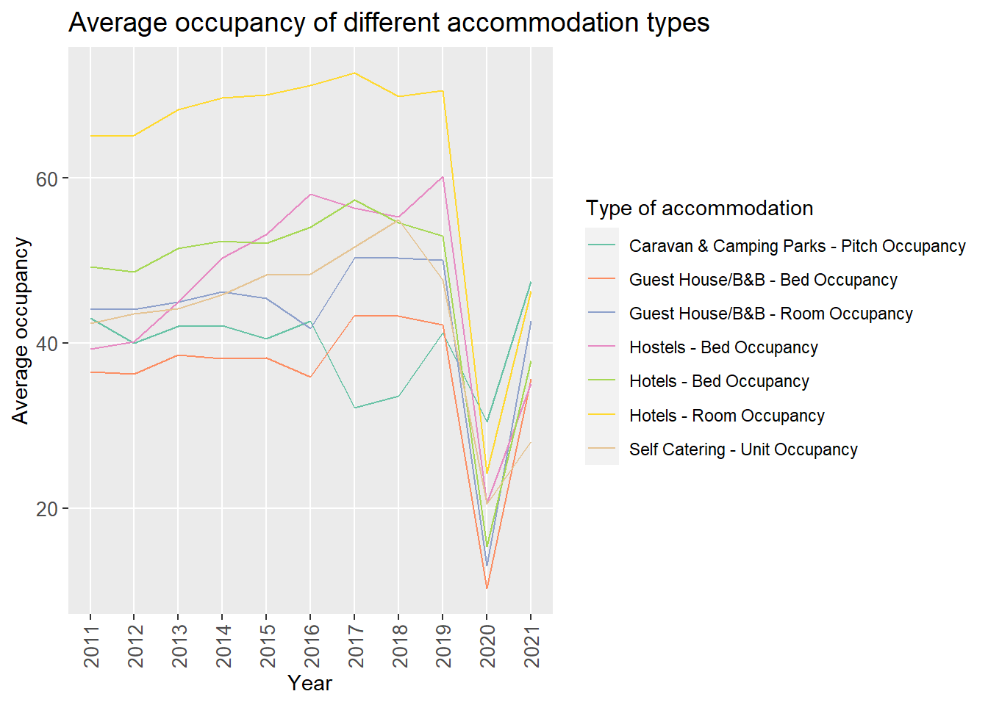
Trends and predictions
Up to 2019 visits were increasing across almost all types of activity and loaction
However in 2020 due to the Covid-19 pandemic these dropped off before showing some recovery
Impossible to predict 2022 or 2023 numbers based on those prior to the pandemic at least until we see full recovery.

Slide 11
Conclusions
With this data Visit Scotland can help new and existing businesses understand the market for their services better
Demographics and popular forms of tourism have been identified to assist with future marketing campaigns
Growth areas with higher spends per visit have been identified to improve income for the Scottish tourism industry
Regional tourism shows the counties of Scotland that would require more support (high tourism levels) and more publicity (low tourism levels)
Any predictions based on pre-pandemic data will be unreliable but tourism is trending up which should be a positive sign for post Covid recovery.

