Slide 1
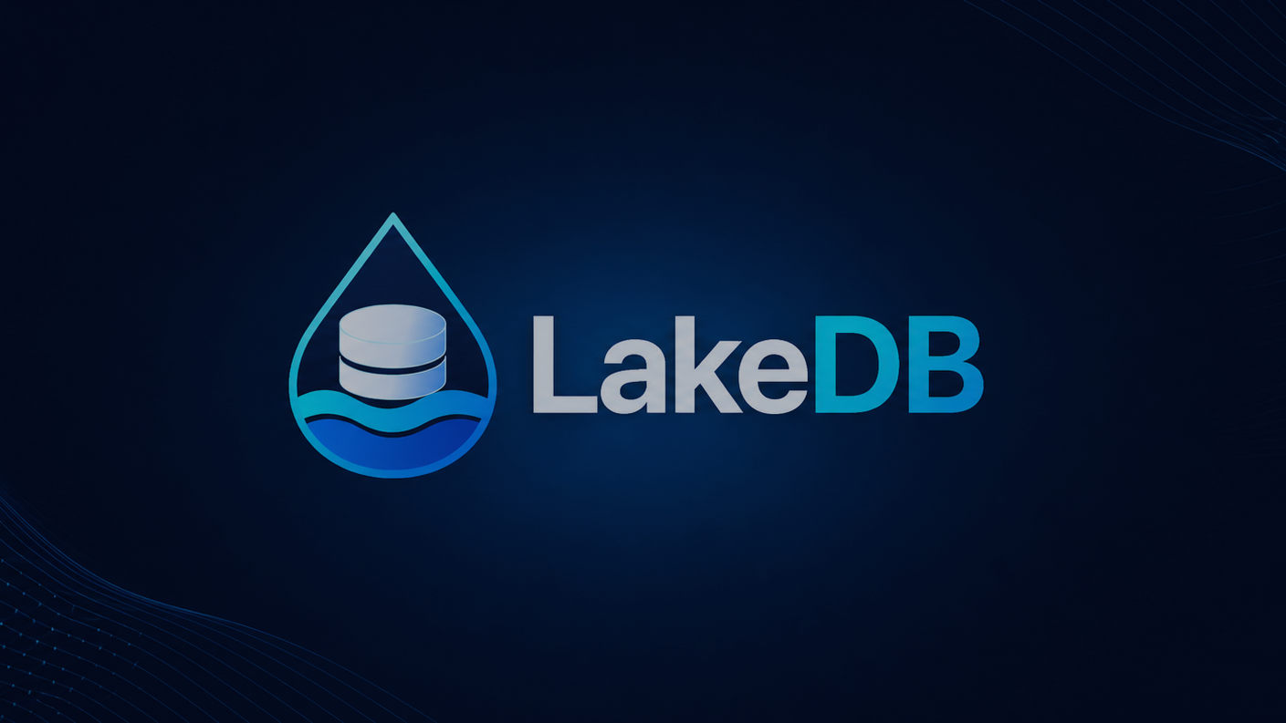

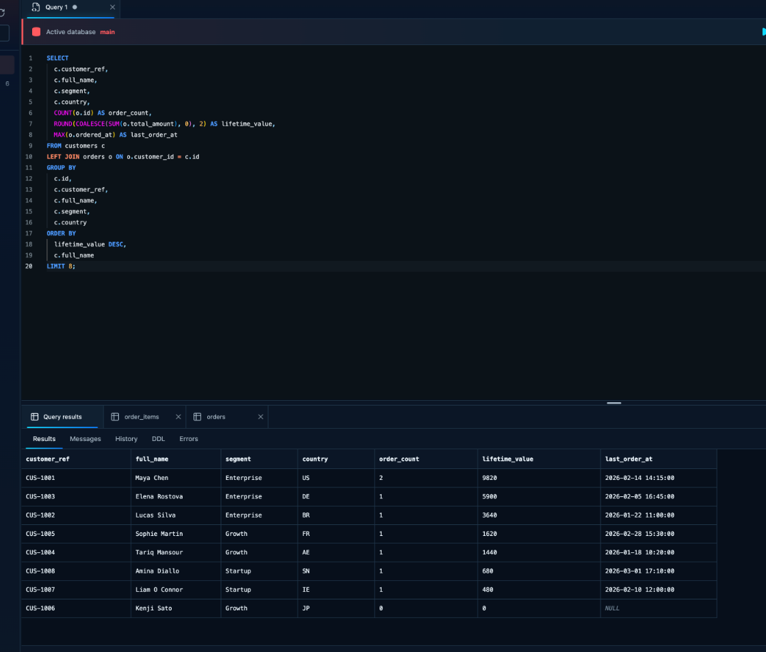

LakeDB
One workspace for SQL, data and database operations.
MySQL · MariaDB · SQLite
ENGINEERING OVERVIEW
A practical walkthrough of connection safety, SQL workflows, local tooling and review-first AI.
github.com/DavLagoHern/LakeDB

Slide 2
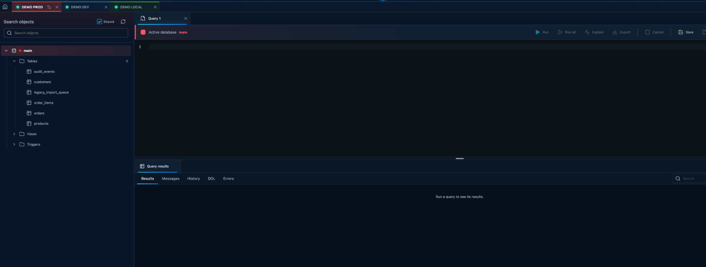
LakeDB
2 / 18
Multiple connections. Separate context. Clear visual identity.
Each connection keeps its own tabs, schema, results and QuerIA context.
DEMO PROD
DEMO DEV
DEMO LOCAL
Names, colors and environment levels are configured by the user.
Switch connections without mixing editor state, tabs or results.

Slide 3
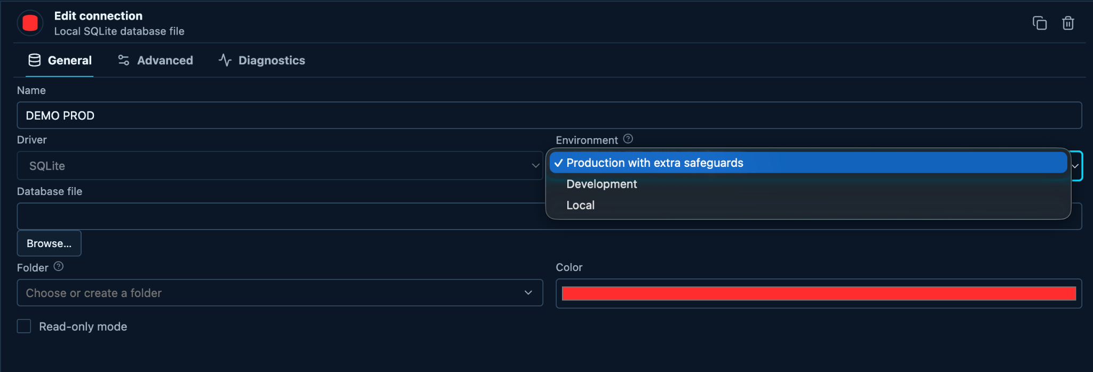
LakeDB
3 / 18
Connection identity is explicit.
The user names the connection, chooses its color and sets the environment level.
User-configured environment
Visual identity
Read-only option
Production, Development and Local are explicit choices, not automatic detection.
Colors make the active connection obvious while working across tabs.
A connection can be marked read-only when writes should never happen.
Connection identity and safety are deliberate settings, not hidden behavior.

Slide 4
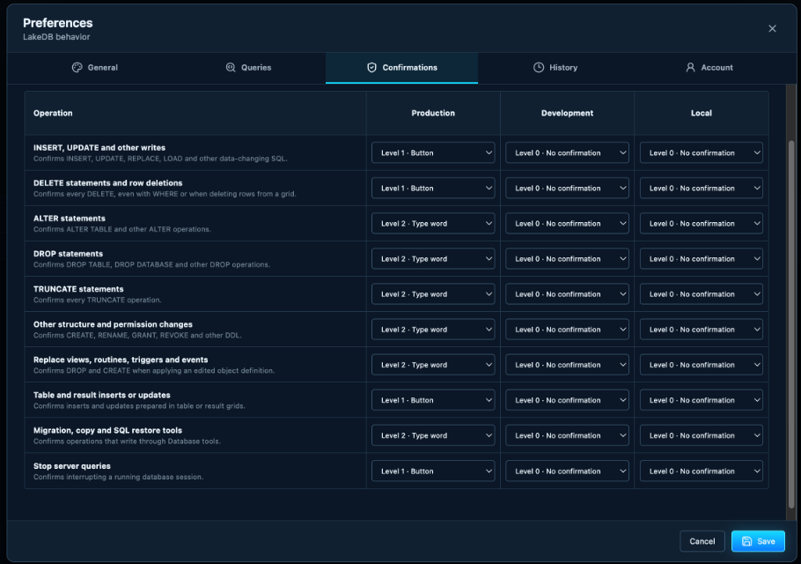
LakeDB
4 / 18
Safety rules match the operation.
Confirmation policies can be different for writes, DDL, restores and server actions.
Policy levels
Level 0: no confirmation
Level 1: button confirmation
Level 2: type-word confirmation
Separate rules per environment
Editable without changing database metadata
Visible before use
The matrix explains exactly what LakeDB will ask for before a risky action runs.
The confirmation matrix is visible, configurable and reviewable.

Slide 5
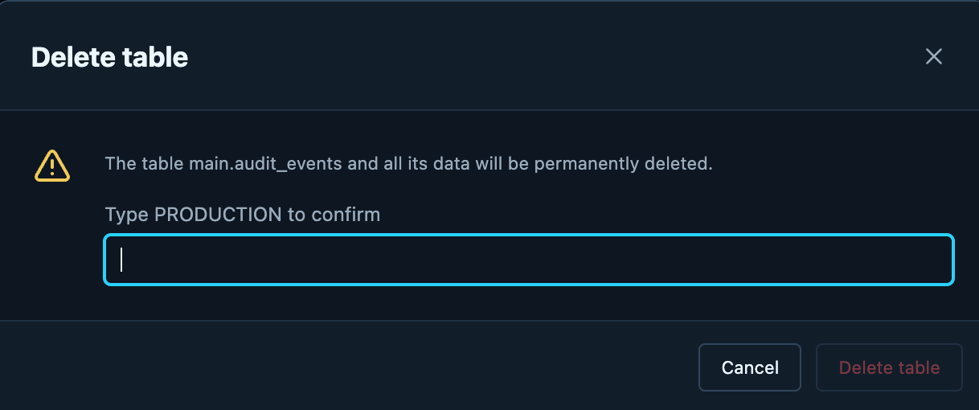
LakeDB
5 / 18
High-risk actions can demand stronger confirmation.
A destructive operation does not continue until the configured token is entered.
Production safeguard
The table is named before deletion.
The required token is shown explicitly.
Cancel remains the safe default.
Type PRODUCTION
The policy comes from the connection and operation configuration.
Stronger safeguards appear only when the configured policy requires them.

Slide 6
LakeDB
6 / 18
A complete SQL workflow before AI.
Write, run and inspect real queries in one workspace.
The basic workflow matters first
SQL editor and results share the same workspace.
Results show real rows from the connected database.
Duration and row count stay visible after execution.
No AI is required for everyday SQL work.
SQL editor
Query results
Duration + rows
Useful even when AI is turned off.

Slide 7
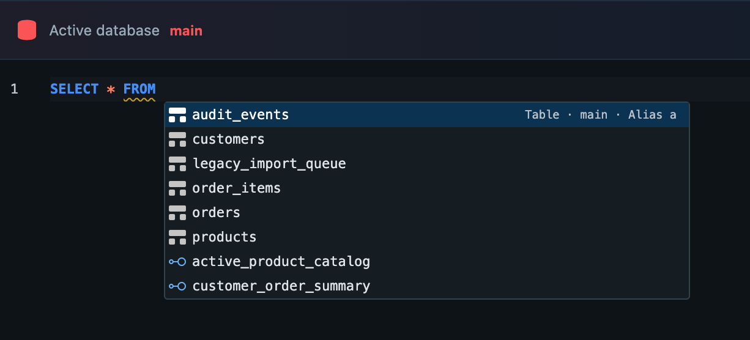
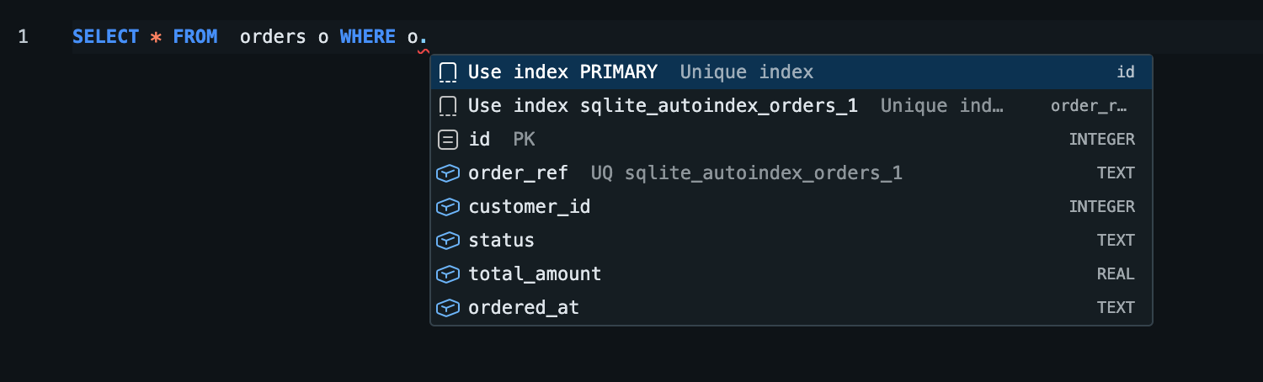
LakeDB
7 / 18
Schema-aware autocomplete stays close to the editor.
Tables, views, indexes and columns appear where they are needed.
Tables and views
Indexes and columns in WHERE
Context from metadata
Less typing, fewer mistakes
No AI required
LakeDB uses the schema you are connected to, not a generic SQL template.
Alias, column and index suggestions reduce friction while writing queries.
The editor remains useful even with QuerIA disabled.
Fast SQL authoring starts with real database metadata.

Slide 8
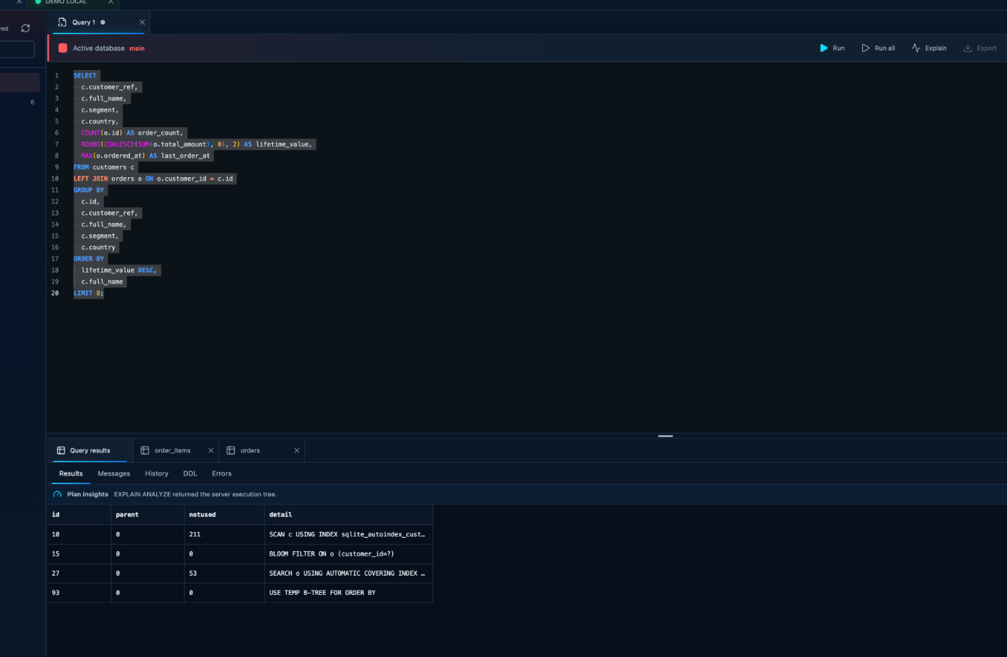
LakeDB
8 / 18
Explain before optimizing.
Plan insights stay next to the SQL that produced them.
Plan review
Run EXPLAIN without leaving the editor.
See scans, indexes and sort operations.
Keep the plan tied to the current query.
SQL first
Plan visible
Useful performance context without switching to another tool.

Slide 9
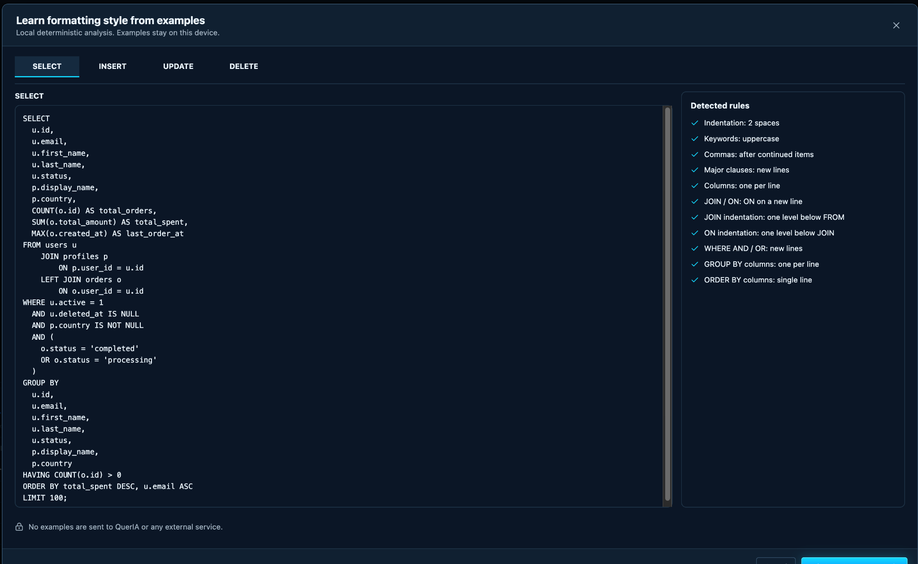
LakeDB
9 / 18
Teach the formatter your style.
Learn a deterministic profile from explicit examples you provide.
SELECT
INSERT
UPDATE
DELETE
Local · deterministic · no external request
Formatting does not consume AI tokens or send SQL to QuerIA.

Slide 10
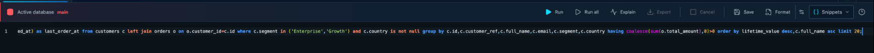
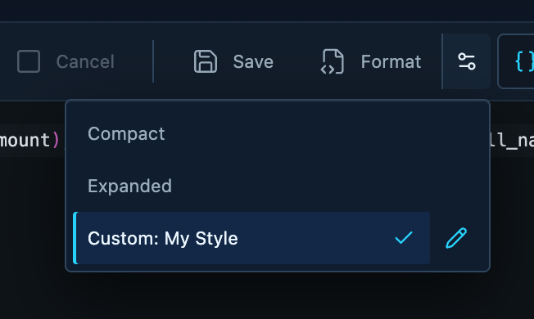
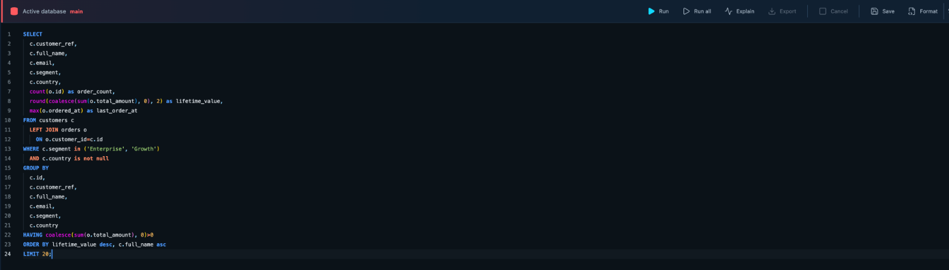
LakeDB
10 / 18
Apply the saved style to real SQL.
Use Custom: My Style whenever you format the editor.
Before: one-line SQL
Formatter profile
After: Custom My Style
The learned profile remains reusable and local.

Slide 11
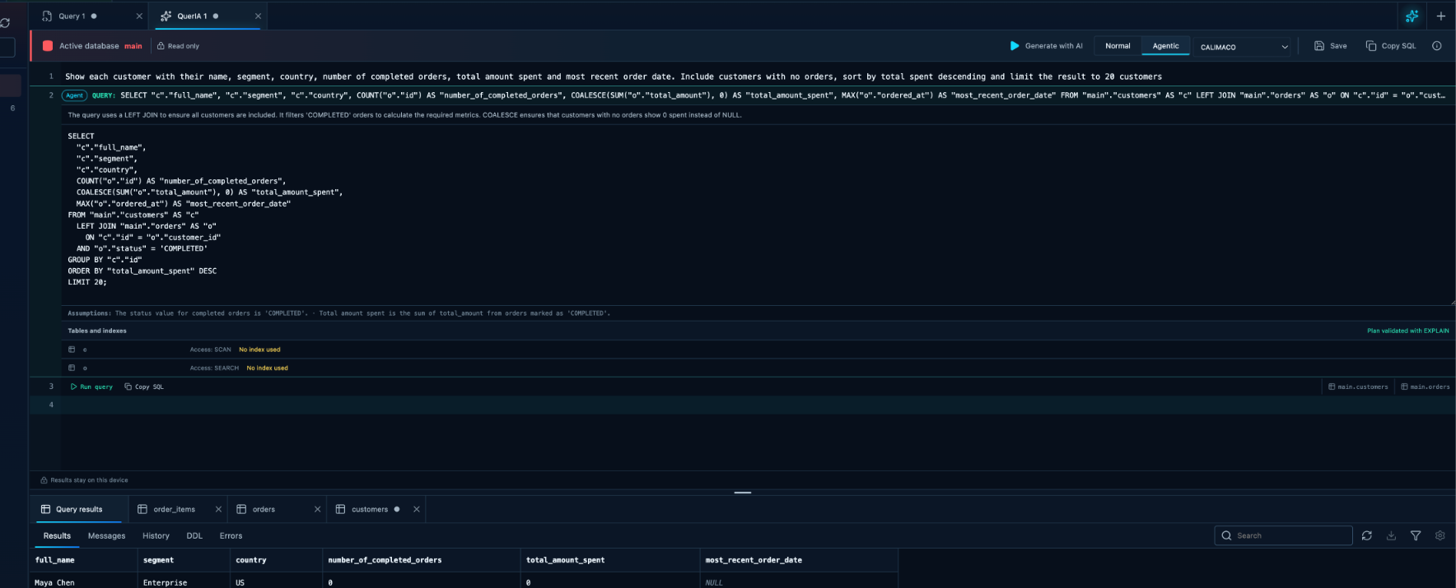
LakeDB
11 / 18
QuerIA proposes. You remain in control.
Generate SQL from natural language, review it, and run it only when you decide.
Ask
Generate
Review SQL
Run when ready
Nothing runs automatically.
AI suggestions remain visible and reviewable before execution.

Slide 12
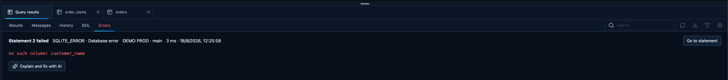
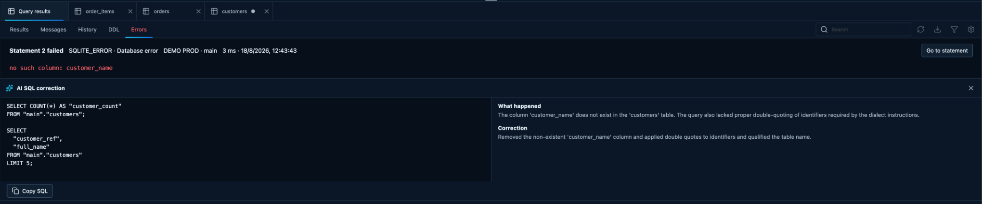
LakeDB
12 / 18
Keep the database error. Add help on top.
Preserve the engine error, then optionally review a corrected SQL proposal.
Original error and failed statement
Optional AI SQL correction
Original error visible
Go to statement
Copy reviewed SQL
No auto-execution
Help without hiding what actually happened.

Slide 13
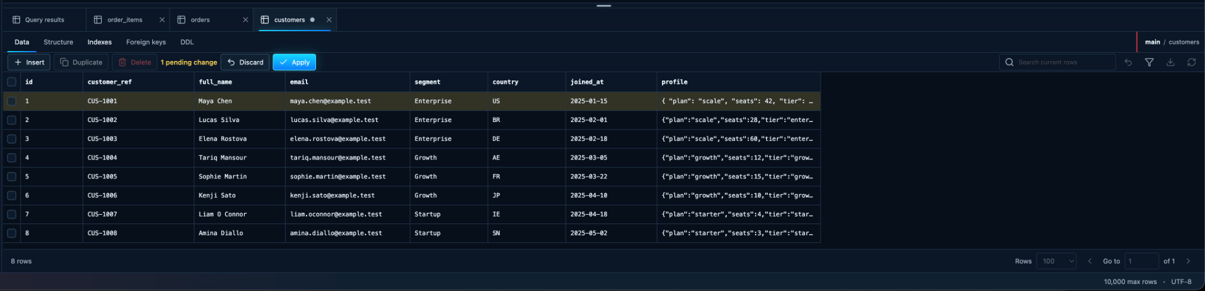
LakeDB
13 / 18
Edit rows without losing control.
Buffered changes remain visible until you explicitly apply or discard them.
One pending change
Apply explicitly
Discard safely
The grid marks unsaved edits before they reach the database.
Commit buffered changes only when the edited row is ready.
Return to the last persisted state without manual rollback SQL.
The data grid stays focused on reviewable, reversible work.

Slide 14
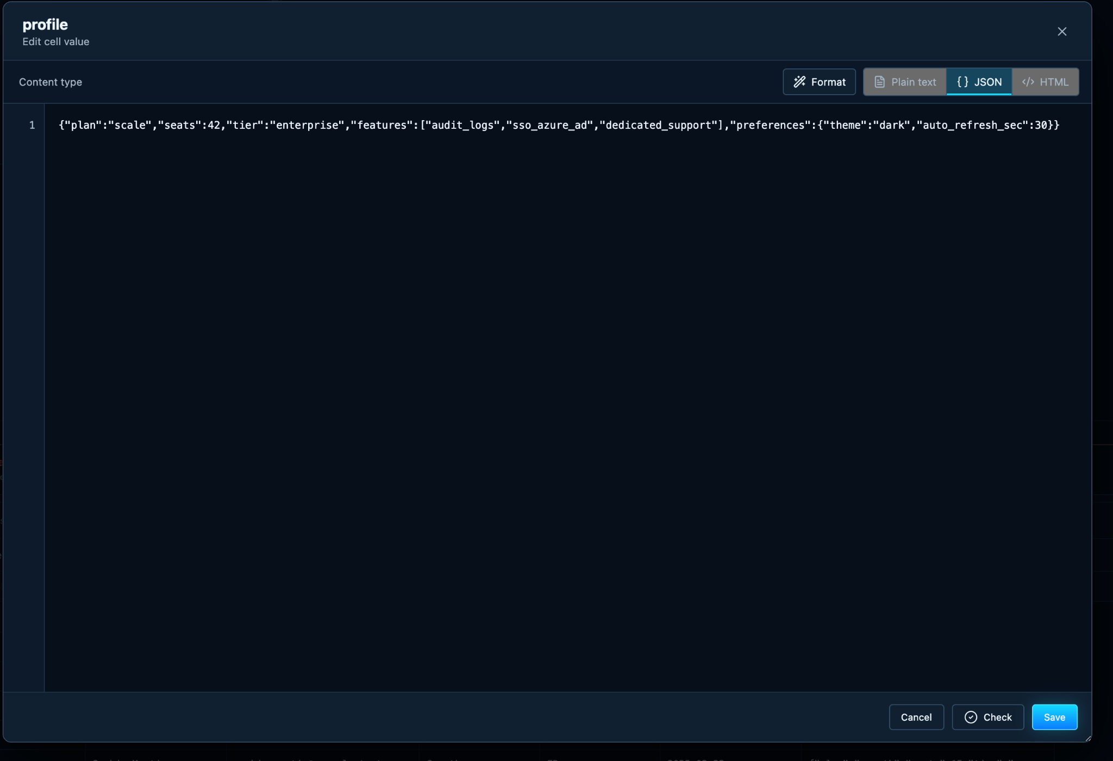
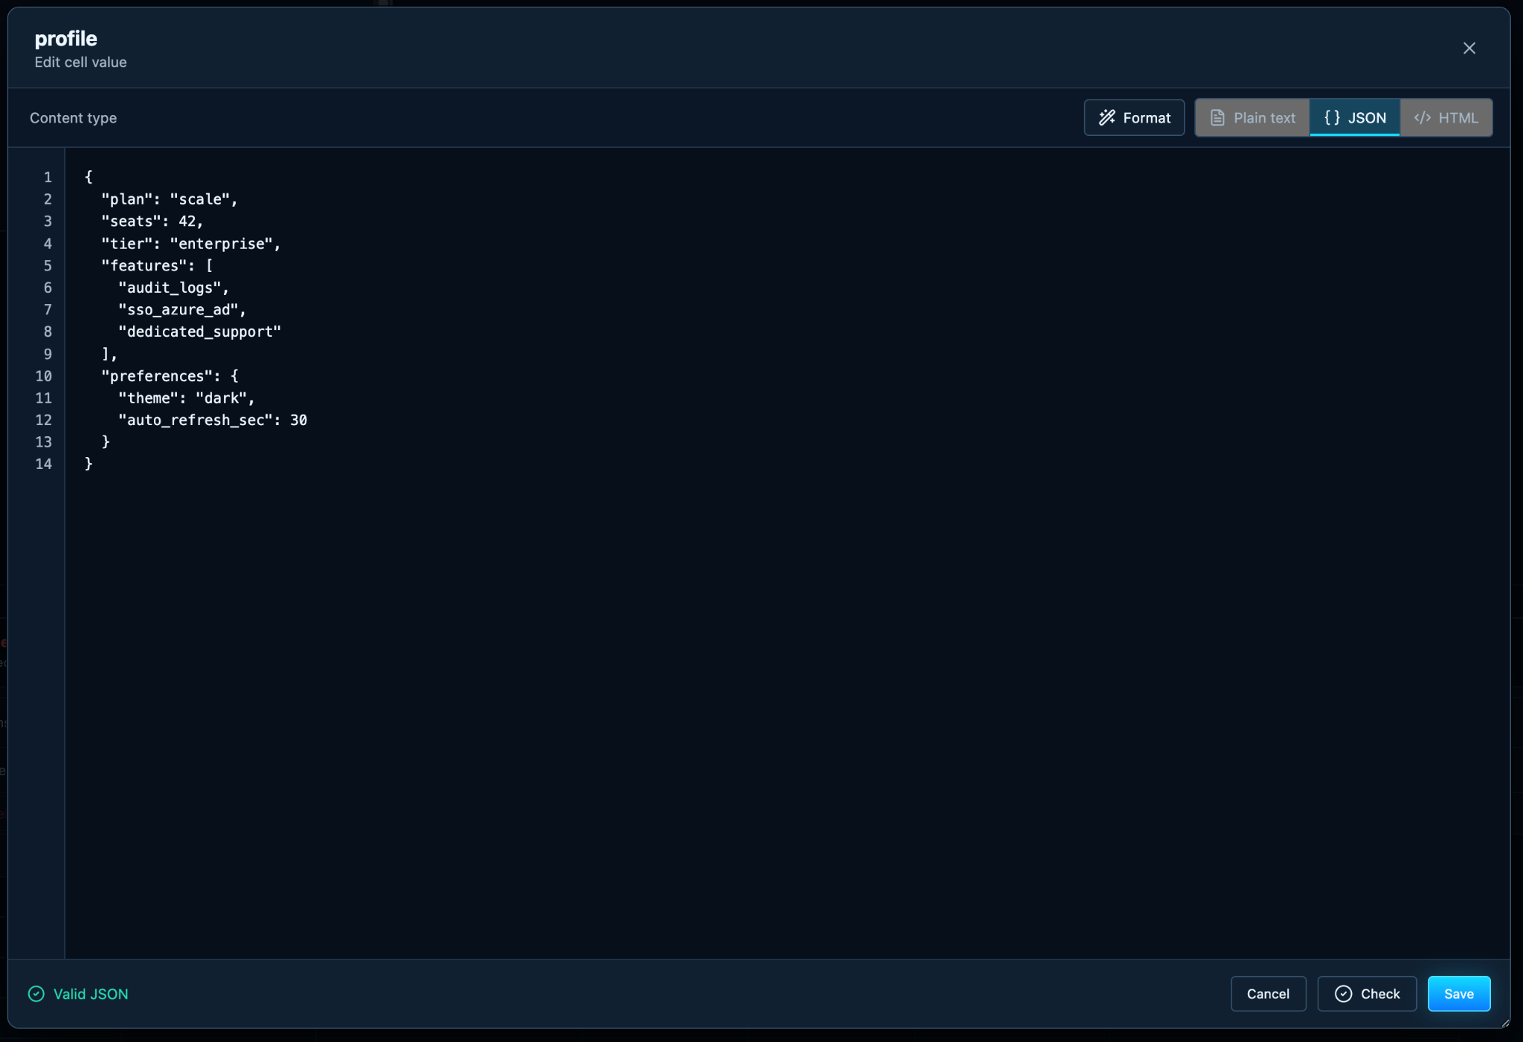
LakeDB
14 / 18
Format structured values before saving.
A dedicated editor makes JSON readable without leaving the table workflow.
Format
Check
Valid JSON
Structured values remain visible and reviewable before save.

Slide 15
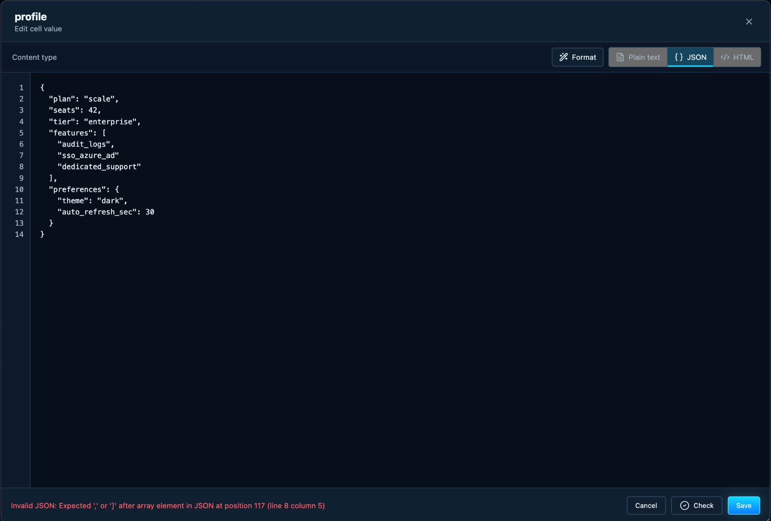
LakeDB
15 / 18
Validation feedback stays precise.
Invalid JSON is blocked with the exact position of the problem.
Invalid JSON
Exact line + column
Fix before save
Clear feedback prevents malformed structured values from being stored.

Slide 16
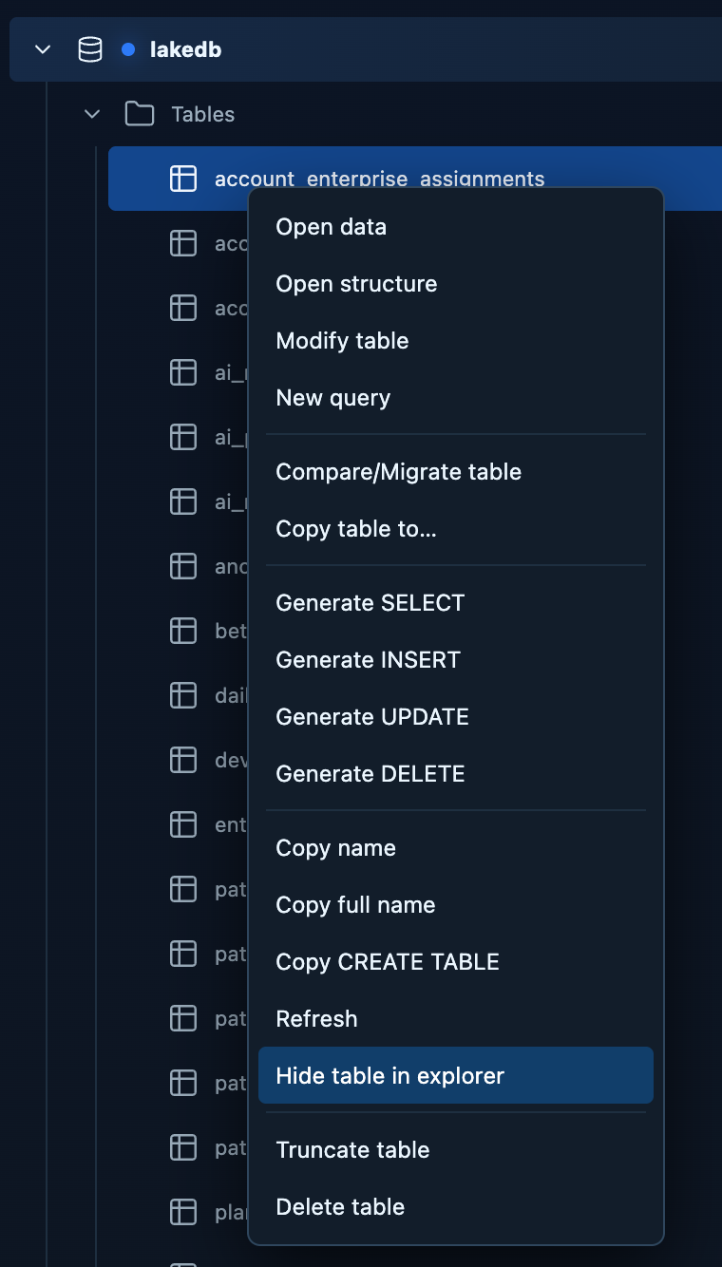

LakeDB
16 / 18
Keep the object explorer focused.
Hide noisy tables locally and restore them without changing database metadata.
Hide from the table context menu
Restore from Hidden tables
Local explorer preferences
Hide auxiliary or noisy tables from the tree.
Restore them later without changing the database.
Hide locally
Restore quickly
The explorer can stay quiet while LakeDB still keeps the objects accessible.

Slide 17
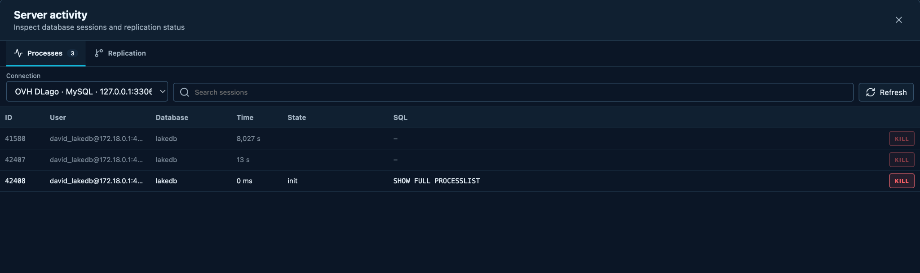
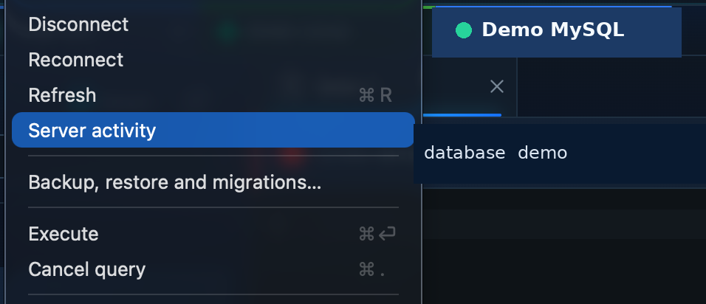
LakeDB
17 / 18
Inspect active database sessions when needed.
Server activity exposes running processes and operational controls on supported engines.
Processes
Kill / cancel
Replication
Inspect active sessions, duration and the SQL currently running.
Stop a selected server session when the workflow requires it.
Check replication status from the same operational view.
Operational tools appear where the connected database engine supports them.

Slide 18
LakeDB
Local client first. Enterprise is optional.
Core database work stays local and free. Enterprise can add isolated services and closer engineering collaboration.
LakeDB desktop client
Optional Enterprise setup
Connections, workspaces and SQL editor
Dedicated QuerIA service
Autocomplete, results and data editing
Organization controls and isolated configuration
Backup, restore, formatting and safety tools
Company-owned provider settings and limits
Free to use; QuerIA includes a free allowance
Closer engineering collaboration when useful
Try it with a real workflow and tell me what gets in your way.
github.com/DavLagoHern/LakeDB
github.com/DavLagoHern/LakeDB/discussions

