Slide 1
The Incidental Catch Model Using Life History & Fishery Removals to (re)construct population dynamic trends
David Keith, Heather Bowlby, Freya Keyser and Julie Charbonneau
MASETRO Meeting 2 Task 4.2
September 15th, 2022

Slide 2
Overview
Review the objectives of Task 4
The Incidental Catch Model (ICM)
How might we use the ICM model to achieve the objectives of Task 4

Slide 3
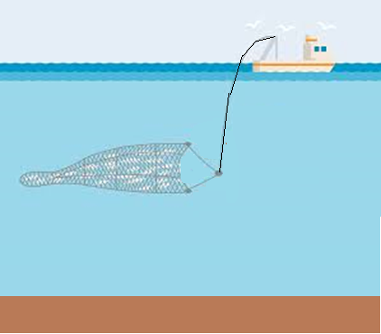


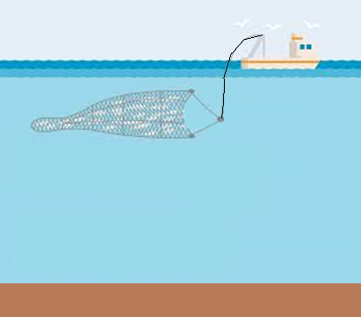



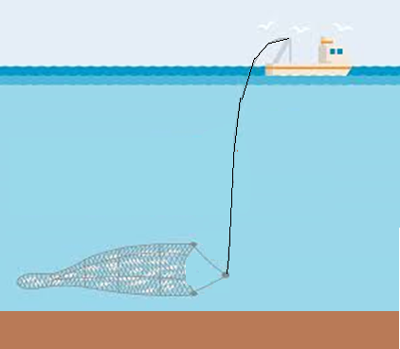
Task 4 Objectives
Explore the impact of varying catch strategies on the diversity of stocks within an ecosystem
How does redistributing catch across species impact function diversity
Are their optimal harvesting strategies that can optimize functional diversity

Slide 4
Task 4 Objectives
Explore the impact of varying catch strategies on the diversity of stocks within an ecosystem
How does redistributing catch across species impact function diversity
Are their optimal harvesting strategies that can optimize functional diversity
How might climate impacts influence these strategies

Slide 5
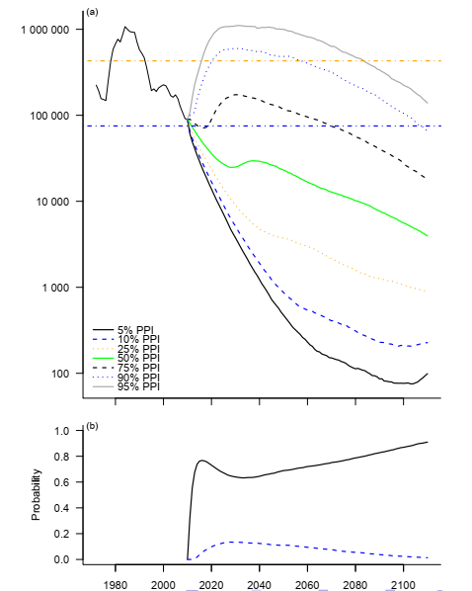
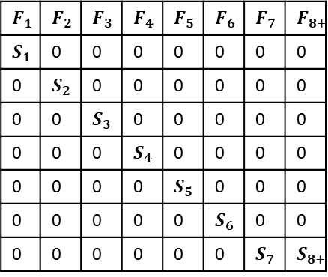
The Incidental Catch Model
To do this we need a model to project into the future
For both data limited and data rich stocks
For data rich stocks it would be nice to use the past to inform the future
For data poor stocks we could use life history information
Widely available life history information can be used to estimate
Longevity
Fecundity
Natural Mortality
This + linear algebra is all we need to estimate population growth rates
Leslie matrix
The Incidental Catch Model (ICM)
Enables us to use data from data rich stocks to parameterize model
Enables us to use life history information for data poor stocks to parameterize model
$$F_{1}$$ | $$F_{2}$$ | $$F_{3}$$ | $$F_{4}$$ | $$F_{5}$$ | $$F_{6}$$ | $$F_{7}$$ | $$F_{8+}$$
$$S_{1}$$ | 0 | 0 | 0 | 0 | 0 | 0 | 0
0 | $$S_{2}$$ | 0 | 0 | 0 | 0 | 0 | 0
0 | 0 | $$S_{3}$$ | 0 | 0 | 0 | 0 | 0
0 | 0 | 0 | $$S_{4}$$ | 0 | 0 | 0 | 0
0 | 0 | 0 | 0 | $$S_{5}$$ | 0 | 0 | 0
0 | 0 | 0 | 0 | 0 | $$S_{6}$$ | 0 | 0
0 | 0 | 0 | 0 | 0 | 0 | $$S_{7}$$ | $$S_{8+}$$

Slide 6
What is the ICM model
Developed for sharks
Used life history information and catch history to reconstruct population dynamics
Life history data included
Size
Longevity
Offspring production
A time series of removals by fisheries (all sources of removals)
An estimate of population size at one point in time
ICM was able to reconstruct a plausible time series for some shark species
But there was no means of groundtruthing the model
ICM was then informally used on a fish species with a full assessment model
It did an excellent job reconstructing the results of a more complex model

Slide 7
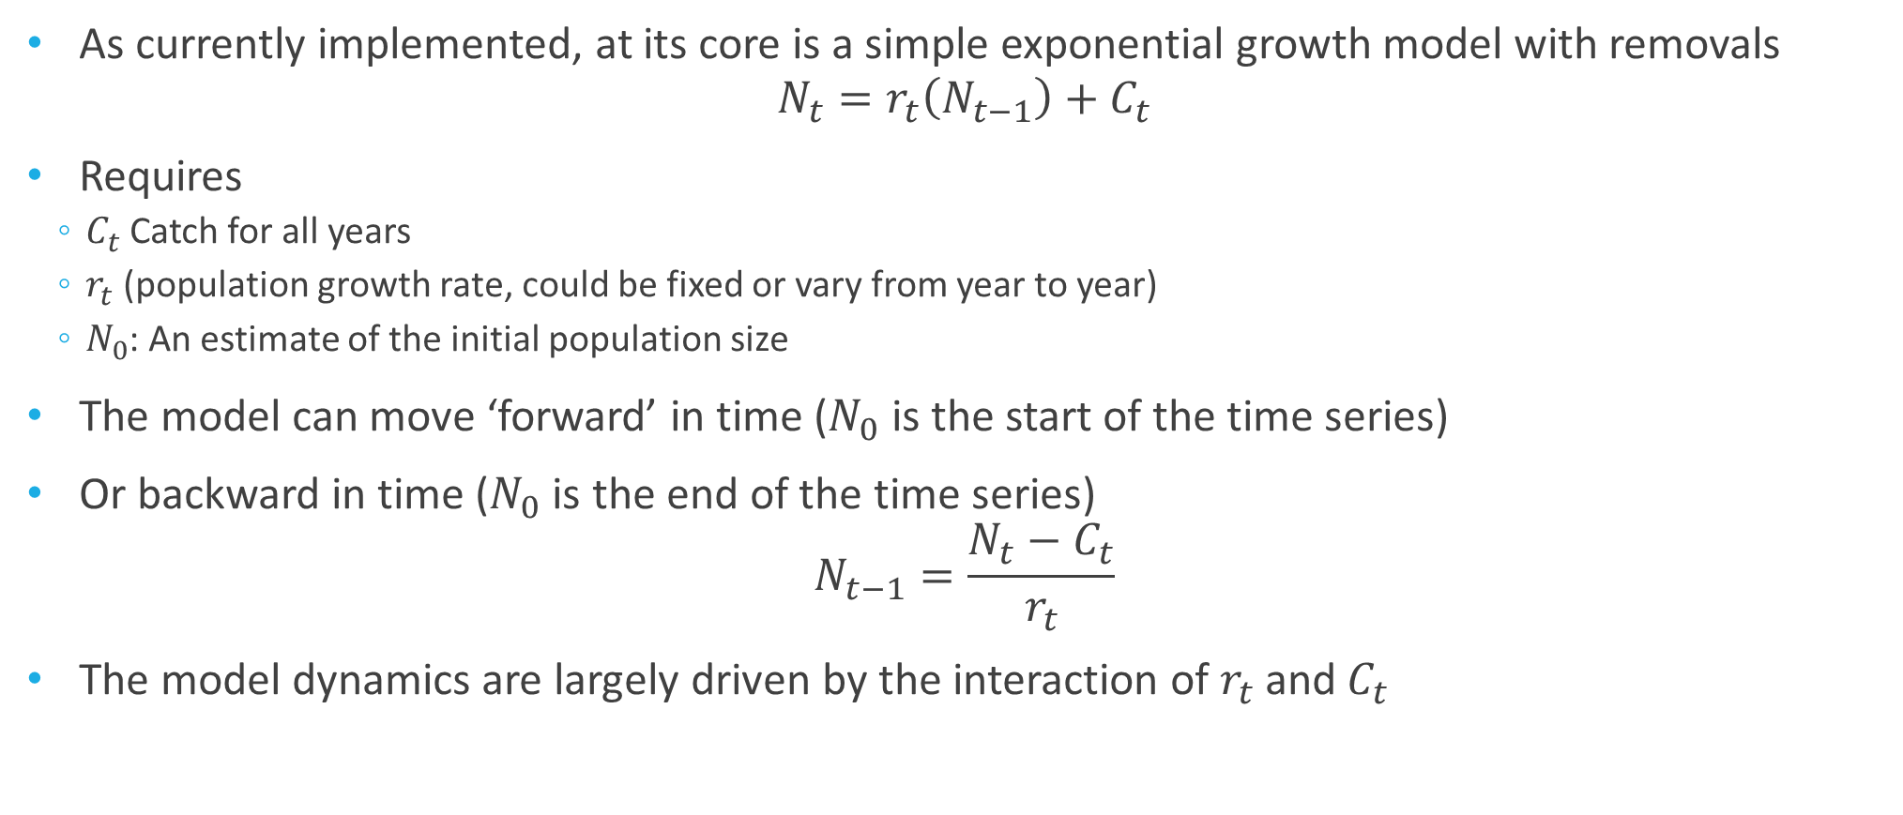
Under the Hood
As currently implemented, at its core is a simple exponential growth model with removals
$$N_{t}=r_{t}\left(N_{t−1}\right)+C_{t}$$
Requires
$C_{t}$Catch for all years
$r_{t}$ (population growth rate, could be fixed or vary from year to year)
$N_{0}$: An estimate of the initial population size
The model can move ‘forward’ in time ($N_{0}$ is the start of the time series)
Or backward in time ($N_{0}$ is the end of the time series)
$$N_{t−1}=\frac{N_{t}−C_{t}}{r_{t}}$$
The model dynamics are largely driven by the interaction of $r_{t}$ and $C_{t}$

Slide 8
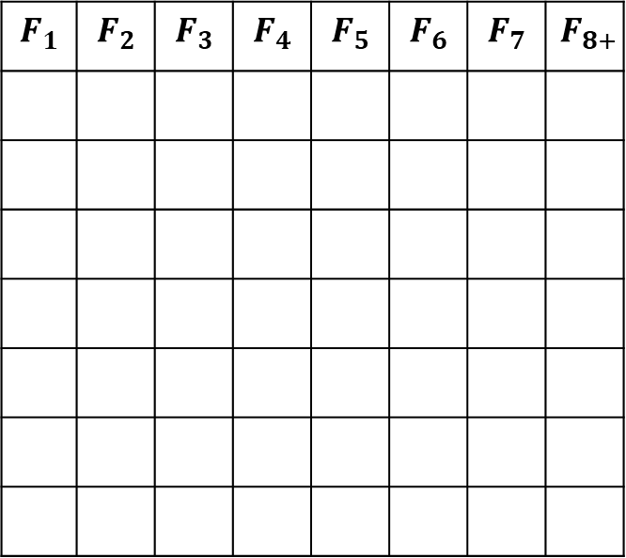
Decomposing $r_{t}$ ($N_{t}=r_{t}\left(N_{t−1}\right)+C_{t}$)
The rate of growth determines how quickly a population grows (or declines)
Driven by fecundity
$$F_{1}$$ | $$F_{2}$$ | $$F_{3}$$ | $$F_{4}$$ | $$F_{5}$$ | $$F_{6}$$ | $$F_{7}$$ | $$F_{8+}$$

Slide 9
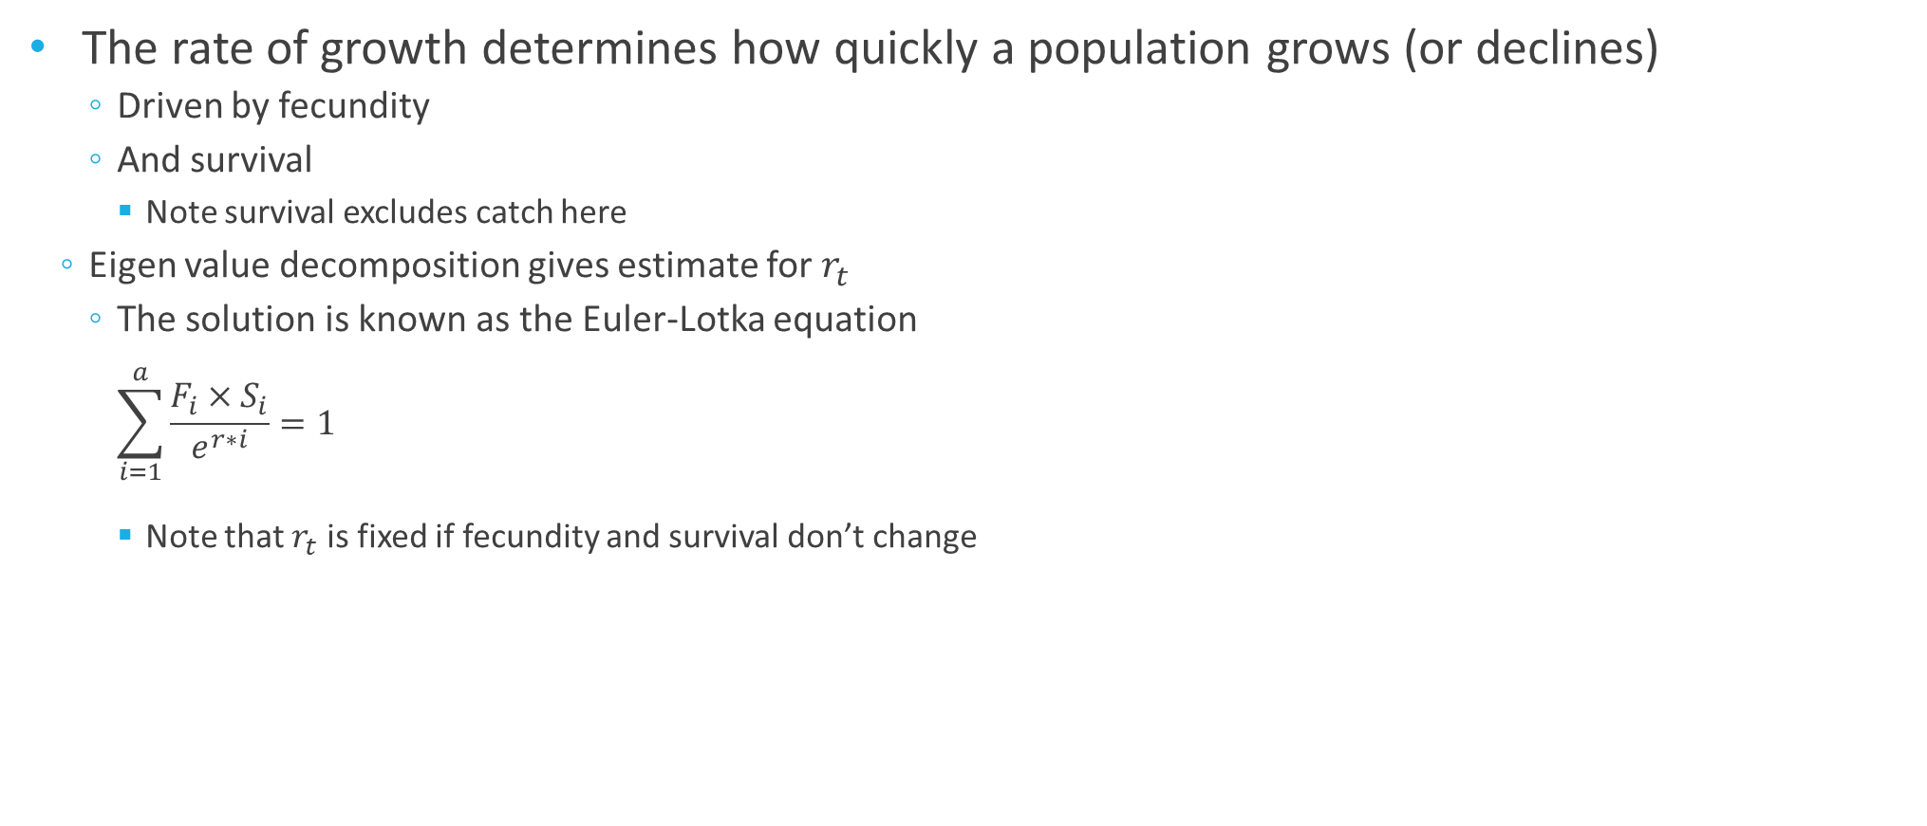
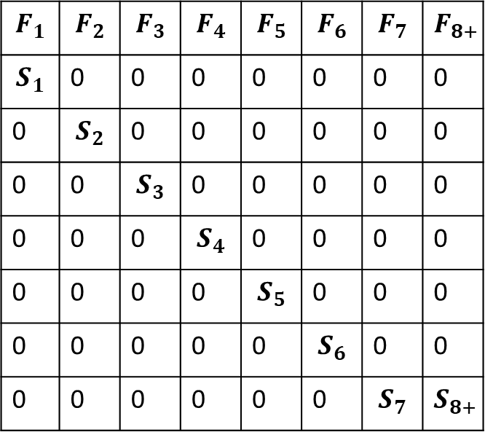
Decomposing $r_{t}$ ($N_{t}=r_{t}\left(N_{t−1}\right)+C_{t}$)
The rate of growth determines how quickly a population grows (or declines)
Driven by fecundity
And survival
Note survival excludes catch here
Eigen value decomposition gives estimate for $r_{t}$
The solution is known as the Euler-Lotka equation
$$\sum_{i=1}^{a}{\frac{F_{i}×S_{i}}{e^{r∗i}}=1}$$
Note that $r_{t}$ is fixed if fecundity and survival don’t change
$$F_{1}$$ | $$F_{2}$$ | $$F_{3}$$ | $$F_{4}$$ | $$F_{5}$$ | $$F_{6}$$ | $$F_{7}$$ | $$F_{8+}$$
$$S_{1}$$ | 0 | 0 | 0 | 0 | 0 | 0 | 0
0 | $$S_{2}$$ | 0 | 0 | 0 | 0 | 0 | 0
0 | 0 | $$S_{3}$$ | 0 | 0 | 0 | 0 | 0
0 | 0 | 0 | $$S_{4}$$ | 0 | 0 | 0 | 0
0 | 0 | 0 | 0 | $$S_{5}$$ | 0 | 0 | 0
0 | 0 | 0 | 0 | 0 | $$S_{6}$$ | 0 | 0
0 | 0 | 0 | 0 | 0 | 0 | $$S_{7}$$ | $$S_{8+}$$

Slide 10
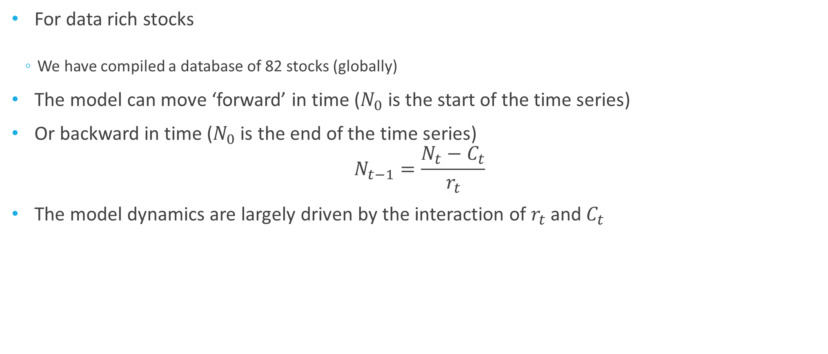
Estimating $r_{t}$ for Data Rich Stocks
For data rich stocks
We have compiled a database of 82 stocks (globally)
The model can move ‘forward’ in time ($N_{0}$ is the start of the time series)
Or backward in time ($N_{0}$ is the end of the time series)
$$N_{t−1}=\frac{N_{t}−C_{t}}{r_{t}}$$
The model dynamics are largely driven by the interaction of $r_{t}$ and $C_{t}$

Slide 11
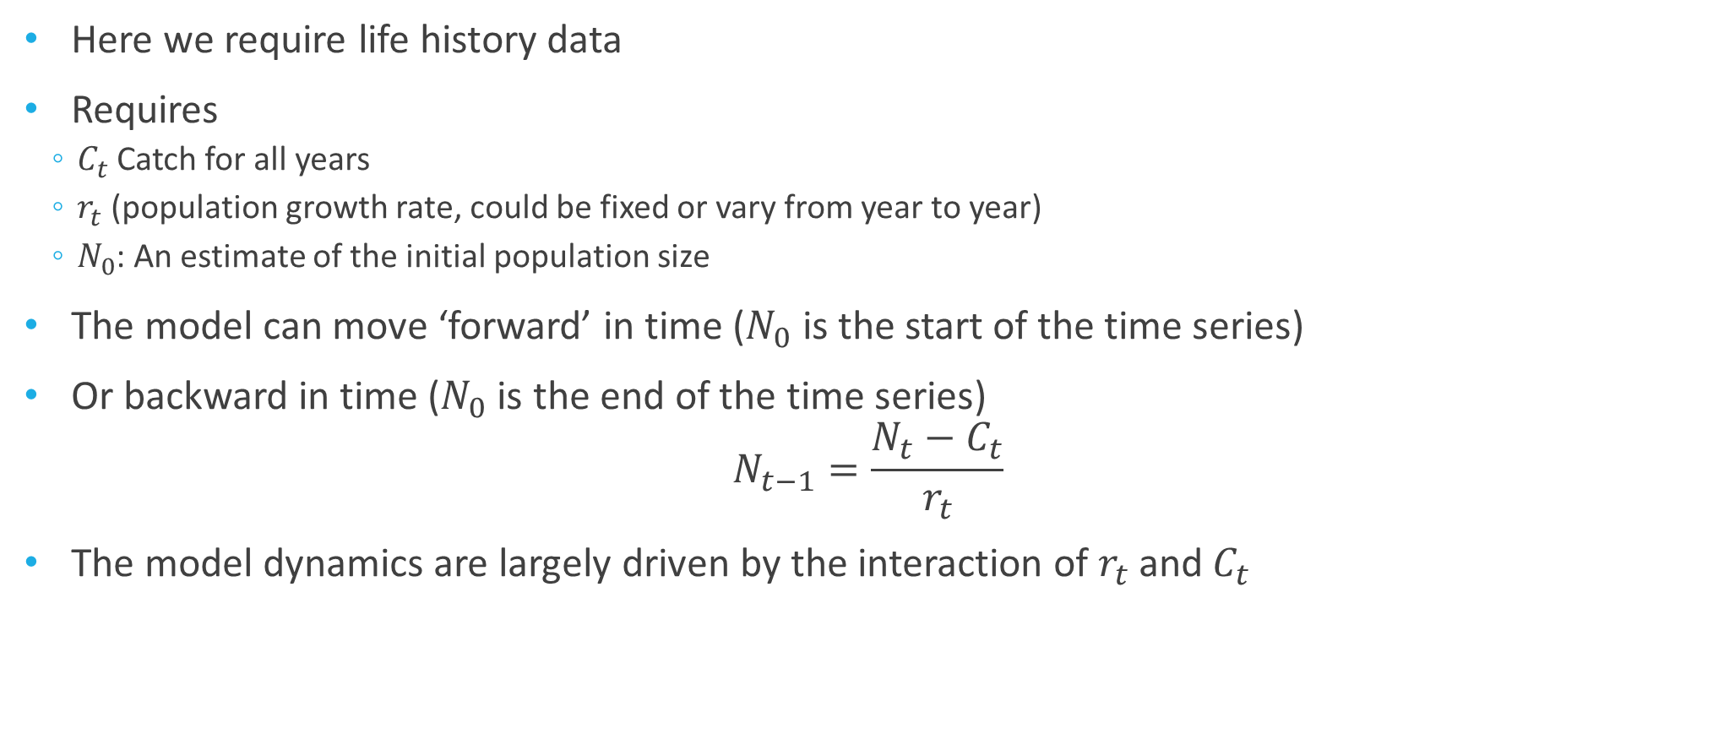
Estimating $r_{t}$ for Data Poor Stocks
Here we require life history data
Requires
$C_{t}$Catch for all years
$r_{t}$ (population growth rate, could be fixed or vary from year to year)
$N_{0}$: An estimate of the initial population size
The model can move ‘forward’ in time ($N_{0}$ is the start of the time series)
Or backward in time ($N_{0}$ is the end of the time series)
$$N_{t−1}=\frac{N_{t}−C_{t}}{r_{t}}$$
The model dynamics are largely driven by the interaction of $r_{t}$ and $C_{t}$

Slide 12
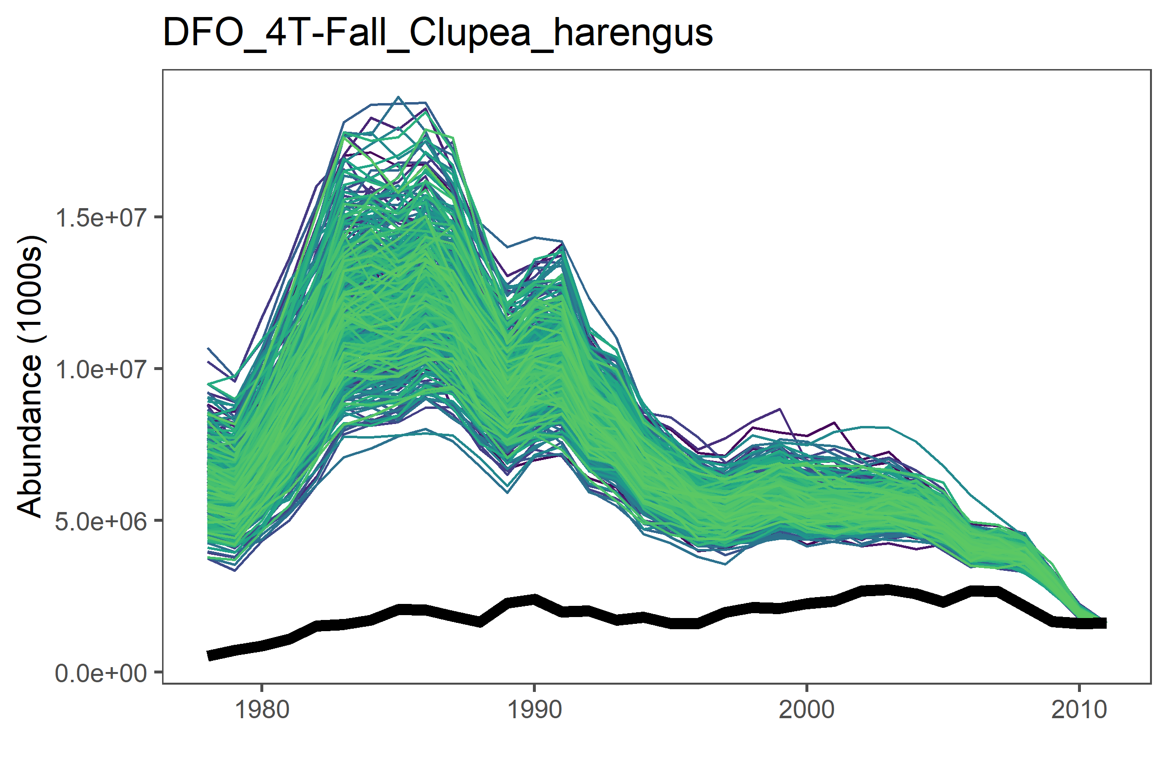
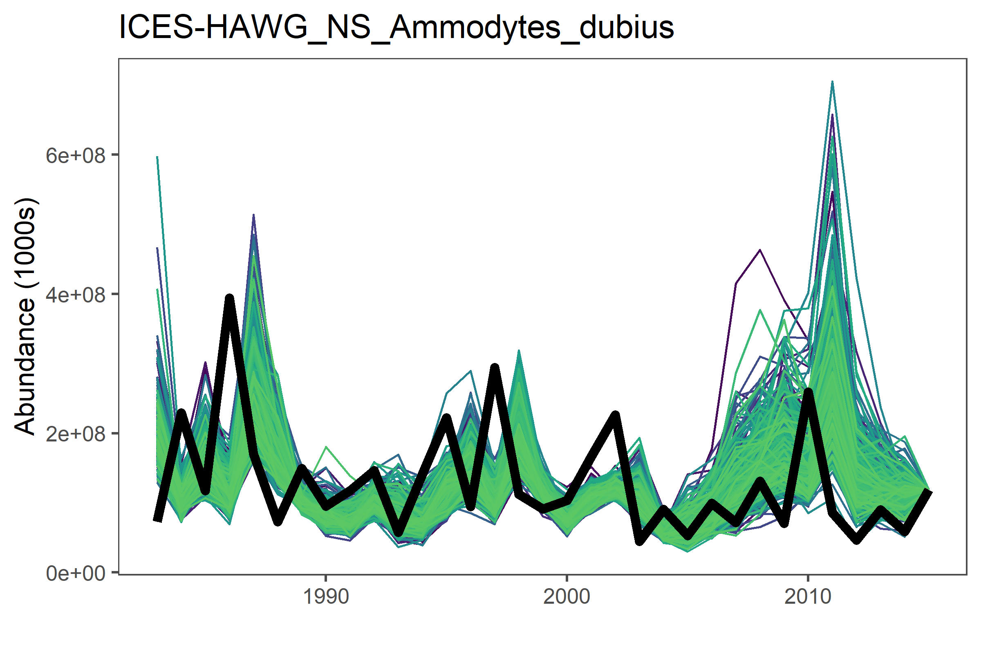
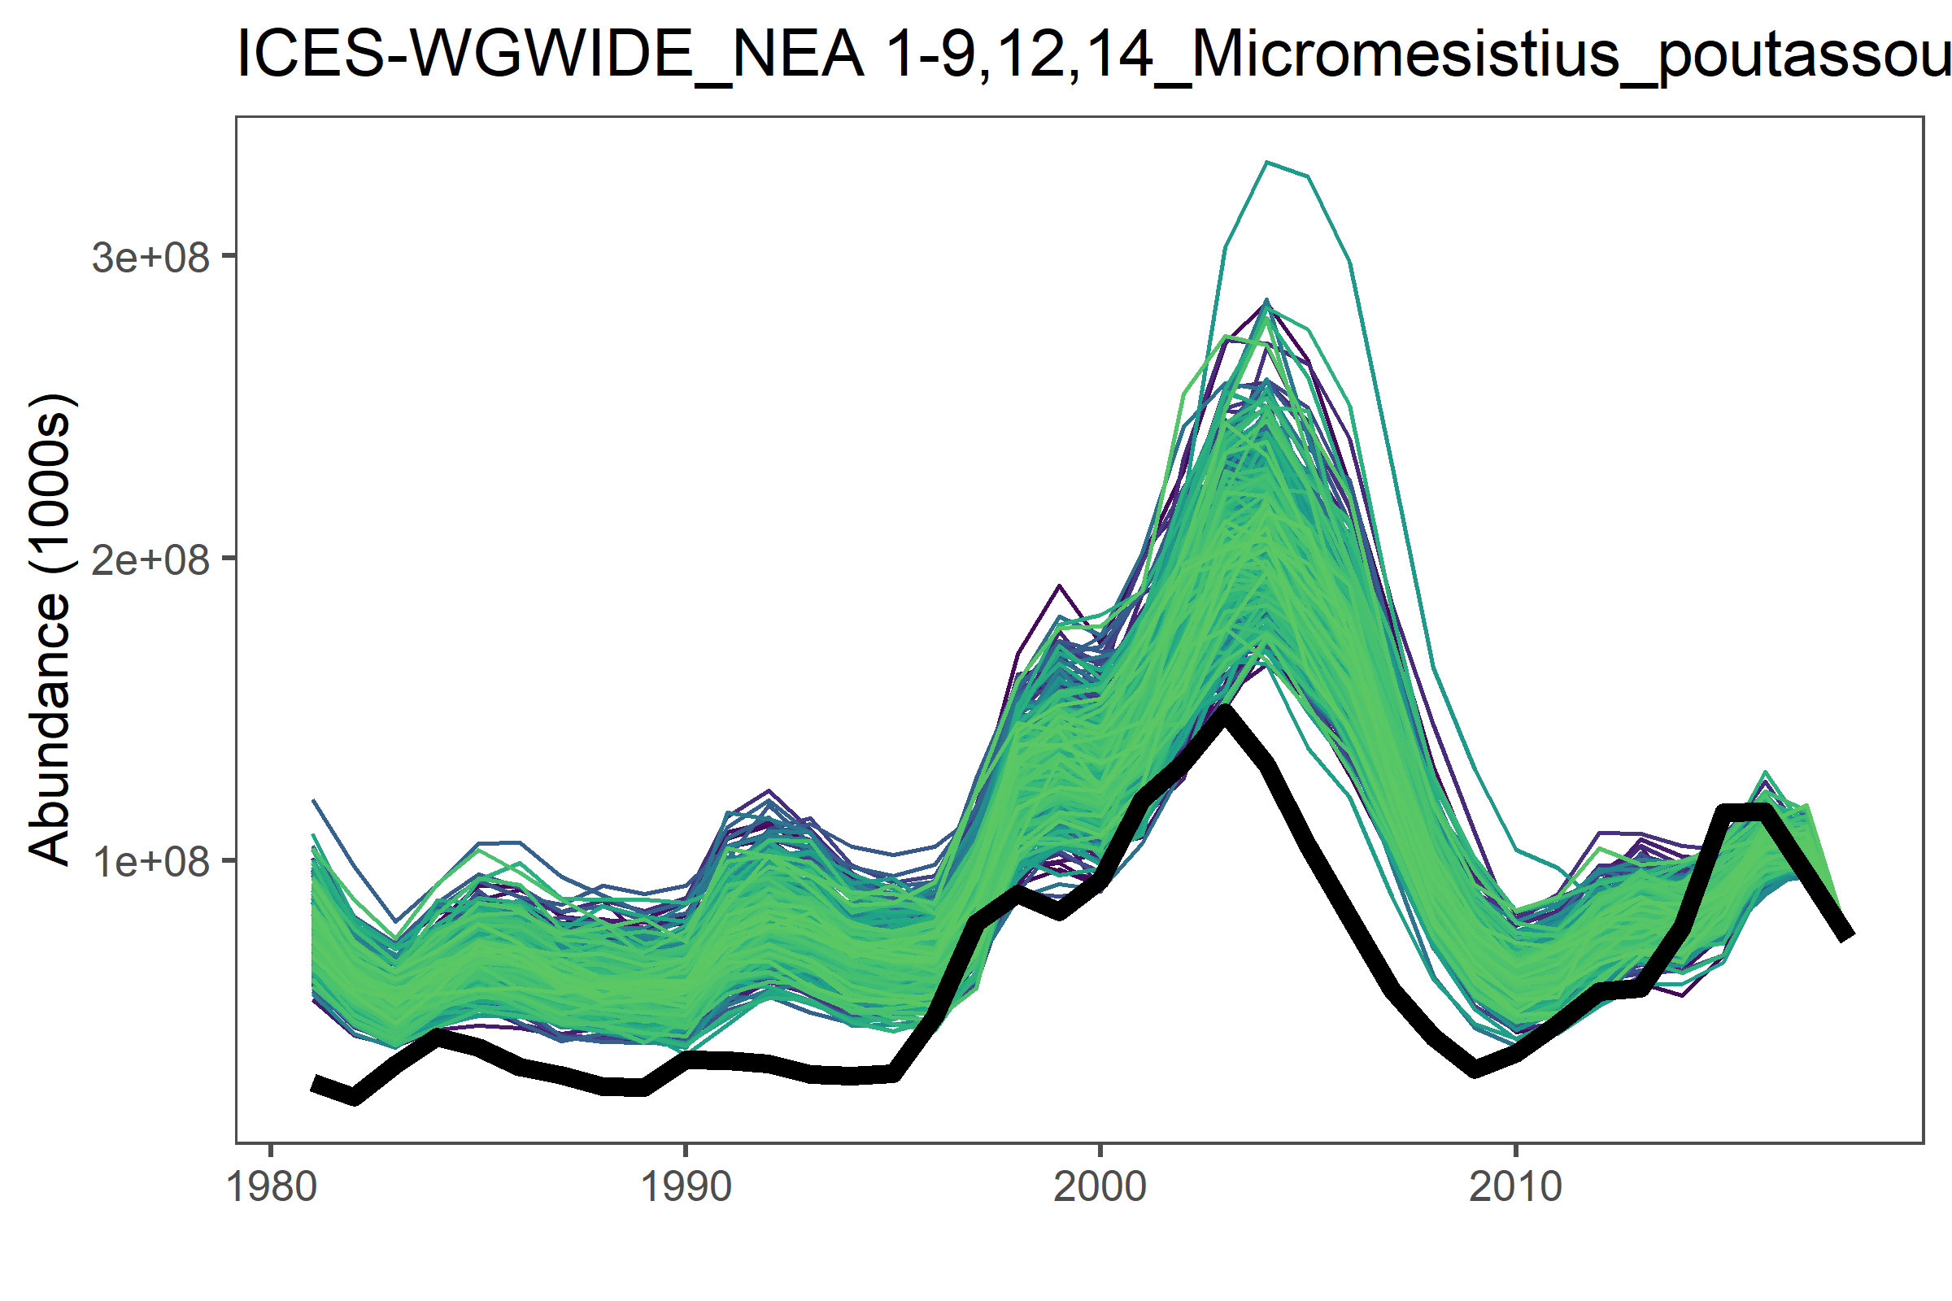
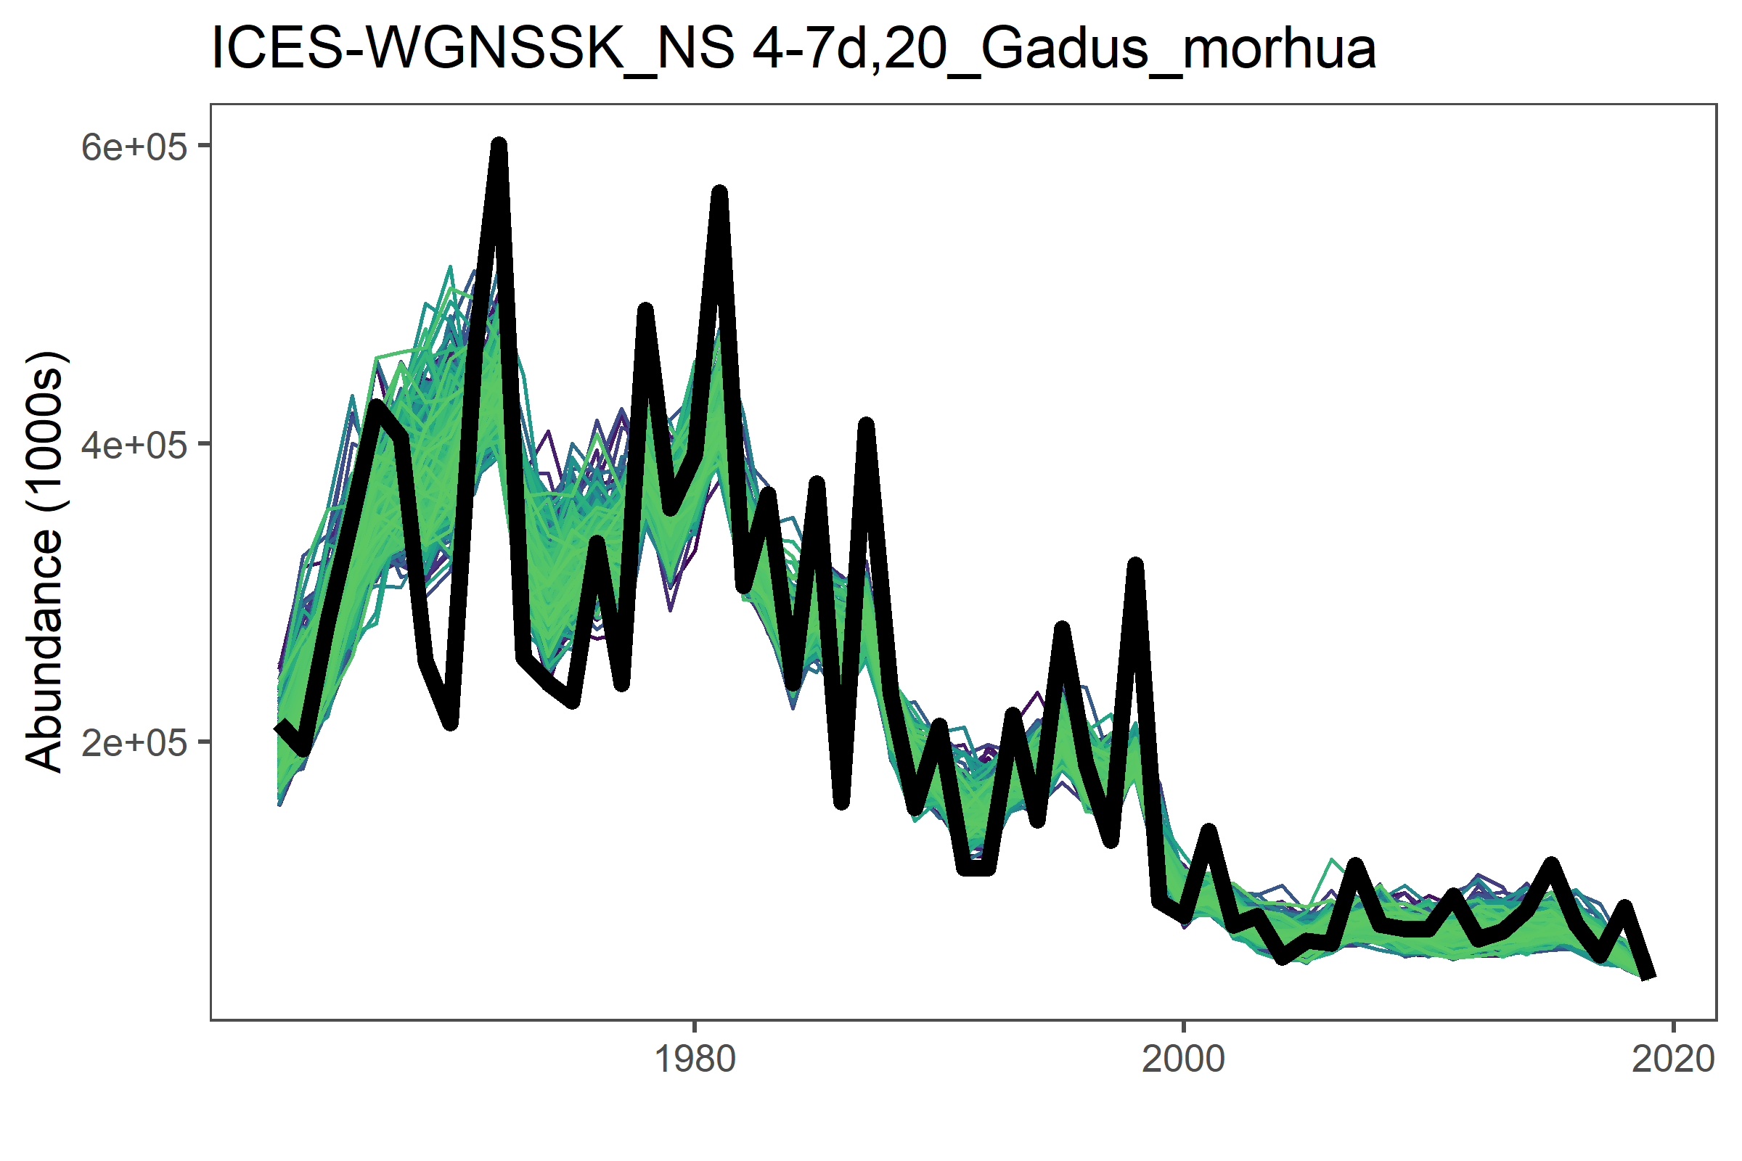
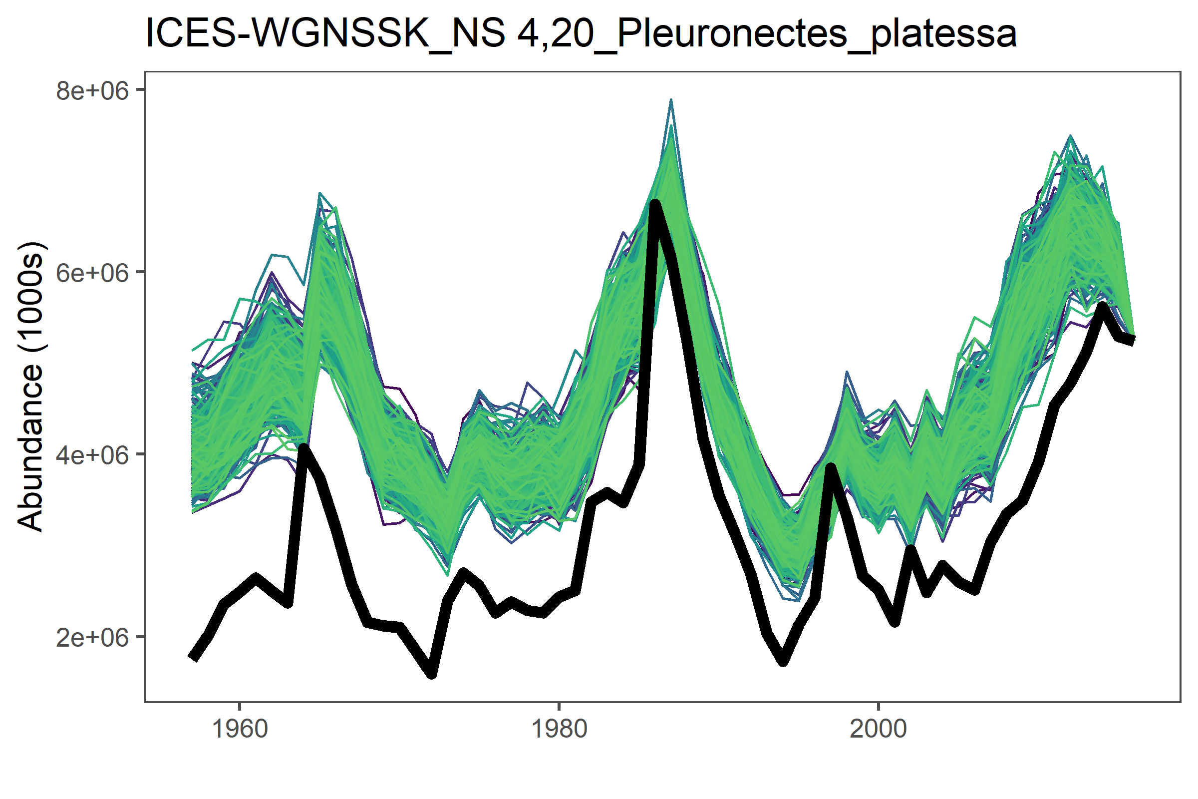
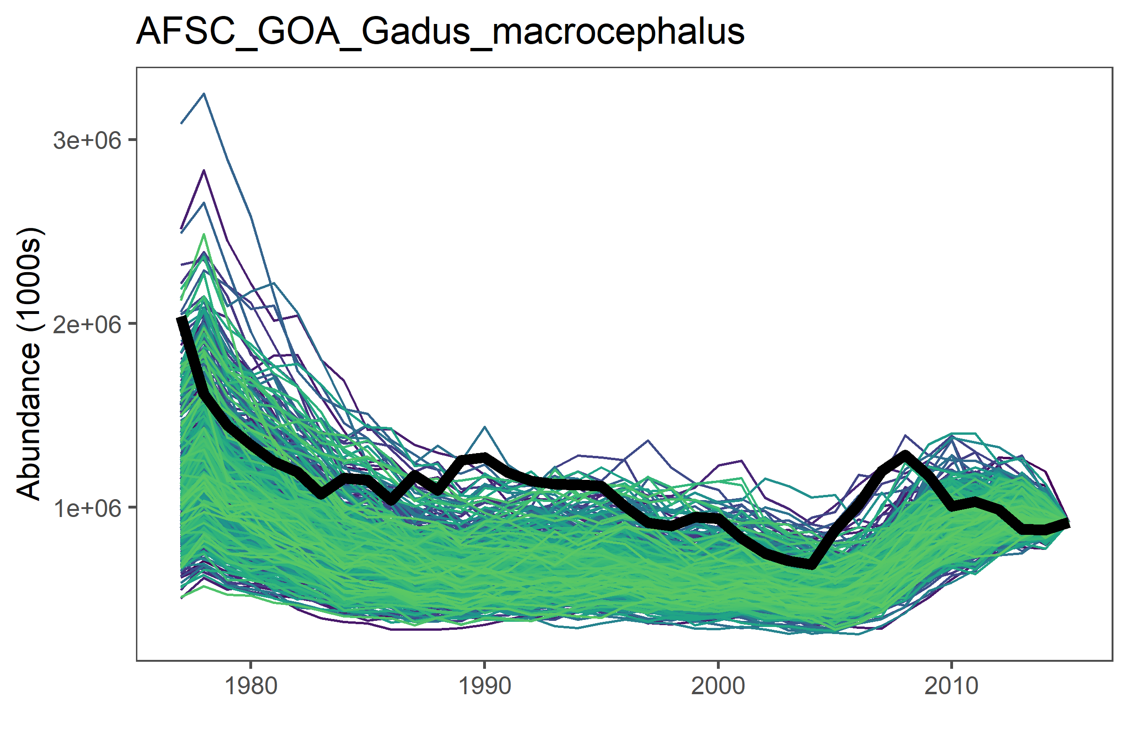
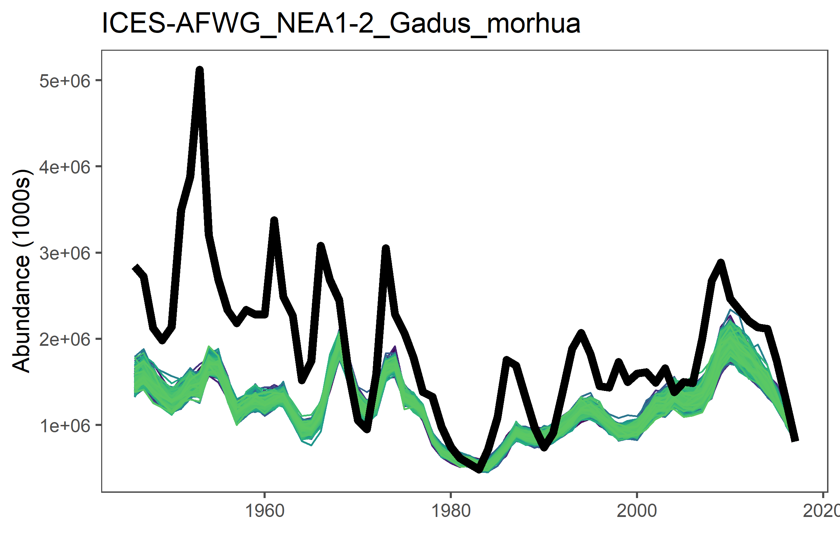
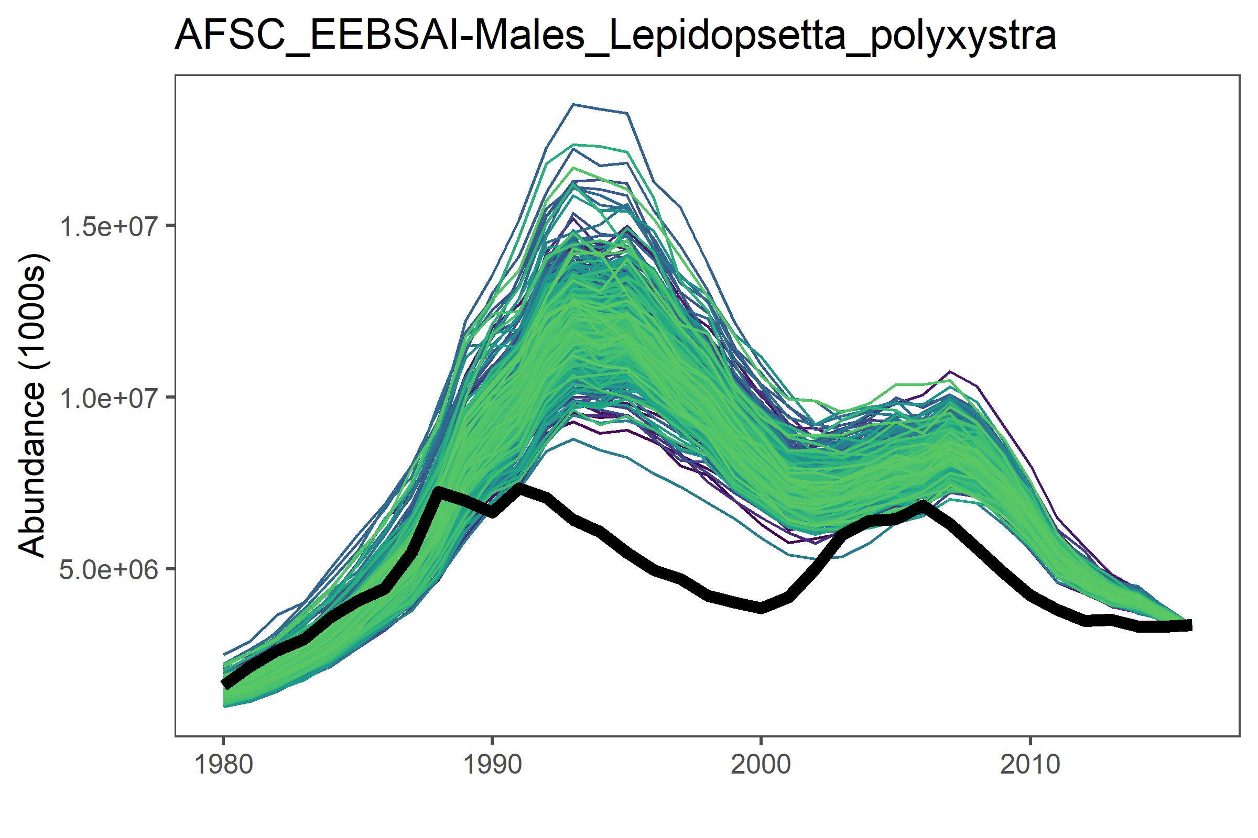
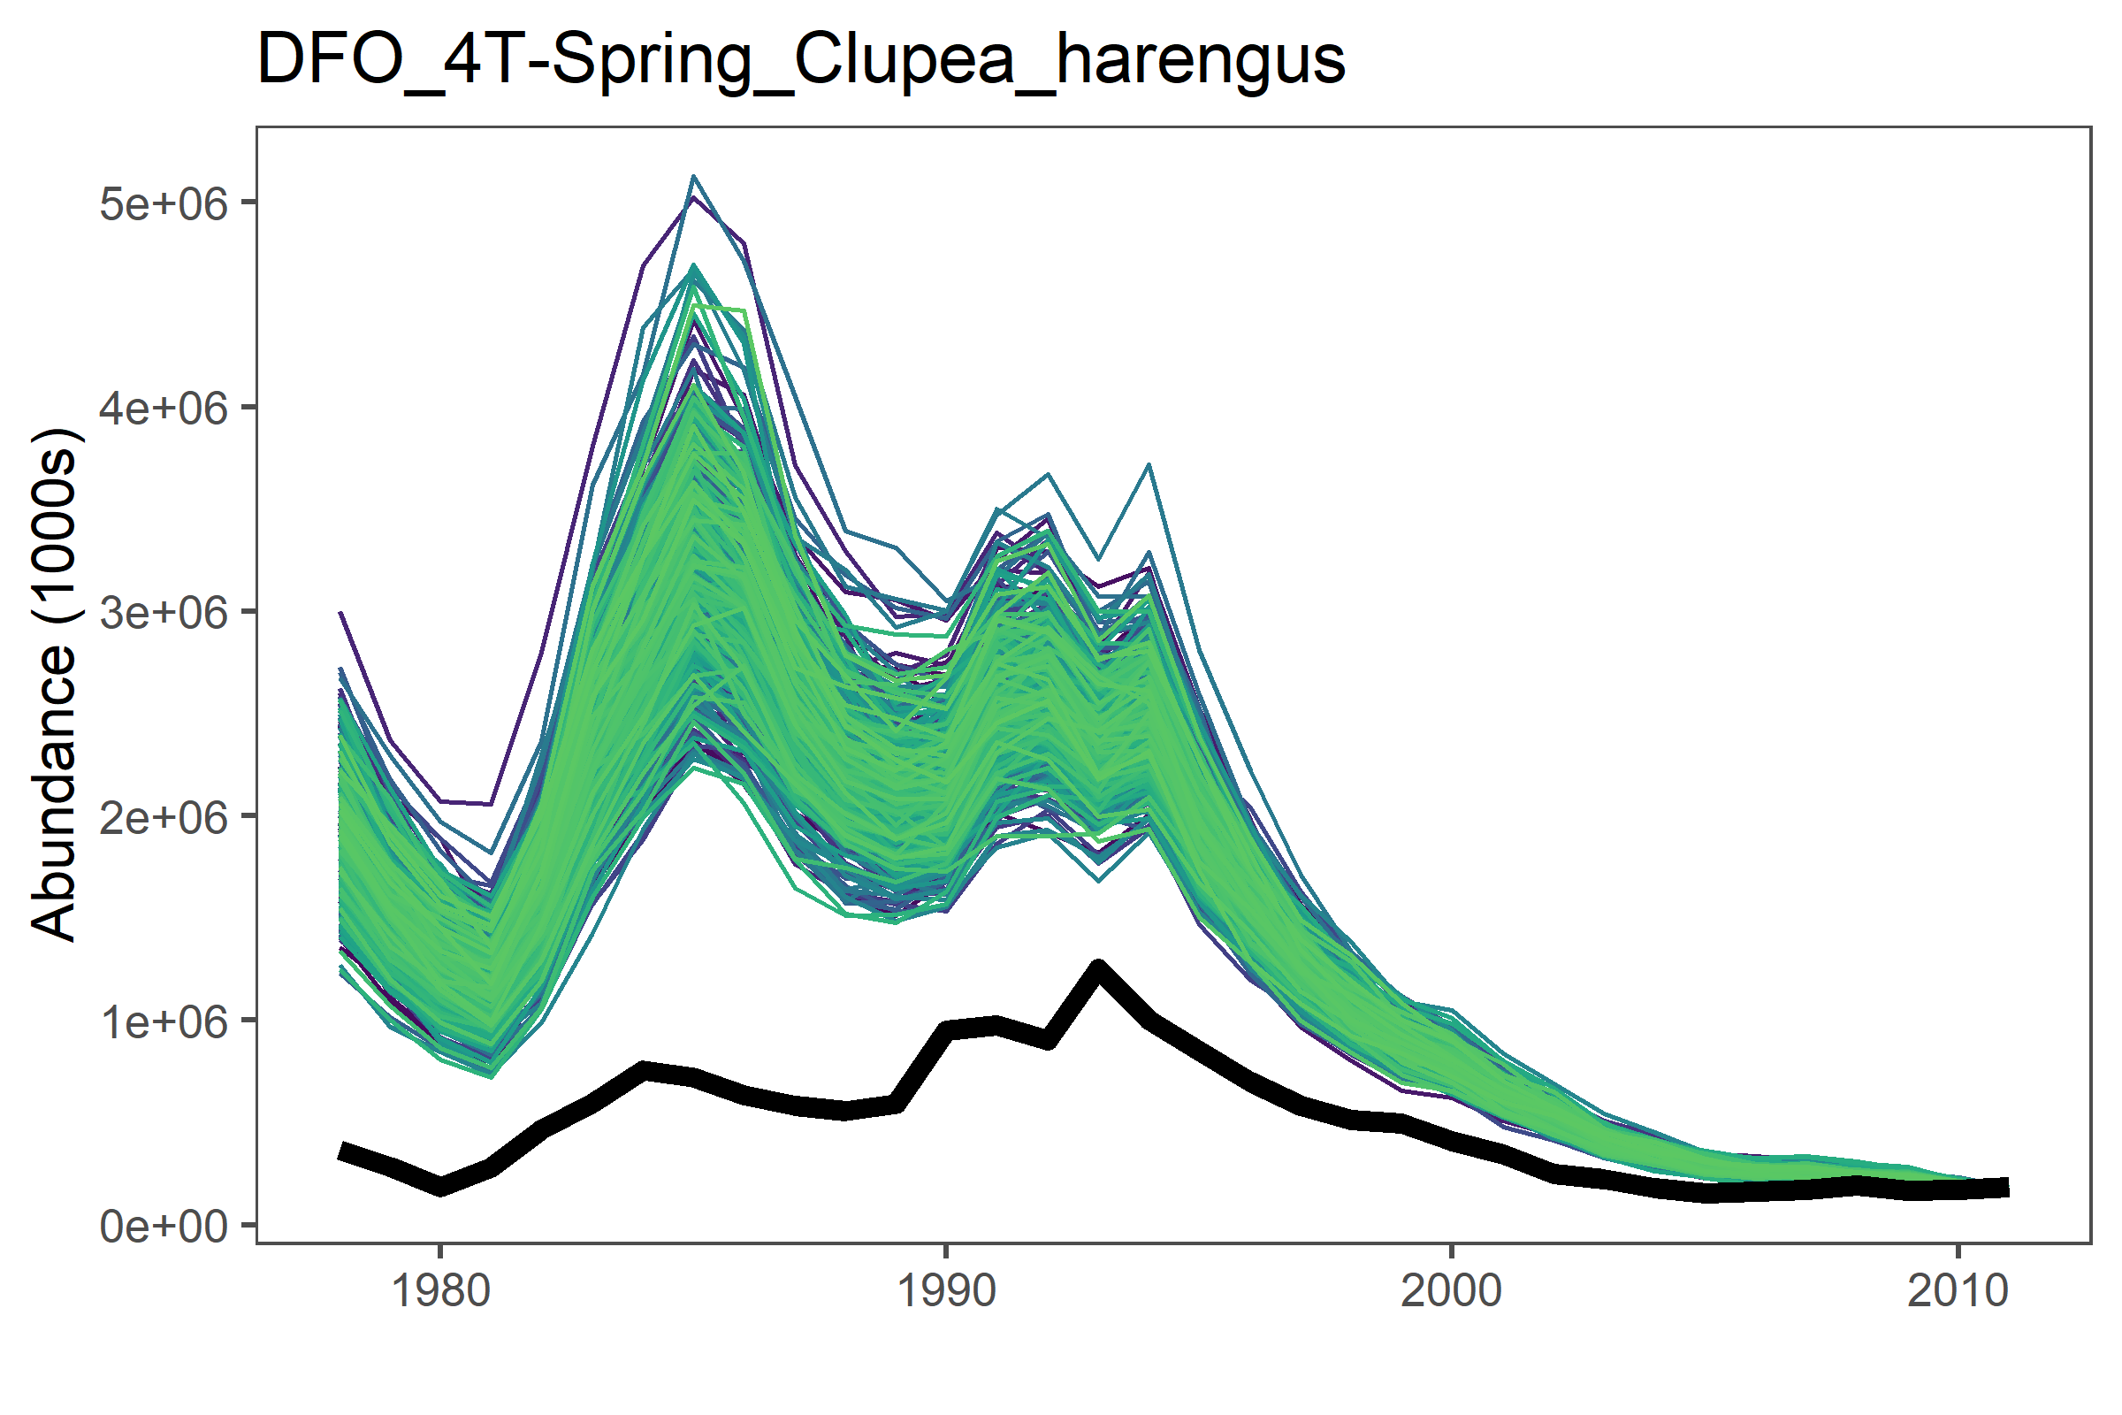
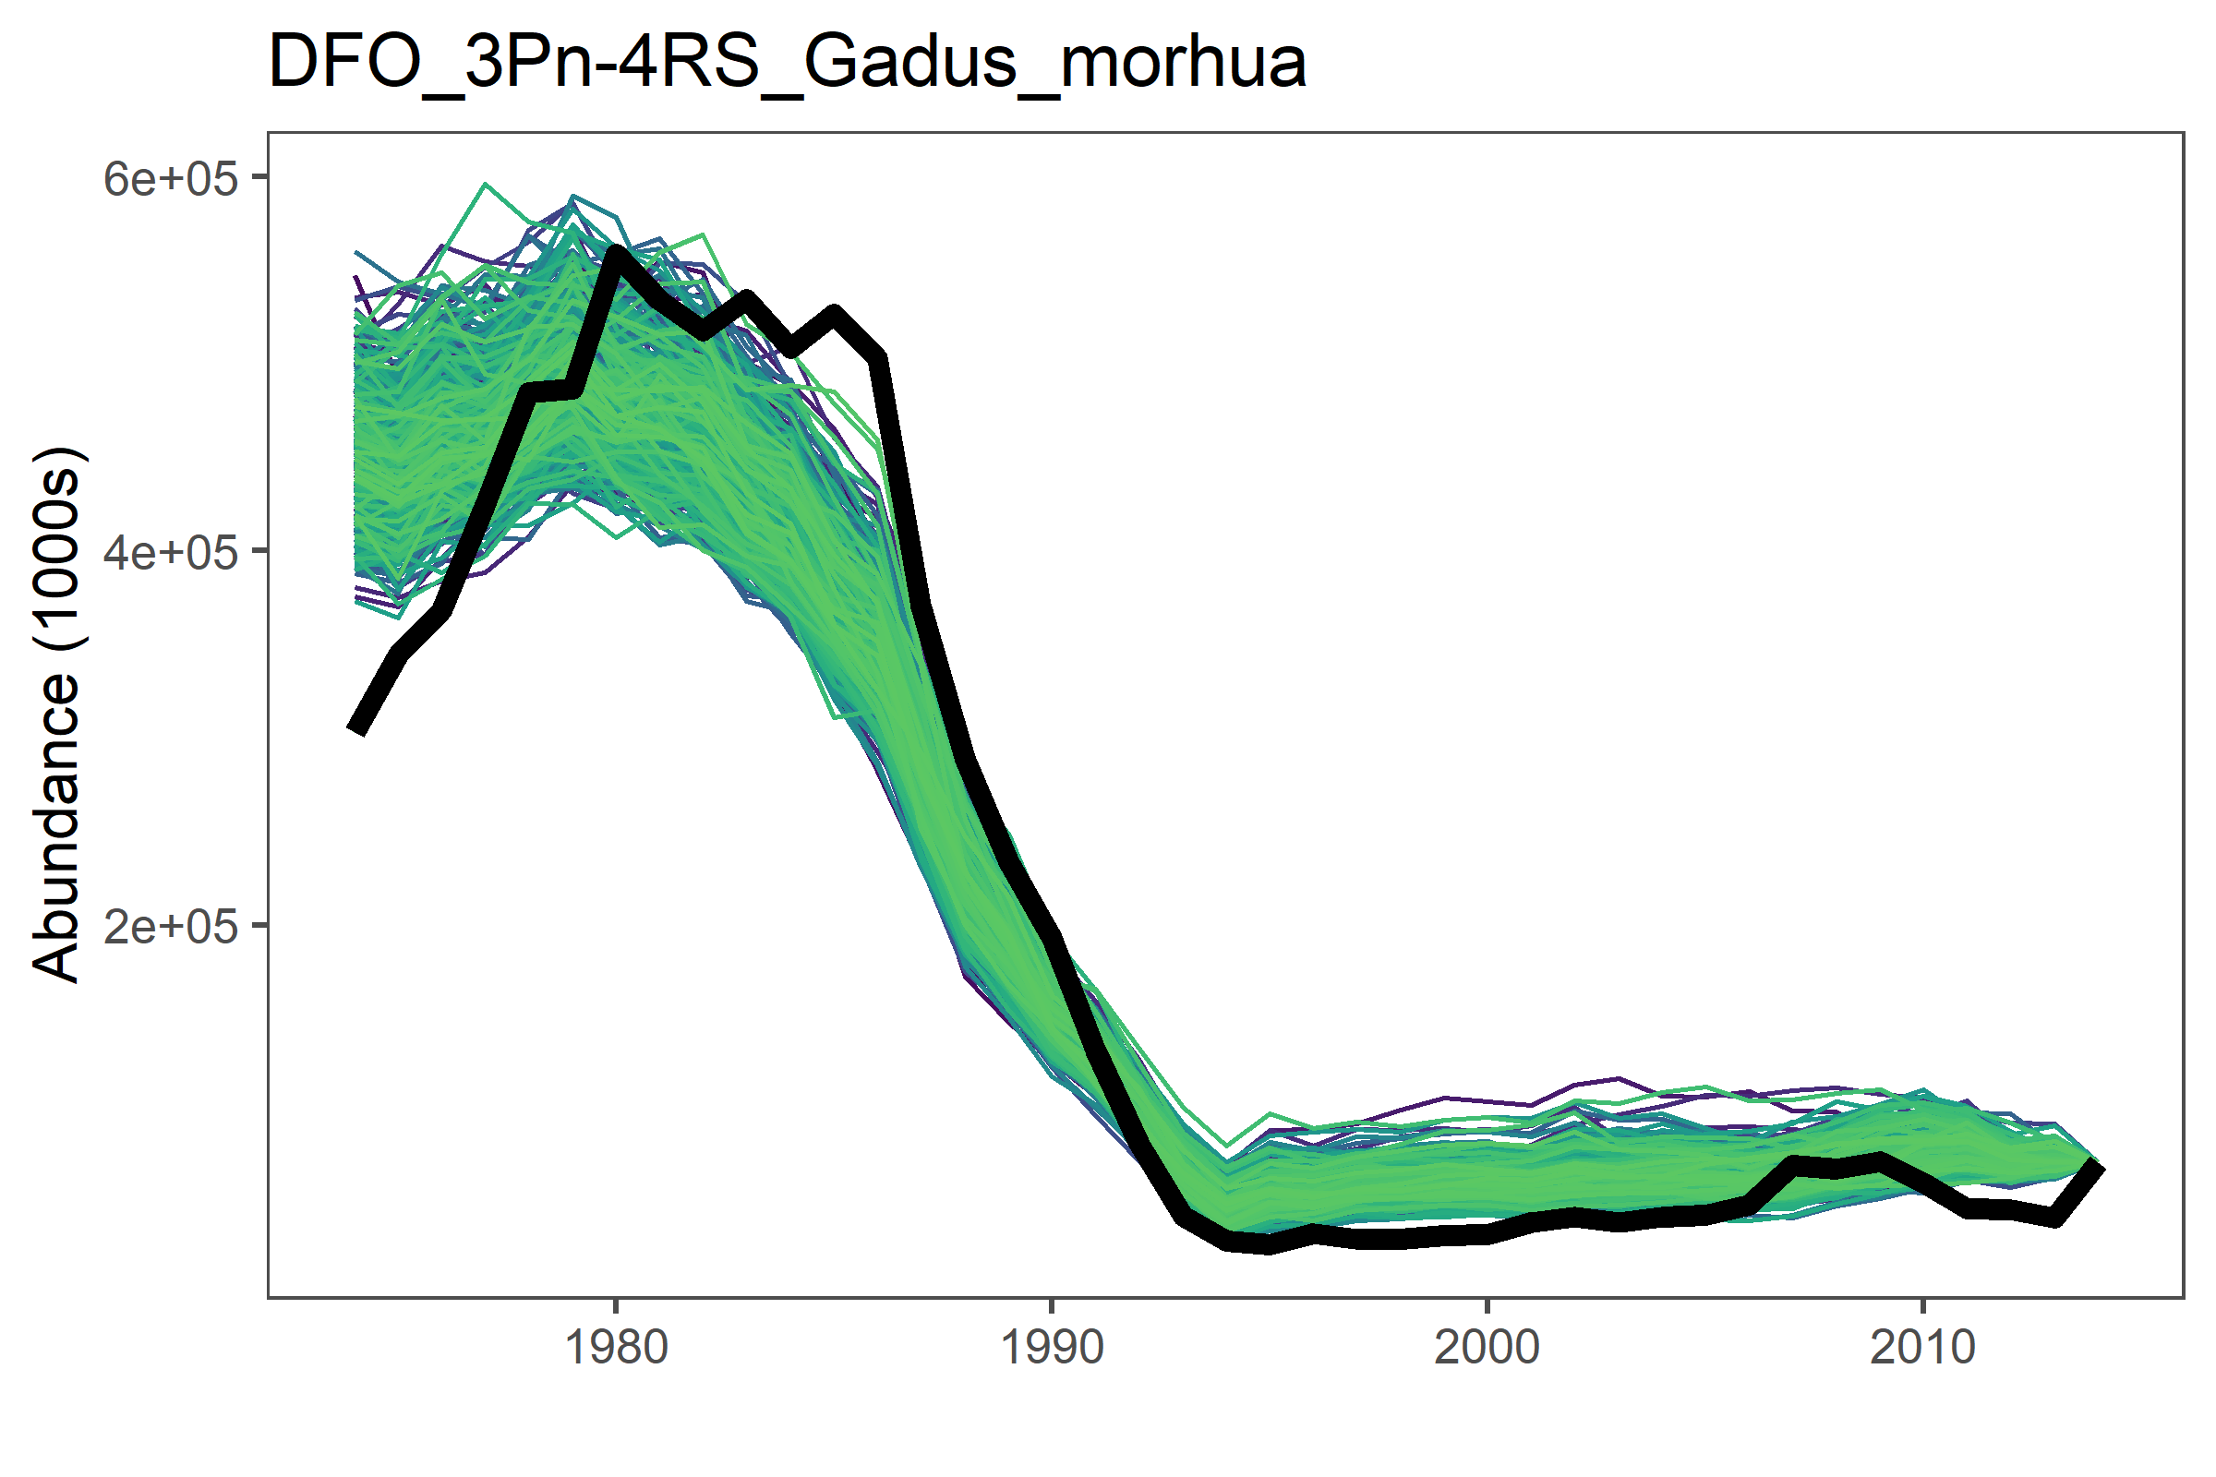
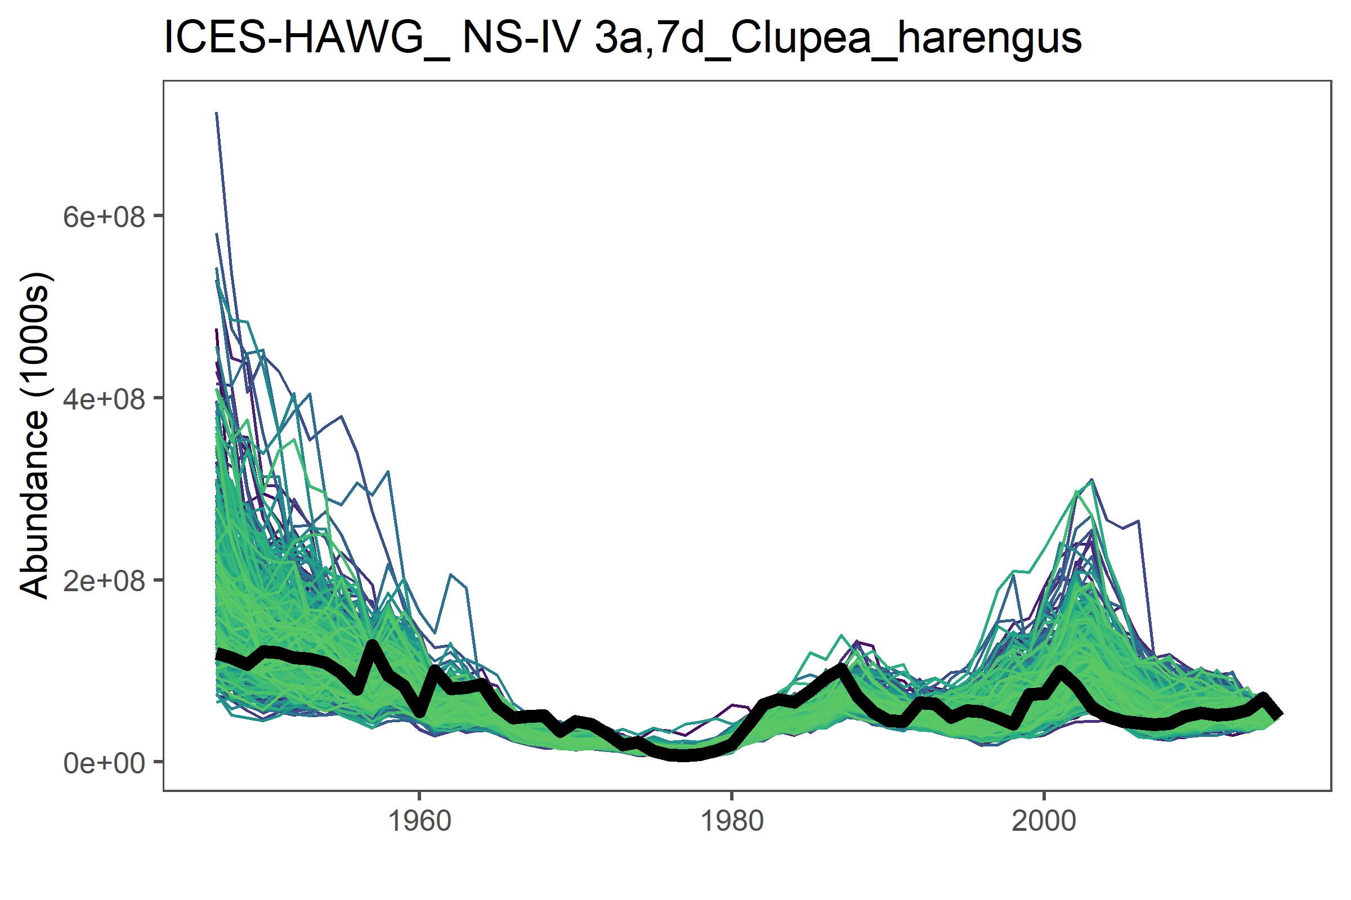
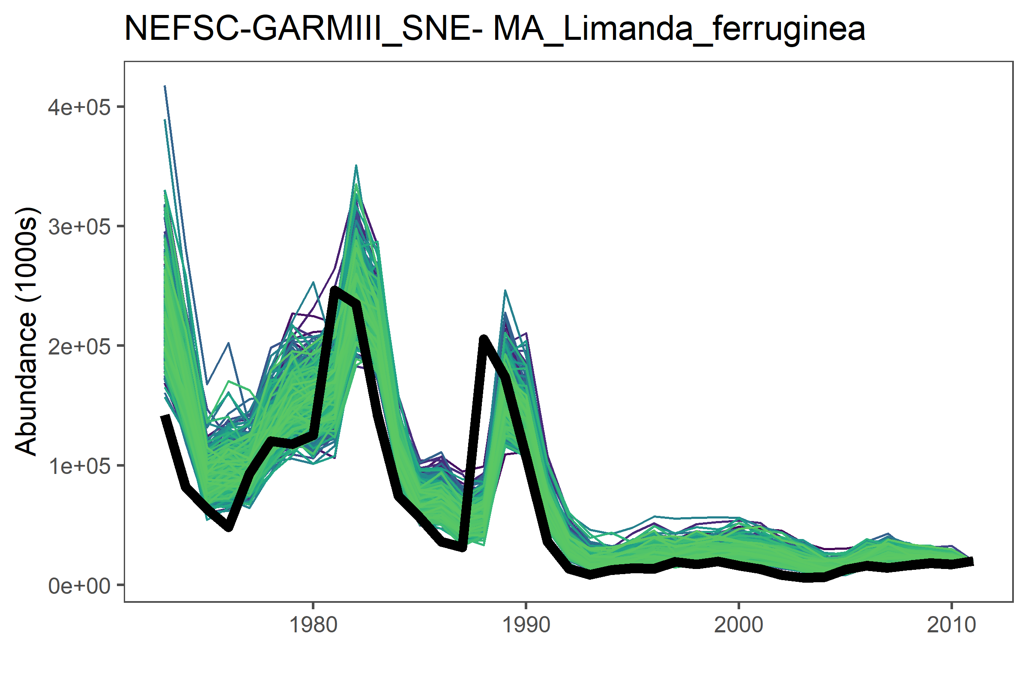
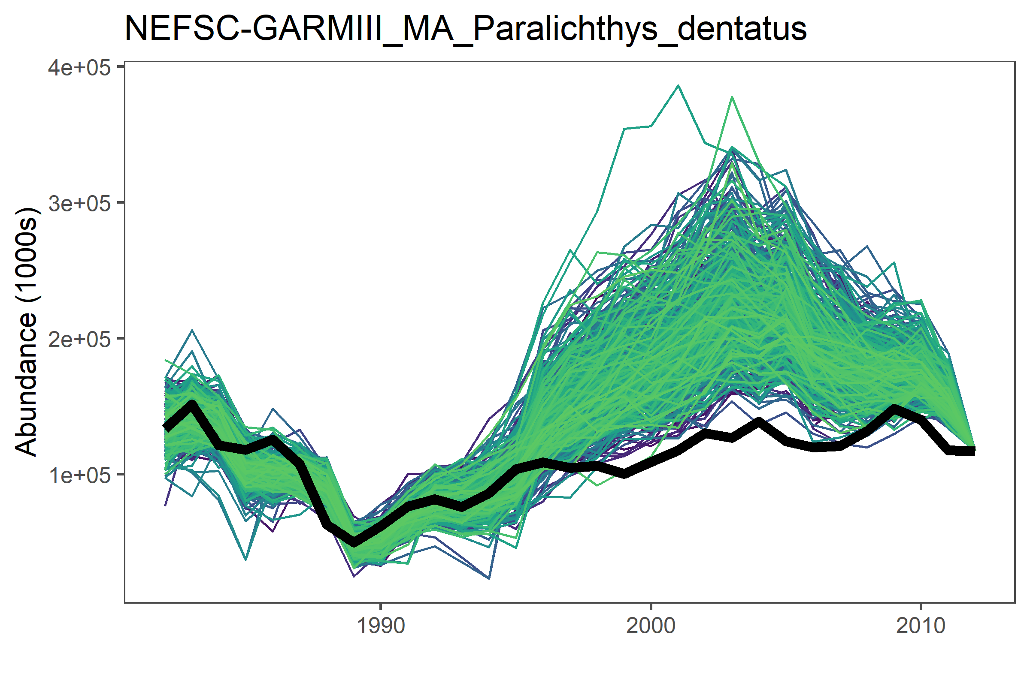
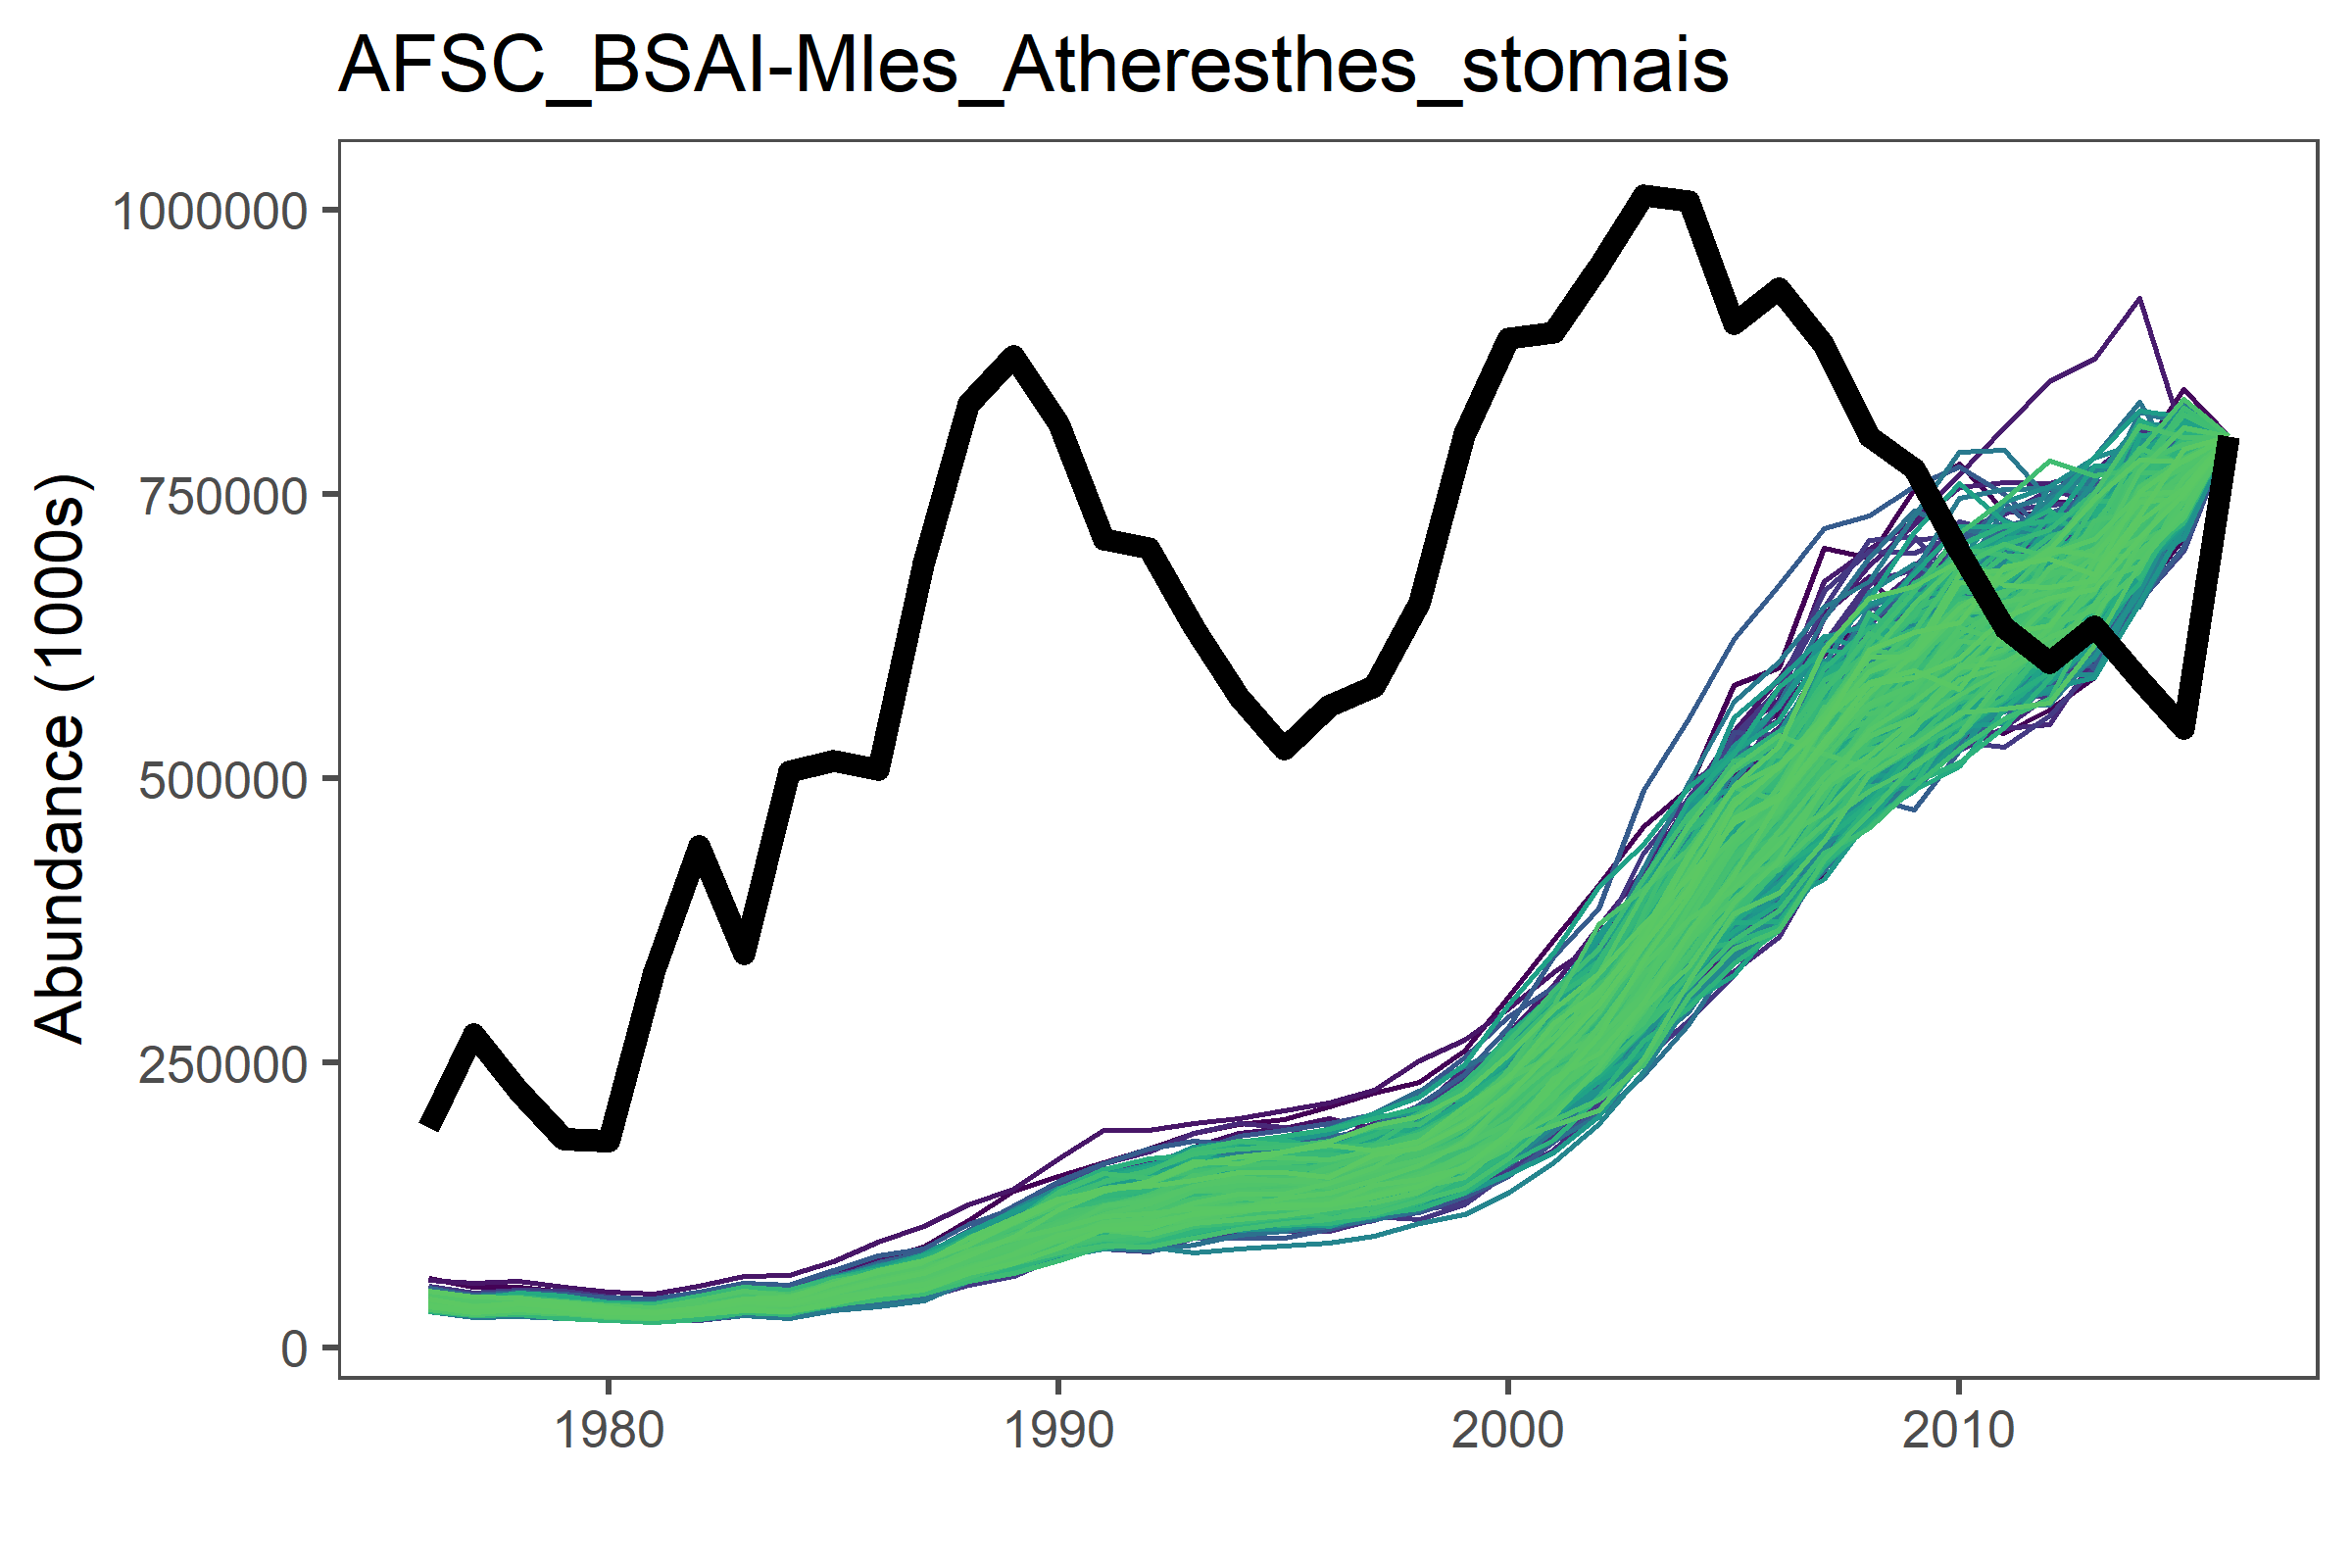
Testing ICM on Marine Fishes
We are testing the model on a Marine Fisheries Database
We have 82 data rich stocks
Method has potential…

Slide 13

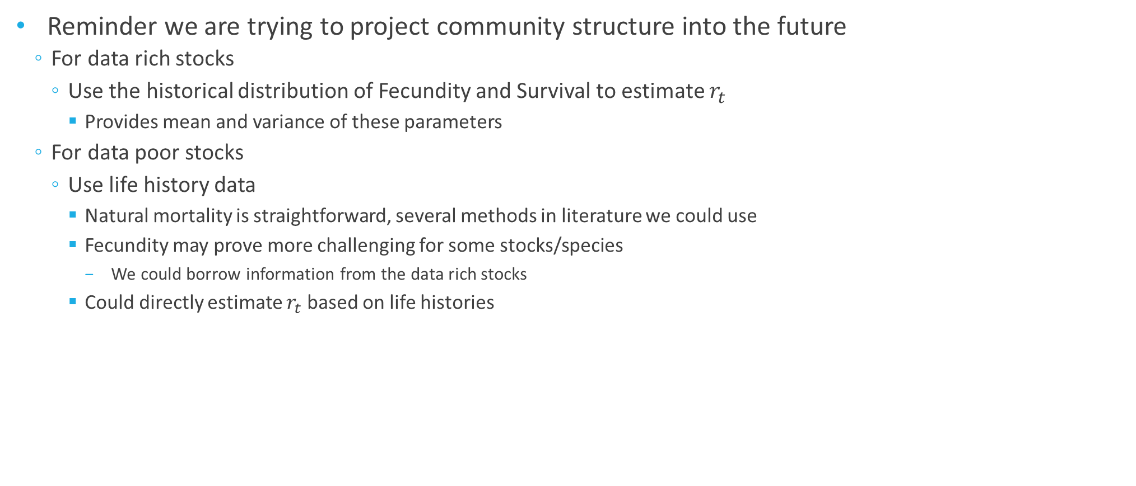
Back to the future
Reminder we are trying to project community structure into the future
For data rich stocks
Use the historical distribution of Fecundity and Survival to estimate $r_{t}$
Provides mean and variance of these parameters
For data poor stocks
Use life history data
Natural mortality is straightforward, several methods in literature we could use
Fecundity may prove more challenging for some stocks/species
We could borrow information from the data rich stocks
Could directly estimate $r_{t}$ based on life histories
$$N_{t}=r_{t}\left(N_{t−1}\right)+C_{t}$$

Slide 14
Back to the future
What about our ‘ecosystem’ and functional diversity?
Interactions between species in our ecosystem via a covariance
In this framework interactions could be done on fecundity, mortality, or r itself

Slide 15
Back to the future
What about climate change?
Again could be applied to fecundity, survival, or r
In this case a directional impact of different strength on various species

