Slide 1
T3/Tutorials
Register/Login
https://triticeaetoolbox.org/

Slide 2
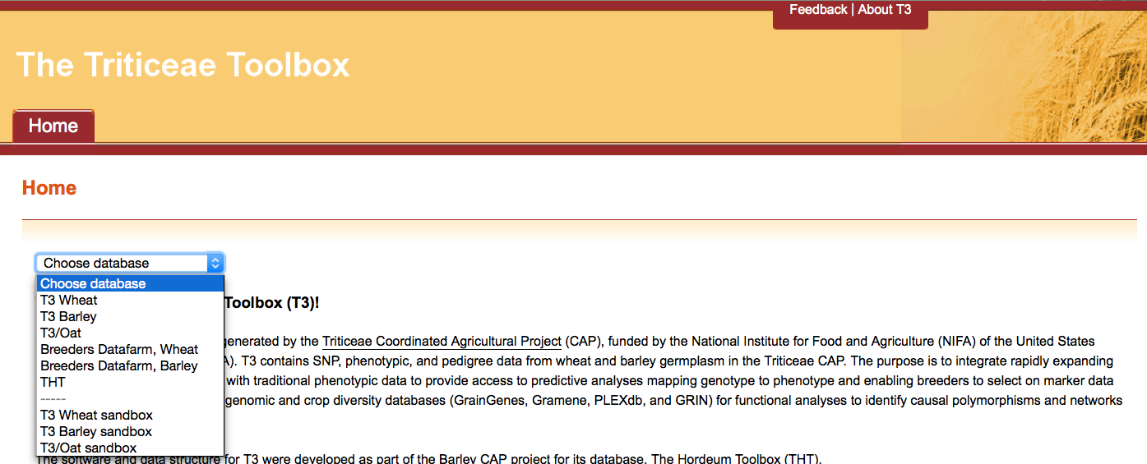
The Triticeae Toolbox (T3)
Each of the T3 databases can be reached from the T3 homepage: https://triticeaetoolbox.org
T3/Wheat will be used for demonstration purposes but these instructions are applicable to each instance of T3

Slide 3
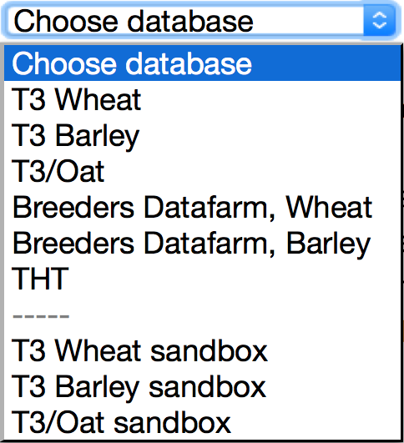
Section 4.1: Test-loading the templates
Each T3 database has a corresponding “sandbox”
Registered users can test-load data in these sandboxes
Data that is successfully uploaded to a sandbox can be submitted to the curator to be uploaded to the related production database
The production databases are the official repositories of T3 data
The sandboxes revert to an exact copy of the production databases each night

Slide 4
Register/login: Overview
Why register?
How to register
The Sandbox curate menu
Additional information

Slide 5
Section 1: Why register?
Registered users can:
Test-load data in a T3 sandbox
Submit data to the production databases
Create private germplasm line panels
Use their “current selections” from a previous session
Access data marked as private in the database

Slide 6
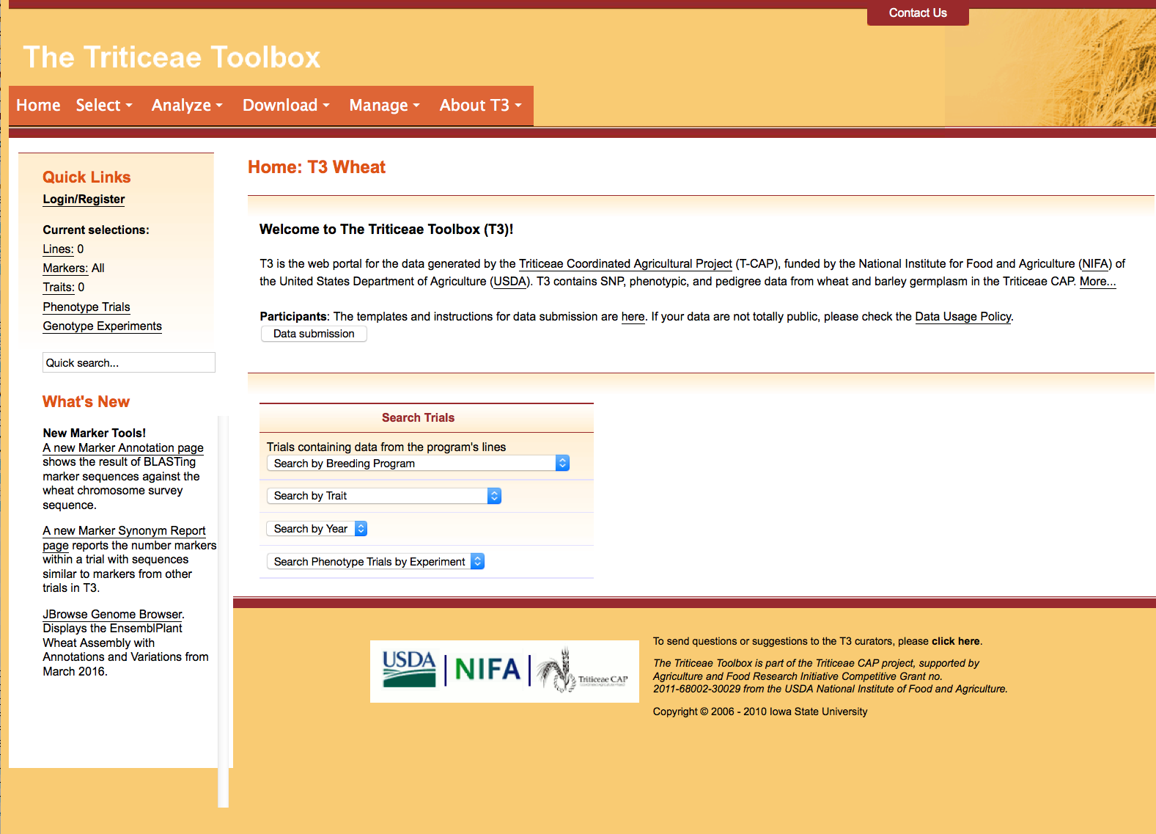
Section 2: How to register
It is necessary to register once for each T3 database you wish to use, including each of the sandboxes
Navigate to the database and click “Login/Register”

Slide 7
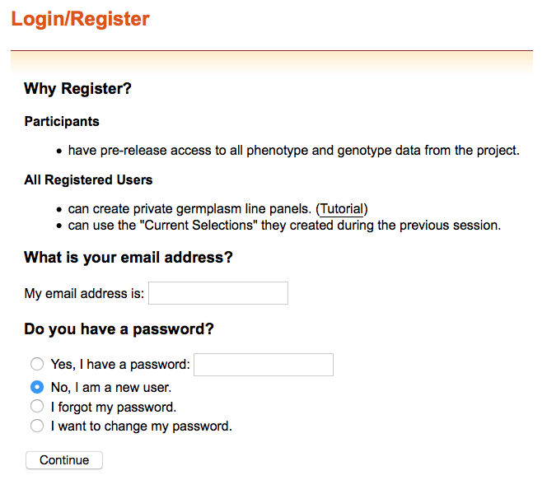
Section 2: How to register
To register as a new user, select “No, I am a new user” and then click “Continue”

Slide 8
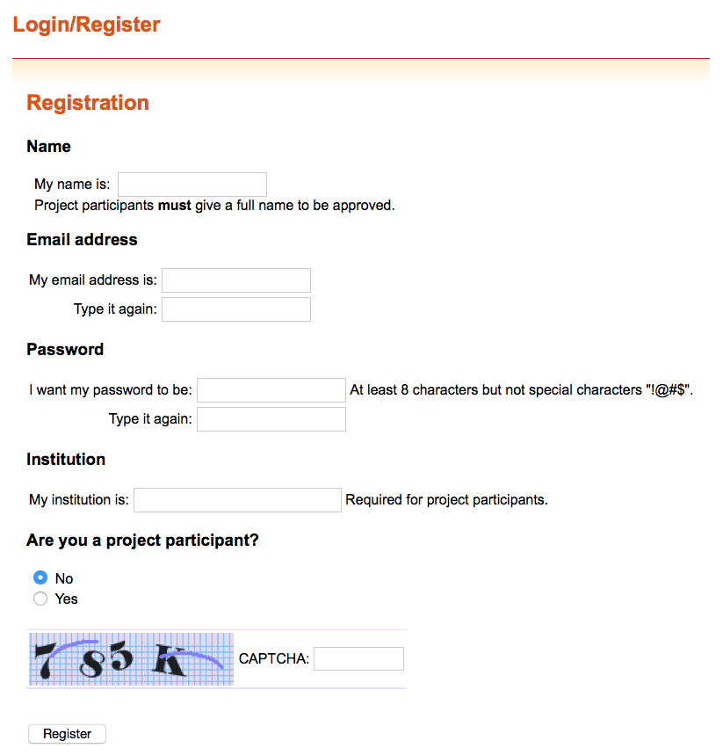
Section 2: How to register
Only users marked as project participants will be able to view data marked as private
After clicking “Register” you will receive an email that asks you to confirm your email address
This email may appear in your spam folder

Slide 9
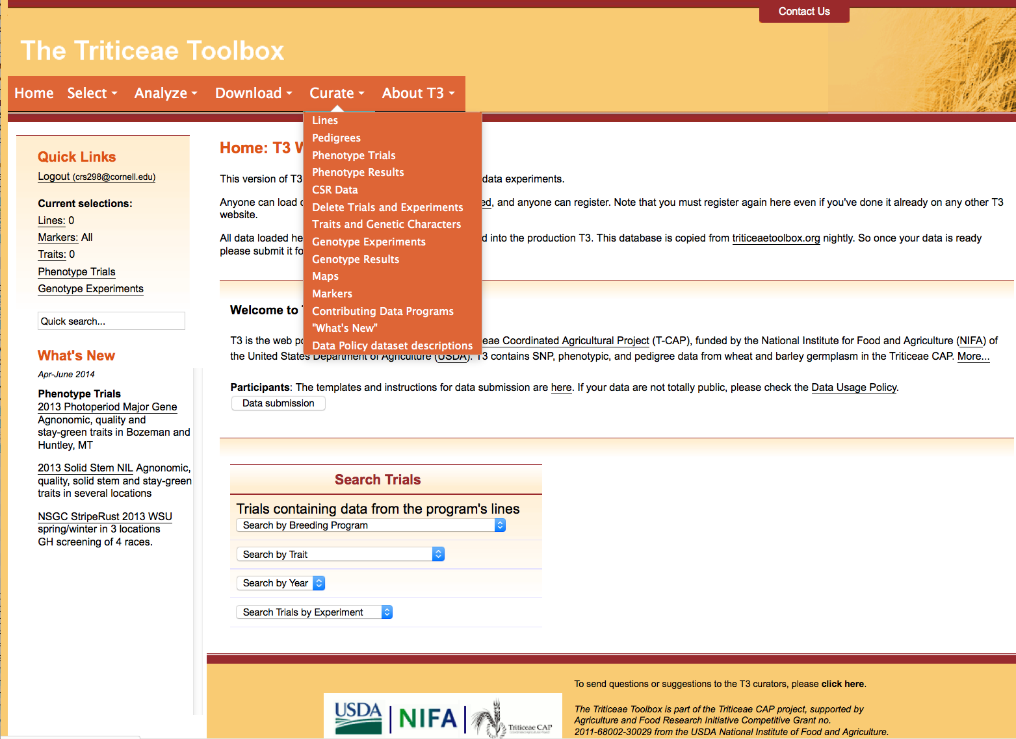
Section 3: The Sandbox curate menu
The curate menu will appear once you login to a sandbox
This additional menu provides tools for test-loading data

Slide 10
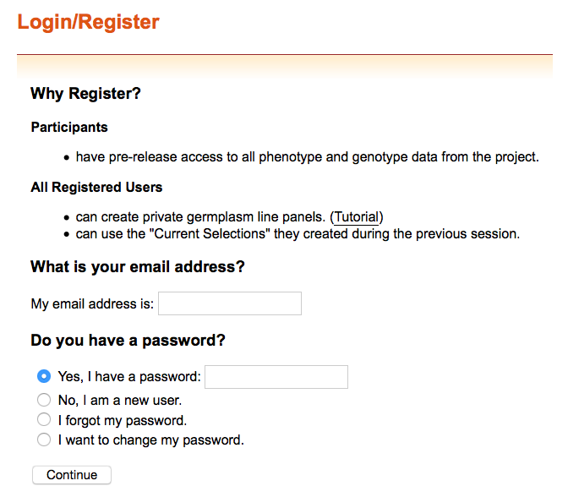
Section 4: Additional information
Your web browser may not distinguish between different T3 databases if it auto fills the email address and password fields
If you login to a second T3 database you will be logged out of the original database that you were using

Slide 11
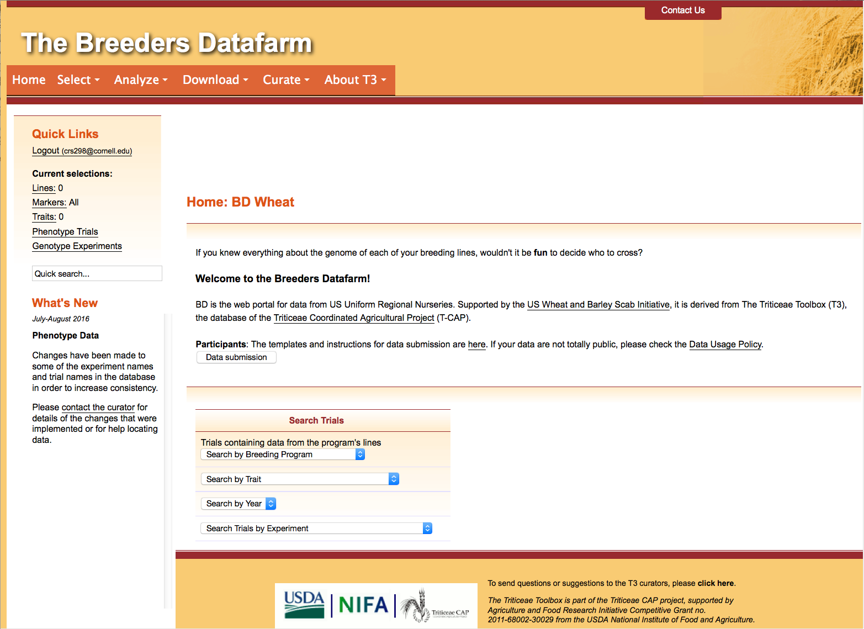
Contact Us
Please contact us if you need help using T3

