Slide 1
T3/Tutorials
Creating a line panel in T3
https://triticeaetoolbox.org/

Slide 2
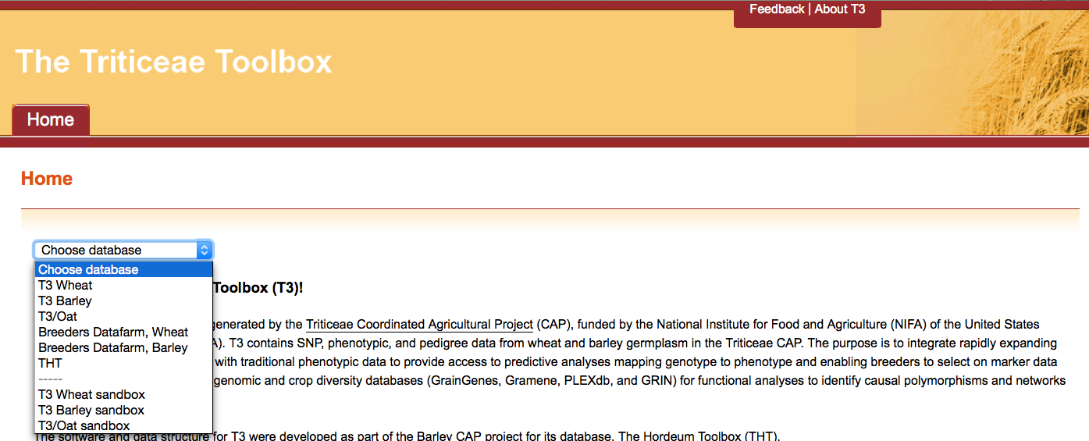
The Triticeae Toolbox (T3)
Each of the T3 databases can be reached from the T3 homepage: https://triticeaetoolbox.org
T3/Wheat will be used for demonstration purposes but these instructions are applicable to each instance of T3

Slide 3
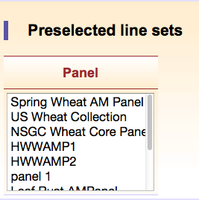
T3 line panels
A line panel is a set of preselected lines that helps to make data selection in T3 easy
Each T3 database has a selection of public line panels
Registered users can create their own private line panels
Custom line panels are saved between T3 sessions
Private line panels can be made public upon request

Slide 4
Creating a line panel in T3: Outline
Register/login
Selecting T3 lines
Creating a line panel
Selecting a line panel
Deleting or modifying a custom line panel

Slide 5
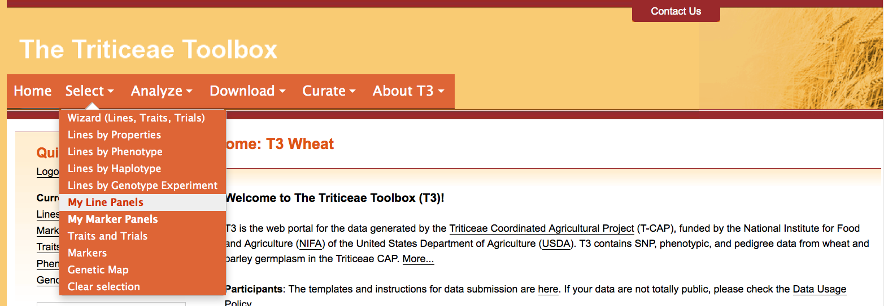
Section 1: Register/login
Navigate to the T3 database homepage of your choice
e.g. https://triticeaetoolbox.org/wheat/
Register and login to view additional items in the Select menu
My Line Panels
My Marker Panels

Slide 6
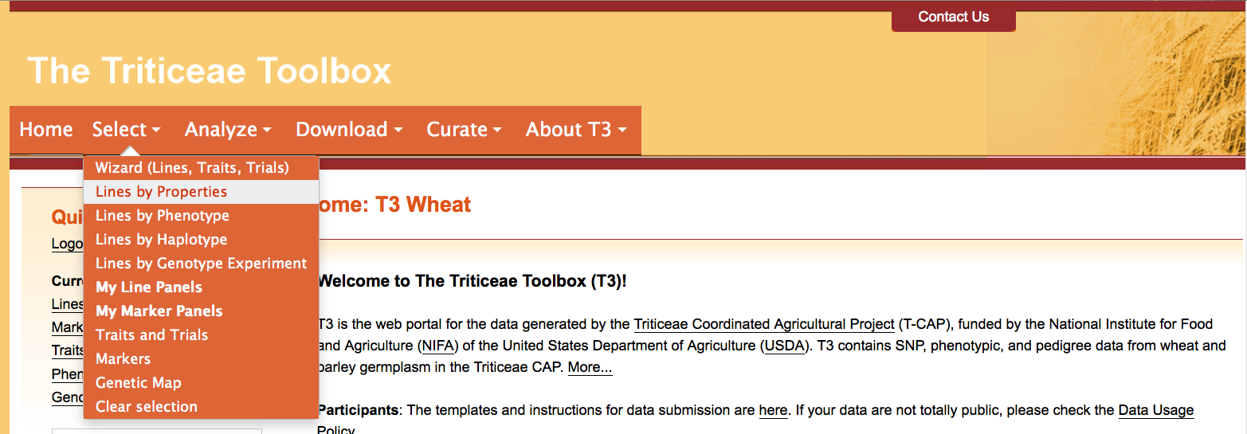
Section 2: Selecting T3 lines
First select the lines that you want to form your custom line panel using one of the T3 line selection tools
e.g. Select menu > Line by Properties

Slide 7
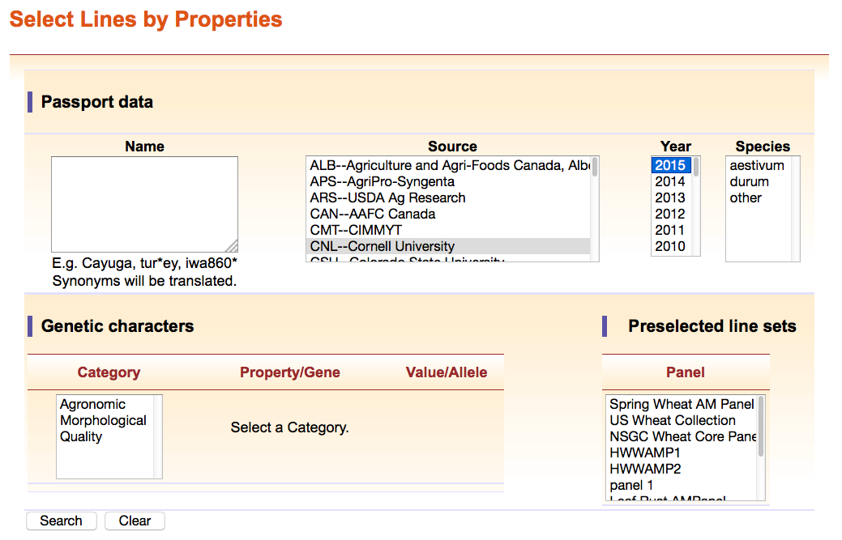
Section 2: Selecting T3 lines
For example, germplasm lines developed by Cornell University that were tested in trials in 2015

Slide 8
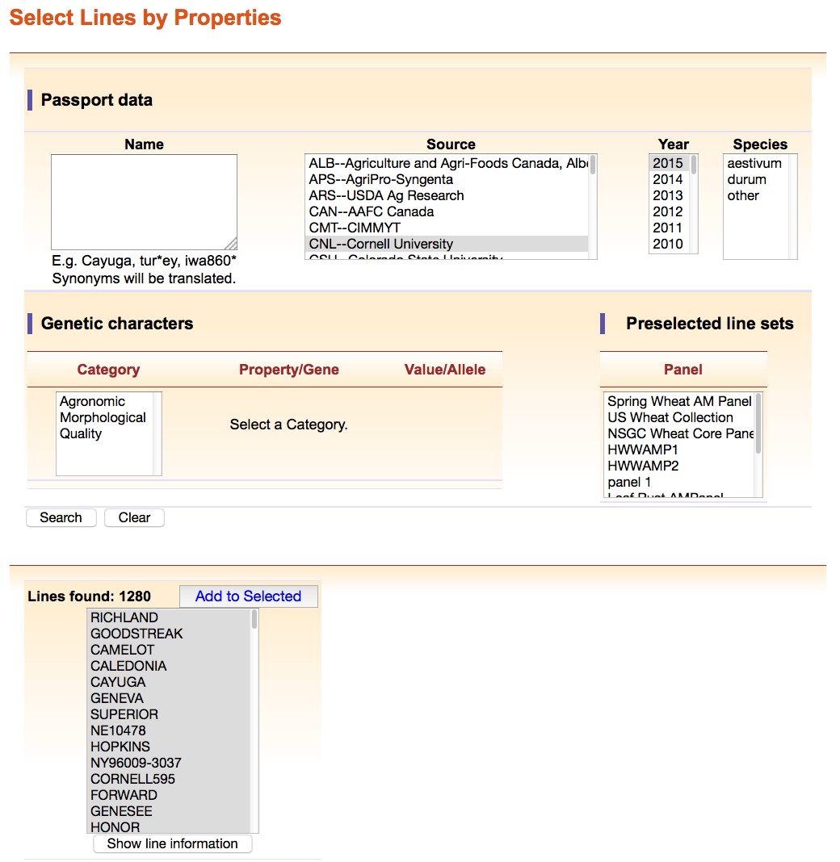
Section 2: Selecting T3 lines
This search generated 1280 line results
“Add to Selected” if you wish to continue with your selection
Be sure to “Clear” your selections if you want to make a completely new selection

Slide 9
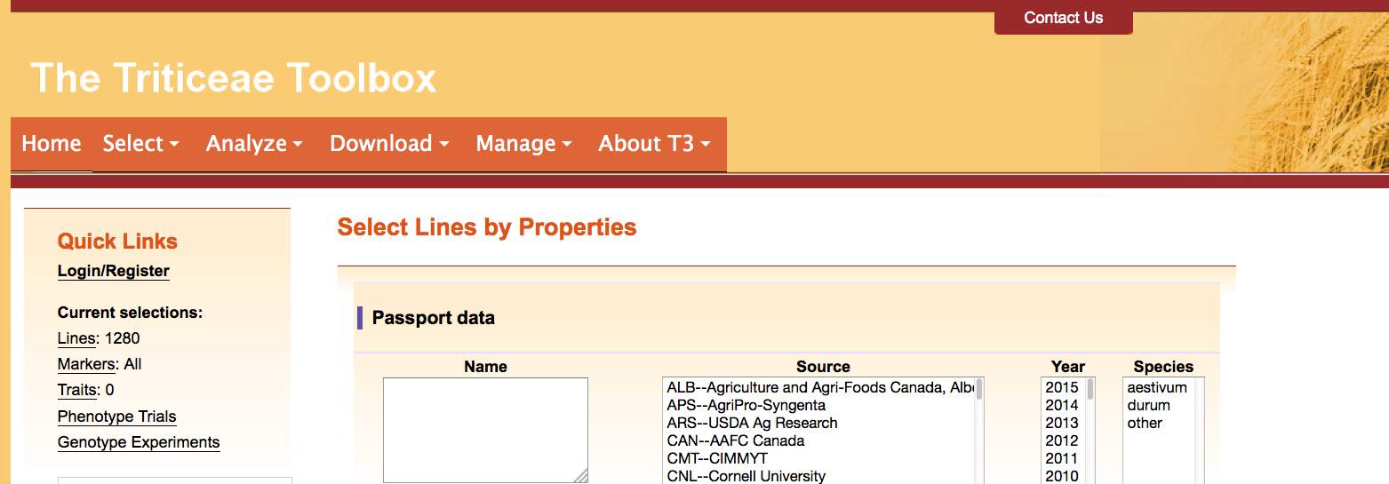
Section 2: Selecting T3 lines
Your line selection will be summarized in the “Current selections” portion of the T3 side panel
Clicking the “Lines” link will take you back to the “Select Lines by Properties” tool

Slide 10
Section 3: Creating a line panel
To create your line panel
Choose the Select menu > My Line Panels

Slide 11
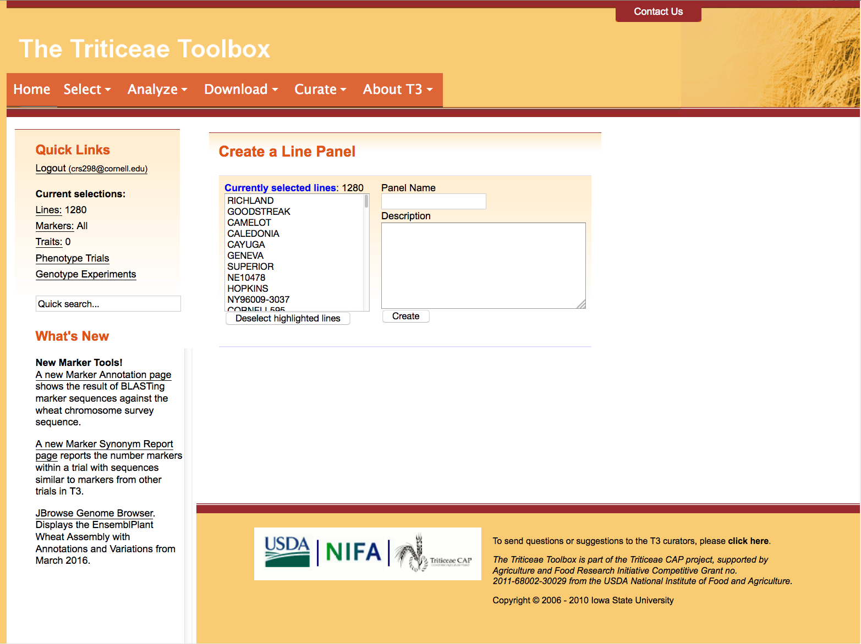
Section 3: Creating a line panel
Your currently selected lines will be displayed in the “Create a Line Panel” portion of the page
You can remove lines from your selection using the “Deselect highlighted lines” option

Slide 12
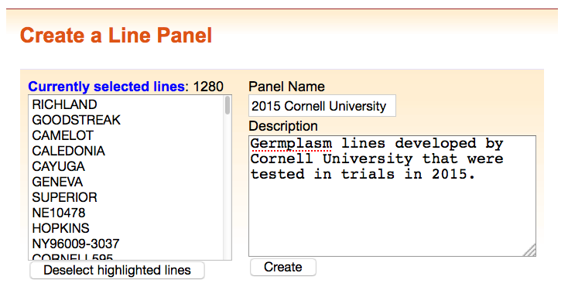
Section 3: Creating a line panel
Name your custom line panel
The line panel description is an optional field

Slide 13
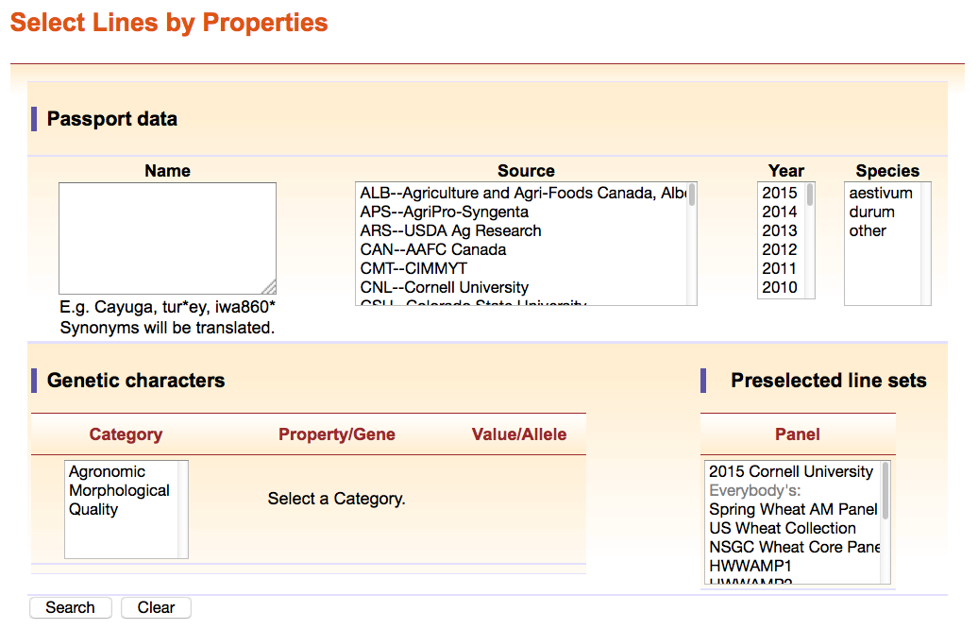
Section 4: Selecting a line panel
Custom line panels are private and appear above the public line panels in the “Select Lines by Properties” tool after login

Slide 14
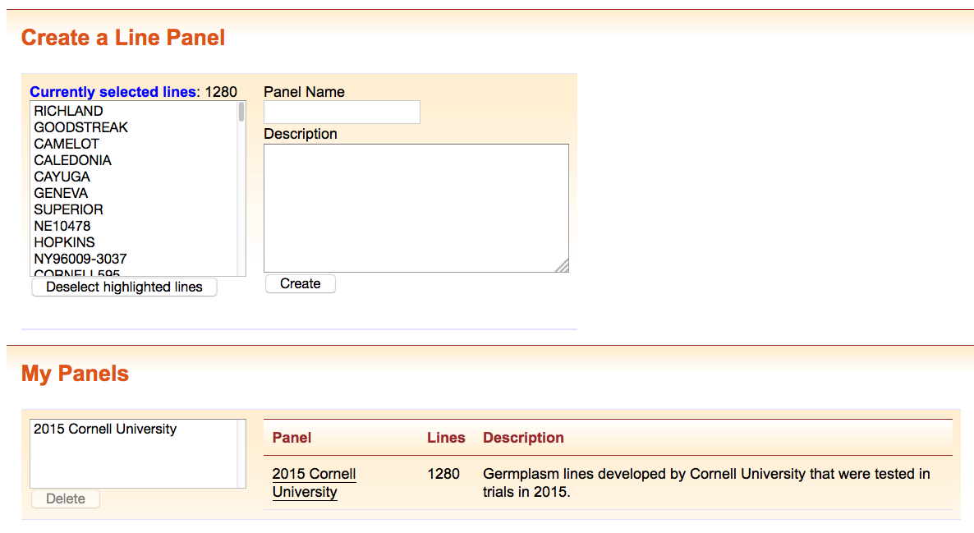
Section 5: Deleting or modifying a custom line panel
Use the “My Panels” selection window to delete a custom line panel
It is not possible to modify existing line panels, instead:
Select the line panel using the “Select Lines by Properties” tool
Modify your line selection
Delete the custom line panel
Recreate the custom line panel

Slide 15
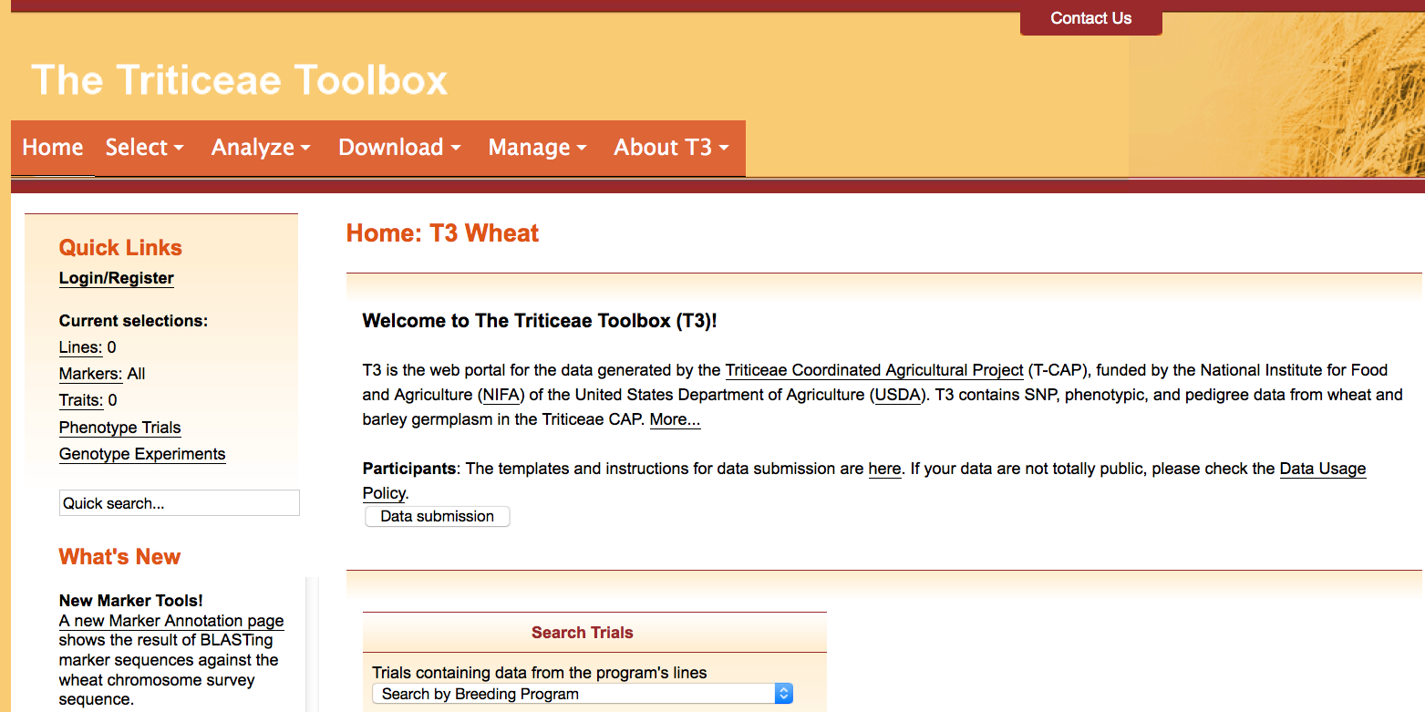
Contact Us
Please contact us if you need help using T3

