Slide 1
T3/Tutorials
Creating a marker panel in T3
https://triticeaetoolbox.org/

Slide 2
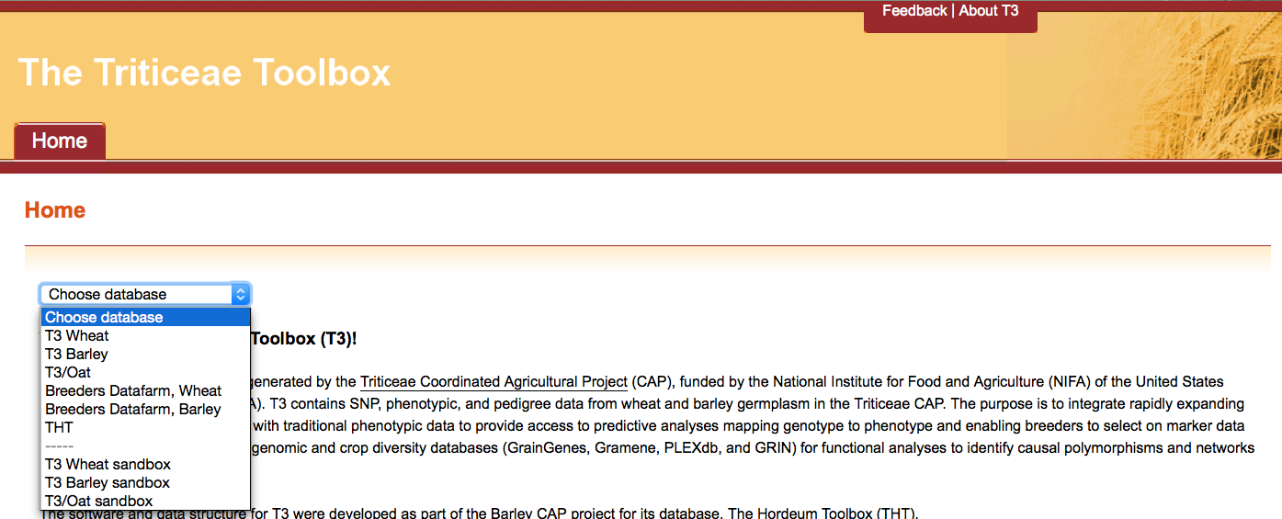
The Triticeae Toolbox (T3)
Each of the T3 databases can be reached from the T3 homepage: https://triticeaetoolbox.org
T3/Wheat will be used for demonstration purposes but these instructions are applicable to each instance of T3

Slide 3
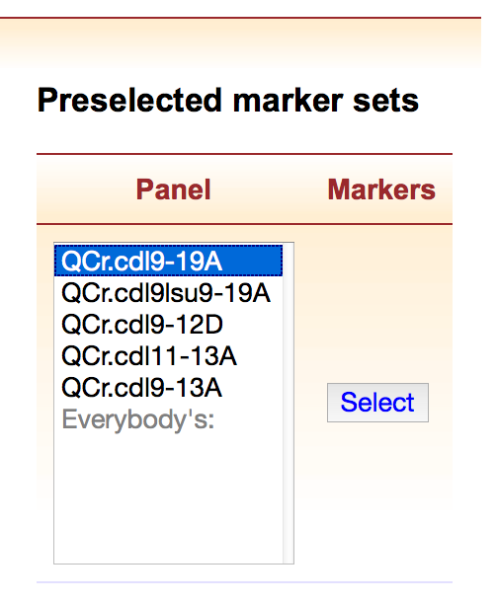
T3 marker panels
A marker panel is a set of preselected markers that helps to make data selection in T3 easy
Registered users can create their own private marker panels
Custom marker panels are saved between T3 sessions
Private marker panels can be made public upon request

Slide 4
Creating a marker panel in T3: Outline
Register/login
Selecting T3 markers
Creating a marker panel
Selecting a marker panel
Deleting or modifying a custom marker panel

Slide 5
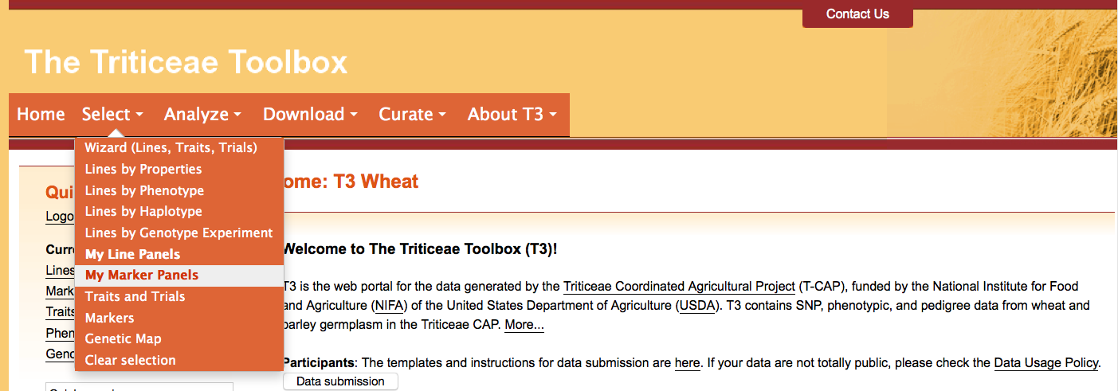
Section 1: Register/login
Navigate to the T3 database homepage of your choice
e.g. https://triticeaetoolbox.org/wheat/
Register and login to view additional items in the Select menu
My Line Panels
My Marker Panels

Slide 6
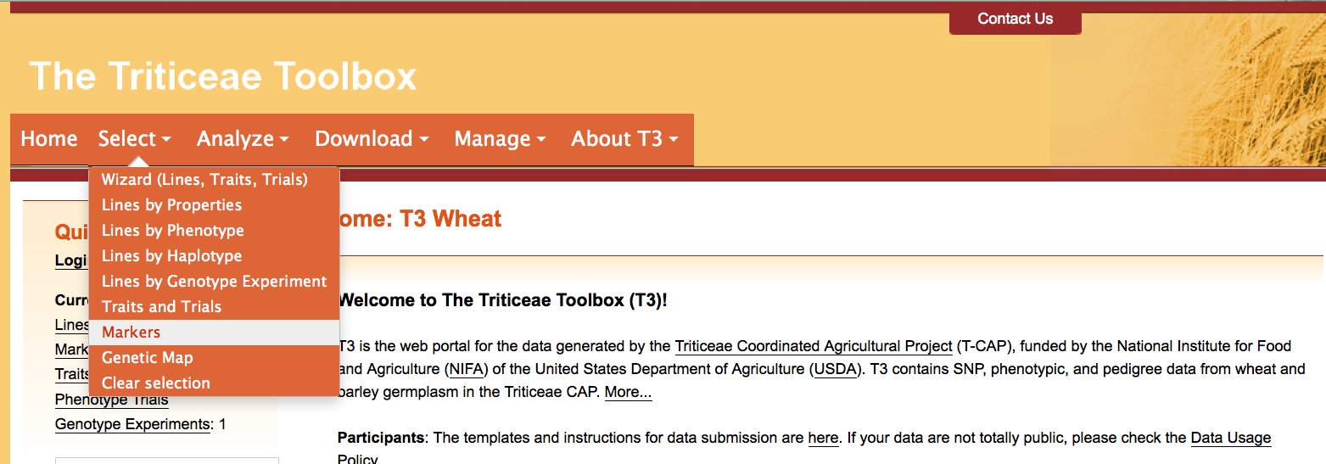
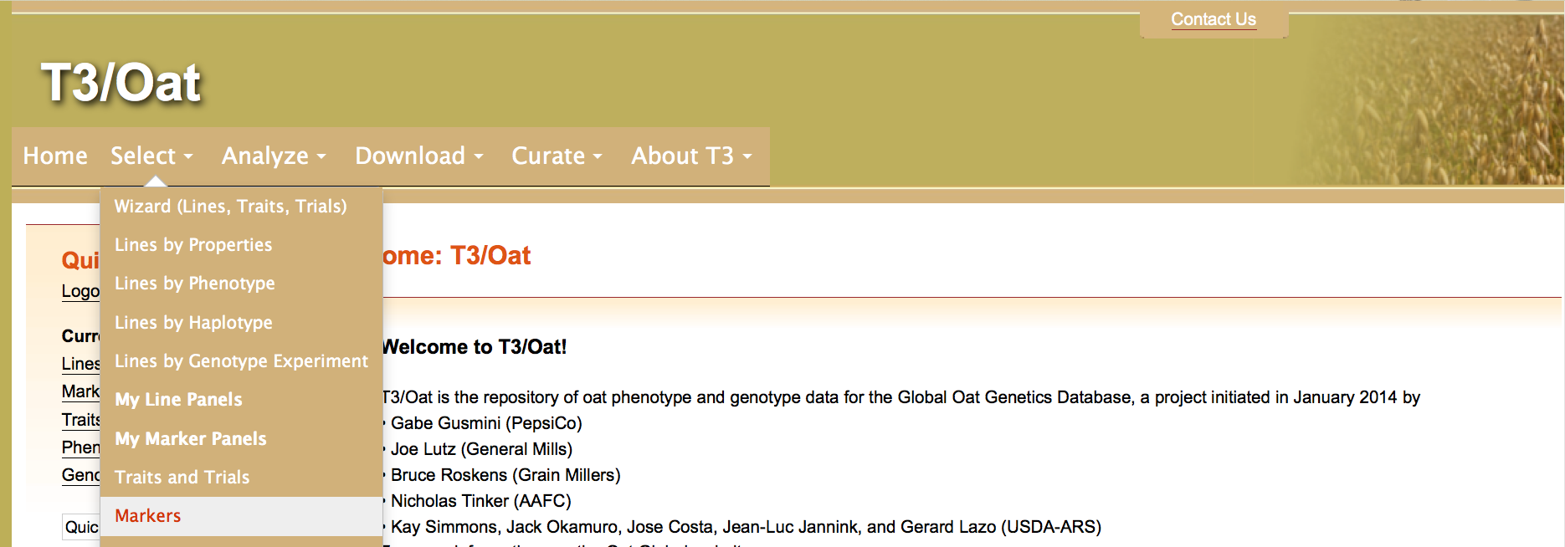
Section 2: Selecting T3 markers
First select the markers that you want to form your custom marker panel using either:
Select menu > Markers
or
Select menu > Lines by Genotype Experiment

Slide 7
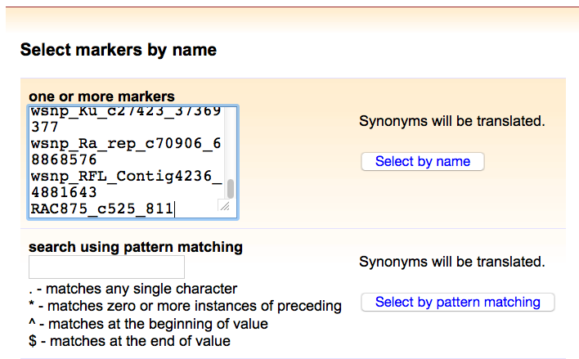
Section 2: Selecting T3 markers
For example, select markers by name using the “Select Markers” tool
If you are unsure of the exact marker name, you can search using a name fragment combined with wildcard values in the “search using pattern matching” window

Slide 8
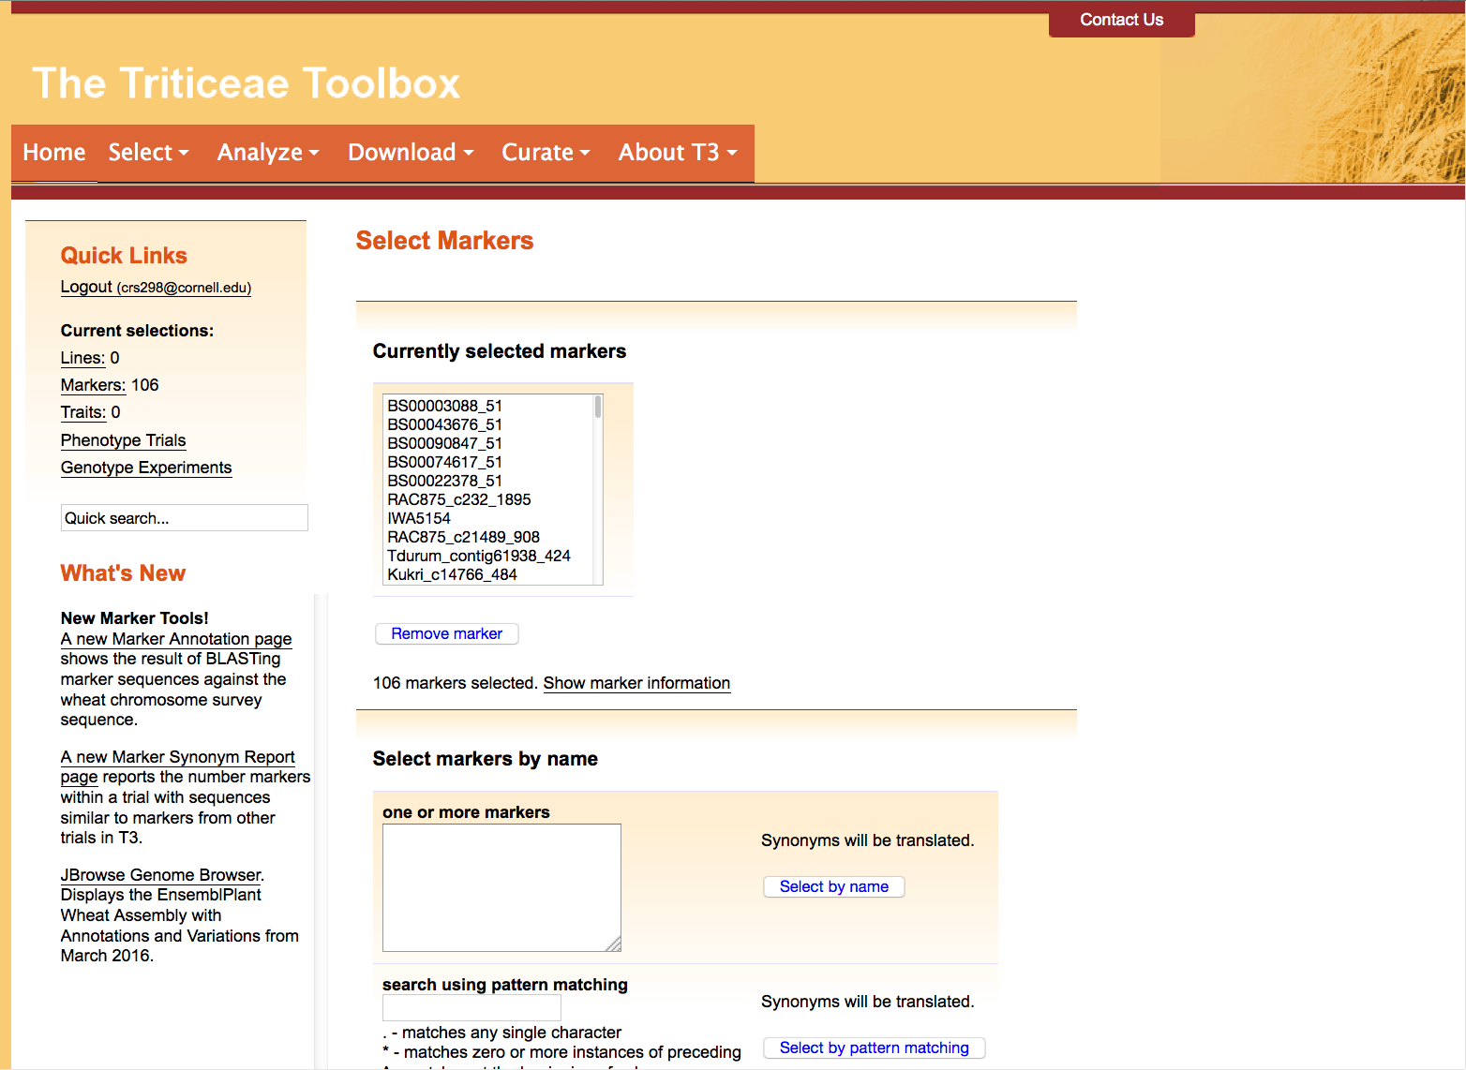
Section 2: Selecting T3 markers
Your marker selection will be summarized in the “Current selections” portion of the T3 side panel
Clicking the “Markers” link will take you back to the “Select Markers” tool

Slide 9
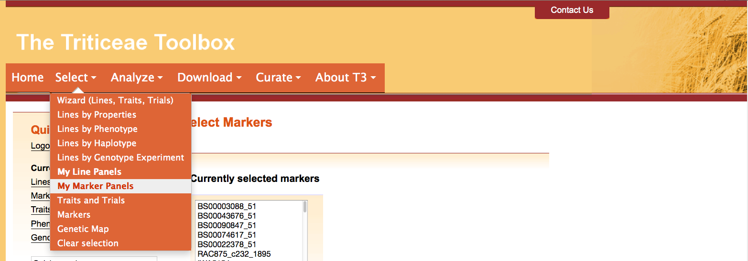
Section 3: Creating a marker panel
To create a marker panel
Choose the Select menu > My Marker Panels

Slide 10
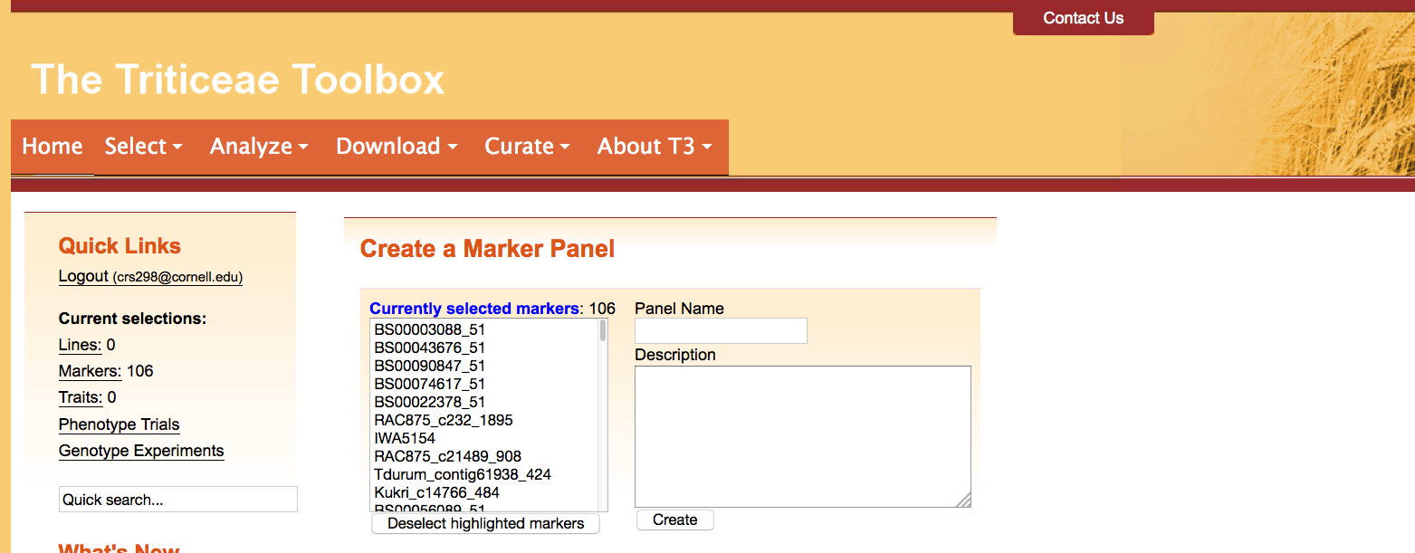
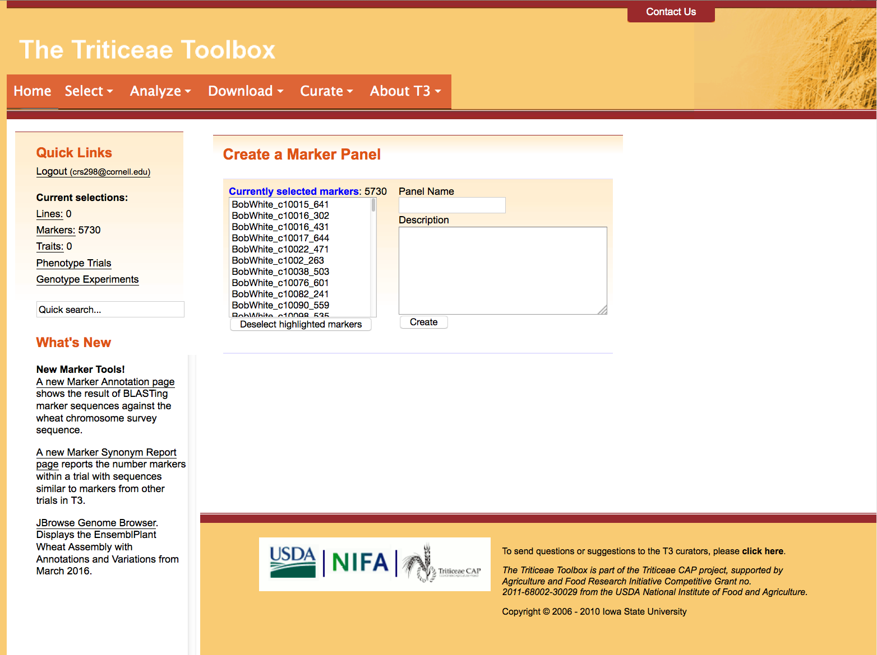
Section 3: Creating a marker panel
Your currently selected markers will be displayed in the “Create a Marker Panel” window
You can manually remove markers from your selection using the “Deselect highlighted markers” option

Slide 11
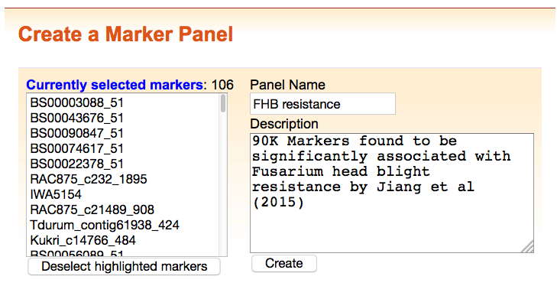
Section 3: Creating a marker panel
Name your custom marker panel
The marker panel description is an optional field

Slide 12
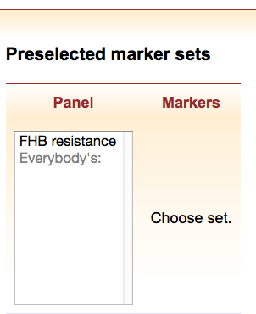
Section 4: Selecting a marker panel
Your custom marker panels are private and appear in the “Select Markers” tool along with any available public marker panels
Private marker panels can be made public upon request

Slide 13
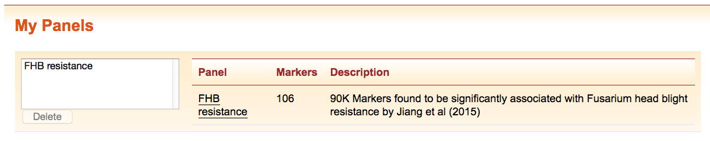
Section 5: Deleting or modifying a custom marker panel
Use the “My Panels” selection window to delete a custom panel
It is not possible to modify existing marker panels, instead:
Select the marker panel using the “Select Markers” tool
Modify your marker selection
Delete the custom marker panel using the “My Marker Panels” tool in the “Select” menu
Recreate the modified custom marker panel

Slide 14
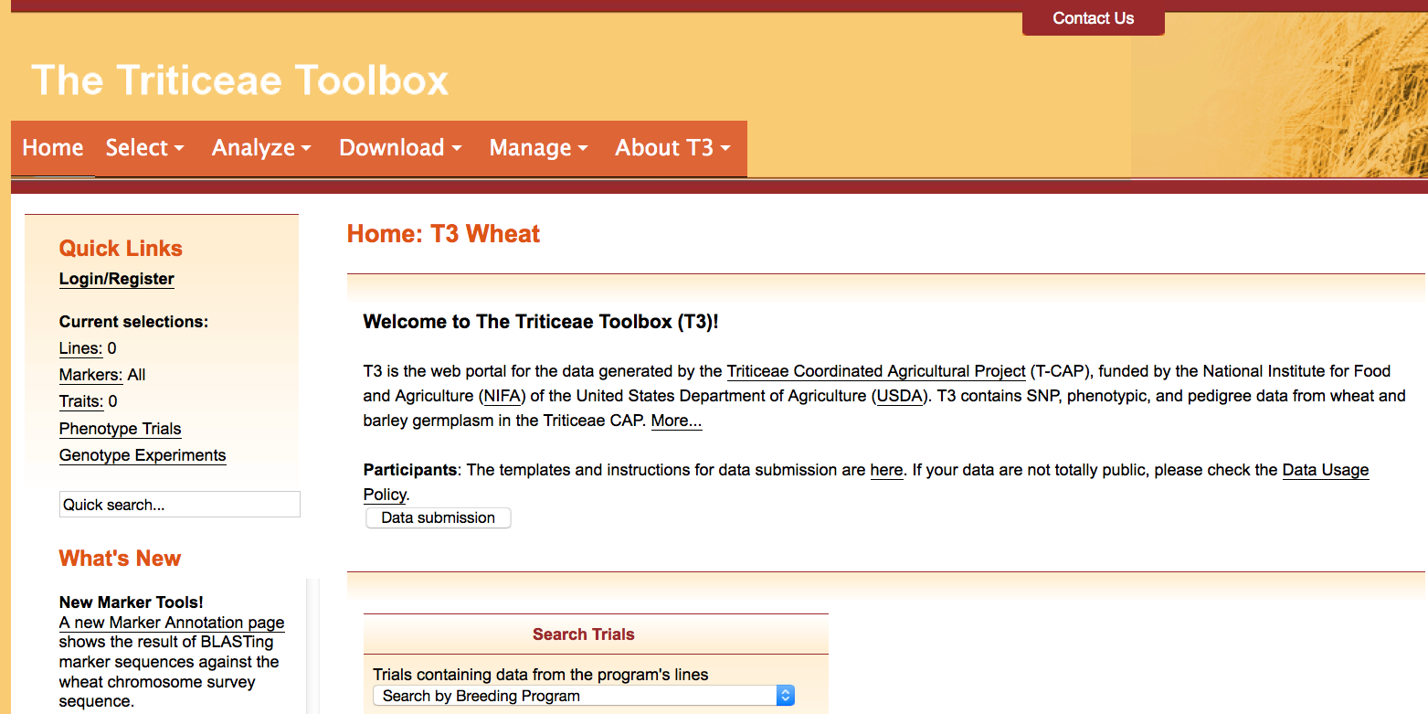
Contact Us
Please contact us if you need help using T3

