Slide 1

Projet Professionnel Personnel
DAI Guohao
SN-2A

Slide 2
INDEX
01
BRIEF INTRODUCTION
02
MOTIVATIONS
03
CAREER PLANNING
04
SUMMARY

Slide 3
PART 1
BRIEF INTRODUCTION
PERSONAL INFO.
MY
PARCOURS
My name is DAI Guohao,
24 years old.
I am from China.
Bachelor’s Degree in 2020
I am studying in N7 – 2A SN
Major in Systèmes Logiciels.
Estimated graduation in 2023

Slide 4
PART 2
WHY I CAME TO FRANCE ?
WHY
ENGINEER?
My own interest;
Strong connection with the enterprises.
WHY
FRANCE?
French engineer system is well known;
Enrich overseas experience.
WHY
N7?
N7 is distinguished in the academic field;
Teaching styles are similar to the enterprises.

Slide 5
PART 3
CAREER PLANNING
Internships in LABs
(Ex. IRIT)
Internship
back to CHINA
Be a Back-end Developer and
keep Learning
Manage a team and
be a Full Stack Developer
2A STAGE
FINAL STAGE
2-YEAR GOALS
5-YEAR GOALS
To be continued ...

Slide 6

PART 3
WHAT IS BILIBILI ?
It is a video-sharing site in China.
Grossly simplified, it's the Chinese equivalent of Youtube.
Zooming out, Bilibili is still small in the context of the Chinese video streaming and live streaming space.
81% of users are born after the 90s. In the past three years, the average age of new users is 21 years old
They attract users with engaging content, retain “Gen Z” with their vibrant community.

Slide 7
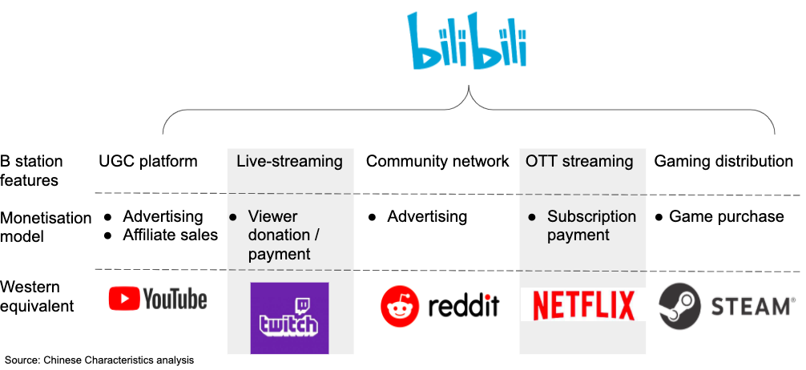
PART 3
WHAT IS BILIBILI ?

Slide 8
PART 4
SUMMARY
01
Thanks to the study in N7,
my ability of engineering will be improved.
After graduation, I will go back to China and start as a backend developer
02
03
The most important thing is
Keep Learning

Slide 9
THANKS FOR YOUR ATTENTION.

