Slide 1
A2D

Slide 2
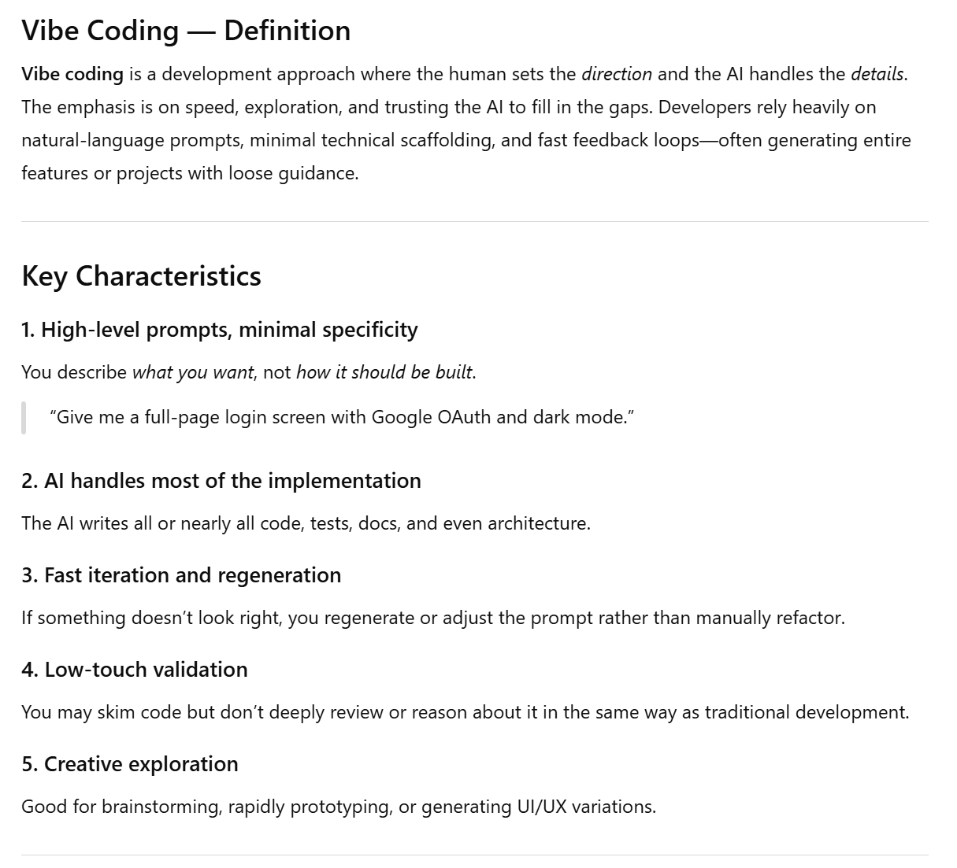
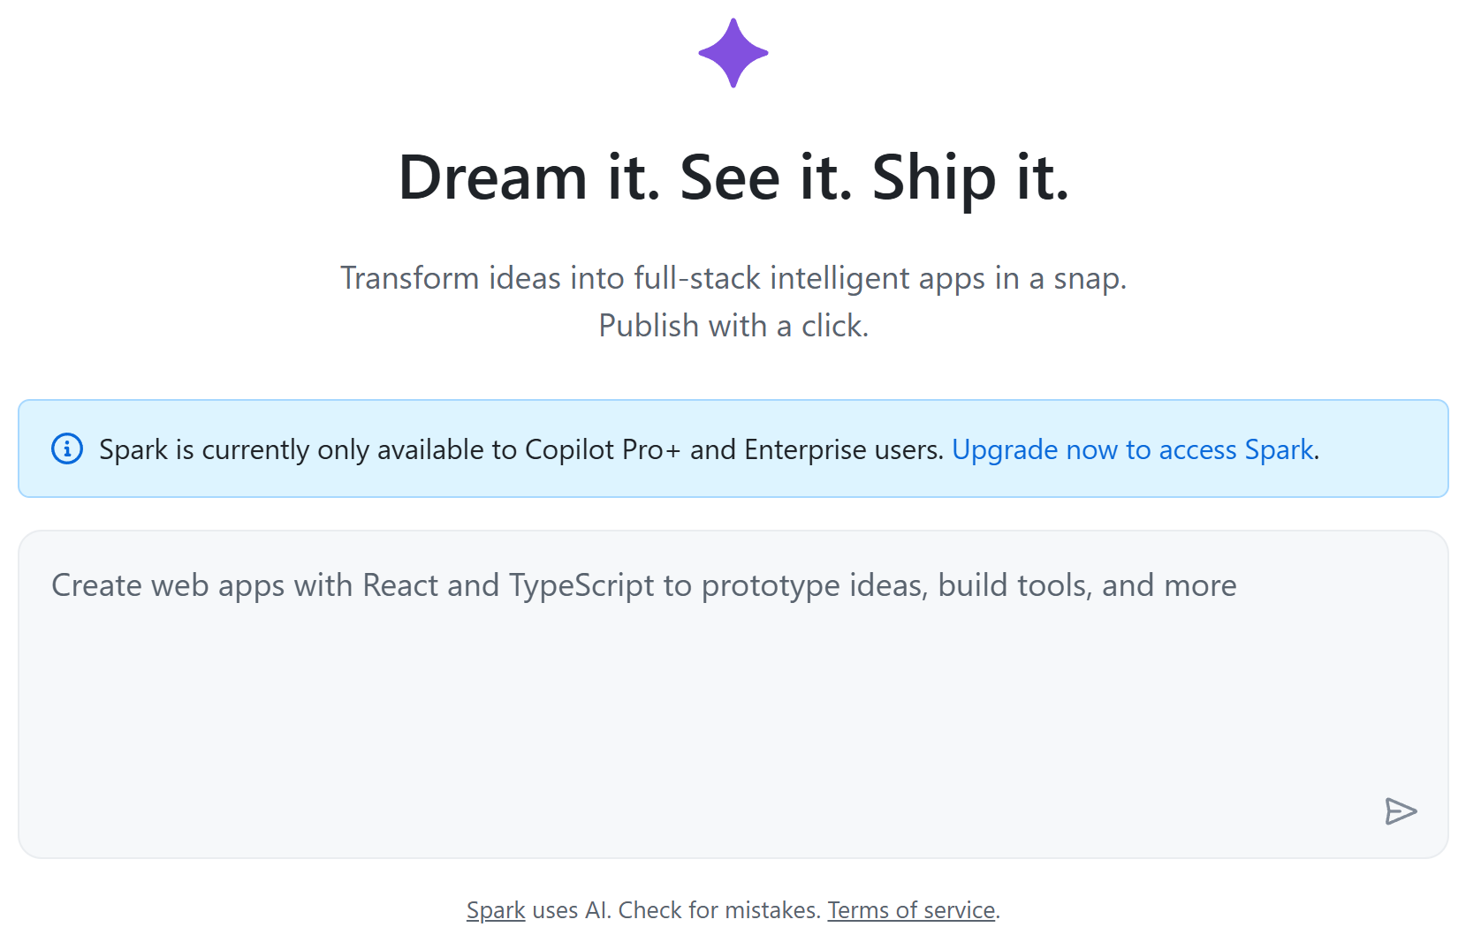
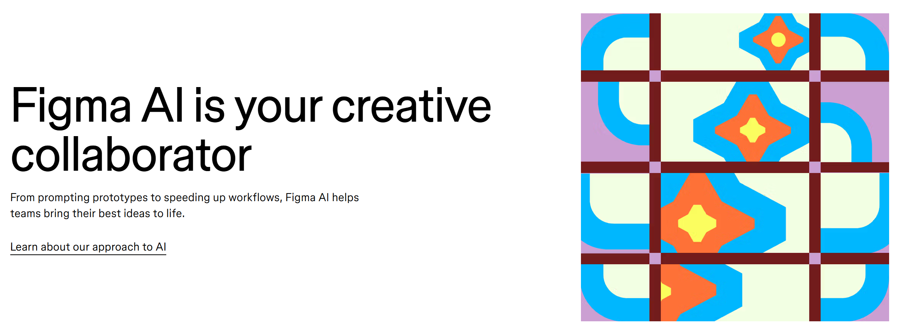
A2D is not vibe coding

Slide 3
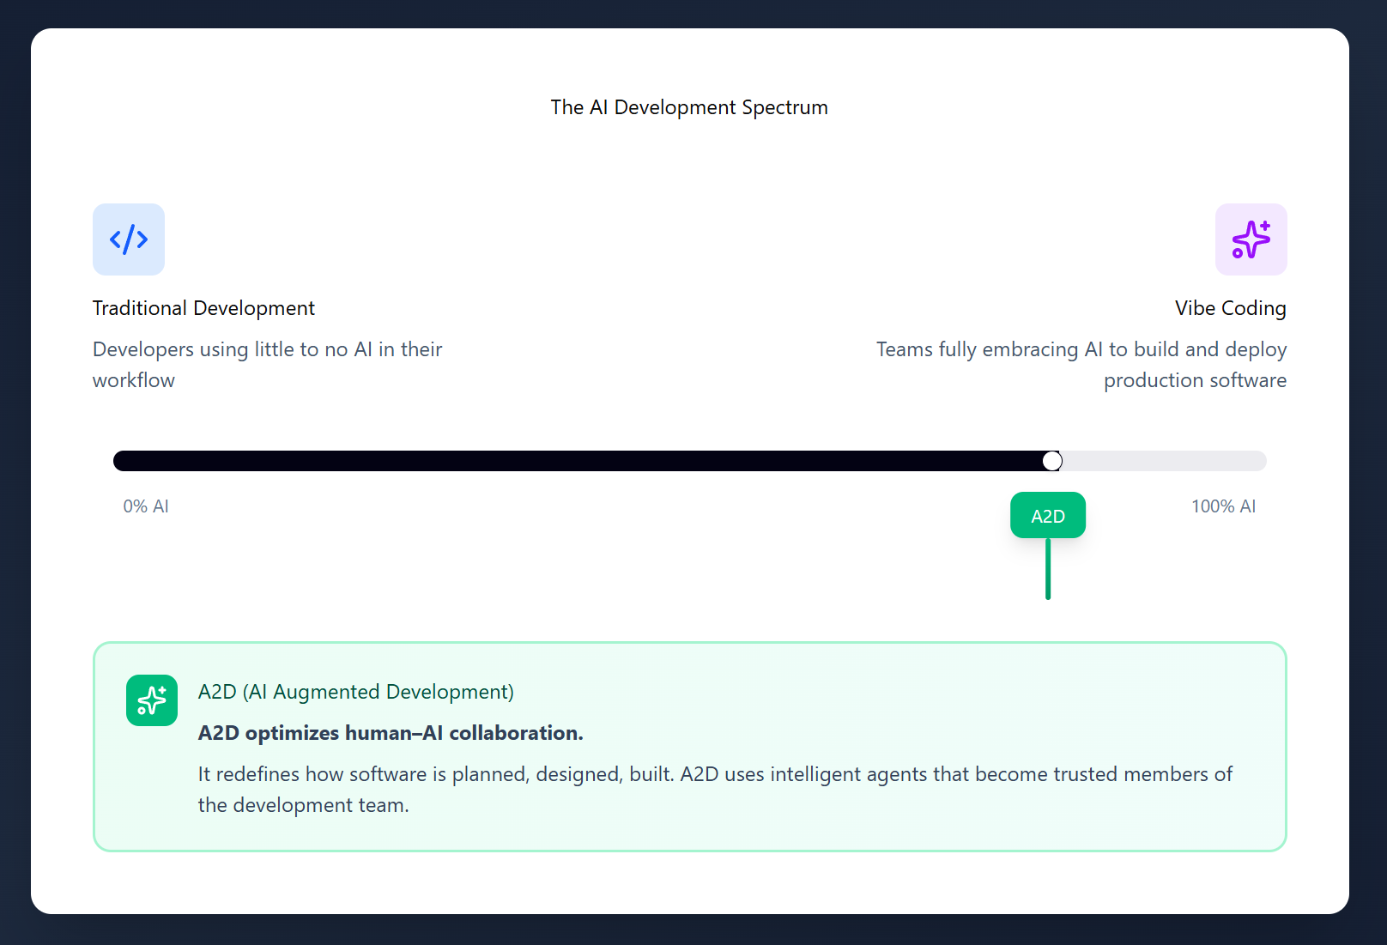
A2D is not vibe coding

Slide 4

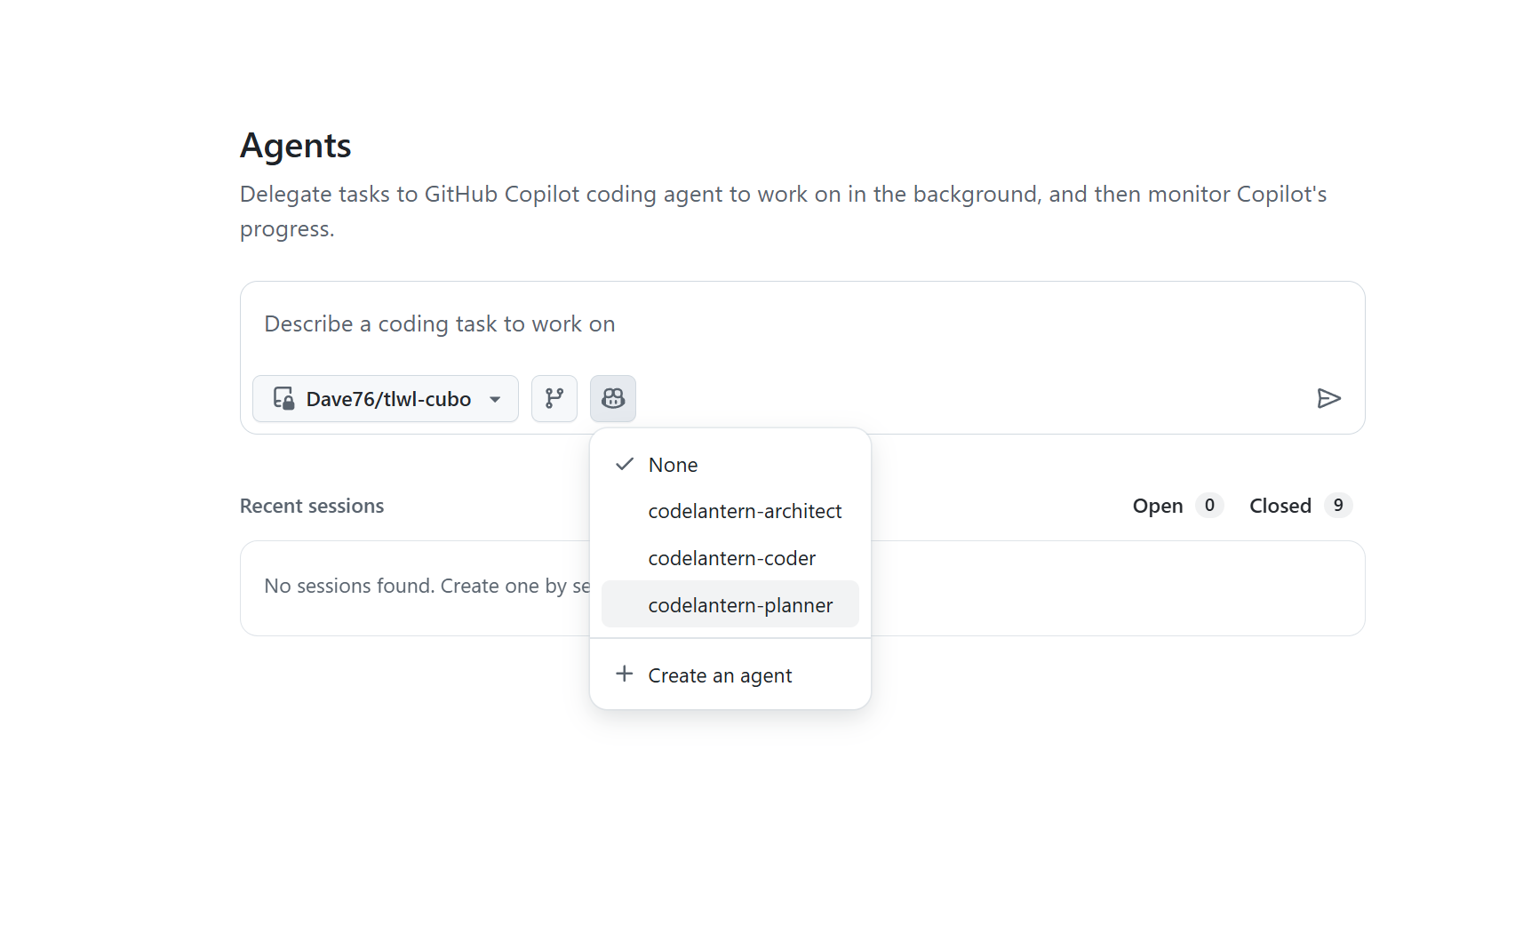
Demo Time

Slide 7
Component Definition
Artifact | Description
Work Item Templates | Issues, Sub-Issues, Pull requests all must structured in a consistent form. Agent definitions will reference these templates for both read/write operations.
Agent Definitions | Describes agent role and purpose. Configures access to “tools” and to enable “workflows”. Reinforce use of archetypes and expectations of output.
Archetypes | Detailed and structured documentation about the frameworks and patterns the agents should use. Curated by experts with AI assistance.
Workflows | Defines the actual work to be completed, who participates, role (AI and Human), with a clear concise goal or outcome.
Notes:
––– Defines the actual work to be completed, who participates (AI and Human), with a clear concise goal or outcome.

Slide 8
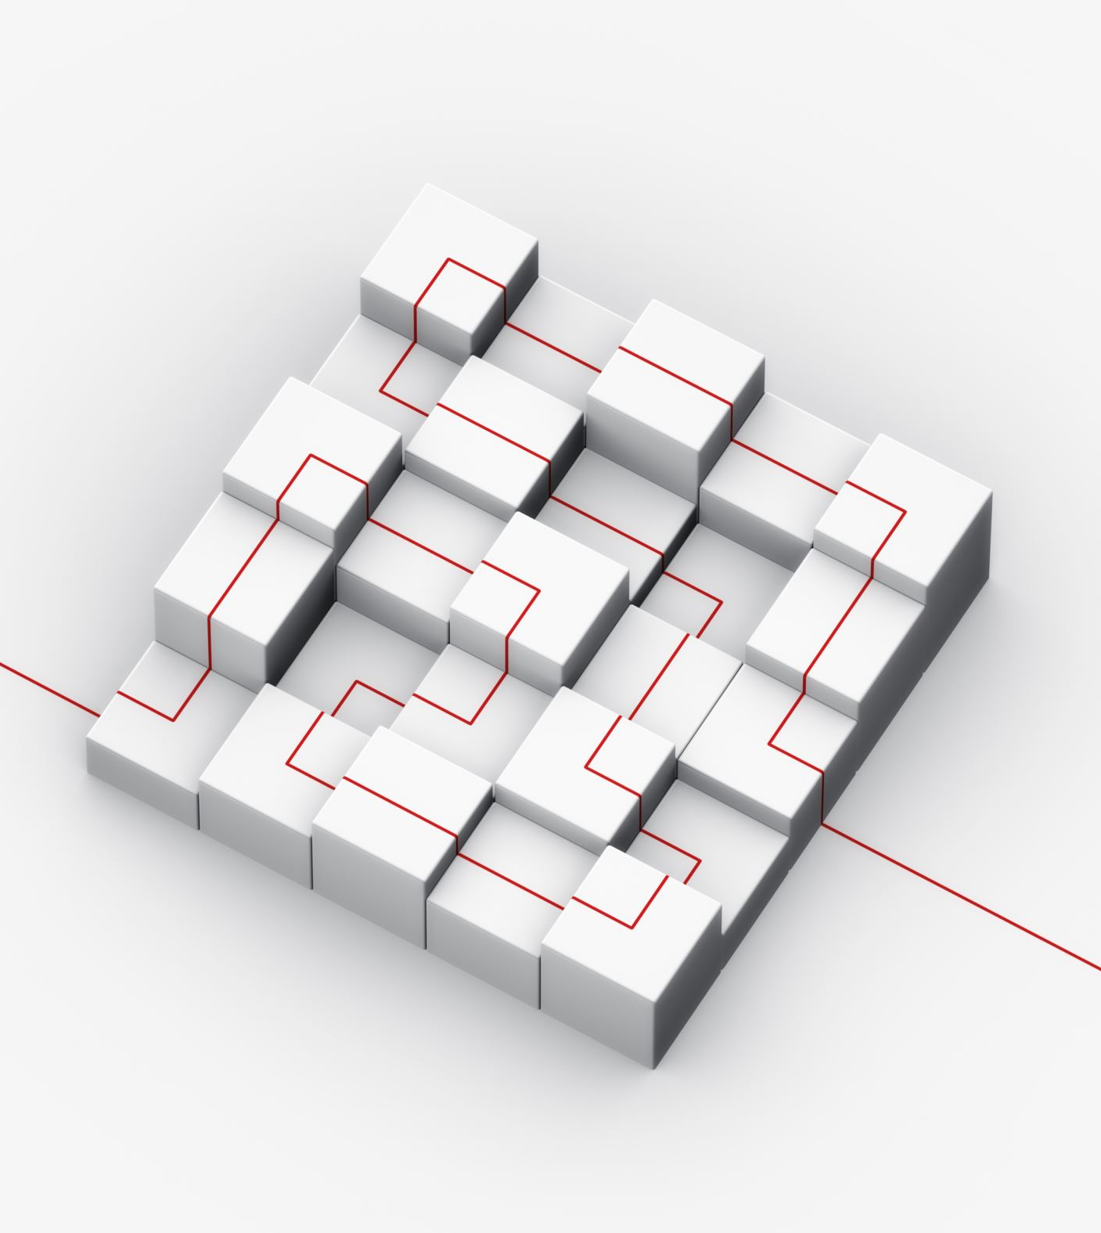
Hiding the IP
Since agents rely on definitions, archetypes, and workflows, these components are produced in markdown format to ensure they remain easily readable.
This format presents challenges in concealing, updating, and managing the artifacts as proprietary, as well as maintaining synchronization with a central repository.
Conceptual Proposed Solution*:
Safeguard intellectual property through a dedicated MCP server.
Deploy the MCP server via the GitHub registry.
Issue access tokens to paying customers and subscribers for MCP server access.
Implement support for multiple versions to maintain backward compatibility and accommodate potential changes in the MCP environment.
*Currently theoretical and unconfirmed

Slide 9
Proposed Architecture

Slide 10

Workflows

Slide 11

Planning Workflow
The planning workflow uses the [planning-agent] to ensure work is well defined and has acceptance criteria.
The [planning-agent] can ask questions, update work items, and split large items into multiple sub-items and tasks.
It can recommend next steps by analyzing what needs to be completed. IE: understanding the task is to create a user interface and recommending the [UI Design Workflow]
A planning conversation is a quick way to build up the backlog.

Slide 12
Suggestion Workflow
Scan the current set of issues, code comments, and markdown checklists to recommend what should be done next.
Used by product owner and architect
Uses [planning-agent]

Slide 13

User Interface Design Workflow (future)
Describe the interface that needs to be built and specific visual requirements.
Generate potential UI options using archetypes defined for the current project (Material Design, MudBlazor, Tailwind)
Present and Refine
Attach to new work item for implementation
Gives the [coding-agent] a visual guide to follow

Slide 14

Solution Design and Analysis Workflow
Deep analysis looking through archetypes, current repository, and similar problem statements
Presents back 2-3 options with detailed approach, code samples, and documentation in markdown format
Score the options and make a recommendation
Also provide insight as to whether this should be done now or can wait until later
Examples:
  Should we refactor the app to use a shared caching model?
  Should we implement the bUnit testing framework?
  Should we refactor the frontend to use React instead of Blazor?

Slide 15

Implement Workflow
This is the real work horse of the system and “pumps” out the code and tests.
The [coder] agent is given instructions to:
Be concise and efficient with coding changes and to minimize refactoring (unless explicitly instructed to do so).
Read and understand existing design patterns and architecture decisions.
Write appropriate unit tests.
Write well documented pull requests with screenshots where it makes sense.

Slide 16
Deployment Workflow
Uses [deployment] agent who will have expertise and knowledge of Terraform, Azure CLI, YAML, GitHub actions.
Inspect solution to ensure components support automated deployment
Create terraform and scripts for deployment
Ensure environment consistency
Ensure secrets remain secret
Ensure code can be deployed to an environment

Slide 17
Workflow Status
Workflow | Status | Notes
Planning | In Progress | Working prototype that can inspect a work-item and enhance description, acceptance criteria and splitting work-item into sub issues. [planning-agent]
Solution Design | In Progress | Working prototype that can inspect a work-item, analyze the repository and archetypes, suggest then compare/contrast multiple options, and make a final recommendation. Creates detailed pull requests with markdown documents. [architect-agent]
Suggestion | In Progress | Working prototype – however, it seems to make the same suggestion multiple times (need to figure out a way to not repeat it-self). Not sure how valuable this is, but I find it useful when there isn’t any defined work to complete and my agents are idle. [planning-agent]
User Interface Design | Planning | Started prototyping with Figma MCP, UX Pilot, and identifying a likely path forward. Right now, I need to use these tools outside of GitHub, and paste the results into a work item.
Implementation | In Progress | This is the most well developed and testing. It does not require much customization and with proper instructions and archetypes it can use the stock sonnet 4.5 agent to produce concise, clean, and tested code. Pull requests are excellent. Documentation is excellent.
Deployment | Not started
Notes:
Might want a dedicated testing agent and workflow as well.

Slide 18
Methodology Definition
Work in progress, and perhaps more related to the service side of things, but the process is likely as important as the underlying technology – like the ceremonies in agile.
A2D is going to require ceremonies, but with quicker iteration
More suited to a kanban style of working because of the velocity of work completed.
The methodology I have been following is daily planning in the morning, followed by review before lunch, resolving comments and iteration, deployment and testing in the afternoon. Repeat.
Design
Implement
Plan
Review
Deploy
Verify
Iterate

Slide 19
The human
Provide context to the agents
Provide positive and negative feedback to completed work
Review and approve all changes
Set direction and priorities
Refine templates and archetypes to meet company culture and standards

Slide 20
Risks
GitHub Copilot is advancing quickly, with numerous features still in preview and no assurance they will be officially released soon.
The MCP registry is currently unstable. I am working with multiple MCP servers from this registry, and agents often report bugs, which means CodeLantern is being developed in a constantly evolving environment.
GitHub Copilot maintains complete control; for example, it limits coding agents to work exclusively with Anthropic Sonnet, including any custom agents you develop.
The cost of GitHub Copilot licenses ranges between $15 and $30 USD per user each month, covering the main features. It’s important to consider how much extra users might be willing to pay for CodeLantern beyond this.
Building, maintaining, and supporting a product involves considerable challenges.
Will a product make the result less flexible for end clients. IE: With consulting, you can use a base set of artifacts and just adapt on a per client basis?
This space is changing at an incredible pace (likely due to the use of AI augmented development). GitHub just release Agent HQ, and Sparks v2, Figma has a tool, Cursor, Claude Code.

Slide 21
Phased Approach?
Start as a service company until enough artifacts are battle tested that they can be packaged as subscription service
This will also allow MCP servers to “settle” with increased reliability
It will take time (and experts) to construct archetypes
Ability to generate revenue while building/testing artifacts and the MCP server
Beta/reference clients - Beta clients will get a life-time subscription once ready to go?
Is it better to get the process right, then just use it as Adam suggested and go after the business of building solutions? For example, arm a team of consultants with the technology and know-how and just have them focusing on modernizing existing apps?

