Slide 1
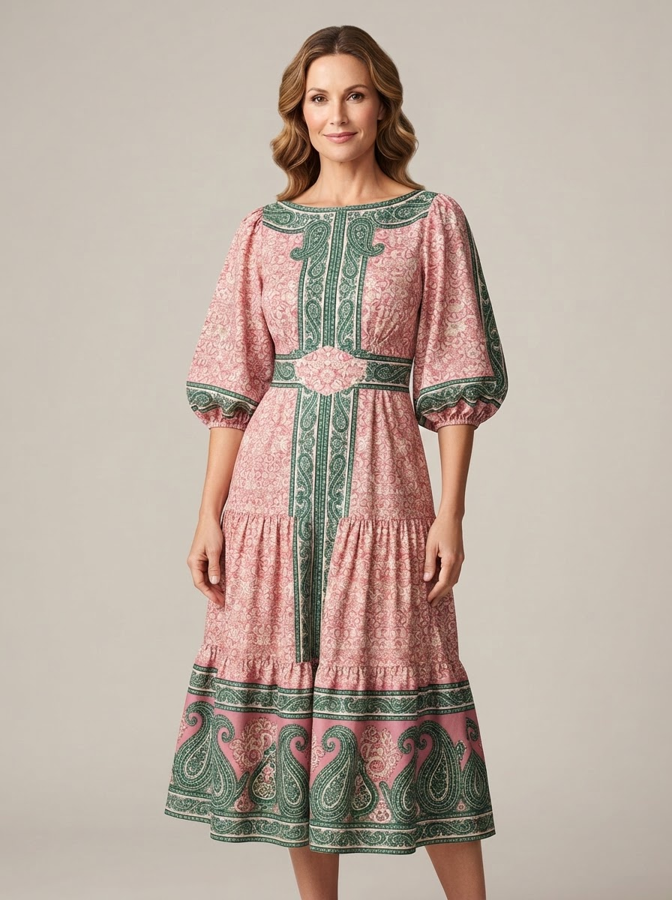
SHANGHAI SILK / CROWN & IVY
Color with a
point of view.
Fall Transition 2026
50 new woven styles across five confirmed directions for BELK online and department stores.
ENGLISH CLIENT PROPOSAL / V2
Notes:
[Sources]
AI concept image: case-assets/crown-ivy/final-v2/assets/CI26-022.png
Customer task brief and approved v2 proposal content.

Slide 2
01 / CUSTOMER BRIEF
02
Everyday polish, built for Fall Transition
MARKET
CONSUMER
United States / BELK online + department stores
Women 35-50 / stable income / polished casual
Mosaic Pink
Meadow Pink
CATEGORIES
MATERIAL
18 tops / 20 dresses / 6 pants / 6 sets
Textured wovens, dobby, slub, eyelet and drape
Harbor Navy
Finley Tan
SIGNATURE
BOUNDARY
Wonka Peri
Hunt Green
Feminine, refined, comfortable and ruffle-aware
Limited embroidery; practical construction
Ripe Olive
Enamel Turq
Mayan Jade
Squash
Notes:
[Sources]
Crown & Ivy customer requirement, Feishu document and six-page customer PDF.
Palette: customer-provided Fall 2026 trend images.

Slide 3
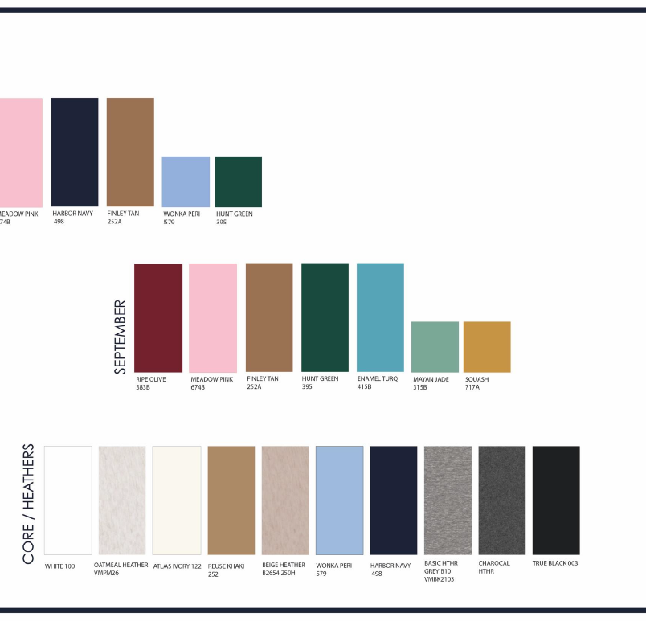
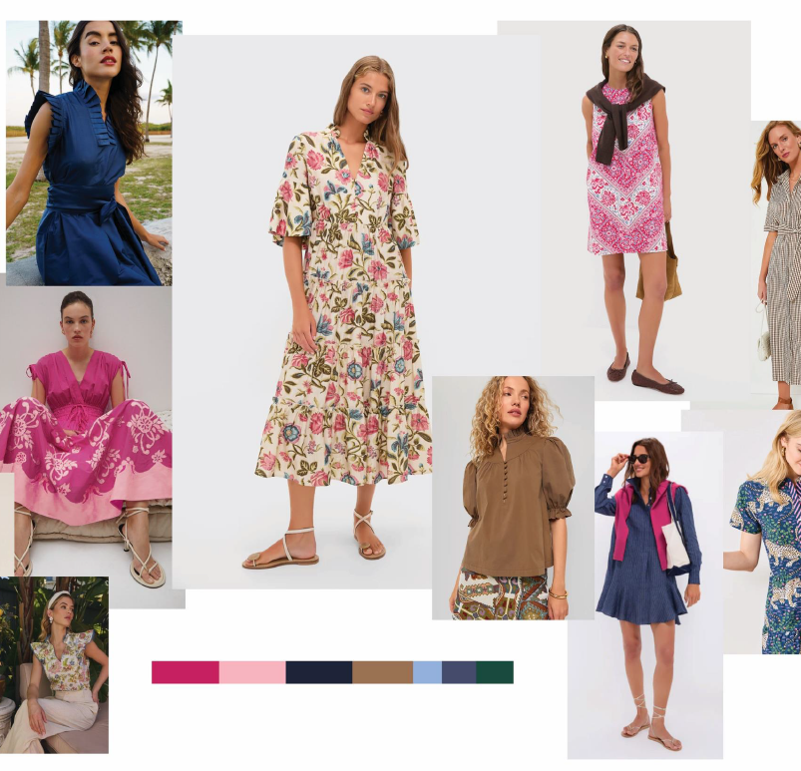
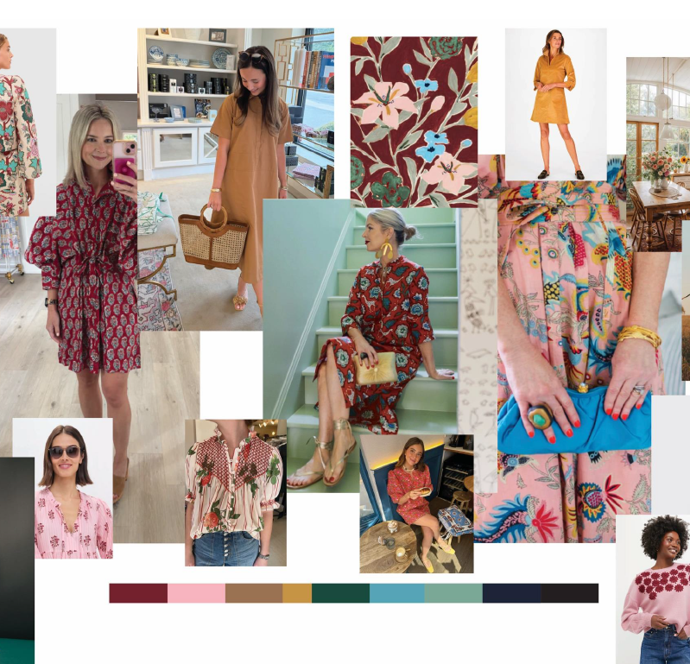
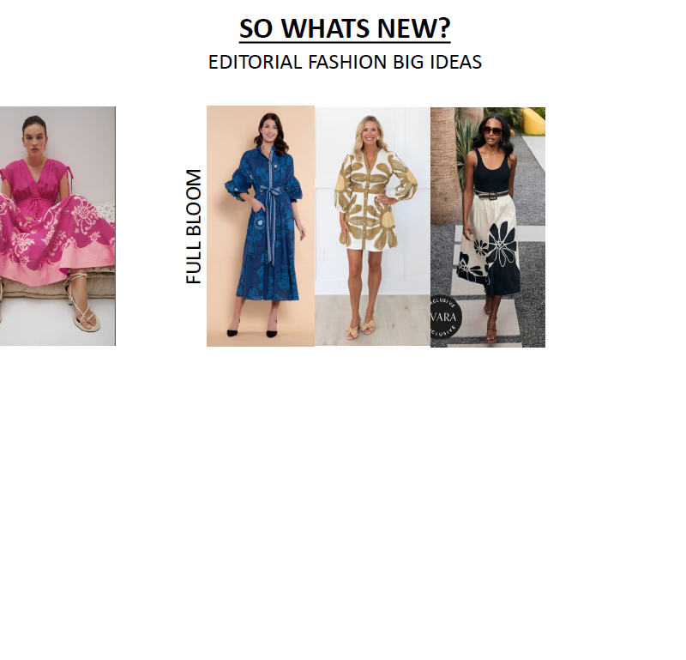
02 / MARKET EVIDENCE
03
Directional signals support the edit, not a sales forecast
60.5k
49.5k
40.5k
$69-$109
matching set
floral dress
shirt dress
observed blouse range
US keyword-volume field
US keyword-volume field
US keyword-volume field
Dillard's public pages
Customer trend images are requirement inputs. Retail, social and search observations remain separate evidence types; no platform metrics are merged.
Notes:
[Sources]
SRCH-DFS-001: US keyword-volume fields, 2025-07 to 2026-06.
RT-DIL-001/002: Dillard's public product pages observed 2026-08-07.
Customer trend images: Feishu requirement document, customer input.

Slide 4
03 / CONFIRMED DIRECTION ARCHITECTURE
04
Five stories balance recognition and design breadth
01
02
03
04
05
Refined Ruffle Utility
Full Bloom Day Dresses
Crafted Texture
Placed Story Prints
Polished Coordinates
Relaxed blouses with split necks, cascading ruffles, flutter and bishop sleeves.
Large florals, frame prints, shirt dresses, fit-and-flare and controlled tiers.
Dobby, eyelet, slub and localized embroidery at garment structure.
Center fronts, neckline frames, sleeve borders, hem borders and side bouquets.
Woven sets and pants with vertical borders, pocket placements and mixability.
Notes:
[Sources]
Confirmed direction names and descriptions from Crown & Ivy final proposal v2.
Retail and social evidence catalog: 03a_evidence_catalog.md.

Slide 5
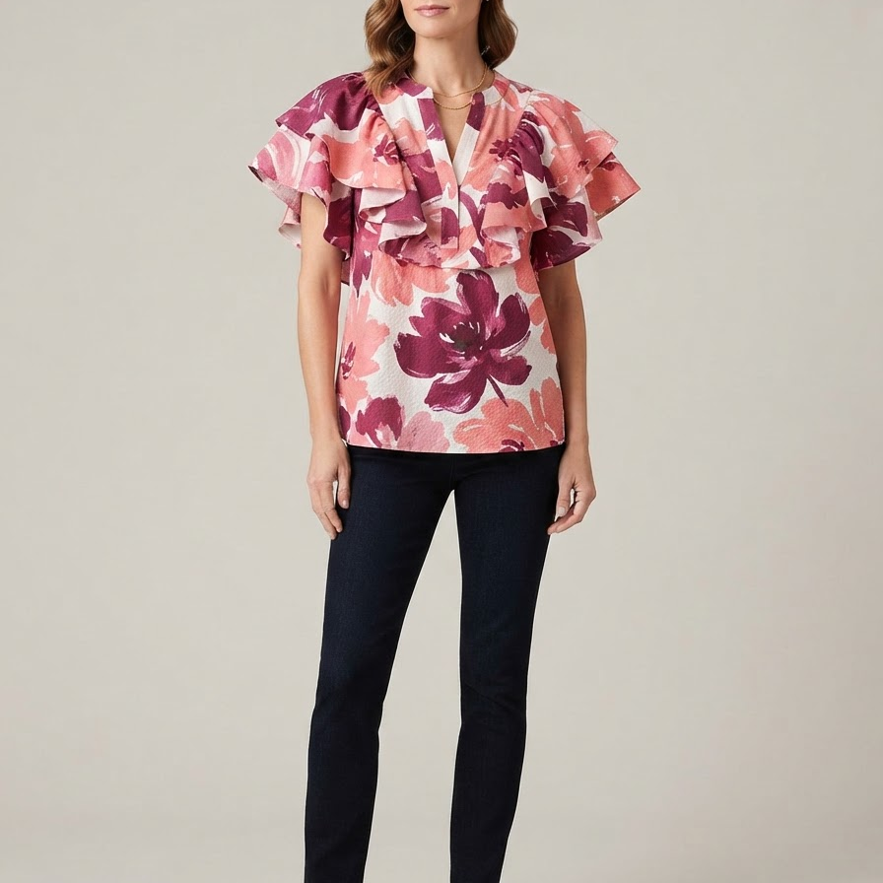
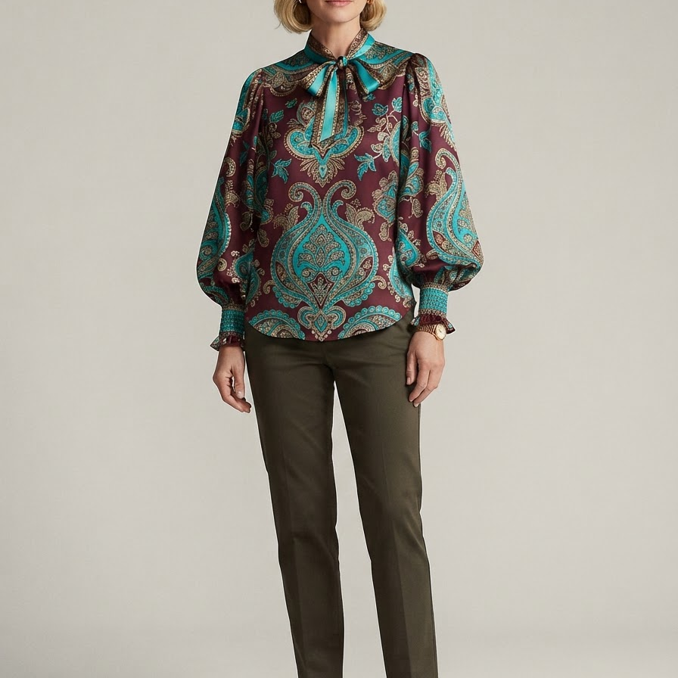
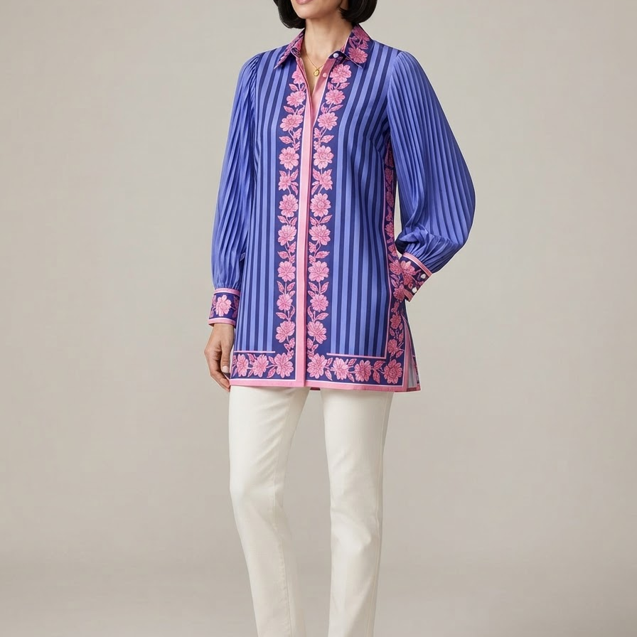
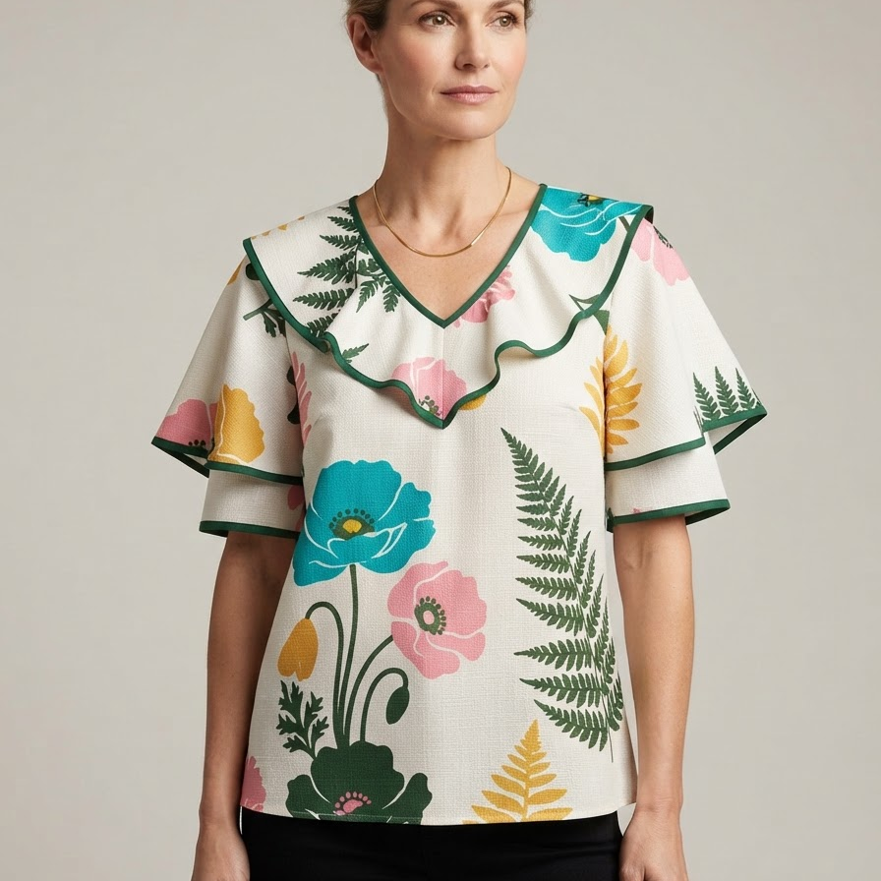
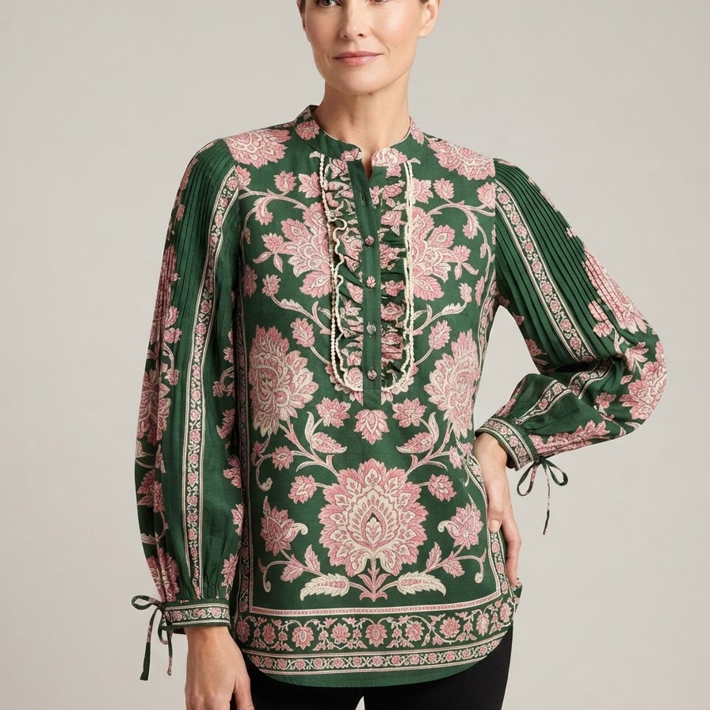
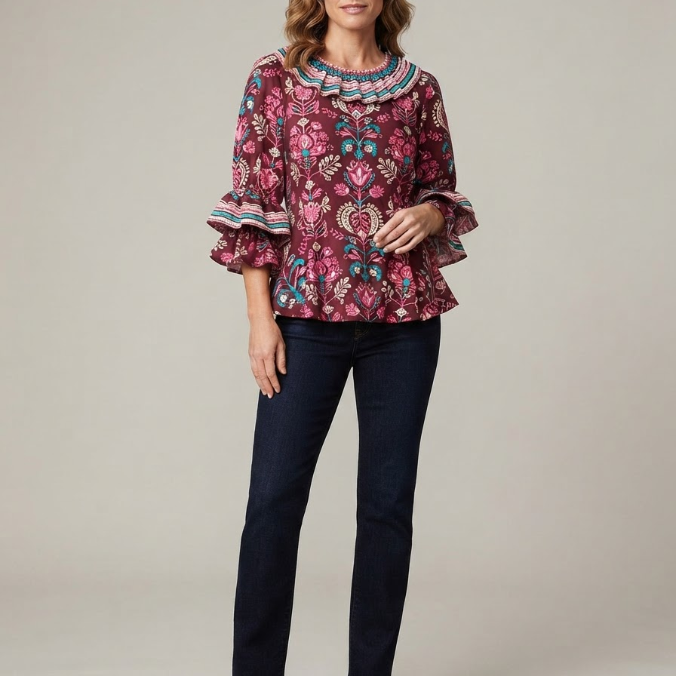
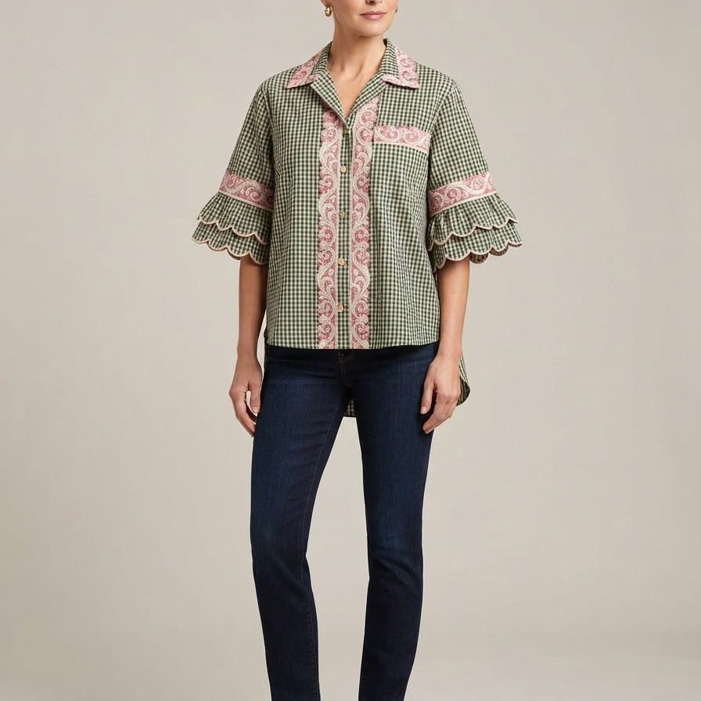
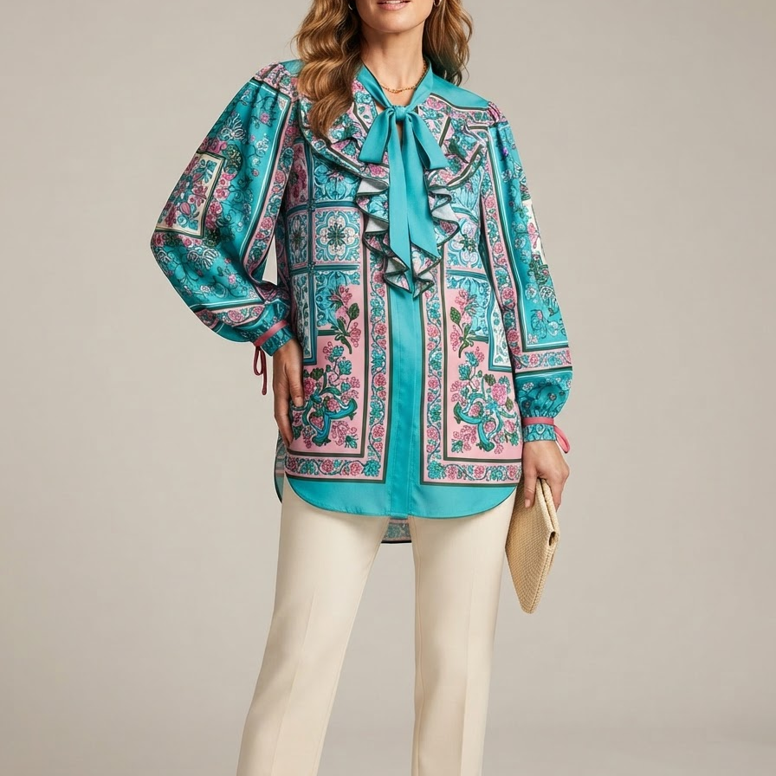
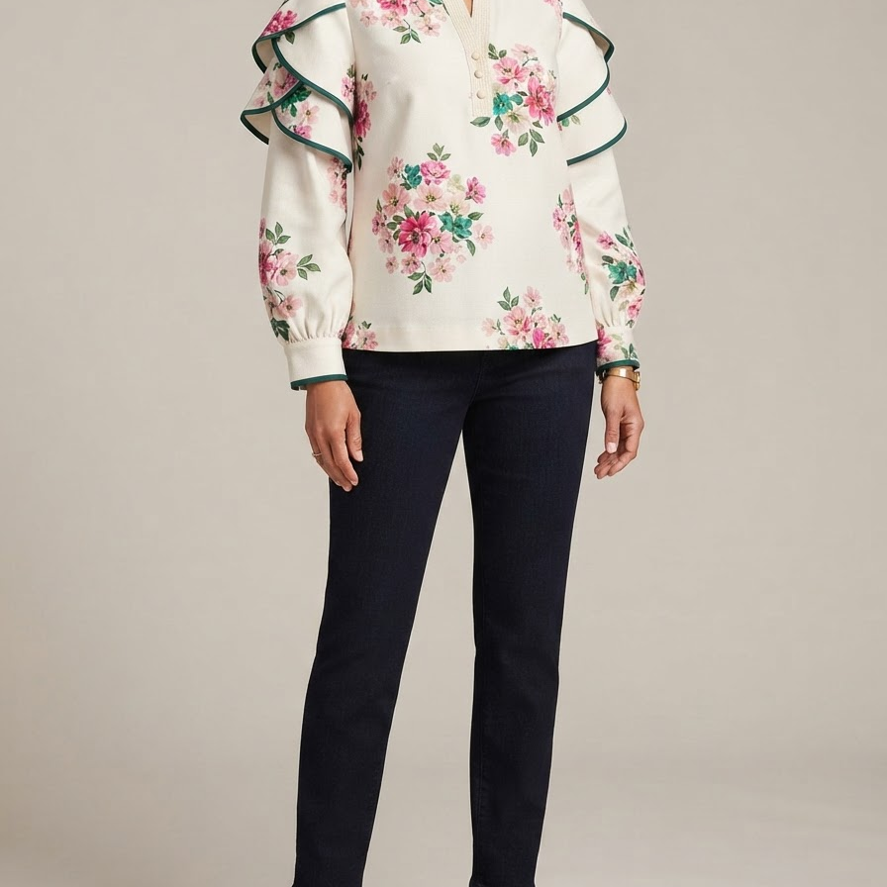
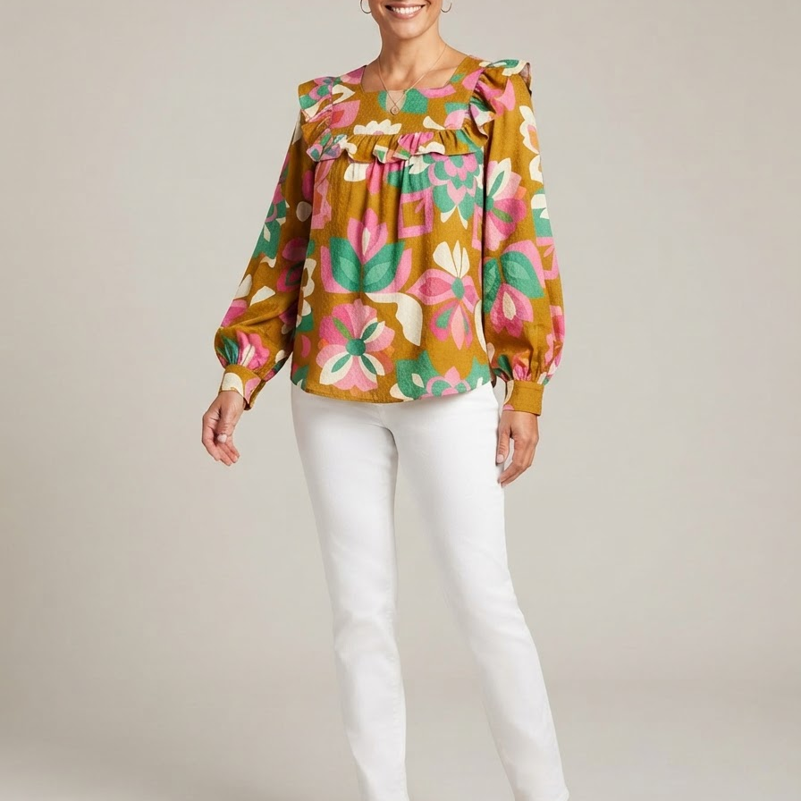
04 / FINAL ASSORTMENT / BATCH 01
05
CI26-001 - CI26-010
CI26-001
Top
CI26-002
Top
CI26-003
Top
CI26-004
Top
CI26-005
Top
Refined Ruffle Utility
Refined Ruffle Utility
Refined Ruffle Utility
Refined Ruffle Utility
Refined Ruffle Utility
CI26-006
Top
CI26-007
Top
CI26-008
Top
CI26-009
Top
CI26-010
Top
Refined Ruffle Utility
Refined Ruffle Utility
Refined Ruffle Utility
Refined Ruffle Utility
Refined Ruffle Utility
Notes:
[Sources]
AI-generated concept: CI26-001; sources mapped in final-v2/manifest.js (EC-AMZ-001, EC-TTS-001).
AI-generated concept: CI26-002; sources mapped in final-v2/manifest.js (EC-AMZ-001, EC-TTS-001).
AI-generated concept: CI26-003; sources mapped in final-v2/manifest.js (EC-AMZ-001, EC-TTS-001).
AI-generated concept: CI26-004; sources mapped in final-v2/manifest.js (EC-AMZ-001).
AI-generated concept: CI26-005; sources mapped in final-v2/manifest.js (SM-PIN-002).
AI-generated concept: CI26-006; sources mapped in final-v2/manifest.js (EC-AMZ-001, SM-PIN-001).
AI-generated concept: CI26-007; sources mapped in final-v2/manifest.js (EC-TTS-001, SM-PIN-003).
AI-generated concept: CI26-008; sources mapped in final-v2/manifest.js (EC-AMZ-001, SM-PIN-002).
AI-generated concept: CI26-009; sources mapped in final-v2/manifest.js (EC-TTS-001, SM-PIN-001).
AI-generated concept: CI26-010; sources mapped in final-v2/manifest.js (EC-AMZ-001, SM-PIN-001).

Slide 6
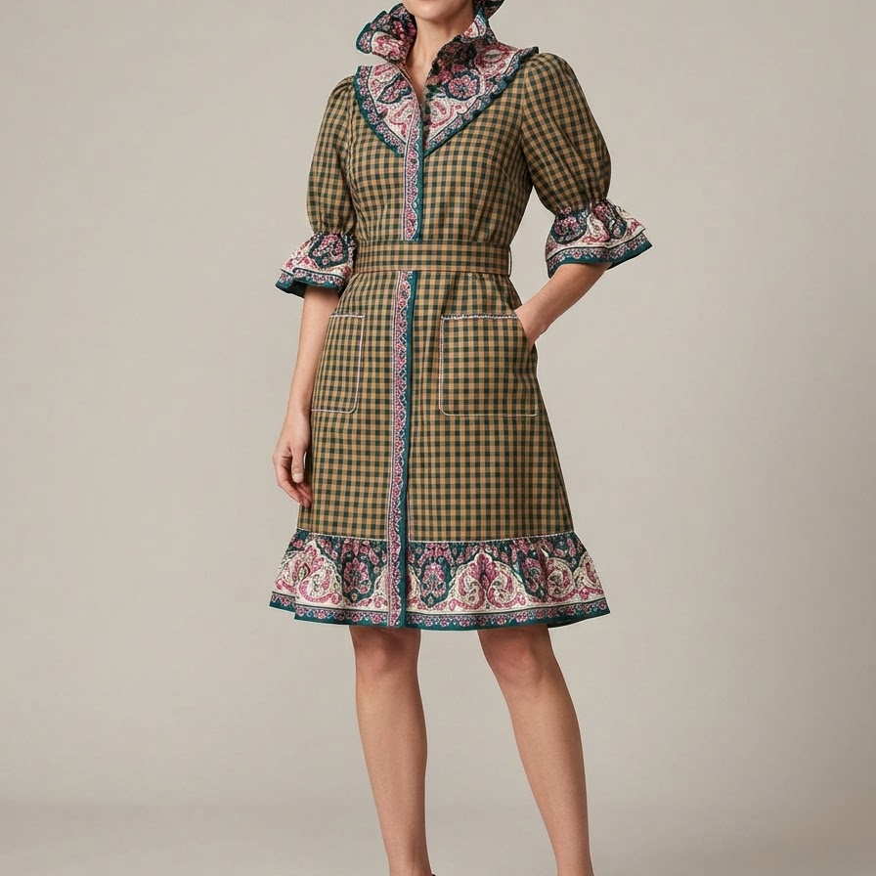
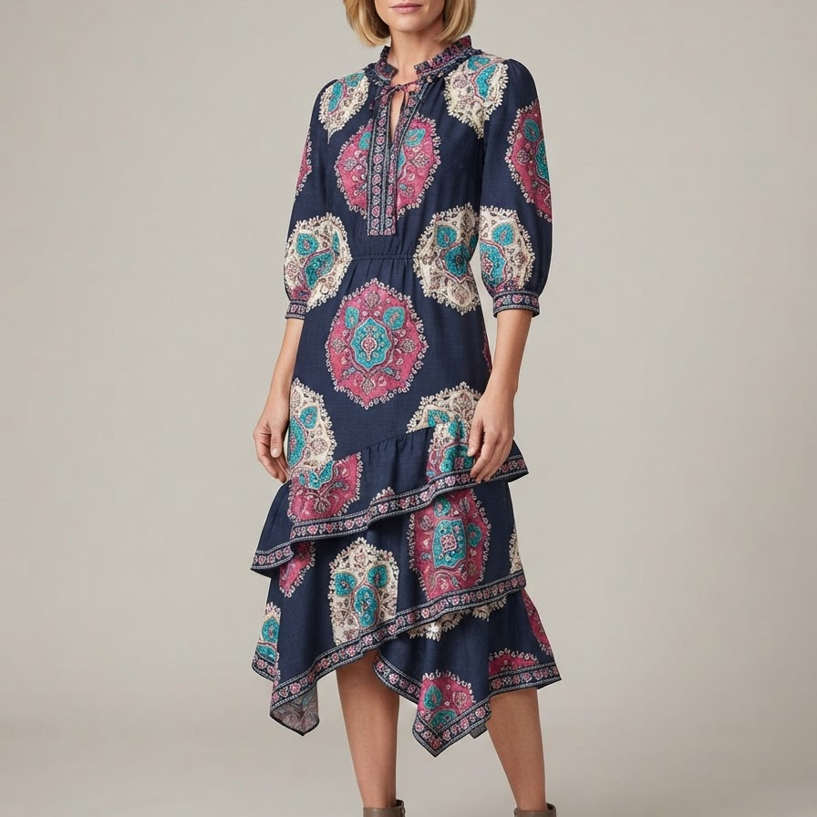
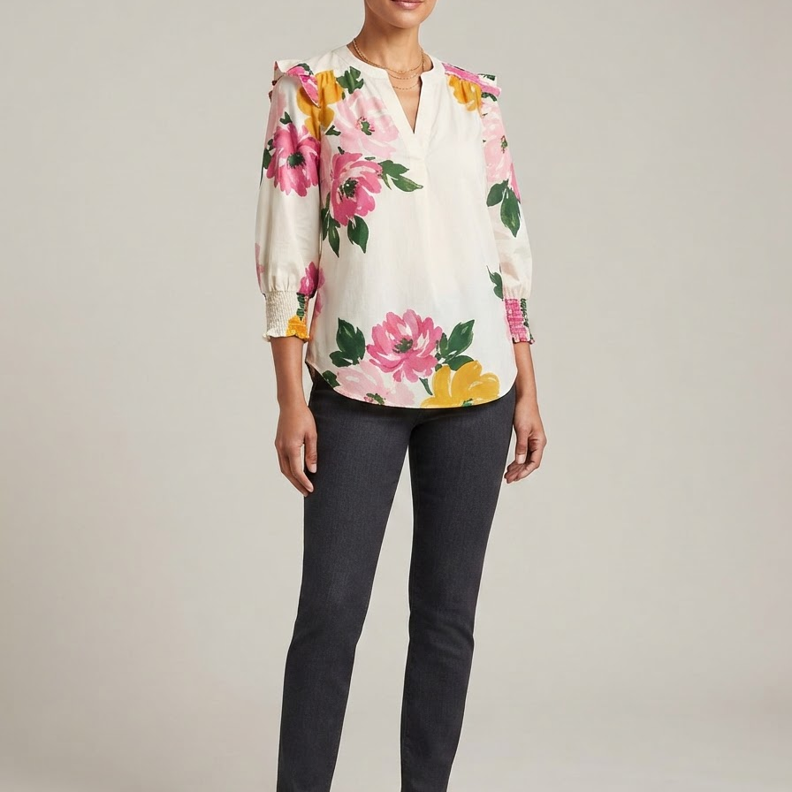
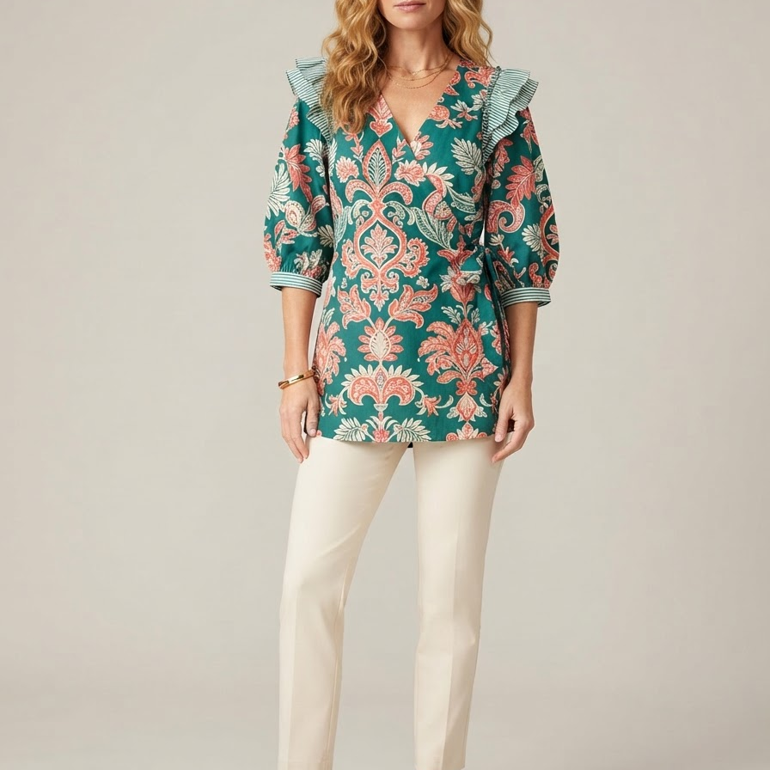
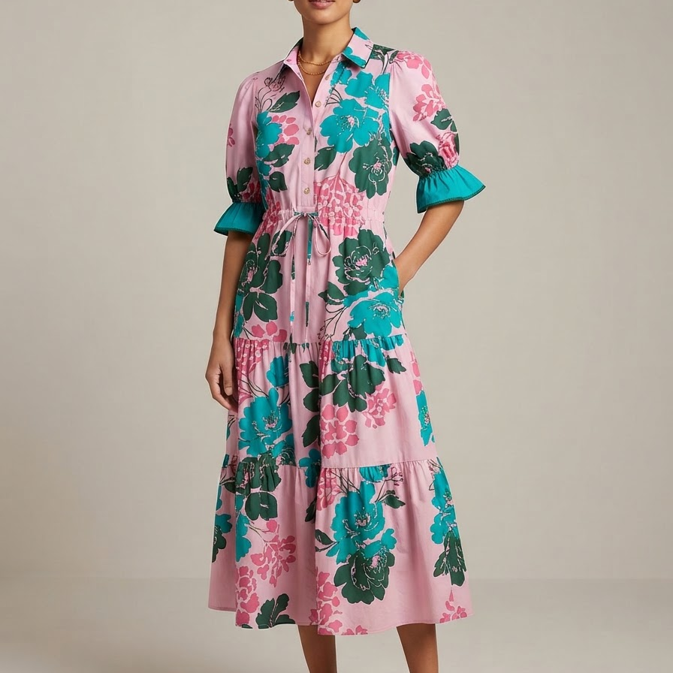
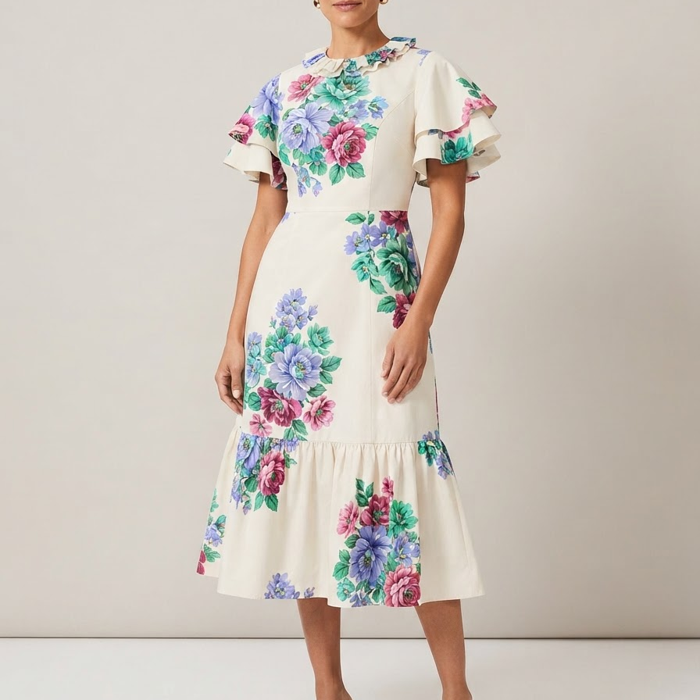
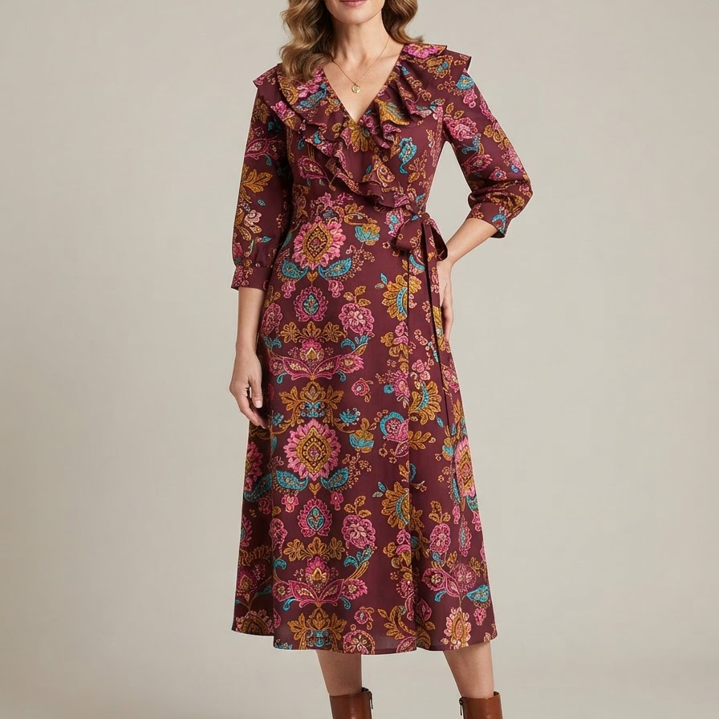
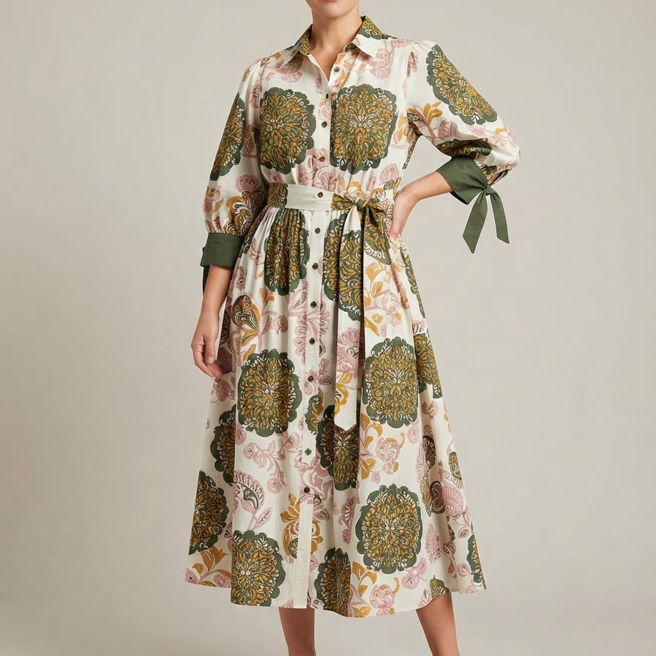
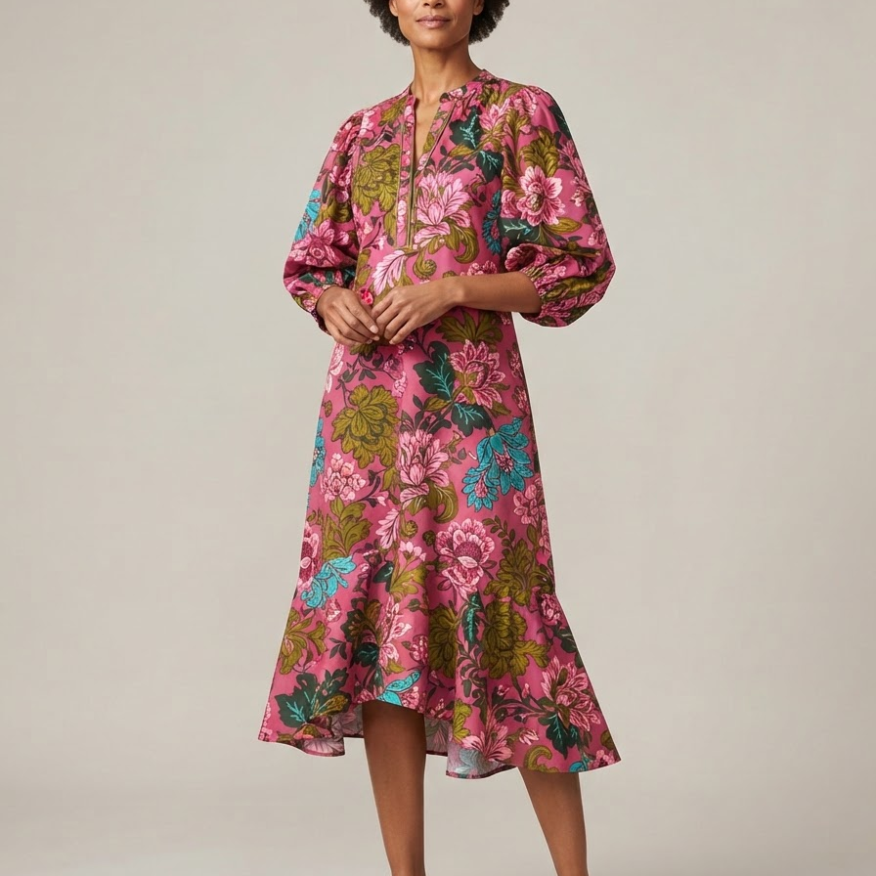
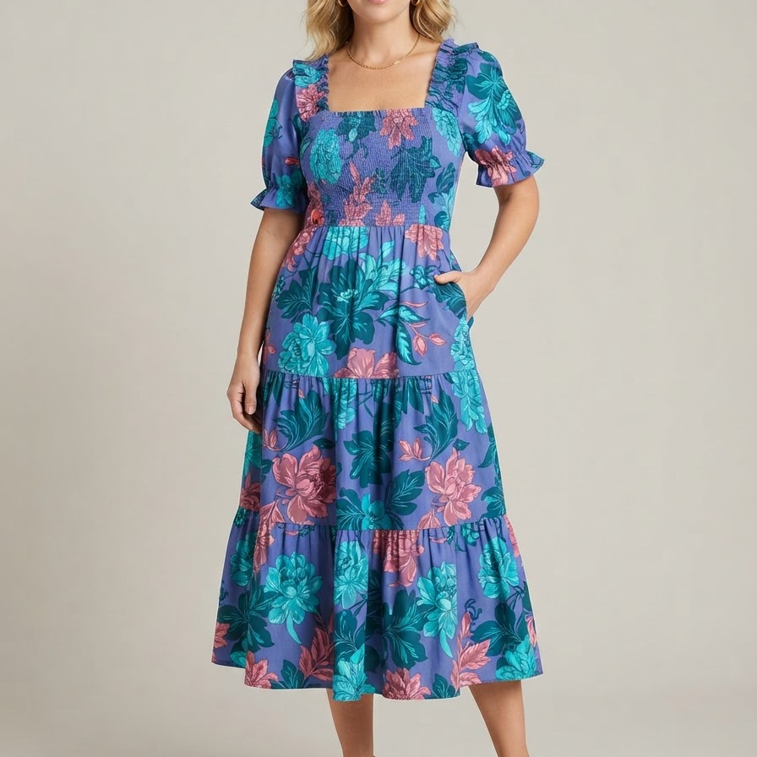
04 / FINAL ASSORTMENT / BATCH 02
06
CI26-011 - CI26-020
CI26-011
Dress
CI26-012
Dress
CI26-013
Top
CI26-014
Top
CI26-015
Dress
Refined Ruffle Utility
Refined Ruffle Utility
Full Bloom Day Dresses
Full Bloom Day Dresses
Full Bloom Day Dresses
CI26-016
Dress
CI26-017
Dress
CI26-018
Dress
CI26-019
Dress
CI26-020
Dress
Full Bloom Day Dresses
Full Bloom Day Dresses
Full Bloom Day Dresses
Full Bloom Day Dresses
Full Bloom Day Dresses
Notes:
[Sources]
AI-generated concept: CI26-011; sources mapped in final-v2/manifest.js (SM-PIN-001).
AI-generated concept: CI26-012; sources mapped in final-v2/manifest.js (EC-AMZ-001, SM-PIN-001).
AI-generated concept: CI26-013; sources mapped in final-v2/manifest.js (SM-PIN-005).
AI-generated concept: CI26-014; sources mapped in final-v2/manifest.js (EC-AMZ-001, SM-PIN-005).
AI-generated concept: CI26-015; sources mapped in final-v2/manifest.js (SM-PIN-001, SM-PIN-005).
AI-generated concept: CI26-016; sources mapped in final-v2/manifest.js (SM-PIN-001, SM-PIN-005).
AI-generated concept: CI26-017; sources mapped in final-v2/manifest.js (SM-PIN-001).
AI-generated concept: CI26-018; sources mapped in final-v2/manifest.js (SM-PIN-001, SM-PIN-005).
AI-generated concept: CI26-019; sources mapped in final-v2/manifest.js (EC-AMZ-001, SM-PIN-001).
AI-generated concept: CI26-020; sources mapped in final-v2/manifest.js (SM-PIN-001).

Slide 7
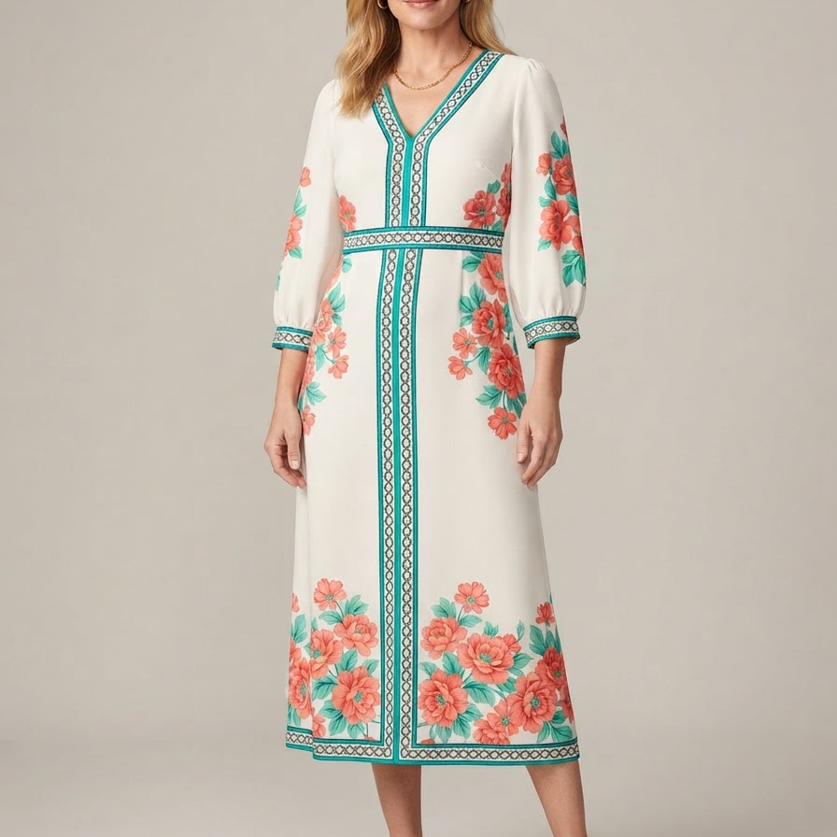
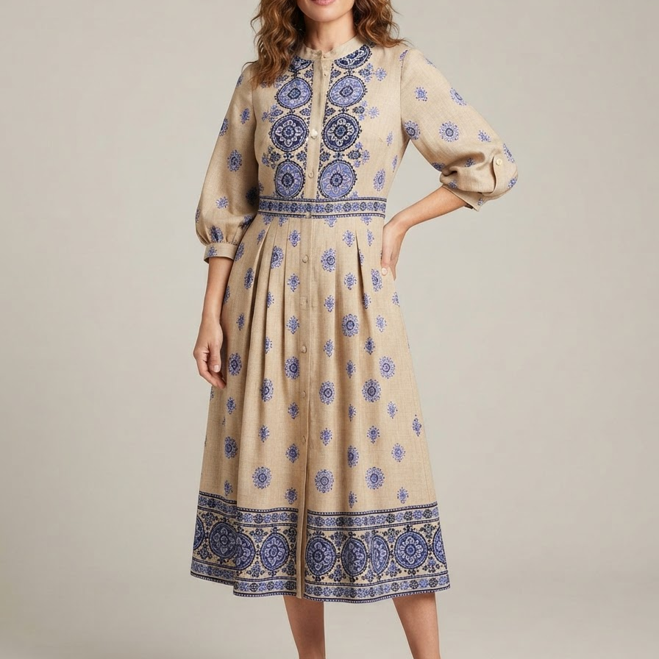
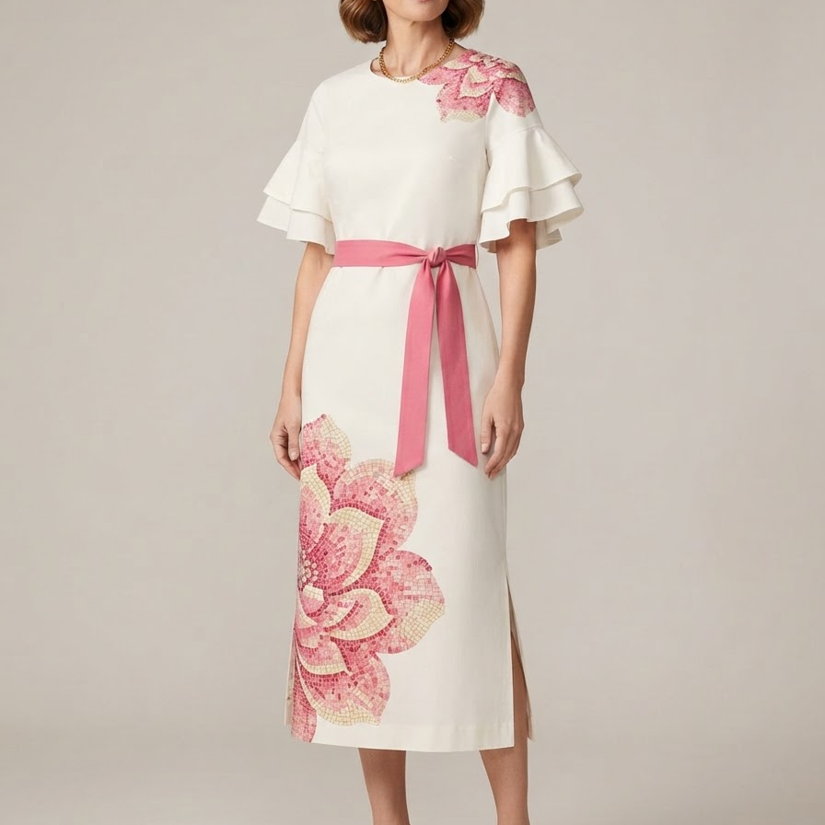
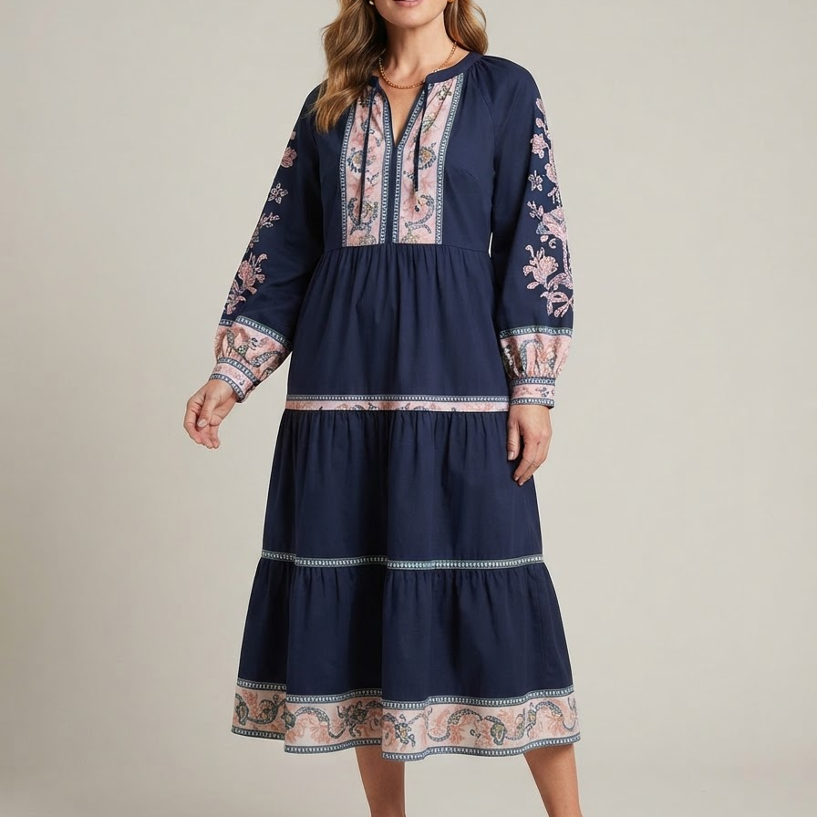
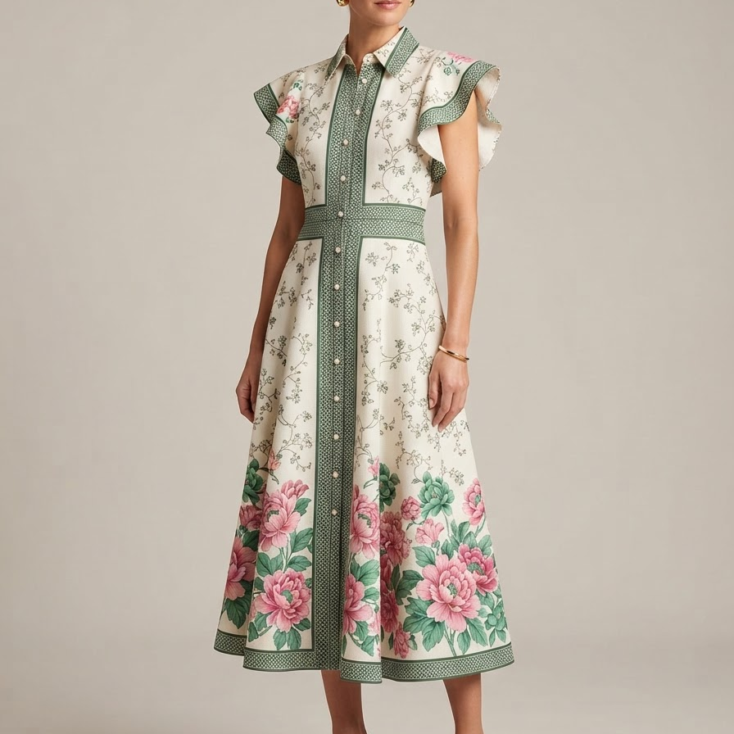
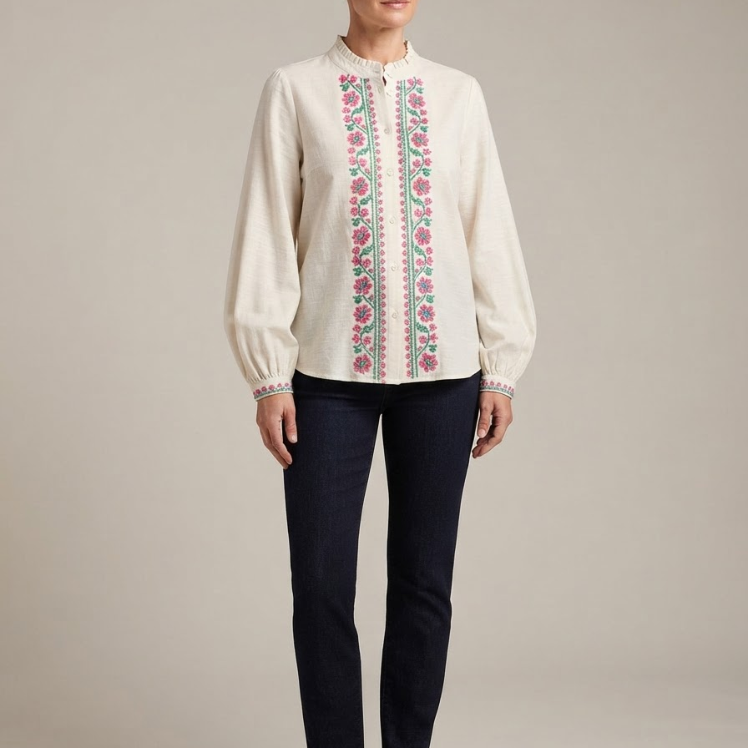
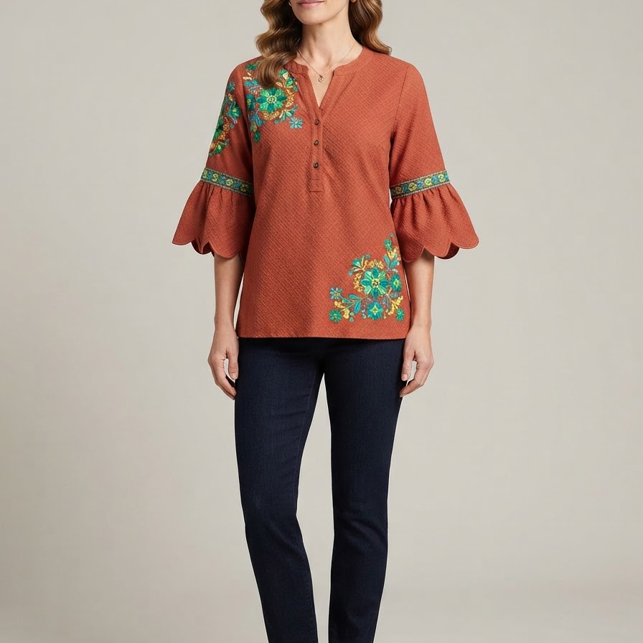
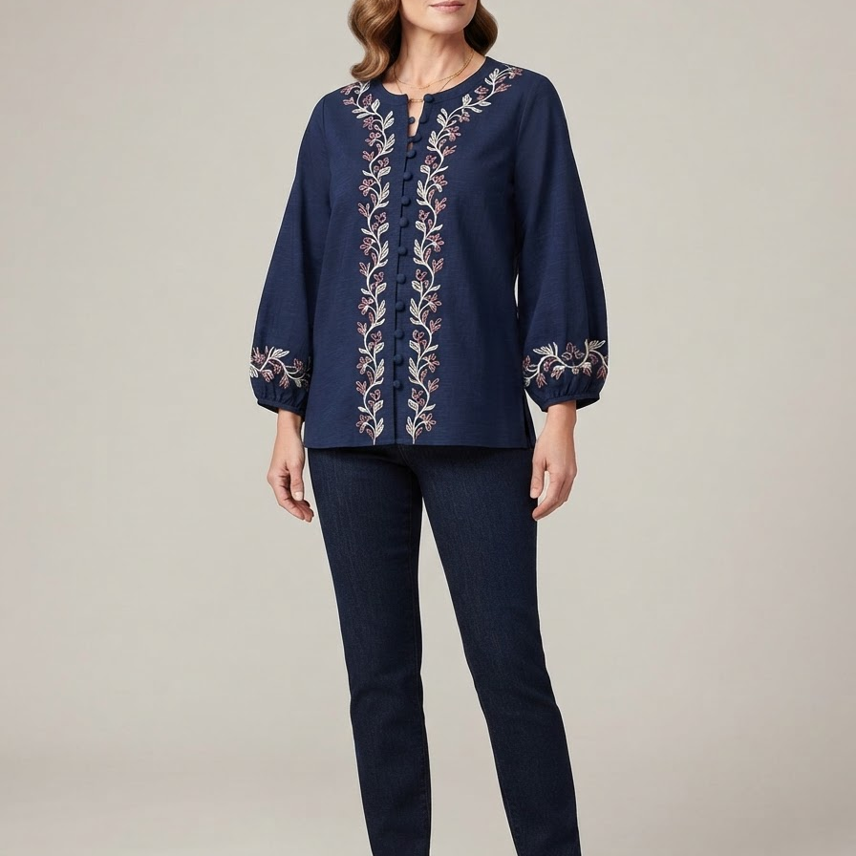
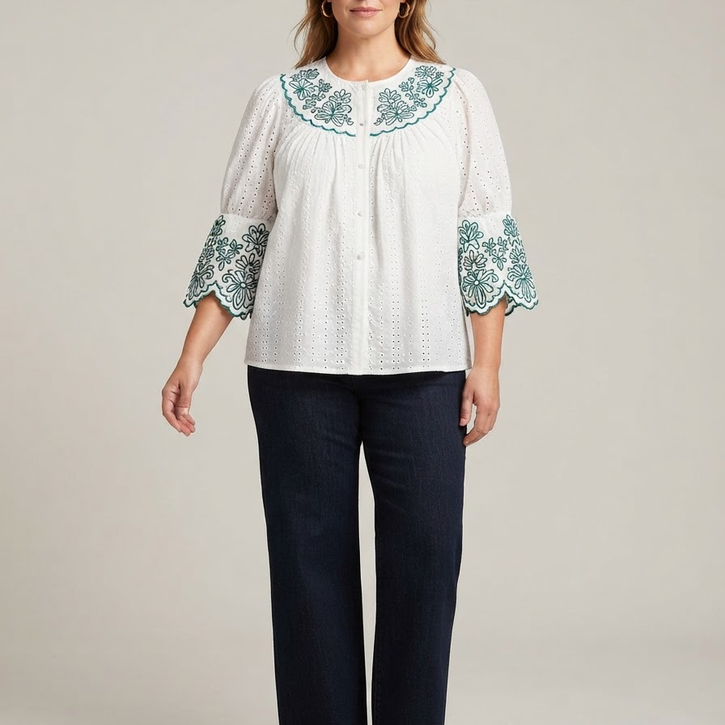
04 / FINAL ASSORTMENT / BATCH 03
07
CI26-021 - CI26-030
CI26-021
Dress
CI26-022
Dress
CI26-023
Dress
CI26-024
Dress
CI26-025
Dress
Full Bloom Day Dresses
Full Bloom Day Dresses
Full Bloom Day Dresses
Full Bloom Day Dresses
Full Bloom Day Dresses
CI26-026
Dress
CI26-027
Top
CI26-028
Top
CI26-029
Top
CI26-030
Top
Full Bloom Day Dresses
Crafted Texture, Lightly Embroidered
Crafted Texture, Lightly Embroidered
Crafted Texture, Lightly Embroidered
Crafted Texture, Lightly Embroidered
Notes:
[Sources]
AI-generated concept: CI26-021; sources mapped in final-v2/manifest.js (SM-PIN-001, SM-PIN-005).
AI-generated concept: CI26-022; sources mapped in final-v2/manifest.js (SM-PIN-001, SM-PIN-002).
AI-generated concept: CI26-023; sources mapped in final-v2/manifest.js (SM-PIN-001, SM-PIN-002).
AI-generated concept: CI26-024; sources mapped in final-v2/manifest.js (SM-PIN-001, SM-PIN-005).
AI-generated concept: CI26-025; sources mapped in final-v2/manifest.js (EC-AMZ-001, SM-PIN-001).
AI-generated concept: CI26-026; sources mapped in final-v2/manifest.js (SM-PIN-005).
AI-generated concept: CI26-027; sources mapped in final-v2/manifest.js (SM-PIN-002).
AI-generated concept: CI26-028; sources mapped in final-v2/manifest.js (SM-PIN-002).
AI-generated concept: CI26-029; sources mapped in final-v2/manifest.js (SM-PIN-002).
AI-generated concept: CI26-030; sources mapped in final-v2/manifest.js (SM-PIN-002).

Slide 8
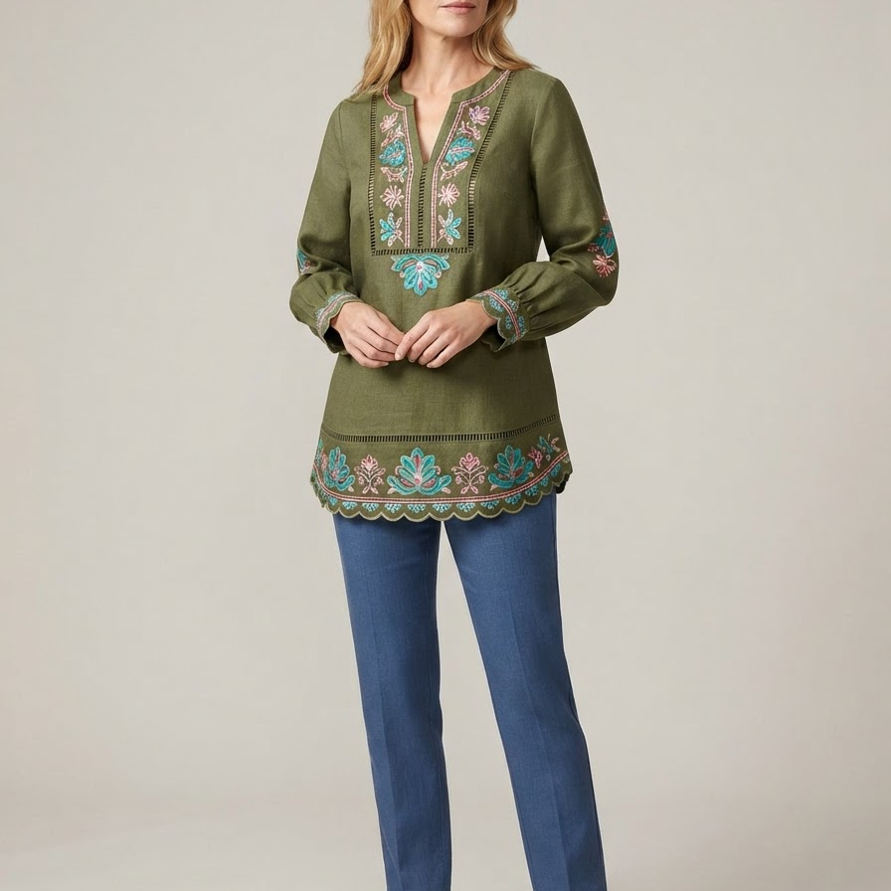
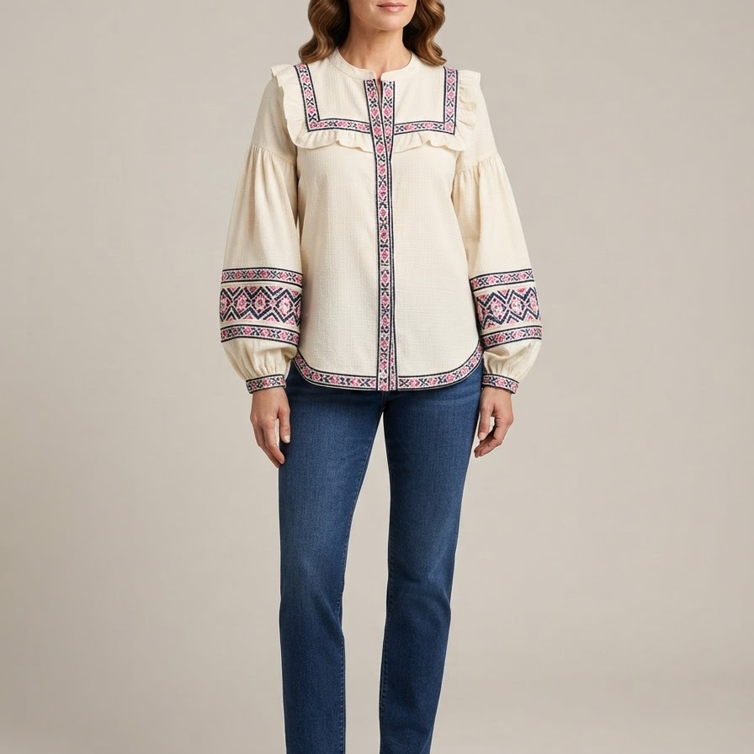
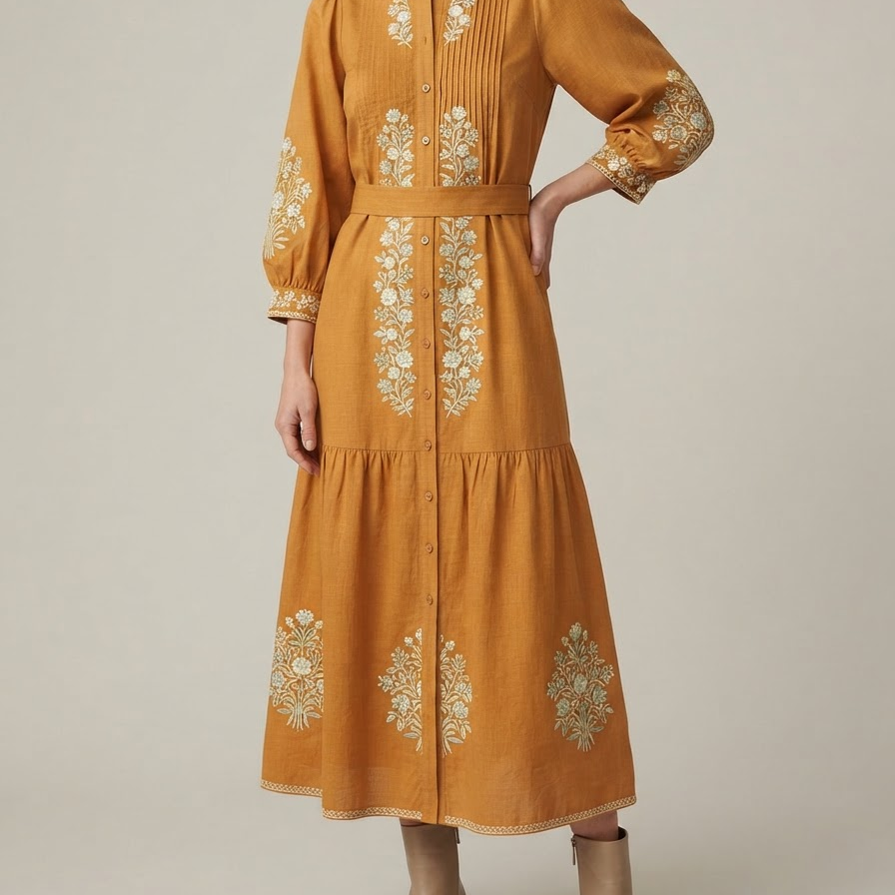
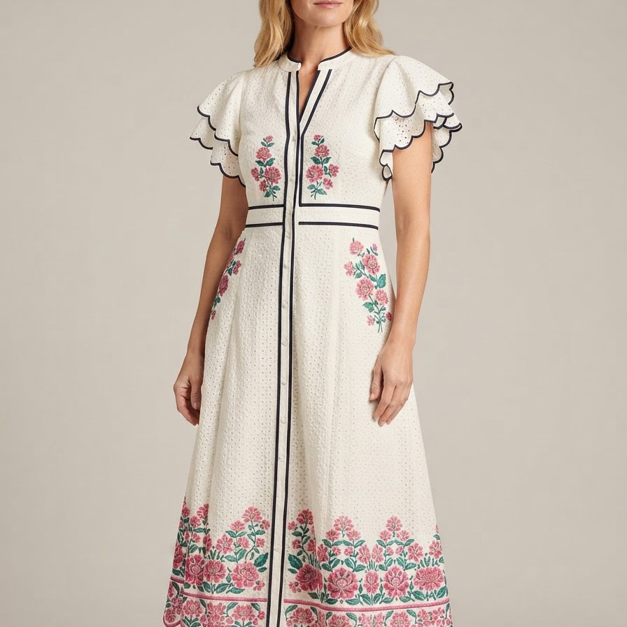
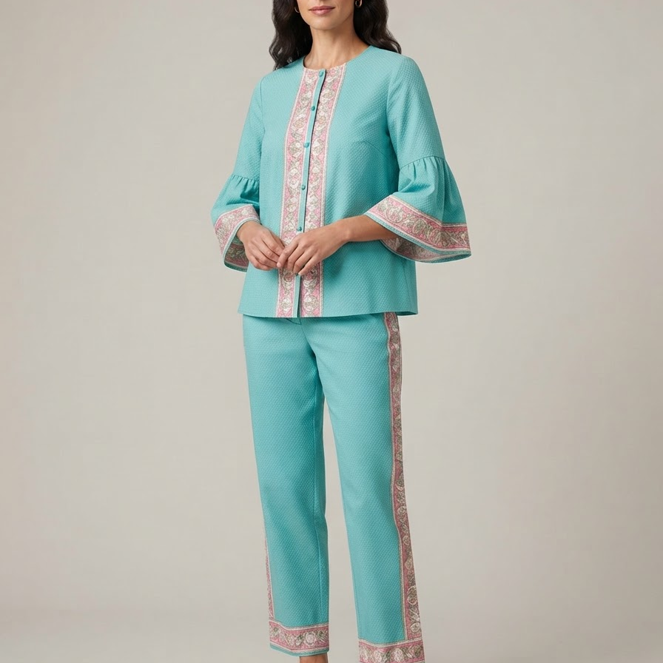
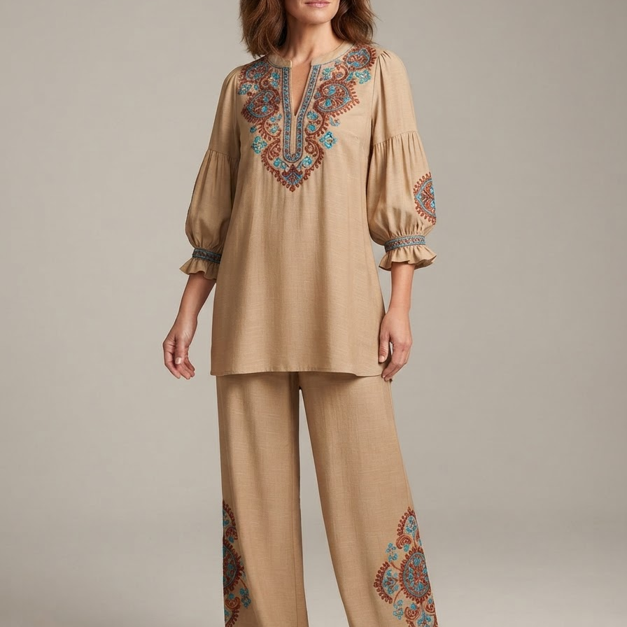
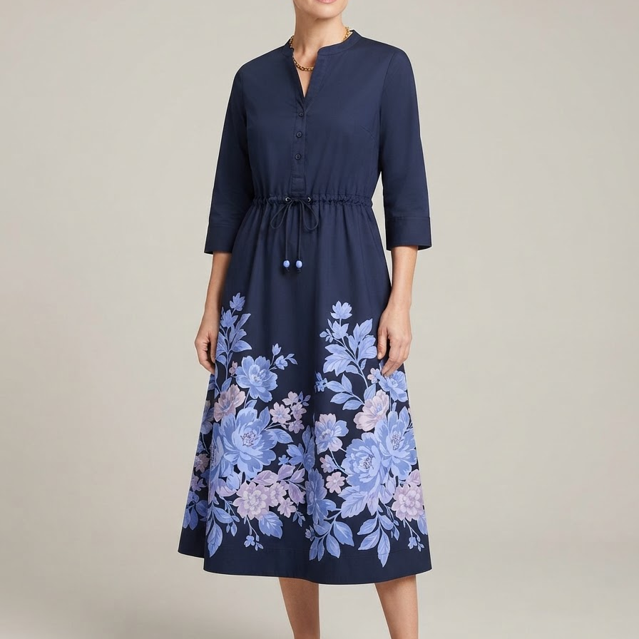
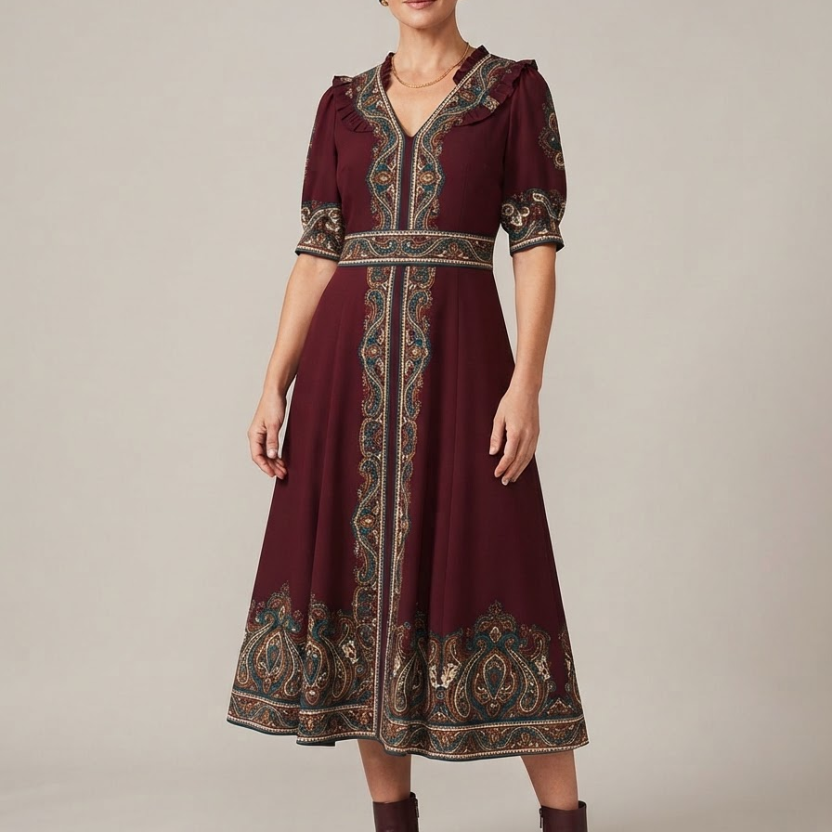
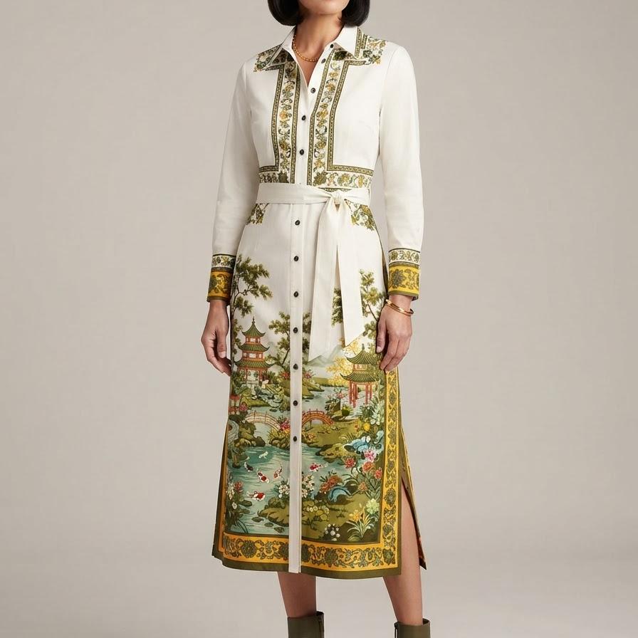
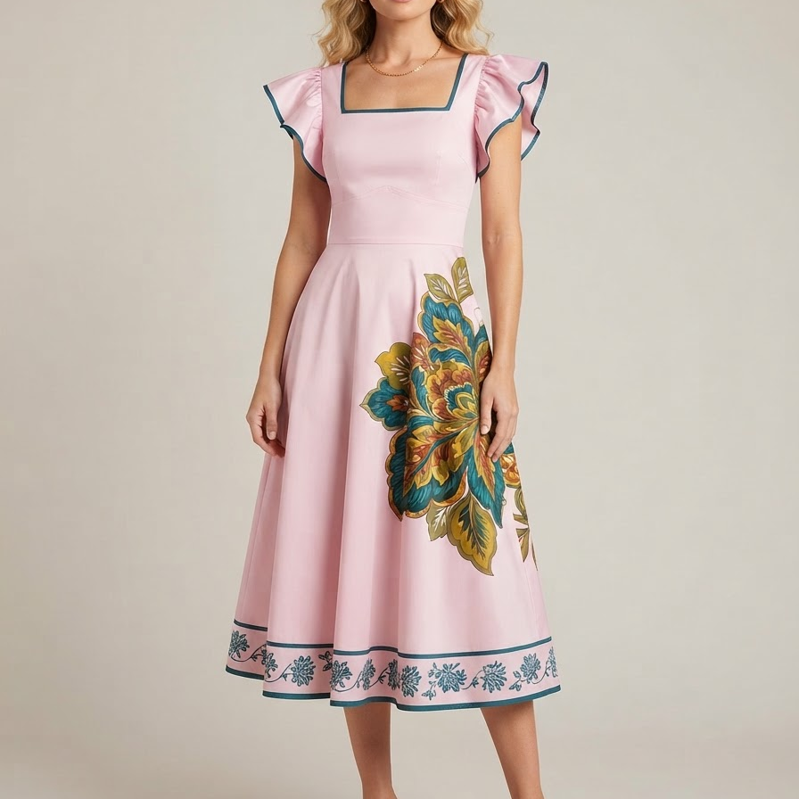
04 / FINAL ASSORTMENT / BATCH 04
08
CI26-031 - CI26-040
CI26-031
Top
CI26-032
Top
CI26-033
Dress
CI26-034
Dress
CI26-035
Set
Crafted Texture, Lightly Embroidered
Crafted Texture, Lightly Embroidered
Crafted Texture, Lightly Embroidered
Crafted Texture, Lightly Embroidered
Crafted Texture, Lightly Embroidered
CI26-036
Set
CI26-037
Dress
CI26-038
Dress
CI26-039
Dress
CI26-040
Dress
Crafted Texture, Lightly Embroidered
Placed Story Prints
Placed Story Prints
Placed Story Prints
Placed Story Prints
Notes:
[Sources]
AI-generated concept: CI26-031; sources mapped in final-v2/manifest.js (SM-PIN-002).
AI-generated concept: CI26-032; sources mapped in final-v2/manifest.js (SM-PIN-002).
AI-generated concept: CI26-033; sources mapped in final-v2/manifest.js (SM-PIN-002, SM-PIN-005).
AI-generated concept: CI26-034; sources mapped in final-v2/manifest.js (SM-PIN-002).
AI-generated concept: CI26-035; sources mapped in final-v2/manifest.js (SM-PIN-002, SM-PIN-003).
AI-generated concept: CI26-036; sources mapped in final-v2/manifest.js (SM-PIN-002, SM-PIN-003).
AI-generated concept: CI26-037; sources mapped in final-v2/manifest.js (SM-PIN-005).
AI-generated concept: CI26-038; sources mapped in final-v2/manifest.js (SM-PIN-006).
AI-generated concept: CI26-039; sources mapped in final-v2/manifest.js (SM-PIN-005, SM-PIN-006).
AI-generated concept: CI26-040; sources mapped in final-v2/manifest.js (SM-PIN-005).

Slide 9
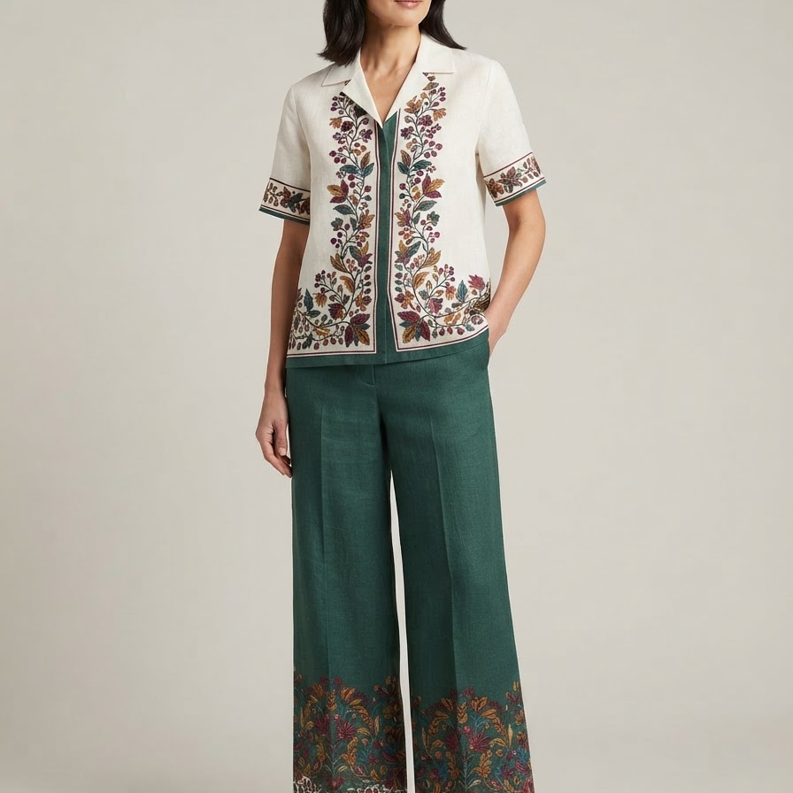
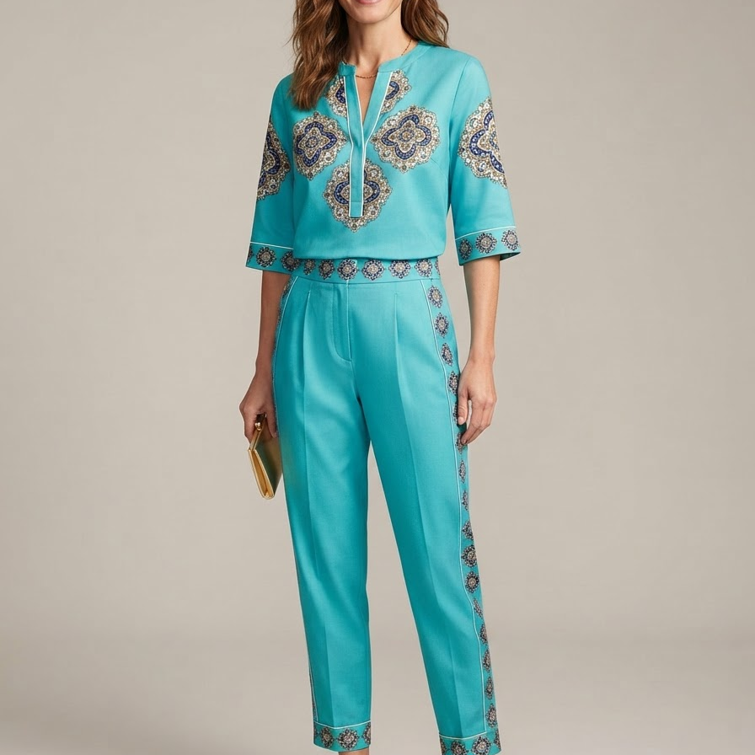
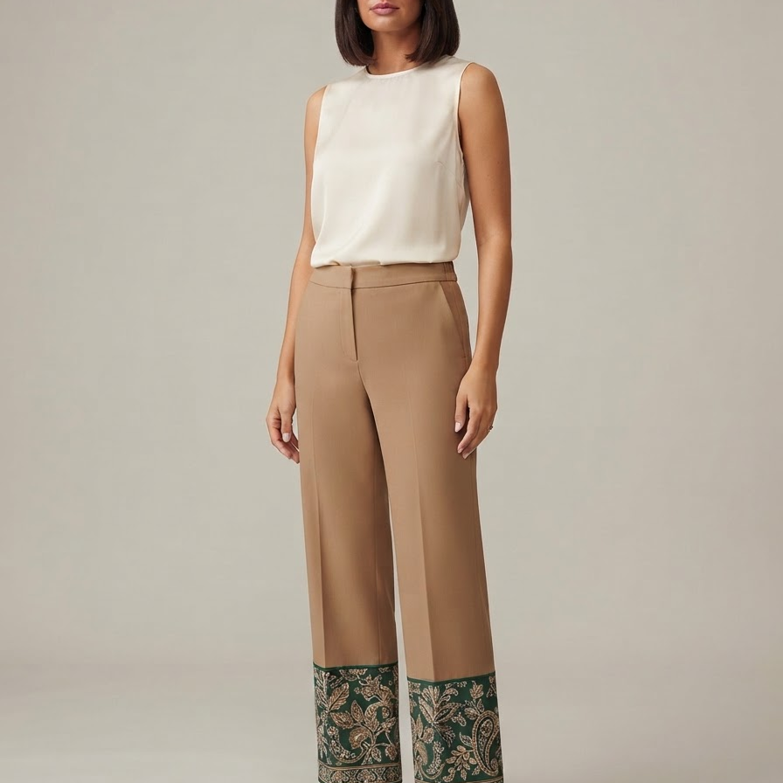
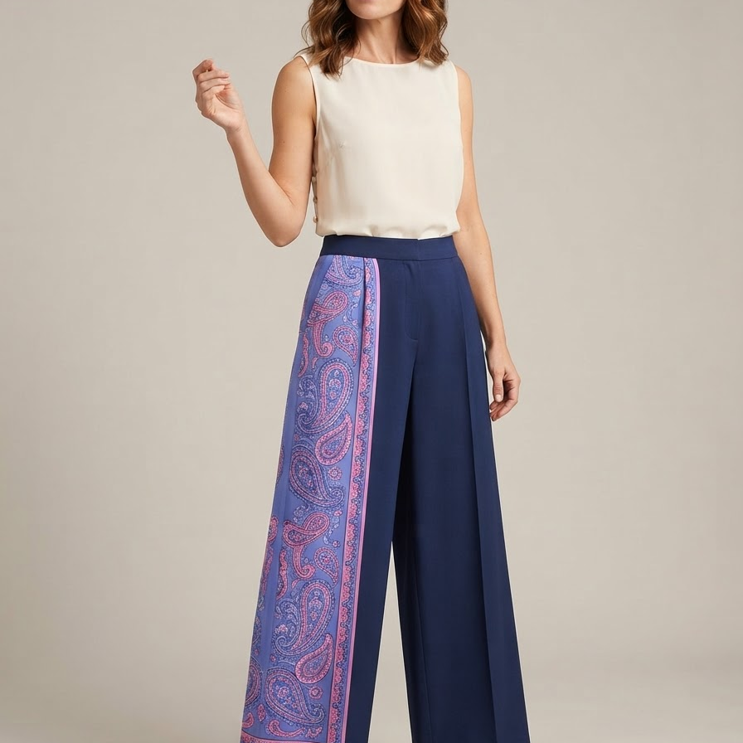
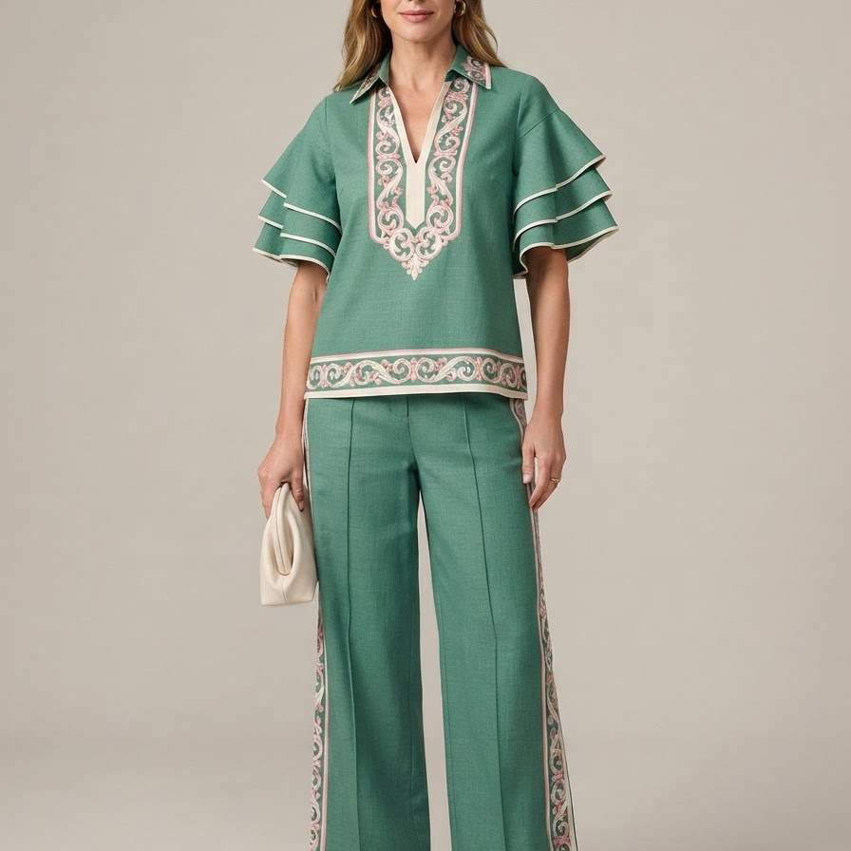
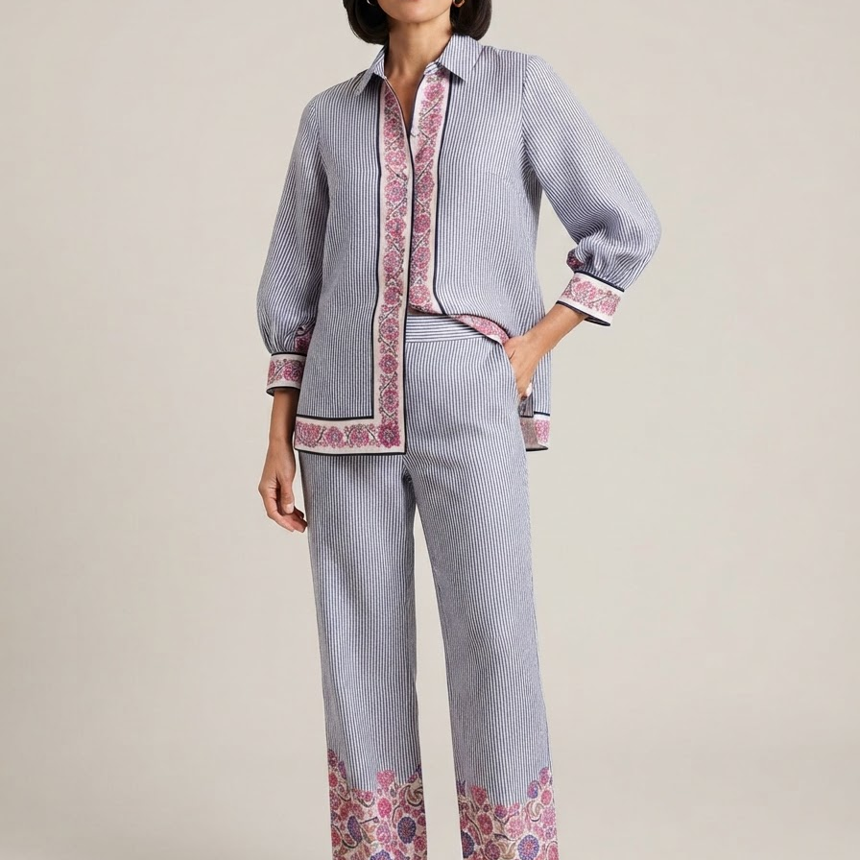




04 / FINAL ASSORTMENT / BATCH 05
09
CI26-041 - CI26-050
CI26-041
Set
CI26-042
Set
CI26-043
Pant
CI26-044
Pant
CI26-045
Set
Placed Story Prints
Placed Story Prints
Placed Story Prints
Placed Story Prints
Polished Woven Coordinates
CI26-046
Set
CI26-047
Pant
CI26-048
Pant
CI26-049
Pant
CI26-050
Pant
Polished Woven Coordinates
Polished Woven Coordinates
Polished Woven Coordinates
Polished Woven Coordinates
Polished Woven Coordinates
Notes:
[Sources]
AI-generated concept: CI26-041; sources mapped in final-v2/manifest.js (SM-PIN-003, SM-PIN-005).
AI-generated concept: CI26-042; sources mapped in final-v2/manifest.js (SM-PIN-003, SM-PIN-006).
AI-generated concept: CI26-043; sources mapped in final-v2/manifest.js (SM-PIN-003, SM-PIN-005).
AI-generated concept: CI26-044; sources mapped in final-v2/manifest.js (SM-PIN-003, SM-PIN-006).
AI-generated concept: CI26-045; sources mapped in final-v2/manifest.js (SM-PIN-003).
AI-generated concept: CI26-046; sources mapped in final-v2/manifest.js (SM-PIN-003).
AI-generated concept: CI26-047; sources mapped in final-v2/manifest.js (SM-PIN-003).
AI-generated concept: CI26-048; sources mapped in final-v2/manifest.js (SM-PIN-003).
AI-generated concept: CI26-049; sources mapped in final-v2/manifest.js (SM-PIN-003).
AI-generated concept: CI26-050; sources mapped in final-v2/manifest.js (SM-PIN-003).

Slide 10
05 / TRACEABILITY
Sources, uses and gaps
Customer brief
Retail context
Search and social
Feishu requirement, six-page PDF and 18 sample-style references. Used for requirement and retrieval anchors, not market proof.
Crown & Ivy/BELK, Dillard's, Ann Taylor and Talbots public pages. Used for silhouette recurrence and visible price context.
US search fields plus filtered TikTok, Pinterest and Instagram samples. Metrics remain separate and directional.
DATA GAPS
Current BELK product-level pricing, Tuckernuck product evidence and a callable fashion trend-vector source were not available in the bounded run. No missing field was filled with zero, estimation or simulation.
Notes:
[Sources]
Crown & Ivy evidence catalog: 03a_evidence_catalog.md.
Final proposal v2 source and data-gap section.

