Slide 1


CAPSTONE PRESENTATION
Notes:
Good afternoon. I will be presenting on global school drop-out rates and will be specifically addressing school drop-out rates according to economic regions and the demographics and regions affected by this.

Slide 2
PROBLEM IDENTIFICATION—SCHOOL DROP-OUT RATES
Developing World more affected
Girls impacted more than boys
Felt more in rural areas than urban
Notes:
School drop-out rates are an on-going issue around the world but no where is this more keenly felt and places a great toll on the population than that of nations that are the least developed within the development regions index. On average, the least developed nations of the development regions index suffer a school drop-out rate that hovers around the 30% range. In addition, girls tend to be more affected by school drop-outs and students in rural areas experience a higher drop-out rate than that of students living in urban areas.

Slide 3
HOW WILL WE VERIFY THIS?
COLLECTED DATA SETS
SVM—SUPPORT VECTOR MACHINE
THREE ADDITIONAL SVM RUNS
CHARTING OUR CLASSES AND ATTRIBUTES
Notes:
In support of the theory from the previous slide, I have gathered some data of school drop-out rates across the globe that spans a decade of data recording. Originally, I combined the three separate data sets of primary, lower secondary, and upper secondary students drop-out rates and selected six features or columns to work with for the SVM. The first feature ‘Development Regions’ functioning as the class feature and the other five features including ‘Total’, ‘Female’, ‘Male’, ‘Rural Residence’, and ‘Urban Residence’ functioning as the attribute features in which the SVM will utilize to predict on the classes that each observation or row belongs to.

Slide 4
SAMPLE OF DATA FRAME FEATURES
 | Development Regions | Total | Female | Male | Rural Residence | Urban Residence
0 | Least Developed | 40% | 56% | 25% | 46% | 23%
1 | More Developed | 2% | 2% | 2% | 2% | 2%
2 | Less Developed | 6% | 6% | 5% | 8% | 4%
4 | Least Developed | 15% | 17% | 14% | 28% | 10%
8 | Less Developed | 1% | 1% | 1% | 0% | 1%
Notes:
As displayed on the slide here, this is a sample of the data frame we are working with but using a small sample of it for illustration purposes. The first column labelled Development Regions serves as the feature with the classes and the following five columns each serve as features with attributes on which the SVM will utilize to predict on the class that each observation or row belongs to.

Slide 5
ORIGINAL SVM RUN AND RESULTS—CONFUSION MATRIX
 | LEAST DEVELOPED | LESS DEVELOPED | MORE DEVELOPED
LEAST DEVELOPED | 20 | 2 | 0
LESS DEVELOPED | 13 | 25 | 0
MORE DEVELOPED | 0 | 5 | 0
Notes:
After running the data set through the SVM’s classifier, I ran both the prediction set and test set on the confusion matrix function which illustrates a diagram of the number of correct predictions for each class. As can be seen here, the predictions for the least developed class were highly accurate as only 2 out of 22 predictions were wrongly classed here. Unfortunately, the more developed class was always wrongly predicted as we didn’t have enough support or observations with which to work with as a lot of more developed observations had to be dropped due to null values otherwise the SVM won’t work.

Slide 6
ORIGINAL SVM RUN AND RESULTS—CLASSIFICATION REPORT
 | PRECISION | RECALL | F1-SCORE | SUPPORT
LEAST DEVELOPED | 61% | 91% | 73% | 22
LESS DEVELOPED | 78% | 66% | 71% | 38
MORE DEVELOPED | 100% | 0% | 0% | 5
ACCURACY |  |  | 69% | 65
Notes:
To provide further clarification on the confusion matrix diagram from before, a classification report is also available which gives the readings for each of the metrics for which each observation of the data set is measured by; this report also expounds on the predictions as provided by the confusion matrix. Overall, the accuracy sits at 69% for this run of the data and is the number of predictions correctly predicted.

Slide 7
ADDITIONAL SVM TRIAL RUN SAMPLE
 | LEAST DEVELOPED | LESS DEVELOPED | MORE DEVELOPED
LEAST DEVELOPED | 5 | 1 | 0
LESS DEVELOPED | 3 | 12 | 0
MORE DEVELOPED | 0 | 1 | 0
Notes:
Here in this slide are the results of one of three additional runs conducted on the SVM’s classifier to test for the efficacy of the model. I used and treated the lower secondary school drop-out data as a separate and distinct data set for this particular run. In this case, both the predictions for the least developed and less developed regions improved in accuracy.

Slide 8
ADDITIONAL SVM TRIAL RUN SAMPLE
 | PRECISION | RECALL | F1-SCORE | SUPPORT
LEAST DEVELOPED | 62% | 83% | 71% | 6
LESS DEVELOPED | 86% | 80% | 83% | 15
MORE DEVELOPED | 100% | 0% | 0% | 1
ACCURACY |  |  | 77% | 22
Notes:
All around the metrics for the least and less developed classes have improved as well with the less developed class noticeably so and with better support as well at 15 observations to test on. The accuracy has improved as well at 77%.

Slide 9
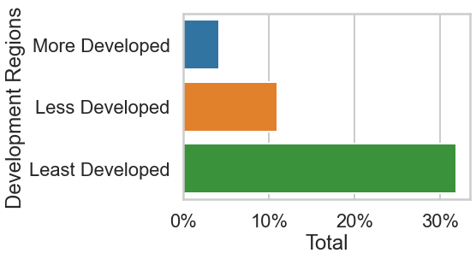
BAR CHART OF DEVELOPMENT REGIONS TOTAL AVERAGE DROP-OUT
Notes:
In support of the results generated by the SVM run, I created charts of all six of the features utilized by the model. For each of the three charts, I used two features each where each pair of features chosen display relevant relations, correlations, or contrasts. For the bar plot displayed here, each class of the Development Regions feature is shown here for comparative purposes to illustrate where they rank in total average drop-out rate. Clearly, development regions that fall in the least developed class suffer significantly higher drop-out rates than other regions lending support to the original theory.

Slide 10
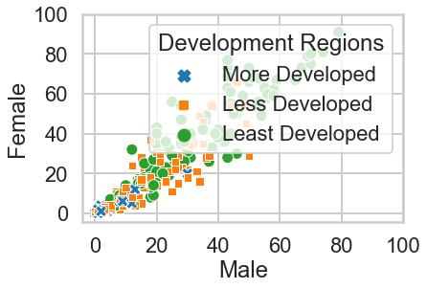
SCATTERPLOT OF MALE AND FEMALE DROP-OUT CORRELATIONS
Notes:
In this first of two scatterplots I created, I used the Male feature as the independent variable and the Female feature as the dependent variable to back my thesis that female students tend to be more adversely affected in suffering drop-outs from school than male students the lesser developed a region is. I also added the Development Regions feature here to provide a more in-depth analysis of which regions exactly experience this disparity between boys and girls drop-out rates. Of note however, are certain data points in the plot which shows anomalies of male students more affected than female students; male and female drop-out rates appear to be on-par in less developed regions and male students appear to experience higher drop-outs in more developed areas. For our purposes though, our primary focus is on the least developed and hardest hit regions.

Slide 11
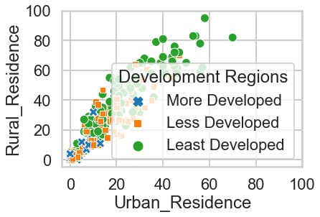
SCATTERPLOT OF URBAN RESIDENCE AND RURAL RESIDENCE DROP-OUT CORRELATIONS
Notes:
In the second scatterplot here, I used the Urban Residence feature as the independent variable and the Rural Residence feature as the dependent variable to support another aspect of my original thesis that rural communities suffer from higher drop-out rates than urban communities in general. On average, the correlations among the two variables here bear claim to that assertion as rural communities on average experience higher drop-out rates by far than urban; the less developed a region is, the more the disparity between the two is apparent.

Slide 12
STRATEGIC IMPLICATIONS
SVM ASSISTS IN CLASSIFICATION
CHOOSING THE RIGHT FEATURES
STEERING TOWARD SPECIFIED TARGETS
Notes:
As demonstrated in the earlier slides with the SVM results and further supported with the scatterplot correlations, the SVM’s classifier can affirm or confirm which attributes identify or make up the identity of a designated class. Experimenting with the SVM in selecting features which contain the attributes helps in informing us of the features relevant to that class and can direct us in how to make use of the data. For instance, if the attribute features of male and urban highly influence the classification of an observation labelled as ‘less developed’, UNICEF can make use of this to shift and focus much of their outreach and efforts to those demographics that are more affected by school drop-out rates.

Slide 13
RECOMMENDATIONS
USE SVM TO TAILOR OUTREACH
PROVIDE SERVICES IN SEQUENCE
PROVIDE SERVICES COMPOSITELY
Notes:
Some recommendations I have in mind based on the predictions of the SVM are to reach out to certain demographics of the population according to critical needs. For our particular purpose and focus on those most affected, if a least developed region has a disproportionate number of girls dropping out in relation to other demographics, we can distribute much of our resources and services to that demographic most in need and address their needs primarily. On the other hand, if the female and rural residence demographics are both in dire need of aid, we can direct our outreach programs to them concurrently and even modify our outlook in how we address these demographics such as prioritizing females in rural areas if this is a particular niche of the population that affects such a profile adversely more so than others.

Slide 14
BUSINESS PROFITABILITY
CAPITALIZE ON SOUND LOGISTICS
PRIORITIZE DIRE NEEDS GROUPS
ENSURE SOCIAL MISSION IS REALIZED
Notes:
With the aid of the SVM model, we can make the necessary adjustments and modifications to our logistics to meet the needs of those demographics within the population that need our assistance and truly ensure that out social mission to meet the needs and welfare of those children that require it is rightly identified, managed, and realized and thus also securing our reputation and reliability as an organization that works efficiently and delivers on its mission. Thank you!

