Slide 1
CAPSTONE
PRESENTATION
Notes:
Good afternoon. Today’s presentation will be about binary text classification in categorizing texts between emergency and non-emergency texts to facilitate access to vital information for news agencies, disaster relief organizations, social media platforms, and communities.

Slide 2
NEWS PROPAGATION FACTS
People often go to Twitter to report and update on the latest news
They often document these events with photos, footage, updates
Twitter is likely the first place for many individuals to be informed
Notes:
On this quest to find the optimal source in which to deploy a binary classifier, what platform immediately comes to mind where people first flock to keep up to date on the latest happenings? Where it is time efficient and user-friendly in exchanging and relaying messages rather quickly? Where one can quickly absorb the needed information in mere seconds with a short text? If Twitter comes to mind, you’re right on target.

Slide 3
IN SEARCH OF THE RIGHT TEXT CLASSIFIER
Social media platforms like Twitter are replete with the latest news
Many of these updates involve emergencies
Tweets that don’t involve emergencies may use similar language
This calls for a binary text classifier
Notes:
In searching for new, innovative ways in which to detect emergencies as quickly as possible, the internet has given rise to quintessential platforms like Twitter where short texts packed with concise messages can be exchanged rapidly, in a time-saving and consistent manner. While many of these texts relay messages that signal an emergency, there also exists many texts that use similar words and phrasing but do not represent an emergency of any kind. This presents a need here for a binary classifier in which our quest to find this solution has led me to deep learning.

Slide 4
THE LOOMING THREAT OF TONE DEAFNESS – GET IT?
There is a need for binary classification of tweets
A classifier that cannot decipher between text ambiguity can be costly
Accurately identifying emergency tweets can directly impact you
Notes:
A binary text classifier is of utmost importance as it could very well mean life and death for some. Although there are many other mediums of communication (legacy media comes to mind here), social media platforms in the age of the Internet, specifically Web 2.0, have grown too much in popularity and in its versatility of use-cases such as being a real-time news update platform, to ignore to everyone’s detriment. However, what is critical here is getting the classifier with as high an accuracy as possible, to separate between texts that share very similar phrasing but have a completely different tone and imply a very different message! Making sure the classifier meets this demand is paramount as an unexpected disaster may strike closer to home for each one of us listening here!

Slide 5
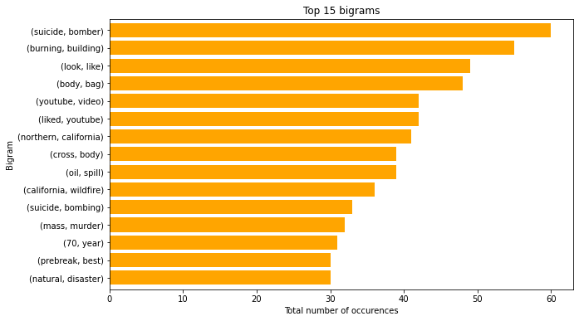
MOST COMMON TWO WORD SEQUENCES
Notes:
As seen in the bigram here or 2-word sequence chart, these are the most common 2-word sequences that surface in the collected data of tweets. To exemplify our need of a binary text classifier that can correctly tease out the emergency from non-emergency tweets, let’s look at the most popular 2-word sequence, suicide bomber. At first glance, the words ‘suicide bomber’ immediately grabs one’s attention as it is of course a tragic phenomenon but may not need to cause alarm or an emergency response if the twitter feed is streaming with tweets that is reporting on a historic incident involving a suicide bomber versus a real-time event currently involving a suicide bomber posing a public threat.

Slide 6
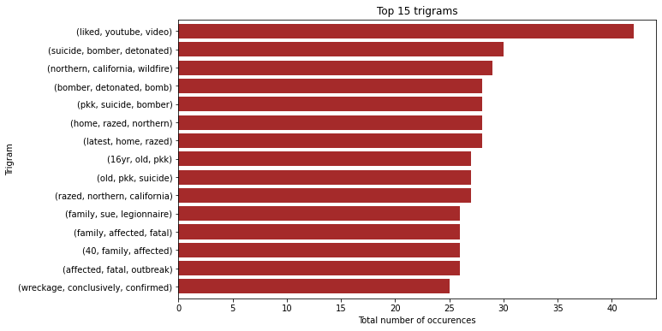
MOST COMMON THREE WORD SEQUENCES
Notes:
In our trigram chart or 3-word sequence chart, to further build upon the example from the previous slide, the second most common trigram ‘suicide bomber detonated’, adds a further layer of info and meaning to the word sequence we last examined. However, detonated can refer to a distant past event or to the recent past or even an ongoing event with danger still present and the repercussions of such a tragedy still keenly felt in the present moment.

Slide 7
DEEP LEARNING MODELS – THE SOLUTION
SIMPLE NEURAL NETWORK
CONVOLUTIONAL NEURAL NETWORK
RECURRENT (LONG-SHORT TERM MEMORY) NEURAL NETWORK
Notes:
Of course, there is nothing quite like the human mind to date that can employ logic and reasoning to decipher the meaning conveyed in a message. Nonetheless, deep learning models come close enough to this as they are a type of artificial intelligence (AI) that are created to imitate the inner workings of the human brain such as processing data, forming patterns, and informing decision-making. Three models I experimented using with the dataset of tweets include the simple neural network, the convolutional neural network which is used for 2D image classification such as images, and the recurrent neural network which is well-suited in working with sequence data which text is a sequence of words so this would have been expected to be the ideal model for our use-case and objective but ultimately I opted for the convolutional neural network as I achieved the highest accuracy with this model on the prediction set which is meant to emulate how the model would perform on unforeseen future data.

Slide 8
CONVOLUTIONAL NEURAL NETWORK – LAYERS
Embedding layer
Convolutional One Dimension layer
Global Max Pooling One Dimensional layer
Dense layer
Notes:
The convolutional neural network that we chose to work with contains four layers where each of those layers are formed from neurons that connect and send messages to one another which in turn, those neurons are formed from math functions to operate like a human neuron. The first layer, the embedding layer, which serves as the first hidden layer of the network, contains five arguments: the first which indicates the size of the vocabulary; the second which defines the size of the vector space in which words will be embedded; the third which indicates the weights or parameters the model will train on; the fourth which indicates the length of the input sequences or the maximum size of each list; and the fifth which indicates whether we are training our own word embeddings or not. Next, we create the convolutional one-dimension layer as we are working with texts which is a one-dimensional sequence of words; here we used the arguments as follows: the first argument which indicates the number of features or kernels; the second which indicates the size of those kernels; and the third which indicates which activation function we intend to use. The third layer, global max pooling, is employed to reduce the feature size. The final layer, the dense layer, a regular densely-connected neural network layer, takes two arguments: the first which indicates the dimensionality of the output space; the second which indicates what activation function to use.

Slide 9
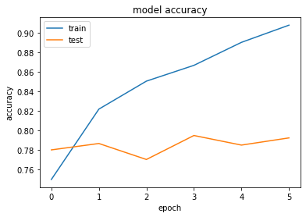
CONVOLUTIONAL NEURAL NETWORK MODEL ACCURACY
Notes:
As seen in the chart above in which the convolutional neural network was trained for a total of five epochs (epochs are iterations over the text and label data but the model itself is not trained ‘five times’ but training for the duration of five epochs), the accuracy for the train and test sets reached about 90% and 79% respectively. There is obvious overfitting here where the model has trained and performed better on the train set whereas any significance between the train and test set should be ideally minimal. Regardless, I opted for the convolutional neural network model reasoning that prediction accuracy is very critical here and that any unforeseen future datasets which would be inputted for the model to work with would be exclusively data consisting of tweets and therefore, highly similar. To be frank, I weighed the cost of generalization against accuracy here and for our purpose accuracy is paramount to our use-case.

Slide 10
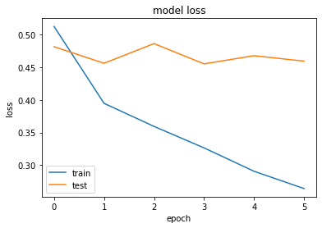
CONVOLUTIONAL NEURAL NETWORK MODEL LOSS
Notes:
As seen above, this chart illustrates the loss function of the model which accounts for the uncertainty or probability of a prediction based on how much it varies from the true value. In contrast to the model accuracy, the loss values are not registered in percentages but as the total summation of errors made for the samples in the train and validation sets. The loss function serves to find the optimal parameter values for the model such as weights for the neural network. However, the loss function was not as much as a deciding factor in choosing the convolutional neural network as accuracy was.

Slide 11
ACTION STEPS – YOUR CONTRIBUTION
Community participation at individual level is key
Your submissions of documenting disasters on Twitter is needed
This helps agencies and organizations response time
This helps model updates and advances tech efficacy
Notes:
Having given a brief overview of the neural network model and its performance on the dataset, there is room for improvement in achieving greater accuracy and overall performance of the model. This can be done on an individual level by each attendant here by being aware of disasters in your vicinity and alerting the public by documenting these events on social media platforms like Twitter. This aids news agencies in broadcasting critical info to warn and raise public awareness and improves relief efforts and response times from disaster relief organizations to address communities and individuals in distress. In addition, this gives the model further data to work with and improve upon to increase both its reliability and efficiency in aiding humanity to detect various threats. Upon taking these action steps, you can help advance the technology and support these organizations in helping to save lives. Thank you!

