Slide 1

Economics of Global Business:
Business Cycle Slides
Prof. Foudy
Copyright ©: Joseph Foudy 2009 (charts and illustrations copyrighted by original sources)

Slide 2
Business Cycle
Aggregate Numbers hide significant sectoral differences
What does it mean to be a low beta stock?
  Why are some stocks high vs. low beta?
What does it mean for marketing/advertising?
What does the business cycle mean for corporate finance? For M&A

Slide 3
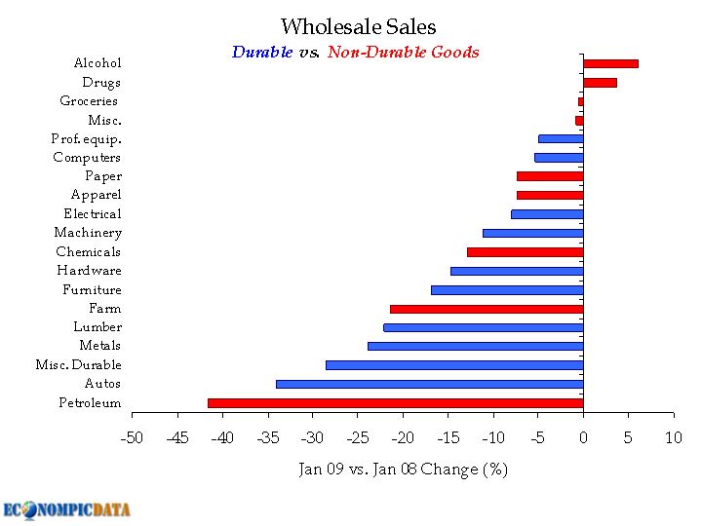
Sector Spending and the Business Cycle

Slide 4
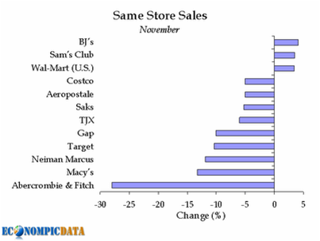
Remember the Concept of Inferior Goods from Micro?

Slide 5
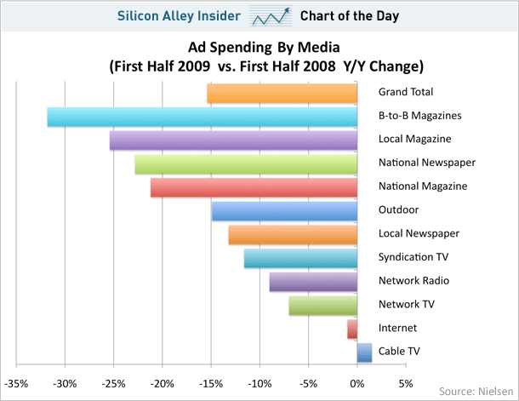
Ad Spending and the Business Cycle

Slide 6
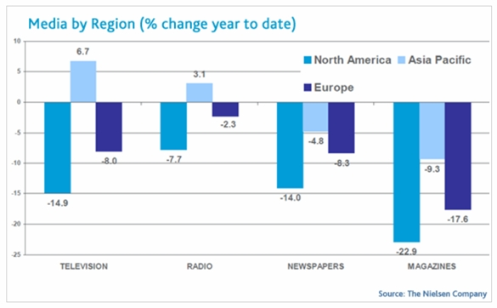
Ad Spending and the Business Cycle

Slide 7
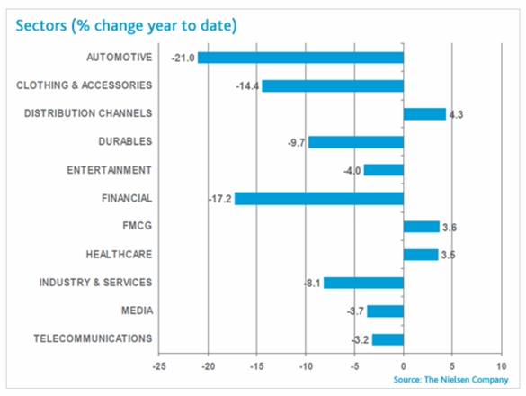
Ad Spending and the Business Cycle

Slide 8
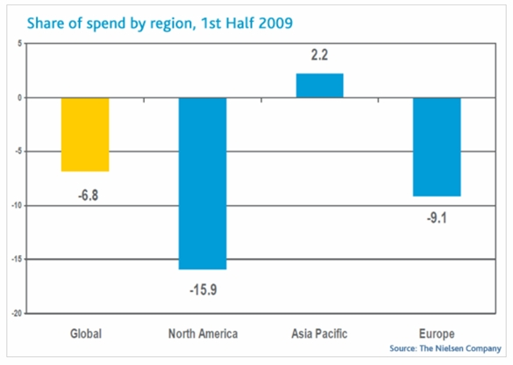
Ad Spending and the Business Cycle

Slide 9
Ad Spending and the Business Cycle
How do marketing strategies change during recessions?
  Channels
  Pricing strategies
  Targeted consumers
  Ad themes and commercial keywords

