Slide 1
Types of Financial Crises
Inflation crisis
Currency crisis
Sovereign default
Asset bubble burst
Intermediation crisis
Sources of disruption
Liquidity
Solvency
Typical event: Bank runs
Adverse feedback between finance and economy

Slide 2
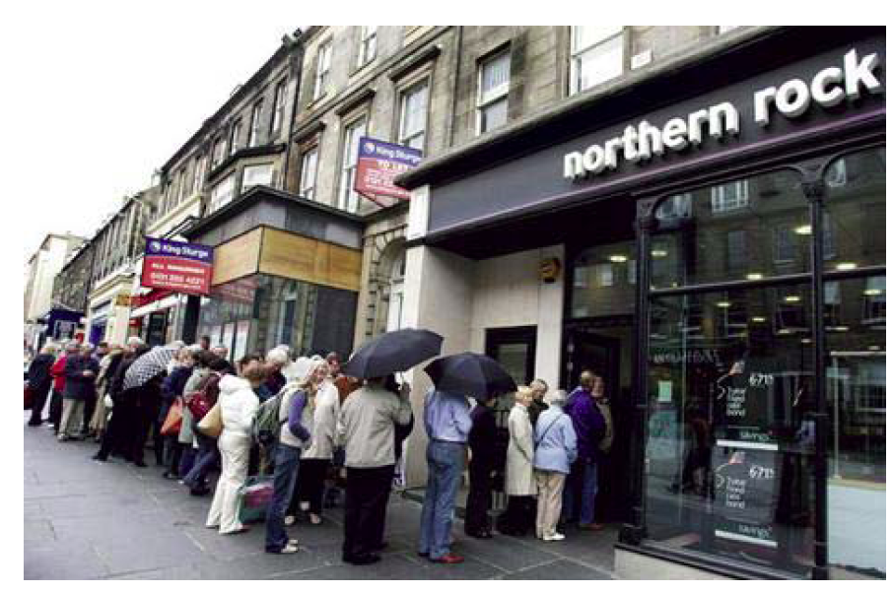
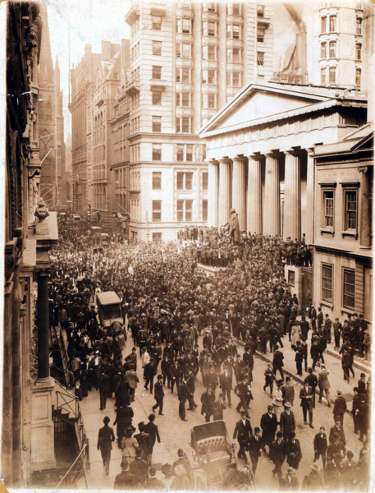
Old-fashioned Bank Runs
1907
2007
Sources: Wikimedia Commons and Shin, BIS presentation, June 2009.

Slide 3
Runs, Panics, and Crises
Source of fragility: provision of liquidity
Depositors can withdraw on demand.
Borrowers can draw down credit lines at will.
Liquidity provision mechanism
First come, first serve
Distribution at face value
Incentive to exit early at price above market value
Illiquidity and insolvency

Slide 4
Classic Ingredients of a Bank Run Based on Diamond-Dybvig (1983)
Long-term, illiquid assets
Short-term liabilities
Sequential promise to pay at face value
Risk-averse investors
Banks provide liquidity insurance, but …
Shock ➔ Asset value concern
Self-fulfilling prophecy
Confidence and multiple equilibria

Slide 5
Illiquidity, Insolvency and Runs
Solvency: value of assets exceeds value of liabilities (positive net worth).
Liquidity: sufficient reserves and immediately marketable assets to meet liquidity demands
Run trigger usually exceeds solvency level
Run can trigger contagion and systemwide panic because depositors/lenders do not know if intermediary is healthy (“lemons”)
Usual triggers: real shocks

Slide 6
Self-fulfilling Prophecies
Diamond (2007):
Because moving away from a good equilibrium requires a large change in beliefs, the initiation of a run when none was expected requires something that all (or nearly all) depositors see (and believe that others see). For example, a newspaper story that the bank is performing poorly could cause a run even if many knew that it was inaccurate, because those who know it is inaccurate can believe that the others will decide to withdraw based on the story. Even sunspots could cause runs if everyone believed that they did.

Slide 7
Real Triggers
Financial disruptions usually occur when net worth falls.
Examples: Recessions and deflation
Lower borrowers’ ability to pay
Reduced revenues and unemployment
Defaults damage intermediary assets and capital.
Banks try to contract their balance sheets.
Reduced lending amplifies the cyclical downturn.
The deeper the cycle, the greater the risk of widespread failures of intermediaries through contagion.

Slide 8
Risk Mispricing Makes System Vulnerable to a Shock
Extrapolate good times
Great Moderation
House prices
Narrow spreads
Low volatility
High liquidity
➔ Easy financial conditions

Slide 9
US Commercial Bank Cash Ratio
Source: FRB H.8.

Slide 10
Rising Rollover Risk Outstanding Repos of Primary Dealers, Dollars in Trillions
Peak on 3-19-08 after Bear
Source: FRBNY, Primary Dealer Positions.

Slide 11
The Deterioration of Credit Incentive Problems I
Principals and agents
Screen for adverse selection
Monitor for moral hazard
Mitigators
Collateral
Equity or “skin in the game”
Intermediaries as delegated monitors

Slide 12
The Deterioration of Credit Incentive Problems II
Securitization and free riding
Mortgage brokers
Securitizers
Rating Agencies
Complexity, opaqueness & OTC Trades
Government guarantees
GSEs
TBTRs

Slide 13
Subprime Tinder Was Small… Non-govt Debt Shares, 2008
Debt Total = $38.2 Trillion
Source: Restoring Financial Stability Figure P.8.

Slide 14
… but sufficient: Subprime as a Systemic Bet
“How can a mortgage be designed to make lending to riskier borrowers possible?”
“The defining feature of the subprime mortgage is the idea that the borrower and the lender can benefit from house price appreciation. The horizon is kept short to protect the lender’s exposure.”
“No other consumer loan has the design feature that the borrower’s ability to repay is so sensitively linked to appreciation of the underlying asset.”
Gorton, “The Panic of 2007.”

Slide 15
What Subprime Wrought
Lehman
Paribas
Bear

Slide 16
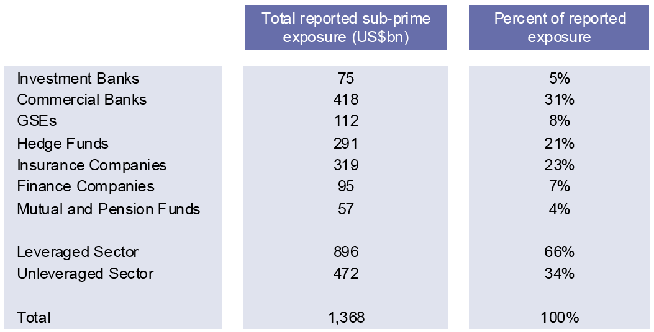
Why Did it Matter? Subprime Hits Leveraged Sector
Source: Greenlaw, Hatzius, Kashyap, and Shin, “Leveraged Losses,” 2008.

Slide 17
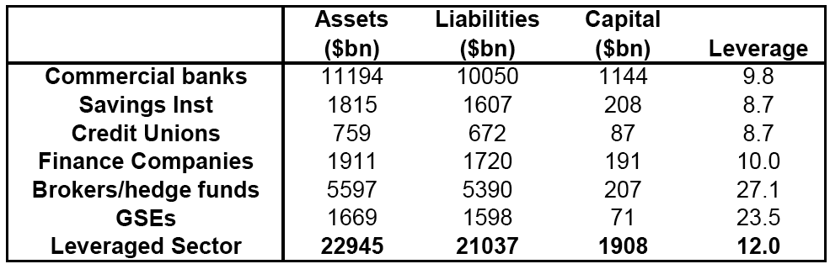
Leverage by Type of Intermediary 2007
Source: Greenlaw, Hatzius, Kashyap, and Shin, “Leveraged Losses,” 2008.

Slide 18
Vulnerability of Shadow Banks Bank Without LOLR or Deposit Insurance
Repo as Deposit
Typically overnight (withdrawal = no rollover)
Collateral and haircuts ➔ Seniority
Collateral may be backed by a portfolio
Collateral can be used in other transactions
Lender ≈ depositor; Borrower ≈ bank
Size ≈ regulated bank assets ≈ $10 trillion (Gorton)
Non-MBS securitization was > corp issuance
Securitization + SPV = off-balance-sheet bank
Senior tranches & CP: information insensitive?

Slide 19
The Run on Repo
Repo “depositors” worry about collateral liquidity
Deterioration outside subprime occurs when LIBOR/OIS widens (August 2007)
Increase haircuts ≈ deposit withdrawals
Insufficient collateral / less rehypothecation
After Lehman – fear of daylight risk exposure
System has to sell assets and shrink
Asset price declines deplete system’s capital

Slide 20
Wholesale Funding and Capital Ratios June 2010
Source: IMF Global Financial Stability Report, October 2010.

Slide 21
Shock ➔ Liquidity Preference Surges
Increased volatility
Doubts about value of securities
Adverse Selection: Lemons
Triple whammy
Market liquidity dries up
Funding liquidity, rollover risk, and bank runs
Involuntary balance sheet expansion
Credit commitments
SIVs
CP backstops

Slide 22
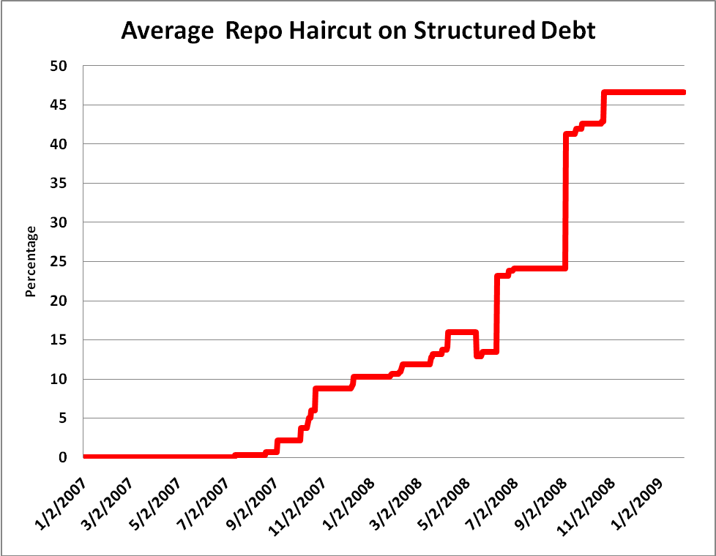
New-fashioned Wholesale Run I
Source: Gorton, “Slapped in the Face by the Invisible Hand.”

Slide 23
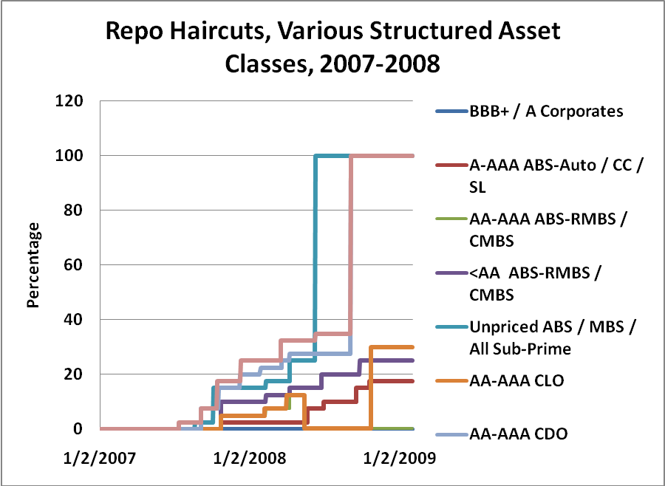
New-fashioned Wholesale Run II
Source: Gorton and Metrick, “The Run on Repo and the Panic of 2007-08,” Figure 21.

Slide 24
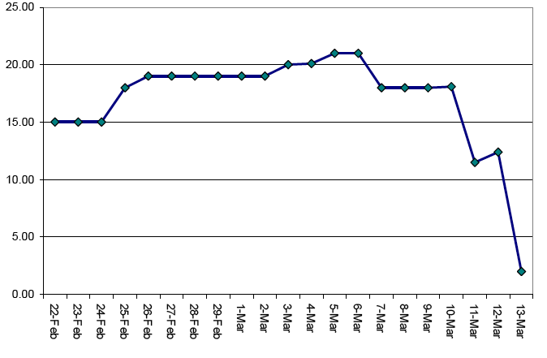
Bear Stearns Liquidity Pool Billions of Dollars
Source: Morris and Shin, “Illiquidity Component of Credit Risk,” 2009, citing SEC.

Slide 25
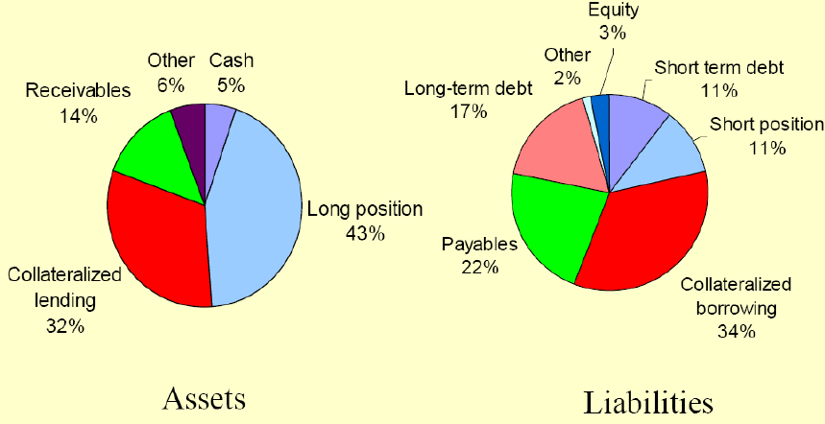
Bear Stearns Balance Sheet End-2007
Source: Shin, “Illiquidity Component of Credit Risk,” 2009, presentation slides.

Slide 26
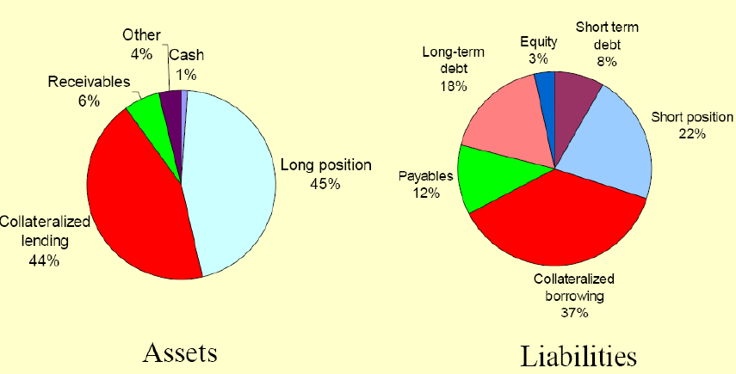
Lehman Balance Sheet End-2007
Source: Shin, “Illiquidity Component of Credit Risk,” 2009, presentation slides.

Slide 27
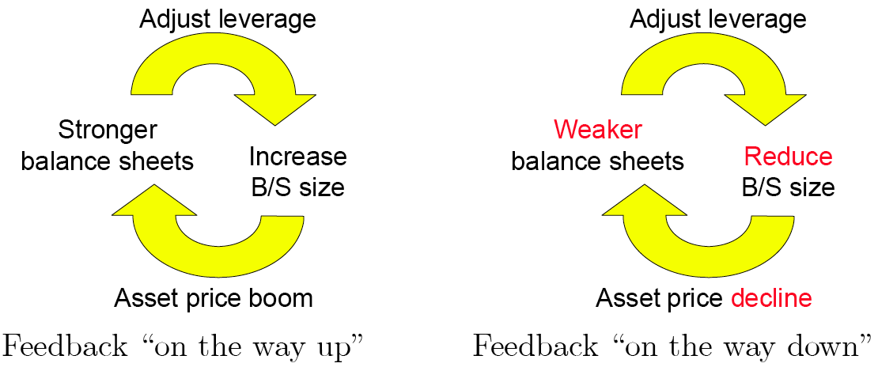
Amplification Through Leverage
Source: Shin, 2009.

Slide 28
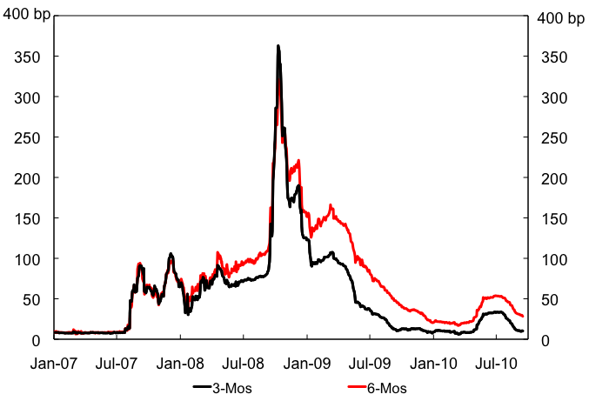
Liquidity Crisis ➔Dysfunctional Markets
LIBOR-OIS Spread
Bear
Lehman
Source: Bloomberg.

Slide 29
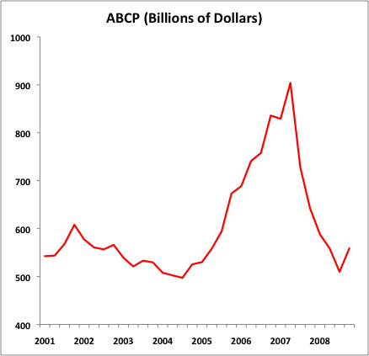
Collapse of Shadow Banking I
Source: Federal Reserve Board.

Slide 30
Collapse of Shadow Banking II Primary Dealer Repo (Billions of US$)
Source: FRBNY.

Slide 31
Economics of Intermediation
Delivering funds from savers to most efficient users
Key role of asymmetric information
Differences in knowledge about a project or transaction create differences in incentives.
If not overcome, incentive problems can undermine (or even eliminate) markets.
Notes:
Free riding arises for goods and services that are not exclusive. Typical econ analysis applies to goods that are called rivalrous. Your consumption means my nonconsumption. What about nonrival goods like knowledge? How do we create incentives to produce nonrival goods? Patents; Tax advantages and subsidies to R&D, etc.
If we don’t create such incentives, do we get a socially desirable supply of nonrival goods? Examples
How does that affect finance?

Slide 32
Information Asymmetries and Information Costs
Asymmetric information poses two major obstacles to the smooth flow of funds from savers to investors:
Adverse selection arises before the transaction occurs.
Lenders need to know how to distinguish good credit risks from bad.
Moral hazard occurs after the transaction.
Will borrowers use the money as they claim?

Slide 33
Adverse Selection
“the tendency for the mix of unobserved attributes to become undesirable from the standpoint of an uninformed party”
Mankiw, Principles of Economics
“the problem of distinguishing a good risk from a bad one before making a loan or providing insurance; it is caused by asymmetric information.”
C & S, Money, Banking and Financial Markets
Market for lemons (Akerlof 1970)
Notes:
What is the market for lemons?
Why does it happen?
Is there a market at all?
What could one do to overcome the auto market for lemons? Hire a mechanic. Costly screening.

Slide 34
Moral Hazard
“the tendency of a person who is imperfectly monitored to engage in dishonest or otherwise undesirable behavior”
Mankiw, Principles of Economics
“the risk that a borrower or someone who is insured will behave in a way that is not in the interest of the lender or insurer: it is caused by asymmetric information.”
C & S, Money, Banking and Financial Markets
Fraud or diversion = ultimate moral hazard
Notes:
Moral hazard originated in insurance. Worries that insured party will not take adequate precautions. Why do insurance companies usually not let you buy fire insurance on someone else’s house. Incentives.
Biggest example of moral hazard during crisis: Bernie Madoff. Also biggest success of crisis.

Slide 35
Free Rider
“a person who receives the benefit of a good without purchasing it”
Mankiw, Principles of Economics
“someone who doesn’t pay the cost but still gets the benefit of a good or service”
C & S, Money, Banking and Financial Markets
Ratings, equity analysis, etc.
Notes:
Free riding arises for goods and services that are not exclusive. Typical econ analysis applies to goods that are called rivalrous. Your consumption means my nonconsumption. What about nonrival goods like knowledge? How do we create incentives to produce nonrival goods? Patents; Tax advantages and subsidies to R&D, etc.
If we don’t create such incentives, do we get a socially desirable supply of nonrival goods? Examples
How does that affect finance?

Slide 36
Intermediaries and Information Costs
Much of the information that financial intermediaries collect is used to:
Reduce information costs and
Minimize the effects of adverse selection and moral hazard.
To do this, intermediaries:
Screen loan applicants,
Monitor borrowers, and
Penalize borrowers by enforcing contracts.

Slide 37
Screening Household Borrowers
A company that collects and analyzes credit information summarizes it for potential lenders in a credit score.
Every time someone requests a credit score, they have to pay, eliminating free riders.
Banks have special technology: they can collect ongoing information on the liquidity of a borrower that goes beyond the credit report and loan application.

Slide 38
Screening Issuers
Underwriters screen and certify firms seeking to raise funds directly in the financial markets.
Underwriters are large investment banks like Goldman Sachs, JPMorgan Chase, and Morgan Stanley.
Without certification by one of these firms, most companies would find it difficult to raise funds. Can you think of exceptions?

Slide 39
Monitoring to Reduce Moral Hazard
Intermediaries monitor firms that issue bonds and stocks.
Mutual funds, hedge funds, pension funds and insurers hold significant number of shares in individual firms.
Private equity and venture capital firms may place a representative on the company’s board of directors.
The threat of takeover can discipline managers.

Slide 40
Case Study: The Madoff Scandal
The Madoff scandal was a classic Ponzi scheme:
Fraud in which an intermediary collects funds from new investors, but instead of investing them, uses the funds to pay off earlier investors.
Investors fail to screen and monitor the managers who receive their funds.
A façade of public respectability contributes to the success of a Ponzi scheme.
Everyone acts as if someone else is monitoring the investment manager, so they can enjoy the free ride.

Slide 41
Case Study: Securitization and the Crisis
When lending standards decline, securitization becomes a game of “hot potato.”
The game ends when defaults soar and someone is left with the loss.
Ratings agencies could have halted the game early, but instead gave their highest ratings to a large share of mortgage-backed securities.
Many investors and government officials assumed agencies’ ratings were accurate: they were free riders.

Slide 42
Case Study: Corporate Finance
A vast majority of investment financing comes from re-investing profits.
Managers’ superior information about their firm’s condition favors internal finance.
Firms’ typically perceive higher costs for external finance (“the financing premium”).

Slide 43
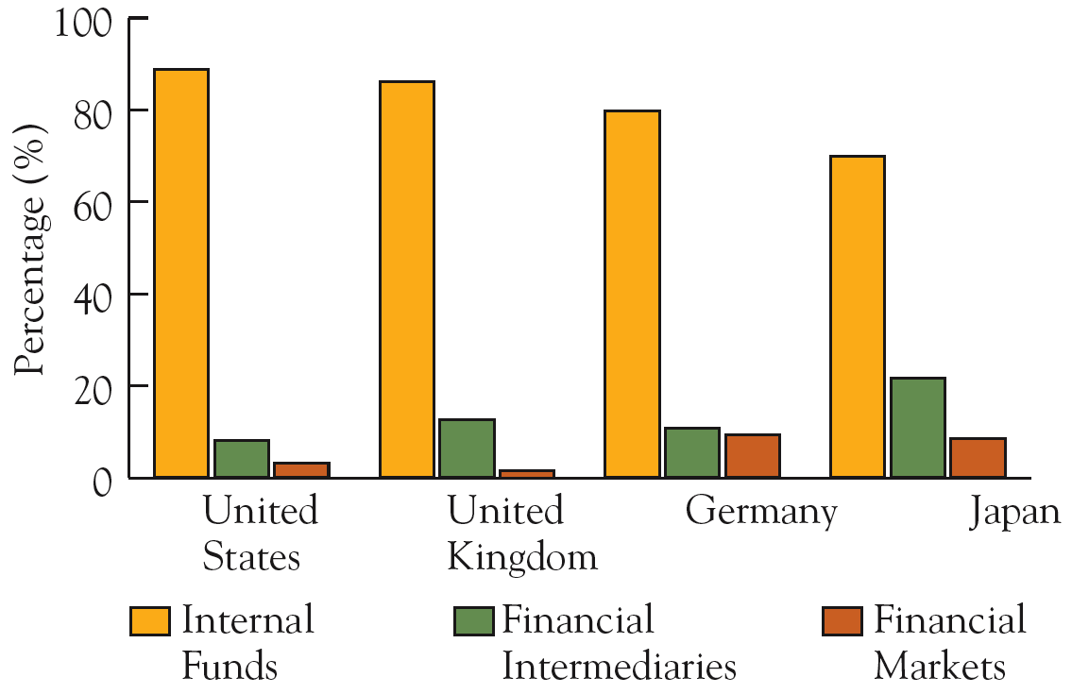
How do firms finance investment? 1970 - 1994
Source: Data are averages from 1970 to 1994 from Table 1 of Corbett and Jenkinson, “How is Investment
Financed?” The Manchester School Supplement, 1997, pp 69-93.

Slide 44
Sources of External Long-term Finance 1970-2000
Source: Andreas Hackethal and Reinhard H. Schmidt, “Financing Patterns: Measurement Concepts and Empirical Results,” University of Frankfurt Working Paper No. 125, Table 5, January 2004.

Slide 45
Will we borrow through Ebay?
Peer-to-peer lending firms are popping up on the web.
Lenders use credit scores, debt ratios, and other factors to select borrowers.
Is this more efficient and cheaper then a bank?
Will these peer-to-peer organizations replace financial intermediaries?

Slide 46
Ben Bernanke on the Great Depression
“Institutions which evolve and perform well in normal times may become counterproductive during periods when exogenous shocks or policy mistakes drive the economy off course.”
“Nonmonetary Effects of the Financial Crisis in the Propagation of the Great Depression,” American Economic Review, 1983.

Slide 47
What is the LOLR?
“stands ready to halt a run out of real assets and illiquid financial assets into money by supplying as much money as may be necessary to forestall the run”
Kindleberger, Manias, Panics and Crashes
Meaning: LOLR makes money supply elastic.
Proposed definition: LOLR delivers liquidity in the volume needed to where it is needed to counter systemic financial stress.

Slide 48
“Letting it Burn Out” and Other Alternatives
Crisis management undermines prevention
Is borrowing costly or impossible?
Other approaches
Stall or shut markets (including holidays)
Private money (clearinghouse certificates)
Bank cooperation
Guarantee liabilities, deposit insurance, regulation
Problem: Is “No” credible?

Slide 49
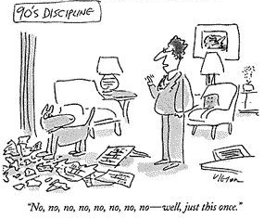
The Lender of Last Resort

Slide 50
Birth of Lender of Last Resort
Liquidity crises frequent in history
UK Exchequer – late 18th century
Bank of England: The Panic of 1825
Bubble in shipping lines, canals, textile factories leads to deposit flight
BoE takes word that one threatened bank is solvent and provides massive cash over weekend.
News that BoE acted stops deposit drain
BoE plays role in preserving orderly markets and financial stability

Slide 51
Bagehot Lombard Street, 1873
Best practice CB role in financial stability
lend to sound institutions facing temporary liquidity shortfall
Doctrine of overwhelming force (use reserves)
Bagehot’s rules of liquidity supply
Lend freely…
…against good collateral…
…at a penalty rate.

Slide 52
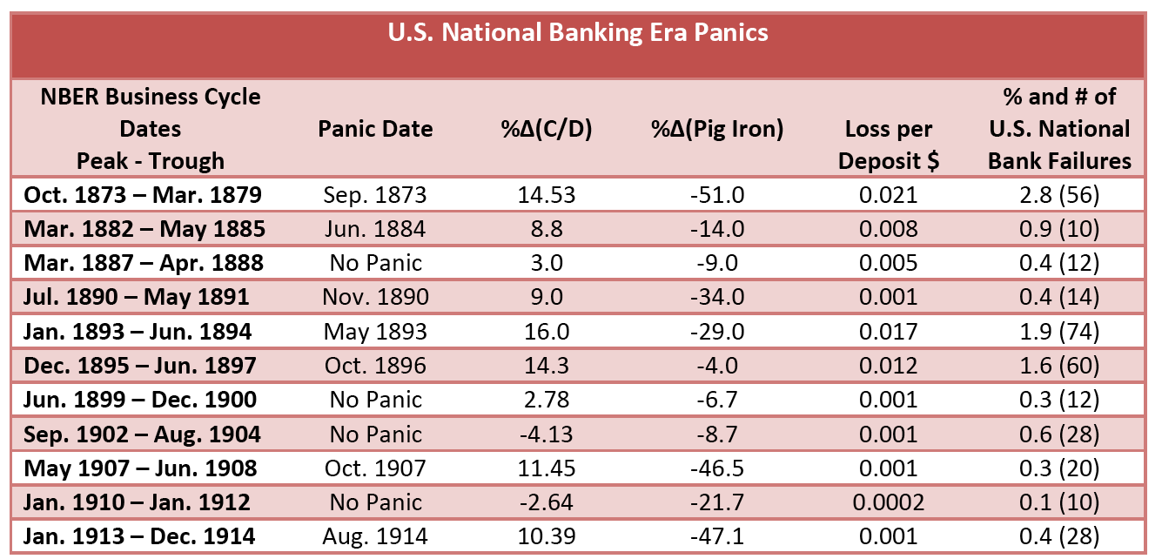
Source: Gorton, “Banking Panics and Business Cycles,” Oxford Economic Papers, December 1988.

Slide 53
The Panic of 1907 Bruner and Carr
Initial shock: SF earthquake of 1906
Clearinghouse vs. trust companies (shadow banks!)
No central bank
Private mechanisms to create money: clearinghouse certificates
JP Morgan as the LOLR
Political fallout leads to FRB in 1914

Slide 54
Irony: The Fed Ignores Bagehot 1929-33
NYFRB tries to expand discount lending after crash, but is constrained by FRB
FRB fails to expand reserves in a panic
Allows nearly half of the banks to fail
Policy attracts gold and spreads crisis abroad

Slide 55
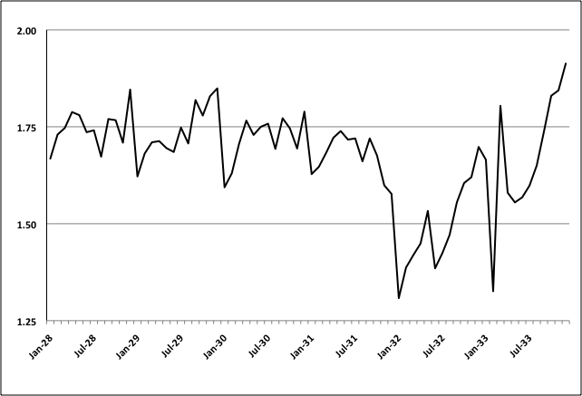
No LOLR … Fed’s Supply of Bank Reserves (Billions of US$)

Slide 56
…Even As Banks Fail
Source: Historical Statistics of the US.

Slide 57
Why No LOLR?
Herbert Hoover citing Andrew Mellon (US Treasury Secretary from 1921-32):
“He held that even a panic was not altogether a bad thing. He said: ‘It will purge the rottenness out of the system. High costs of living and high living will come down. People will work harder, live a more moral life. Values will be adjusted, and enterprising people will pick up the wrecks from less competent people.’ ”

Slide 58
Operationalizing Bagehot
To whom should one lend?
“They must lend to merchants, to minor bankers, to ‘this man and that man,’ whenever the security is good.”
When and how much?
Does “good collateral” depend on conditions?
How to distinguish illiquidity and insolvency?
Does the liquidity subsidy favor moral hazard?

Slide 59
The Fed Before LTCM
Lends only to banks
Trades only with primary dealers
Discount window borrowing is small
Continental Illinois 1984 (“TBTF”)
BoNY 1985
Even 9-11-01
Virtually no default risk
Cajoled banks to lend in October 1987
Allows Drexel to fail 1990: Junk spillover
No use of emergency powers since 1930s

Slide 60
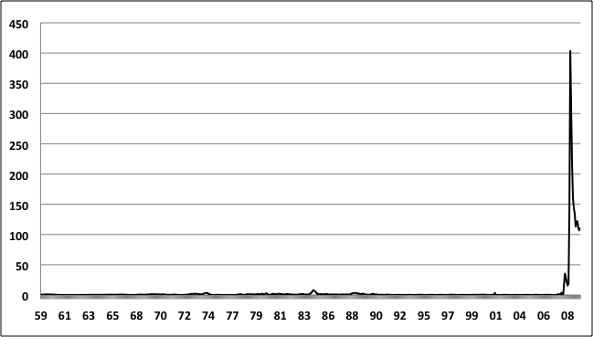
Fed Discount Window Lending Billions of Dollars, 1959-2009

Slide 61
LTCM
Opaque, highly leveraged hedge fund
Reputation allows minimal haircuts
Multi-sigma events August 1998
Shocks become correlated
Capital halves in month
Lenders get cautious
What does Fed do?

Slide 62
Greenspan on LTCM
It’s the NYFRB, not the FRB.
No use of FRB money
Convening power of NYFRB
Private sector keeps LTCM’s managers
Too complex to resolve quickly

Slide 63
Bagehot Machine?
Automatic lending mechanisms
Bundesbank’s Lombard Window
Liquidity against collateral at a penalty rate
ECB inherits Bundesbank practice
Widens collateral to reflect existing practices
BoE follows
Fed alters discount rate (2003) to match Lombard window function

Slide 64
Fed’s Initial Limitations in Crisis
Counterparties: no lending beyond banks
Maturities: typically very short-term repo
Collateral: mostly Treasuries, some agencies
No arrangements outside US
So how do you deliver liquidity where it is needed?

Slide 65
Fed Bagehot Steps I Changing the Delivery Mechanism
Decrease cost of liquidity (discount spread)
Stigma
Term Auction Facility
Anonymity, maturity, collateral
Transmission problems: Banks don’t deliver liquidity where needed (markets break down)
Dollar swaps
After Bear: Counterparties and FRA 13(3)
“unusual and exigent circumstances”
Primary dealers (PDCF and TSLF)

Slide 66
Fed Bagehot Steps II Changing the Delivery Mechanism
After Lehman: End of sterilization leads to explosion of reserves
Run on money funds and CP
MMMFs won’t borrow because their investors see leverage as a risk
AMLF: Fed lends to banks that pledge ABCP purchased from MMMFs (no penalty rate!)
CPFF: Fed lends to CP issuers
Crisis in other markets leads to TALF
Lend to investors against collateral at penalty rate

Slide 67
Proliferation of Policy “Tools”
Traditional: OMO, Discount Rate, RR
Before Bear: Term Auction Facility (TAF)
After Bear and Before Lehman
Primary Dealer Credit Facility (PDCF)
Term Securities Lending Facility (TSLF)
After Lehman
Interest on Reserves
ABCP MMMF Liquidity Facility
Commercial Paper Funding Facility (CPFF)
Money Market Investor Funding Facility (MMIFF)
Term Asset-Backed Security Loan Facility (TALF)

Slide 68
Other Liquidity Provisions
Lending to prevent collapse of Bear and AIG
Maiden Lane SPVs (well collateralized?)
Collateralized loans to AIG
Fed at the limit of its emergency powers under Section 13(3) of the Federal Reserve Act

Slide 69
Unconventional Monetary Policy Billions of Dollars
Source: FRB Cleveland.

Slide 70
What The Fed Did
Collapse in Treasuries as share of assets
Direct funding of nonbanks
Unprecedented balance sheet expansion after Lehman: Reserves surge
No precedent among modern central banks
Taylor: “Mondustrial” policy?
Fed at the limits of its emergency powers

Slide 71
Criticism of LOLR Policy
“The Board had never developed or enunciated a lender-of-last resort policy. Markets had to observe its actions and interpret the statements as always in the past. Instead of reducing uncertainty by offering and following an explicit lending policy, it continued to prevent some failures while permitting others. It failed to give a believable explanation of its reasons and reasoning.”
Allan Meltzer, 2009

Slide 72
What Have We Learned
Long history of liquidity crises with large economic spillover
Illiquidity and insolvency tough to distinguish
Lender of last resort
Macro purpose: financial stability needed to achieve economic stability
Micro purpose: promote function of markets while limiting moral hazard
Still an art, not a science

Slide 73
At the Zero Bound
Why is there a zero bound?
Does policy run out of ammunition?
How predictable is unconventional policy?
How does a CB limit risk of hitting zero bound?
Inflation cushion
Preemptive policy action: “respond aggressively to any adverse demand shock, in effect, substituting speed of the move for the cumulative size of the easing” (Meyer, 2001)
Promote financial stability

Slide 74
Unconventional Policy Approaches
Policy Duration Commitments
Conditional
Unconditional
Rate-pegging
Pre-1951: Fed caps long-term yields at 2½%
Exchange Rate Policy (Gold Standard)
Quantitative Easing
Credit Easing (“influence yields on privately issued securities”)
Cooperation with fiscal authorities (tax cut)

Slide 75
Unconventional Policies Vary Greatly
Deviation from prevailing practices
Distortions
Costs of Exit
Fiscal character (or cooperation)
Efficacy depends on conditions, including:
Current policy regime
Level of distant forward rates
Size of an economy in the world economy
Deflation risks
Effectiveness of financial intermediation

Slide 76
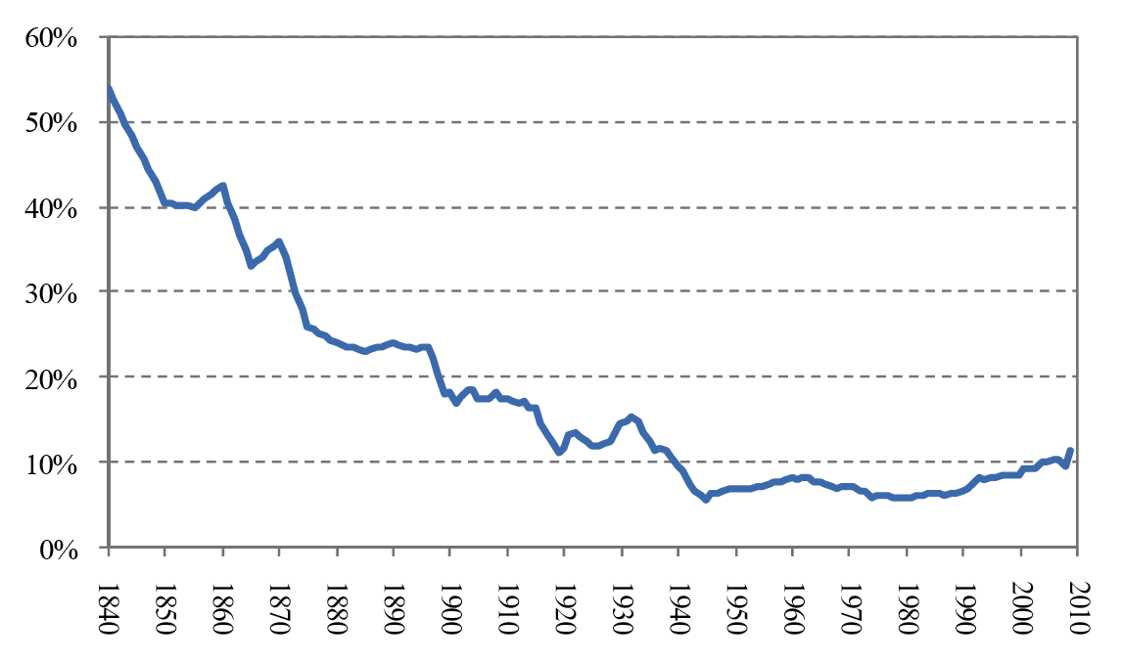
U.S. Commercial Banks Book Equity to Assets, 1840-2009
Source: Hanson, Kashyap, and Stein, A Macroprudential Approach to Financial Regulation.

Slide 77
Modigliani-Miller Theorem “Firm Value is Independent of its Financing”
Firm Value_{levered} = Firm Value_{unlevered}
R_{E} = R_{U} + D/E (R_{U} – R_{D}) R_{E} = required return on equity R_{U} = return on equity without leverage D/E = Debt/Equity (leverage) ratio R_{D} = interest on debt
What does M-M assume?
Efficient markets
No asymmetric information or bankruptcy costs
No taxes or transaction costs (bankruptcy)

Slide 78
Do Higher Capital Requirements Boost Costs?
Modigiliani-Miller implies irrelevance if:
No taxes
Symmetric information
No deadweight loss in bankrupcty
Key point: risk of equity rises with leverage, so the required return does, too.
If M-M assumptions hold, falling leverage lowers risk just enough to offset equity cost.
HKS: no compelling evidence of link between capital ratios and lending markups

Slide 79
So why do we see high leverage?
HKS:
Fierce competition in financial services
Biggest competitive advantage = funding costs
Otherwise little differentiation for biggest firms
Small banks have higher K-ratios because their services are more differentiated, so they can afford modest additional costs
Deregulation tests show that increased competition lowers capital ratios on average and reduces dispersion
Other arguments: Information asymmetries

Slide 80
Capital Requirement Pros and Cons
Hanson, Kashyap and Stein:
“More stringent capital regulation would seem to hold the promise of reducing competition on a dimension that creates negative externalities and systemic risk, while at the same time not raising loan rates by much. However, the complication is that these same competitive pressures also create powerful incentives to evade the letter or the spirit of the rules.”

Slide 81
Admati: Capital Requirements Far Too Low
In what way is M-M violated for banks?
Government policy favors debt finance (leverage and “debt overhang”) and excessive risk taking
Analogy: Government subsidizes pollutants
How? Tax rules and safety net artificially lower debt finance cost
Result: Equity finance would not raise social costs, even if it raises bank costs
Set rule on leverage, not risk-weighted capital
Crisis prevention is better than resolution
Challenges: regulatory umbrella, shadow banks, measuring risk on and off balance sheet

Slide 82
Euro Area: Financial Stability III
“When I was going to Frankfurt as a central banker, my role was clear. I had to vote for the best monetary policy for the euro zone. As the Spanish banking supervisor, my mandate in the Spanish law was to defend the Spanish banking system. I was accountable to the Spanish Parliament. Fortunately, protecting the Spanish banking system was consistent with protecting the European one, but I think that introducing some balance, some European mandate, would be better.”
Jaime Caruana, former Governor of the Bank of Spain (2000-06)
“At this stage, what we are calling for is a close relationship – intimate cooperation between the banking surveillance authorities themselves, and very close links with the central banks, including a full transfer of information.”
Jean-Claude Trichet, President of the ECB since 2003

Slide 83
Economics of Regulation
Identify the market failure (externalities)
Address the market failure through intervention
Ex ante taxes
Politically unpopular
Externalities difficulty to measure
Ex post response (deposit insurance and bailouts)
Creates moral hazard and support for TBTF
Costs unbounded (Irish banks, GSEs)
Recognize and contain the costs of intervention
Anticipate moral hazard, regulatory arbitrage, unintended consequences
Prevent externality
Bound behavior (leverage and LTV)
Change market structures (clearinghouses)
Anticipate circumvention efforts
Shadow banks

Slide 84
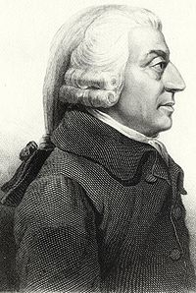
Adam Smith on Bank Regulation
“To restrain private people, it may be said, from receiving in payment the promissory notes of a banker for any sum, whether great or small, when they themselves are willing to receive them; or, to restrain a banker from issuing such notes, when all his neighbors are willing to accept of them, is a manifest violation of that natural liberty, which it is the proper business of law not to infringe, but to support. Such regulations may, no doubt, be considered as in some respects a violation of natural liberty.
But those exertions of the natural liberty of a few individuals, which might endanger the security of the whole society, are, and ought to be, restrained by the laws of all governments; of the most free, as well as of the most despotical. The obligation of building party walls, in order to prevent the communication of fire, is a violation of natural liberty, exactly of the same kind with the regulations of the banking trade which are here proposed.”
From The Wealth of Nations

Slide 85
Systemic Risk
Systemic risks are threats to the basic functions of the financial system, such as the provision of liquidity or credit, that support economic activity. Systemic risks usually have low probability (tail risks), but high costs.
Systemic risks usually arise from the behavior of financial institutions that impose uncompensated costs on others (externalities). The risks can become acute when the financial system is undercapitalized.
Financial instruments and markets can raise systemic risks by adding to vulnerability.

Slide 86
Why don’t markets resolve systemic threats?
In good times, intermediaries try to economize on capital and often rely on low-cost short-term funding: These practices do not take account for spillover effects on others (fire sales and rollover risk) in bad times (externality).
When a firm has a capital shortfall, many benefits of new capital flow to creditors, not equity holders. Owners prefer deleveraging over new equity issuance (agency problem).
These problems are not limited to regulated banks ...
… or to “TBTF” intermediaries. Think MMMFs, SIVs, ABCP, etc.

Slide 87
Sources of Systemic Risk
Common Exposure
Asset side
Liquidity side
Counterparties
Procyclicality
Boom-bust cycle
Example: Target VaR
Opacity and Complexity
Concealed risk taking

Slide 88
Parting Words
“Thinking that we have abolished [crises] is an illusion and perhaps a dangerous illusion, because if you think you have abolished crises, your policymakers, business people, consumers, et cetera, will behave in more reckless ways and thereby make crises more likely. The lesson that really should be learned, and I’m afraid will never be learned, is that the time for fiscal prudence is when times are good. That’s when governments should be running substantial surpluses, so that when crises or a recession hit, they can spend freely without worrying about debt. Unfortunately, the reason the lesson will never be learned is that good economic times are especially conducive to the illusion that bad times will never return.”
Avinash Dixit, December 2010
IMF Finance and Development

