Slide 1
THE STATE OF THE GLOBAL ECONOMY
RESEARCH DAY
FEBRUARY 1, 2013

Slide 2
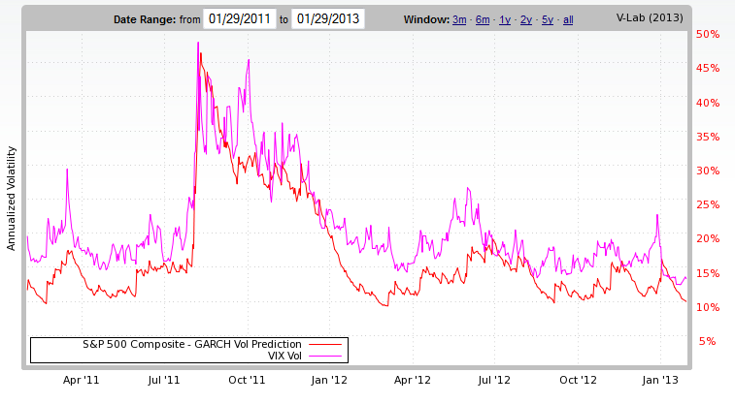
VOLATILITY AND THE “FISCAL CLIFF”

Slide 3
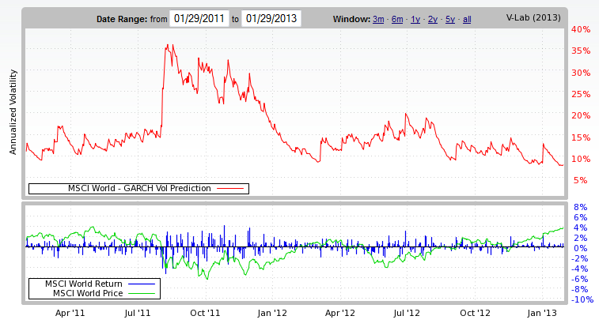
GLOBAL EQUITY VOL

Slide 4
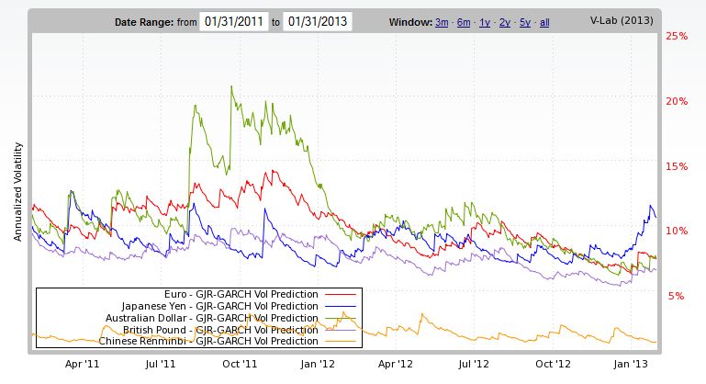
CURRENCY VOLS

Slide 5
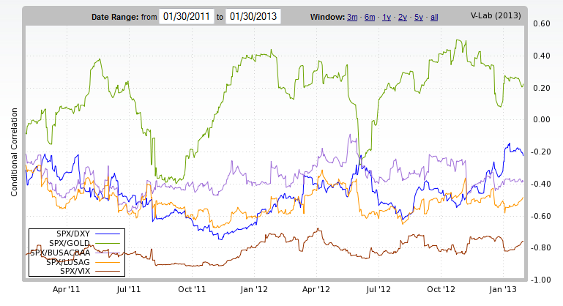
CORRELATIONS WITH SPX (DOLLAR, GOLD, BAA, GOVT,VIX)

Slide 6
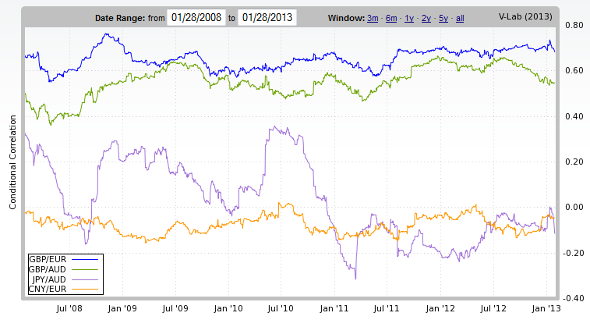
CURRENCY CORRELATIONS

Slide 7
SYSTEMIC RISK MEASURES
How much capital would the financial sector of a country need to raise in order to continue functioning if we have another financial crisis?
If this is a “big” number, then financial firms will begin rebuilding balance sheets now by raising loan standards and selling assets, thus bringing on the economic slowdown.
In a crisis it is hard to raise capital so do it now! Regulators may demand this.
“Big” relative to what? GDP, Market Cap?

Slide 8
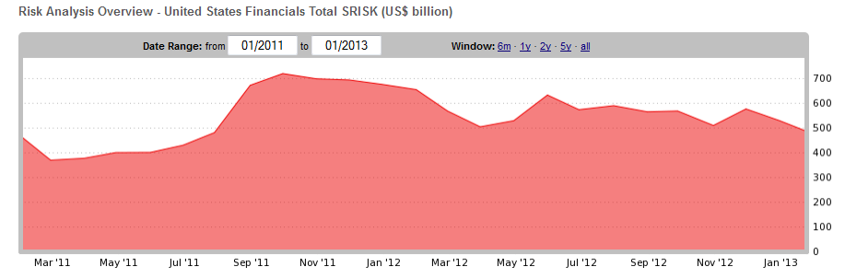
SYSTEMIC RISK IN US

Slide 9
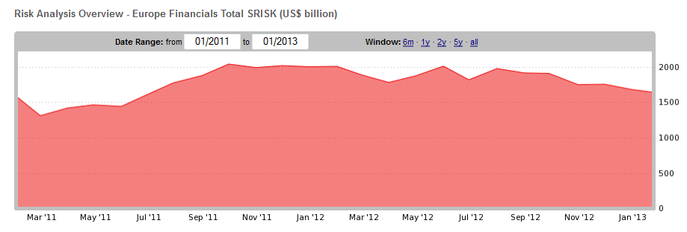
SYSTEMIC RISK IN EUROPE

Slide 10
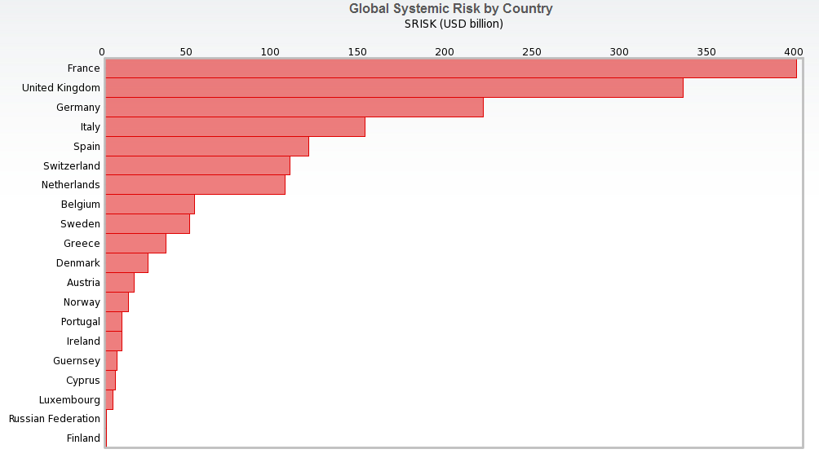
WHERE IS EUROPEAN SYSTEMIC RISK?

Slide 11
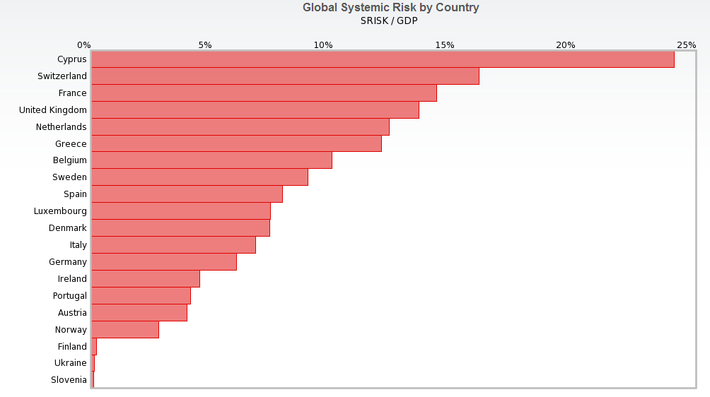
HOW BIG IS IT RELATIVE TO GDP?

Slide 12
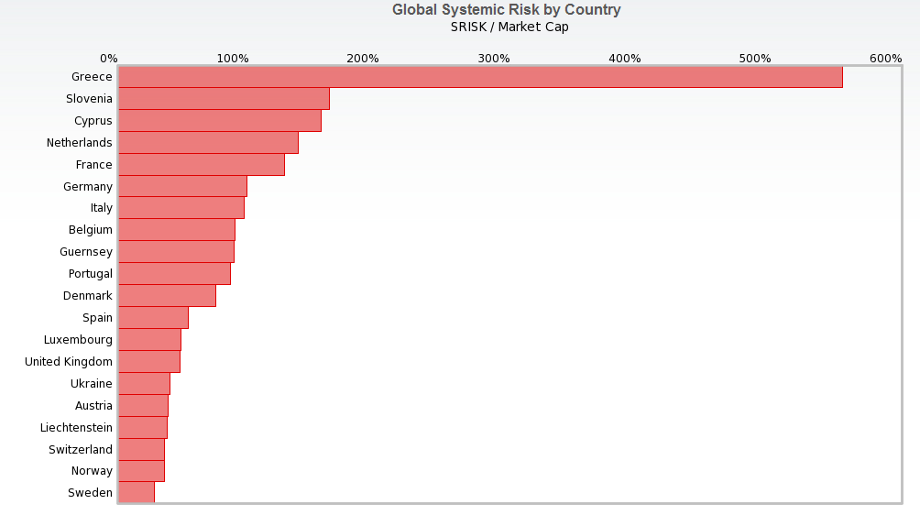
HOW BIG IS IT RELATIVE TO MARKET VALUE?

Slide 13
CONCLUSIONS
Volatility is low pretty much everywhere.
European banks are still very exposed – politicians are “holding their breaths.” They are hoping they will not have to “show their cards.”
Need a banking union with lender of last resort and deposit insurance. This is on a slow boat but moving. It makes no sense to have national regulators or national obligations to decide whether to rescue failing institutions. Think of the cost benefit calculations involved.

