Slide 1

FINAL GROUP PROJECT – EMERGING MARKET INVESTMENT OPPORTUNITY
LUIS ALVES DE LIMA
DANIELLE METSON
MAUREEN MULLEN
LUIS ORENSANZ

Slide 2
The Selected Country
The Selected Sectors
The Selected Companies

Slide 3
The Selected Country
The Selected Sectors
The Selected Companies

Slide 4
THE SELECTED COUNTRY
Brazil: A quick profile
Area – 8.5 million km²
Population – 189 million
GDP – US$ 1,315 BB
GDP – US$ 1,836 BB (PPP)
GDP per capita – US$ 7,150 / capita
Exports / Imports – US$ BB 160.5 / 120.5
Brazil
Population growth 1.1
Real GDP growth 3.6
Real domestic demand growth 4.1
Inflation 4.2
Current-account balance (% of GDP) 1.1
FDI inflows (% of GDP) 2.1
Source: BNDES, The Economist, Eletrobras

Slide 5
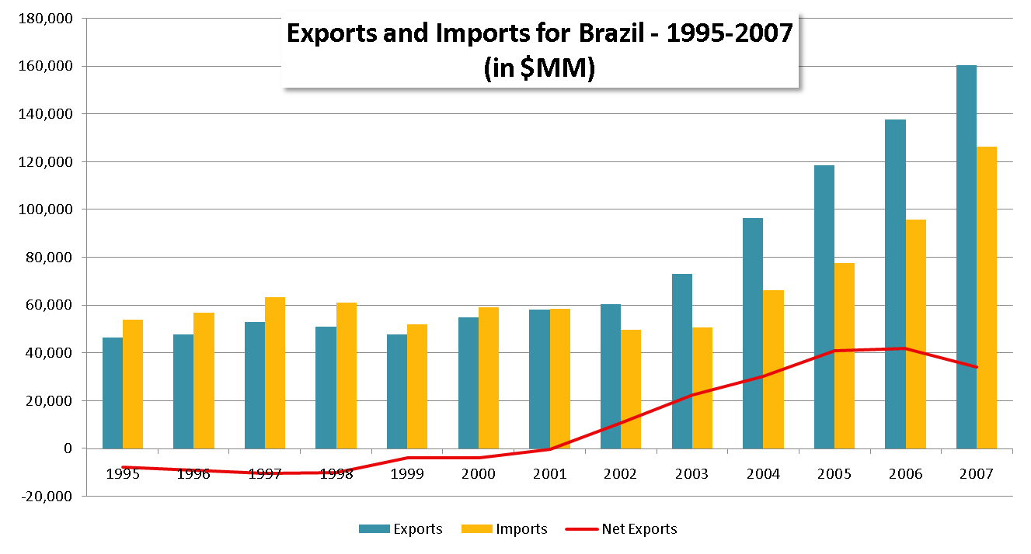
THE SELECTED COUNTRY
Brazil is a Key Player in International Trade
    Brazil was traditionally not an important international trade player. The fall of trade tariffs and the beginning of the privatization process served as catalysts for Brazil ‘s increasing role in the international trade arena.
    Brazil plans to expand its trade activities to Asia (specifically Japan) and continental Europe
Source: Global Market Information Base, Aliceweb

Slide 6
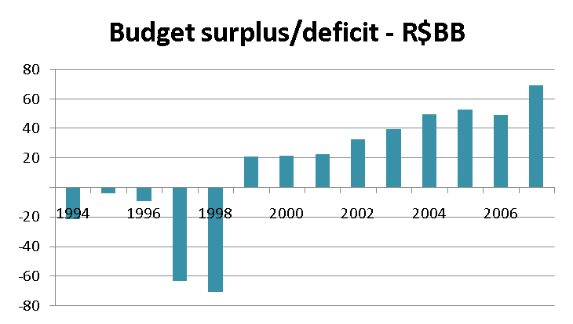
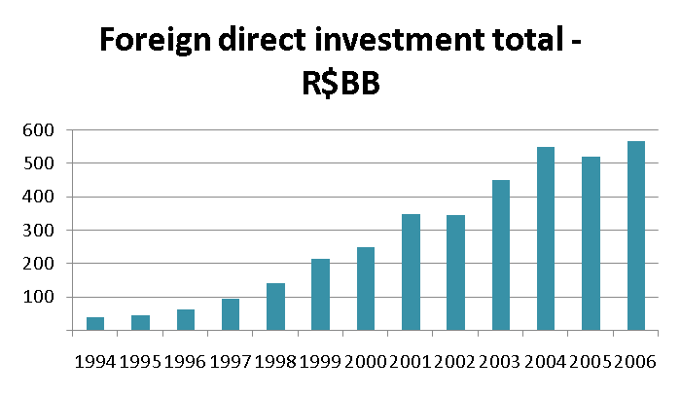
THE SELECTED COUNTRY
Strong macroeconomic figures have led to an increase in investments
Improved and controlled government spending
    Improved fiscal policy in the country
    Incredible change in profile of government debt
    Constant positive balance accounts
Increase in attractiveness of country
    A more stable government and fiscal policy has led to a change in the image of the country internationally
    A significant growth in foreign investment is evidence of the improvement in the country’s profile
Source: BNDES, Global Market Information Base, Ministry of Finance

Slide 7
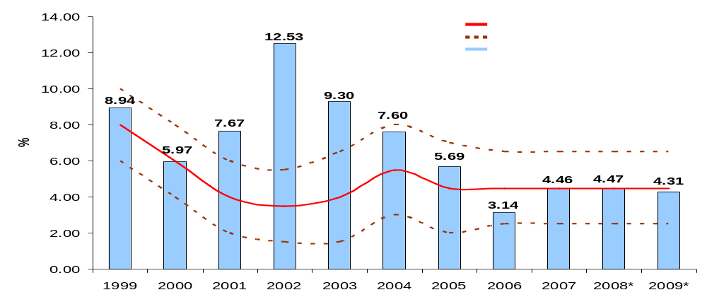
THE SELECTED COUNTRY
Controlled inflation allows stable forward growth
    After a period of high inflation (prior to 1994) ,the country has been successful in maintaining reasonably stable inflation
    Brazil went through higher inflation periods in 2002-2003 as a consequence of international turbulence but since then has been successful in maintaining inflation below the government’s target range
    The country has avoided being affected by the current international increase in product prices and is currently forecasting low level inflation for future years
Source: Banco Central do Brasil, Ministry of Finance

Slide 8
The Selected Country
The Selected Sectors
The Selected Companies

Slide 9
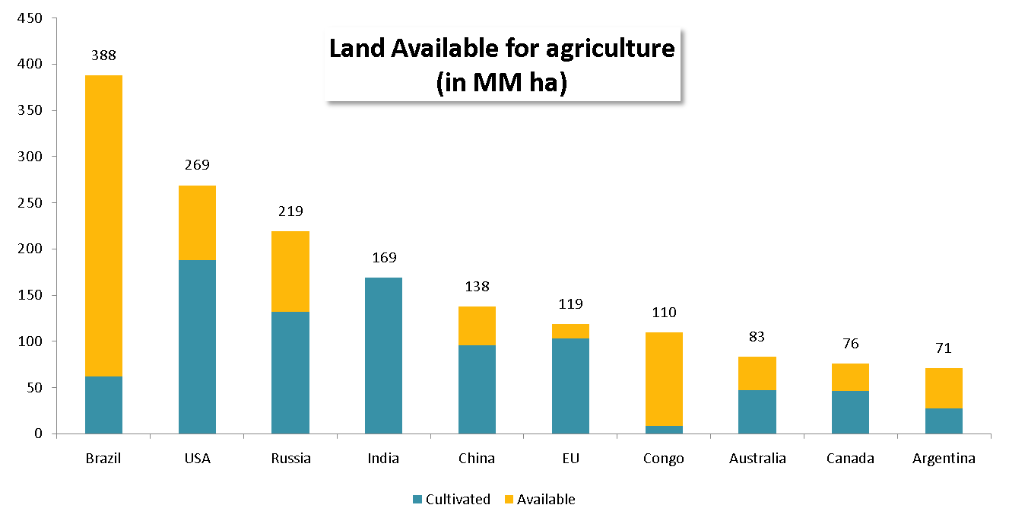
THE SELECTED SECTORS
Agriculture: One of the powerhouses of the country
    Brazil is already one of the main commodities players in the world and still has incredible potential for growth.
    The country has an extensive amount of land available for expansion, and its climate and location allow for two harvests per year
    Productivity is still expected to grow as the country has not mechanised the field entirely as well as efficiency derived from bio-technology
Source: IBGE, BNDES

Slide 10
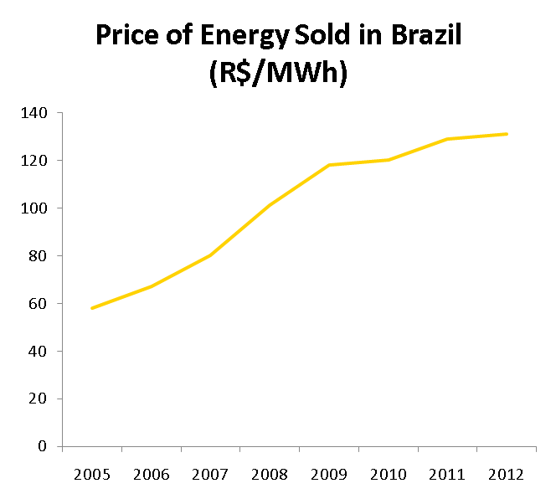
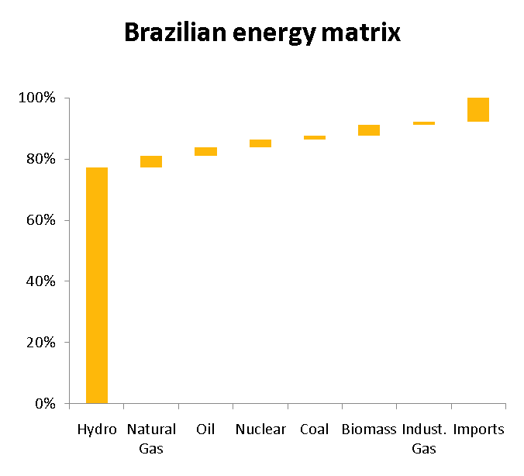
THE SELECTED SECTORS
Utilities: Opportunity in growth and expansion
    The deregulation of the electric utilities sector will increase the average price of the MWh, creating strong cash flows for generators
    Expected growth in GDP and productivity in the country will certainly stretch the demand for electricity, pushing prices further upward
    Brazil has an atypical hydroelectric installed capacity energy matrix with high growth potential; the matrix provides low running cost and prices independent from commodity price fluctuations
Source: IBGE, Eletrobras, Analyst Reports

Slide 11
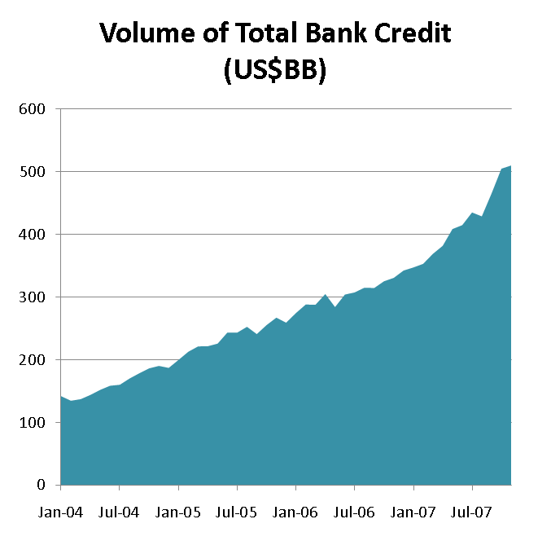
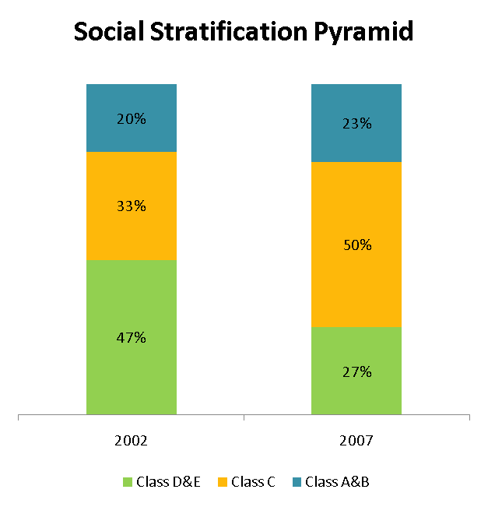
THE SELECTED SECTORS
Financial Institutions: Credit expansion in the country
    The current growth of the Brazilian economy is driven mainly by an increase in the middle class.
    This creates a growing market for the commercial banks in the country which is demonstrated by the growth in the total bank credit in the country
    Although net interest margins are being reduced ,they are still extremely attractive.
Source: Banco Central do Brasil, Ministry of Finance

Slide 12
The Selected Country
The Selected Sectors
The Selected Companies

Slide 13

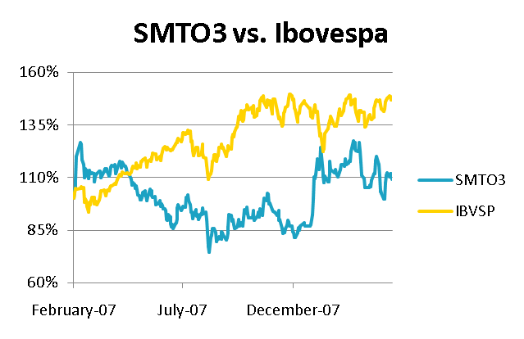
THE SELECTED COMPANIES
Usina Sao Martinho (Bovespa:SMTO3)
Current Price - R$ 26.80
Market Cap - R$ 2.7 BB
US$EV/ton of cane crushed – US$127
EV/EBITDA – 22.8
EPS – 0.57
Revenues – R$ 830 MM
A company listed in the Novo Mercado of the Bovespa
This company is one of the market leaders in the sugar and ethanol business
Different from some of its competitors, Sao Martinho is known for its professional and ethical management that seeks to maximize shareholder value
Brazil has recently passed the barrier of consuming more ethanol that gasoline. An evidence of the strong demand for the fuel
Company | EV/Capacity (US$/ton) | EV/EBITDA
Sao Martinho | 127 | 22.8
Cosan | 100 | 18.0
Acucar Guarani | 97 | 11.6
Source: Bloomberg, CapitalIQ, Company annual report

Slide 14

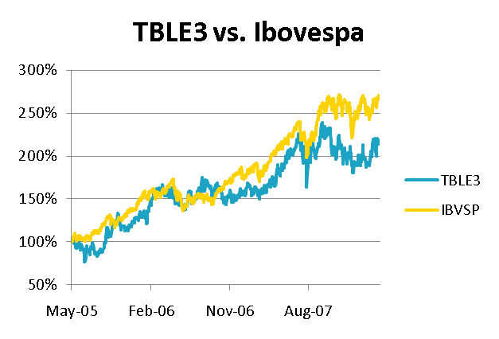
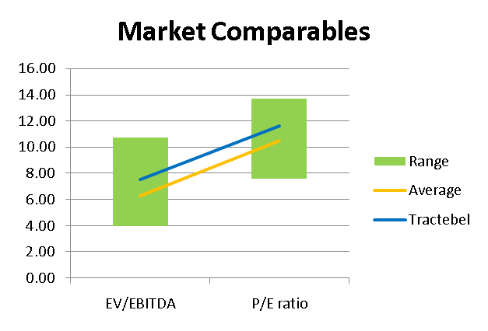
THE SELECTED COMPANIES
Tractebel (Bovespa:TBLE3)
Current Price - $26.80
Market Cap – R$ 13,6 BB
P/E – 14,1
EV/EBITDA – 7,5
EPS – 1,6
Revenues – R$ 3,1 BB
All of Tractbel’s concessions are due to expire after 2027.
This is an important factor given the potential risk of current expiring concessions to be renewed.
The company pays a large dividend yield allowing high returns in a short time frame.
Tractebel has a private management with experience in the industry.
Some of its main competitors have a conflict of interest, as they are government owned and have a social responsibility as well (Eletrobras).
Source: Bloomberg, CapitalIQ, Company annual report

Slide 15

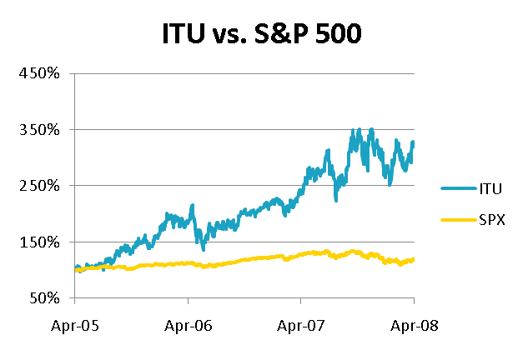
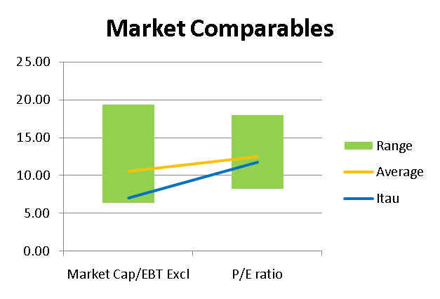
THE SELECTED COMPANIES
Banco Itau (NYSE:ITU)
Current Price - $26.80
Market Cap - US$63.7 BB
P/E - 13.0
ROE – 30.6%
EPS – R$3.2
Revenue – R$29.4 BB
Leading commercial bank in the country.
Itau has constantly reported record earnings and ROE.
It has also reported operating margins superior to its peers in the last couple of years.
The bank is also renowned for having top management.
The international expansion Itau is currently performing exposes it to a larger market and hence greater opportunities for growth when compared to its peers.
The Brazilian financial industry is one of the most sophisticated in the world and international players have always had a hard time trying to enter the market. The local expertise is an essential factor to be successful in this market.
Source: Bloomberg, CapitalIQ, Company annual report

