Slide 1
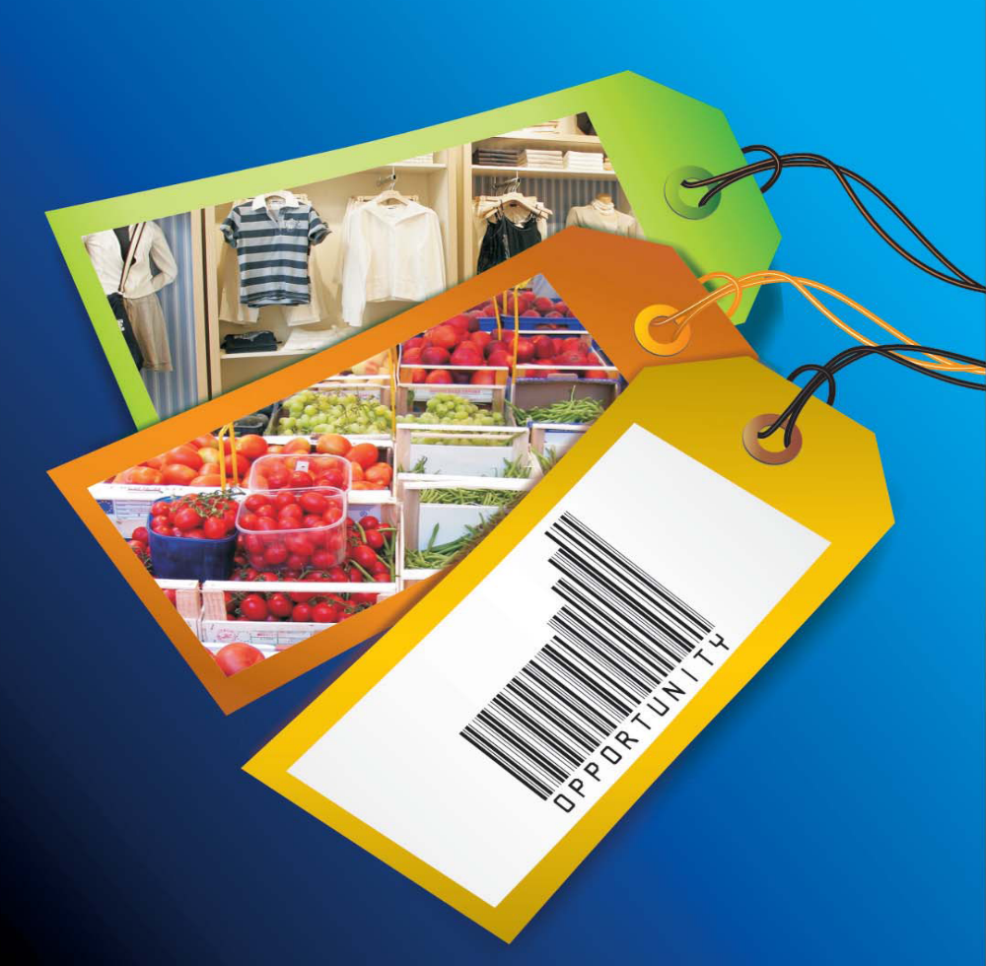

INDIA
THE STORY RETAILED
Naili (Fiona) An
Aditi Chandarana
Jack Grady
Virendra Jain
Lakshmi Kannan
Ameet Prabhu-Salgaonker
Front page: Edelweiss Securities – Retail goes Hyper

Slide 2
EXECUTIVE SUMMARY
Background
- 2nd most populous country, rapid economic expansion
- Strong middle-class, high disposable incomes
- Government more amenable to FDI in recent years
Investment Sequence
- Access India through local partnership or with own wholesale operation
- Invest in Organized Retail
- Focus on Food/Grocery
- Future prospects include Luxury Retail & Logistics
- 3PL is the next hot investment in the retail value chain
Business Strategy
- Look to capitalize on India’s rising household income & surging private consumption
- Enter business in which superior supply chain and distribution systems of a large corporation are especially valuable
- Look for competitive advantages in chosen market but also explore partnerships with local Indian businesses
Conclusions
- Organized Retail Sector is a great investment opportunity
- Food/Grocery is particularly lucrative in Organized Retail
- Luxury Retail & Logistics are also promising sectors
- Opportunities exist in both large and small Indian cities

Slide 3

THE STORY AHEAD
        Emerging Markets
        Retail Markets Comparison
        The Retail Destination
        Risks vs. Returns
        Risk Mitigation
        Retail - Segments & Formats
        Food & Grocery Supermarkets
        Distribution & Third Party Logistics
        Infrastructure
        Locations
Markets
Risk vs.
Return
Options

Slide 4
Emerging Markets
Comparing the BRICs with members of the G-7
Country | Population | Pop. Rank | GDP (Billions of USD) | GDP Rank | GDP (PPP) Per Capita (USD) | GDP (PPP) Per Capita Rank | Exports (Billions of USD) | Exports Rank
China | 1,321,851,888 | 1 | 2,518 | 4 | 7,700 | 84 | 974 | 3
India | 1,129,866,154 | 2 | 804 | 15 | 3,800 | 124 | 112 | 28
United States | 301,139,947 | 3 | 13,210 | 1 | 44,000 | 6 | 1,024 | 2
Brazil | 190,010,647 | 5 | 967 | 10 | 8,800 | 72 | 138 | 21
Russia | 141,377,752 | 9 | 734 | 6 | 12,200 | 61 | 318 | 12
Japan | 127,433,494 | 10 | 4,883 | 2 | 33,100 | 16 | 590 | 4
Germany | 82,400,996 | 14 | 2,872 | 3 | 31,900 | 20 | 1,133 | 1
NOTE: IMF and UN cite Russia’s GDP as 979 billion and 987 billion respectively, which would place it 11th in the rankings.
Source: The World Factbook 2007

Slide 5
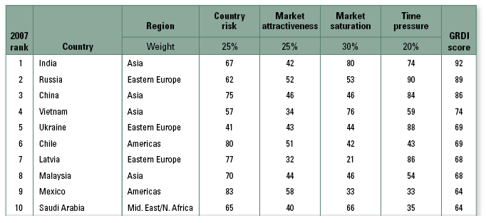
Emerging Markets: Retail
Comparing the Retail Sector across Emerging Economies
Source: AT Kearney – Report GRDI 2007

Slide 6
INDIA: “bird of gold”
The driving factors behind India’s growth
Burgeoning new middle-class¹
→ Households with incomes over USD 3,000 the driving force
→ Rapid expansion from 33% of households in 2006 to 73% in 2011
→ Middle class to swell from 50 Mn to 583 Mn by 2025²
Inflated household incomes³
→ Rise in productivity and is sustainable
→ Consuming class risen from 20% of households in 1995-96 to 35% in 2005-06
→ Expected to rise to 48% by 2010
Potential for Organized Retailing⁴
→ Total Retail sales in India: USD 281 Billion
→ Presently, organized retailing accounts for only 4.2% of total retail sales
Breaking the shackles of poverty⁵
→ 291 million people projected to move from poverty
→ 291 million people projected to move from poverty
¹EIU Country Commerce Data for India: Market Indicators and Forecasts, August 2007
²‘Bird of Gold’: The Rise of India’s Consumer Market –McKinsey & Company
³ ‘Retail goes Hyper’ - Edelweiss Securities Ltd. Report, Feb 2008
⁴ CRISIL Research, Standard & Poor’s India
⁵ Indian Brand Equity Foundation Retail industry report

Slide 7
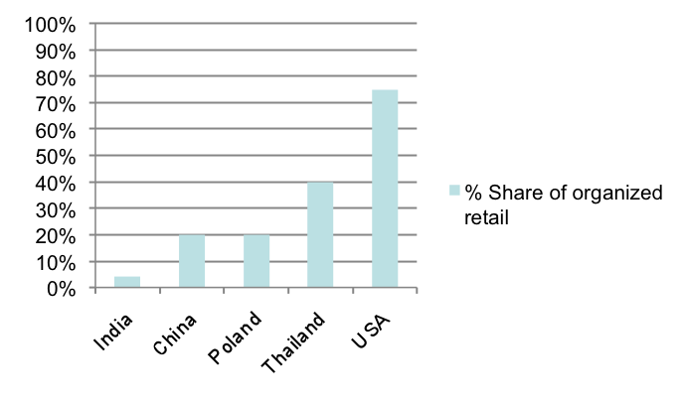
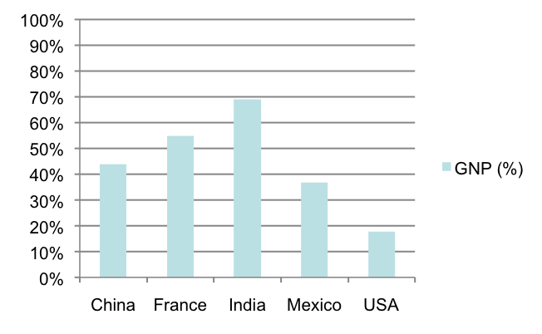
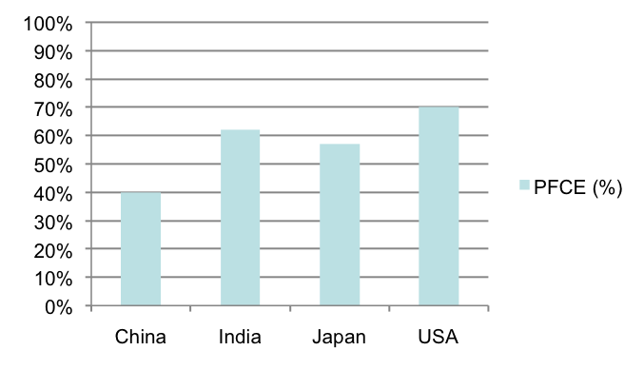
Target Segments
The Target Segments hold promise
Target Segment – Consuming Class
The consuming class, defined as population with annual income higher than INR 90,000, has risen from 20% of total households in 1995-96 to 35% in 2005-06. The Urban population accounts for close to 30% of the population.
Household savings rate in India higher than other countries
Source: McKinsey Global Institute
Rising share of organized retail - a growing opportunity
Source: Edelweiss Securities Ltd. report/CII-A T Kearney
Indian population has traditionally been more pro-savings!
Source: Edelweiss Securities Ltd. report/CII-A T Kearney
Growing Private Final Consumption Expenditure (PFCE)
Source: McKinsey Global Institute

Slide 8
Retail: Return vs. Risk
The Benefits likely and the Risks to be considered
Benefits | Risks
Favorable demographics - Convergence of lifestyle changes is increasing demand to insatiable levels | Infrastructure challenges and lack of access to talented labor force for middle and senior retail management (AT Kearney – Report on Global Retail Development Index 2007)
Positive economics - Opening up of retail sector, coupled with investor friendly govt. policies | Political uncertainty & protection measures for the local retailing industry
Consumption to grow due to growth in wages. (EIU – Country Report on India for April 2008) | Impact of global slowdown on India’s growth projections
High Return on investment and lowered costs for consumers due to economies of scale & high growth margins (Edelweiss Securities Ltd. Report ) | Domestic competition with high fragmentation, moderate barriers to entry and poor wholesale & logistical frameworks. (Foreign Direct Investment in India – a report by ICICI Bank, India)
Increasing urbanization & development of tier-II and III cities | Real-estate markets are highly distorted with pro-tenant laws & obscure zoning laws, making it difficult to acquire large tracts of land.
Source: Edelweiss Securities Ltd. report/CII-A T Kearney

Slide 9
Risk & Mitigation Strategy
Potential Risks & reasons for optimism
Risks | Strategy
Protests from small scale retailers Opposition from political players → Government has deferred Foreign Direct Investment (FDI) in multi-brand retailing. | Government plans to study impact on traditional retailers Option of increasing FDI kept alive
Domestic players have first-mover advantages → Prime locations, lower rental payments & better understanding of domestic market | Domestic players lack experience and expertise A Joint Venture/ Partnership route to market entry with a domestic player should be explored
High Real Estate costs | There has been changes in Real Estate Laws Developments of mill lands ensures availability
Numerous licenses (37-45 ) required to start operations Taxation hurdles | Government is working on simplifying the system of taxation and reducing bureaucracy
Inadequate supply of skills in Merchandising, Supply Chain & Customer Management | Emphasis on Education in Indian society Current budget includes large spending increases on education
Source: Edelweiss Securities Ltd. report/CII-A T Kearney

Slide 10
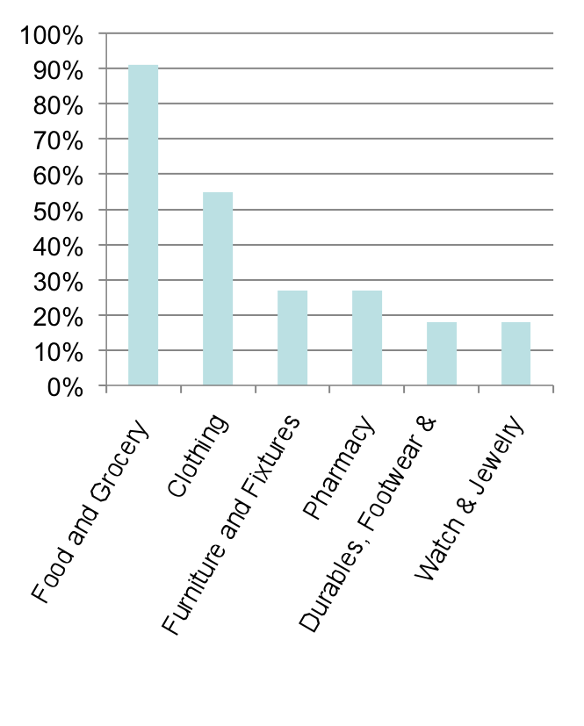
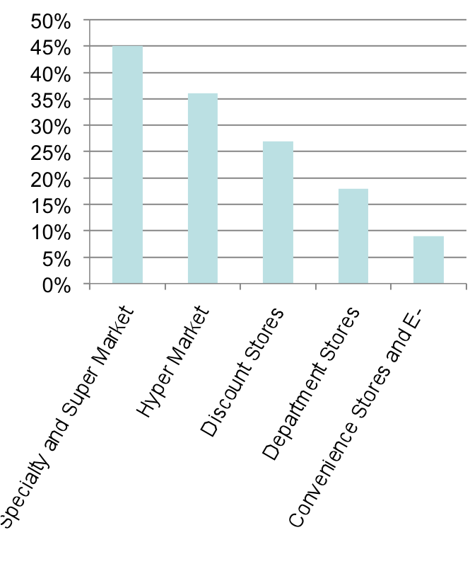
Potential Segments & Formats
Segments and Formats that have potential
Expected Growth Rate in attractive segments
Expected Growth Rate in attractive formats
Source: Growth Opportunities for Global Retailers- The A.T. Kearney 2007 Global Retail Development Index

Slide 11
Recommendations
Segments and Formats that we recommend
Food and Grocery
The biggest retail market in India
The fastest growing retail segment
→ Expected annualized growth of 91%
Limited penetration by large companies/corporations
→ Market dominated by family-run stores; organized players only 1% of market
Ideal for mass-market food retailers
→ Fewer restrictive regulatory hurdles (up to 100% FDI permitted)
→ Economies of scale & supply chain mgmt. advantages over domestic retailers
Super market retailers have access through local Joint Ventures
→ Symbiotic advantages for Local retailers and international companies
→ Carrefour has set precedent with Britannia partnership
1
Source: Growth Opportunities for Global Retailers- The A.T. Kearney 2007 Global Retail Development Index

Slide 12
Other Recommendations
Segments and Formats that we also recommend
Luxury & Fashion
High demand due to spiraling standards of living
Promising market for international companies
→ Expected annualized growth of 55%
→ Jewelry & watch market expected to grow 17%
Opportunities in luxury goods, especially single brand retailers
→ Modern Luxury Retail has just 2% of total market
→ Rapidly growing at an annual rate of 25%
→ Single brand retailers have minimum regulatory hurdles, highest penetration
→ Zegna, Gucci & Louis Vuitton are expanding aggressively into big cities
Regulatory restrictions relaxed in recent years
→ Opportunities should eventually open up for multi-brand retailers
2
Source: Growth Opportunities for Global Retailers- The A.T. Kearney 2007 Global Retail Development Index

Slide 13
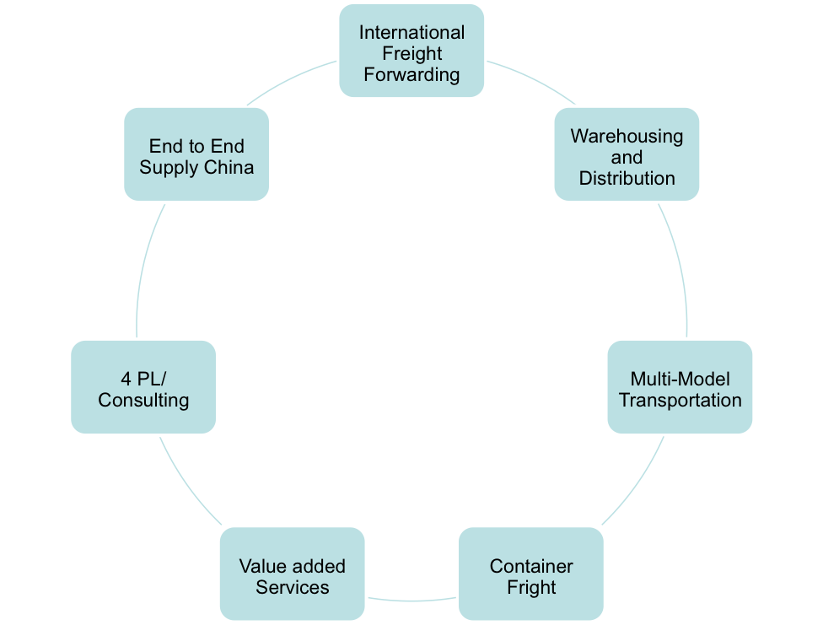
Other Recommendations
Segments and Formats that we also recommend
Logistics & Distribution
Current Model: Hub-and-Spoke
Most models capture fragmented markets; Efficient supply chain management is key
Operate smaller stores in the distant catchments while using larger store to keep adequate stocks
Smaller stores increase the penetration levels of organized retailing beyond the larger catchments
3
Future of Logistics

Slide 14
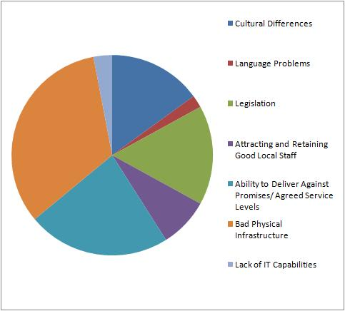
Related Business
Other opportunities in the value chain
3PL Model & its challenges
Third party logistics [3PL] is a
fast growing industry
→ Niche players provide back-
end support for cash and carry
services
→ Global retailers like Metro &
Shoprite have brought in global
expertise in effective supply
chain management
→ According to a recent study,
India and China are clear
leaders as the most popular
choices for 3PL users to
expand their activities
Infrastructure is key to success of
the 3PL model, key to success of
organized retail
Sources: 3PL Study, 3PL.com

Slide 15
Location Factors
Location Factors and Future Expansions
Big Cities
Tier I cities (Delhi, Nagpur, Hyderabad, Coimbatore, Ahmedabad, Mumbai, Pune, Chennai, and Bangalore): 85-90% of total organized retail
Urban consumer has most sophisticated tastes and greatest buying power
Overcrowded nature of cities such as Mumbai and Delhi guarantees steady consumer traffic
Small Cities
Tier II and Tier III cities: currently untapped; tremendous potential as economy expands in the next few years; great opportunities for discount retailers
15% to 30% cost advantage over larger cities (reduced employee costs, real estate costs, and staff attrition rates)
Improved infrastructure and roads have made smaller cities more accessible for consumers
Unilever has made a successful foray into smaller cities though with slashed prices
According to S&P: “Organized retail will expand mostly in India’s 25 largest cities through 2011. By then, retail development will have saturated the large urban areas, including Mumbai and Delhi, and will expand into smaller cities.”
Source: Edelweiss Securities Ltd. report/CII-A T Kearney

Slide 16
Page: Edelweiss Securities – Retail goes Hyper

