Slide 1
Mobile Telecommunications in Nigeria:
An international business opportunity for Global Telecoms Corp.
Presentation prepared by:
Saima Ahmed
Vito Giurazza
Gonzalo Gomez-Arrue Azpiazu
Andreas Habersetzer
Cem Padir

Slide 2
AGENDA
Executive Summary
Situation of Global Telecoms Corp.
Country Analysis
Industry Analysis
Competitive Landscape
Market Entry Strategy
Data sources

Slide 3
Executive Summary
Investments in Africa are becoming more and more attractive due to increasing competition in other emerging markets (BRIC etc.)
Nigeria is the most promising opportunity within Africa; the country out performs most of its peers in terms of the size of its population and growth potential
Moreover, the country offers a great business environment especially for companies in the telecommunications industry
The Nigerian telecom market is the fastest growing market in Africa; however, market penetration (~30% in mobile) is still far below that of developed markets
With about 37mln subscribers, the mobile telecommunications market is the dominant story in Nigeria
An investment in Nigeria would be an excellent opportunity for Global Telecoms Corp. to diversify its operations geographically, to increase the company`s future growth potential and to extend its operations throughout Africa
Global Telecoms Corp. should enter the market via an acquisition or by building an alliance with one of the four existing operators; Celtel is the preferred target

Slide 4
AGENDA
Executive Summary
Situation of Global Telecoms Corp.
Country Analysis
Industry Analysis
Competitive Landscape
Market Entry Strategy
Data sources

Slide 5
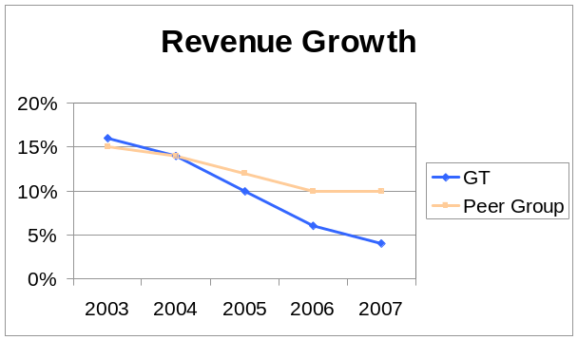
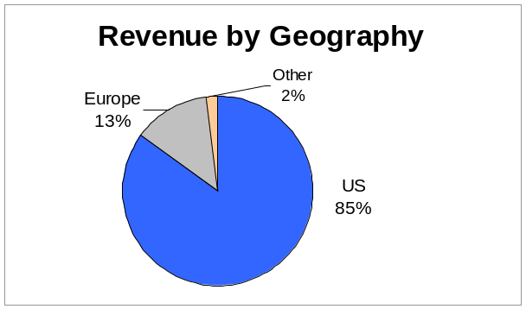
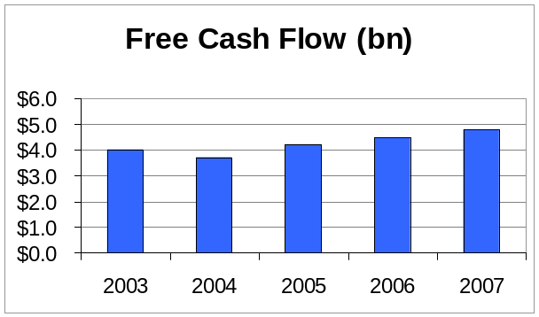
Situation of Global Telecoms Corp.
Global Telecoms (GT) is still the 3rd largest mobile operator in terms of revenue in the US
However, GT has fallen behind its competitors with regard to revenue growth
Global Telecoms generates only 15% of its revenues outside the US; Emerging Markets account for only 2%
Other operators generate on average 40% of its revenues in foreign markets
Competitors already built a significant presence in emerging, fast-growing markets like Eastern Europe, India and China (intense competition!)
Global Telecoms has strong cash flows and growing cash reserves
Investors urge for reinvestment of funds in business opportunities or dividend payouts
Global Telecoms has the need and resources to invest in international business opportunities that generate high growth

Slide 6
Business Opportunities in the African Telecommunications Market
Africa has low (fixed, mobile and broadband) penetration rates (~30%) and represent a relevant economic opportunity both for those already in the region, and those that have not yet secured a foothold: 14% of the world’s population lives in Africa, but this area accounts for only around 7% of all fixed and mobile subscribers worldwide
As of today in Africa there are ~280 million total telephone subscribers, of which ~260 million (over 85%) are mobile cellular subscribers, representing the continent with the highest ratio of mobile to total telephone subscribers of any region in the world
Africa is the region with the highest mobile cellular growth rate. Growth over the past 5 years averages almost 65% year on year
The broadband penetration is more than 1% in only a few countries. Broadband penetration in OECD countries exceeds 18%
Africa has ~50 million Internet users, for an Internet penetration of just 5% (Europe’s Internet penetration is 8 times higher)
Source: ITU World Telecommunication/ICT Indicators, 2007

Slide 7
AGENDA
Executive Summary
Situation of Global Telecoms Corp.
Country Analysis
Industry Analysis
Competitive Landscape
Market Entry Strategy
Data sources

Slide 8
African Business Environment Ranking
 | Limits To Potential Returns |  | Risks to Realization of Returns
 | Telecoms Market | Country Structure | Independence of regulator | Country Risk | Score | Regional Rank
Nigeria | 68.8 | 47.3 | 70.0 | 52.6 | 61.3 | 1
South Africa | 62.5 | 50.7 | 50.0 | 70.5 | 58.9 | 2
Tanzania | 54.6 | 60.0 | 70.0 | 58.3 | 58.8 | 3
Uganda | 52.3 | 60.0 | 80.0 | 46.1 | 57.4 | 4
Botswana | 37.5 | 60.0 | 90.0 | 77.3 | 56.9 | 5
Gabon | 47.5 | 66.7 | 50.0 | 46.4 | 52.4 | 6
Sudan | 52.3 | 60.0 | 40.0 | 52.1 | 52.3 | 7
Ghana | 57.5 | 50.0 | 30.0 | 61.2 | 52.1 | 8
Algeria | 52.5 | 50.7 | 40.0 | 64.1 | 51.9 | 9
Morocco | 47.5 | 56.7 | 50.0 | 59.1 | 51.9 | 10
Egypt | 43.3 | 43.7 | 70.0 | 71.0 | 51.6 | 11
Senegal | 42.5 | 63.0 | 50.0 | 57.9 | 51.0 | 12
Cote d'Ivoire | 55.0 | 50.0 | 60.0 | 31.2 | 51.0 | 13
Cameroon | 47.5 | 66.7 | 50.0 | 29.6 | 49.9 | 14
Mauritania | 42.5 | 60.0 | 40.0 | 48.2 | 47.3 | 15
Mauritius | 35.0 | 66.7 | 30.0 | 65.8 | 46.6 | 16
Mali | 47.5 | 66.7 | 10.0 | 45.6 | 46.3 | 17
Tunisia | 37.5 | 56.7 | 30.0 | 63.2 | 44.9 | 18
Kenya | 45.1 | 40.2 | 40.0 | 48.9 | 43.7 | 19
Angola | 38.5 | 43.2 | 20.0 | 34.5 | 36.3 | 20
Mozambique | 35.0 | 32.4 | 30.0 | 44.0 | 35.0 | 21
Source: Business Monitor International
Scores are weighted as follows: Limits to Potential Returns: 70%, of which Telecoms Market 65% and Country Structure 35%; Risks to Realisation of returns: 30%, of which Independence of Regulator 40% and Country Risk 60%. Limits to Potential Returns evaluates the size and growth potential of a telecoms market in any given state, and industry/state characteristics that may inhibit its development; Risks to Realisation of Returns evaluates industry specific dangers and those emanating from the state's political/economic profile that could affect realisation of anticipated returns.

Slide 9
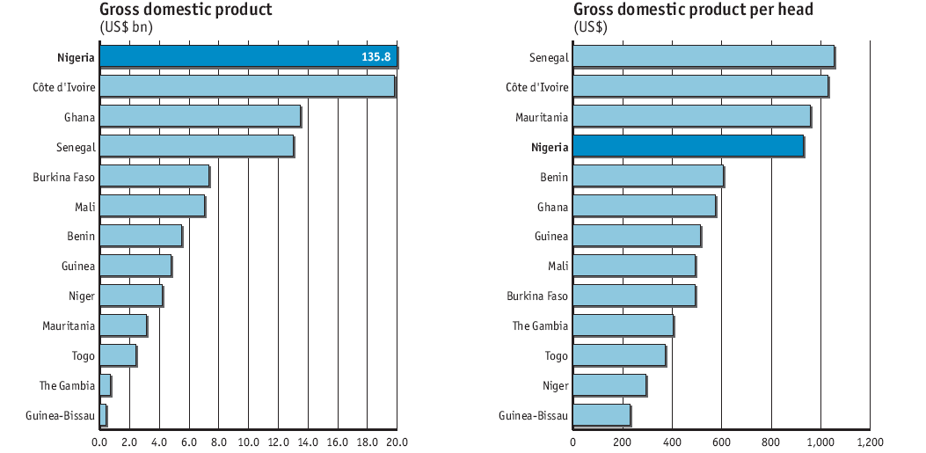
Country Analysis – Nigeria vs. Peers
Comparable countries: GDP and GDP per capita
Source: Economist Intelligence Unit 2008 report on Nigeria

Slide 10
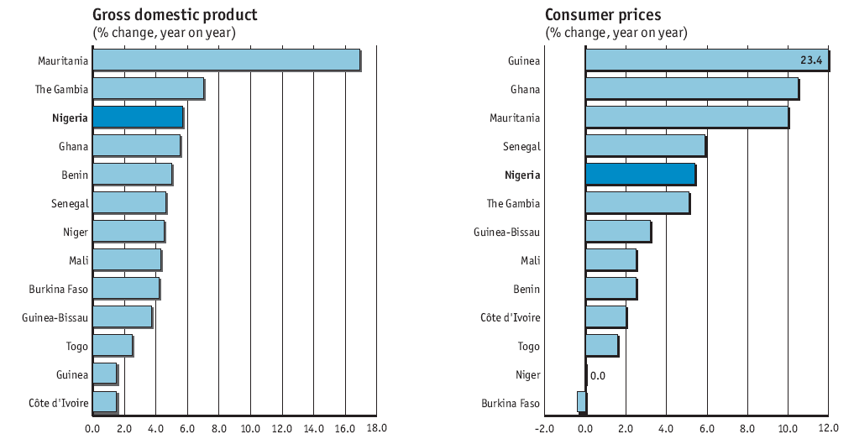
Country Analysis – Nigeria vs. Peers
Comparable countries: GDP growth and CPI
Source: Economist Intelligence Unit 2008 report on Nigeria

Slide 11
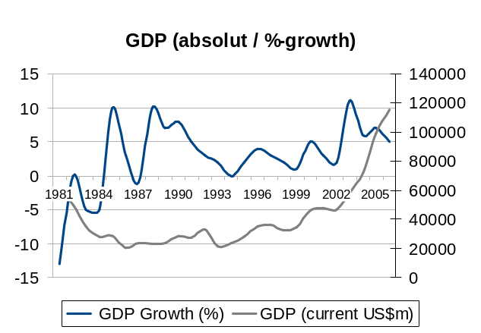
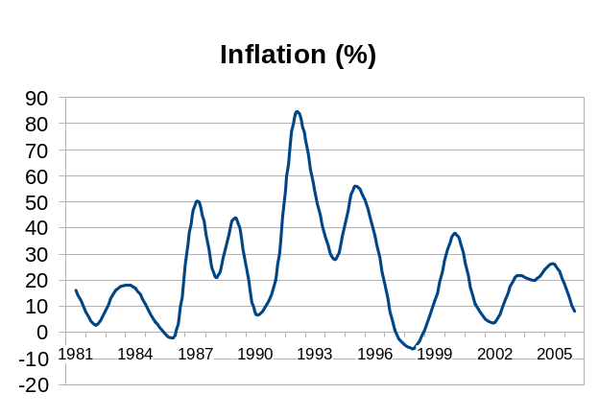
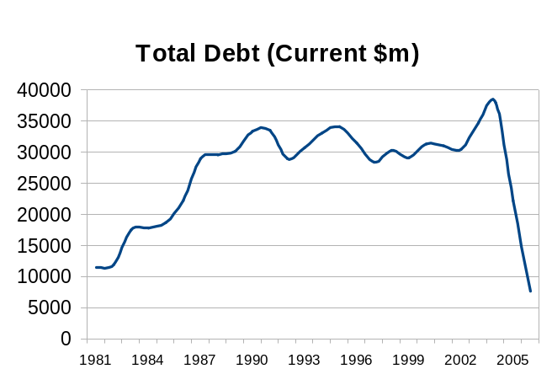
Country Analysis – Economic Risk in Nigeria
Nigeria is the most populated country and the second largest economy in Africa (behind South Africa and paired with Algeria)
GDP has grown erratically in the last 30 years, but GDP shows a positive trend since General Abacha took power in 1993
This trend has been maintained through the democratization process that began in 1999 and culminated in 2007 with the first civil power transfer in the country’s recent history
The country’s GNI per capita (PPP adjusted) has increased steadily (almost doubled) since 1993
Nigeria has gone through periods of ravaging inflation in its recent past
Inflation has come down from a peak of 80% in 1993 to 8%
The increasing role of the Central Bank of Nigeria and its improving performance have helped curve down inflation
Nigeria has greatly reduced its debt and increased its foreign reserves
Nigeria’s central bank has increased its room for maneuver in the past years

Slide 12
Country Analysis – Economic Risk in Nigeria
Dependency from oil
  Nigeria has one of the largest oil reserves in the world
  25% of Nigeria’s GDP comes from oil; this accounts for 75% of the government’s revenue
  A substantial share of Nigeria’s positive past performance is related to the trend in oil prices
  This trend shows no signs of slowing down – which if handled properly will allow Nigeria to establish a much more stable economic environment
  The government is implementing ambitious programs to develop the underlying economic infrastructure beyond oil, including transportation and education
Institutions
  Institution in Nigeria show a positive trend that has made the confidence of international organisms like the World Bank or the IMF grow
  Corruption is still a major issue

Slide 13
Country Analysis – Political Risk in Nigeria
Political Background
  Nigeria achieved independence in 1960 and since then has had a political history marred by ethno-religious violence and military rule. The country consists of 250 ethnic groups with Hausa, Yoruba, and Ibo being the dominant ones
  The discovery of oil has led to further violence and human right’s abuses as each group tries to gain a larger share of the revenues
Current Situation and Political Outlook
  In May 2007 President Umaru Yar’Adua took power in what is the first ever successful handoff of power between two civilian regimes. While the expectation is that he will continue to consolidate power his administration faces several challenges:
      Quelling the unrest in the Delta region and ensuring that oil output recovers
      Addressing the extremely pervasive problem of corruption
      Distancing himself from the prior President who is being investigated for having misused approximately $13 billion in funds allocated for power sector development
      Building an image of Nigeria as a stable economic power on the continent while continuing to play a role in regional politics

Slide 14
Country Analysis – Political Risk in Nigeria
Key Risk Factors
  Sovereign Risk. Low. Paris club obligations are expected to be repaid with ease
  Political Risk. Moderate. The President’s election is not being as hotly contested any longer and his image of a ‘servant-leader’ is gaining him support
  Security Risk. High. Military may not be able to effectively curb politically motivated violence or the targeting of multinational business personnel
  Institutional Risk. Moderate. The institutions remain weak and are marred by corruption. However, regulatory bodies within the telecommunications industry are a positive exception.
Mitigants
  Continued development of oil resources should allow for economic stability
  The current administration is actively attempting to address the corruption issue
  Domestic developments are being followed closely by international agencies

Slide 15
Summary of Country Analysis and Recommendation
Nigeria offers the most attractive business environment for telecommunications companies in Africa
Its large population, high GDP-growth and the relatively stable political environment make Nigeria especially interesting for foreign investors
Despite a poor reputation for governance, regulation in the telecommunication industry is good
Investments in Nigeria are highly attractive

Slide 16
AGENDA
Executive Summary
Situation of Global Telecoms Corp.
Country Analysis
Industry Analysis
Competitive Landscape
Market Entry Strategy
Data sources

Slide 17
SWOT Analysis
Strengths | Weaknesses
Competition in fixed-line market is having a positive effect, with the regional fixed-wireless operators driving market growth and stealing market share from incumbent Nitel Growth of mobile sector remains robust, with a fifth foreign-managed company to rival existing operators, MTN Nigeria, Globacom, Celtel and Mtel Competition and regulatory measures have helped bring down prices in the mobile sector | Despite strong growth in the mobile market, network quality is still very poor and could hamper further sustained growth Rapid subscriber growth has put downward pressure on ARPU rates M-Tel has suffered from huge customer losses due to frequent service outages and a poor public image
Opportunities | Threats
NCC has announced plans to increase investment in the whole industry, especially in rural fixed-line telephony and data revenue segments. As local operators realize the need to improve quality of networks, a substantial number of contracts are being won by multinational telecoms solutions providers 3G licenses recently awarded, and NGN infrastructure has already been deployed by some operators | Probable removal of tax breaks for cellular operators unlikely to encourage further FDI in the sector Longer-term risks to the fixed-line sector, if NCC seeks to introduce VoIP services Recent hike in VAT likely to raise retail prices across the industry

Slide 18
Regulatory Developments
The Government of Nigeria recommended in November 2007 that the country's cellular operators are to be banned from selling new SIM cards to customers for a 12-months period in a bid to prevent operators from overselling capacity on their networks, which then results in ongoing poor service quality in Nigeria
However, the recommendations are not binding, so it is far from certain that a ban can be enforced and little has been done from November to now
The NCC has demanded that affected subscribers receive refunds and that the operators cease promoting their service

Slide 19
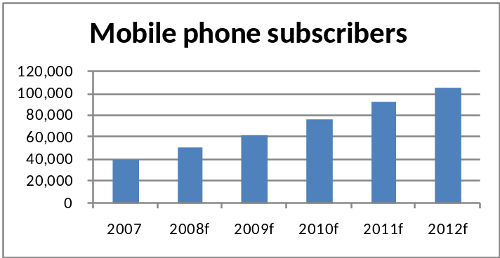
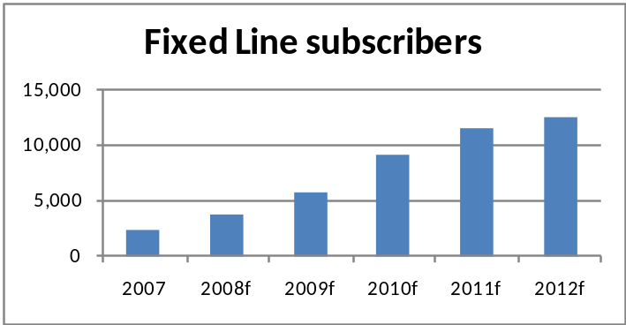
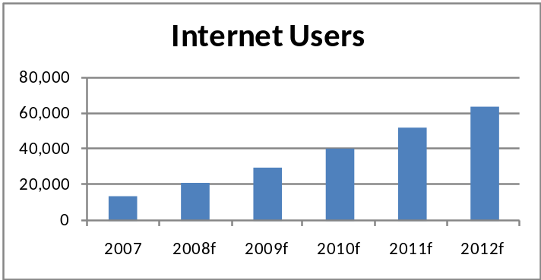
Industry Forecasts
Substantial growth
Increase of competition
Introduction of 3G technology
Exceptional growth
Investments in fiber installation
Entrance of regional wireless operators
Double digit growth potential
Underdeveloped market
Limited installed PC base but great increase of use of internet in common facilities (i.e. internet café’, bar,…)
Data in `000 subscribers

Slide 20
Summary of Industry Analysis and Recommendation
Great Potential of subscribers’ and revenues’ growth in all the 3 main services (Mobile, Fixed and Internet)
Mobile remains the dominant story in Nigeria`s telecoms market
The service level is low and an increase in competition on the quality is likely in the near future
New players are entering in the market exploiting the 3G and internet opportunities
Possible takeovers of operators in the next 12 months (i.e. Intercellular from Sudanese Telecommunications)
Nigerian telecom industry (especially mobile) is an excellent investment opportunity

Slide 21
AGENDA
Executive Summary
Situation of Global Telecoms Corp.
Country Analysis
Industry Analysis
Competitive Landscape
Market Entry Strategy
Data sources

Slide 22
Mobile Telecommunications– Competitive Landscape
Key facts
Key Players
Ongoing liberalization of the market
The 4 Country Operators (MTN, Globacom, Celtel and M-Tel) with almost 37mln subscribers
Robust growth in the last year with a net increase of 7mln new clients
Still room for penetration, the current level is only 30% of the population
Low service level: high level of dropped calls and lost sms
In 2008 launch of Mubudala as a 5th operator will increase the competition
Operator | Ownership | Mln subscribers | Market share
MTN | MTN Group¹ (81.87%) | 15.0 | 40.5%
Globacom | Mike Adenuga (100%) | 12.0 | 32.5%
Celtel | Celtel Internat.² (65%) | 9.9 | 26.7%
M-Tel | Nitel³ (100%) | 0.1 | 0.3%
Total |  | 37.0 | 100.0%
1) South African telecommunications operator
2) Overseas and pan-African operating arm of Kuwait`s Zain Group
3) Nigerian Telecommunications (fixed-line operator)

Slide 23
AGENDA
Executive Summary
Situation of Global Telecoms Corp.
Country Analysis
Industry Analysis
Competitive Landscape
Market Entry Strategy
Data sources

Slide 24
Recommendation for a Market Entry Strategy
Criteria | Relevance for GT | Strategy and degree of fulfillment
 |  | Build | Acquisition | Joint Venture | Alliance
Speed | High | Low | High | Medium | High
Control | Medium | High | High | Medium | Low
Risk share | Low | High | Low | High | Low
Antitrust avoidance | Low | High | Medium | Medium | Medium
Probability of success | High | Low | High | Medium | High
Global Telecoms has to choose a strategy that allows the company to gather quickly a significant share of the market and limits the risk of failure
An acquisition or the formation of an alliance with another operator seems to be the most promising startegy
Each of the existing operators faces investments in infrastructure and might be interested in getting a partner with substantial financial strength
M-Tel is actively looking for an investor, as the company is struggling to pay wages; however, the companies market share is insignificant
A (partial) acquisition of Celtel might be the alternative with the highest probability of success, as the company is currently owned by an investor from Kuwait

Slide 25
AGENDA
Executive Summary
Situation of Global Telecoms Corp.
Country Analysis
Industry Analysis
Competitive Landscape
Market Entry Strategy
Data sources

Slide 26
Data Sources
Institution | URL
Business Monitor International | www.businessmonitor.com
Economist Intelligence Unit | www.eiu.com
ISI Emerging Markets | www.isi.com
Nigerian Communication Commission (NCC) | www.ncc.gov.ng
World Bank (Country Profiles) | www.worldbank.org

