Slide 1

The Global Economy
© NYU Stern School of Business

Slide 2
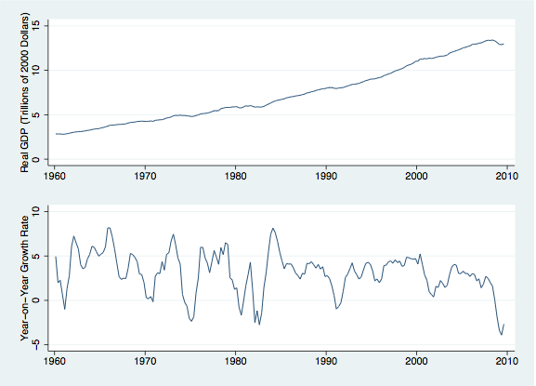
Growth and Fluctuations (US)

Slide 3
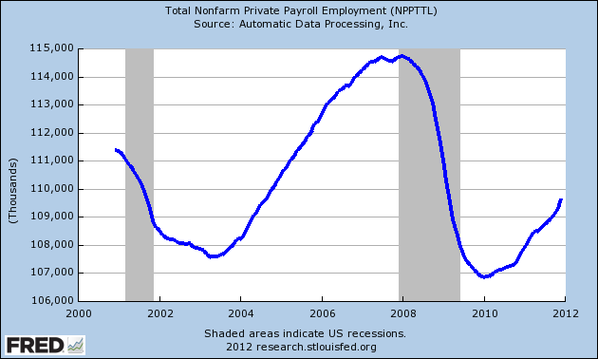

Slide 4
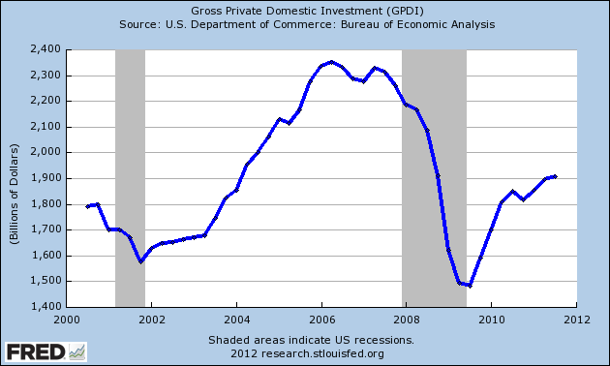

Slide 5
What is an “economy”?
3 dimensions to every economic problem
Physics (“Opportunities”)
  How does physical reality constrain our choices?
Psychology (“Preferences”)
  What do people want and how does that drive behavior?
Institutions (“Markets, governments, laws, customs, etc”)
  How do people interact to get what they want?
  Markets? Allocations based on efficiency guided by prices.
  Market failures? ➔ Governments. Allocations based on politics and guided by special interest and political influence.

Slide 6
Catch 22: (Yossarian the macroeconomist?)
Yossarian: Those bastards are trying to kill me.
Milo: No one is trying to kill you sweetheart. Now eat your dessert like a good boy.
Yossarian: Oh yeah? Then why are they shooting at me Milo?
Dobbs: They're shooting at everyone Yossarian.
Yossarian: And what difference does that make?

Slide 7
About the course
Mixture of quantitative and qualitative
  Neither is enough on its own
  Just like business
My goals
  Give you an economy-wide perspective on business
  Keep things as simple as possible – but not simpler!

Slide 8
About class notes
Conceptual background to class discussion
Executive summaries: more concise than a textbook
Custom designed for this course
Notes:
Questions?

Slide 9
About slides
Catalyst for discussion: not intended to be read on their own
Often more than we need: don’t panic if we skip some
My goal is to post them to Blackboard before class (“just in time”) to insure freshness
I’ll bring copies to class for note taking

Slide 10
About grades
Participation | 10%
Group Assignments (2 @ 30%) | 60%
Individual Assignment | 30%

Slide 11
About grades
Pass | ~ 65%
High Pass | < 35%-PD
Pass with Distinction | <10%

Slide 12
About participation
Keeps things interesting – for you and me both
I’ll informally track
  Comments posted on Blackboard
  Comments in class
Use your name plate so I know who you are

Slide 13
About Assignments
Short case-study-like exercises
First 2 are group work
Last 1 is individual work
Dates
  Group Assignment #1:
    Distributed on June 1st ➔ Due on June 14th
  Group Assignment #2:
    Distributed on June 15th ➔ Due on June 28th
  Individual Assignment #3:
    Distributed on June 28th ➔ Due on July 14th

Slide 14
About laptops
Please turn them off
Ditto cell phones, Blackberries, etc
(I realize this is impossible, but… let’s give it a try.)

Slide 15
About feedback
If you have ideas, comments, questions, whatever:
  Tell me during a class break
  Send me an email
  Post a comment to Blackboard
  … no reason to keep things to yourself.

Slide 16
Takeaways
Read the syllabus
Look through the Blackboard site
Look through the notes
  Read them before class if possible
Expect to participate
Have some fun

Slide 17
The Global Economy
Macroeconomic Data
© NYU Stern School of Business
Notes:
Set fast pace: lots to do
Notes + this session + GP1

Slide 18
The idea
Quick overview of macroeconomic data, including
  GDP
  Separating prices from quantities
  Connections between expenditures and financial flows
Do now at high speed, reinforce later through constant use

Slide 19
Questions
How can we measure aggregate economic activity?
How are these measurements used in practice?
We’ll see lots of statements like:
  “Per Capita GDP in 2008 prices is 30% higher in the US than France”
What does this mean?
Why do we care?

Slide 20
Plan
Measuring economic performance for a country:
  GDP
  Prices and quantities
  Flows of goods and assets (“identities”)
Does the US save too little/borrow too much?
Per Capita GDP vs. “Social Welfare”

Slide 21
GDP
GDP = Gross Domestic Product
Total amount of production in an economy (“output”)
  Sum value-added by all production units
  Equals: payments to labor and capital (owners)
  Equals: income
  Equals: sales of final good (last stage of value chain)
Why “domestic”? Why “gross”?
Do countries differ much in GDP? GDP growth?
  Let’s look at some data…

Slide 22
GDP per capita (2008, US dollars, PPP adj)
Source: IMF, WEO; also Wikipedia.

Slide 23
GDP growth (2010 % real)
Source: The Economist.

Slide 24
GDP measurement
Three related approaches
  Value added
  Income
  Final sales of finished goods
Example: I had a bottle of wine in a restaurant last week, how will that show up in GDP?
  As value added [by the restaurant]
  As income [salary of the waiter + profits of owner]
  As final sales [the price I paid for the wine]
  All of these things are linked in an obvious way

Slide 25
GDP as value added
Example:
  Farmer produces grapes, sells them for 100
  Winemaker buys grapes, produces wine, sells it for 175
  Restaurant buys wine, re-sells it for 300
What is value added for each producer?
What is the contribution to GDP?

Slide 26
GDP as value added
Producer | Value Added = Income | Final Sales
Farmer | 100 | 0
Winemaker | 75 | 0
Restaurant | 125 | 300
GDP (total) | 300 | 300
Notes:
VA = income

Slide 27
GDP as income
Recall: GDP = payments to labor and capital
  ➔ A measure of aggregate income
There are a few things we commonly include in income but are not part of current GDP
  Capital gains, interest on government debt, foreign income
…and in GDP but not in income
  Depreciation, income payments to foreigners
Bottom line: these things tend not to be a big deal for most questions, so we routinely think of GDP as aggregate income
Notes:
Draw venn diagram?

Slide 28
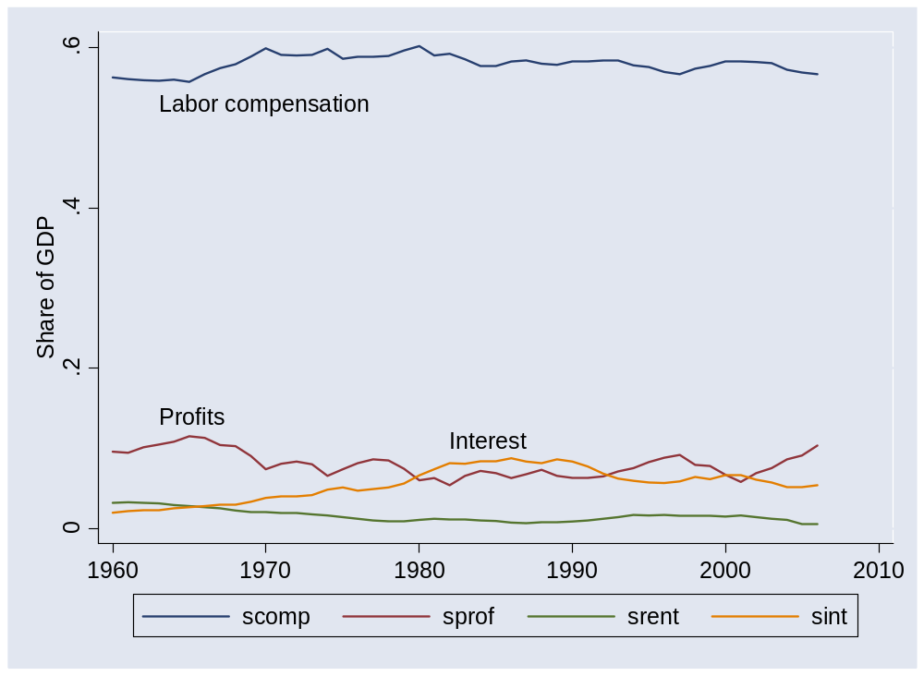
GDP by income component
Source: US NIPA.

Slide 29
GDP by income component
Notice the regularity in these income components:
  “Capital” gets about 1/3rd of total value added
  “Labor” gets about 2/3rds
Small fluctuations, but no trend
Similar across a wide range of countries
What could be driving this result?
  We’ll see later that it reflects a particular feature of technology

Slide 30
GDP as final sales
Allocate GDP across purchasers of final goods:
Y = C + I + G + (X-M)
  Y = GDP (“output”)
  C = sales to households (“consumption”)
  I = sales of capital goods to firms (“investment”)
  G = purchases of goods and services by government
  (X-M) = net exports (often abbreviated NX)
    Note: we could’ve netted out X from Y directly, and M from each component C, I, and G, but this is much simpler and gives the same answer
We call these: “expenditure components”

Slide 31
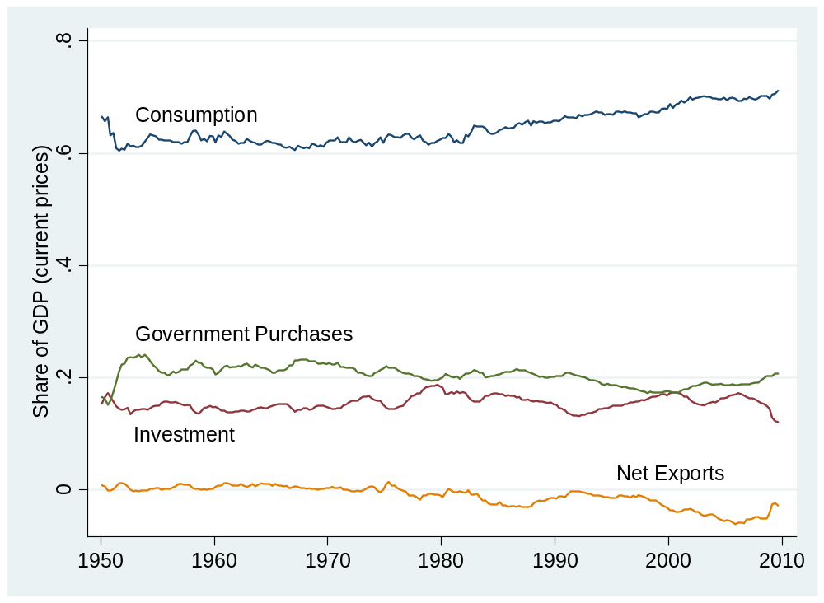
GDP by expenditure component
Source: US NIPA.

Slide 32
GDP by expenditure component
I/Y and G/Y don’t trend
Since the early 1980s, C/Y trends up and NX/Y trends down
Is that a coincidence? Absolutely not!
Do we care?
  Do American’s save too little?
    Can we tell from these data? No!
  How do American’s finance their current expenditures?
    Can we tell from these data? Yes!

Slide 33
Separating Price and Quantity
Note the important role played by market prices
To measure value added we use prices as to determine relative values
  A car costs $20,000 and a cup of coffee costs $2 because the car embodies 10,000 times the value of the cup of coffee
  Note that it’s the relative value that is really important here: if we measured prices in British Pounds, then the car would cost 30,000 and the coffee 3, but the relative value is the same
We often forget how much information there is in market prices and how much work they for us
  imagine how hard it would be to assign meaningful relative values to millions of products otherwise
Problem: Monetary units are fickle and can change for reasons that have nothing to do with fundamental value of goods and services
  In Zimbabwe in July 2008 prices rose by 231 million percent… do we really think that economic activity increased by 231 million percent?

Slide 34
Prices and quantities
General Electric (say)
  Sales up 25% year-on-year
  Higher prices or more units?
  Which prices? Units of which product?
US economy
  Nominal GDP (meaning GDP measured with current dollar prices) up 5% year-on-year
  How much is just higher prices, how much more real value?
What to remember
  Inflation is the “average” increase in prices
  “Real” growth is the “average” increase in quantities
  “Averaging” is trickier than it looks
  Several natural approaches sometimes produce different answers

Slide 35
Prices and quantities
We measure dollar values easily (that’s one of the benefits of having dollars)
Value = p₁q₁ + p₂q₂ + …
Note the important role played by prices:
  Everything in the same units of measurement ($)
  Prices reflect fundamental value (at least in a reasonably competitive environment
We want to separate Value into one price and one quantity
Value (V) = Price Index (P) x Quantity Index (Q)
Basic problem: sums of products don’t factor nicely into products of sums

Slide 36
Separating price from quantity
Two standard approaches to calculating a single price, P, and a single quantity, Q, in the relationship V = P x Q
Approach 1: get P first then infer Q
  Compute GDP at current prices (“nominal GDP”) ➔ V
  Compute a price index as a weighted average of all prices
    What are the weights? Pick a “base-year” and use the quantities of each good in that year as weights
    Higher volume goods are given higher weights as determined by base-year quantities
  Find real GDP as ratio ➔ Q=V/P
  The “Consumer Price Index” is a typical measure of P used in such calculations, but there are lots of others

Slide 37
Separating price from quantity
Approach 2: get Q first, then infer P
  Compute GDP at current prices (“nominal GDP”) ➔ V
  Compute a quantity index as a weighted average of all quantities
    What are the weights? Pick a “base-year” and use the prices of each good in that year as weights
    Higher valued goods are given higher weights as determined by base-year prices
  A direct calculation of Q ➔ real GDP
  Find the price index as ratio ➔ P = V/Q
  Jargon for Q is “real GDP at 2008 prices” and for P it’s the “implicit price deflator”
But… they can give slightly different answers
  Do we care? Depends on the question!!!

Slide 38
Separating price from quantity
But… they can give different answers
  Do we care? Depends on the question!!!
Which one is “the right answer”?
  Recall that it was a pretty abstract question we were trying to answer, so we shouldn’t be surprised if we have to make some simplifying assumptions to make progress
  Specific answers depend on those simplifying assumptions
  And there are a million other details (eg, how often do you change the base year?)
For understanding the big picture, these measurement details are not typically a big issue
For other questions, eg, indexing social security or the AMT threshold, it can be a really big deal!!!

Slide 39
Prices and quantities
Example: GDP in Canada
 | Beer |  | Donuts
Date | Price | Quantity | Price | Quantity
2011 | 0.50 | 10 | 0.25 | 10
2012 | 0.75 | 12 | 0.50 | 8
What is “real” GDP growth?
What is the inflation rate?

Slide 40
Prices and quantities
Approach 2: GDP deflator with base year 2011
Date | Nominal GDP | Real GDP | Price Deflator
2011 | 7.50 | 7.50 | 1.000
2012 | 13.00 | 8.00 | 1.625
Growth rate | 73.3% | 6.7% | 62.5%
Notes:
Where does this [pick one] number come from?

Slide 41
Prices and quantities
Approach 2: GDP deflator with base year 2012
Date | Nominal GDP | Real GDP | Price Deflator
2011 | 7.50 | 12.50 | 0.600
2012 | 13.00 | 13.00 | 1.000
Growth rate | 73.3% | 4.0% | 66.7%

Slide 42
Prices and quantities
Approach 1: CPI
Date | Price Index (2004 Basket) | Price Index (2005 Basket)
2011 | 7.50 | 8.00
2012 | 12.50 | 13.00
Growth rate | 66.7% | 62.5%

Slide 43
Flows of goods and assets
Examples linking spending to financing
  Firms invest: how is it financed?
  Governments run deficits: how are they financed?
  Households save: where does it go?
Notes:
Expenditures: who we sell to
Financing: how are expenditures financed?

Slide 44
Flows of assets
Recall: Y = C + I + G + NX
Allocate flows of assets:
Y – C – G = I + NX
S = I + NX
  I = (gross) investment (new plant and equipment)
  S = (gross) national saving (purchases of assets)
  NX = net purchases of foreign assets
Why are these “flows of assets”?

Slide 45
Flows of assets
Households+ Govt
S
Financial Markets
I
Firms
NX
Rest-of-World

Slide 46
National accounts summary
Production
GDP
Income
Labor, Capital
Expenditures
C,I,G,NX
Financial Flows
S = I + NX

Slide 47
GDP vs. Social Welfare
Bill Easterly, WSJ, Mar 07:
  Bill Gates expressed indifference to Africa’s stagnant GDP, since “you can’t eat GDP.”
  Mr Gates apparently missed the economics class that listed the major components of GDP, such as food.
But there’s something that rings true about the sentiment of Bill Gates’ statement
What’s the connection between GDP and something like “social welfare”?

Slide 48
GDP per capita (2008, US dollars, PPP adj)
Source: IMF, WEO; also Wikipedia.

Slide 49


US and France (2008 numbers)
Per capita GDP: $47,440
Avg weekly hours: 35
Per capita GDP: $34,205 Avg weekly hours: 29

Slide 50
Per Capita GDP vs. “Welfare”
We know that GDP isn’t really what we want for a measure of “standard of living”
  It leaves out lots of important stuff like the value of leisure, mortality, inequality, risk…
  Even if we are naïve enough to think that only material goods matter, then we should measure just consumption not GDP
These are valid reasons to question GDP, but it has become fashionable to completely dismiss GDP as misleading… is it misleading?

Slide 51
Per Capita GDP vs. “Welfare”
The value of important components of “well being” like leisure, health, mortality, and risk are difficult to measure directly.
But the contributions of these factors to welfare can be modeled in simple and sensible ways. (Note: conclusions will be model specific, hence, more subjective.)
What do these models tell us?
Some interesting differences, but…
  Per capita GDP is highly correlated with broader measures of welfare
  ➔ corr = 95%
  Rich countries are more similar than GDP might suggest
  Poor countries are actually worse than GDP suggests
Conclusion: per capita GDP isn’t a perfect measure of economic performance, but neither is it grossly misleading

Slide 52
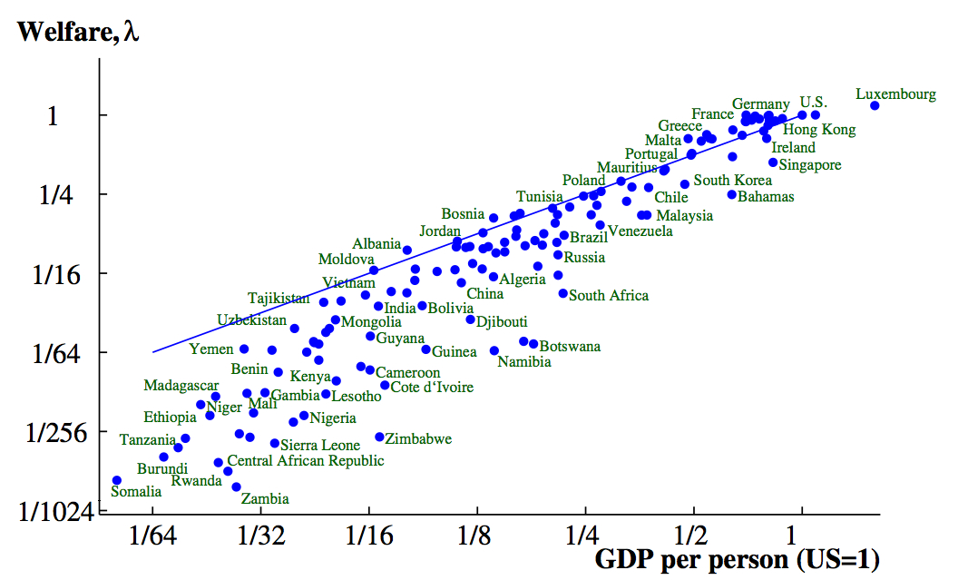
Welfare vs. Per Capita GDP (2000)

Slide 53
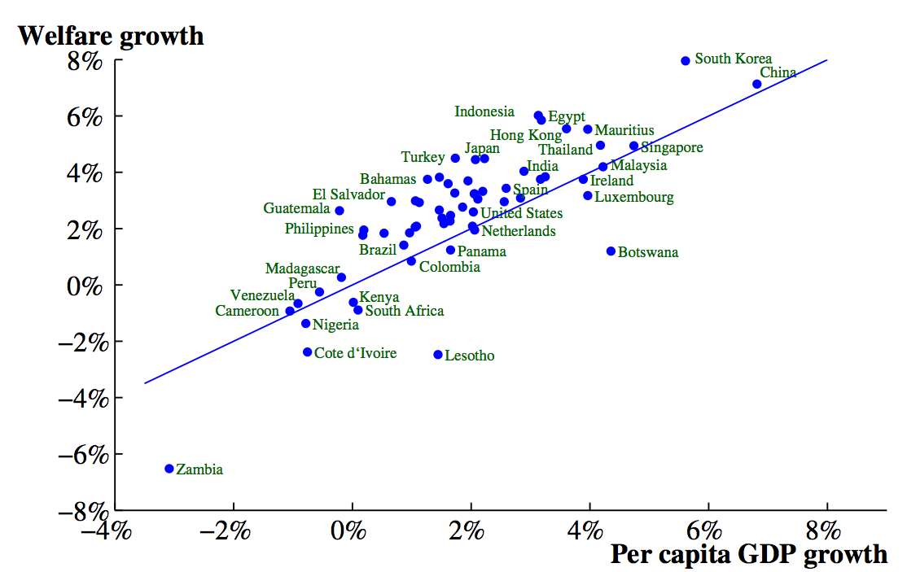
Growth Rates (1980-2000)

Slide 54
Questions
Why large differences in economic performance as measured by GDP per capita?
Pure luck? Something more systematic and controllable? A combination of both???
Notes:
Stretch…. SAME QUESTION!!!

Slide 55
Takeaways
Economic data are like sausages (my Dad was a butcher so I know… honest!!!)… tasty, provided you don’t focus too much on how they are made
GDP ≈ output, income, economic performance
Per Capita GDP is a good indicator of broader measures of social welfare
Separating prices and quantities is tricky: we do our best
Flows of goods and assets
  Goods: Y = C + I + G + NX
  Assets: S = I + NX

Slide 56
The Global Economy
What Determines GDP?
(The Aggregate Production Function)
© NYU Stern School of Business
Notes:
Check participation against volunteers, ask for new people
Open BB, Gapminder (x 2)
Fast pace
Hand signals
Two hands = important point
Point up = louder
Faster, Timeout, Facepalm

Slide 57
The idea
GDP
Capital & Labor
Productivity
Political Process
“Institutions”

Slide 58
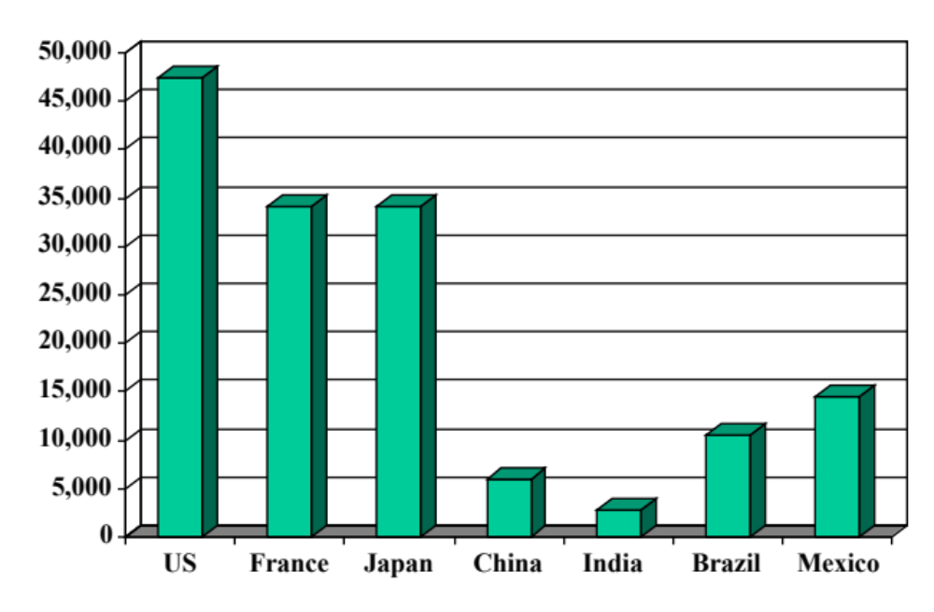
GDP per capita (2008, US dollars, PPP adj)
Source: IMF, WEO; also Wikipedia.

Slide 59
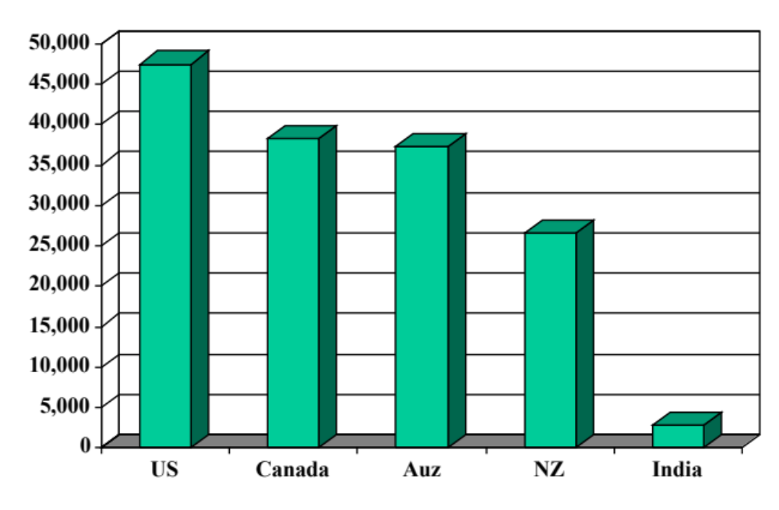
GDP per capita (2008, US dollars, PPP adj)
Source: IMF, WEO; also Wikipedia.

Slide 60
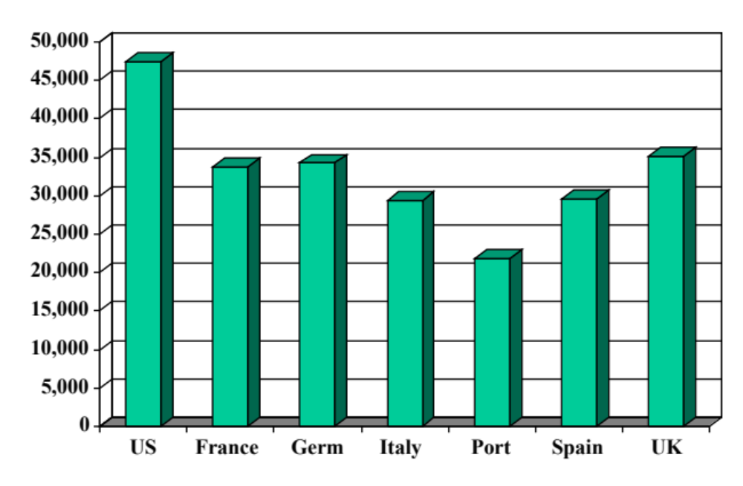
GDP per capita (2008, US dollars, PPP adj)
Source: IMF, WEO; also Wikipedia.

Slide 61
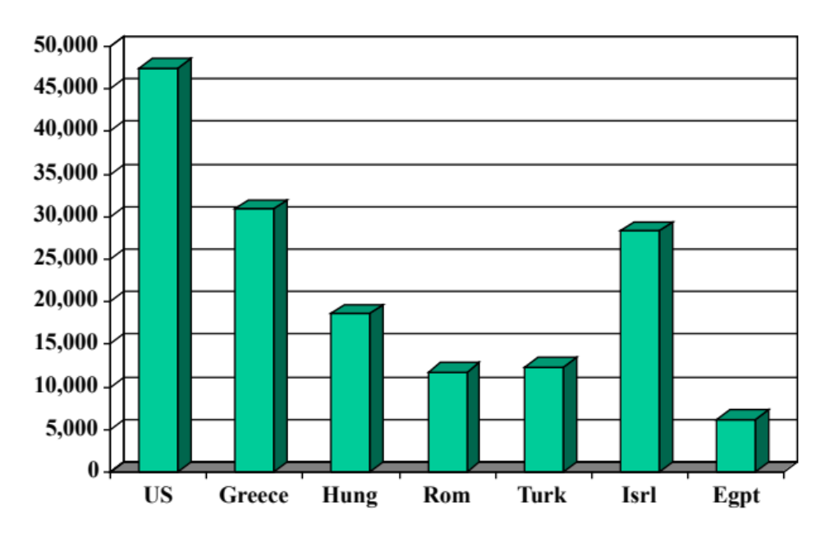
GDP per capita (2008, US dollars, PPP adj)
Source: IMF, WEO; also Wikipedia.

Slide 62
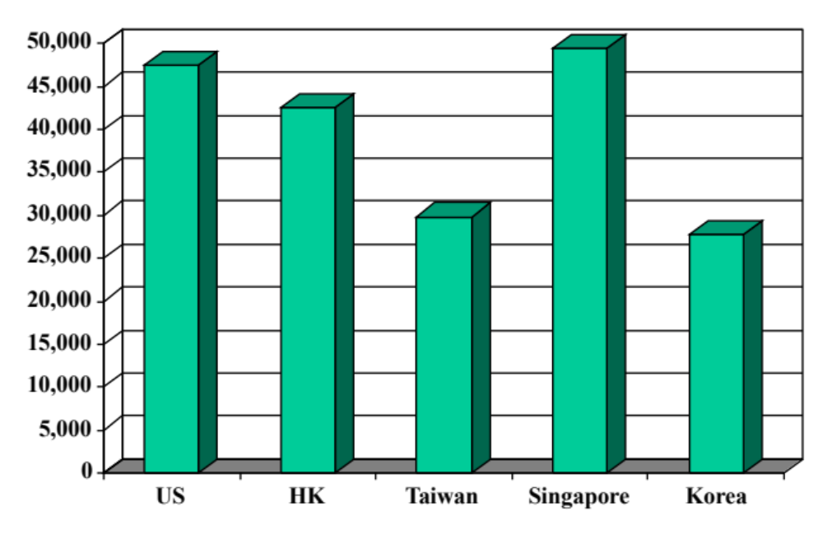
GDP per capita (2008, US dollars, PPP adj)
Source: IMF, WEO; also Wikipedia.

Slide 63
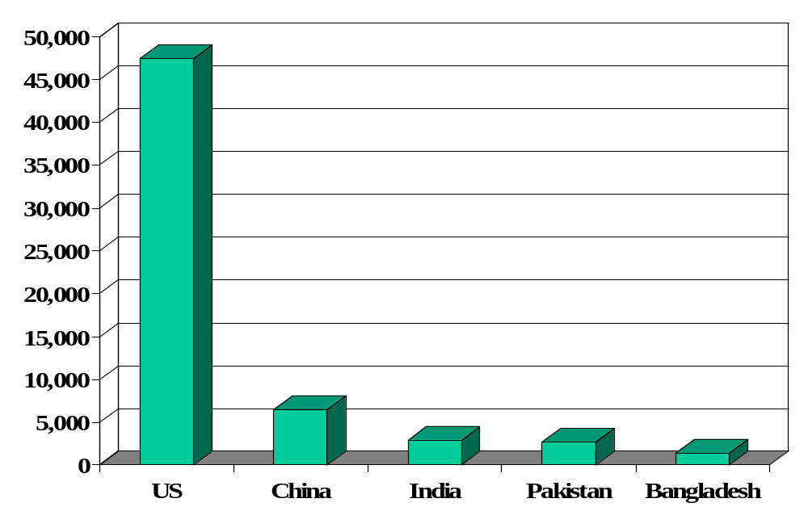
GDP per capita (2008, US dollars, PPP adj)
Source: IMF, WEO; also Wikipedia.

Slide 64
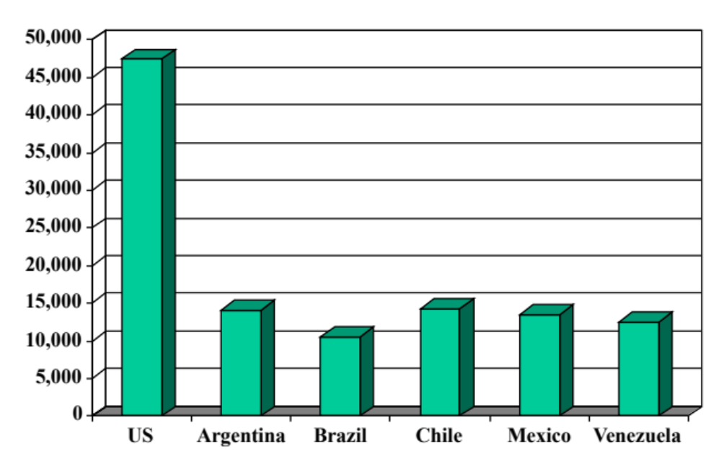
GDP per capita (2008, US dollars, PPP adj)
Source: IMF, WEO; also Wikipedia.

Slide 65
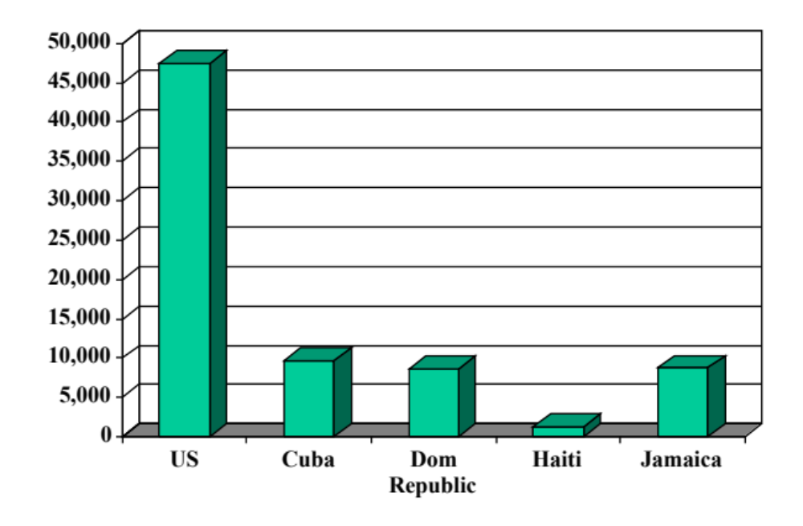
GDP per capita (2008, US dollars, PPP adj)
Source: IMF, WEO; also Wikipedia.

Slide 66
Questions
Why large differences in GDP per capita?
Pure luck? Something more systematic and controllable? A combination of both???
What is the “physical reality”? Where did this output come from?
Notes:
Stretch…. SAME QUESTION!!!

Slide 67
Production function
How are things produced?
What are the inputs?
Production function
  A simple abstraction to organize the data

Slide 68
Production function
GDP
Capital & Labor
Productivity

Slide 69
Production function: math
Idea: relate output to inputs
Mathematical version:
Y = A F(K,L)
= A K^{α} L^{1-α} (“Cobb-Douglas”)
Definitions:
  K = quantity of physical capital used in production (plant and equipment)
  L = quantity of labor used in production
  A = total factor productivity (everything else)
  α = 1/3 (recall labor’s share of income)

Slide 70
Production function: properties
What features do we capture with this choice of functions?
More inputs lead to more output
  Positive marginal products of capital and labor
Diminishing marginal products
  If we increase one input, holding the other input constant, each increase leads to less additional output
Constant returns to scale
  If we double both inputs, we double output
Notes:
Write out MPL …

Slide 71
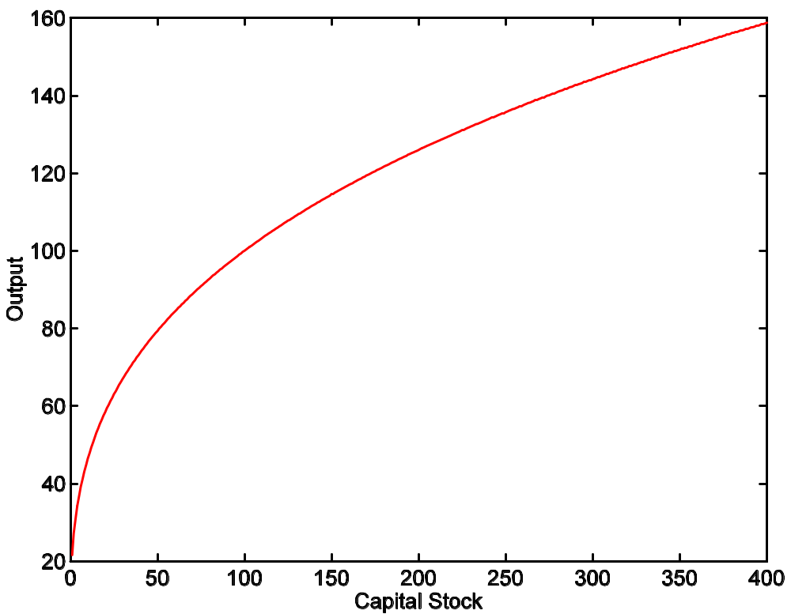
Production function: properties
A = 1
L = 100
α = 1/3

Slide 72
Why Cobb-Douglas with α = 1/3?
What did you learn in Firms & Markets?
Competition implies that factors of production earn their marginal products:
w L = (MPL) * L = (2/3) Y
r K = (MPK) * K = (1/3) Y
  The function that has this property is the Cobb-Douglas production function with α = 1/3.

Slide 73
GDP by income component
Source: US NIPA.

Slide 74
Capital
Meaning: physical capital used in production (plant and equipment)
Why does it change?
  Depreciation/destruction
  New investment
Mathematical version:
K_{t+1} = K_{t} – δK_{t} + I_{t}
= (1 – δ)K_{t} + I_{t}

Slide 75
Capital measurement
Option #1: direct surveys of plant and equipment
Option #2: perpetual inventory method
  Pick an initial value K₀ (survey?)
  Pick a depreciation rate (or measure depreciation directly)
  Measure K like this:
K_{t+1} = (1 – δ)K_{t} + I_{t}
In practice, #2 is the norm:
  Get I from NIPA
  Set δ = 0.06 [ballpark number]
  Example: K₂₀₀₄ = 100, δ = 0.06, I = 12 → K₂₀₀₅ = 106

Slide 76
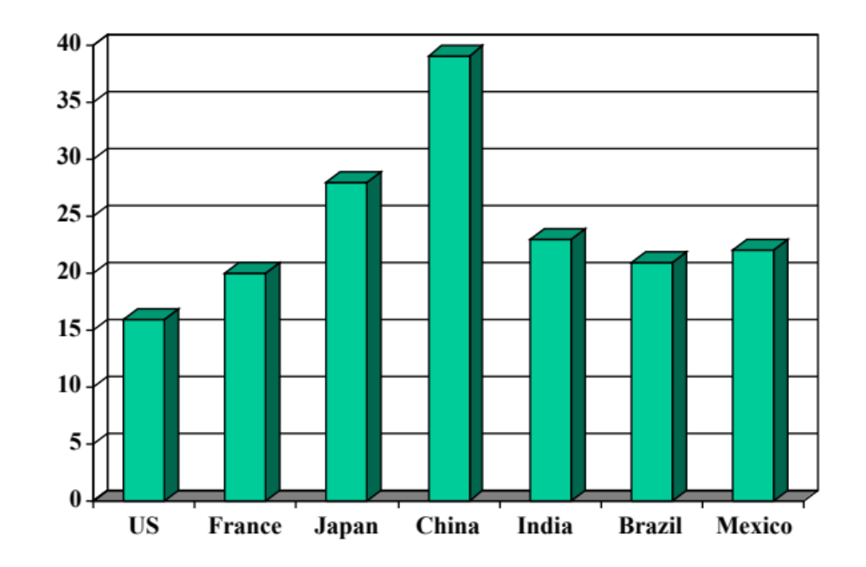
Investment rates (% of GDP)
Source: International Financial Statistics, averages for 1990-present.

Slide 77
Labor
Meaning: units of labor used in production (labor input)
Why does it change?
  Population growth
  Age distribution
  Participation: fraction of population working
What about changes in skills/education?
Notes:
Gapminder: fertilility v income per person

Slide 78
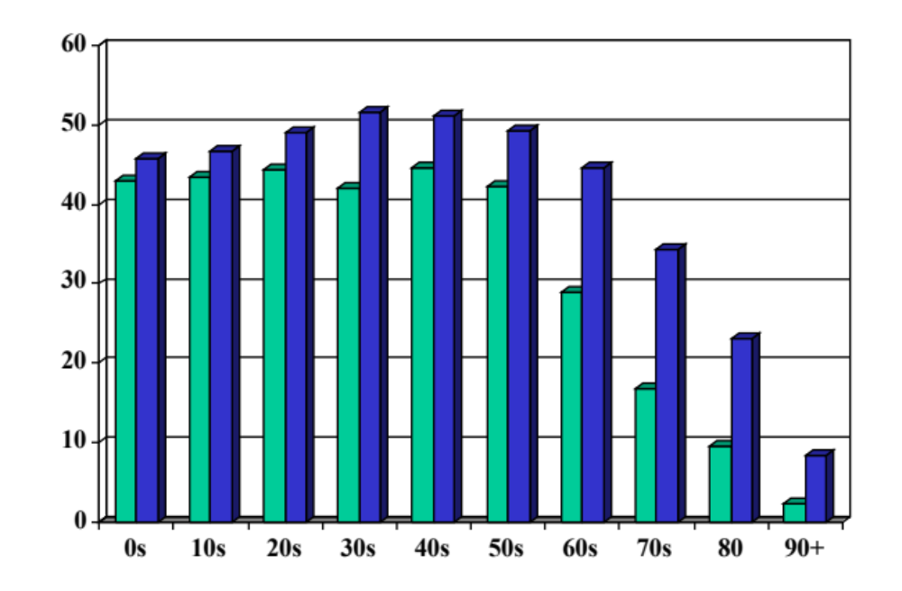
Population by age: US (millions)
Source: UN (link); green=2010, blue=2050.

Slide 79
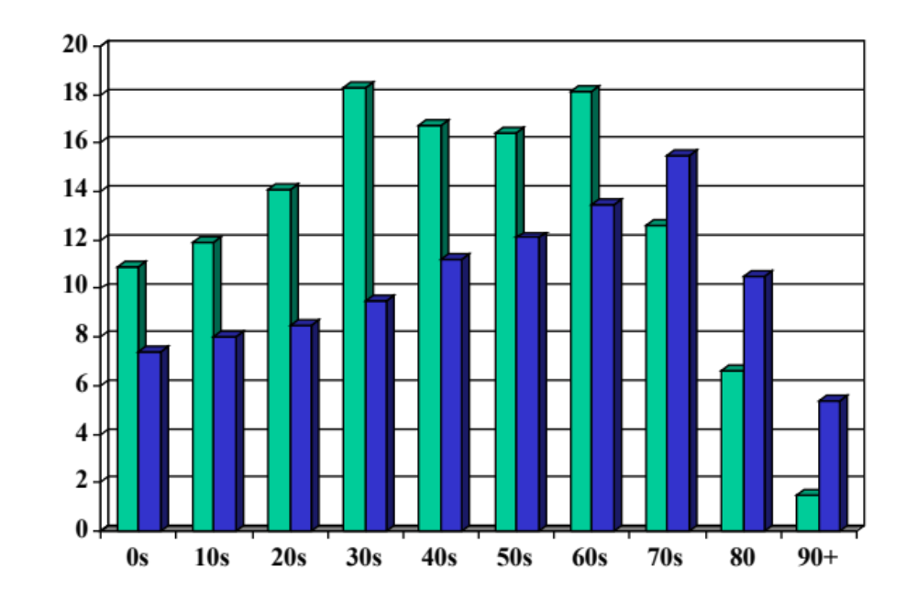
Population by age: Japan (millions)
Source: UN (link); green=2010, blue=2050.

Slide 80
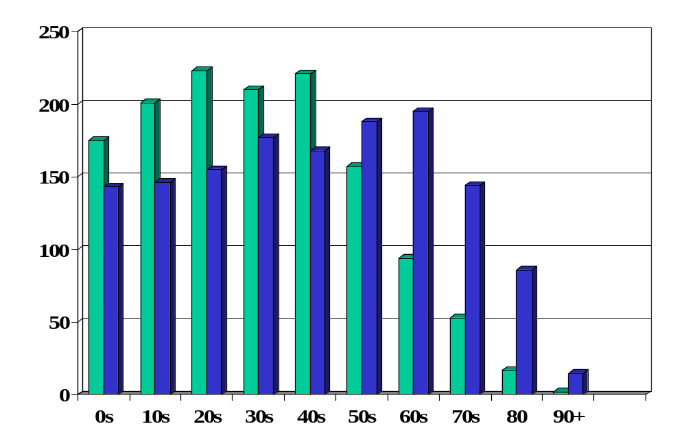
Population by age: China (millions)
Source: UN (link); green=2010, blue=2050.

Slide 81
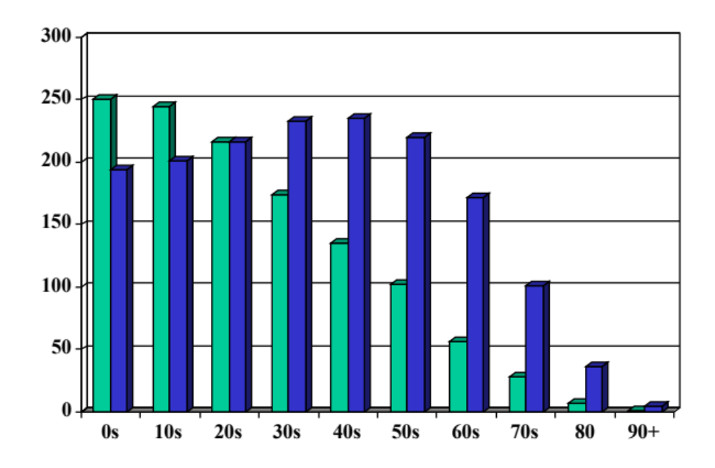
Population by age: India (millions)
Source: UN (link); green=2010, blue=2050.

Slide 82
Labor measurement
Basic measure: L = number of workers (employment)
  Government surveys of employers and people
Adjustments for quality? Hours?
  Skill: education? other? [H = “human capital”]
  Hours: if you know them [h = hours]
  Leads to an “augmented production function”:
Y = A F(K,hHL) = A K^{α} (hHL)^{1-α}

Slide 83
Productivity
The last component of the production function is “A”
  Y = A F(K,L) = A K^{α} L^{1-α}
Really important: higher A makes everyone better off
  “free lunch”?
“Total Factor Productivity” or TFP
Why this mouthful?
  Lots of other ways people measure productivity

Slide 84
Productivity measurement
We “measure” it indirectly
Solve the production function for A:
  Y = A K^{α} L^{1-α}
  A = Y/[K^{α} L^{1-α}] = (Y/L)/(K/L)^{α}
Example (US): Y/L = 33, K/L = 65:
A = 33/65^{1/3} = 8.21
Comments
  Any mistakes in our production function model or measurements will be absorbed in A
    eg, If H and h are important but we just use L, they will show up as A
  ➔ Value added through factors other than K and L

Slide 85
Takeaways
The production function links output to inputs and productivity:
Y = A K^{α} L^{1-α}
Capital input (K)
  Plant and equipment, a consequence of investment (I)
Labor input (L)
  Population growth, age distribution, participation
  Could add skill (H) or hours per person (h)
TFP (A) is everything else
  can be inferred from data on output and inputs

Slide 86
Where are we headed?
Use this production function to…
  Decompose cross-country differences in economic performance
  Decompose economic growth into its basic components
  Understand the role of productivity for economic performance
  Understand the role of institutions for economic performance

