Slide 1

The Global Economy Welcome: http://youtu.be/jvXRTUqdpB4
Notes:
Stan’s video
Welcome: for me to have fun, tell Stan I was better
This course is about countries: why are some countries more prosperous than others, what’s it like doing business in country X
The focus: data and a framework for thinking about it
Gapminder

Slide 2
The Global Economy Macroeconomic Data

Slide 3
Gapminder
What do you see?
http://www.gapminder.org/world/
(growth, corruption, life expectancy)
Questions that might cross your mind
What striking features do you see?
Where are the business opportunities?
Other thoughts?

Slide 4
Measurement
Bill Gates, Wall Street Journal, January 2013:
I have been struck by how important measurement is to improving the human condition. You can achieve incredible progress if you set a clear goal and find a measure that will drive progress toward that goal.
Is that true in your world? Examples?

Slide 5
Objective
Know what these headline numbers are
(Real) GDP: how much stuff did we produce? growth rate?
Inflation: how much did average prices change?
Why do we need this?
Common vocabulary (like financial statements for businesses)
Do at high speed now, reinforce with constant use

Slide 6
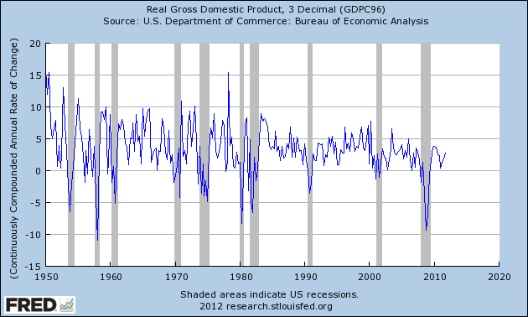
US (real) GDP growth
Source: FRED

Slide 7
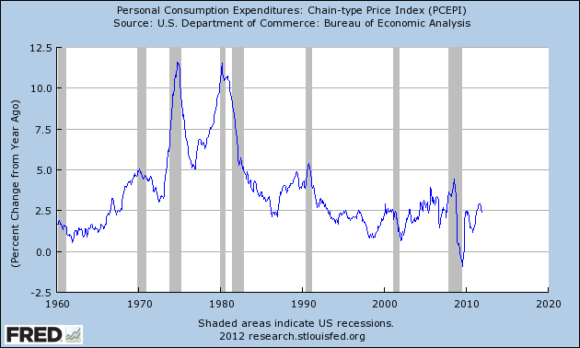
US inflation
Source: FRED

Slide 8
GDP per capita (USD, PPP adj)
Source: World Bank, World Development Indicators

Slide 9
Growth in GDP per capita (20-year avg)
Source: Penn World Tables.

Slide 10
Growth in GDP per capita (2013 est)
Source: OECD.

Slide 11
Roadmap
GDP: Gross Domestic Product
Expenditures and financial flows (“identities”)
Prices and quantities
Second thoughts

Slide 12
GDP

Slide 13
GDP
GDP = Gross Domestic Product
Total value of production in a geographic area
Sum value-added across all production units
By convention we don’t subtract depreciation (“gross”)
Three approaches to the same answer
Value-added
Income
Final sales (the end of the value chain)

Slide 14
GDP: example 1
Example
Farmer produces wheat, sells it for 100
Miller buys the wheat, produces flour, sells it for 175
Baker buys the flour, makes bread, sells it for 300
What is value-added for each producer?
What is GDP?
What is total income for the economy?
What is final sales?
Who eats the bread?

Slide 15
GDP: example 1
Producer | Farmer | Miller | Baker | GDP
Value-added
Final sales

Slide 16
GDP: example 1
Producer | Farmer | Miller | Baker | GDP
Value-added | 100 | 75 | 125 | 300
Final sales | 0 | 0 | 300 | 300

Slide 17
GDP: example 2
Barley farmer
Sales = 10
Rent = 3
Farmer’s profit = 7
Brewer
Sales = 110
Rent = 30
Wages = 70
Barley input = 10 (COGS)

Slide 18
GDP: example 2
Producer | Farmer | Brewer | Total
Value-added
Income
Final sales

Slide 19
GDP: example 2
Producer | Farmer | Brewer | Total
Value-added | 10 | 100 | 110
Income | 10 | 100 | 110
Final sales | 0 | 110 | 110

Slide 20
GDP: fine points
Investment not an input cost
Like corporate financial statements
Except: we never do subtract depreciation
Government purchases valued at cost
If the government produces goods and services, we value the output at whatever the input cost is
Imports are negative final sales
Exports are final sales outside the country
Imports final sales for the other country, negative final sales for us

Slide 21
GDP: example 3
Computer maker
Sales = 100
Wages = 65
Materials = 10
Owners’ income = 25
New building = 15
What is value added?
What is income?
What is final sales?
Concept | Total
Value-added
Income
Final sales

Slide 22
GDP: example 3
Computer maker
Sales = 100
Wages = 65
Materials = 10
Owners’ income = 25
New building = 15
What is value added?
What is income?
What is final sales?
Concept | Total
Value-added | 90
Income | 90
Final sales | 100*
* Includes 10 from materials producer

Slide 23
GDP: example 4
Government
Wages = 75
Rent = 25
What is value added?
What is income?
What is final sales?
Concept | Total
Value-added
Income
Final sales

Slide 24
GDP: example 4
Government
Wages = 75
Rent = 25
What is value added?
What is income?
What is final sales?
Concept | Total
Value-added | 100
Income | 100
Final sales | 100

Slide 25
GDP: example 5
Import-export firm
Sales = 140
Of which: 120 local, 20 abroad
Inputs = 25 from abroad
What is value added?
Income?
Final sales?
Concept | Total
Value-added
Income
Final sales

Slide 26
GDP: example 5
Import-export firm
Sales = 140
Of which: 120 local, 20 abroad
Inputs = 25 from abroad
What is value added?
Income?
Final sales?
Concept | Total
Value-added | 115
Income | 115
Final sales | 115*
* Note that we subtract imports here

Slide 27
GDP as value added by industry
mfg
FIRE
bus. services
agriculture
Source: BEA
Notes:
Agriculture, Manufacturing, FIRE, Business Services

Slide 28
GDP as income by type
labor comp.
rental income
corp. profits
interest
Source: BEA

Slide 29
Expenditures & financial flows

Slide 30
Expenditure flows
Allocate GDP among purchasers of final goods:
Y = C + I + G + NX
Y = GDP
C = sales to households (“consumption”)
I = sales of capital goods to firms (“investment” = “capex”)
G = purchases of goods and services by government
NX = net exports (exports minus imports)

Slide 31
GDP as final sales by expenditure
private cons
gov. cons
investment
net exports

Slide 32
Saving flows 1
Allocate flows of assets
Y – C – G = I + NX
S = I + NX
S = gross domestic saving (purchases of assets)
NX = net purchases of foreign assets

Slide 33
Saving flows 2
Separate household and government
(Y – C – T) + (T – G) = I + NX
S_{p} + S_{g} = I + NX
T = taxes net of transfers paid by households to govt
Warning: many measures of saving, all different
Call me is this ever comes up

Slide 34
Saving flows 3
Do Americans save too little?

Slide 35
US saving and investment
investment
saving
net exports

Slide 36
Household net worth
Source: Flow of Funds Accounts
Notes:
Table L.10

Slide 37
Prices & quantities

Slide 38
Prices and quantities
What we’ve seen so far is “nominal GDP”
GDP measured at current prices, in local currency units
If nominal GDP goes up
How much is more stuff? (more “real GDP”)
And how much higher prices? (“inflation”)
[We could ask the same of a firm’s sales]
Problem
There’s no clear answer
Or rather: several answers, equally sensible but different

Slide 39
Prices and quantities
Our problem: find P and Q so that
Nominal GDP = PQ = p₁q₁ + p₂q₂ + etc
Nominal GDP = GDP at current prices
p,q = price and quantity of a specific product
P,Q = “average” price (“price level”) or quantity (“real GDP”)
Growth rates
Of Q: real GDP growth
Of P: inflation
How do we compute P and Q?

Slide 40
Prices and quantities
Method 1 (“fixed price method”)
Find average quantity Q using “base-year” prices
Find “average” price from P = Y/Q (“deflator”)
Method 2 (“fixed quantity method”)
Find average price P using “base-year” quantities
Find “average” quantity from Q = Y/P
Problems
Both make sense, but answers are different
Choice of base year matters too

Slide 41
Example
 | Fish |  | Chips
Date | Price | Quantity | Price | Quantity
2004 | 0.50 | 10 | 0.25 | 10
2005 | 0.75 | 12 | 0.50 | 8
What is the inflation rate?
What is real output growth?

Slide 42
Fixed price method (GDP deflator)
 | Fish |  | Chips
Date | Price | Quantity | Price | Quantity
2004 | 0.50 | 10 | 0.25 | 10
2005 | 0.75 | 12 | 0.50 | 8
Date | Nominal GDP | Real GDP | Price Deflator
2004
2005
Growth rate
Base year: 2004

Slide 43
Fixed price method (GDP deflator)
 | Fish |  | Chips
Date | Price | Quantity | Price | Quantity
2004 | 0.50 | 10 | 0.25 | 10
2005 | 0.75 | 12 | 0.50 | 8
Date | Nominal GDP | Real GDP | Price Deflator
2004 | 7.50 | 7.50 | 1.000
2005 | 13.00 | 8.00 | 1.625
Growth rate | 73.3% | 6.7% | 62.5%
Base year: 2004

Slide 44
Fixed price method (GDP deflator)
 | Fish |  | Chips
Date | Price | Quantity | Price | Quantity
2004 | 0.50 | 10 | 0.25 | 10
2005 | 0.75 | 12 | 0.50 | 8
Date | Nominal GDP | Real GDP | Price Deflator
2004
2005
Growth rate
Base year: 2005

Slide 45
Fixed price method (GDP deflator)
 | Fish |  | Chips
Date | Price | Quantity | Price | Quantity
2004 | 0.50 | 10 | 0.25 | 10
2005 | 0.75 | 12 | 0.50 | 8
Date | Nominal GDP | Real GDP | Price Deflator
2004 | 7.50 | 12.50 | 0.600
2005 | 13.00 | 13.00 | 1.000
Growth rate | 73.3% | 4.0% | 66.7%
Base year: 2005

Slide 46
Fixed quantity method (CPI)
 | Fish |  | Chips
Date | Price | Quantity | Price | Quantity
2004 | 0.50 | 10 | 0.25 | 10
2005 | 0.75 | 12 | 0.50 | 8
Date | Price Index (2004 Basket) | Price Index (2005 Basket)
2004
2005
Growth rate

Slide 47
Fixed quantity method (CPI)
 | Fish |  | Chips
Date | Price | Quantity | Price | Quantity
2004 | 0.50 | 10 | 0.25 | 10
2005 | 0.75 | 12 | 0.50 | 8
Date | Price Index (2004 Basket) | Price Index (2005 Basket)
2004 | 7.50/7.50*100=100.0 | 8.00/8.00*100=100.0
2005 | 12.50/7.50*100=166.7 | 13.00/8.00*100=162.5
Growth rate | 66.7% | 62.5%

Slide 48
Prices in Argentina
Former president instituted “new methodology”
Only certain products are in the official price index
Prices of those products subject to “persuasion”
Inflation lower with new method
What happened next
Official products cheap, but not available (why?)
Unofficial estimates of inflation more than double official rate
Economists arrested for producing private inflation estimates
[Search: “inflation Argentina”]

Slide 49
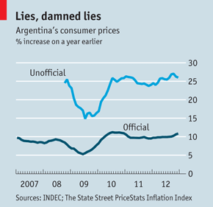
Prices in Argentina
“The IMF and Argentina,” The Economist, Feb 9, 2013:

Slide 50
Second thoughts

Slide 51
Do we care about GDP?
Bill Gates
“You can’t eat GDP.”
Bill Easterly
“Mr Gates apparently missed the economics lecture that listed the components of GDP, such as food.”
WSJ, March 2007

Slide 52

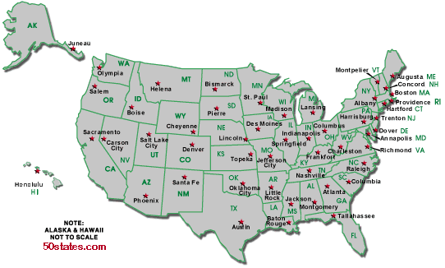
Do we care about GDP?
Per capita GDP: $47k
Per capita GDP: $34k
Avg weekly hours: 35
Avg weekly hours: 29

Slide 53
Do we care about GDP?
The obvious
GDP per person reflects income and standard of living
The less obvious
Correlated with many other things we care about: life expectancy, child mortality, poverty
Recall Gapminder
But it’s one number, not the answer to all questions

Slide 54
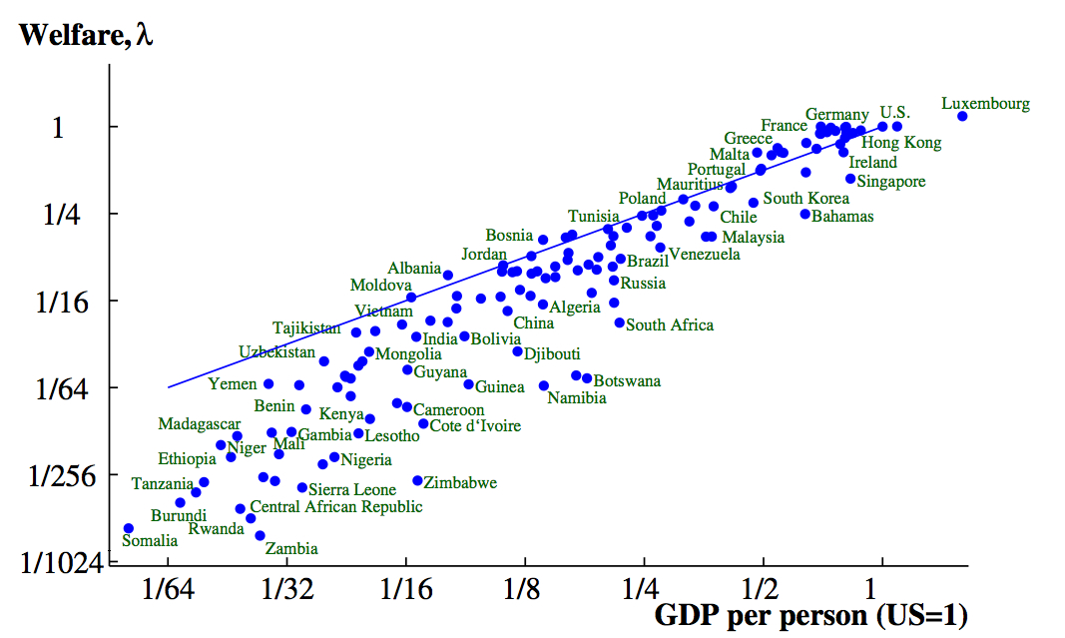
Do we care about GDP? (2000)
Source: Jones and Klenow, “Beyond GDP”

Slide 55
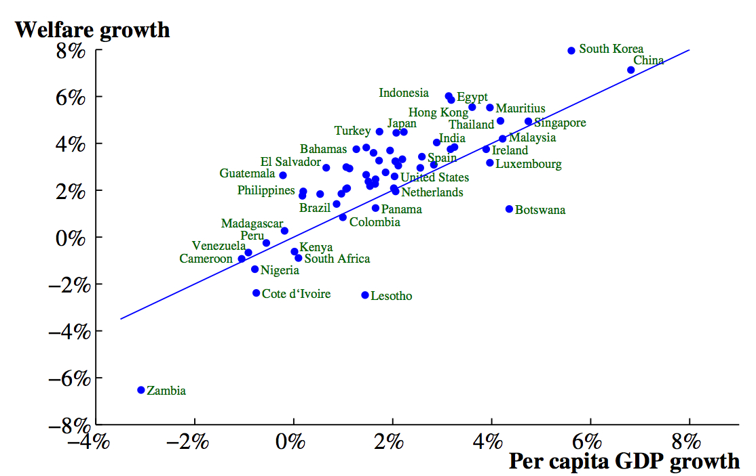
Do we care about GDP? (1980-2000)
Source: Jones and Klenow, “Beyond GDP”

Slide 56
More fine points
Home production not counted in GDP
Black market transactions not counted either
Some “income” not in GDP
Capital gains (houses, equity)
Interest on government debt
Returns on foreign assets
Call me if you ever have to deal with this

Slide 57
Macroeconomic data
Caption for old New Yorker cartoon:
“Final, revised government figures for the fourth quarter of 1981 now indicate that the Yankees, not the Dodgers, won the World Series.”

Slide 58
What have we learned?
GDP measures output and income
Per capita GDP wildly different across countries
Composition always changing (where did those factory jobs go?)
Labor gets about 2/3, “capital” 1/3
Real GDP measures the quantity of output
Inflation measures the change in average prices
Macroeconomic data are like sausages

Slide 59
The Global Economy The Production Function
Notes:
Open spreadsheet, Solow
Also website

Slide 60
What’s happening?
Zeeshan Haider, Sara Bitteti*, and Shiyue Cheng weighed in on taxes, including this from Bloomberg:
Amazon.com was among three U.S. companies singled out by U.K. lawmakers last year for not paying enough tax in Britain. Members of Parliament’s Public Accounts Committee criticized the online retailer, Starbucks Inc. and Google Inc. for using complex accounting methods to reduce their tax liabilities in the U.K.
What would you do if you were Amazon? If you were the UK?

Slide 61
What’s happening?
Questions about tax policy
If you’re a CEO, how important are taxes to your location decision?
If you’re Mayor Bloomberg, are tax breaks for firms good for the NYC economy?
Is competition between localities good for economic performance overall?
Should we tax firms directly, or collect the same revenue with income and sales taxes?

Slide 62
What’s happening?
An old joke:
Opinion polls show that 100% of voters think other people should pay more tax.

Slide 63
Roadmap
What’s happening? ✓
Reminders
Economic history of the world
Theory: the production function
Inputs: capital and labor
Productivity

Slide 64
Reminders

Slide 65
Reminder: real and nominal GDP
Real GDP (“quantity”)
GDP in constant dollars
GDP in 2005 USD
GDP in USD, PPP adjusted
GDP chain-weighted in 2010 USD
Nominal GDP (“value = price times quantity”)
GDP at current prices
GDP in LCUs
Both come from “NIPA”:
National Income and Product Accounts

Slide 66
Reminder: GDP per capita (USD, PPP adj)
Source: World Bank, World Development Indicators

Slide 67
Reminder: where are we headed?
Module 1: long-term economic performance
Why are some countries rich, and others poor?
Where are the economic and business opportunities?
Suggested answer (developed over several weeks)
Business opportunities and economic performance generally reflect effective markets backed by institutions that keep them honest
Effective markets , not “free” markets
More bluntly: low price is good, not messed up also good

Slide 68
Reminder: where are we headed?
Where would you open a new Nike factory?
What factors are important to you?
How do Indonesia, Kazakhstan, Viet Nam compare? Others?
Where should Four Seasons expand?
What factors are important to you?
How do Baku, Dublin, Guangzhou compare? Others?
Where should Genpact open a new BPO operation?
What factors are important to you?
How do Ghana, India, Jamaica compare? Others?

Slide 69
Economic history of the world

Slide 70
Economic history of the world
Until recently, life was “poor, nasty, brutish, and short”
Hobbes, “Leviathan,” 1651
[In the natural state of Man] there is no place for industry . … [There is] continual fear and danger of violent death, and the life of man [is] solitary, poor, nasty, brutish, and short.“

Slide 71
Economic history of the world
Statistic | Year
 | 1 | 1000 | 1820 | 2008
Population (millions) | 225 | 267 | 1,042 | 6,694
GDP Per Capita (1990 USD) | 467 | 425 | 666 | 7,614
Life expectancy (years) | 24 | 24 | 26 | 66
Source: Angus Maddison, Millenial Perspective.

Slide 72
Economic history of the world

Slide 73
GDP per capita (1990 international USD)
Region | Year
 | 0 | 1000 | 1820 | 2008
Western Europe | 599 | 425 | 1,218 | 21,672
Western “offshoots” | 400 | 400 | 1,202 | 30,152
Japan | 400 | 425 | 669 | 22,816
Latin America | 400 | 400 | 691 | 6,973
Former USSR | 400 | 400 | 688 | 7,904
China | 450 | 466 | 600 | 6,725
Africa | 472 | 425 | 420 | 1,760
World Average | 467 | 453 | 666 | 7,614
Source: Angus Maddison, website.

Slide 74
Some examples
Notes:
2^8=256, 2^9=512, 2^10=1024, 2^11=2048,2^12=4096, 2^13=8192, 2^14=16384, 2^15=32768
Log2 scale: each number represents a doubling, Arg<13, Ger>14, Germany GDP/capita (19,144) almost double Argentina(7,666)
Germany, US, most of Western Europe: 2% growth over last 100 years
Argentina: used to be as rich as Germany

Slide 75
Growth
Source: World Bank, World Development Indicators.

Slide 76
Summary
Several centuries ago, we were all poor
Now there’s enormous variation across countries
Also variation in growth rates
Modest variation among rich countries
Greater variation among poor countries
Questions
Why?
What will the future bring?
Where are the opportunities?

Slide 77
Open questions
Why did Western Europe do so well?
Why not the Greeks and Romans?
Why not China?
Why not the Islamic world?

Slide 78
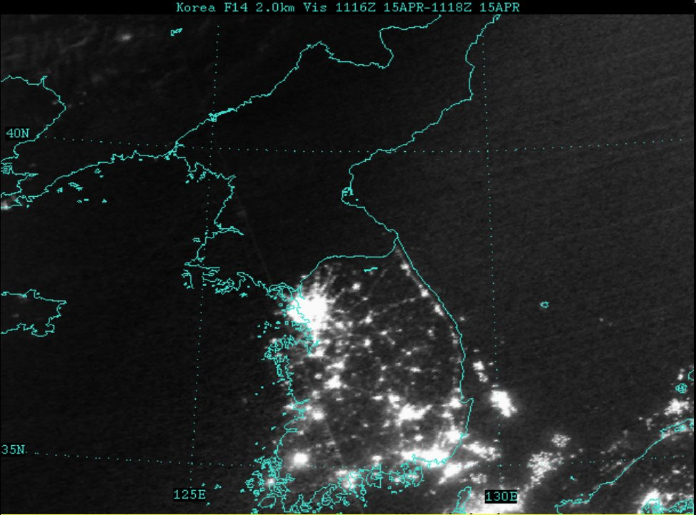
A controlled experiment
What separates the successes from the others?
What roleAlso variation in growth rates
Modest variation among rich countries
More variation among poor countries

Slide 79
Theory: The Production Function

Slide 80
Why theory?
A tool to help us organize our thoughts
What factors facilitate good performance?
What factors offer attractive business opportunities?

Slide 81
Theory: the picture
GDP
Capital & Labor
Productivity
Political Process
“Institutions”

Slide 82
Theory: the math
The idea: relate output to inputs
Mathematical version (“production function”):
Y = A F(K,L) = A K^{α} L^{1-α}
A formula we can compute in a spreadsheet
Definitions:
K = quantity of physical capital used in production (plant and equipment)
L = quantity of labor used in production
A = total factor productivity (everything else)
α = a parameter we set equal to 1/3 (more soon)

Slide 83
Production function properties
More inputs lead to more output
Positive marginal products of capital and labor
Diminishing marginal products
If we increase one input at a time, each increase leads to less additional output
Marginal product = partial derivative of production function
Constant returns to scale
If we double **both** inputs, we double output (no inherent advantage or disadvantage to size)

Slide 84
Production function properties

Slide 85
Where does α come from?
Capital’s share of value-added
If you know calculus, this is how we show it
Profit is
Profit = pY – rK – wL = pAK^{α}L^{1-α} – rK – wL
Maximize profit by setting derivative wrt K equal to zero
dProfit/dK = αpAK^{α-1}L^{1-α} – r = 0
Multiply by K
α pAK^{α}L^{1-α} = rK
α = rK / pAK^{α}L^{1-α}
Evidence (last week): about 1/3

Slide 86
Capital (K)
What we mean: plant and equipment, physical capital
Why does it change?
Depreciation/destruction
New investment (“capex”)
Mathematical version:
K_{t+1} = K_{t} – δ_{t}K_{t} + I_{t}
= (1 – δ_{t}) K_{t} + I_{t}
Adjustments for quality?

Slide 87
Measuring capital
Option #1: direct surveys of plant and equipment
Option #2: perpetual inventory method
Pick an initial value K₀
Pick a depreciation rate (or measure depreciation directly)
Measure K like this:
K_{t+1} = (1 – δ_{t})K_{t} + I_{t}
In practice, #2 is the norm:
Get I from “NIPA” [“real” investment]
Set δ = 0.06 [ballpark number]
Example: K₂₀₁₀ = 100, δ = 0.06, I = 13 → K₂₀₁₁ = ??

Slide 88
Labor (L)
What we mean: units of work effort
Why does it change?
Population growth
Fraction of population employed (extensive margin)
Hours worked per worker (intensive margin)
Our starting point: number of people working

Slide 89
Measuring labor
Our starting point
L = number of people working
Adjustments for hours worked
Replace L with hL (h = hours per worker)
Adjustments for skill, education
Replace L with HL (H = “human capital”)
H commonly connected to years of school

Slide 90
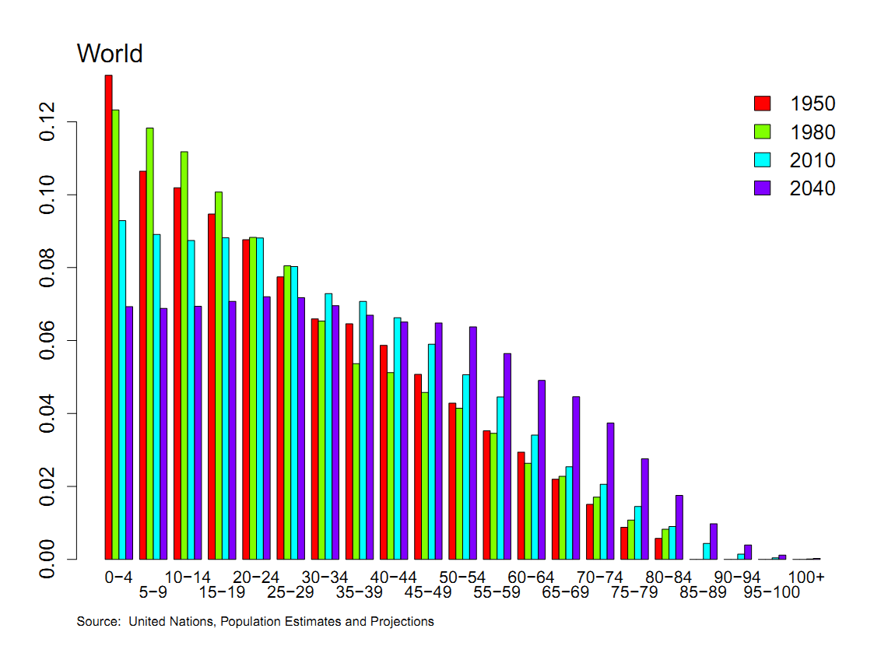
Population by age

Slide 91
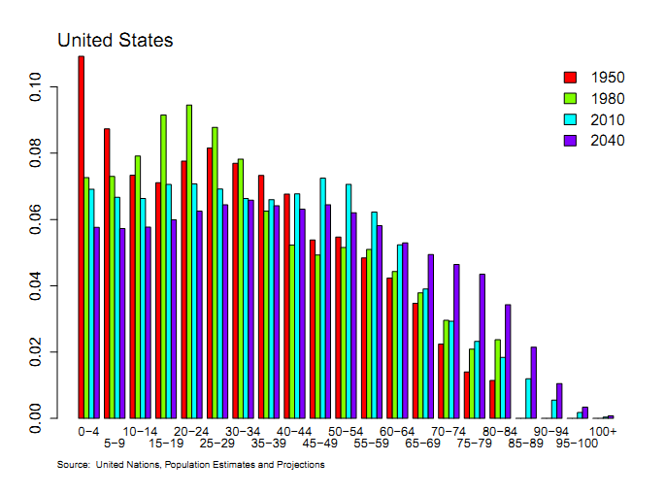
Population by age

Slide 92
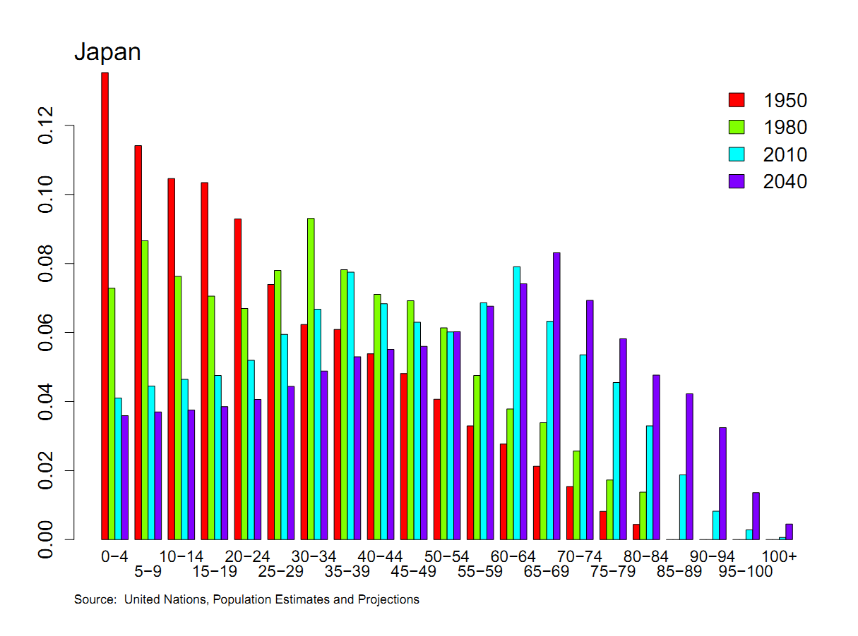
Population by age

Slide 93
Population by age
Business Week, Nov 2012:
Last year, for the first time, sales of adult diapers in Japan exceeded those for babies.
We’ll come back to this.

Slide 94
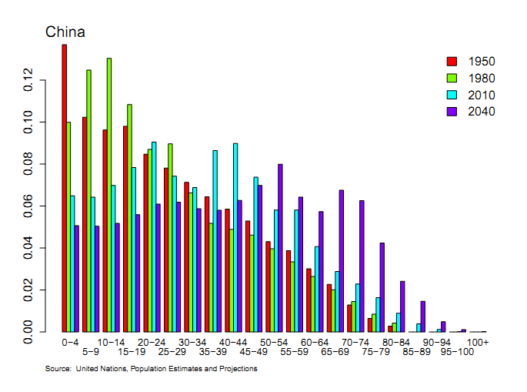
Population by age

Slide 95
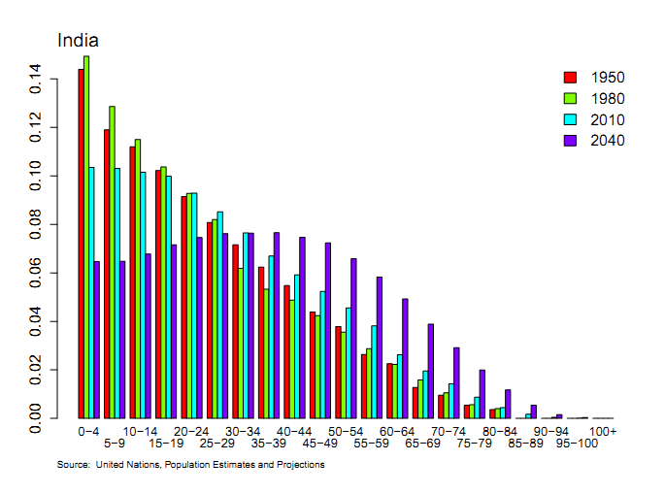
Population by age

Slide 96
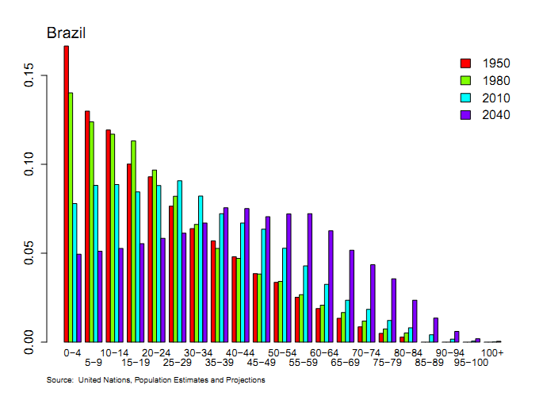
Population by age

Slide 97
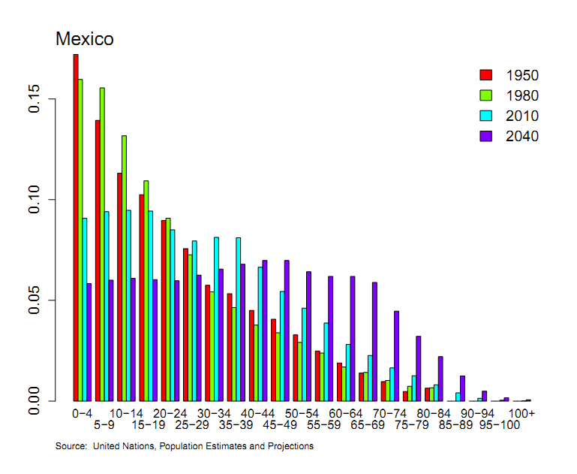
Population by age

Slide 98
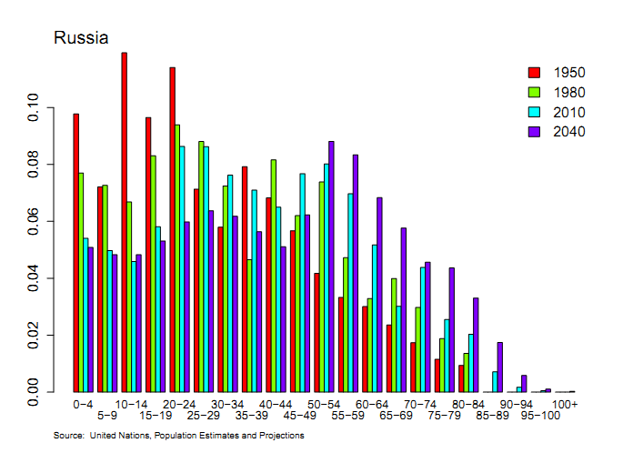
Population by age

Slide 99
Productivity (A)
Standard number
Average product of labor: Y/L
How do we measure it?
Measure output and input, take the ratio
Our number
Total Factor Productivity (TFP): A = Y/F(K,L)
How do we measure it?
Same idea, but “input” combines capital and labor (“total”)

Slide 100
Productivity
Solve the production function for A
Y = A K^{α} L^{1-α}
A = Y/[K^{α} L^{1-α}] = (Y/L)/(K/L)^{α}
Example: Y/L = 33, K/L = 65,
A = 33/65^{1/3} = 8.21
Note: units meaningless, but the same across time or countries

Slide 101
Production function review
Remember: Y = A F(K,L)
What changes in this equation if
A firm builds a new factory?
Fewer people retire at 65
Spanish banks channel funds to unproductive firms
Workers shift from agriculture to industry in Viet Nam?
Competition drives inefficient firms out of business?
Venture capital fund identifies good unfunded projects?
Alaska builds a bridge to nowhere?
China invests in massive infrastructure projects?

Slide 102
What have we learned?
The production function links output to inputs and productivity:
Y = A K^{α} L^{1-α}
Capital input (K)
Plant and equipment, a consequence of investment (I)
Labor input (L)
Population growth, age distribution, participation, hours (h), skill (H)
TFP (A) can be inferred from data on output and inputs

