Slide 1

The Global Economy
International Trade
© NYU Stern School of Business
Notes:
Start quickly – full class
Note: students should argue – no need for unquestioned market religion
When we get to trade:
Samuelson: nontrivial result
Nobel laureate Paul Samuelson (1969) was once challenged by the mathematician Stanislaw Ulam to "name me one proposition in all of the social sciences which is both true and non-trivial." It was several years later than he thought of the correct response: comparative advantage. "That it is logically true need not be argued before a mathematician; that is is not trivial is attested by the thousands of important and intelligent men who have never been able to grasp the doctrine for themselves or to believe it after it was explained to them."
http://www.wto.org/english/res_e/reser_e/cadv_e.htm

Slide 2
The idea
International Trade Theory
  International trade, and markets in general, are win-win: both sides of a trade benefit, or (presumably) they wouldn’t do it. This is simple and compelling logic, not opinion, but it remains controversial.
International Trade Reality
  A fact of life in international business situations is that locals use their political connections to hamper foreign competitors.

Slide 3
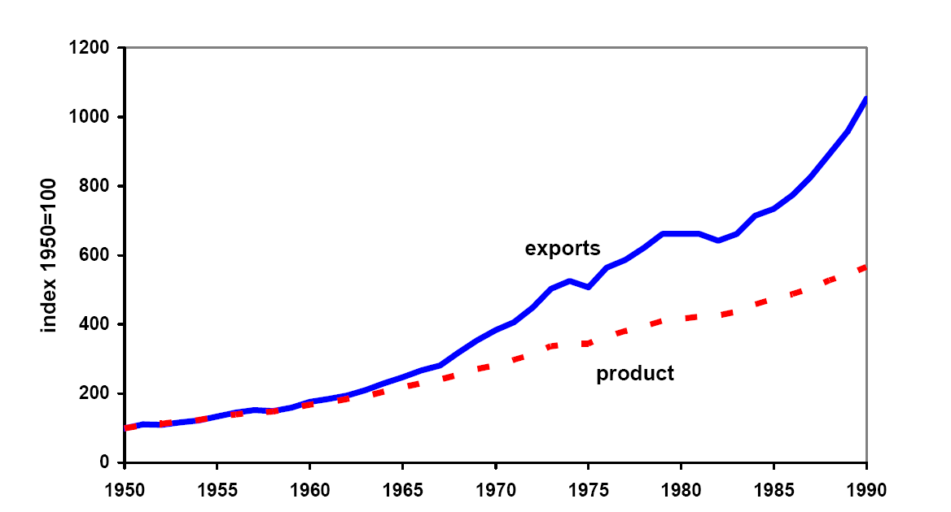
Growth in trade and output since 1950
Source: Kehoe and Boergoing.
Notes:
What do you see here? Why?

Slide 4
Lou Dobbs
Commentator ex-CNN now with Fox Business and critic of “exporting jobs”
  The shipment of American jobs to cheap foreign labor markets threatens not only millions of workers and their families, but also the American way of life. Corporate raiders are breaking down our borders in search of the lowest-price labor available anywhere in the world. For the first time in history, corporations are laying off Americans from well-paying jobs and replacing them with low-paid foreign workers. … Corporate America isn’t doing all this alone: Big business and Washington are in cahoots, trading our nation’s livelihood for short-term gain.
Notes:
From blurb for his book, Exporting America.

Slide 5
Global Trade Watch
Anti-globalization group on NAFTA:
  The data are in and they clearly show the damage NAFTA has wrought for millions of people in the US, Mexico, and Canada. As we predicted: a race-to-the-bottom in wages, destruction of hundreds of thousands of good US jobs, undermining of democratic control of domestic policy-making, and threats to health, environmental and food safety standards. … Millions of campesinos throughout Mexico have lost a significant source of income and left their small corn farms.

Slide 6
Ernesto Zedillo
Former president of Mexico, now at Yale:
  Half of the world’s population lives on less than $2 a day. I say to you, with all conviction, that a vital part of the solution consists of promoting more globalization. More international trade, more investment flowing across countries, more knowledge diffused internationally among communities and individuals … will do much to defeat the evil of poverty during this new century.

Slide 7
Adam Smith
Wealth of Nations, 1776:
  All political writers since the time of Charles II had been prophesying that in a few years we would be reduced to an absolute state of poverty by international trade, but we find ourselves far richer than before.
Notes:
http://www.econlib.org/library/Smith/smWN.html

Slide 8
Greg Mankiw
Reflections on trade policy, 2006:
  The prevailing view in the nation’s capital is precisely the view that Adam Smith campaigned against two centuries ago: exports are good because they create jobs, and imports are bad because they take jobs away from Americans. Economists understand that [this] has things almost exactly backwards: imports are good because they expand our consumption opportunities, and exports are the price we have to pay because foreigners want payment for the goods they sell us.

Slide 9
Questions
How should we think about international trade?
Is it different from trade across households and firms within the same country?

Slide 10
The logic of markets
Adam Smith, Wealth of Nations (1776)
  By pursuing his own interest, [an individual] is led by an invisible hand to promote the interest of the society more effectively than when he really intends to promote it.
  Logic: if two people voluntarily exchange products, it suggests both find it advantageous. It’s “win-win.” Economic activity is a positive sum game.

Slide 11
The logic of markets
First theorem of welfare economics
  Competitive markets produce a good allocation of resources.
  This follows from mathematical logic, not opinion
What conditions?
  Clearly defined property rights
  Competitive buyers and sellers
What do we mean by a “good allocation”?
  No one can be made better off without someone else being made worse off (“Pareto optimal”)
  ➔ No resources are being wasted or left idle
Does everyone end up equal? Is this fair?

Slide 12
The logic of trade
Voluntary exchange is “win-win”
We live with voluntary exchange of goods and services every minute of every day
We could all choose to be subsistence farmers
  Not me, of course… I would slowly starve to death
Suppose two people or firms value a product or an asset differently
  Why? Preferences? Opportunities?
Trade can benefit both
  Who loses?
Notes:
http://www.econlib.org/library/Smith/smWN.html

Slide 13
The logic of international trade
“Comparative Advantage”
Paul Samuelson, when asked for an example of a proposition from the social sciences that was true but not trivial, mentioned comparative advantage:
  That it is logically true need not be argued before a mathematician; that it is not trivial is attested by the thousands of important and intelligent people who have never been able to grasp the doctrine for themselves or to believe it after it was explained to them.
Notes:
http://www.wto.org/english/res_e/reser_e/cadv_e.htm

Slide 14
Ricardo’s model of trade
Why a model?
  Simpler than the real world
  That’s a strength not a weakness!!! ➔ Allows us to see exactly what’s going on
Ricardo’s insight (1817)
  Trade based on relative productivity
  Produce the good at which you’re relatively more productive, import the others
  Both countries benefit!
We’ll run through this quickly, but the notes go through the mechanics in detail
Notes:
Talk about abstract logic

Slide 15
Ricardo: setup
Two countries (US, Mexico), two goods (apples, bananas), one input (labor)
  Our production function: Y = AL (no K, for simplicity)
Productivities A (output from one unit of labor):
 | Apples | Bananas | Labor
US | 20 | 10 | 100
Mexico | 5 | 5 | 100
Notes:
What would Americans say? Mexicans? Wages and productivity…

Slide 16
Ricardo: consumption possibilities

Slide 17
Ricardo: consumption possibilities
Mexico
Compare: TFP, trade
b
500
Shown for: q = p_{b}/p_{a} > 1
500
a
Notes:
Talk about this in class, show that opportunities expand with trade
For extra work: do the US case…
In a sense, we’re done…

Slide 18
Ricardo: details
We’ll compare free trade (no tariffs) with no trade (prohibitive tariffs = no international markets)
  Extreme, but makes the point
Utility is a composite of the two goods:
u(a,b) = a^{0.75} b^{0.25}
  Translation: consumers spend 75% of income on apples, 25% on bananas
  Analogous to Cobb-Douglas production function
Producers maximize profit
Competitive markets

Slide 19
Ricardo: numbers
 | Free Trade | No Trade
 | US
Price of apples (p_{a}) | 0.05 | 0.05 dollars
Price of bananas (p_{b}) | 0.0667 | 0.10 dollars
Consumption of apples (a) | 1500 | 1500
Consumption of bananas (b) | 375 | 250
GDP | 100 | 92
 | Mexico
Price of apples (p_{a}) | 0.05 | 0.2 pesos
Price of bananas (p_{b}) | 0.0667 | 0.2 pesos
Consumption of apples (a) | 500 | 375
Consumption of bananas (b) | 125 | 125
GDP | 27 | 23
Notes:
Note change in relative prices:
No trade: US q = 2, Mex q = 1
Free trade: q = 4/3 in both cases (in between)
Pick a number and show where it comes from
Comment on shift in production
Contrast consumption baskets in Mexico (draw on previous diagram)

Slide 20
Ricardo: impact of trade
Consumption and GDP (and utility) up in both countries
Production changes
  US shifted to specialize in apples
  Mexico shifted to specialize in bananas
Trade shows up as increase in productivity
  Real GDP = consumption at world prices
  GDP rises in both countries
  Y = AL: rise in Y shows up as rise in A

Slide 21
Ricardo: summary
Mexican households are better off
  Consumption possibilities set is strictly larger
Mexican production is more efficient
  Shift production to bananas, at which it is relatively more productive than the US
Similar arguments for the US
  Both sides benefit

Slide 22
Was NAFTA good for Mexico?
Mexican auto manufacturing is booming
  Many small old factories shut down, new ones opened scaled for full North American market ➔ economies of scale ➔ efficiency
Mexican garment manufacturing booming
  Clothes made with US cloth, shipped back to US
Mexican corn farmers wiped out
  Corn is US comparative advantage ➔ large scale + high tech + agricultural subsidies
  “Displaced” small farmers move north to work in manufacturing

Slide 23
The Global Economy
Trade Reality
© NYU Stern School of Business
Notes:
http://www.pbs.org/wgbh/commandingheights/lo/story/ch_menu_03.html
NAFTA
3:50?

Slide 24
Trade and wages
Can US workers compete with cheaper Mexican workers? [Or Chinese, Indian, …]
Can Mexican workers compete with more productive Americans? [Or German, Japanese, …]

Slide 25
Trade and wages in Ricardo’s model
In the “free trade” equilibrium
  Why are Mexican wages lower?
  What if Mexican wages increased?
US wage (w₁) | 1
Mexican wage (w₂) | 1/3
Apple price (p_{a}) | 0.05
Banana price (p_{b}) | 0.0667

Slide 26
Fallacy #1
Trade costs us jobs
Why a fallacy?
  Trade is about what the jobs are, not how many
  What you typically hear people saying:
  “I lost my job, and I’m mad”
  In most countries, trade is a small factor in job creation and destruction [in US, replace “small” with “tiny”]

Slide 27
Fallacy #2
Tariffs are good for us
Why a fallacy?
  Higher prices for consumers
  Inefficient production
  Note: true even if other countries have tariffs

Slide 28
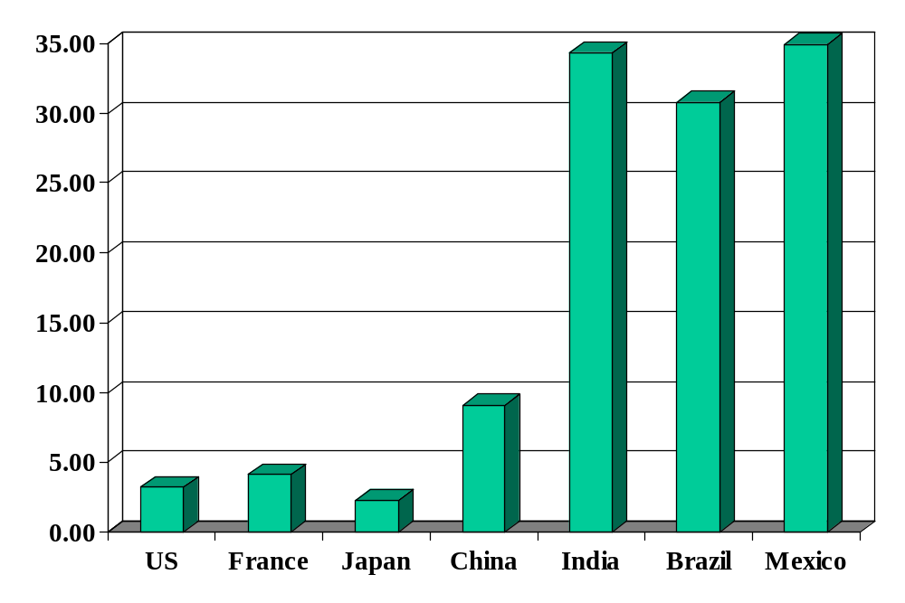
Average tariffs (non-agriculture)
Source: World Trade Organization, World Trade Report, 2004.

Slide 29
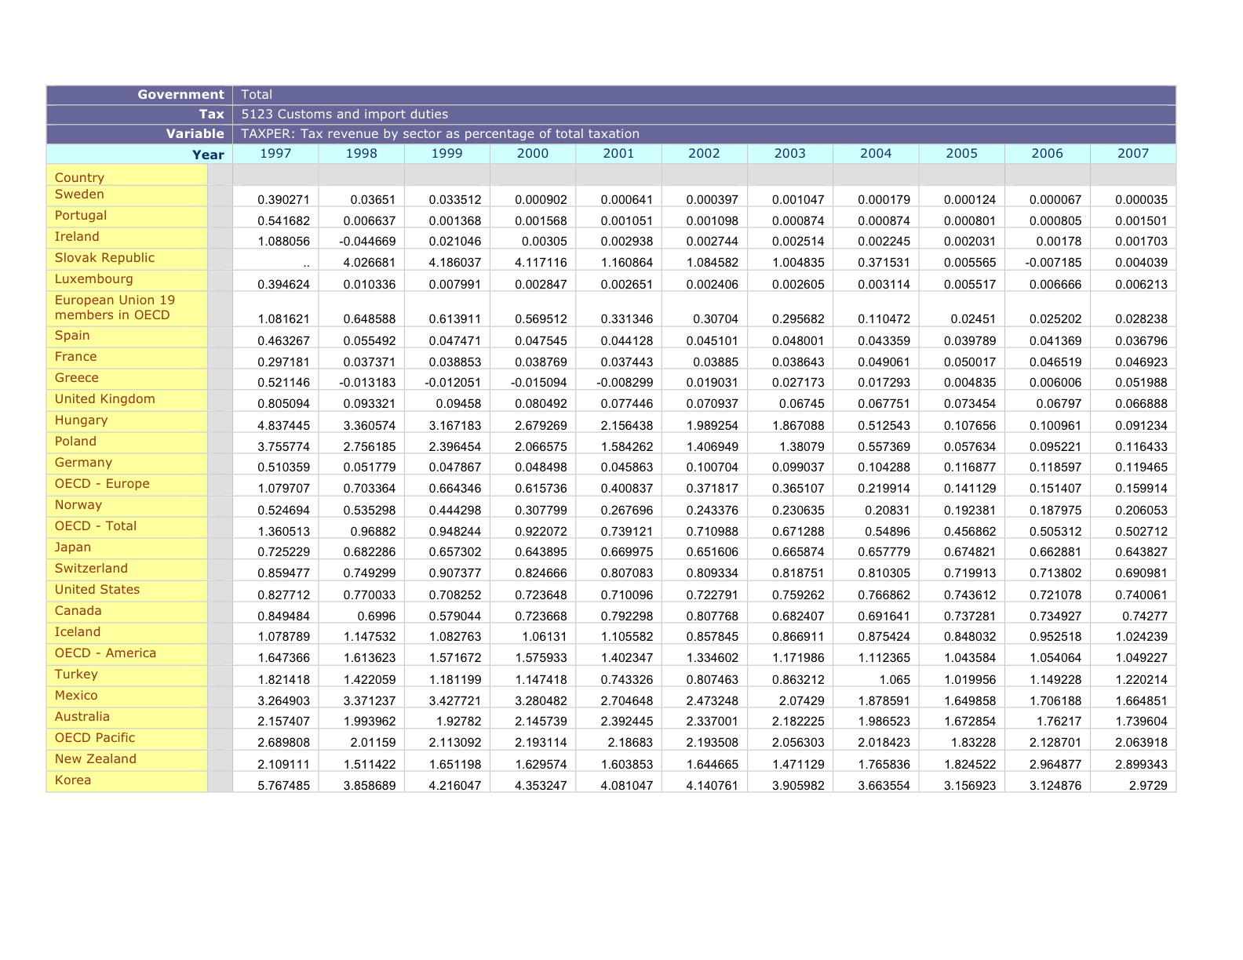
Tariffs as tax revenue
Source: OECD

Slide 30
Frederic Bastiat (“Economic Sophisms” 1845)
had this question to resolve:
“Why should a thing made in Brussels, for example, cost more when it reaches Paris?”
Now, it did not take me long to perceive that the rise in price results from the existence of obstacles of several kinds between Paris and Brussels. First of all, there is the distance; we cannot traverse it without effort or loss of time, and we must either submit to this ourselves or pay someone else to submit to it. Then come rivers, marshes, irregularities of terrain, and mud; these are just so many more impediments to overcome. We succeed in doing so by raising causeways, by building bridges, by laying and paving roads, by laying steel rails, etc. But all this costs money, and the commodity transported must bear its share of the expenses. There are, besides, highway robbers, necessitating a constabulary, a police force, etc.
Now, among these obstacles between Brussels and Paris there is one that we ourselves have set up, and at great cost. There are men lying in wait along the whole length of the frontier, armed to the teeth and charged with the task of putting difficulties in the way of transporting goods from one country to the other. They are called customs officials. They act in exactly the same way as the mud and the ruts. They delay and impede commerce; they contribute to the difference that we have noted between the price paid by the consumer and the price received by the producer, a difference that it is our problem to reduce as much as possible.
And herein lies the solution of the problem. Reduce the tariff.
You will then have, in effect, constructed the Northern Railway without its costing you anything. Far from it! You will effect such enormous savings that you will begin to put money in your pocket from the very first day of its operation.
Really, I wonder how we could have ever thought of doing anything so fantastic as to pay many millions of francs for the purpose of removing the natural obstacles that stand between France and other countries, and at the same time pay many other millions for the purpose of substituting artificial obstacles that have exactly the same effect; so that the obstacle created and the obstacle removed neutralize each other and leave things quite as they were before, the only difference being the double expense of the whole operation.
I had this question to resolve: “Why should a thing made in Brussels, for example, cost more when it reaches Paris?”
Now, it did not take me long to perceive that the rise in price results from the existence of obstacles of several kinds between Paris and Brussels. First of all, there is the distance; we cannot traverse it without effort or loss of time, and we must either submit to this ourselves or pay someone else to submit to it. Then come rivers, marshes, irregularities of terrain, and mud; these are just so many more impediments to overcome. We succeed in doing so by raising causeways, by building bridges, by laying and paving roads, by laying steel rails, etc. But all this costs money, and the commodity transported must bear its share of the expenses. There are, besides, highway robbers, necessitating a constabulary, a police force, etc.
Now, among these obstacles between Brussels and Paris there is one that we ourselves have set up, and at great cost. There are men lying in wait along the whole length of the frontier, armed to the teeth and charged with the task of putting difficulties in the way of transporting goods from one country to the other. They are called customs officials. They act in exactly the same way as the mud and the ruts. They delay and impede commerce; they contribute to the difference that we have noted between the price paid by the consumer and the price received by the producer, a difference that it is our problem to reduce as much as possible.
And herein lies the solution of the problem. Reduce the tariff.
You will then have, in effect, constructed the Northern Railway without its costing you anything. Far from it! You will effect such enormous savings that you will begin to put money in your pocket from the very first day of its operation.
Really, I wonder how we could have ever thought of doing anything so fantastic as to pay many millions of francs for the purpose of removing the natural obstacles that stand between France and other countries, and at the same time pay many other millions for the purpose of substituting artificial obstacles that have exactly the same effect; so that the obstacle created and the obstacle removed neutralize each other and leave things quite as they were before, the only difference being the double expense of the whole operation.

Slide 31
Bastiat cont’d (“Candlemakers’ Petition”)
had this question to resolve:
“Why should a thing made in Brussels, for example, cost more when it reaches Paris?”
Now, it did not take me long to perceive that the rise in price results from the existence of obstacles of several kinds between Paris and Brussels. First of all, there is the distance; we cannot traverse it without effort or loss of time, and we must either submit to this ourselves or pay someone else to submit to it. Then come rivers, marshes, irregularities of terrain, and mud; these are just so many more impediments to overcome. We succeed in doing so by raising causeways, by building bridges, by laying and paving roads, by laying steel rails, etc. But all this costs money, and the commodity transported must bear its share of the expenses. There are, besides, highway robbers, necessitating a constabulary, a police force, etc.
Now, among these obstacles between Brussels and Paris there is one that we ourselves have set up, and at great cost. There are men lying in wait along the whole length of the frontier, armed to the teeth and charged with the task of putting difficulties in the way of transporting goods from one country to the other. They are called customs officials. They act in exactly the same way as the mud and the ruts. They delay and impede commerce; they contribute to the difference that we have noted between the price paid by the consumer and the price received by the producer, a difference that it is our problem to reduce as much as possible.
And herein lies the solution of the problem. Reduce the tariff.
You will then have, in effect, constructed the Northern Railway without its costing you anything. Far from it! You will effect such enormous savings that you will begin to put money in your pocket from the very first day of its operation.
Really, I wonder how we could have ever thought of doing anything so fantastic as to pay many millions of francs for the purpose of removing the natural obstacles that stand between France and other countries, and at the same time pay many other millions for the purpose of substituting artificial obstacles that have exactly the same effect; so that the obstacle created and the obstacle removed neutralize each other and leave things quite as they were before, the only difference being the double expense of the whole operation.
A Petition from the Manufacturers of Candles, Tapers, Lanterns, Candlesticks, Street Lamps, Snuffers, and Extinguishers, and from the Producers of Tallow, Oil, Resin, Alcohol, and Generally of Everything Connected with Lighting.
To the Honourable Members of the Chamber of Deputies.
Gentlemen:
You are on the right track. You reject abstract theories and have little regard for abundance and low prices. You concern yourselves mainly with the fate of the producer. You wish to free him from foreign competition, that is, to reserve the domestic market for domestic industry…
We are suffering from the ruinous competition of a foreign rival who apparently works under conditions so far superior to our own for the production of light that he is flooding the domestic market with it at an incredibly low price; for the moment he appears, our sales cease, all the consumers turn to him, and a branch of French industry whose ramifications are innumerable is all at once reduced to complete stagnation. This rival, which is none other than the sun, is waging war on us mercilessly…
We ask you to be so good as to pass a law requiring the closing of all windows, dormers, skylights, inside and outside shutters, curtains, casements, bull’s-eyes, deadlights, and blinds—in short, all openings, holes, chinks, and fissures through which the light of the sun is wont to enter houses, to the detriment of the fair industries with which, we are proud to say, we have endowed the country, a country that cannot, without betraying ingratitude, abandon us today to so unequal a combat….
If France consumes more tallow, there will have to be more cattle and sheep, and, consequently, we shall see an increase in cleared fields, meat, wool, leather, and especially manure, the basis of all agricultural wealth.
If France consumes more oil, we shall see an expansion in the cultivation of the poppy, the olive, and rapeseed. These rich yet soil-exhausting plants will come at just the right time to enable us to put to profitable use the increased fertility that the breeding of cattle will impart to the land…
The same holds true of shipping. Thousands of vessels will engage in whaling, and in a short time we shall have a fleet capable of upholding the honour of France and of gratifying the patriotic aspirations of the undersigned petitioners…
Will you tell us that, though we may gain by this protection, France will not gain at all, because the consumer will bear the expense? We have your answer ready: You no longer have the right to invoke the interests of the consumer. You have sacrificed him whenever you have found his interests opposed to those of the producer. You have done so in order to encourage industry and to increase employment. For the same reason you ought to do so this ime too…

Slide 32
Andy Grove (former Intel CEO)
had this question to resolve:
“Why should a thing made in Brussels, for example, cost more when it reaches Paris?”
Now, it did not take me long to perceive that the rise in price results from the existence of obstacles of several kinds between Paris and Brussels. First of all, there is the distance; we cannot traverse it without effort or loss of time, and we must either submit to this ourselves or pay someone else to submit to it. Then come rivers, marshes, irregularities of terrain, and mud; these are just so many more impediments to overcome. We succeed in doing so by raising causeways, by building bridges, by laying and paving roads, by laying steel rails, etc. But all this costs money, and the commodity transported must bear its share of the expenses. There are, besides, highway robbers, necessitating a constabulary, a police force, etc.
Now, among these obstacles between Brussels and Paris there is one that we ourselves have set up, and at great cost. There are men lying in wait along the whole length of the frontier, armed to the teeth and charged with the task of putting difficulties in the way of transporting goods from one country to the other. They are called customs officials. They act in exactly the same way as the mud and the ruts. They delay and impede commerce; they contribute to the difference that we have noted between the price paid by the consumer and the price received by the producer, a difference that it is our problem to reduce as much as possible.
And herein lies the solution of the problem. Reduce the tariff.
You will then have, in effect, constructed the Northern Railway without its costing you anything. Far from it! You will effect such enormous savings that you will begin to put money in your pocket from the very first day of its operation.
Really, I wonder how we could have ever thought of doing anything so fantastic as to pay many millions of francs for the purpose of removing the natural obstacles that stand between France and other countries, and at the same time pay many other millions for the purpose of substituting artificial obstacles that have exactly the same effect; so that the obstacle created and the obstacle removed neutralize each other and leave things quite as they were before, the only difference being the double expense of the whole operation.
Our fundamental economic beliefs, which we have elevated from a conviction based on observation to an unquestioned truism, is that the free market is the best of all economic systems—the freer the better. Our generation has seen the decisive victory of free-market principles over planned economies. So we stick with this belief, largely oblivious to emerging evidence that while free markets beat planned economies, there may be room for a modification that is even better…
Such evidence stares at us from the performance of several Asian countries in the past few decades. These countries seem to understand that job creation must be the No. 1 objective of state economic policy. The government plays a strategic role in setting the priorities and arraying the forces and organization necessary to achieve this goal. The rapid development of the Asian economies provides numerous illustrations. In a thorough study of the industrial development of East Asia, Robert Wade of the London School of Economics found that these economies turned in precedent-shattering economic performances over the '70s and '80s in large part because of the effective involvement of the government in targeting the growth of manufacturing industries.
(Business Week, July 2010)

Slide 33
Argentina in the 1930s
Export-oriented agriculture
  Wheat
  Beef (refrigerated and canned)
  Major markets: US and UK
During the Depression, both the US and UK raised tariffs on Argentine beef to protect their own farmers
Argentina responded with its own tariffs to protect domestic manufacturing from US and UK imports
First step in 60-year decline in performance
Notes:
Argentina: think Canada in the Southern hemisphere
This isn’t all due to trade!

Slide 34
Voluntary export restraints
In 1980s, US “persuaded” Japanese carmakers to limit exports to US
Similar to a tariff, but
  “Voluntary” (hence ok with trade law)
  US got no revenue (Japanese carmakers did)
Limits on numbers benefited Japanese:
  Reduced competition among them in US (profits up)
  Instigated increase in quality (eg, Lexus instead of Corolla)
What were we thinking of?

Slide 35
Fallacy #3
We should subsidize local producers to help them compete with foreign producers
Why a fallacy?
  Costs us money
  Encourages inefficient production

Slide 36
Agriculture
Farmers are subsidized in all developed countries:
Country | Subsidy per Farmer
Norway | $33,000
Switzerland | $32,000
Japan | $26,000
US | $21,000
EU | $17,000
Plus: health and safety regulations keep out imports
Local milk in Norway? Starbucks in Norway?
Peanuts and sugar in the US
Notes:
Data: The Economist, “From bad to worse,” May 5, 2001

Slide 37
Fallacy #4
Free trade creates trade deficits
Why a fallacy?
  Trade is always balanced, but often only in a present-value sense
  My deficit is necessarily someone else’s surplus: can’t cause deficits for everyone
  Trade deficits are about international financial flows like in the Mankiw quote above [more later]
  Rather than receiving goods immediately form a trading partner, we accept a promise of future goods as payment (this is a financial contract!)

Slide 38
Fallacy #5
Outsourcing costs us jobs
Why a fallacy?
  It’s an issue of which jobs, not how many.
  Countries should do jobs at which they have comparative advantage
Notes:
Goldman Sachs: you hire the Indian, or they do.

Slide 39
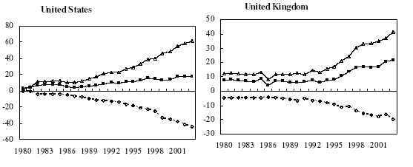
Outsourcing: business services
Billions of dollars: Δ = in, o = out, ■ = net

Slide 40
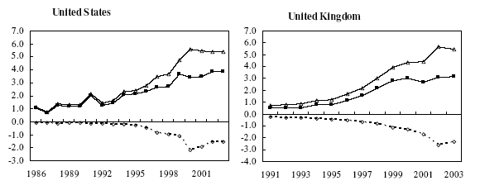
Outsourcing: IT services
Billions of dollars: Δ = in, o = out, ■ = net
Source: Amiti and Wei, NBER 10808.

Slide 41
Fallacy #6
High wages hurt competitiveness
Why a fallacy?
  Competitiveness depends on relation between wage and productivity
  If high wages reflect productivity, a sign of competitive strength

Slide 42
Why protection?
High-performance “institutions” include
  Rule of law
  Property rights
  Open, honest competitive markets
What political process leads to good institutions?
  Democratic leaders often protect supporters from competition
  Dictators often protect friends
Trade complicates this:
  Protect us from “unfair” foreign competition (remember: foreigners don’t vote)
  Costs are concentrated but benefits are widely distributed

Slide 43
Why protection?
Winston Churchill (1904):
  “Will the shutting out of foreign goods increase the total amount of wealth in this country? Can foreign nations grow rich at our expense by selling us goods under cost price? Can a people tax themselves into prosperity? Can a man stand in a bucket and lift himself up by the handle?”
  Speech at the Free Trade Hall, Manchester, England (1904)

Slide 44
Takeaways
Globalization is a fact of life
There is clear economic logic for international markets and trade
  Consumers benefit from lower prices
  Production more efficient
Political opposition also a fact
  Trade liberalization creates more winners than losers, but…
  Concentrates costs on a relatively small number of people (a few big losers), benefits widely distributed (lots and lots of small winners)

