Slide 1

The Global Economy Introduction

Slide 2
Roadmap
News this week
Trends
Trade in goods and services
Fluctuations
Inflation and output
Course information

Slide 3
What is happening this week?
Try to touch on each class
The Economist or Financial Times
Order now if you haven’t already
Interesting articles, anecdotes?

Slide 4
What is happening?
Week of September 19
FOMC meeting
Existing Home Sales
Week of September 26
New Home Sales
S&P Case-Shiller House Prices
Consumer Confidence
Durable Goods Orders

Slide 5
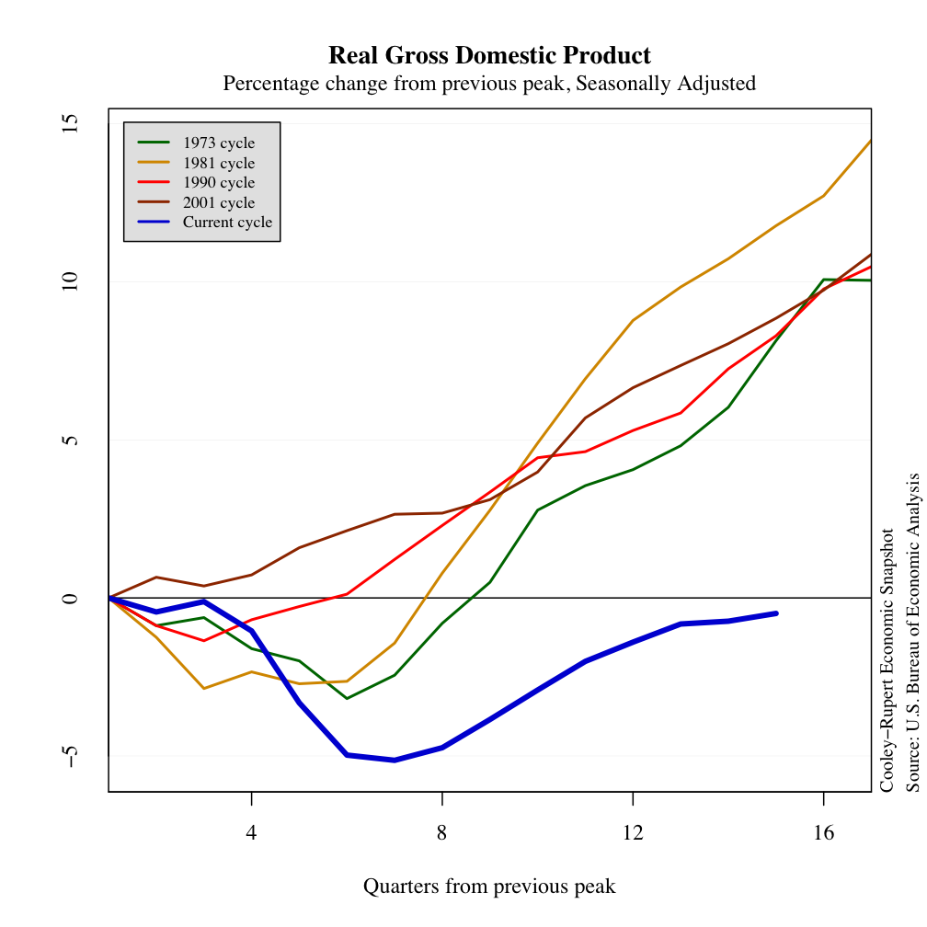
Where do we Stand? Output by cycle

Slide 6
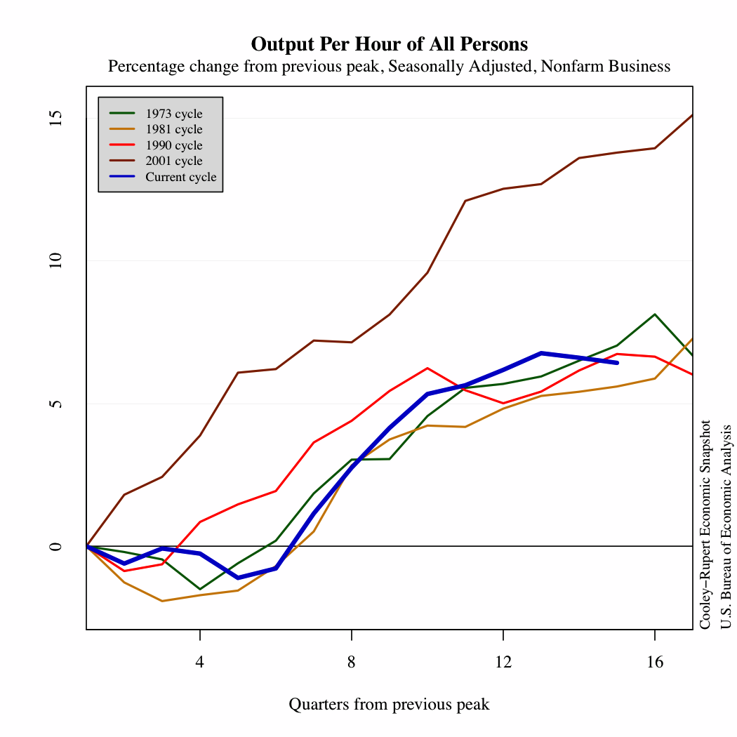
Productivity by cycle

Slide 7
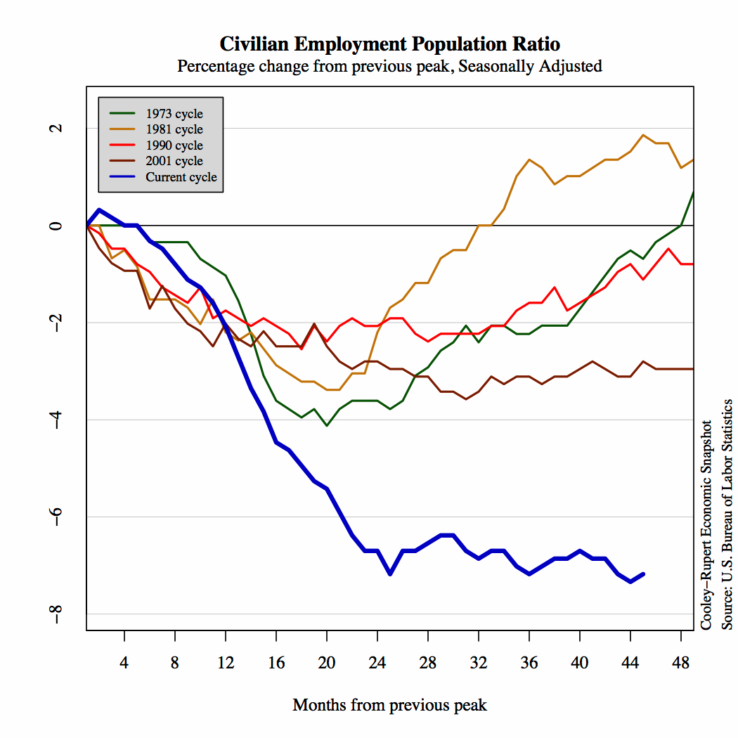
Labor by cycle

Slide 8
Class participation
A part of class
I expect everyone to participate: expect cold calls
Answer a question
Make a comment
Share an experience
Post to Bb discussion
Broad range of backgrounds
Expert: keep it short
Non-expert: don’t panic

Slide 9
Roadmap
News this week
Trends
Trade in goods and services
Fluctuations
Inflation and output
Course information

Slide 10
The big picture
Long-Run Performance
Production, Saving & Investment, Productivity, Institutions, Capital & Labor Markets, International Trade
First half:
Short-Run Performance
Inflation, Economic Indicators, Aggregate Supply & Demand, Monetary Policy, Taxes & Deficits, Exchange Rates, Capital Flows, Emerging Market Crises
Second half:

Slide 11
Long run: GDP per capita
Source: Penn World Tables 7.0.

Slide 12
Short run: US real GDP growth
?

Slide 13
Trends

Slide 14
The wealth of nations
GDP/Capita is 64 times larger in US than Burundi
What can explain these differences?

Slide 15
Long-run economic growth GDP per capita in Year 2000 international dollars
Source: Maddison, 2001; 2008 estimate based on Maddison tables.

Slide 16
Trends are important
Source: Maddison, “Historical Statistics for the World Economy”
Notes:
2^8=256, 2^9=512, 2^10=1024, 2^11=2048,2^12=4096, 2^13=8192, 2^14=16384, 2^15=32768
Log2 scale: each number represents a doubling, Arg<13, Ger>14, Germany GDP/capita (19,144) almost double Argentina(7,666)
Germany, US, most of Western Europe: 2% growth over last 100 years
Argentina: used to be as rich as Germany

Slide 17
Do institutions matter?
U.S.
India
Note: Size of circle is proportional to population. Data sources: World Bank and Transparency International.

Slide 18
Do institutions matter?
U.S.
China
Note: Size of circle is proportional to population. Data sources: World Bank and Heritage Foundation.

Slide 19
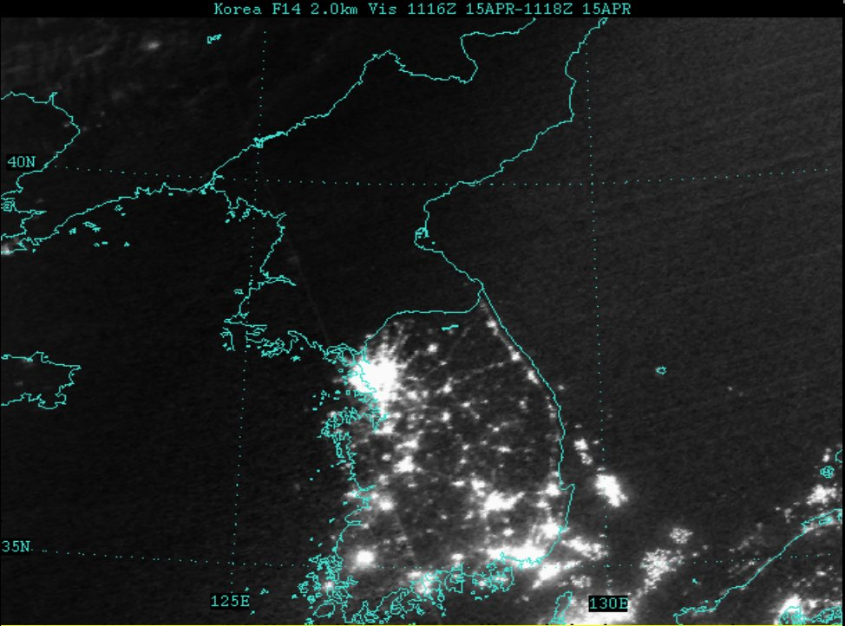
Common culture, different institutions

Slide 20
Trade in Goods and Services Who trades what, and why?

Slide 21
How do trade patterns evolve?
Who are the U.S.’s largest trade partners?
What good is most traded? (value-wise)
How are trade patterns changing?
Why are they changing?

Slide 22
US imports
Notes:
China, Mexico, Japan, Canada

Slide 23
US imports
Canada
Japan
Mexico
China
Notes:
China, Mexico, Japan, Canada
Why has Japan fallen so much? Why might they trade fewer cars now? Is this a bad thing?

Slide 24
US exports
Canada
Mexico
Japan
China
Notes:
China, Mexico, Japan, Canada
Why has Japan fallen so much? Why might they trade fewer cars now? Is this a bad thing?

Slide 25
Short-run Fluctuations: Business Cycles

Slide 26
Business cycles

Slide 27
Business cycles
Notes:
27

Slide 28
Inflation and Output

Slide 29
US inflation (annual)

Slide 30
Argentina inflation (annual)

Slide 31
Inflation and output: evidence 1959-69

Slide 32
Inflation and output: evidence 1959-99

Slide 33
About the course
Main data sources
Blackboard
Syllabus: on Bb
Announcements: on Bb
Course by session: on Bb

Slide 34


About me
Originally from Madison, WI
PhD in Economics, U. Minnesota
Previous: U. Texas-Austin
Research interests:
International trade policy
Firm level export decisions
Emerging market crises
Other interests:
Computers, running, beer

Slide 35
About the teaching assistant
W & R: Matt Sims
mds436@stern.nyu.edu
S: Sarah Beaumont
seb464@stern.nyu.edu

Slide 36
About class notes
No textbook!
Theoretical background to class discussion
Executive summaries: more concise than a textbook
Custom designed for this course
Read them – preferably before class

Slide 37
About your grade
Participation | outliers/ tiebreakers
Assignments | 30%
Exam 1 | 30%
Exam 2 | 40%

Slide 38
About Assignments
5 problem sets
Group work is fine
You chose the group
No more than 6 to a group
Group of 1 is fine
Drop lowest score, average the rest
Notes:
38

Slide 39
About Assignments
Weekly discussion board
A way to
Participate
Keep up on current issues
Once during the semester, you will post a “lead” comment
Details in handout
Notes:
39

Slide 40
About help!
Problem set help
Post to discussion board, I will answer there
Other help
Send me an email
Stop by
See the teaching assistant
Notes:
40

Slide 41
About helping me
Course works best if communication goes both ways
If you have ideas, comments, questions, whatever:
Send an email
Speak to the teaching assistant
Post on the discussion board

Slide 42
What have we learned today?
As Haiku:
read notes before class
if you need help ask for it
Blackboard is knowledge

Slide 43
The Global Economy Measurement

Slide 44
Roadmap
Headline Data
Gross Domestic Product (GDP)
Inflation
How are they measured?
What are the basic facts?
Why care about GDP?

Slide 45
Why worry about measurement?
Need a common vocabulary
Small changes in definition make big differences
Accurate forecasting requires consistent measurements

Slide 46
GDP per capita (PPP adj, 2006 USD)
Source: PWT 7.0

Slide 47
Growth of GDP per capita (forecast for 2012, in 2011)
Source: OECD Economic Outlook, September 2011.

Slide 48
GDP
GDP = Gross Domestic Product
Total value of production in an economy
Sum of value-added by production units
Equals:
payments to labor and capital (owners)
sales of final goods
(almost) income

Slide 49
GDP identities
Farmer
Sales = $10
Farm Rent = $3
Net Income = $7
Value Added =??
Brewer
Sales = $110
Factory Rent = $30
Wages = $70
Barley = $10
Value Added =??
Landlord’s income +wages + profits = ??
Value added farming + value added brewing = ??
Final production farming + final production brewing = ??

Slide 50
GDP identities
Farmer
Sales = $10
Farm Rent = $3
Net Income = $7
Value Added =??
Brewer
Sales = $110
Factory Rent = $30
Wages = $70
Barley = $10
Value Added =??
Landlord’s income +wages + profits = ??
(3+30) + (70) + (7) = 110
Value added farming + value added brewing = ??
(10) +(100) =110
Final production of barley + final production of beer = ??
(0) +(110) =110

Slide 51
GDP identities
Now try the extended example

Slide 52
GDP by industry
mfg
FIRE
bus. services
agriculture
Notes:
Agriculture, Manufacturing, FIRE, Business Services

Slide 53
GDP by income type
labor comp.
rental income
corp. profits
interest

Slide 54
Expenditure flows
Allocate GDP among purchasers of final goods:
Y = C + I + G + NX
Y = GDP
C = sales to households
I = sales of capital goods to firms
G = purchases of goods and services by government
NX = net exports (net sales to other countries)

Slide 55
GDP by expenditure
private cons
gov. cons
investment
net exports

Slide 56
Savings flows I
Allocate flows of assets:
Y – C – G = I + NX
S = I + NX
S = (gross) national saving (purchases of assets)
NX = net purchases of foreign assets

Slide 57
Savings flows II
Allocate flows of assets:
(Y–C–T) + (T– G) = I + NX
S_{p} + S_{g} = I + NX
T = taxes net of transfers paid by households to govt
Beware: many measures of saving
Later in the course
We’ll include income and transfers with foreign countries and replace NX with the “current account”

Slide 58
Saving
investment
saving
net exports

Slide 59
Personal saving
saving=personal income-taxes-personal consumption+net transfers
Notes:
NIPA Table 2.1

Slide 60
Household net worth
Source: flow of funds
Notes:
Table L.10

Slide 61
Household net worth
Source: BEA
Notes:
61
Table L.10

Slide 62
What about prices?
Nominal GDP (at current prices):
What happens when prices change?

Slide 63
Prices and quantities
GDP measures output at market prices
What if prices change?
If GDP rises, how much is higher quantity, how much higher prices?
Two measures
GDP at current prices
GDP at constant prices (e.g. 2005 prices)
Problem: many ways to do this

Slide 64
Two ways to measure inflation
Approach 1 (“fixed weight/price”) (“Paasche”)
Compute GDP at current prices (“nominal GDP”)
Compute GDP at constant prices (eg, 1990) (“real GDP”)
Compute price deflator = ratio of first to second
Inflation is rate of change of deflator
Approach 2 (“fixed basket/quantity”) (“Laspeyres”)
Compute GDP at current prices (“nominal GDP”)
Compute price index as cost of a fixed “basket” of products
Compute real quantity as ratio of nominal quantity to index
Inflation is rate of change of index

Slide 65
Example
 | Fish |  | Chips
Date | Price | Quantity | Price | Quantity
2004 | 0.50 | 10 | 0.25 | 10
2005 | 0.75 | 12 | 0.50 | 8
What is the inflation rate?
What is real output growth?

Slide 66
Fixed price method (GDP deflator)
 | Fish |  | Chips
Date | Price | Quantity | Price | Quantity
2004 | 0.50 | 10 | 0.25 | 10
2005 | 0.75 | 12 | 0.50 | 8
Date | Nominal GDP | Real GDP | Price Deflator
2004
2005
Growth rate
Base year: 2004

Slide 67
Fixed price method (GDP deflator)
 | Fish |  | Chips
Date | Price | Quantity | Price | Quantity
2004 | 0.50 | 10 | 0.25 | 10
2005 | 0.75 | 12 | 0.50 | 8
Date | Nominal GDP | Real GDP | Price Deflator
2004 | 7.50 | 7.50 | 1.000
2005 | 13.00 | 8.00 | 1.625
Growth rate | 73.3% | 6.7% | 62.5%
Base year: 2004

Slide 68
Fixed price method (GDP deflator)
 | Fish |  | Chips
Date | Price | Quantity | Price | Quantity
2004 | 0.50 | 10 | 0.25 | 10
2005 | 0.75 | 12 | 0.50 | 8
Date | Nominal GDP | Real GDP | Price Deflator
2004
2005
Growth rate
Base year: 2005

Slide 69
Fixed price method (GDP deflator)
 | Fish |  | Chips
Date | Price | Quantity | Price | Quantity
2004 | 0.50 | 10 | 0.25 | 10
2005 | 0.75 | 12 | 0.50 | 8
Date | Nominal GDP | Real GDP | Price Deflator
2004 | 7.50 | 12.50 | 0.600
2005 | 13.00 | 13.00 | 1.000
Growth rate | 73.3% | 4.0% | 66.7%
Base year: 2005

Slide 70
How important was IT in the 1990s?
Features:
Output grew rapidly (60%/year)
Prices fell
Output quality improved
Result: when base year was updated, real growth fell
Why?
Approaches:
Chain weighting
Adjust prices for quality change (easier said than done)

Slide 71
Fixed quantity method (CPI)
 | Fish |  | Chips
Date | Price | Quantity | Price | Quantity
2004 | 0.50 | 10 | 0.25 | 10
2005 | 0.75 | 12 | 0.50 | 8
Date | Price Index (2004 Basket) | Price Index (2005 Basket)
2004
2005
Growth rate

Slide 72
Fixed quantity method (CPI)
 | Fish |  | Chips
Date | Price | Quantity | Price | Quantity
2004 | 0.50 | 10 | 0.25 | 10
2005 | 0.75 | 12 | 0.50 | 8
Date | Price Index (2004 Basket) | Price Index (2005 Basket)
2004 | 7.50/7.50*100=100.0 | 8.00/8.00*100=100.0
2005 | 12.50/7.50*100=166.7 | 13.00/8.00*100=162.5
Growth rate | 66.7% | 62.5%

Slide 73
Details, details
Not in GDP
Capital gains, (houses, equity)
Interest on government debt
Government services are valued at cost
Home production not counted
Black market transactions not counted
GNP = GDP + net foreign factor income
Difference a fraction of a percent in US
Larger for countries with substantial foreign investment

Slide 74
Why worry about GDP?
The obvious
GDP is income
GDP is correlated with employment, investment,…
The less obvious
GDP is highly correlated with human development
GDP is (inversely) correlated with poverty rates

Slide 75

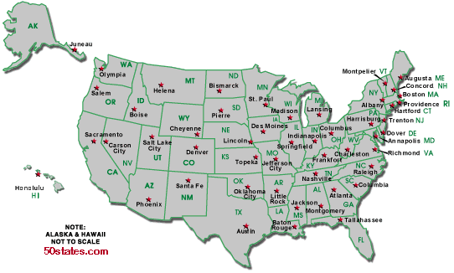
GDP and quality of life
Per capita GDP: $41,000
Per capita GDP: $31,000
Avg weekly hours: 35
Avg weekly hours: 29

Slide 76
What have we learned today?
GDP is: output, income, and expenditure
Measuring real GDP is tricky
Fixed weight index
Fixed price index
Neither is perfect

Slide 77
What have we learned today?
Composition by industry
Manufacturing shrinking
Services growing
Payments to factors
Labor share near 2/3, rest payments to capital
Shares constant
Expenditure
Private consumption: 60% to 70% of GDP
Private investment: 15% to 20% of GDP

Slide 78
Something for the ride home
How would you adjust social security payments to ensure a constant real payout?
What is the big picture?
What are the issues?

