Slide 1

The Global Economy
The Production Function

Slide 2
Roadmap
PS0 Answers
In the news
Long run growth facts
Production function theory
Capital and labor inputs
Productivity
GDP per capita revisited

Slide 3
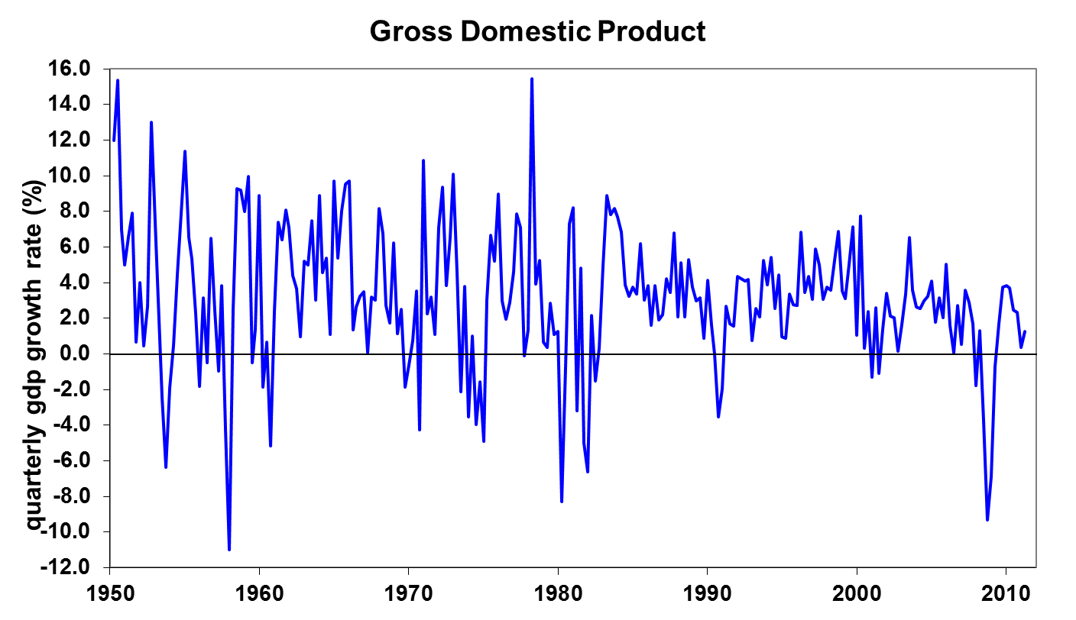
Practice Problems I

Slide 4
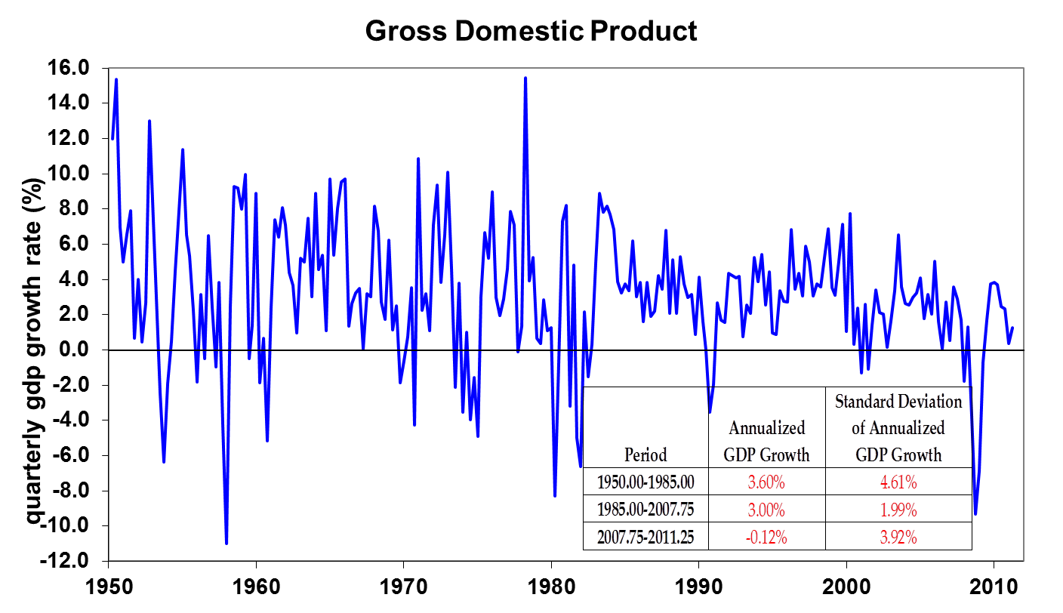
Practice Problems I

Slide 5
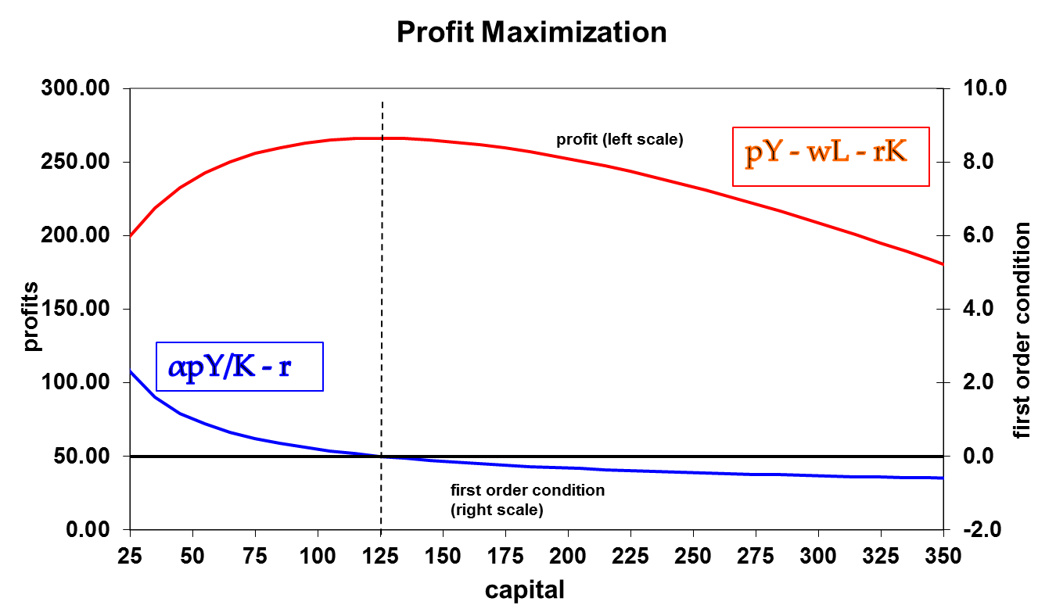
Practice Problems II

Slide 6
Submitting Assignments
Electronic submission under Assignments
All answers in one MS WORD file
Can insert Excel graphs into WORD file
“Compute XYZ and turn in a plot”
  Just submit the plot, not the computations
Neatness helps!

Slide 7
In the news
Housing Market
  Case-Shiller House Prices
  New Home Sales
  Consumer Confidence
What’s special about housing?
  Forward-looking (leading indicator)
  Leverage
  Role in crisis

Slide 8
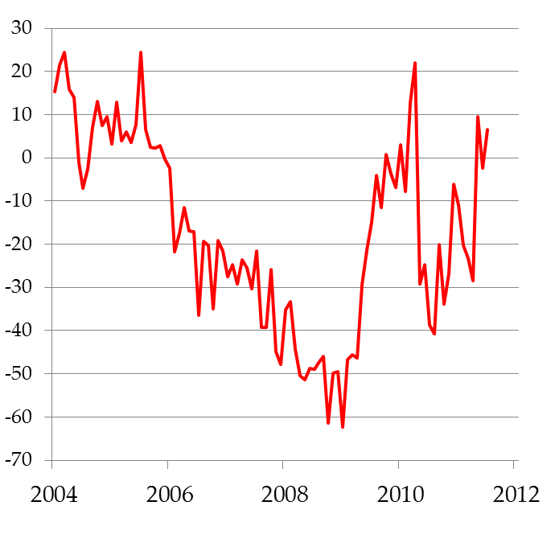
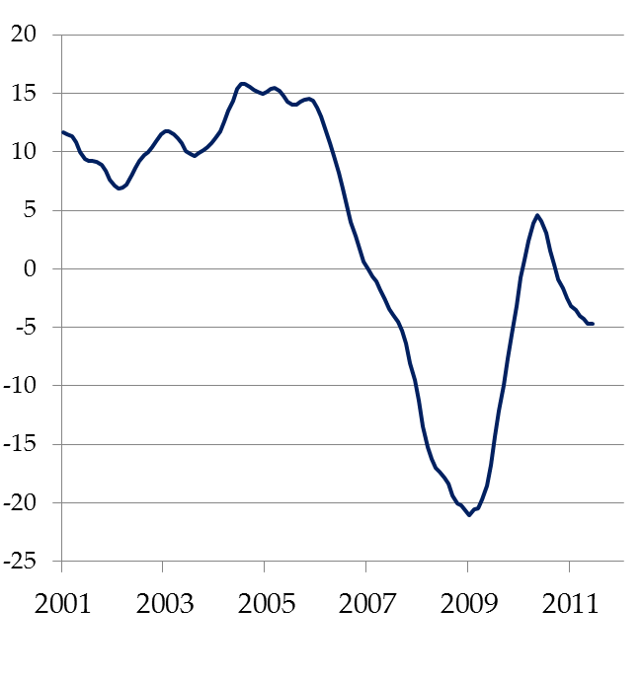
Home Sales and Prices
Annual Percentage Change
New Single-family Home Sales
Home Prices
Sources: Standard and Poors Case-Shiller Index and Dept. of Commerce.

Slide 9
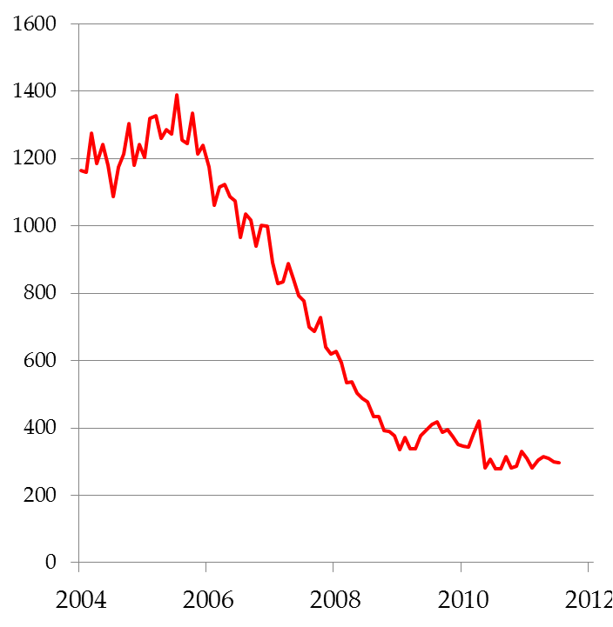
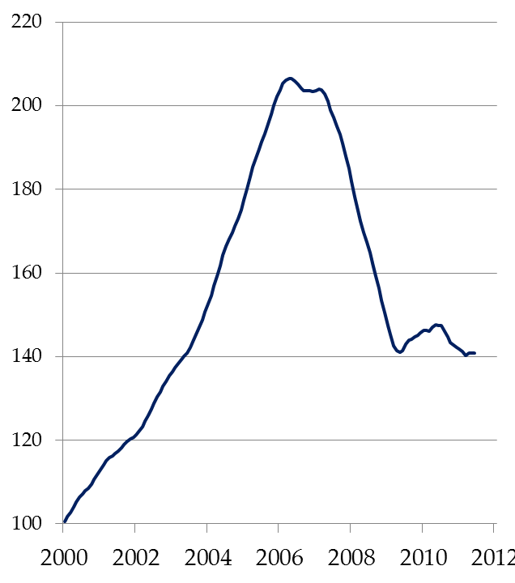
Home Sales and Prices
Levels
New Single-family Home Sales, Thousands
Home Prices, 2000=100
Sources: Standard and Poor’s Case-Shiller Housing Prices and Dept. of Commerce.

Slide 10
Roadmap
PS0 Answers
In the news
Long run growth facts
Production function theory
Capital and labor inputs
Productivity
GDP per capita revisited

Slide 11
What can growth theory tell us?
Why do some countries grow quickly?
What produces a growth “miracle?”
Can miracles be replicated?
Does a country save “too much?”
How can we forecast long-run growth?

Slide 12
A brief history of time
Statistic | Year
 | 1 | 1000 | 1820 | 2008
Population (millions) | 225 | 267 | 1,042 | 6,694
GDP Per Capita | 467 | 425 | 666 | 7,614
Life expectancy | 24 | 24 | 26 | 66
Source: Maddison website. For life expectancy, Maddison, 2001. Life expectancy shown in 2008 is for the year 2000.

Slide 13
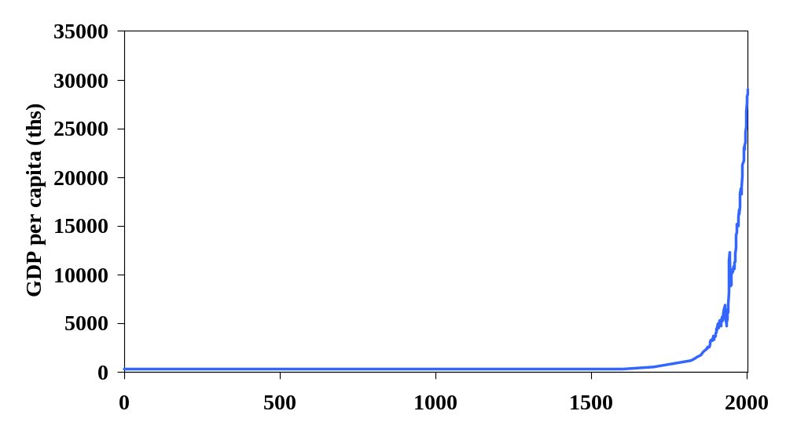
Trends are important
Source: Maddison, “Historical Statistics for the World Economy”

Slide 14
GDP per capita
Region | Year
 | 0 | 1000 | 1820 | 2008
Western Europe | 599 | 425 | 1,218 | 21,672
Western offshoots | 400 | 400 | 1,202 | 30,152
Japan | 400 | 425 | 669 | 22,816
Latin America | 400 | 400 | 691 | 6,973
Former “USSR” | 400 | 400 | 688 | 7,904
China | 450 | 466 | 600 | 6,725
Africa | 472 | 425 | 420 | 1,760
World Average | 467 | 453 | 666 | 7,614
Source: Maddison website.

Slide 15
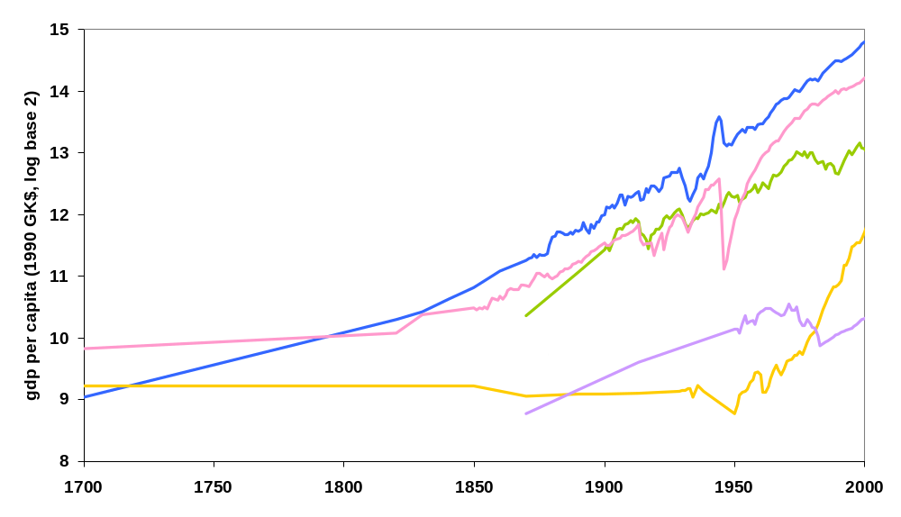
Trends are important
Source: Maddison, “Historical Statistics for the World Economy,” 2001.
Notes:
2^8=256, 2^9=512, 2^10=1024, 2^11=2048,2^12=4096, 2^13=8192, 2^14=16384, 2^15=32768
Log2 scale: each number represents a doubling, Arg<13, Ger>14, Germany GDP/capita (19,144) almost double Argentina(7,666)
Germany, US, most of Western Europe: 2% growth over last 100 years
Argentina: used to be as rich as Germany

Slide 16
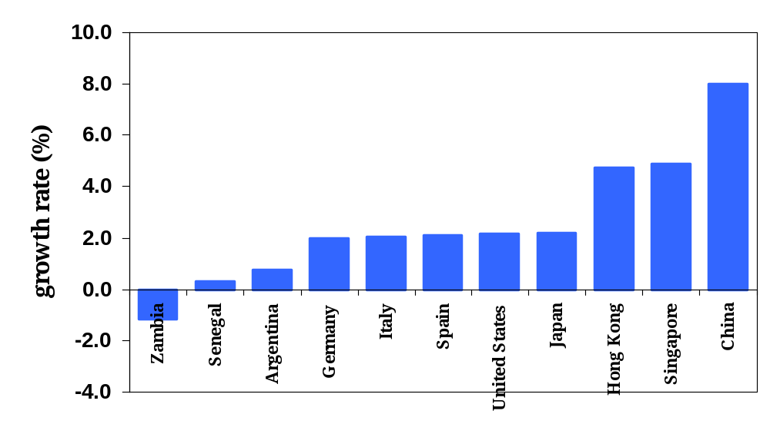
GDP growth rates, 1975-2005
Source: World Bank, World Development Indicators, 2000 prices in USD, PPP adjusted.

Slide 17
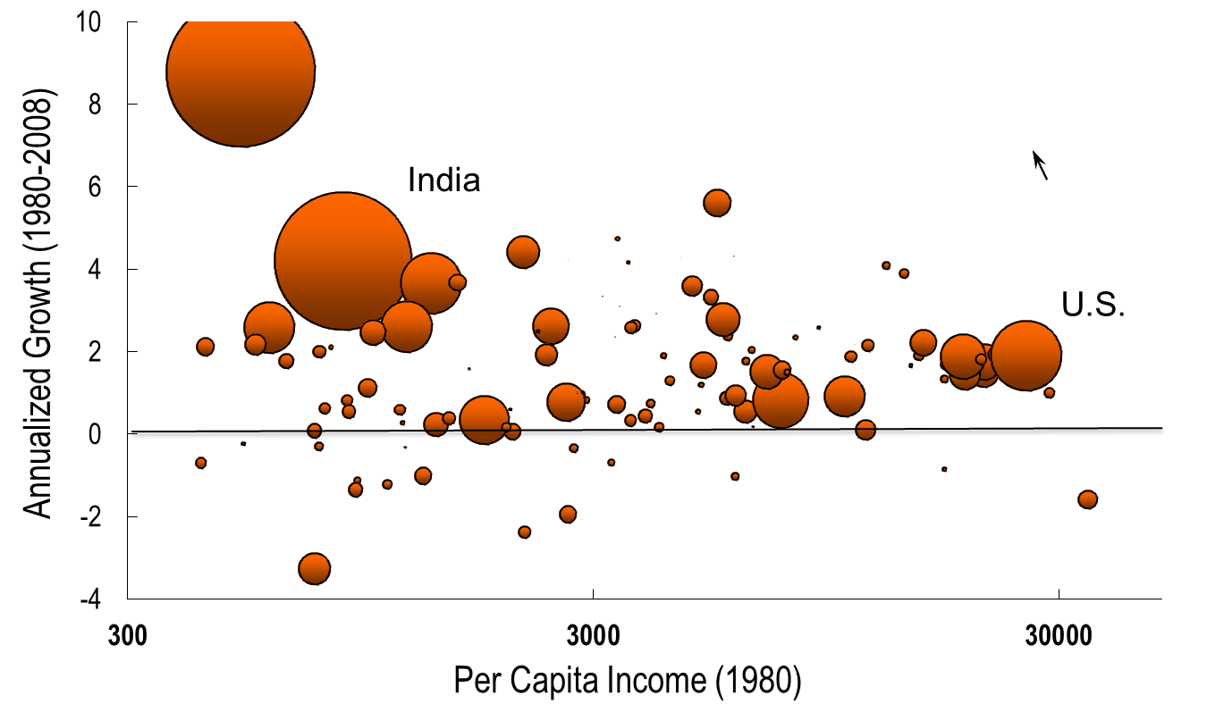
Take-off Pattern: 1980-2008
China
Note: Size of circle is proportional to population. Data source: World Bank.

Slide 18
Long run growth facts
Huge variation in cross-country income
Large variation in growth rates
  Poor countries grow slowly
  Rich countries grow moderately
  Some poor countries grow very fast

Slide 19
Production Function Theory

Slide 20
Why theory?
Theory is a tool to help organize thoughts
Theory is a framework for analyzing data
Theory helps simplify a complex world

Slide 21
Theory: the moving parts
GDP
Capital & Labor
Productivity
Political Process
“Institutions”

Slide 22
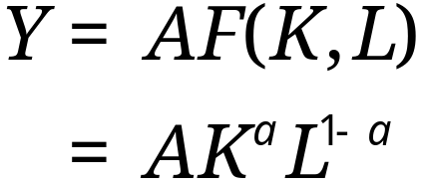
Production function
Idea: relate output to inputs
Mathematical version:
Definitions:
  K = quantity of physical capital used in production (plant and equipment)
  L = quantity of labor used in production
  A = total factor productivity (everything else)

Slide 23
Production function properties
More inputs lead to more output
  Positive marginal products of capital and labor
Diminishing marginal products
  If we increase one input, each increase leads to less additional output
  Marginal product = partial derivative of production function
Constant returns to scale
  If we double **both** inputs, we double output

Slide 24
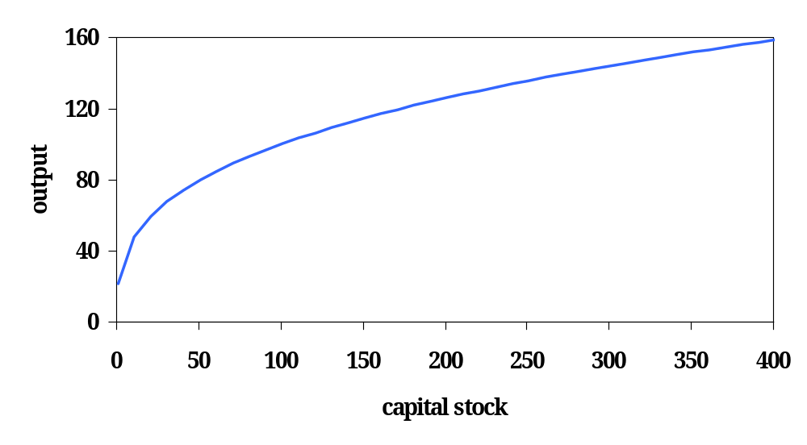
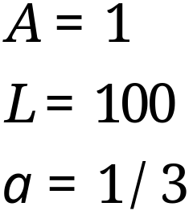
Production function properties

Slide 25

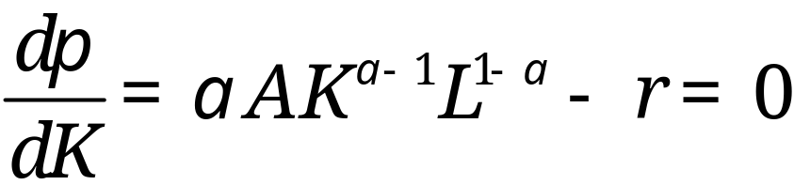
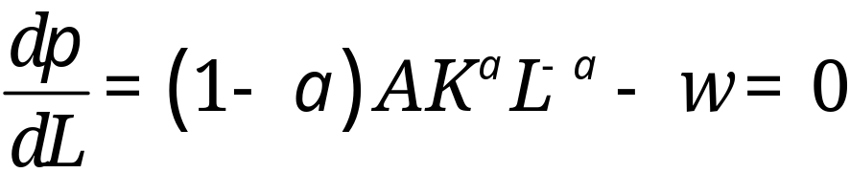
What is labor’s income share?
Profit maximization
First order conditions (marg. rev = marg. cost)

Slide 26
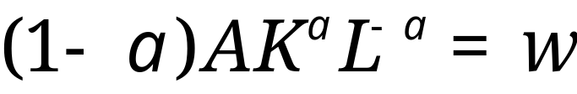
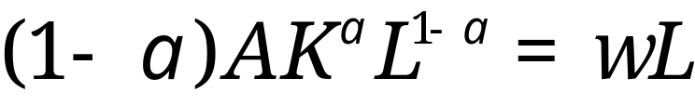
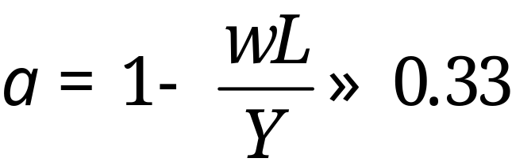
What is labor’s income share?
Work with the second condition
Multiply each side by L
Substitute Y on left side and note that right side is payments to labor to estimate alpha:

Slide 27
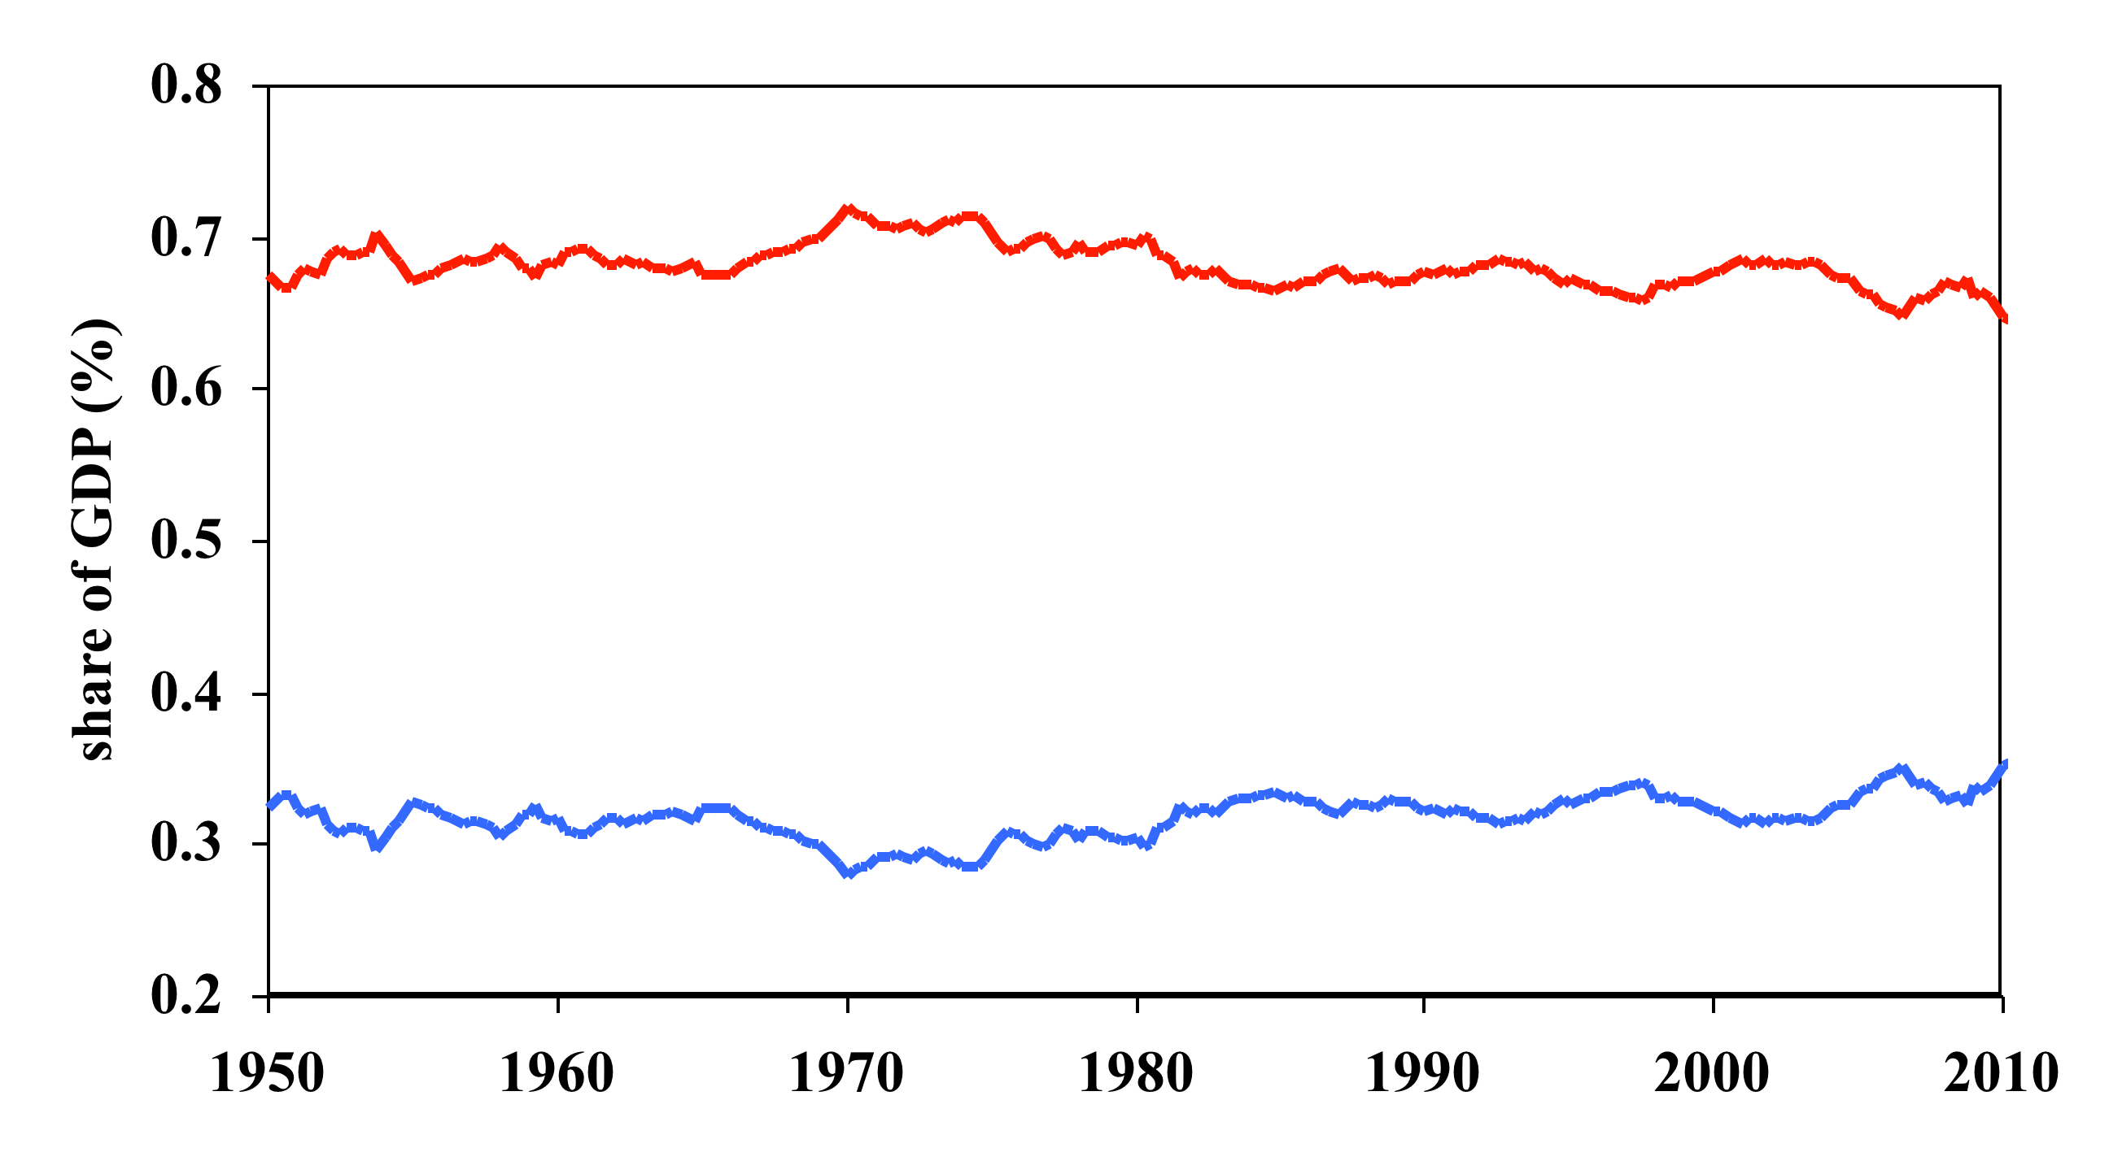
GDP by income type
labor income
capital income

Slide 28
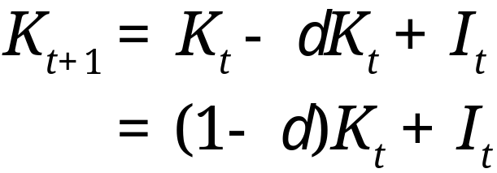
Inputs: capital
Meaning: physical capital, plant and equipment
Why does it change?
  Depreciation/destruction
  New investment
Mathematical version:
Adjustments for quality?

Slide 29

Measuring Capital
Option #1: direct surveys of plant and equipment
Option #2: perpetual inventory method
  Pick an initial value K₀
  Pick a depreciation rate (or measure depreciation directly)
  Measure K like this:
In practice, #2 is the norm:
  Get I from NIPA
  Set δ = 0.06 [ballpark number]
  Example: K₂₀₁₀ = 100, δ = 0.06, I = 12 → K₂₀₁₁ = ??

Slide 30
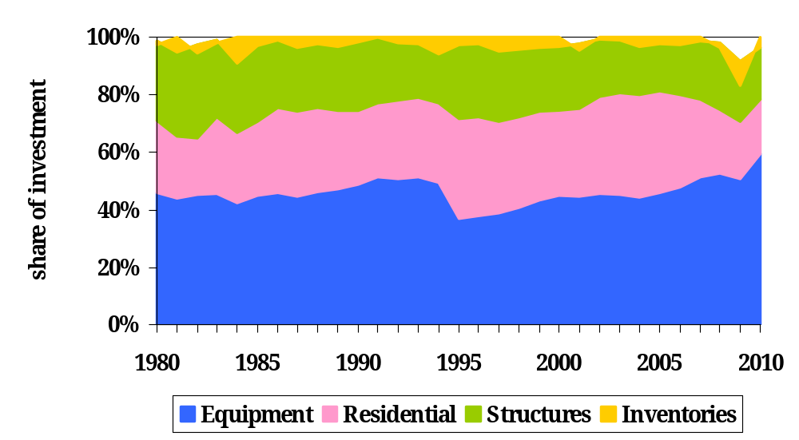
Investment composition
Note: Data prior to 1995 on difference base year.

Slide 31
Inputs: labor
Meaning: units of work effort
Why does it change?
  Population growth
  Fraction of population employed
  (extensive margin)
  Hours worked per worker
  (intensive margin)

Slide 32
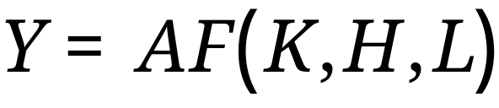
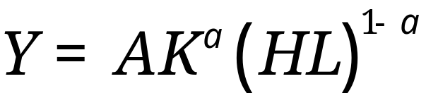
Inputs: labor
Adjustments for quality? Quantity?
  Skill: education? other?
Mathematical version
  Human capital = H (years of school?)

Slide 33
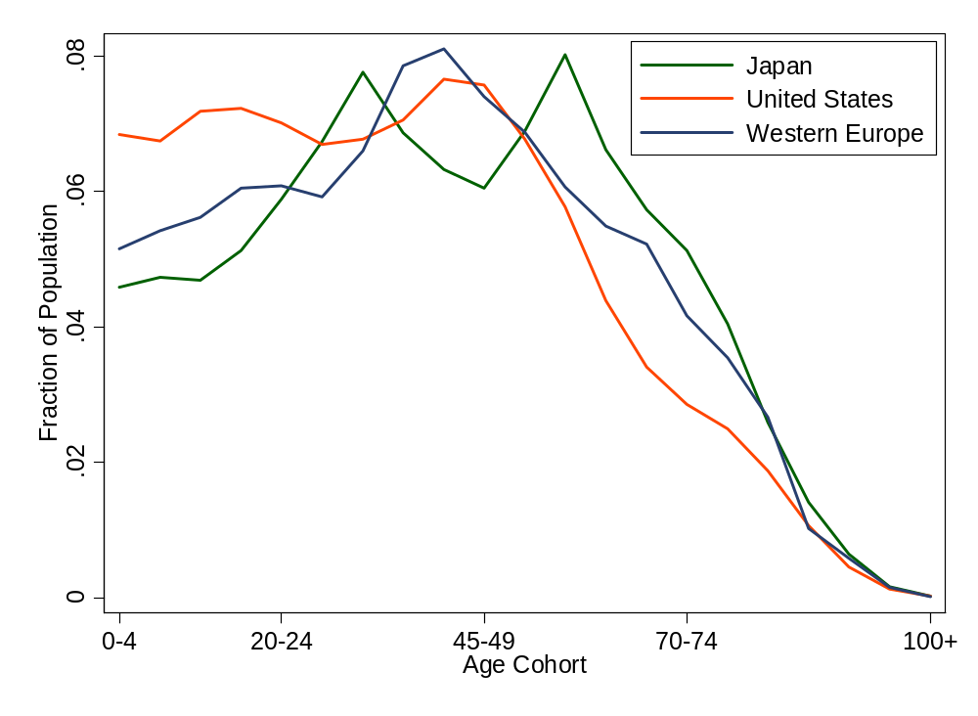
Age distribution

Slide 34
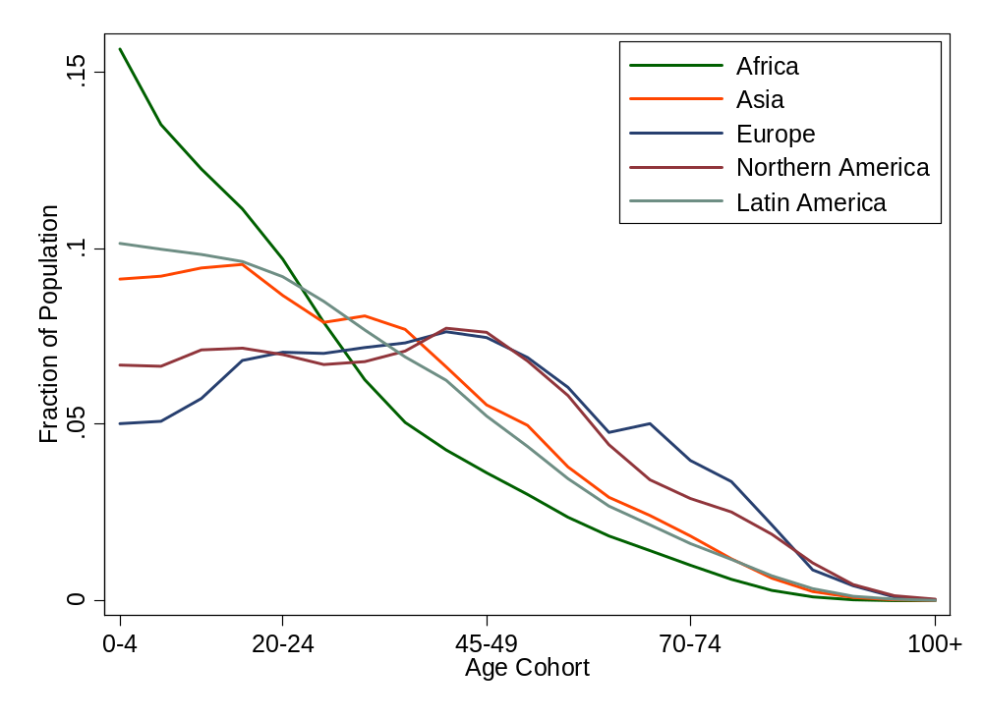
Age distribution

Slide 35
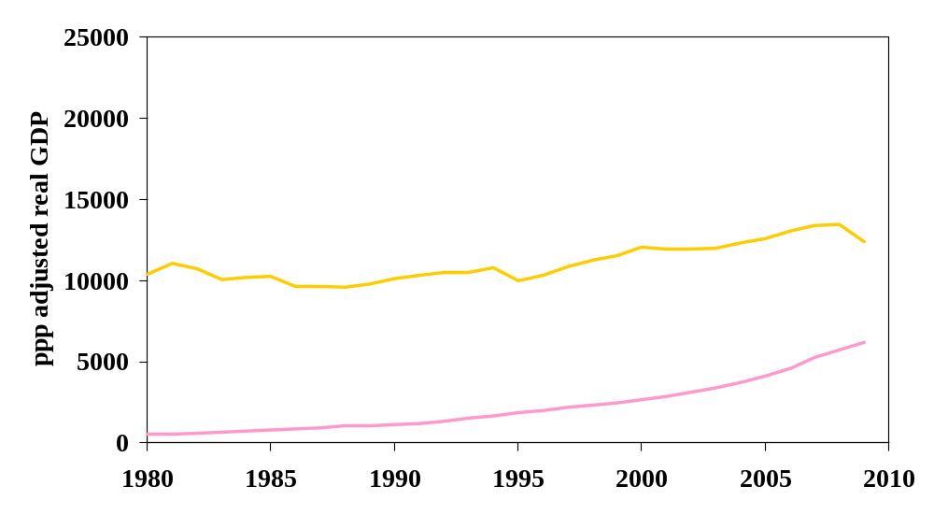
GDP per capita
Mexico
China

Slide 36
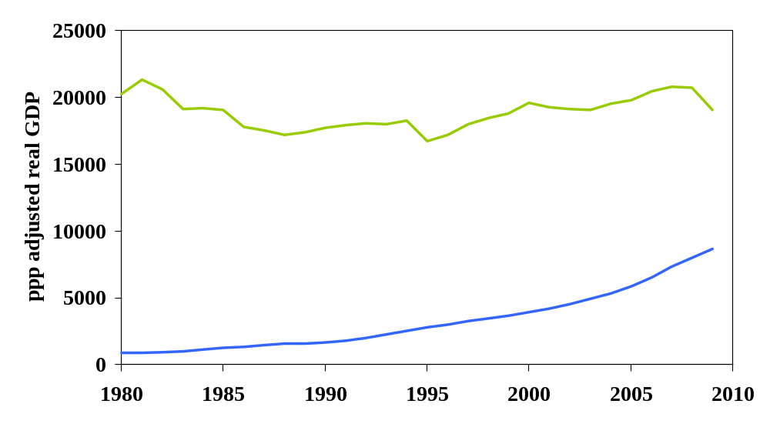
GDP per working age person
Mexico
China

Slide 37
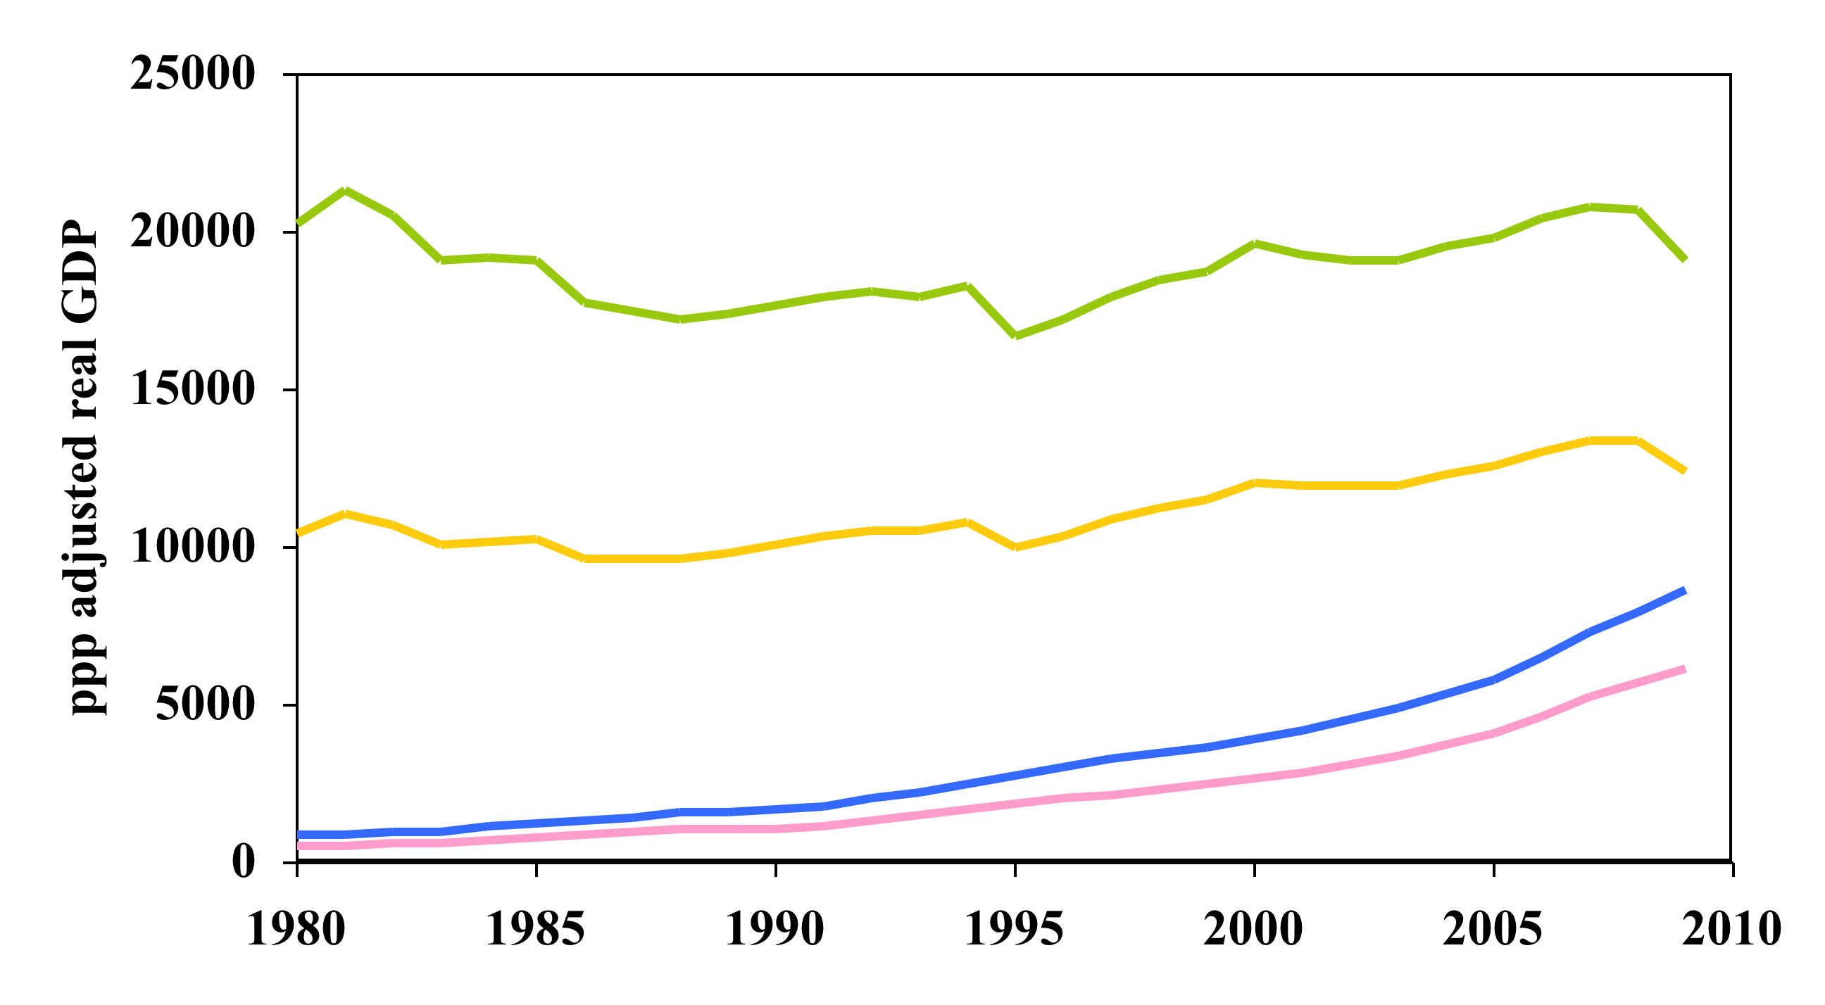
GDP
Mexico GDP per Working Age Person
Mexico GDP per Capita
China GDP per Working Age Person
China GDP per Capita

Slide 38

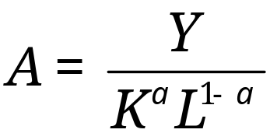
Productivity
Standard number:
  Average product of labor: Y/L
Our number:
  Total Factor Productivity: Y/F(K,L)
How do we measure it?
  Solve the production function for A

Slide 39
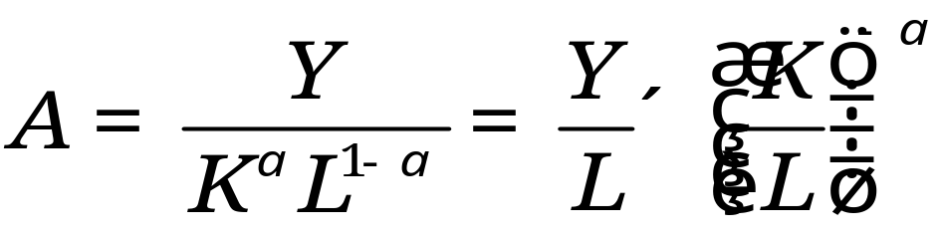

Productivity
Example (US): Y/L = 33, K/L = 65
Note: the TFP number by itself is meaningless, but comparisons across countries or time are useful.

Slide 40
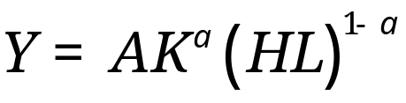
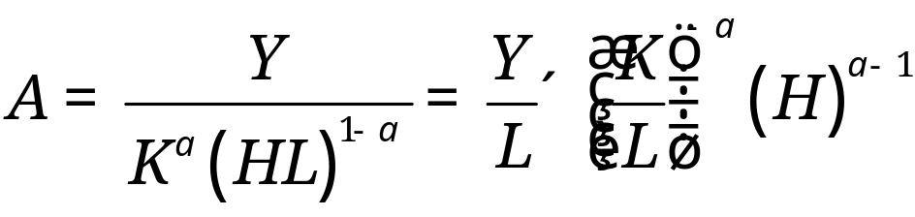
Productivity with human capital
How do we measure it?
  Solve the production function for A
Example (US): Y/L = 33, K/L = 65, H = 12.05

Slide 41
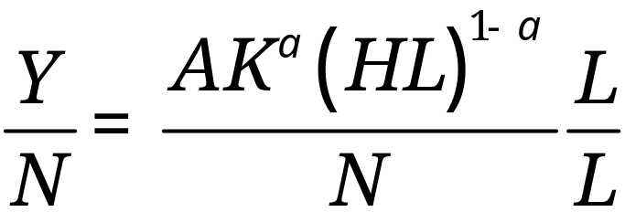
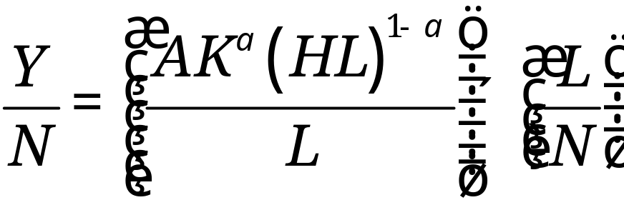
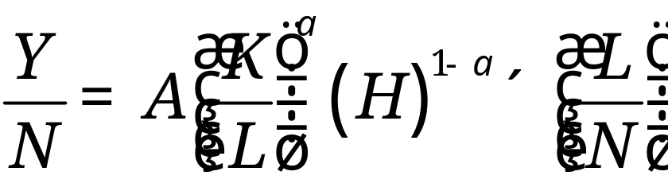
GDP per capita, revisited
What accounts for GDP per capita?

Slide 42
GDP per capita, revisited
Reasons for high GDP per capita:
  More workers: L/N
  More productivity: A
  More capital: K/L
  More skill: H
  Not present but could be added: hours worked

Slide 43
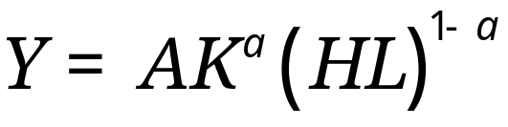
What have we learned today?
The production function links output to inputs and productivity:
The capital input (K):
  Plant and equipment, a consequence of investment (I)
The labor input (HL):
  Population growth, age distribution, participation and hours, skill (H)
TFP (A) can be inferred from data on output and inputs

Slide 44
The Global Economy
Solow Growth Model

Slide 45
Capital accumulation and growth
Can capital accumulation sustain growth?
Can capital accumulation explain miracles?
How does population growth affect growth?
How do saving rates affect growth?
Recurring themes in politics

Slide 46
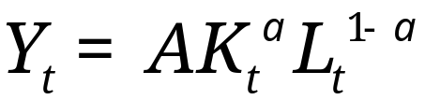
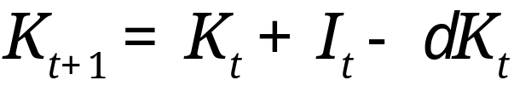

Simple model
Production function
Capital accumulation equation
Saving flow equation

Slide 47


Savings rates
Assumption: constant saving rate
Is this a good assumption?
  How would we check?
Savings identity

Slide 48
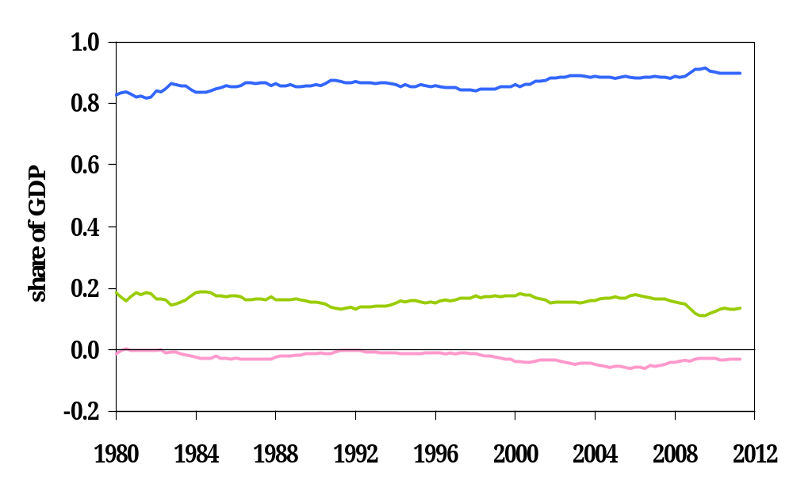
Savings
Private + Government Consumption
Investment = Saving – Net Exports
Net Exports

Slide 49

Solow model
Production function
Capital accumulation equation
Saving flow equation
Saving rate

Slide 50
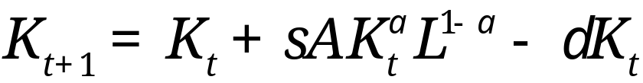

Solow model
Combining the equations
Evolution of the capital stock
Two forces: investment, depreciation

Slide 51
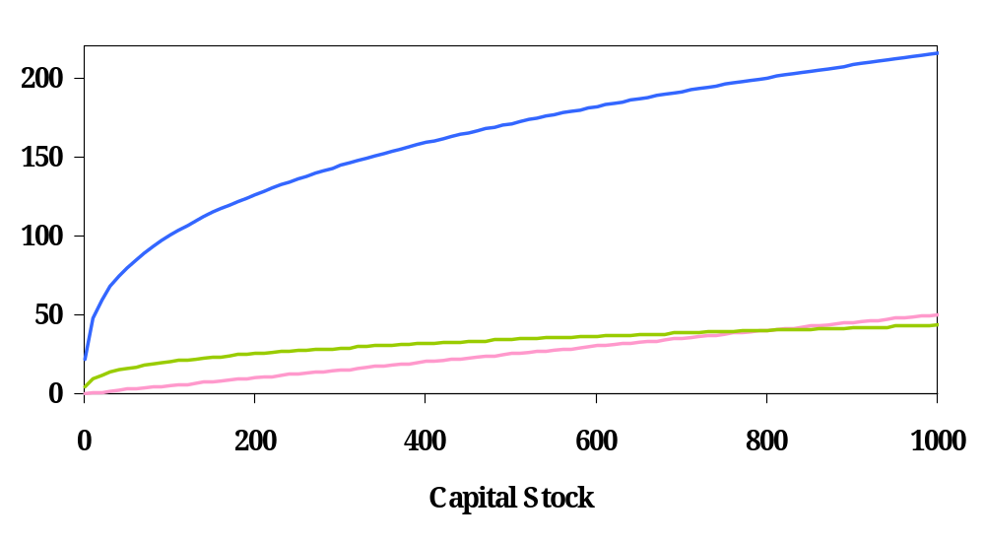
Solow model: dynamics
output
saving
depreciation

Slide 52

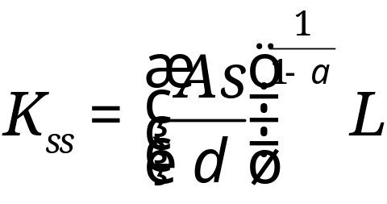
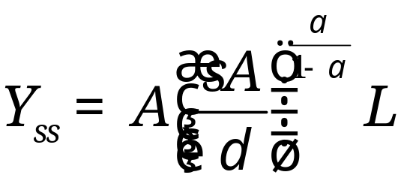
Solow model: convergence
Eventually: constant K, => Y, K/L, and Y/L
Countries with low K and Y grow faster
Eventually K stops changing
This is the steady state

Slide 53
Solow model: convergence
Do we see convergence?
What data could we use to test this implication of the theory?
  GDP per capita
  GDP per capita vs. growth rates
  What would we see?

Slide 54
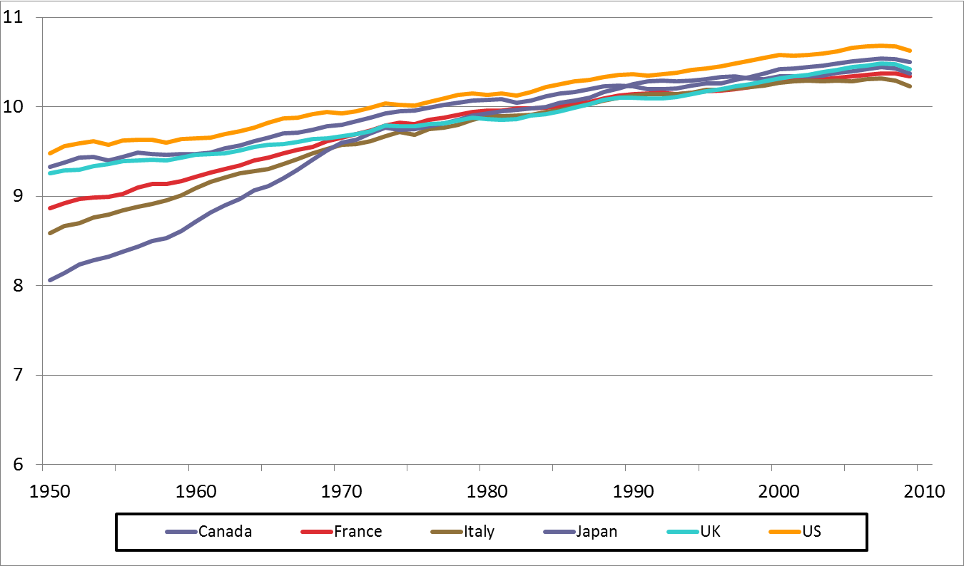
Convergence?
Log of Real Per Capita GDP (PPP, 2005 Chained US$)
Source: Penn World Tables 7.0

Slide 55
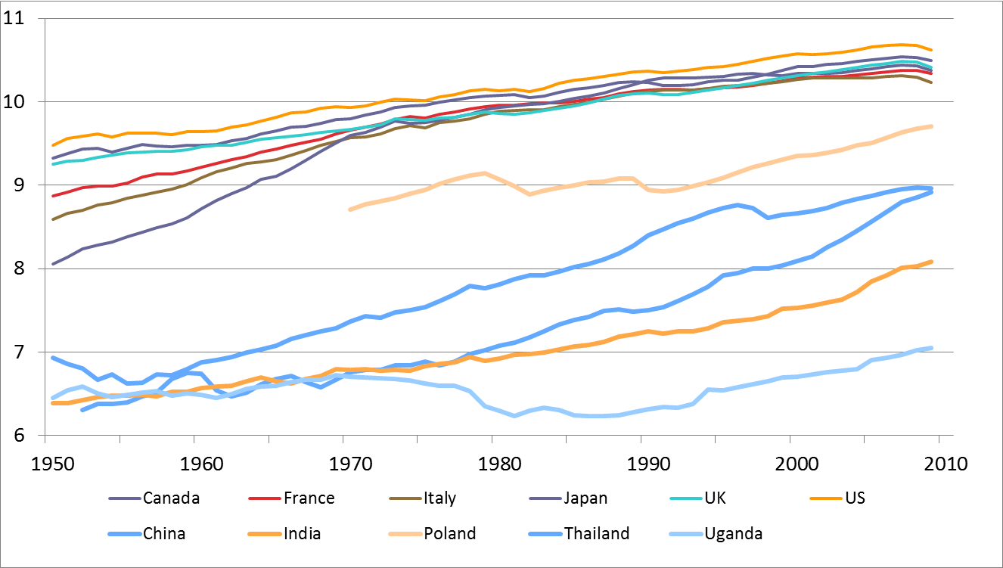
Convergence?
Log of Real Per Capita GDP (PPP, 2005 Chained US$)
Source: Penn World Tables 7.0

Slide 56
Level effects vs. growth effects
Level effect: change in GDP level
  Temporary change in growth rate
Growth effect: permanent change in growth rate
Level or growth rate?
  Saving rate
  Population growth

Slide 57
Saving?
How does the saving rate affect growth?
See Solow.xls

Slide 58
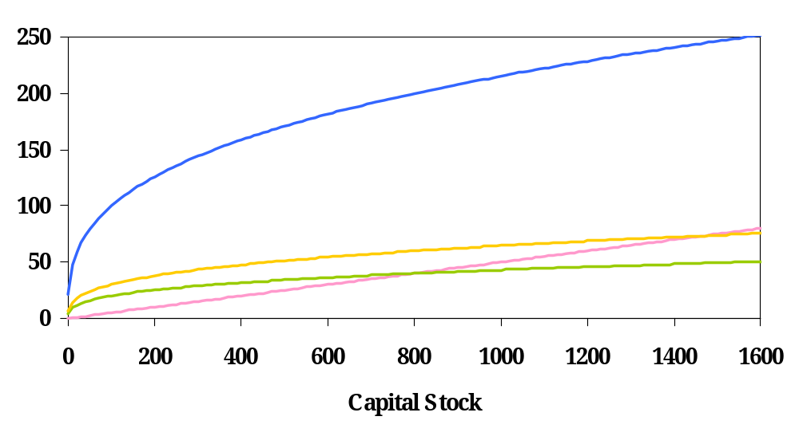
Solow model: saving
output
high saving
low saving
depreciation

Slide 59
Population growth?
More on this next week, but…
Increases GDP, decreases GDP per capita
Must invest more to provide capital for new workers
In data, doesn’t vary enough to account for growth experiences

Slide 60
Making a “miracle”
Solow model
  High saving rate
  Low capital-labor ratio
Are these enough?

Slide 61
What have we learned today?
Solow model
  Growth from saving-financed increases in capital
  Convergence property: growth eventually stops
  Conclusion: capital not the key to sustained growth
  Value: tool for exploring growth of emerging economies
What are we missing?
  TFP growth

Slide 62
For the ride home
Is aid ($$) good for developing countries?
  Bono: yes
  Bill Easterly (NYU faculty): maybe, proof?
In the Solow model
  Is money/capital helpful?
  What else might be?
Discussion board topic: Housing story

