Slide 1

The Global Economy
Money and Central Banks

Slide 2
What is money?
Commodity money
  Trade gold, fur skins, stones, cigarettes
Commodity-backed money
  Keep gold in a bank, trade claims to gold
  Gold certificates
Fiat money
  Trade slips of paper
  Currently used in Europe, U.S., etc.

Slide 3
The gold standard
Commodity backed money
  Backed by gold
  Fully convertible: bank has to give you gold
Should we return to the gold standard?
  Ron Paul: Yes.
  Students of Great Depression: No.

Slide 4
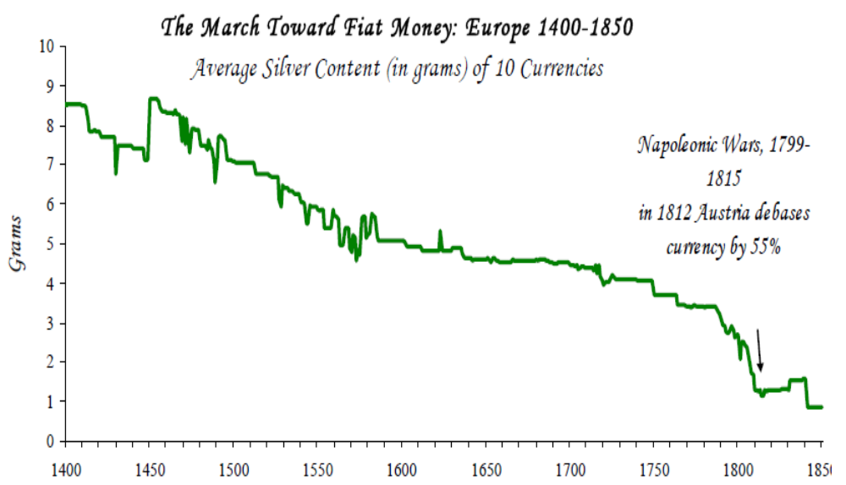
Debasement of Commodity Moneys
Source: Reinhart and Rogoff, This Time is Different, NBER WP13882, 2008.

Slide 5
Quantity theory
Milton Friedman, 1976 Nobel Laureate:
  Inflation is always and everywhere a monetary phenomenon. To control inflation, you need to control the money supply.
Money
Growth
Inflation

Slide 6
Quantity theory
One equation (technology for transactions)
M V = P Y
  M = stock of money in circulation (e.g. currency)
  V = velocity (how often a unit of currency is used in a specified time period, such as a year)
  P = price level (e.g. GDP deflator)
  Y = output (e.g. real GDP)

Slide 7
Quantity theory: two assumptions
Velocity is constant
M does not influence Y
  True in the long run: “money is neutral”
  True in the short run?
Result:
  Money growth causes inflation

Slide 8
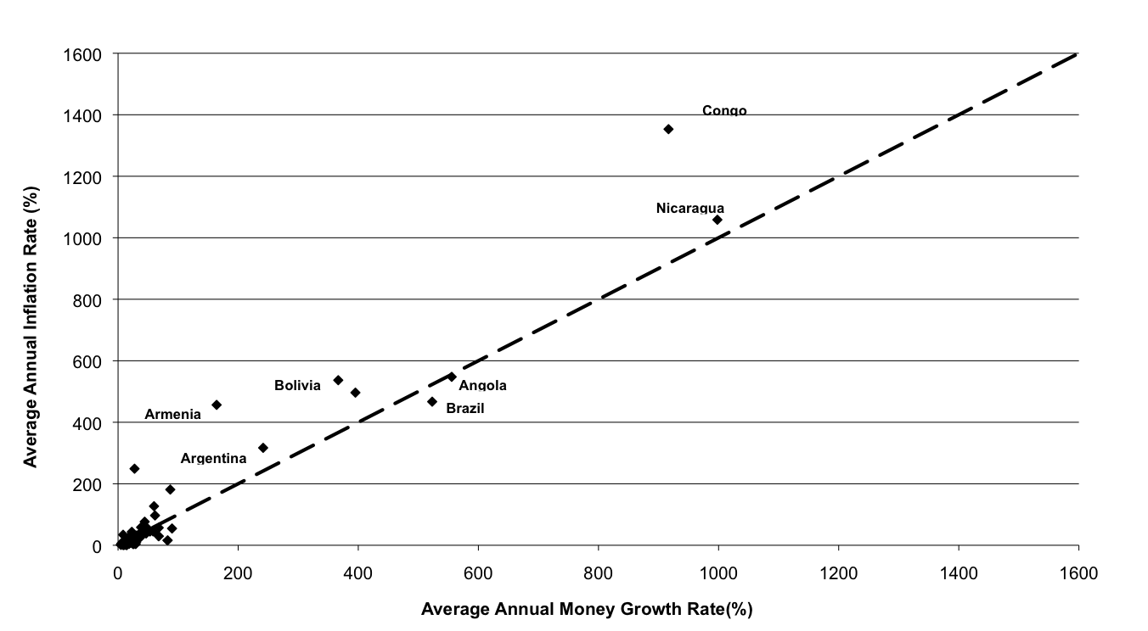
Inflation and Rapid Money Growth

Slide 9
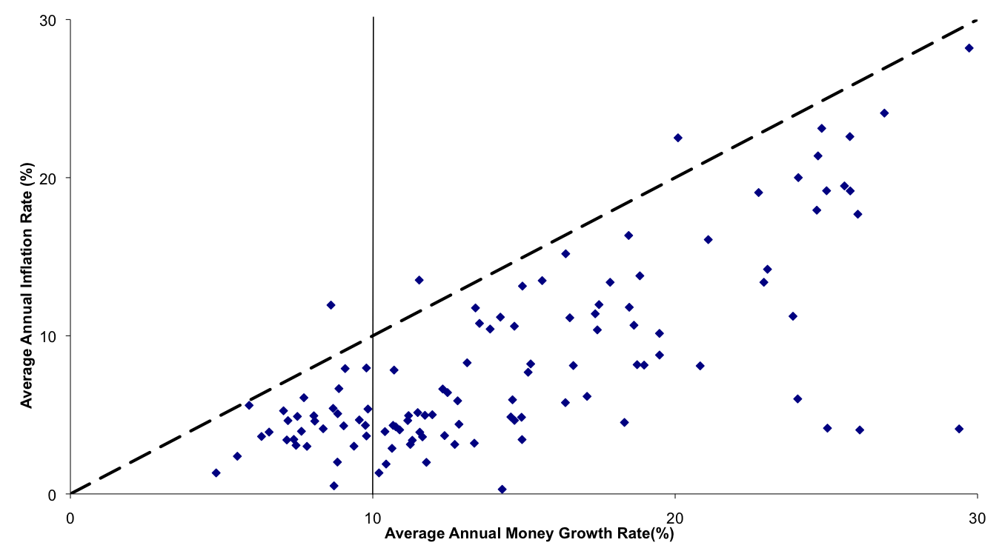
Inflation and Moderate Money Growth

Slide 10
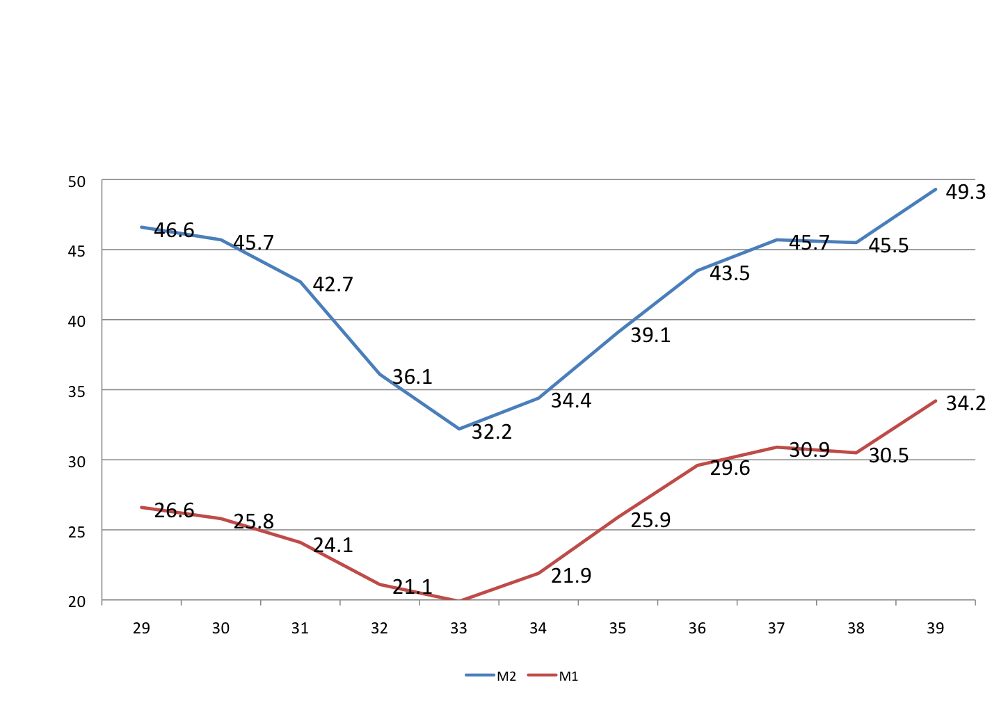
Great Depression: Money Stock
Billions of Dollars
Source: Historical Statistics of the US.
Notes:
But it went much further than intended and far beyond expectations.
Define M1 and M2 as narrow (liquid) and broad (less liquid) money.
Both are aggregates from the liabilities of the banking system.
M1 = currency + demand deposits
M2 = M1 + time deposits (CDs)

Slide 11
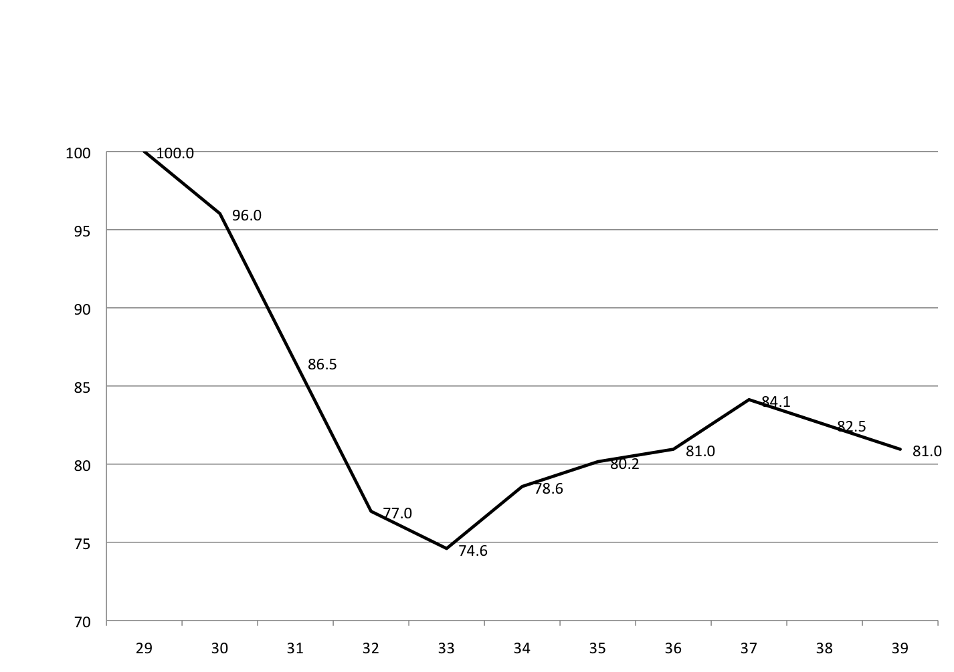
Great Depression: GDP Deflator
Note: 1929=100.
Notes:
Not just real economic plunge. DEFLATION!
Expectations of falling prices changes behavior!
How? Spending tomorrow may be better than today. REAL INTEREST RATES HIGH!

Slide 12
A Monetary Depression
1929-33
M V ➔ P Y
⬇
⬇
⬇
-25%
-25%
-32%
Notes:
What happened to velocity? Why?
What happened to prices? Was this expected?
Friedman and Schwartz (1960): Fed led money supply collapse driving an unexpected deflation. Price level eventually could fall far enough to raise real balances (Pigou effect), but perhaps not fast enough to avoid mass unemployment if wages don’t collapse.
Understanding of Great Depression evolved since 1980.
How did we get persistent weakness?
Not a typical business cycle. Much longer! Why don’t prices and wages adjust to restore full employment.
One answer: structural damage to financial system – destruction of information
Other possibilities: policy errors: fiscal/monetary/regulatory (real wages higher)

Slide 13
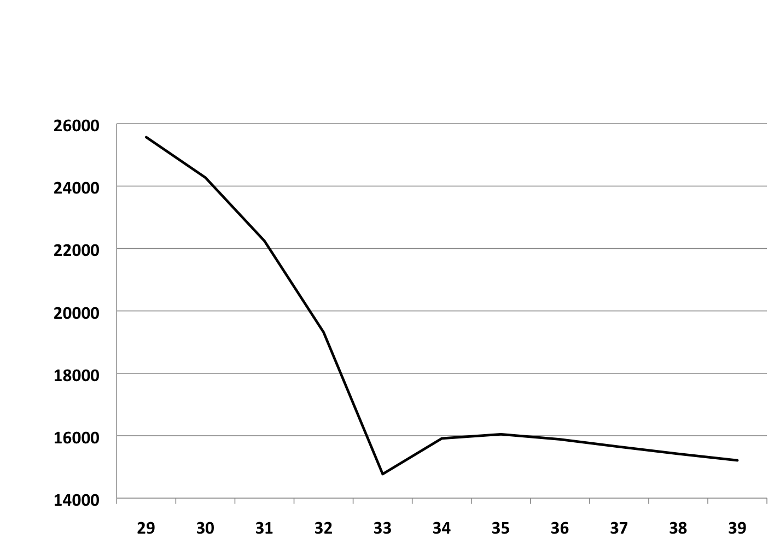
Deflation and Default Threaten Banks
Number of US Commercial Banks
Source: Historical Statistics of the US.

Slide 14
Why No LOLR?
Herbert Hoover citing Andrew Mellon
(US Treasury Secretary from 1921-32):
“He held that even a panic was not altogether a bad thing. He said: ‘It will purge the rottenness out of the system. High costs of living and high living will come down. People will work harder, live a more moral life. Values will be adjusted, and enterprising people will pick up the wrecks from less competent people.’ ”

Slide 15
Modern money supply mechanics
How is the money supply determined?
Central Bank manages the money supply
  Tools: interest rates and reserve supply
Treasury issues debt: bills, bonds, etc
Balance sheets for
  Treasury
  Central bank
  Private agents: households and firms

Slide 16
Open market operations
Treasury
Assets |  | Liabilities
 |  | Bills | 200
The FED wants to increase the money supply by 40
How does it work?
Central bank
Assets |  | Liabilities
Bills | 20 | Money | 20
Households and firms
Assets |  | Liabilities
Money | 20
Bills | 180

Slide 17
Open market operations
Treasury
Assets |  | Liabilities
 |  | Bills | 200
The FED wants to increase the money supply by 40
How does it work?
No change in anyone’s net worth
Central bank
Assets |  | Liabilities
Bills | 20 | Money | 20
+40
+40
Households and firms
Assets |  | Liabilities
Money | 20
Bills | 180
Money +40
Bills -40

Slide 18
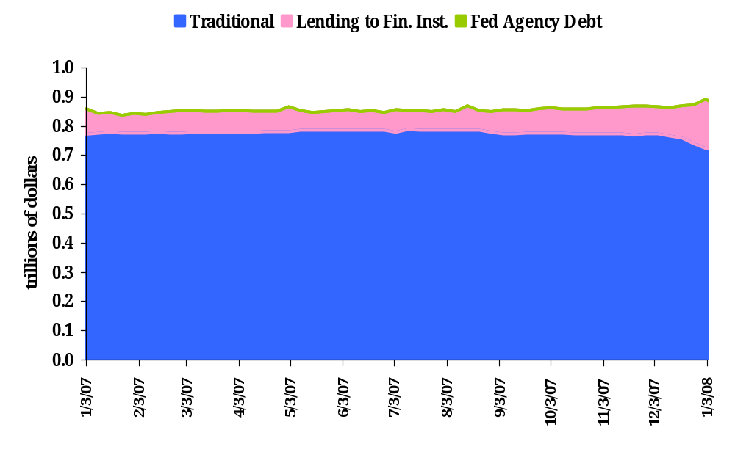
Fed Assets

Slide 19
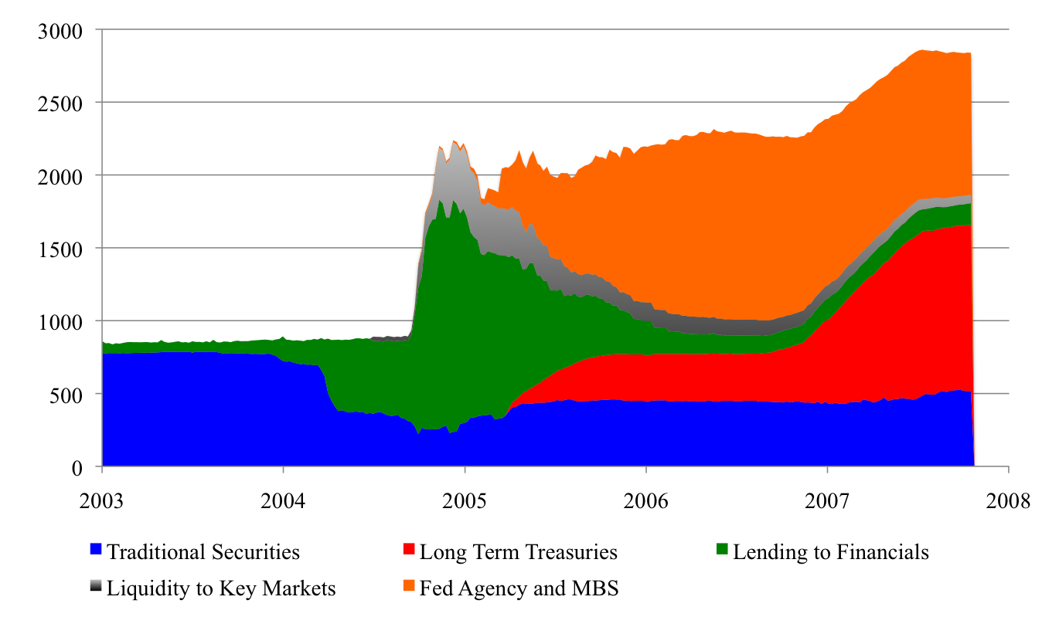
Unconventional Monetary Policy
Billions of Dollars
Source: FRB Cleveland.
Notes:
10/14/10

Slide 20
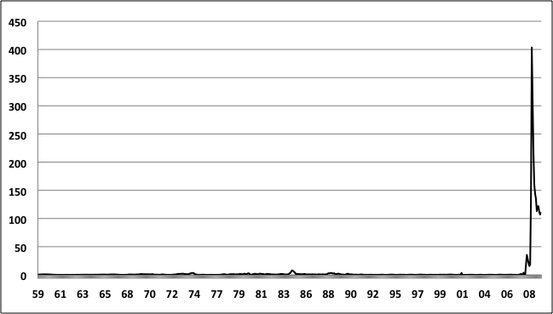
Fed Discount Window Lending
Billions of Dollars, 1959-2009

Slide 21
The market for bank reserves
Fed buys and sells securities to provide reserves to the banking system
  Fed is monopoly supplier of aggregate reserves to banks
  Banks hold reserves with the Fed (the Fed is the bank for banks); reserves are the banks’ most liquid assets
  At the end of the day, if a bank is low on reserves, it borrows from a bank with excess reserves.
  This interbank market keeps banks from having to hold a lot of reserves to guard against a shortfall
  The rate at which these overnight loans are made is the federal funds rate

Slide 22
Supply and demand for reserves
Federal
Funds Rate
Supply of reserves
(from FED)
Rate
Demand for reserves
(from banks)
Quantity of Reserves

Slide 23
Two tools
Choose quantity of reserves
  Demand curve yields interest rate
Choose the interest rate
  Demand curve yields quantity
Like any monopolist, the FED can choose prices or quantities, but not both! (we’ll see a very important exception later in the course)

Slide 24
Two targets
Could target the reserve supply directly
  Add/subtract funds to keep supply fixed
Could target the interest rate
  FED sets a “target rate”
  If the FED wants to increase the reserve supply, it lowers the target rate

Slide 25
Hitting a lower target rate
Federal
Funds Rate
S₁
S₂
i₁
i₂
Demand for reserves
(from banks)
Quantity of Reserves

Slide 26
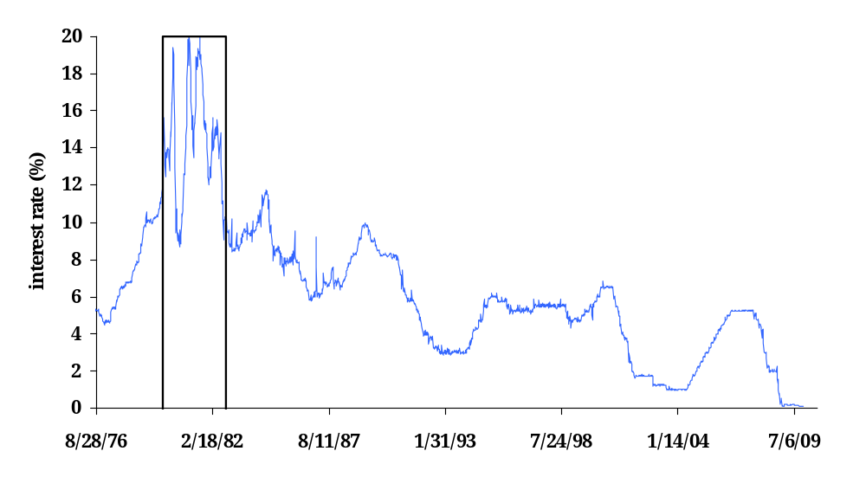
Managing reserve supply vs. interest rates
FED targets nonborrowed reserve supply directly
FED targets interest
rates directly

Slide 27
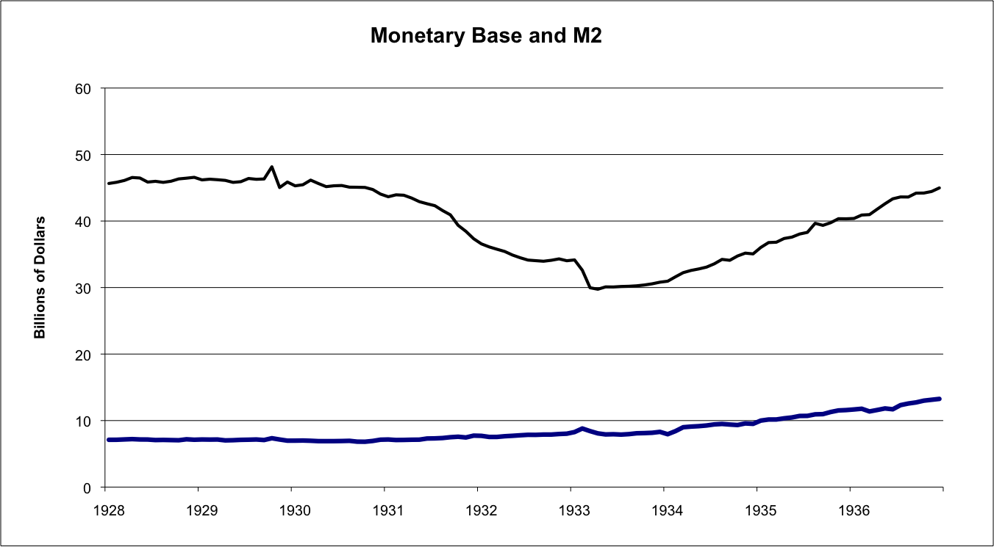
“Fed creates reserves, banks create money”
M2 = Currency + Deposits in Banks
MB = Currency + Reserves
Source: Friedman and Schwartz, 1963.

Slide 28
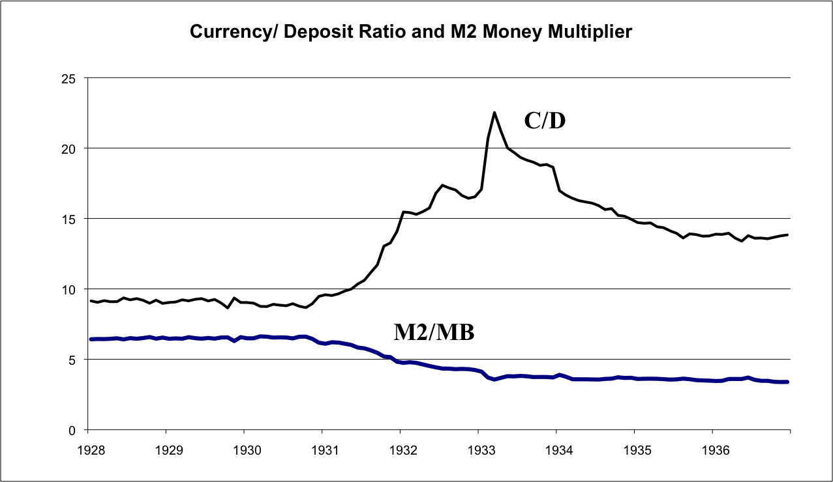
Bank Runs Depress Money Stock
Source: Friedman and Schwartz, 1963.

Slide 29
Summary
The U.S. dollar is a fiat currency
  No gold in the vault to back it up
  Money is “printed” by the central bank (Fed)
Conventional policy: buy and sell T-bills
  Buy bills = increase money supply, lower interest rates
  Sell bills = decrease money supply, increase interest rates

Slide 30
Summary
Central bank could use as an instrument reserves or interest rates
  Most banks use interest rates
  Controlling reserves can lead to high interest rate volatility
Next few weeks
  Central banks’ goal is price stability
  How does Fed policy affect inflation and output?

