Slide 1

The Global Economy
Growth

Slide 2
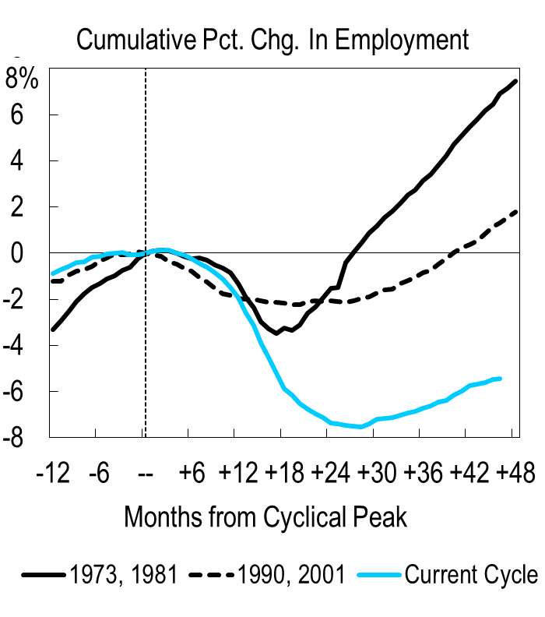
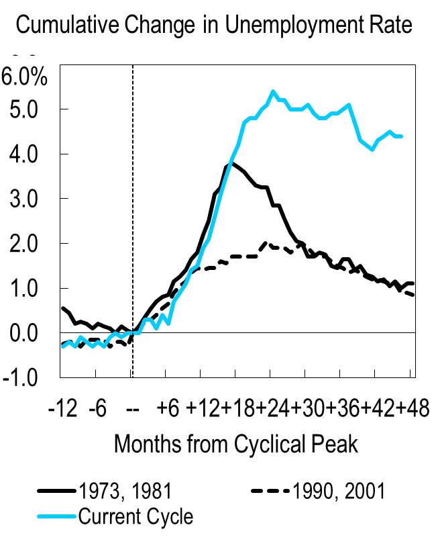
In the News
Sources: BEA and Citi.

Slide 3
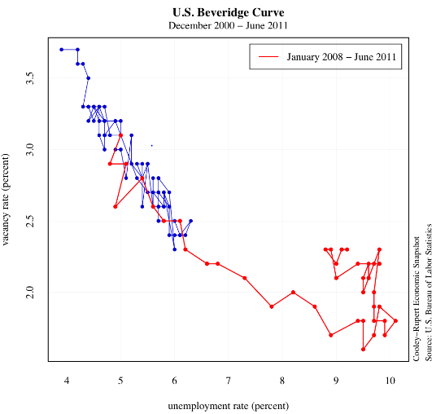
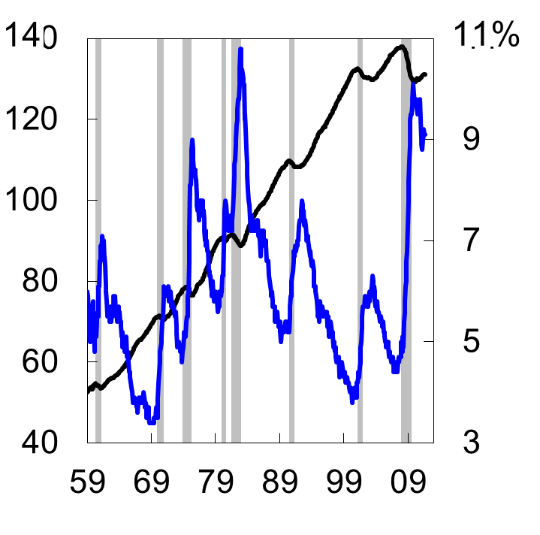
In the news
Labor Market Highlights
Note: Shaded areas denote recessions. Sources: BEA and FRB Cleveland.

Slide 4
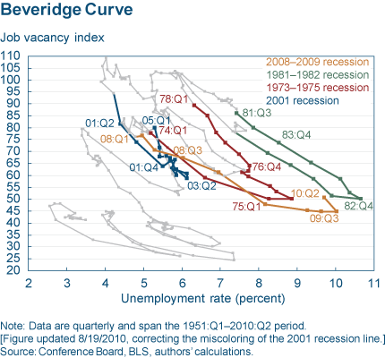
In the News
“How much of the current unemployment rate is really due to mismatch? The answer seems to be a lot. I mentioned that the relationship between unemployment and job openings was stable from December 2000 through June 2008. Were that stable relationship still in place today, and given the current job opening rate of 2.2 percent, we would have an unemployment rate closer to 6.5 percent, not 9.6 percent.”
Narayana Kocherlakota,
President,
FRB Minneapolis, September 8, 2010
Sources: FRB Cleveland and FRB Minneapolis.

Slide 5
Roadmap
News
Review from last week
Solow model with technology growth
Growth accounting
Data
What drives technology growth?

Slide 6
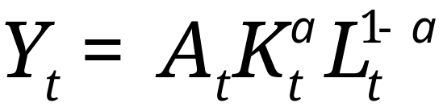
Review
Production function
Solow Growth Model
  Savings funded investment drives growth
  No long-run growth. Why?

Slide 7
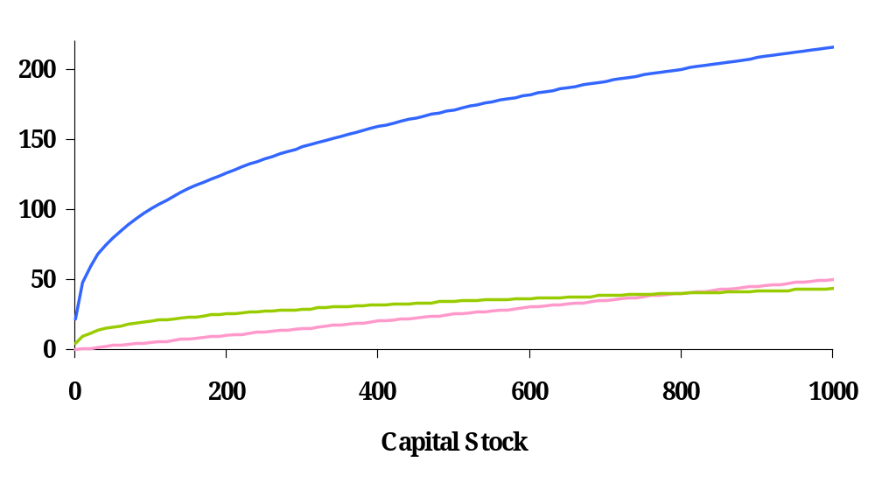
Solow model: dynamics
output
saving
depreciation

Slide 8
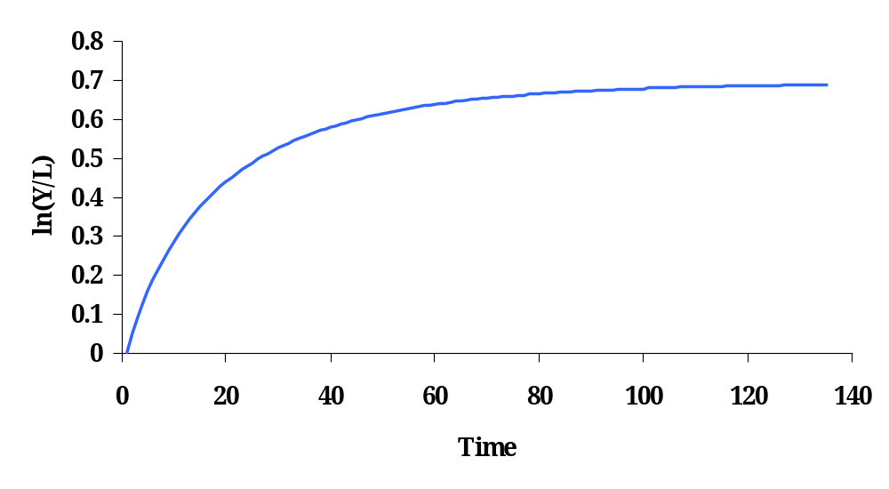
Steady state

Slide 9
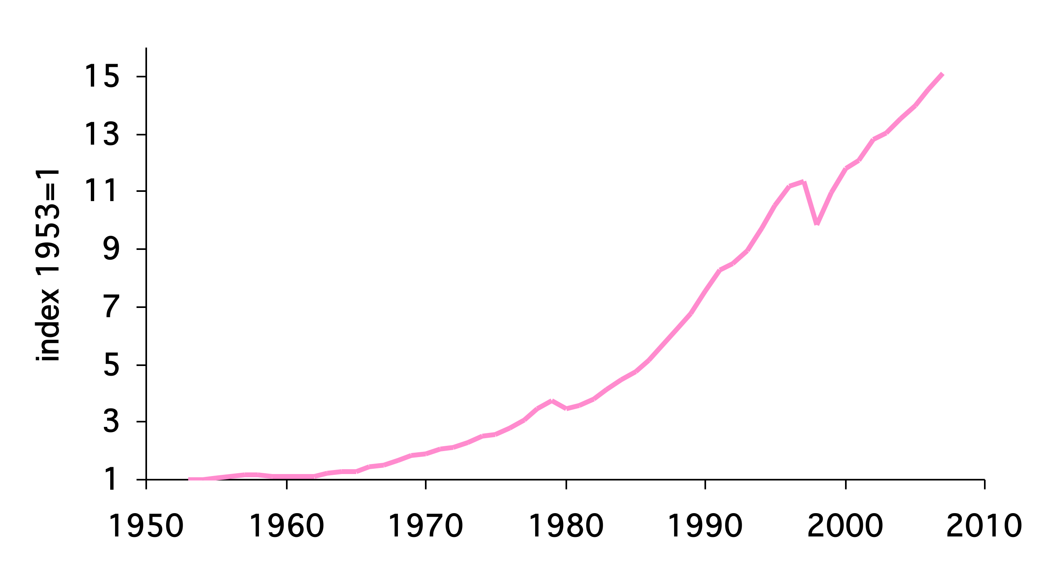
Korean GDP per capita

Slide 10
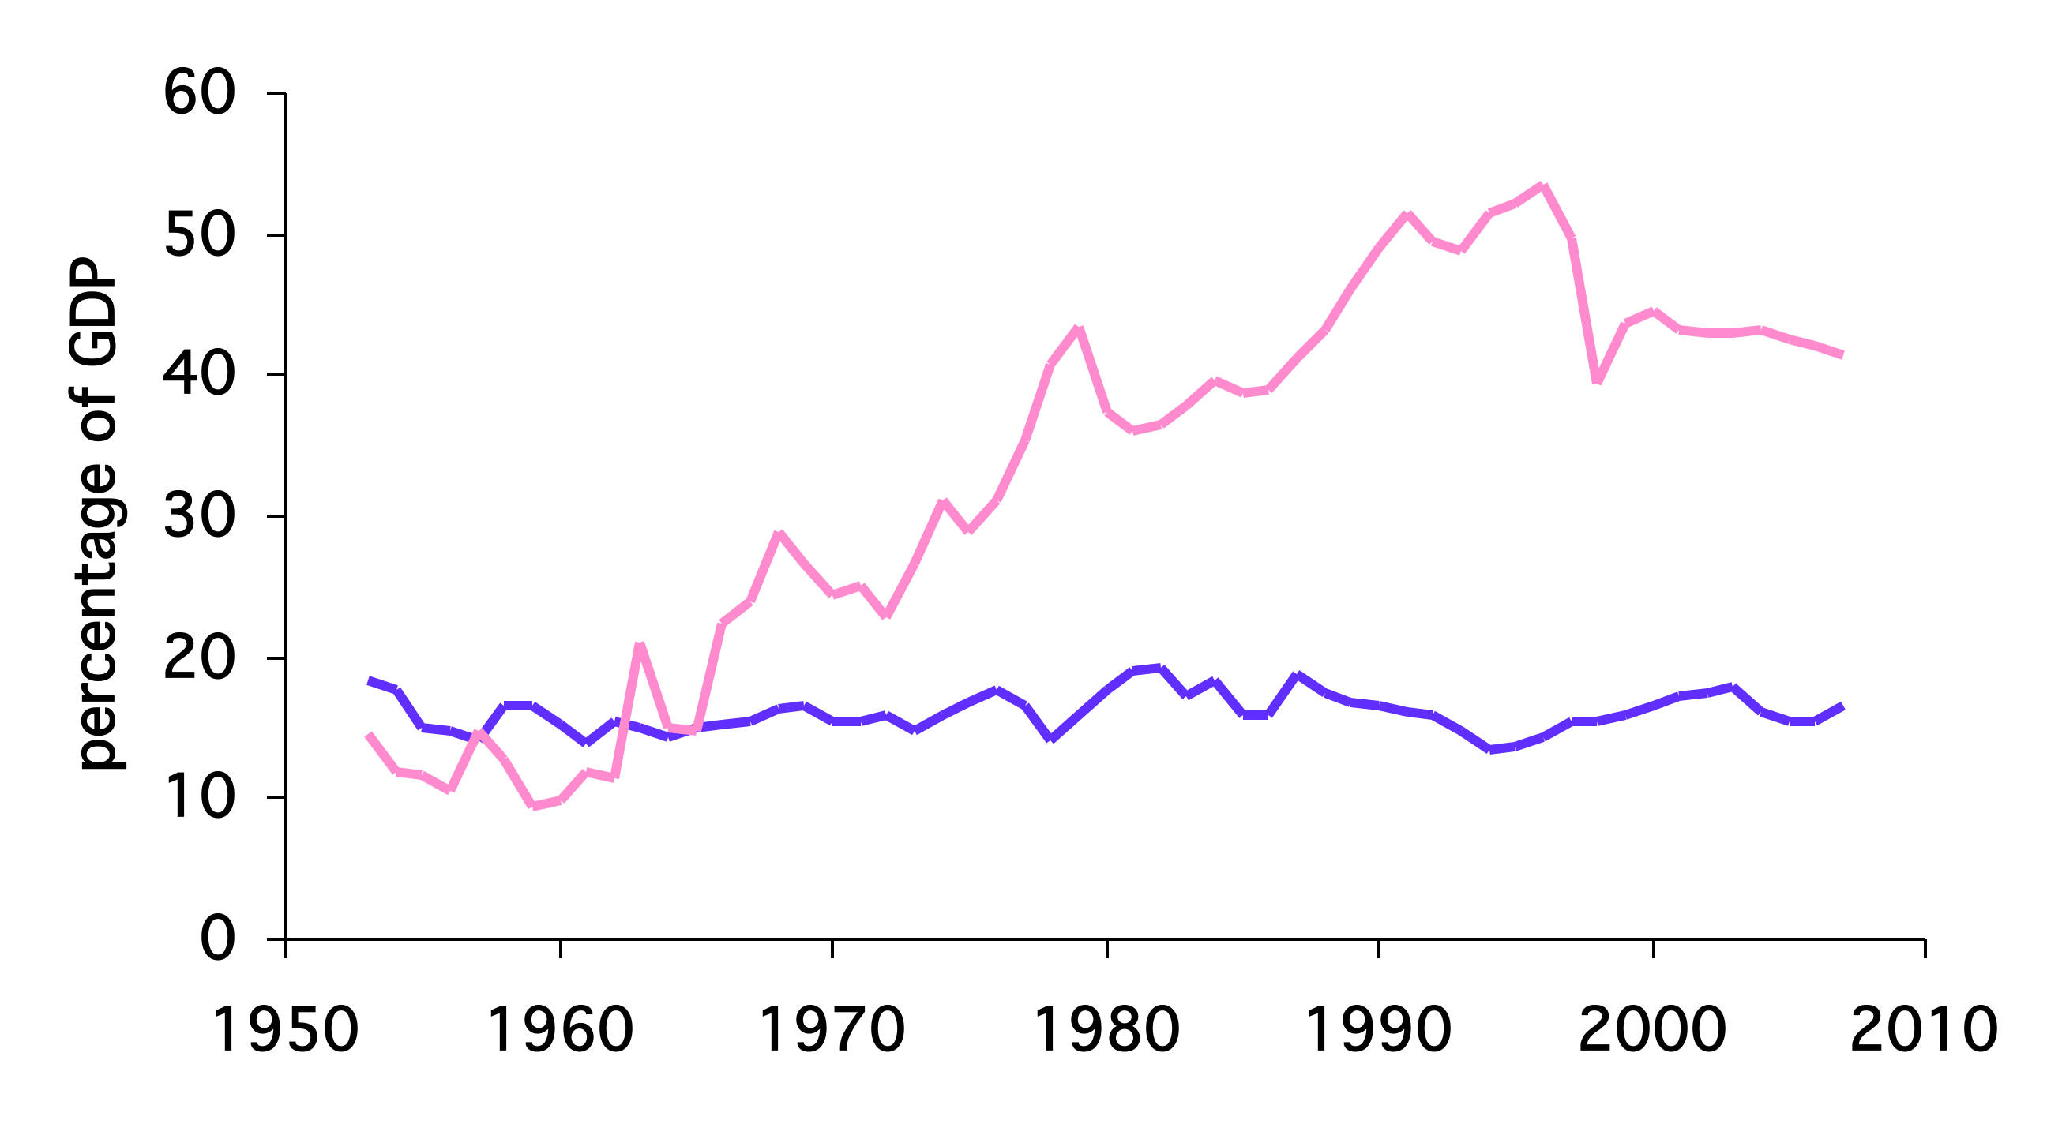
Investment Rates
Korea
United States

Slide 11
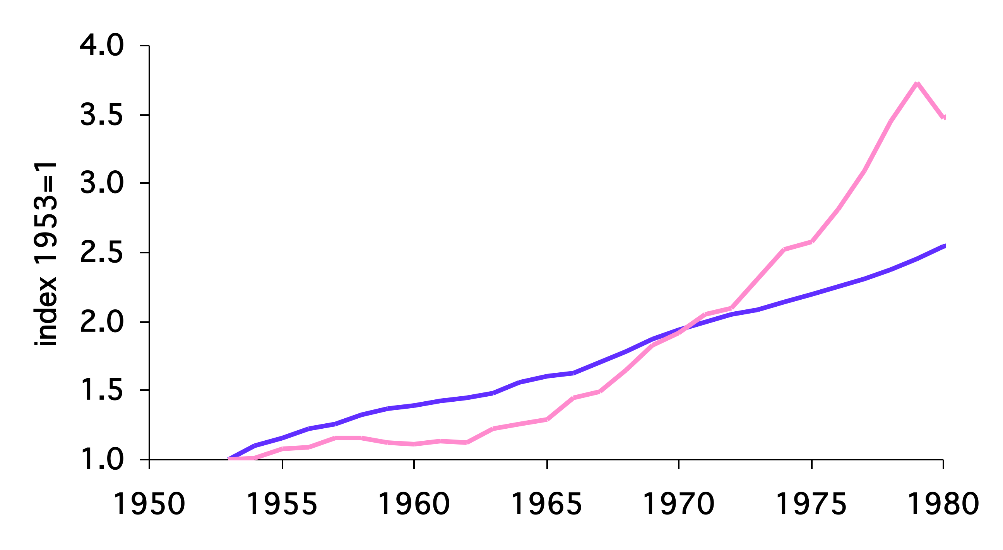
Korean GDP per capita
Data
Model

Slide 12
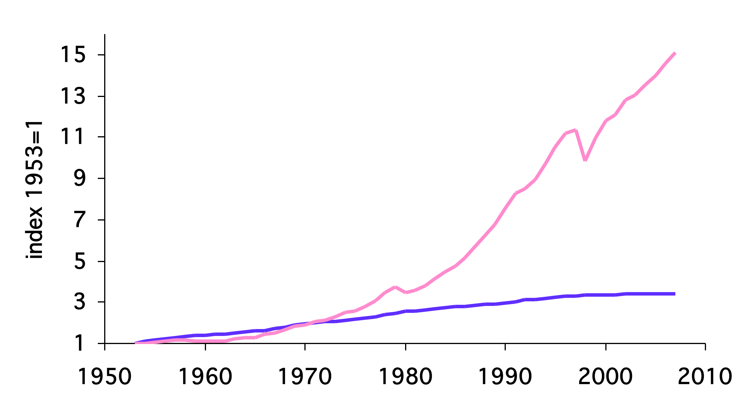
Korean GDP per capita
Data
Model

Slide 13
What are we missing?
Total Factor Productivity Growth

Slide 14

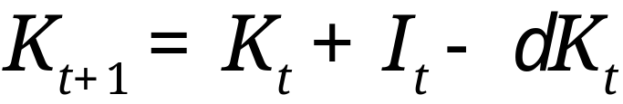
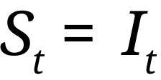
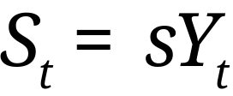
Model with TFP and population growth
Production function
Capital accumulation
Savings flow
Savings rate

Slide 15
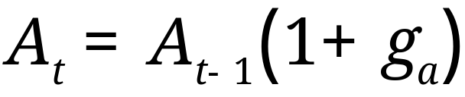
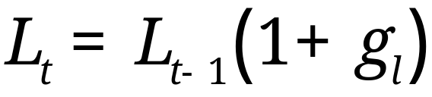
Model with TFP and population growth
Assume TFP and labor grow at constant rates
Growth is exogenous to the model

Slide 16
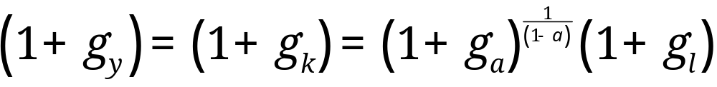
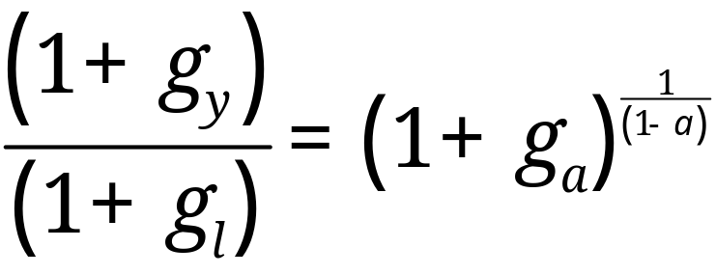
Model with TFP and population growth
Guess capital and output grow at the same rate
After some algebra we can show

Slide 17
Balanced growth path
Output grows in the steady state
  Sometimes called a “balanced growth path”
Saving rates
  Do not affect growth rates in steady state
  Do affect levels of Y/L

Slide 18



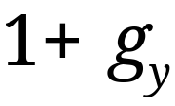
Example: United States
Ballpark numbers:
What is ?

Slide 19
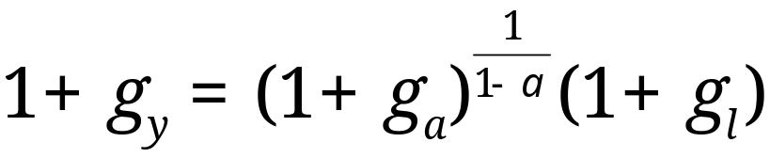
Example: United States
Ballpark numbers:
What is ?

Slide 20


Example: China
Ballpark numbers:
What is ?

Slide 21
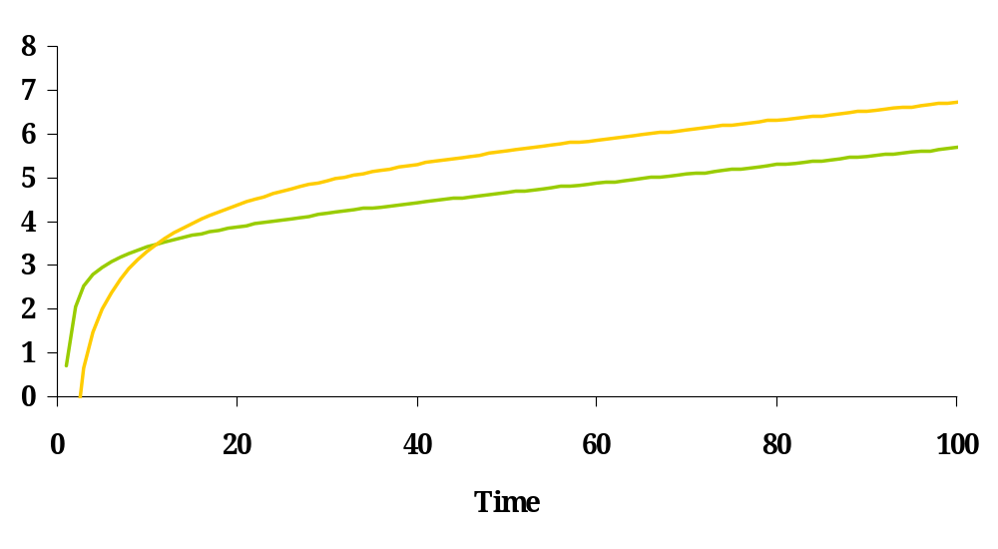
Savings rates
K/L
Y/L
Note: K/L, not K/Y!

Slide 22
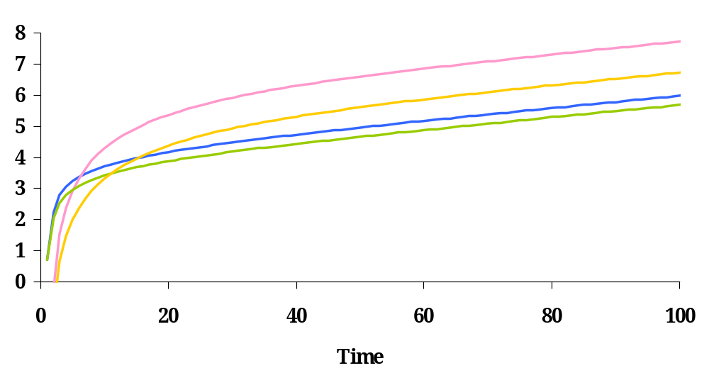
Saving rates
K/L (high s)
K/L (low s)
Y/L (high s)
Y/L (low s)
Note: K/L, not K/Y!

Slide 23
Summary
Q: Why does technological progress sustain growth?
A: Because technology does not have diminishing returns.

Slide 24
Understanding Solow
Succeeding-period Ratios in the Steady State
Variable | Fixed Labor | Population Growth | Population Growth + TFP Growth
Y | 1
L | 1
Y/L | 1
K/L | 1
K/Y | 1 | 1 | 1

Slide 25
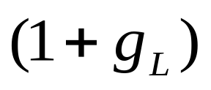
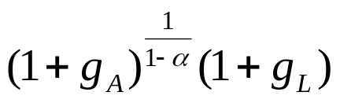
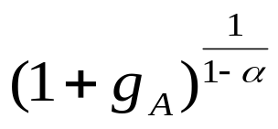
Understanding Solow
Succeeding-period Ratios in the Steady State
Variable | Fixed Labor | Population Growth | Population Growth + TFP Growth
Y | 1
L | 1
Y/L | 1 | 1
K/L | 1 | 1
K/Y | 1 | 1 | 1

Slide 26
Growth accounting
Using theory to decompose data on growth

Slide 27
Level comparisons
Why is Y/L larger in the U.S. compared to Mexico?
 | Employment (mils) | Capital (bil. $) | GDP (bil. $)
Mexico | 46.94 | 4,278 | 1,293
U.S. | 155.45 | 42,238 | 12,619
Source: Penn World Tables 7.0 and own calculations.

Slide 28
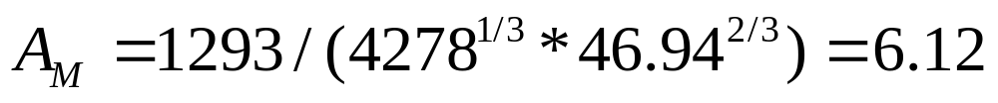
Level comparisons
 | Employment (mils) | Capital (bil. $) | GDP (bil. $)
Mexico | 46.94 | 4,278 | 1,293
U.S. | 155.45 | 42,238 | 12,619
Compute TFP:

Slide 29
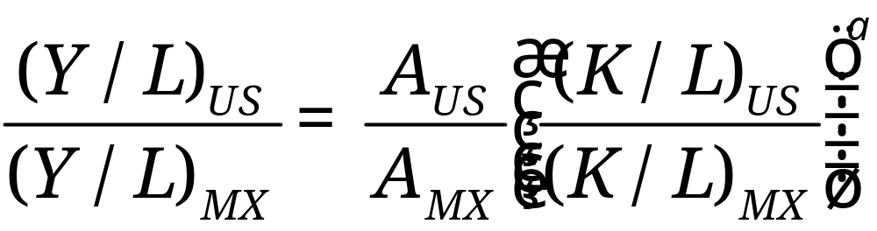
Level comparisons
Use the production function to make comparisons

Slide 30
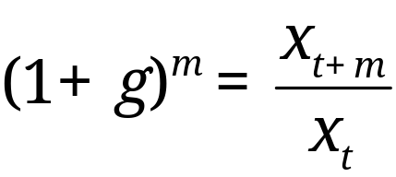
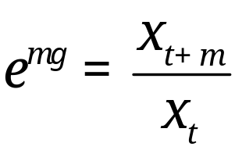
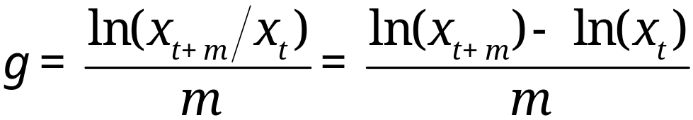
Growth rate review
Traditional growth rate
Continuously-compounded growth rate
Computing the growth rate
See
  “Math review”
  “Sources of growth”

Slide 31
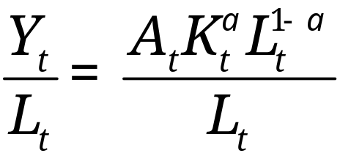
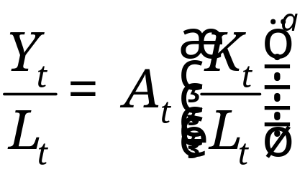
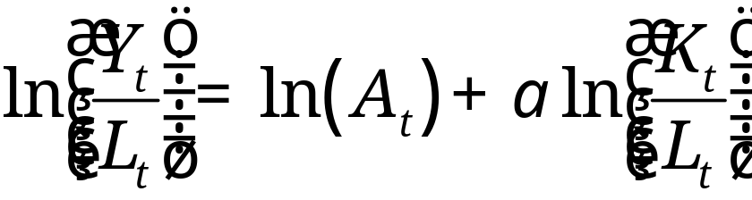
Growth accounting

Slide 32


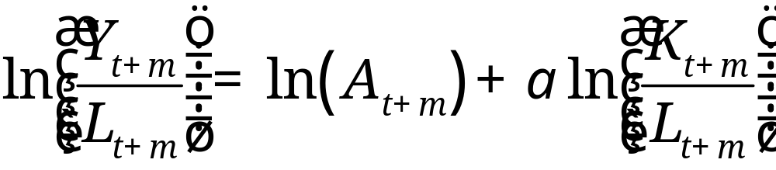

Growth rates
In period
In period
Subtract from and divide all by

Slide 33
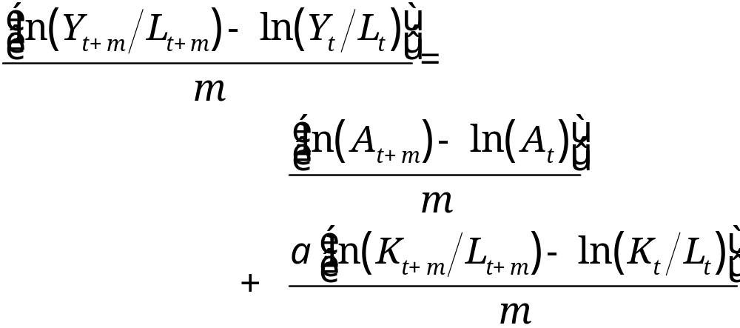
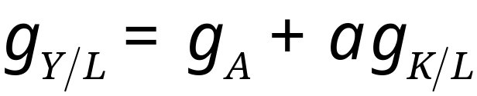
Growth rates

Slide 34
Growth accounting
Each term is an annual growth rate
How much growth can be attributed to
  Changes in the capital stock?
  Changes in technology?

Slide 35

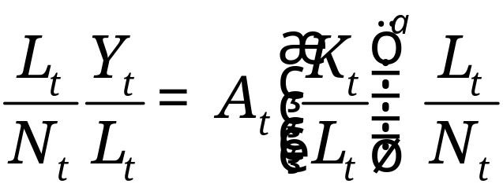
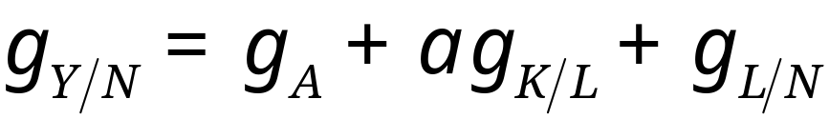
With population growth (notes, pg 7)
Population,

Slide 36
Growth accounting
Each term is an annual growth rate
How much growth can be attributed to
  Changes in the capital stock?
  Changes in technology?
  Changes in labor supplied?

Slide 37
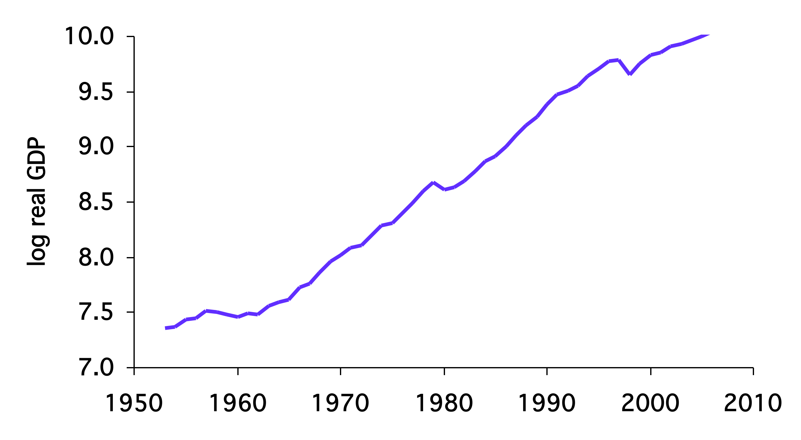
Example: Korean GDP per capita

Slide 38

Example: Korea
 | Y (bil 2005 US$) | K (bil 2005 US$) | L (ths) | N (ths) | A
1970 | 97.32 | 131 | 10062 | 32241 | 0.041
2009 | 1214 | 4551 | 24275 | 48509 | 0.087
 | Y/N | L/N | K/L | A
1970-2009 | 5.42 | 1.21 | 2.28 | 1.93

Slide 39
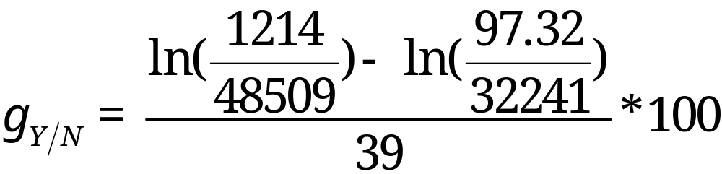
Example: Korea

Slide 40
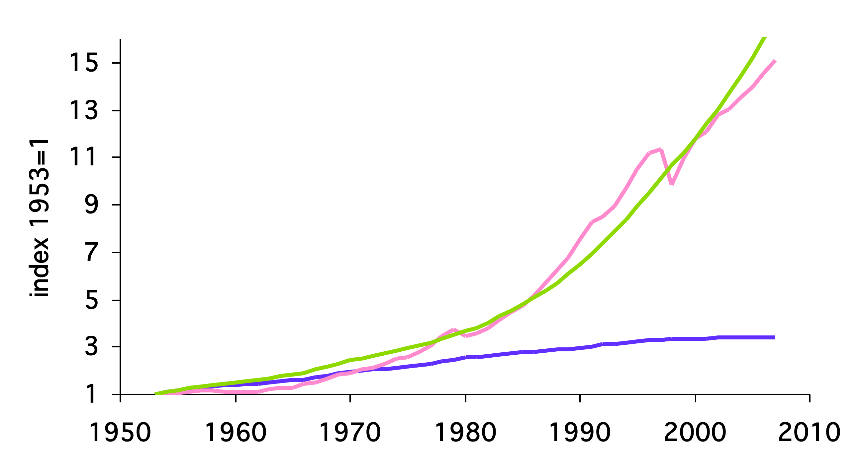
Korean GDP per capita
Model with TFP Growth
Data
Model No TFP Growth

Slide 41
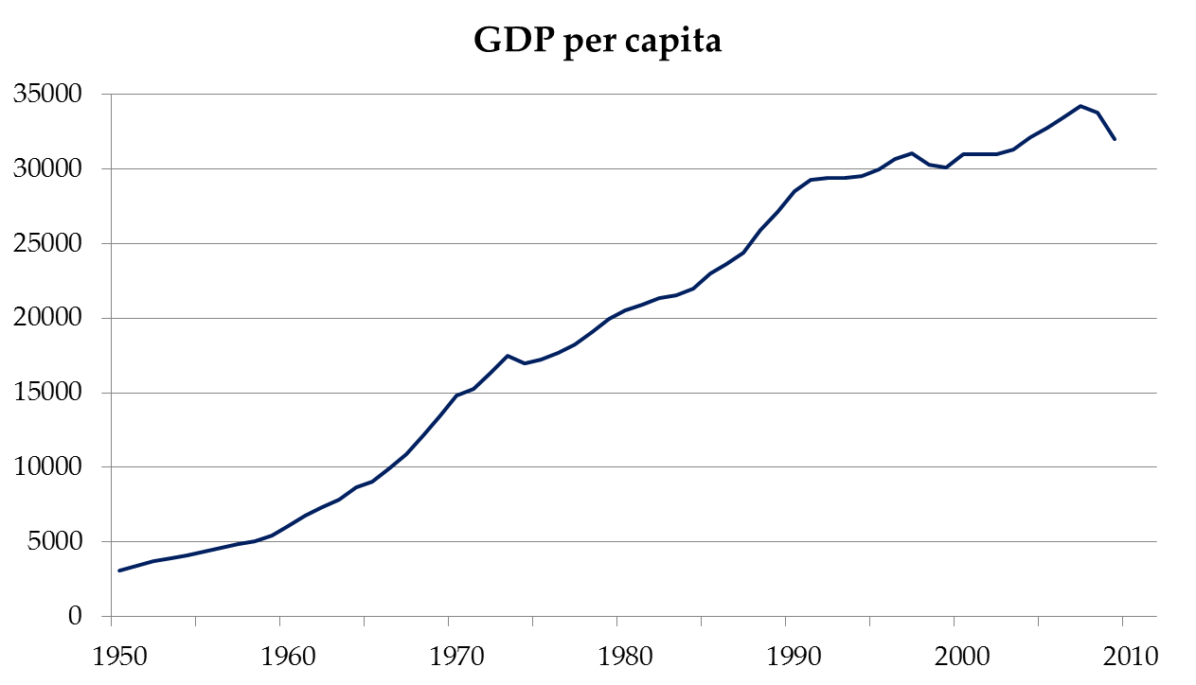
Japan

Slide 42
What happened in Japan?
 | Y/N | L/N | K/L | A
1960-1970
1970-1991
1991-2009

Slide 43
Productivity in Japan
“The 1990s in Japan: A Lost Decade”
Fumio Hayashi and Edward Prescott
“the problem is low productivity growth… perhaps the low productivity growth is the result of a policy that subsidizes inefficient firms and declining industries.
This policy results in lower productivity because the inefficient producers produce a greater share of output.”
More on this later.

Slide 44
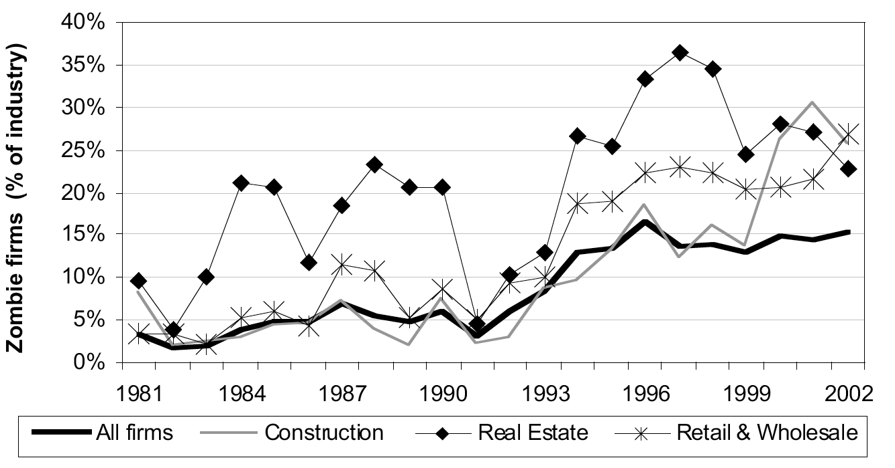
Zombie Firms in Japan
Source: Caballero, Hoshi and Kashyap, American Economic Review, 2008.

Slide 45
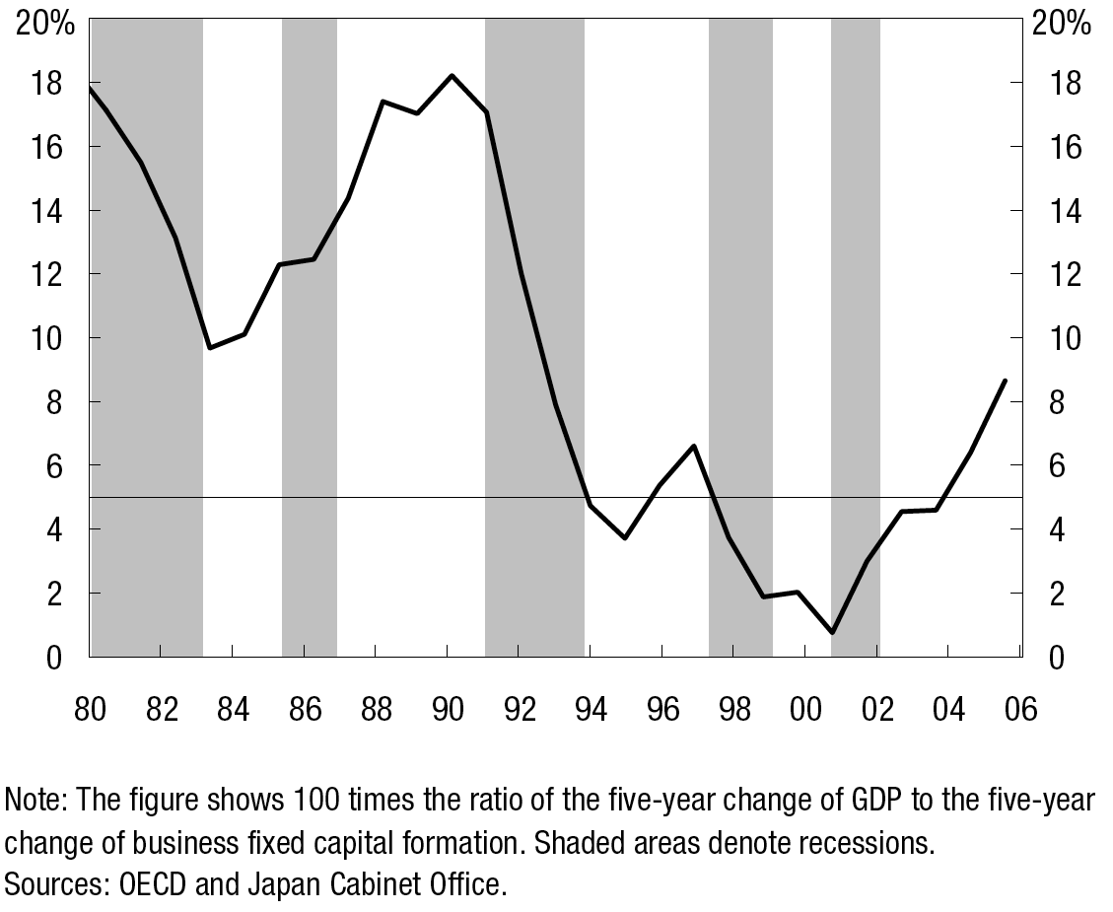
Japan: Marginal Product of Capital

Slide 46
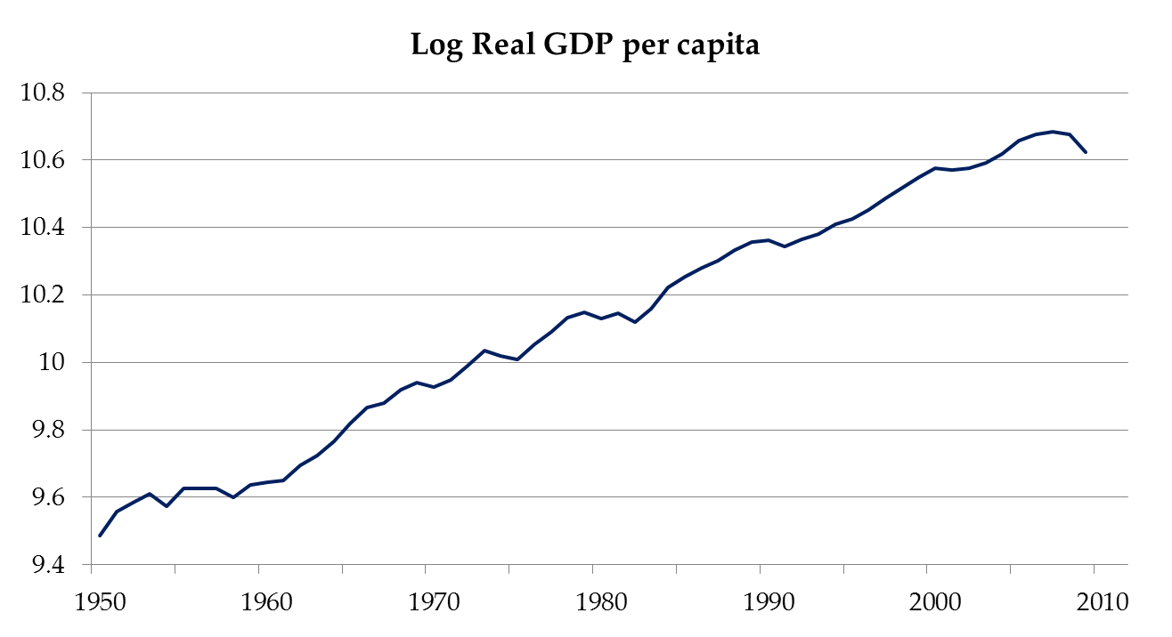
United States

Slide 47
What happened in the U.S.?
 | Y/N | A | αK/L | L/N
1960-2009 | 2.00 | 0.62 | 0.51 | 0.87
1960-1973 | 3.91 | 1.91 | 0.29 | 1.71
1973-1995 | 1.86 | 0.41 | 0.46 | 0.99
1995-2007 | 2.17 | 0.68 | 0.94 | 0.55
2007-2009 | -3.06 | -2.63 | 0.57 | -0.99
Solow (1987): “You can see the computer age everywhere but in the productivity statistics.”
Source: PWT 7.0

Slide 48
Summary
Growth accounting: quantifies sources of GDP growth
Data: TFP is important
  Important for fast growth (Korea 1980s)
  Important for slow (or negative) growth (Japan 1990s)
Solow model with TFP growth
  Balanced growth path
  Technology growth: no diminishing returns

Slide 49
The Global Economy
Productivity and Institutions

Slide 50
Productivity and institutions
GDP
Capital & Labor
Productivity
Productivity
Productivity
“Institutions”

Slide 51
What are institutions?
“Social mechanisms” that facilitate economic activity
… through higher productivity (“TFP”)
Like what?
What institutions are important in your industry?

Slide 52
Institutions
Rule of law
Clearly defined property rights
Open competitive markets (not “free”)

Slide 53
Vibrant entrepreneurship
Social capacity for innovation
  creation of new businesses
  new products
  new processes
  higher quality
  new markets
  new organizational forms
…requires property rights, open access to opportunity, downside risk protections and cultural support

Slide 54
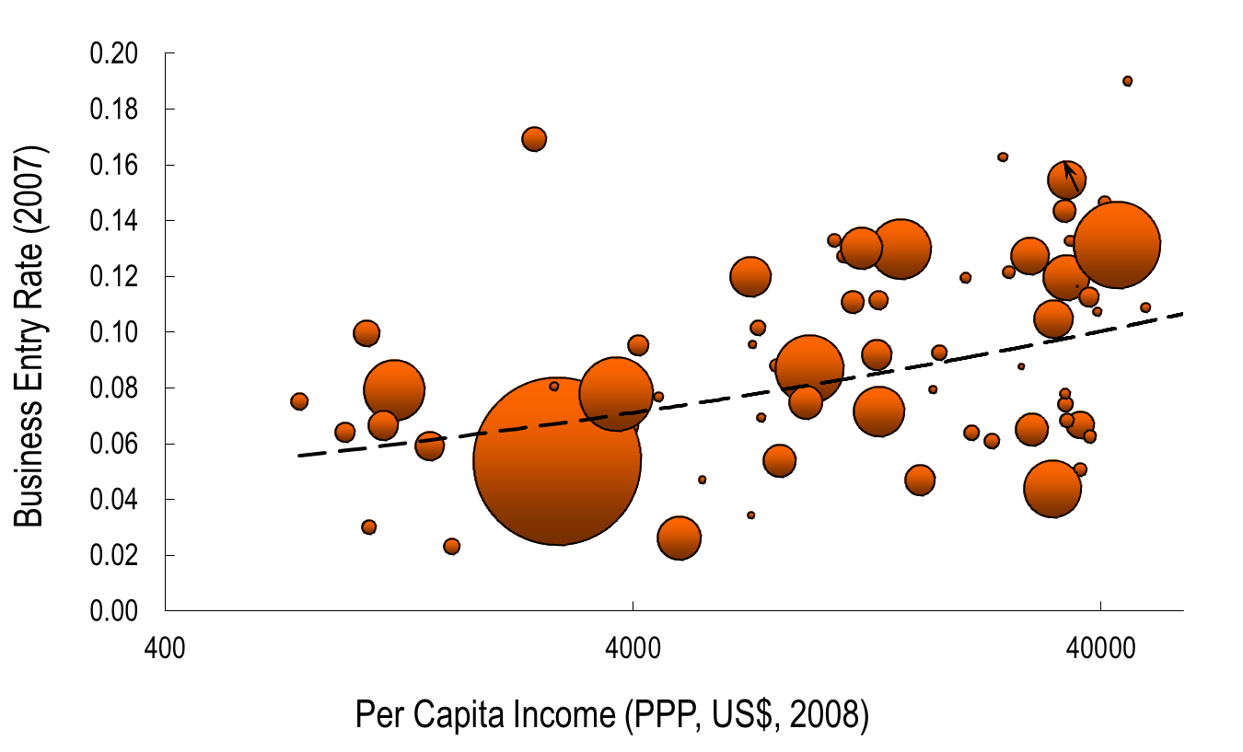
Entrepreneurship and Income
Source: World Bank Entrepreneurship Database 2008 and World Development Indicators 2009.

Slide 55
Effective financial systems
Historical Perspective
Efficiently channel funds for optimal deployment
  provide liquidity and leverage
  provide capital for public and private projects
Components in mature economies
  credible money
  banks (CB, public and private institutions)
  efficient tax system (and stable public finances)
  efficient capital markets
  insurance programs
  liberal corporation laws
Source: Professor George Smith.

Slide 56
Reduce Transaction Costs
Allocate Resources to Most Productive Use
Mobilizing and pooling savings
Boost investment, innovation, productivity
  Liquidity and payments system access
    Safekeeping and accounting
  Collecting and processing information
    Screening
    Monitoring
    Influence corporate governance
  Diversifying, transforming and managing risk
    Helps risk-taking
Question: Ebay and Prosper.com

Slide 57
What We Observe
Countries with better-developed private financial systems grow faster. Both intermediaries and markets matter for growth.
Better financial systems add to productivity growth and facilitate external financing.
Well-functioning financial systems need macro stability and strong legal/information systems.
Effective regulation empowers markets.
Source: Demirguc-Kunt and Levine, “Finance, Financial Sector Policies and Long-Run Growth,”
World Bank Policy Research Working Paper 4469, January 2008.

Slide 58
Capital markets
Note: creditor rights help borrowers!
  Making it easy to default simply kills off loan market, which hurts borrowers as well as lenders
  Result: positive NPV projects not funded, TFP lower than it could be
Evidence:
  States/countries with stronger creditor rights have more lending, lower rates
  Countries with strong creditor rights have more advanced financial systems and higher GDP per capita

Slide 59
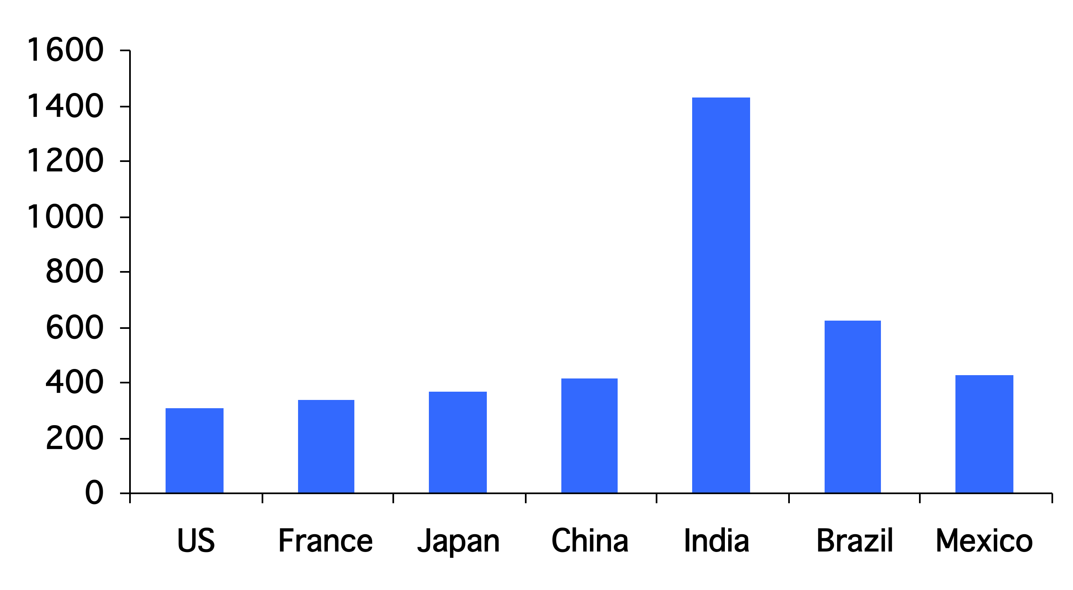
Days to enforce contracts
Source: World Bank Group, Doing Business

Slide 60
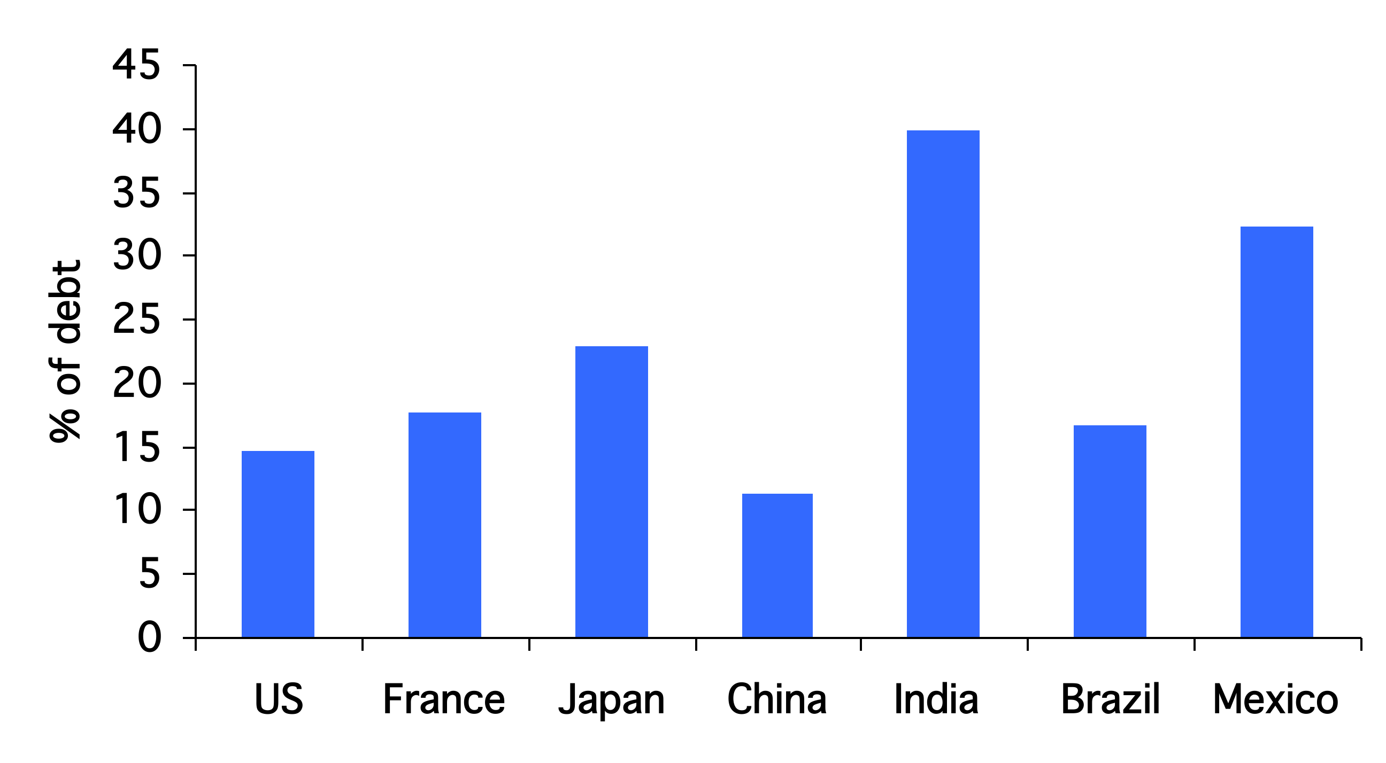
Cost of enforcing contracts
Source: World Bank Group, Doing Business

Slide 61
Measuring institutions
Measures of institutional quality are attempts to quantify important features of the economic and business environment but are inherently subjective
Sources
  Corruption Indices (Transparency International)
  Doing Business (World Bank Group)
Lord Kelvin: “If you can’t measure it, you can’t improve it”

Slide 62
Competitive markets
Entry and exit of firms
  Inefficient firms exit
  efficient firms enter, grow
Frictions to entry/exit from
  Property rights
  Corporate governance, rule of law
  Corruption, lobbying
  Subsidies, competition policy

Slide 63
Barriers to entry
The Other Path by Hernando de Soto
Researchers tried to set up a small garment factory in Lima while complying with all regulations.
  Steps required: 11
  Time needed: 289 days
  Bribes requested: 10 (2 paid)
  Cost: $1,231 (32 times monthly min. wage)

Slide 64
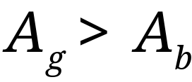


Efficiency across firms
Example: two firms
  High productivity (g)
  Low productivity (b)

Slide 65

Efficiency across firms
Aggregate TFP

Slide 66

Efficiency across firms
We can show (but don’t worry about being able to do it)
Aggregate TFP is a weighted sum of firms’ TFP
More K, L to good firms: higher aggregate TFP and output

Slide 67
Governments and institutions
GDP
Capital & Labor
Productivity
Political Process
“Institutions”

Slide 68
Enabling political systems
Organize geographic and economic unity
Provide stability and related public goods
Establish legitimate “monopoly of force”
Establish “rule of law”
  legitimize economic activity
  protect property rights and reduce risks
  judicial processes for dispute resolution
  address market failures and dysfunctional inequalities
Public goods: Security of life, liberty and property
Promote “open access” to opportunity
  baseline access to education and employment
Legitimize innovation
Source: Professor George Smith.

Slide 69
Non-enabling Political Systems
Anarchy (rule of the strongest)
Predatory government (arbitrary seizure)
  Public vs private interest
Incompetent government
  Unable to supply public goods of protecting life, liberty and property
Note: Democracies can be predatory and incompetent (slavery)

Slide 70
How Government Can Promote Financial Development
Macroeconomic stability
Limit corruption and crime
Enforce legal rights of investors
  Strengthens access to external finance
  Flexible and adaptive conflict resolution
Regulation through private empowerment
Contestable markets
Private allocation of credit
Sequencing of liberalization (example: Korea)

Slide 71
Equity Liberalization
Did equity market liberalizations boost economic growth?
Controversy: consumption boom, hot speculative capital, reduced domestic savings?
Answer: It raised investment and productivity, especially in countries with high-quality institutions.
Lower cost of capital due to:
  Improved risk-sharing
  Supply of external financing from abroad
Source: Bekaert et al., “Does Financial Liberalization Spur Growth,” Journal of
Financial Economics, Volume 77, Issue 1, July 2005, pages 3-55.

Slide 72

Government Effectiveness
Source: World Bank, Governance Indicators
Notes:
Worldbank Governance Indicators

Slide 73

Governments: Ireland and Argentina
GDP per capita

Slide 74
Governments
Argentina then
  Facing inflation over 1000%, the government announced in 1991 that citizens could use either dollars or local currency and pegged the peso to the dollar. A decade later, the government converted all dollar assets into pesos (“pesification”) and devalued by 75%.

Slide 75
What happened?
Pegging the Peso meant the government could not finance government debt by printing money
Requires fiscal discipline
  Provincial governments
  Federal governments
Short answer: it didn’t happen

Slide 76
Governments
Argentina now… (WSJ, Oct 28 08):
  Argentina's government pressed forward with its controversial plan to nationalize private pension funds. … [President] Kirchner said her move to seize the private funds is designed to protect contributors from alleged mismanagement amid the global market crisis.
… and again (NYT, Jan 25 10):
  Mrs. Kirchner fired the bank president, Martín Redrado, by decree this month for refusing to release $6.59 billion in reserves …. A federal judge … ruled that Mrs. Kirchner could not fire Mr. Redrado or take control of the reserves without congressional approval…. Mr. Redrado said on Sunday that the police in Buenos Aires had prevented him from entering the bank.

Slide 77
Governments: Ireland and Argentina
GDP per capita

Slide 78
What happened in Ireland?
Why did growth accelerate in early 1990s?
Where do we start?

Slide 79
What happened in Ireland?
 | L/N | K/L | A
1960 | 0.39 | 39,456 | 0.052
1993 | 0.39 | 111,540 | 0.095
2007 | 0.51 | 162,061 | 0.141
2009 | 0.49 | 167,819 | 0.122
Contribution 1960-1993 | -0.01 | 1.05 | 1.83
Contribution 1993-2007 | 1.85 | 0.89 | 2.83
Contribution 2007-2009 | -1.61 | 0.58 | -7.01

Slide 80
What happened in Ireland?
EU membership, aid recipient
Fiscal discipline (>1987)
  Tax rates slashed
  Government budget balanced
Attractive terms for foreign firms
  Lowest corporate tax rates in OECD
Private credit surge before 2007
2007: Guarantee for banks!

Slide 81
What have we learned today?
Good institutions are ones that
  Put capital and labor to efficient use
  Ensure proper incentives (finance!)
Examples
  Rule of law
  Property rights
  Competitive markets

Slide 82
Something for the ride home
Labor market institutions
  Unemployment benefits
  Firing taxes
  Union coverage
  Work rules
  No-compete clauses
What incentives do these create?
Why do they exist?

