Slide 1

The Global Economy Growth

Slide 2
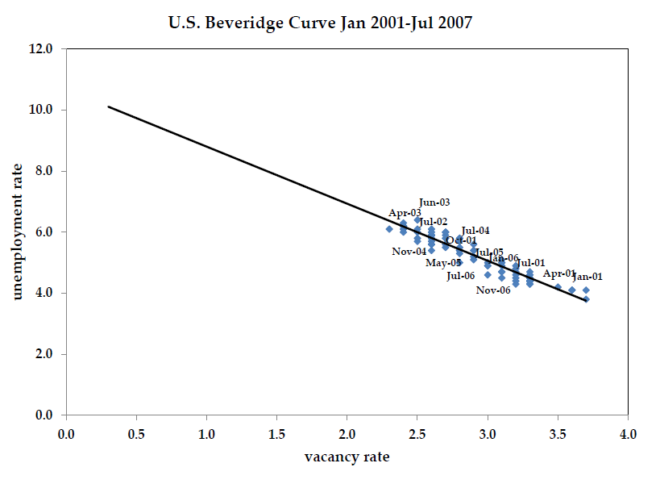
Job openings and unemployment

Slide 3
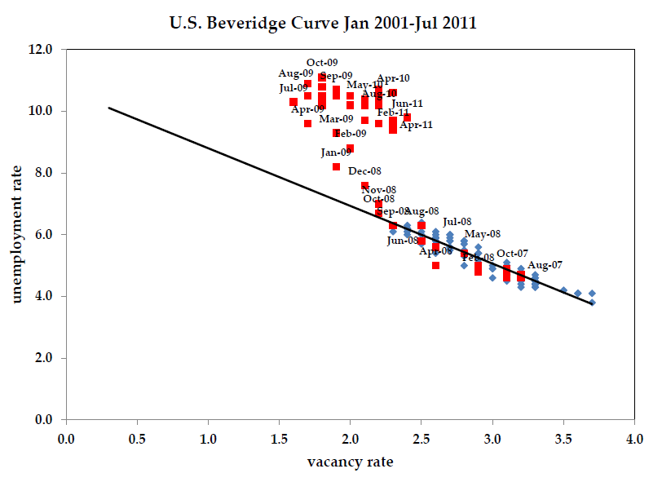
Has the Beveridge Curve shifted?

Slide 4
Roadmap
News
Review from last week
Solow model with technology growth
Growth accounting
Data
What drives technology growth?

Slide 5
Review
Production function
Solow Growth Model
Savings funded investment drives growth
No long-run growth. Why?

Slide 6
Solow model: dynamics
output
saving
depreciation

Slide 7
Steady state

Slide 8
Korean GDP per capita

Slide 9
Investment Rates
Korea
United States

Slide 10
Korean GDP per capita
Data
Model

Slide 11
Korean GDP per capita
Data
Model

Slide 12
What are we missing?
Total Factor Productivity Growth

Slide 13
Model with TFP and population growth
Production function
Capital accumulation
Savings flow
Savings rate

Slide 14
Model with TFP and population growth
Assume TFP and labor grow at constant rates
Growth is exogenous to the model

Slide 15
Model with TFP and population growth
Guess capital and output grow at the same rate
After some algebra we can show

Slide 16
Balanced growth path
Output grows in the steady state
A “balanced growth path”
Productivity growth
Drives long-run growth in Y/L
Saving rates
Do not affect growth rates in steady state
Do affect levels of Y/L

Slide 17
Example: United States
Ballpark numbers:
What is ?

Slide 18
Example: United States
Ballpark numbers:
What is ?

Slide 19
Example: China
Ballpark numbers:
What is ?

Slide 20
Savings rates
K/L
Y/L
Note: K/L, not K/Y!

Slide 21
Saving rates
K/L (high s)
K/L (low s)
Y/L (high s)
Y/L (low s)
Note: K/L, not K/Y!

Slide 22
Understanding Solow
In a balanced growth path:
Variable | Fixed Labor | Population Growth | Population Growth + TFP Growth
Y | 1
L | 1
Y/L | 1
K/L | 1
K/Y | 1 | 1 | 1

Slide 23
Understanding Solow
In a balanced growth path:
Variable | Fixed Labor | Population Growth | Population Growth + TFP Growth
Y | 1
L | 1
Y/L | 1 | 1
K/L | 1 | 1
K/Y | 1 | 1 | 1

Slide 24
Growth accounting
Using theory to decompose data on growth
Compare countries at a point in time
Comparison of levels
Compare the same country at different times
Comparison of growth rates

Slide 25
Level comparisons
Why is Y/L larger in the U.S. compared to Mexico?
 | Employment (mils) | Capital (bil. $) | GDP (bil. $)
Mexico | 46.94 | 4,278 | 1,293
U.S. | 155.45 | 42,238 | 12,619
Source: Penn World Tables 7.0 and own calculations.

Slide 26
Level comparisons
 | Employment (mils) | Capital (bil. $) | GDP (bil. $)
Mexico | 46.94 | 4,278 | 1,293
U.S. | 155.45 | 42,238 | 12,619
Compute TFP:

Slide 27
Level comparisons
Use the production function to make comparisons

Slide 28
Aside: growth rate review
Traditional growth rate
Continuously-compounded growth rate
Computing the growth rate
See
“Math review”
“Sources of growth”

Slide 29
Growth accounting

Slide 30
Growth rates
In period
In period
Subtract from and divide all by

Slide 31
Growth rates

Slide 32
Growth accounting
Each term is an annual growth rate
How much growth can be attributed to
Changes in the capital stock?
Changes in technology?

Slide 33
With population growth (notes, pg 7)
Population,

Slide 34
Growth accounting
Each term is an annual growth rate
How much growth can be attributed to
Changes in the capital stock?
Changes in technology?
Changes in labor supplied?

Slide 35
Example: Korean GDP per capita

Slide 36
Example: Korea
 | Y (bil 2005 US$) | K (bil 2005 US$) | L (ths) | N (ths) | A
1970 | 97.32 | 131 | 10062 | 32241 | 0.041
2009 | 1214 | 4551 | 24275 | 48509 | 0.087
 | Y/N | L/N | K/L | A
1970-2009 | 5.42 | 1.21 | 2.28 | 1.93

Slide 37
Korean GDP per capita
Model with TFP Growth
Data
Model No TFP Growth

Slide 38
Japan

Slide 39
What happened in Japan?
 | Y/N | L/N | K/L | A
1960-1970
1970-1991
1991-2009

Slide 40
Productivity in Japan
“The 1990s in Japan: A Lost Decade” Fumio Hayashi and Edward Prescott
“the problem is low productivity growth… perhaps the low productivity growth is the result of a policy that subsidizes inefficient firms and declining industries.
This policy results in lower productivity because the inefficient producers produce a greater share of output.”
More on this later.

Slide 41
United States

Slide 42
What happened in the U.S.?
 | Y/N | A | αK/L | L/N
1960-2009 | 2.00 | 0.62 | 0.51 | 0.87
1960-1973 | 3.91 | 1.91 | 0.29 | 1.71
1973-1995 | 1.86 | 0.41 | 0.46 | 0.99
1995-2007 | 2.17 | 0.68 | 0.94 | 0.55
2007-2009 | -3.06 | -2.63 | 0.57 | -0.99
Solow (1987): “You can see the computer age everywhere but in the productivity statistics.”
Source: PWT 7.0

Slide 43
Summary
Growth accounting: quantifies sources of GDP growth
Data: TFP is important
Important for fast growth (Korea 1980s)
Important for slow (or negative) growth (Japan 1990s)
Solow model with TFP growth
Balanced growth path
Technology growth: no diminishing returns

Slide 44
The Global Economy Productivity and Institutions

Slide 45
Productivity and institutions
GDP
Capital & Labor
Productivity
Productivity
Productivity
“Institutions”
Notes:
45

Slide 46
What are institutions?
“Social mechanisms” that facilitate economic activity
… through higher productivity (“TFP”)
Like what?
What institutions are important in your industry?

Slide 47
Institutions
Rule of law
Clearly defined property rights
Open competitive markets (not “free”)

Slide 48
Vibrant entrepreneurship
Social capacity for innovation
creation of new businesses
new products
new processes
higher quality
new markets
new organizational forms
…requires property rights, open access to opportunity, downside risk protections

Slide 49
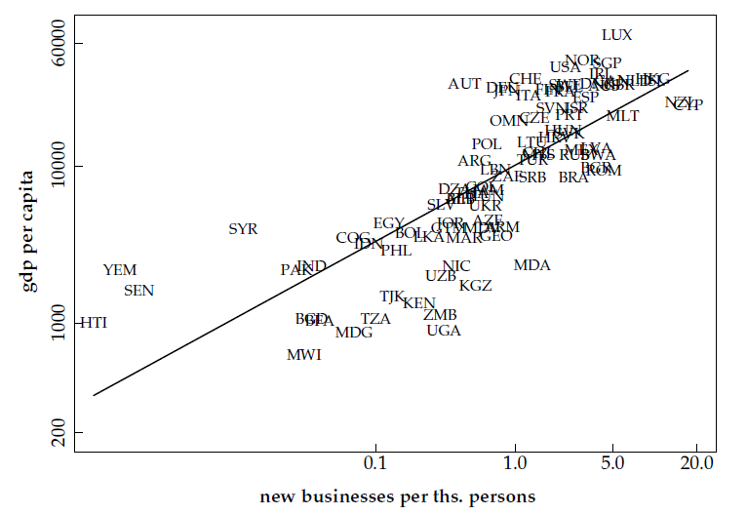
Business entry and GDP

Slide 50
Efficiency across firms
Example: two firms
High productivity (g)
Low productivity (b)

Slide 51
Efficiency across firms
Aggregate TFP

Slide 52
Efficiency across firms
We can show (but don’t worry about being able to do it)
Aggregate TFP is a weighted sum of firms’ TFP
More K, L to good firms: higher aggregate TFP and output

Slide 53
Productivity in Japan
“The 1990s in Japan: A Lost Decade” Fumio Hayashi and Edward Prescott
“the problem is low productivity growth… perhaps the low productivity growth is the result of a policy that subsidizes inefficient firms and declining industries.
This policy results in lower productivity because the inefficient producers produce a greater share of output.”

Slide 54
What encourages firm creation?
Availability of finance
Low barriers to entry
Official barriers
Unofficial barriers

Slide 55
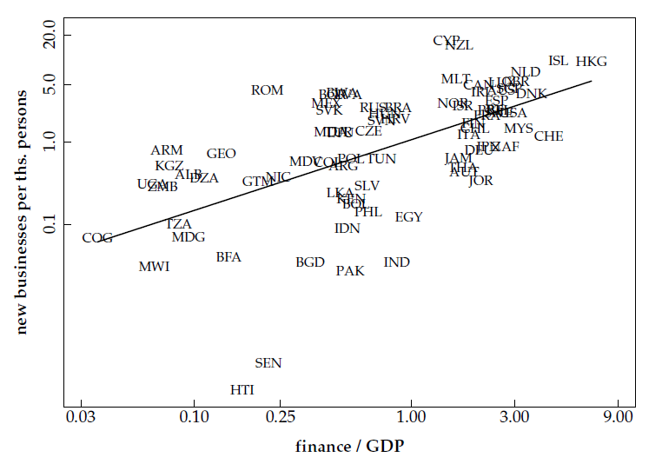
Finance and firm creation

Slide 56
Capital markets
A bit of game theory…
Parameters:
Borrower has project that generates 100 + 15
Lender offers 100 to borrower for one year
Lender’s cost of funds is 5%, charges 10%, the competitive risk-adjusted rate
In default, borrower uses up 50, keeps the rest
Note: the deal generates value (115 – 105 = 10)
What happens?

Slide 57
Capital markets
Don’t lend
Payoffs = (0,0)
L
(+5,+5)
Repay
Lend
B
Default
(–105,+65)
What’s the outcome? What can we do about it?
Notes:
57
Note: economic activity creates value

Slide 58
Capital markets
Don’t lend
Payoffs = (0,0)
L
(+5,+5)
Repay
Lend
B
0
X
Default
(–105,+65)
What’s the outcome? What can we do about it?
Notes:
58
Note: economic activity creates value

Slide 59
Capital markets
Note: creditor rights help borrowers!
Making it easy to default simply kills off loan market, which hurts borrowers as well as lenders
Result: positive NPV projects not funded, TFP lower than it could be
Evidence:
States/countries with stronger creditor rights have more lending, lower rates
Countries with strong creditor rights have more advanced financial systems and higher GDP per capita

Slide 60
Days to enforce contracts
Source: World Bank Group, Doing Business

Slide 61
Cost of enforcing contracts
Source: World Bank Group, Doing Business

Slide 62
Measuring institutions
Measures of institutional quality are attempts to quantify important features of the economic and business environment but are inherently subjective
Sources
Corruption Indices (Transparency International)
Doing Business (World Bank Group)
Lord Kelvin: “If you can’t measure it, you can’t improve it”

Slide 63
Barriers to entry
The Other Path by Hernando de Soto
Researchers tried to set up a small garment factory in Lima while complying with all regulations.
Steps required: 11
Time needed: 289 days
Bribes requested: 10 (2 paid)
Cost: $1,231 (32 times monthly min. wage)

Slide 64
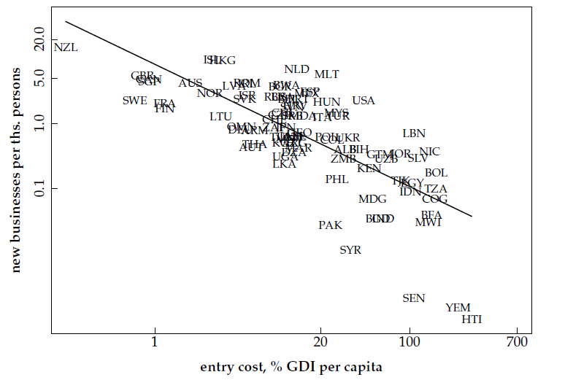
Entry costs and firm creation

Slide 65
Governments and institutions
GDP
Capital & Labor
Productivity
Political Process
“Institutions”
Notes:
65

Slide 66
Government Effectiveness
Source: World Bank, Governance Indicators
Notes:
Worldbank Governance Indicators

Slide 67
Governments: Ireland and Argentina

Slide 68
Governments
Argentina then
Facing inflation over 1000%, the government announced in 1991 that citizens could use either dollars or local currency and pegged the peso to the dollar. A decade later, the government converted all dollar assets into pesos (“pesification”) and devalued by 75%.

Slide 69
What happened?
Pegging the Peso meant the government could not finance government debt by printing money
Requires fiscal discipline
Provincial governments
Federal governments
Short answer: it didn’t happen

Slide 70
Governments
Argentina now… (WSJ, Oct 28 08):
Argentina's government pressed forward with its controversial plan to nationalize private pension funds. … [President] Kirchner said her move to seize the private funds is designed to protect contributors from alleged mismanagement amid the global market crisis.
… and again (NYT, Jan 25 10):
Mrs. Kirchner fired the bank president, Martín Redrado, by decree this month for refusing to release $6.59 billion in reserves …. A federal judge … ruled that Mrs. Kirchner could not fire Mr. Redrado or take control of the reserves without congressional approval…. Mr. Redrado said on Sunday that the police in Buenos Aires had prevented him from entering the bank.

Slide 71
Governments: Ireland and Argentina

Slide 72
What happened in Ireland?
Why did growth accelerate in early 1990s?
Where do we start?

Slide 73
What happened in Ireland?
 | L/N | K/L | A
1960 | 0.39 | 39,456 | 0.052
1993 | 0.39 | 111,540 | 0.095
2007 | 0.51 | 162,061 | 0.141
2009 | 0.49 | 167,819 | 0.122
Contribution 1960-1993 | -0.01 | 1.05 | 1.83
Contribution 1993-2007 | 1.85 | 0.89 | 2.83
Contribution 2007-2009 | -1.61 | 0.58 | -7.01

Slide 74
What happened in Ireland?
EU membership, aid recipient
Fiscal discipline (>1987)
Government hiring frozen
Personal and corporate tax rates slashed
Government budget balanced
Peaceful labor relations
Attractive terms for foreign firms
Lowest corporate tax rates in OECD

Slide 75
But, then what happened in Ireland?
Private credit surge before 2007
2007: Guarantee for banks!
Swap private debt for public
Sometimes good governments make bad decisions

Slide 76
What have we learned today?
Good institutions are ones that
Put capital and labor to efficient use
Ensure proper incentives (finance!)
Examples
Rule of law
Property rights
Competitive markets

Slide 77
Something for the ride home
Labor market institutions
Unemployment benefits
Firing taxes
Union coverage
Work rules
No-compete clauses
What incentives do these create?
Why do they exist?

