Slide 1

The Global Economy
Labor Markets and Volatility

Slide 2
Roadmap
In the news
Measuring labor markets
Labor market institutions
Dynamics of employment
Volatility and labor markets

Slide 3
FOMC Minutes
Meeting of September 21, 2010
“Many” see slow economic growth ahead and unemployment above levels associated with structural factors. “Most” see underlying inflation somewhat below levels consistent with mandate.
“Many” see further accommodation as appropriate if these conditions persist. Method: Focus on Treasury purchases and on steps to affect inflation expectations
Possible actions to affect inflation expectations
  Clarify inflation rate that FOMC sees as consistent with mandate
  Price-level target
  Nominal GDP target
Policy effect depends on communicating framework

Slide 4
PS1 Q3: Classify the data
Put numbers into
  Final expenditures
  Payments to labor or capital
  Intermediates
By sector, VA=wL+rK
  A way to check your work

Slide 5
Cafes
Cheeseburgers
  50K in sales Consumption
  7K beef sesame seeds Intermediates, imports
  10K catsup Intermediates
  20K wages Payment to labor
  3K rent Payment to capital
  10K profit Payment to capital
VA = 50 – 7 – 10 = 33

Slide 6
Tomatoes
Tomatoes
  8K sales to catsup makers Sales of Intermediate
  2K exports Exports
  9K wages Payment to labor
  1K rent Payment to capital
VA = 8+2-0=10

Slide 7
Blenders
Blenders
  40K exports Exports
  60K local sales Consumption
  15K metal Intermediate, Import
  15K CNC machine Investment, Import, Payment to Capital
  70K wages Payment to Labor
VA = 100 – 15 = 85

Slide 8
Government
Government
  10K taxes collected Transfer
  10K regulator wages Payment to labor, Gov’t spending
VA = 10

Slide 9
Catsup
Catsup
  10K sales to local cafes Sales of Intermediate
  8K tomatoes Intermediate
  2K wages Payment to labor
VA = 10 – 8 = 2

Slide 10
Roadmap
In the news
Measuring labor markets
Labor market institutions
Dynamics of employment
Volatility and labor markets

Slide 11
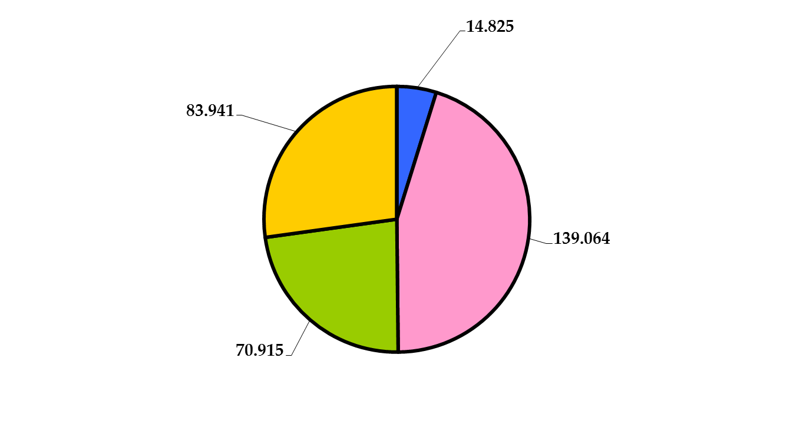
U.S. employment status
2010 in millions
Unemployed
Not in Labor Force
Employed
Not of working age

Slide 12
Standard indicators
Employment rate = employed/(working-age) population
Labor force = employed + unemployed
Unemployment rate = unemployed/labor force
Participation rate = labor force/working-age population
Inactivity rate = out of labor force/working-age population
Hours worked = average hours worked of employed people

Slide 13
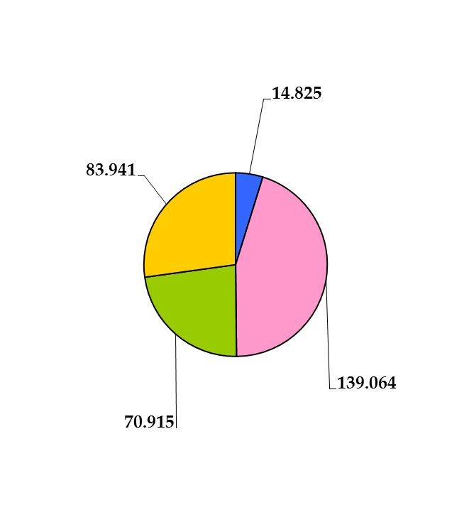
U.S. labor market indicators
2010
Unemployed
Labor force =
Employment rate =
Unemployment rate =
Participation rate =
Not in
Labor Force
Employed
Not of Working Age

Slide 14
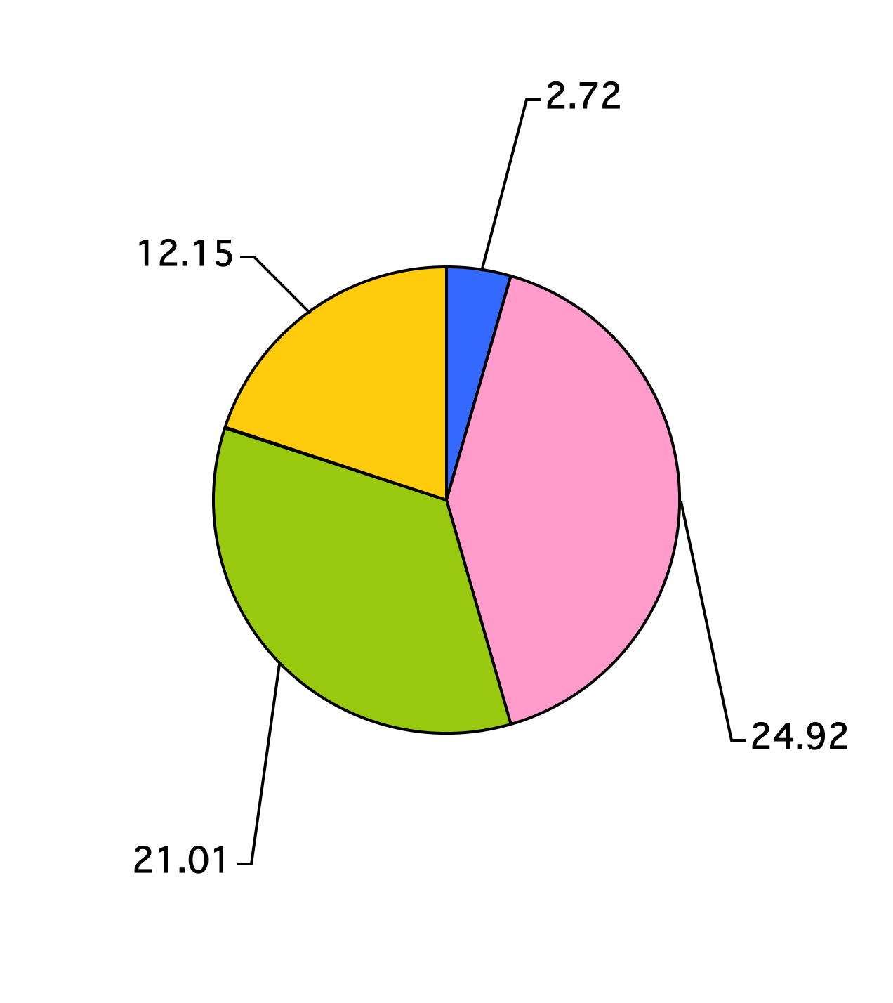
France labor market indicators
Unemployed
Labor force = 27.63 mil
Employment rate = 62.6%
Unemployment rate = 9.83%
Participation rate =69.45%
Not in
Labor Force
Employed
Not of Working Age

Slide 15
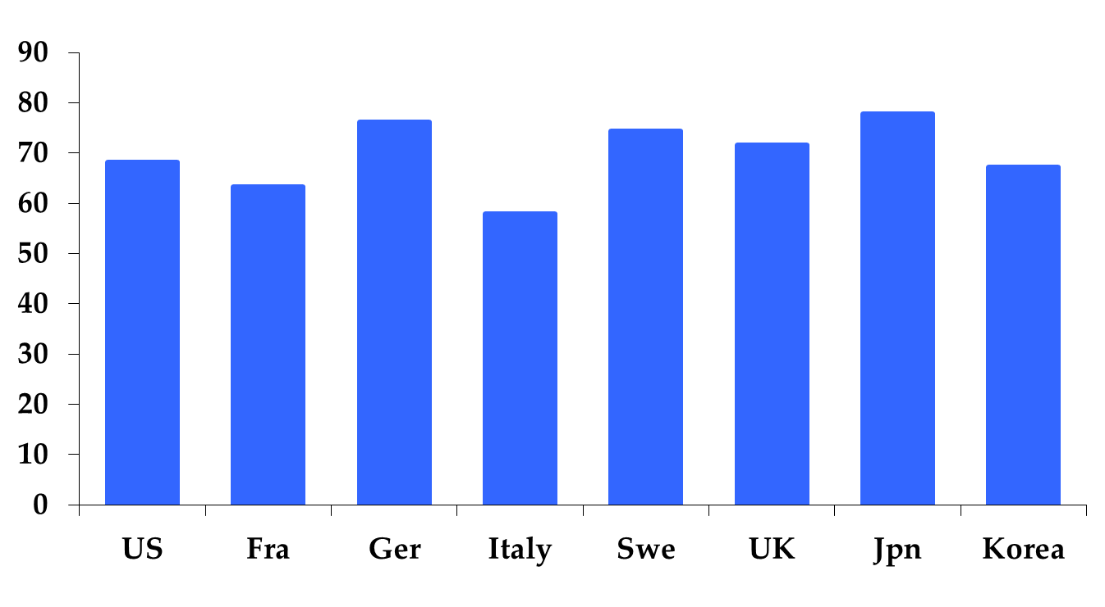
Employment rate (% of 15-64)
2011
Source: OECD, Employment Outlook.. Note: US (2009) and Sweden (2010).

Slide 16
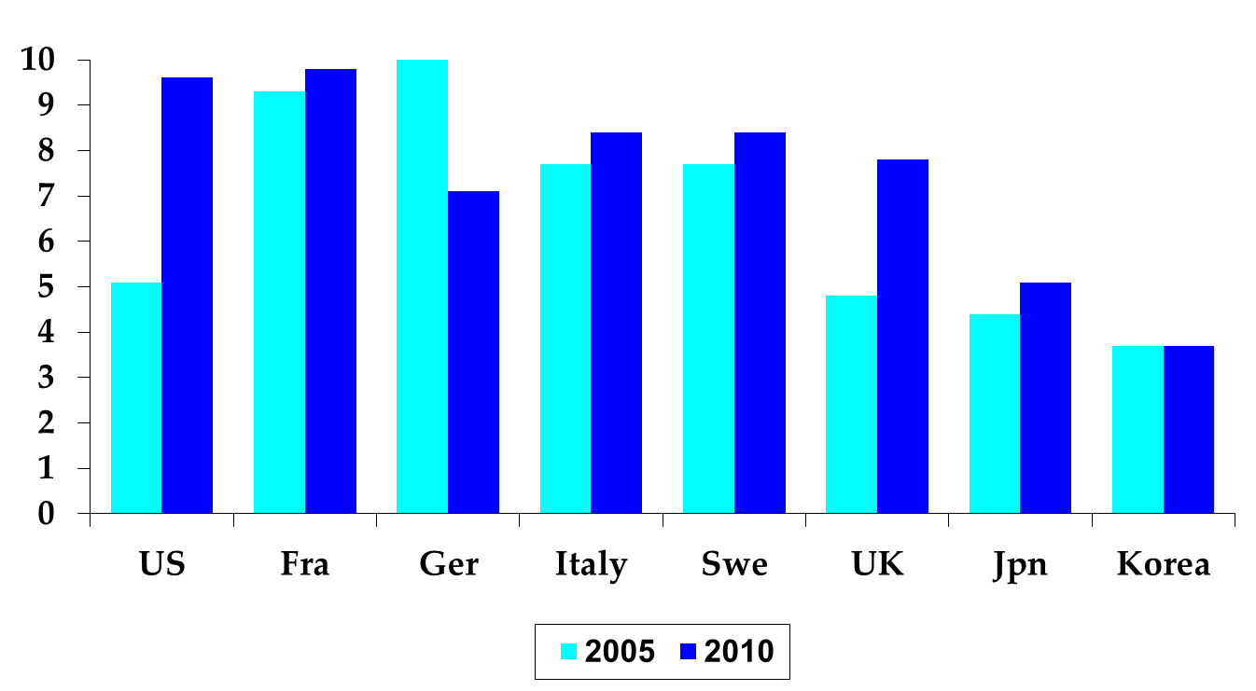
Unemployment rate (%)
Source: OECD, Employment Outlook. Standardized rates intended to be comparable across countries.

Slide 17
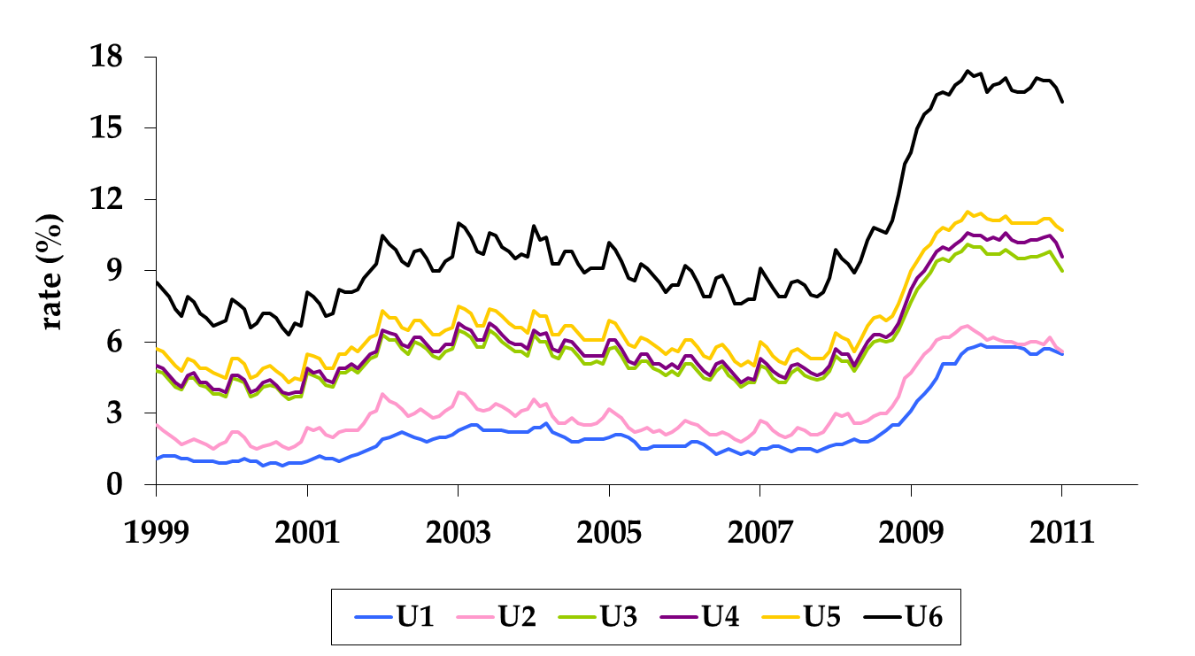
Alternative measures (U.S.)
What are these? Why do we care?

Slide 18
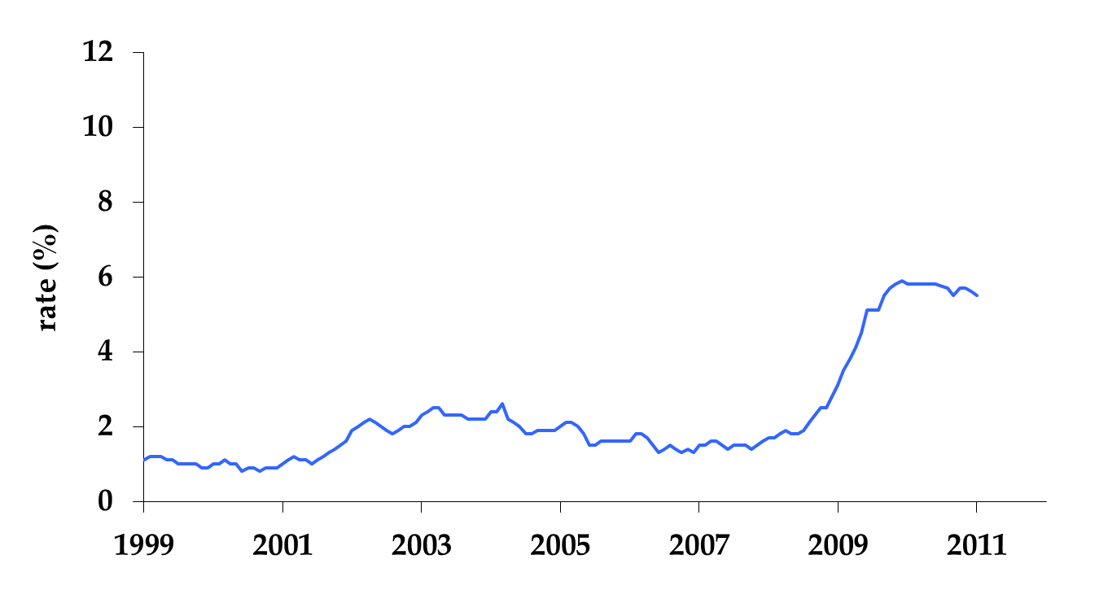
Alternative measures (U.S.)
U1=unemployed 15 wks or longer / labor force

Slide 19
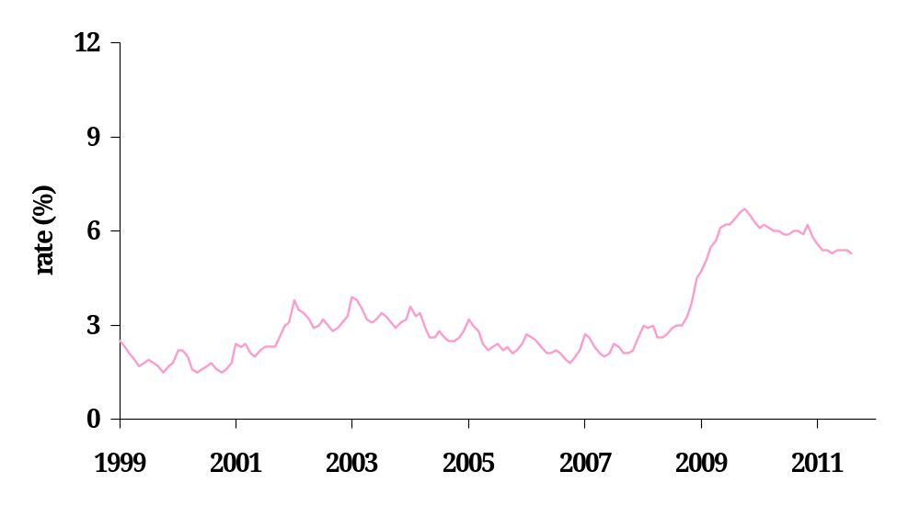
Alternative measures (U.S.)
U2 = lost job or finished temp job
labor force

Slide 20
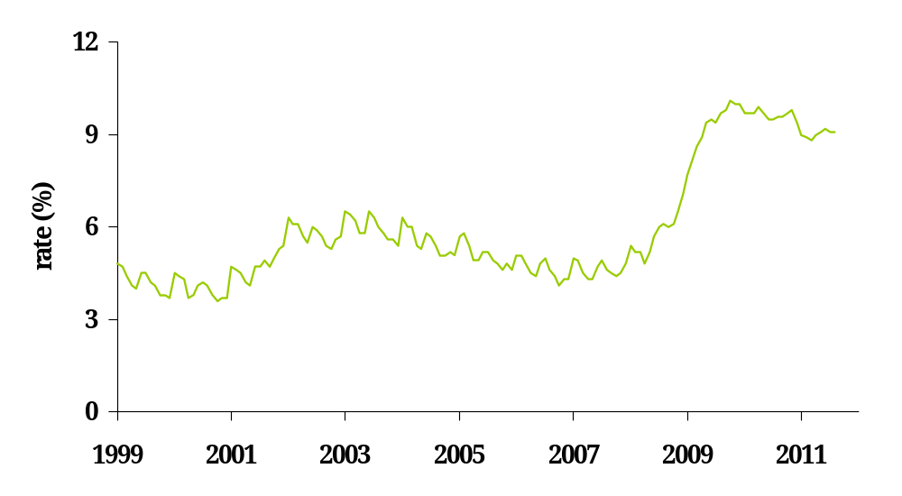
Alternative measures (U.S.)
U3 = unemployed (official rate)
labor force

Slide 21
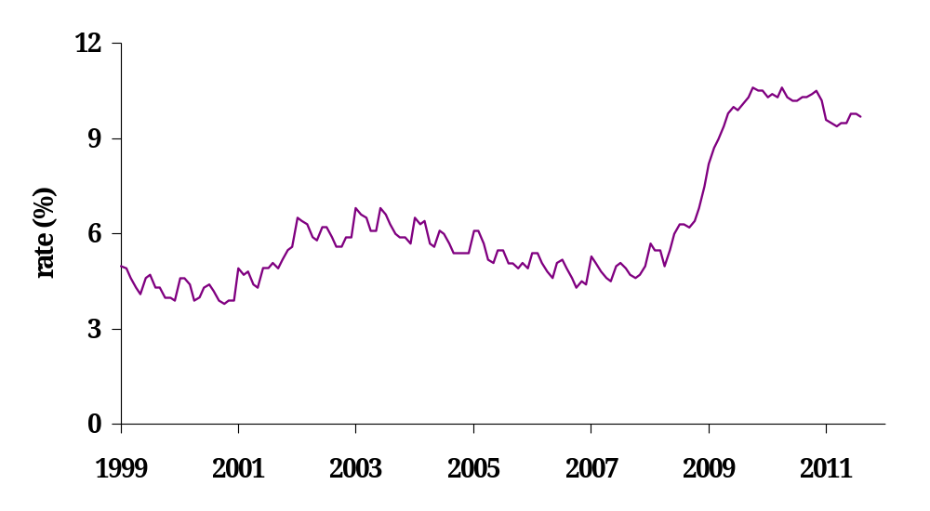
Alternative measures (U.S.)
U4 = unemployed + disc workers
labor force + disc. workers

Slide 22
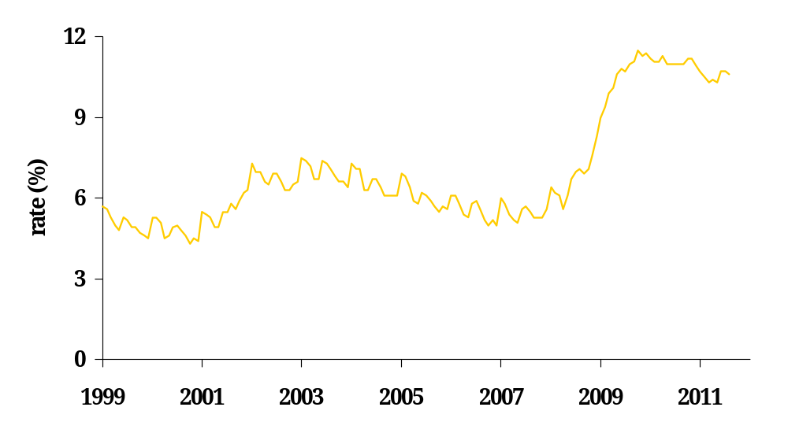
Alternative measures (U.S.)
U5 = unemployed + marg. attached
labor force + marg. attached

Slide 23
Marginally Attached?
Marginally attached workers are persons who currently are neither working nor looking for work but indicate that they want and are available for a job and have looked for work sometime in the recent past.
Discouraged workers, a subset of the marginally attached, have given a job-market related reason for not looking currently for a job.
Persons employed part time for economic reasons are those who want and are available for full-time work but have had to settle for a part-time schedule.

Slide 24
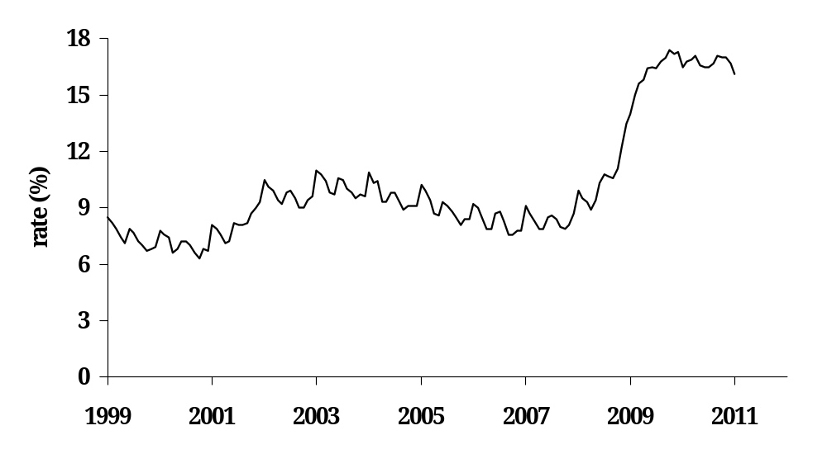
Alternative measures (U.S.)
U6 = unemployed + marg. attached + part-time f.e.r.
labor force + marg. attached

Slide 25
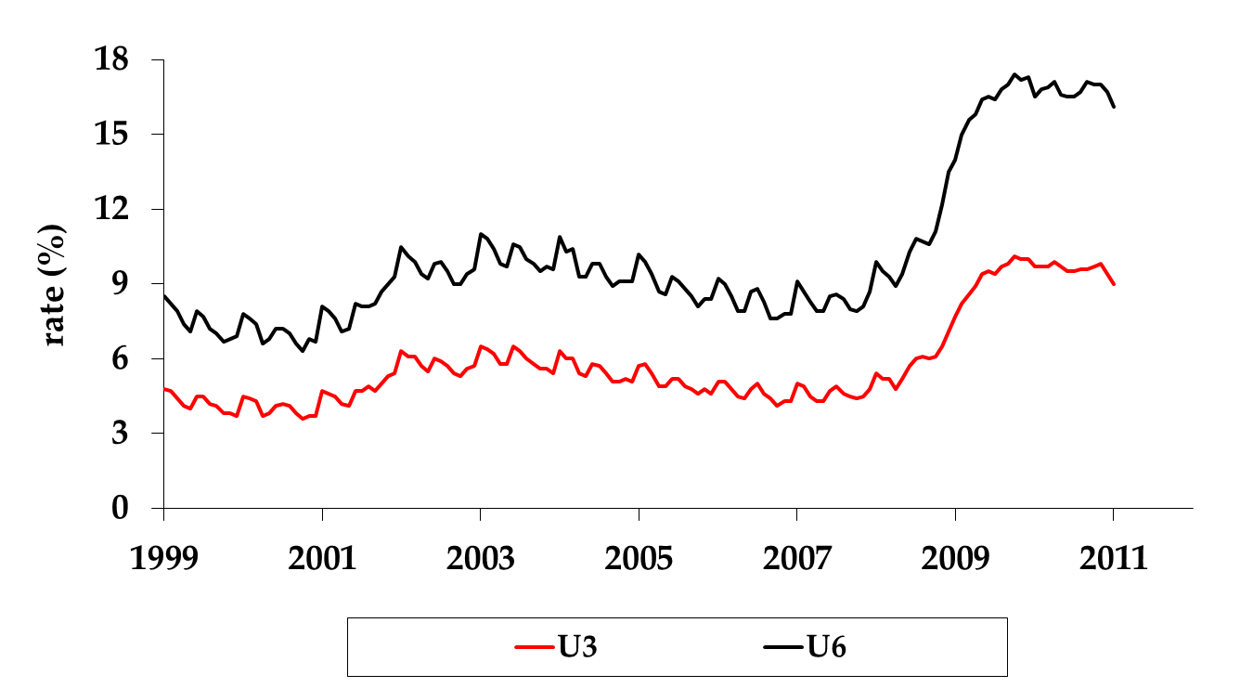
Alternative measures (U.S.)

Slide 26
Unemployment: why?
Institutions
  Contracting policy, minimum wages, etc.
Physics
  It takes time to match workers and jobs

Slide 27
Labor Market Institutions

Slide 28
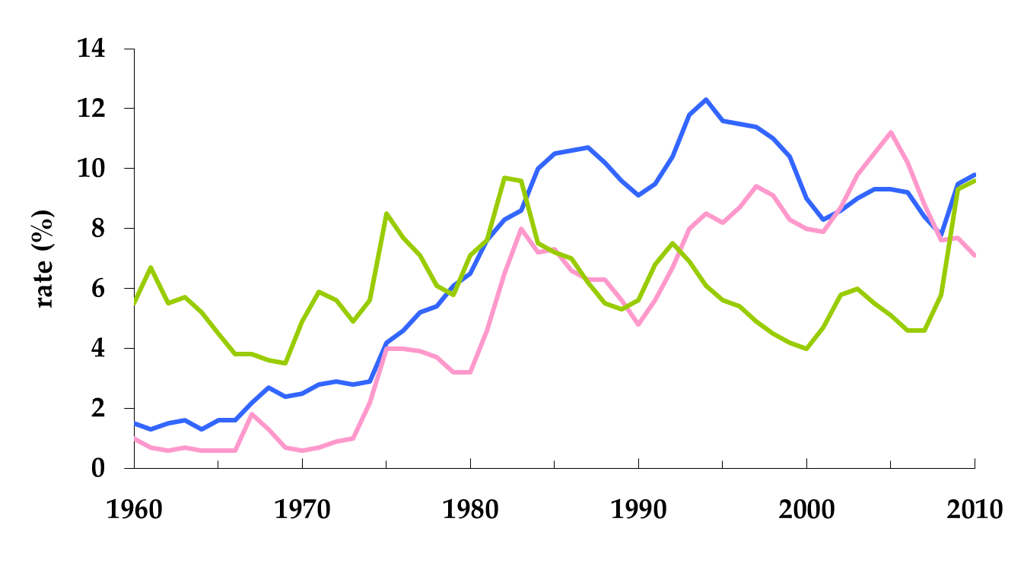
How do institutions shape outcomes?
France
Germany
U.S.
Sources: OECD Employment Outlook and Economic Outlook, 2010.

Slide 29
France and the US
2007
 | Y/POP | Y/L | Y/hL
US | 42,286 | 84,342 | 46.91
France | 29,633 | 66,021 | 42.43
Ratio | 1.43 | 1.28 | 1.11
Source: Penn World Tables, version 6.3, and OECD, Employment Outlook 2010.

Slide 30
Yogi vs. Tin Man
According to WB Doing Business (2006)
  Most flexible labor market = New Zealand
  Least flexible labor market = Portugal
Employment protection law (EPL)
  Overtime compensation
  Dismissal
  Collective bargaining
  Minimum wage

Slide 31
Yogi vs. Tin Man
Overtime
  PRT Mandatory premium for overtime work ranges from 50% to 75%, additional restrictions on night work, and there are 24 days of paid leave per year
  NZL No required premium for overtime work, no restrictions on night work, and the minimum paid leave is 15 days per year
Source: Botero, Djankov, La Porta, Lopez-de-Silanes, Shleifer, 2003

Slide 32
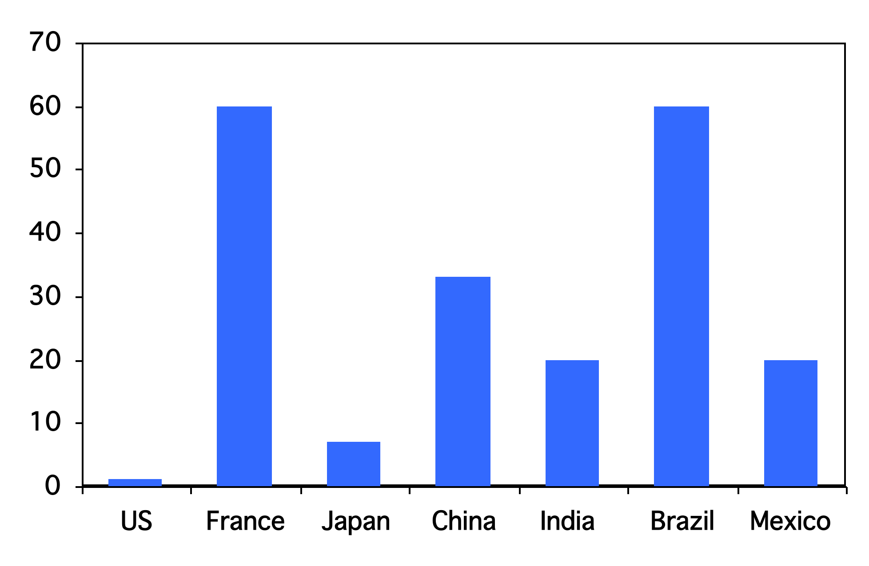
Rigidity of hours (index)
Source: World Bank, Doing Business.

Slide 33
Yogi vs. Tin Man
Dismissal
  PRT Has a list of fair grounds for termination and stringent procedural limitations on dismissals, such as mandatory notification of the government and priority rules for re-employment of redundant workers.
  NZL Allows “contracts at will,” which can be terminated with notice without cause
Source: Botero, Djankov, La Porta, Lopez-de-Silanes, Shleifer, 2003

Slide 34
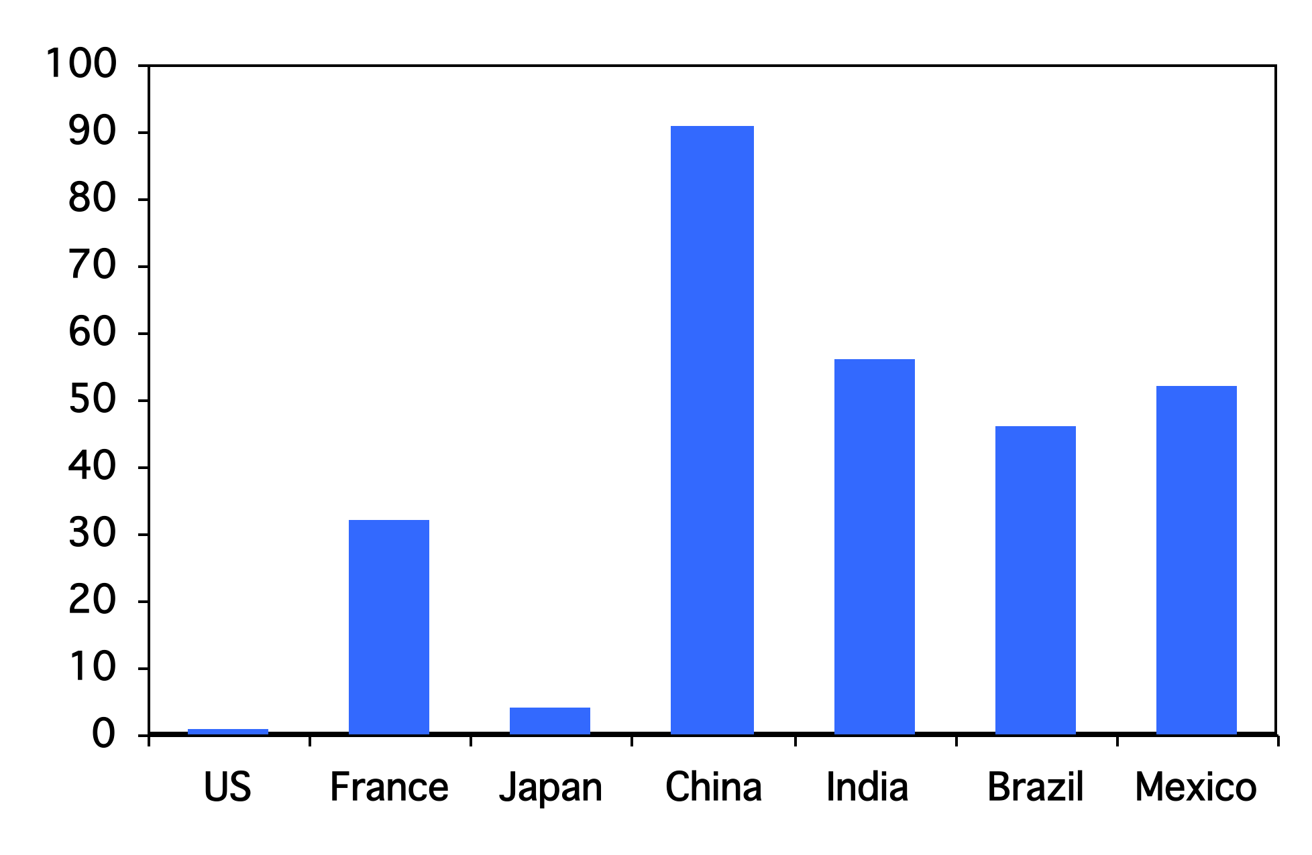
Firing costs (weeks of wages)
Source: World Bank, Doing Business.

Slide 35
Yogi vs. Tin Man
Collective bargaining
  PRT Employers have a legal duty to bargain with unions, collective agreements are extended to third parties by law, workers councils are mandatory, and employer lockouts are prohibited.
  NZL Employers have no legal obligation to bargain with unions, collective agreements are not legally extended, labor participation in management is not required by law, and employer lockouts are allowed.
Source: Botero, Djankov, La Porta, Lopez-de-Silanes, Shleifer, 2003

Slide 36
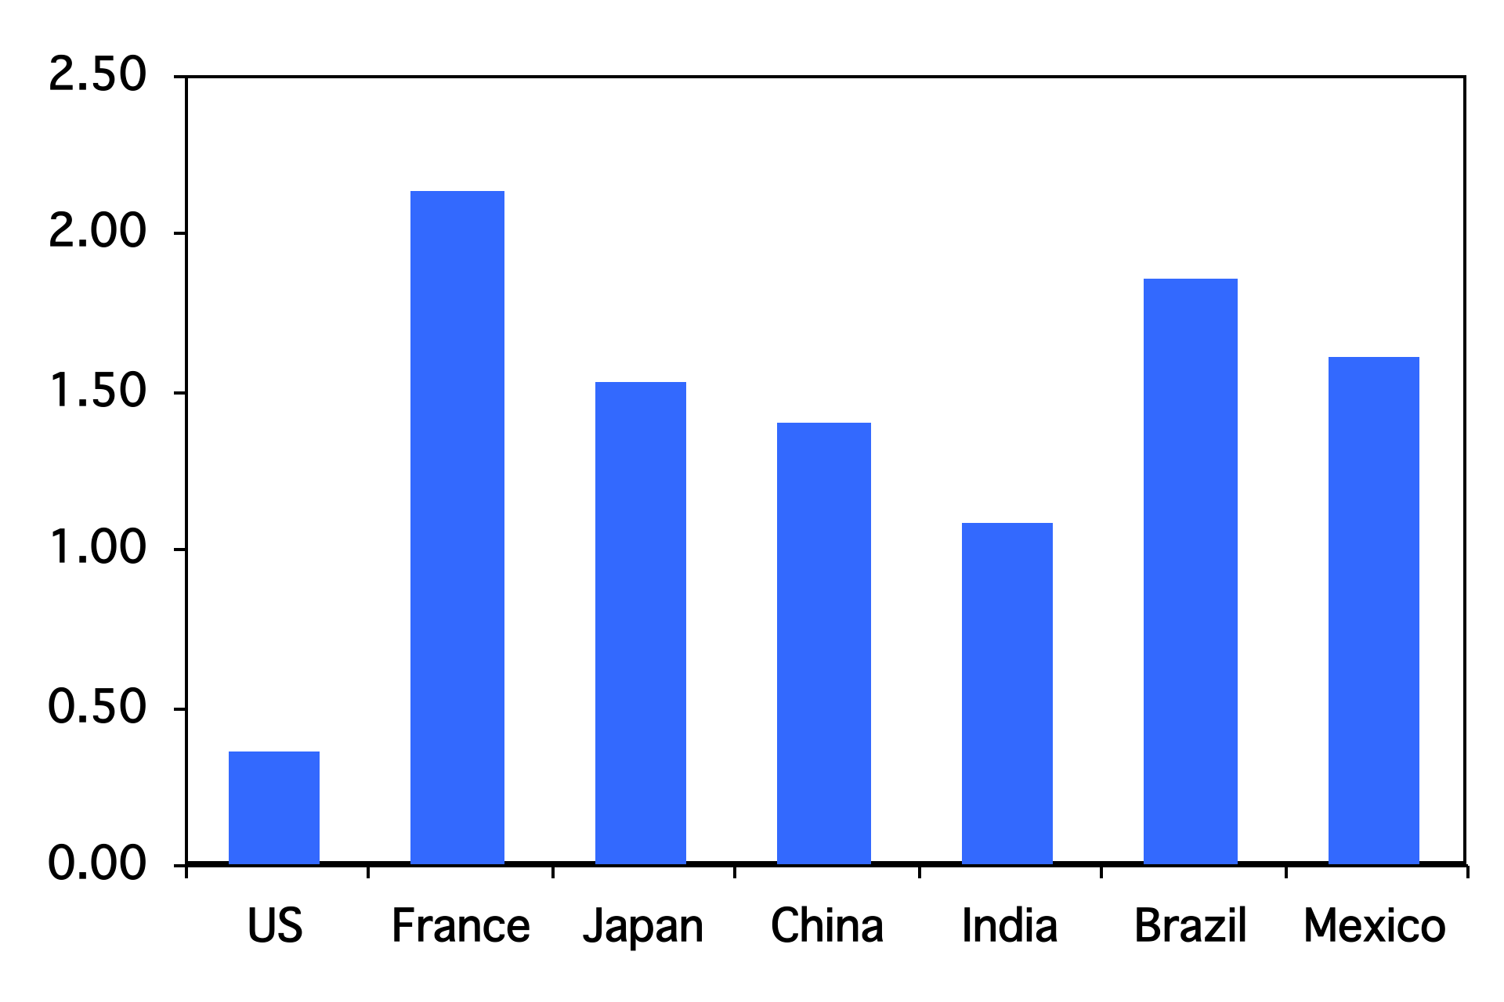
Union rights (index)
Source: Botero, Djankov, La Porta, Lopez-de-Silanes, Shleifer, Regulation of Labor.

Slide 37
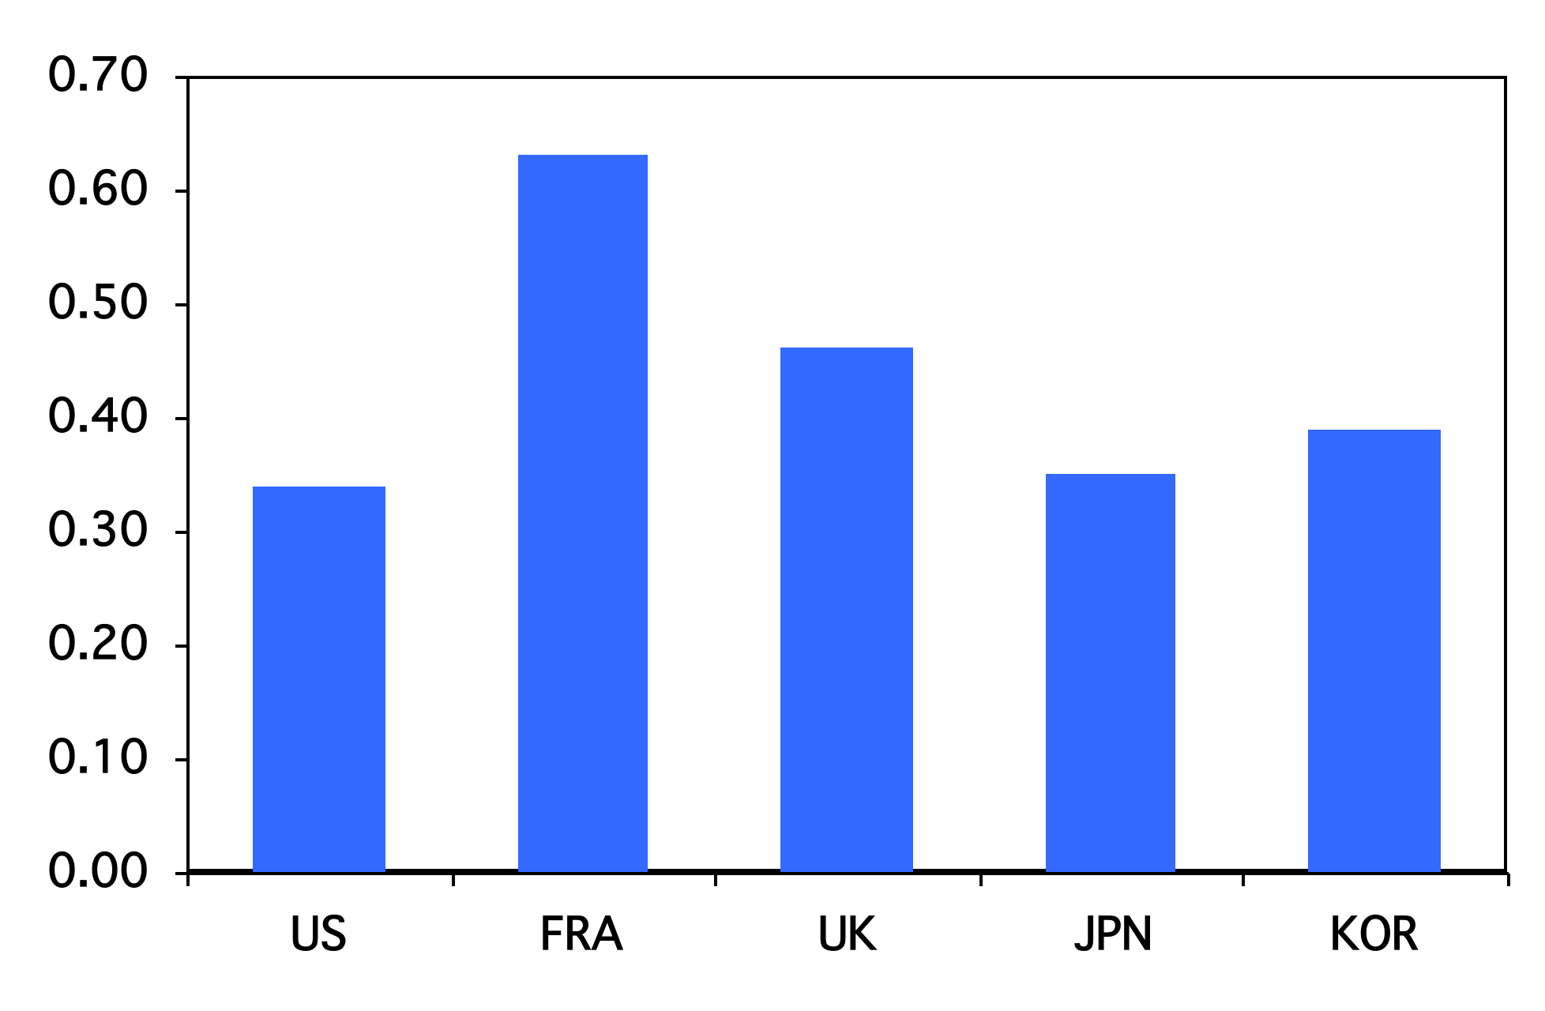
Minimum wage (ratio to median wage)
Source: OECD, employment database.

Slide 38
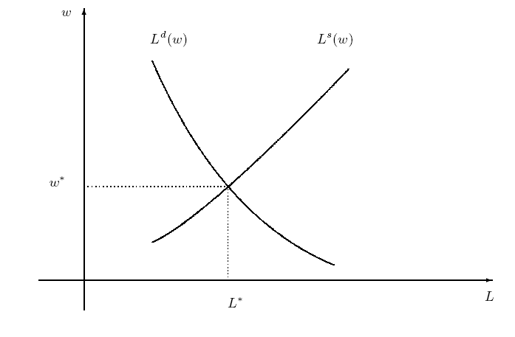
Frictionless model

Slide 39
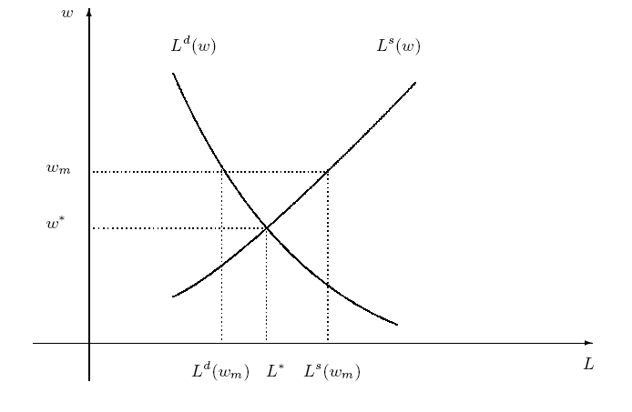
Institution: minimum wage

Slide 40
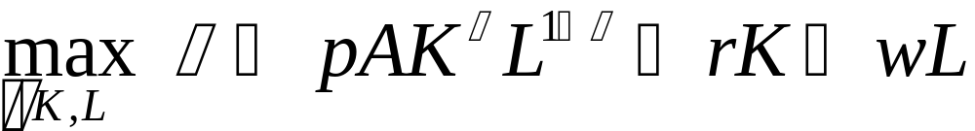
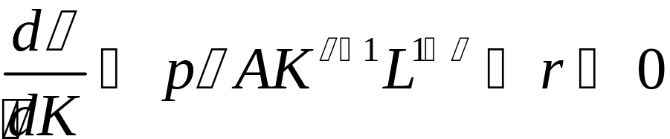
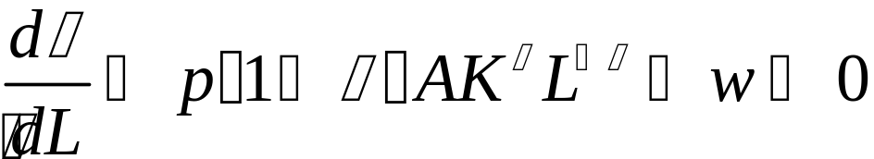
Labor Demand and Profits
Profit maximization
First order conditions (marg. rev = marg. Cost)

Slide 41
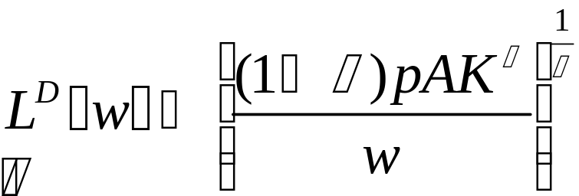
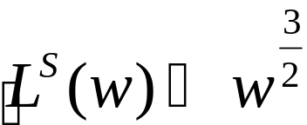
Labor market frictions: a simple model
Labor demand function
  Firms hire labor to maximize profits
Labor supply function
  Individuals sell labor to maximize utility

Slide 42
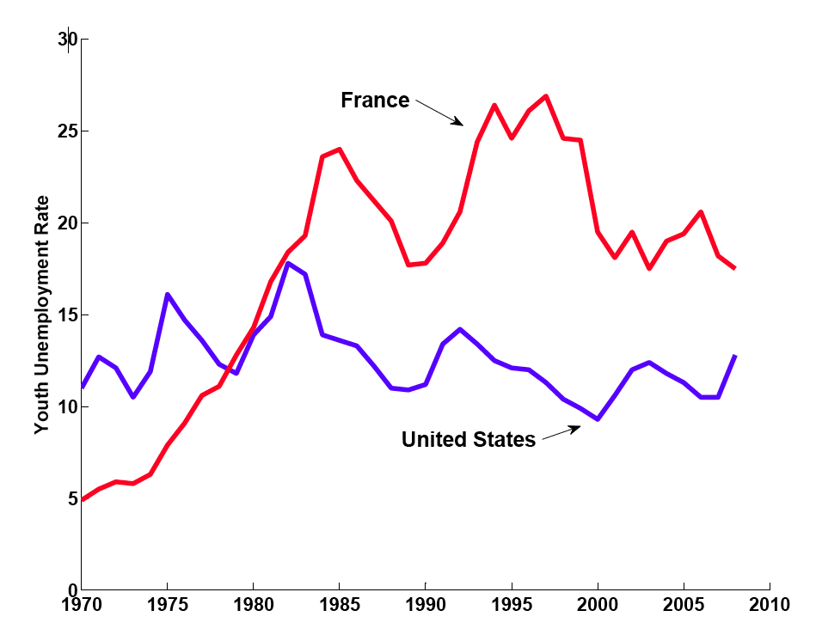
Youth Unemployment Rate
Source: Botero, Djankov, La Porta, Lopez-de-Silanes, Shleifer, 2003

Slide 43
What’s going on in France?
Gary Becker: “Generous minimum wages and other rigidities of the French labor market caused unemployment rates that have remained stubbornly high since the early 1990's. Immigrants, youths, and other new entrants into the labor market have been hurt the most.”

Slide 44
Putting it together:
Institutions, Volatility, and Unemployment

Slide 45
Volatility and employment
Demand for labor is volatile
  How does labor market flexibility affect labor market outcomes?
  What role do institutions play?

Slide 46
Labor market turnover
Creation and destruction of jobs by firms
  Creation: sum of all increases in number of employees by individual establishments
  Destruction: sum of all decreases in number of employees by individual establishments
Changes in job status by workers
  Accessions: number of workers taking new jobs, whether their previous status was employed, unemployed, or not in labor force
  Separations: number of workers leaving current jobs, whether they become employed, unemployed, or leave labor force
Bottom line from both: enormous turnover

Slide 47
Labor market transitions (avg. 93-05)
Monthly!
(percent relative to source of flow)
2.6% “job-to-job”
Employment
122.0m
1.3%
4.8%
28.3%
2.7%
2.4%
Unemployment
6.2m
Out of labor force
59.3m
23.3%
Source: US data, monthly, reported in Davis, Faberman, and Haltiwanger, “Flow approach,” 2005.

Slide 48






Unemployment dynamics: assumptions
Fixed labor force:
  unemployed agents:
  employed agents:
In rates
  Unemployment rate:
  Employment rate:
  everyone is employed or unemployed:

Slide 49
Labor market transitions (avg. 93-05)
Monthly!
(percent relative to source of flow)
2.6% “job-to-job”
Employment
122.0m
1.3%
4.8%
28.3%
2.7%
2.4%
Unemployment
6.2m
Out of labor force
59.3m
23.3%
Source: US data, monthly, reported in Davis, Faberman, and Haltiwanger, “Flow approach,” 2005.

Slide 50


Unemployment dynamics: assumptions
Constant rate of separations per period
Constant rate of accessions per period
Stand-in for: need to match worker and firm
  A simplification, could make a, s functions

Slide 51
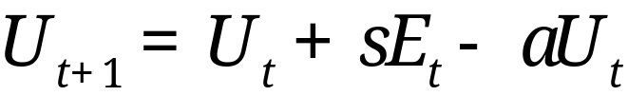
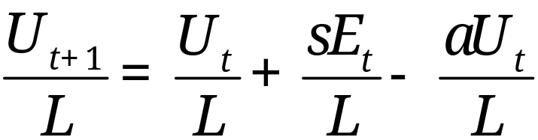
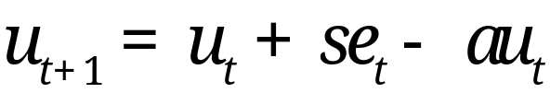
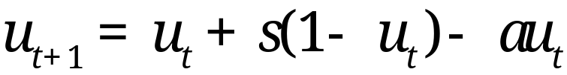
Unemployment dynamics

Slide 52

Unemployment dynamics
Example:
Use:
Next period’s unemployment rate is

Slide 53
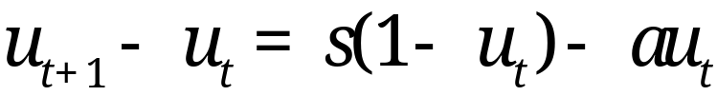
Unemployment dynamics
Two forces
  Newly employed
  Newly unemployed

Slide 54
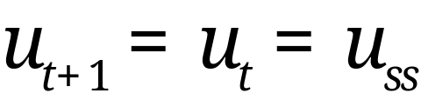

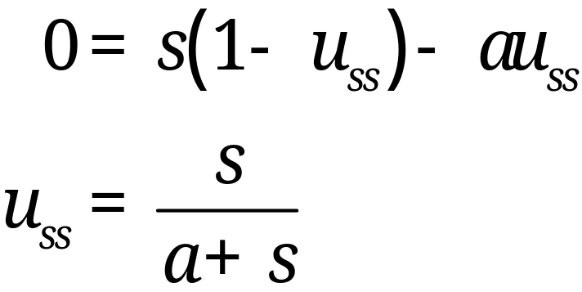
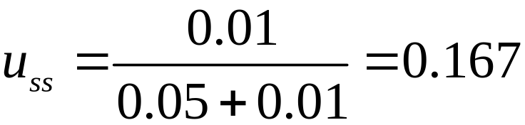
Steady state unemployment
Set
Solve for
Example continued

Slide 55
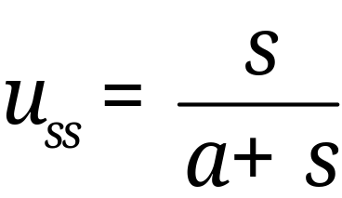


Steady state
Steady state unemployment level
  What is the effect of ?
  What is the effect of ?

Slide 56
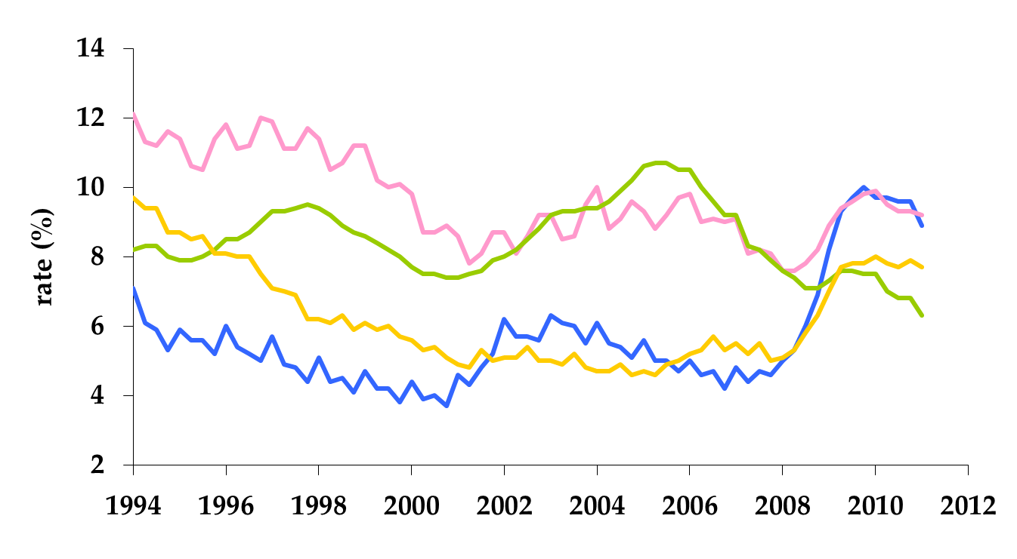
Unemployment rates
France
Germany
U.K.
U.S.

Slide 57


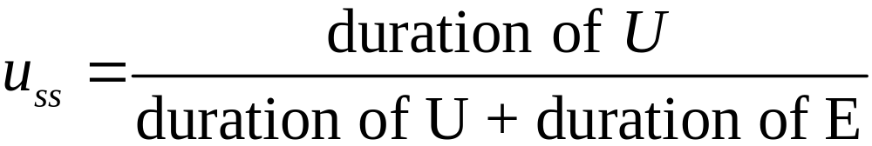
Duration
It can be shown (we won’t do it)
  Average duration of unemployment is
  Average duration of employment is

Slide 58
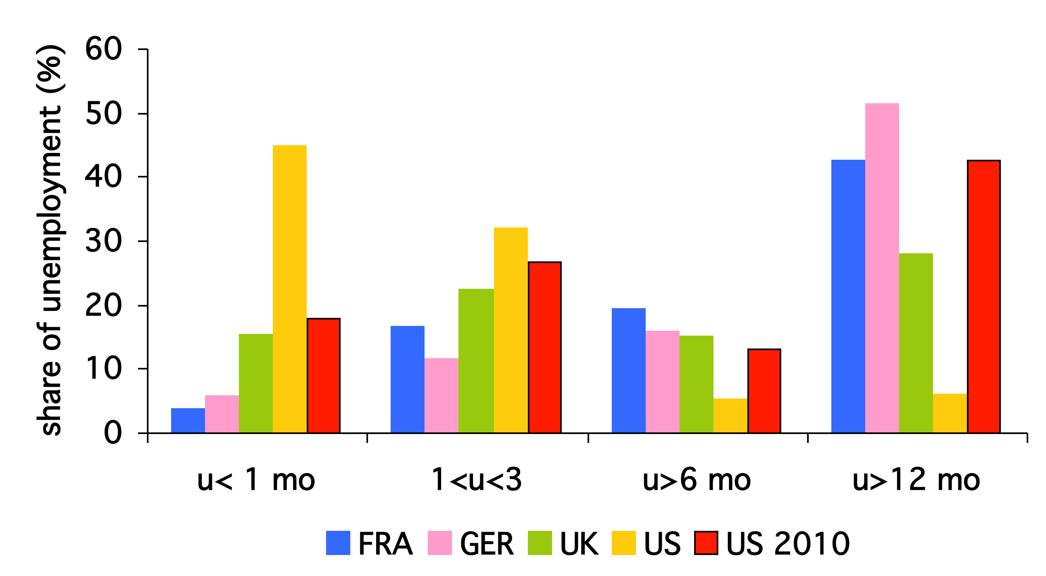
Unemployment duration (2000)

Slide 59
Turnover and employment
High a
  Easier to get a job
  Lower “natural” unemployment rate
  Shorter duration of unemployment
High s
  Easier to lose a job
  Higher “natural” unemployment rate
  Shorter duration of employment

Slide 60
Transitions in US and EU
 |  | Workers and Jobs
Country |  | Accessions | Separations | Reallocation
Denmark |  | 29.0 | 29.0 | 58.0
France |  | 28.9 | 30.7 | 59.6
Germany |  | 31.6 | 30.4 | 62.0
Italy |  | 34.5 | 33.6 | 68.1
Sweden |  | 16.8 | 17.8 | 34.6
UK |  | 37.2 | 37.6 | 74.8
USA |  | 45.2 | 46.0 | 91.2
Source: OECD, Employment Report, 1994; numbers are annual percentages of labor force.

Slide 61
Institutions
What influences a and s?
Institutions
  Employment protection
  Unemployment benefits
  Unions
  Contract laws
  Others??

Slide 62
Volatility
How do economies respond to shocks?
Use our model
  Begin in steady state
  “Displace” some workers: higher unemployment
  How does the economy return to steady state?

Slide 63


From out example
Example:
Steady state unemployment is
Shock increases unemployment 50%

Slide 64
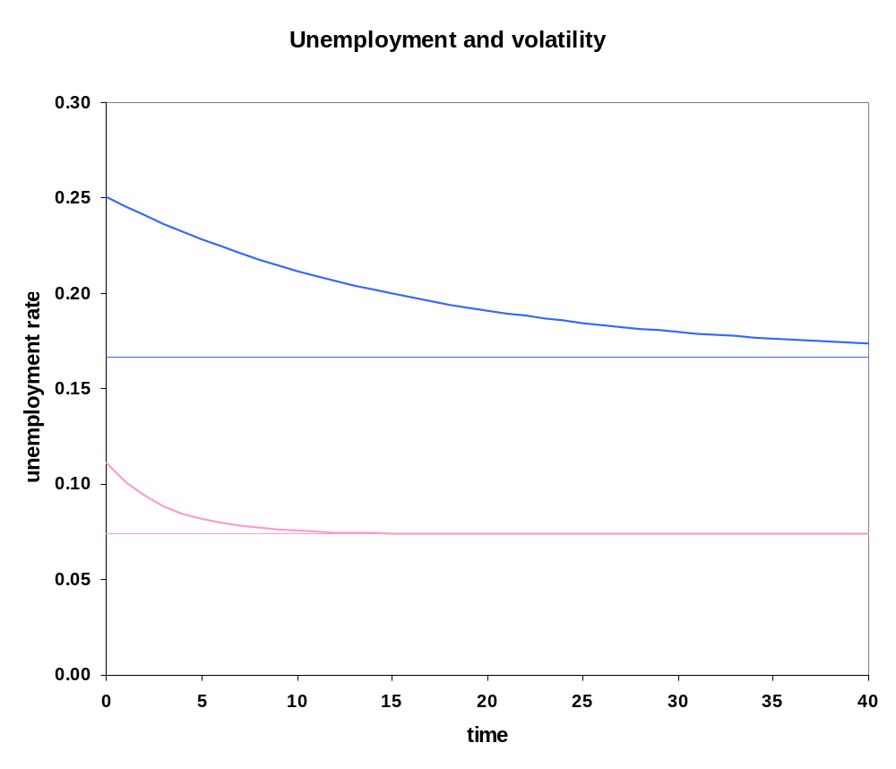
Responding to shocks
See DynamicUnempModel.xls for details

Slide 65


Conditions in United States
and move over the business cycle:
  currently about 0.25 (long-run avg. 0.57)
  currently 0.027 (long-run avg. 0.03)
Implies steady-state unemployment rate of 9.75 percent
Why should decline on trend?

Slide 66
Back to France and the US
Increase in volatility in 1970s
Unemployment increases in US, France
France responds by increasing EPL

Slide 67
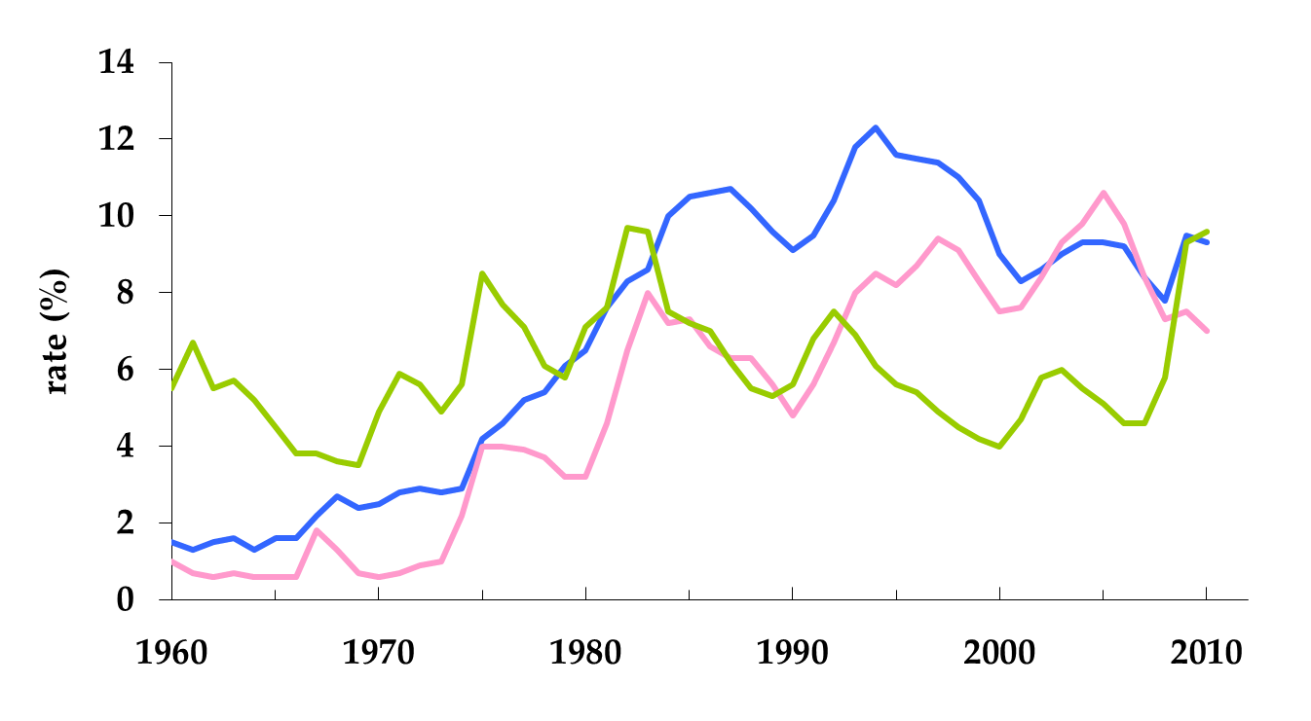
Back to France and the U.S.
France
Germany
U.S.

Slide 68
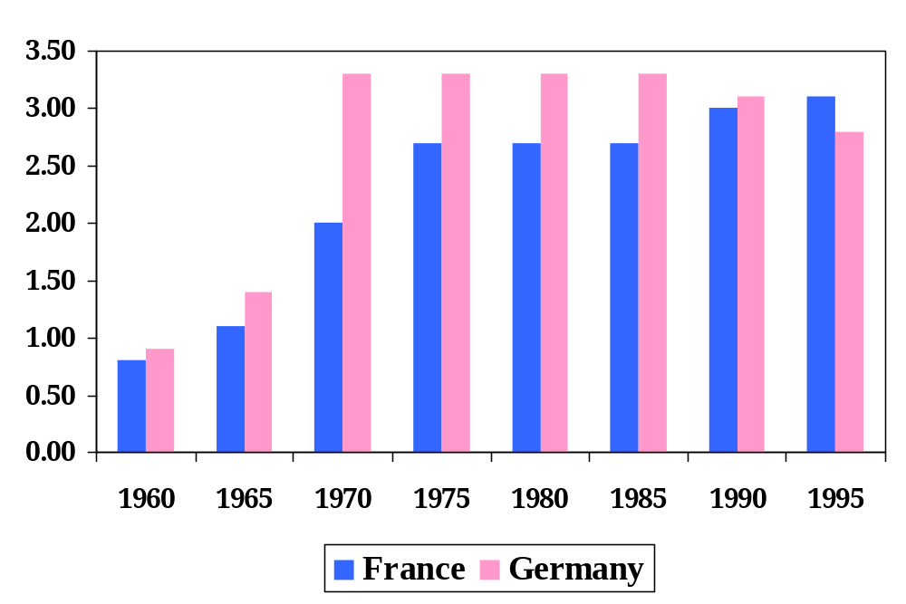
Employment protection in Europe
Source: Blanchard and Wolfers.

Slide 69
What have we learned today?
Wide variation in labor market institutions
Connection between institutions and outcomes
Flexible labor markets
  Lower steady state unemployment
  Quicker response from shocks
  Good? Bad? For whom?

