Slide 1

The Global Economy
Trade Theory

Slide 2
Roadmap
In the news: Nobel at Stern!
PS1 Question 4
Trade facts
Ricardo’s model of trade
Distributional aspects of trade
Trade policy

Slide 3
In the News: Sargent and Inflation
Models of inflation in the 1960s and 1970s implied a very high output cost of reducing inflation. The output lost for each percent of such disinflation is called the “sacrifice ratio.” In these models, the sacrifice ratio is structural. Inflation has its own momentum, and can be lowered only by keeping output sharply below potential.
Sargent: “[Stopping inflation] would require a change in the policy regime: … How costly such a move would be … would depend partly on how resolute and evident the government’s commitment was.”¹ The key point is that inflation depends on the behavior of wage- and price-setters who are forward looking.
In this view, the sacrifice ratio is not structural, but depends on the policy regime. If the policy commitment to lower inflation is credible, a quick disinflation may result in a lower sacrifice ratio because expectations about wages and prices adjust rapidly.
¹Thomas Sargent, “The Ends of Four Big Inflations,” 1982.

Slide 4
Sacrifice Ratio in Practice
Volcker disinflation: What happened?
  Volcker Fed changes policy regime: Targets reserves to lower inflation (Oct 1979 to Oct 1982)
  1981-85: Inflation drops by 6.7 pct points
  Old models would anticipate output loss of about 33% relative to trend (Mankiw, 6e, p. 393)
  Estimated loss: about 19% (Mankiw, 6e, p. 395)
Ball (1993) examines 65 episodes of disinflation in 19 OECD countries with moderate inflation:
    Sacrifice ratio declines with speed of disinflation (“cold turkey” policy shock cuts output losses)
    Sacrifice ratio declines with flexibility of labor contracts (especially with contract duration)

Slide 5
PS1 Q4: Classify the data
Put numbers into
  Final expenditures
  Payments to labor or capital
  Intermediates
By sector, VA=wL+rK
  A way to check your work

Slide 6
Cafes
Cheeseburgers
  50K in sales Consumption
  7K beef sesame seeds Intermediates, imports
  10K catsup Intermediates
  20K wages Payment to labor
  3K rent Payment to capital
  10K profit Payment to capital
VA = 50 – 7 – 10 = 33

Slide 7
Tomatoes
Tomatoes
  8K sales to catsup makers Sales of intermediate
  2K exports Exports
  9K wages Payment to labor
  1K rent Payment to capital
VA = 8+2-0=10

Slide 8
Blenders
Blenders
  40K exports Exports
  60K local sales Consumption
  15K metal Intermediate, Import
  15K CNC machine Investment, Import, Payment to Capital
  70K wages Payment to Labor
VA = 100 – 15 = 85

Slide 9
Government
Government
  10K taxes collected Transfer
  10K regulator wage Payment to labor, Gov’t spending
VA = 10

Slide 10
Catsup
Catsup
  10K sales to local cafes Sales of Intermediate
  8K tomatoes Intermediate input
  2K wages Payment to labor
VA = 10 – 8 = 2

Slide 11
Roadmap
In the news: Nobel at Stern!
PS1 Question 4
Trade facts
Ricardo’s model of trade
Distributional aspects of trade
Trade policy

Slide 12
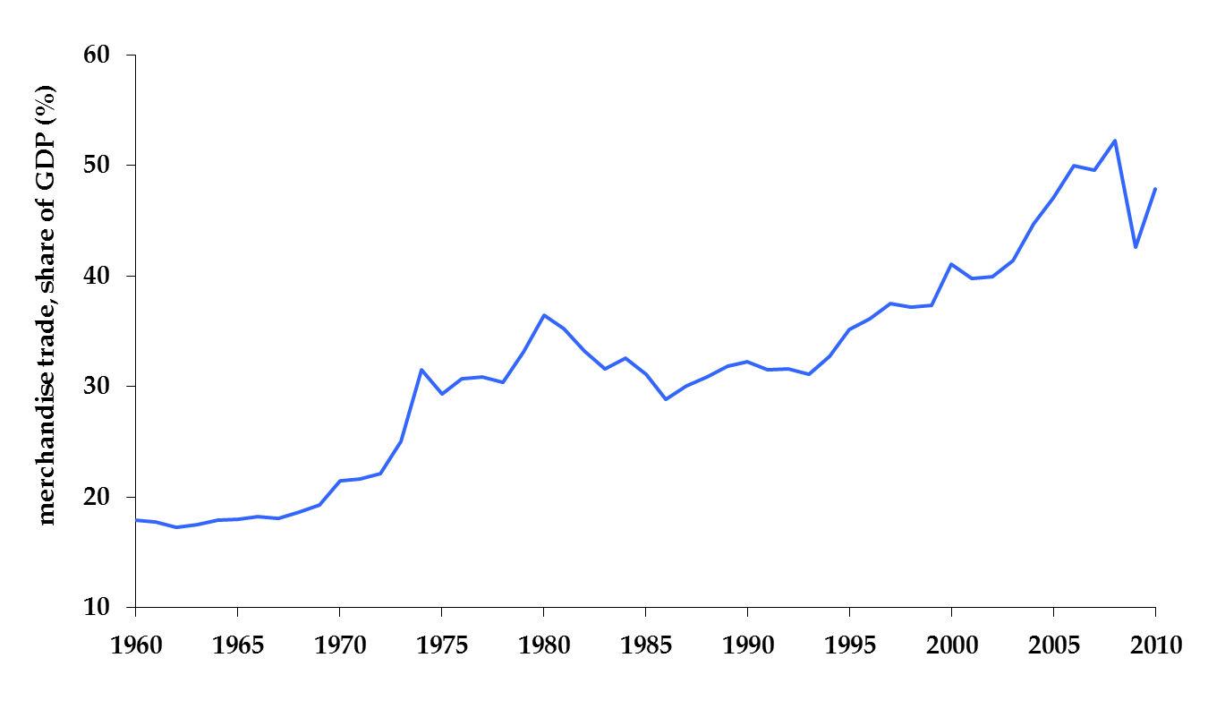
World trade has grown quickly
World trade / GDP

Slide 13
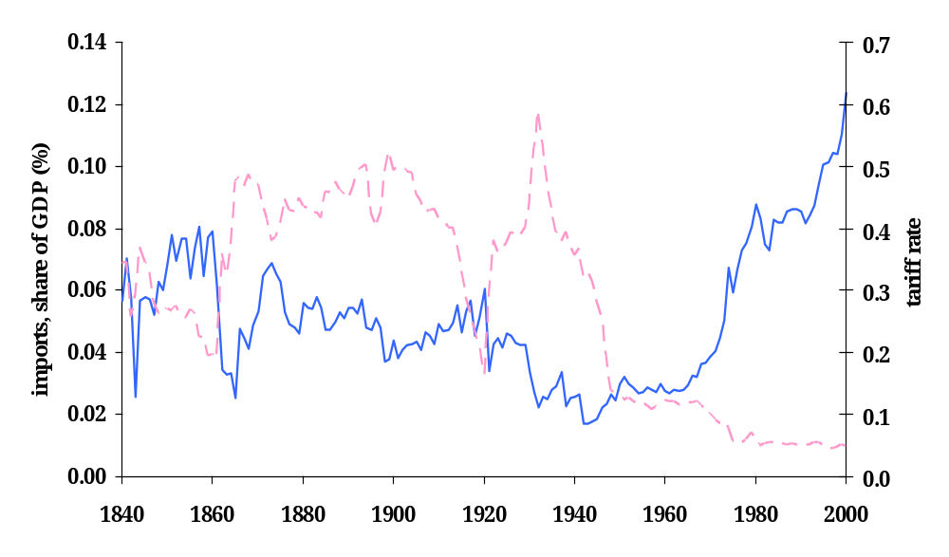
…but hasn’t always
US Tariffs
US Imports

Slide 14
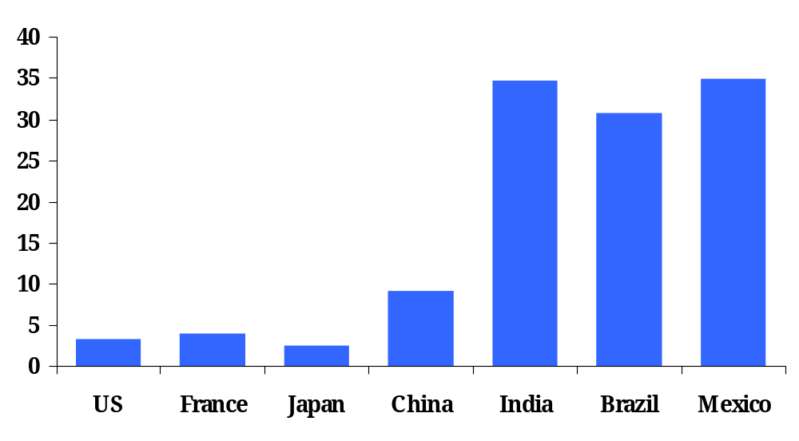
Average tariffs
non-agriculture

Slide 15
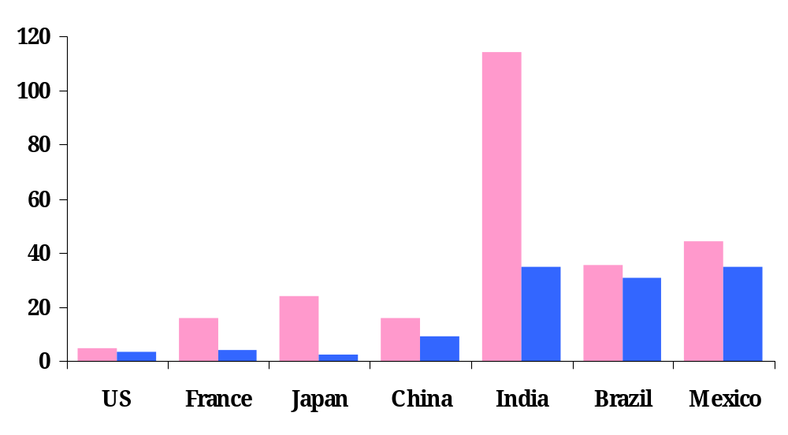
Average tariffs
agriculture
non-agriculture

Slide 16
More than just tariffs
Subsidies to producers
  Agriculture in “rich” countries
Health and safety regulations
Voluntary export restraints
Anti-dumping duties

Slide 17
Trade facts
Trade is becoming increasingly important
  Reversals are possible, e.g. great depression
Many ways to stifle trade
  Tariffs, regulations, paperwork
Barriers on manufactured goods low
Barriers on agriculture much higher
  Especially in rich countries

Slide 18
The logic of markets
Adam Smith, Wealth of Nations (1776)
  By pursuing his own interest, [an individual] is led by an invisible hand to promote the interest of the society more effectively than when he really intends to promote it. I have never known much good done by those who affected to trade for the public good. (paraphrase)
  Logic: if two people voluntary exchange products, it suggests that both find it in their interest. It’s “win-win.” Economic activity is a positive sum game.

Slide 19
The logic of markets
First theorem of welfare economics
  Under certain conditions, competitive markets produce a good allocation of resources.
What conditions?
  Clearly defined property rights, full information
What do we mean by a “good allocation”?
  No one can be made better off without someone else being made worse off. (“Pareto optimal”)

Slide 20
The logic of trade
Voluntary exchange is “win-win”
  Suppose two people or firms value a product or asset differently
  Trade benefits both
Questions
  How do we prove this?
  At what price do we trade?
  How are the benefits distributed?

Slide 21
Roadmap
In the news: Nobel at Stern!
PS1 Question 4
Trade facts
Ricardo’s model of trade
Distributional aspects of trade
Trade policy

Slide 22
Ricardo’s model of trade
David Ricardo (1817)
  Two goods: fixed productivity in production
  With free trade: each country produces one good
Key concept: comparative advantage
  Each country should produce the good at which it is comparatively most productive

Slide 23
Comparative advantage: true and non-trivial
Nobel laureate Paul Samuelson (1969) was challenged by the mathematician Stanislaw Ulam to:
“Name me one proposition in all of the social sciences which is both true and non-trivial.”
His response: comparative advantage.
“That it is logically true need not be argued before a mathematician; that it is not trivial is attested by the thousands of important and intelligent men who have never been able to grasp the doctrine for themselves or to believe it after it was explained to them.”
Notes:
http://www.wto.org/english/res_e/reser_e/cadv_e.htm

Slide 24
Ricardo: setup
Two countries: US, Mexico
Two goods: apples, bananas
One input (labor)
Production function: Y = AL (no K)
Productivities A (output from one unit of labor):
 | Apples/hr | Bananas/hr | Labor (hrs)
US | 20 | 10 | 100
Mexico | 5 | 5 | 100

Slide 25
Opportunity cost
Opportunity cost: the opportunity you forego when making a choice
  This context: bananas you give up to make one more apple
For the U.S.
  1 apple takes 1/20 hours
  In 1/20 hours could make 1/20 * 10 = 0.5 bananas
  The opportunity cost of 1 apple is 0.5 bananas
 | Apples/hr | Bananas/hr | Labor (hrs)
US | 20 | 10 | 100
Mexico | 5 | 5 | 100

Slide 26
Production possibilities in U.S.
b
1000
Slope = -0.5
2000
a

Slide 27
Opportunity cost
Opportunity cost in Mexico for one apple? One banana?
 | Apples/hr | Bananas/hr | Labor (hrs)
US | 20 | 10 | 100
Mexico | 5 | 5 | 100

Slide 28
Production possibilities in Mexico
b
500
Slope = -1.0
500
a

Slide 29
No trade: “autarky”
In a closed economy
  Production = consumption
  Production possibility set = consumption possibility set

Slide 30
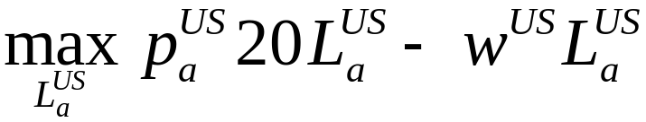


Prices in autarky: U.S.
Apple production
First order condition (derivative w.r.t. L)
Banana production

Slide 31

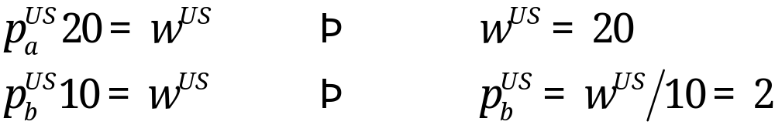
Prices in autarky: U.S.
Apples are numeraire good
  Only relative prices matter!
  Same as choosing units
  Price of bananas, wages, in terms of apples:
First order conditions
Prices reflect opportunity cost

Slide 32
Prices in autarky: Mexico
Apple production
First order condition (derivative w.r.t L)
Banana production

Slide 33
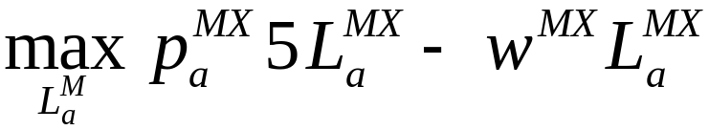


Prices in autarky: Mexico
Apple production
First order condition (derivative w.r.t L)
Banana production

Slide 34
With trade: comparative advantage
In the U.S., what is the opportunity cost of
  A banana? 1/10 * 20 = 2.0 apples
  An apple? 1/20 * 10 = 0.5 bananas
In Mexico, what is the opportunity cost of
  A banana? 1/5* 5 = 1.0 apples
  An apple? 1/5 * 5 = 1.0 bananas
Who has the comparative advantage in
  bananas? Mexico only gives up 1 apple; U.S. gives up 2 apples
  apples? U.S. only gives up 0.5 bananas; Mexico gives up 1 banana

Slide 35



Trade: at what price?
For what prices will the U.S. trade?
  If export apples to buy bananas
For what prices will Mexico trade?
  If export bananas to buy apples
For prices countries trade
Actual price depends on demand as well

Slide 36

Consumption possibilities in U.S.
b
Consumption possibilities with trade,
1000
Consumption possibilities without trade
2000
a

Slide 37

Consumption possibilities in Mexico
b
500
Consumption possibilities with trade,
Consumption possibilities without trade
500
a

Slide 38
Trade
Specialization
  U.S. produces apples and exports them
  Mexico produces bananas and exports them
Incomplete specialization
  If one country is relatively large
  Large country may produce both goods, small country specializes

Slide 39
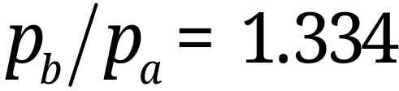

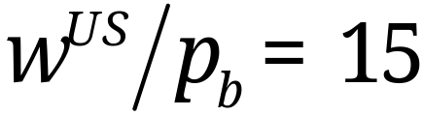
Impact of trade: rich country
If
In U.S.
Real wages; an hour’s work buys:
  apples (vs. 20 when no trade)
  bananas (vs. 10 when no trade)

Slide 40
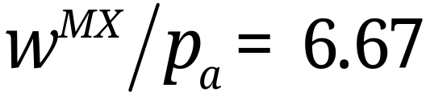
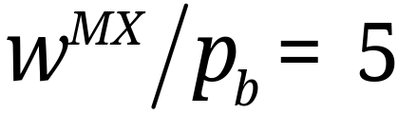
Impact of trade: poor country
Still
In Mexico
Real wages; an hour’s work buys:
  apples (vs. 5 when no trade)
  bananas (vs. 5 when no trade)

Slide 41
Impact of trade: productivity
Countries specialize in the good in which they are relatively more productive
Opening to trade increases aggregate productivity
  Stop producing in the inefficient sector
  Shift resources to the efficient sector
  Two weeks ago: efficient across firm allocations
People eat more apples and bananas
No change in “number of jobs,” but
  No banana growers in U.S.
  No apple growers in Mexico

Slide 42
Impact of trade: NAFTA
Mexican auto manufacturing is booming
  Many old factories shut down, new ones opened aimed at full North American market
Mexican garment manufacturing booming
  Clothes made with US cloth, shipped back to US
  Rules of origin keep out Asian textiles
Mexican corn farmers wiped out
  Corn is US comparative advantage
  Many small farmers displaced

Slide 43
Extension: outsourcing
“Outsourcing” or “offshoring”
  Usually means: “trade in services”
Previously:
  Services were difficult to trade
  Long distance telephone calls, faxes
  Difficult to trade within countries, too
Now:
  Some services more easily traded
  Generated by decreases in communication costs
  Can be within or across firms

Slide 44
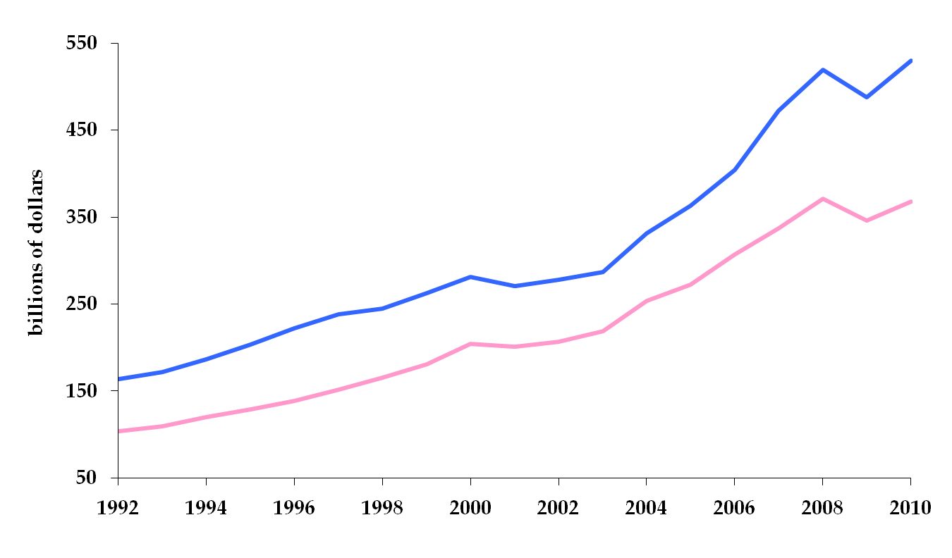
United States service trade
Insourcing: exports of services
Outsourcing: imports of services

Slide 45
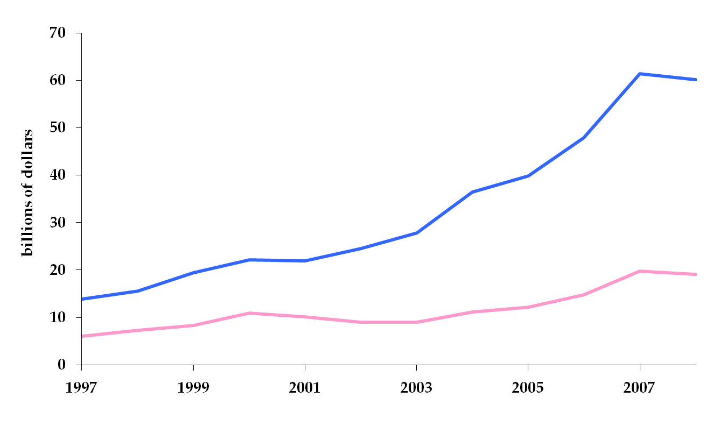
United States service trade
Insourcing of financial services
Outsourcing of financial services

Slide 46
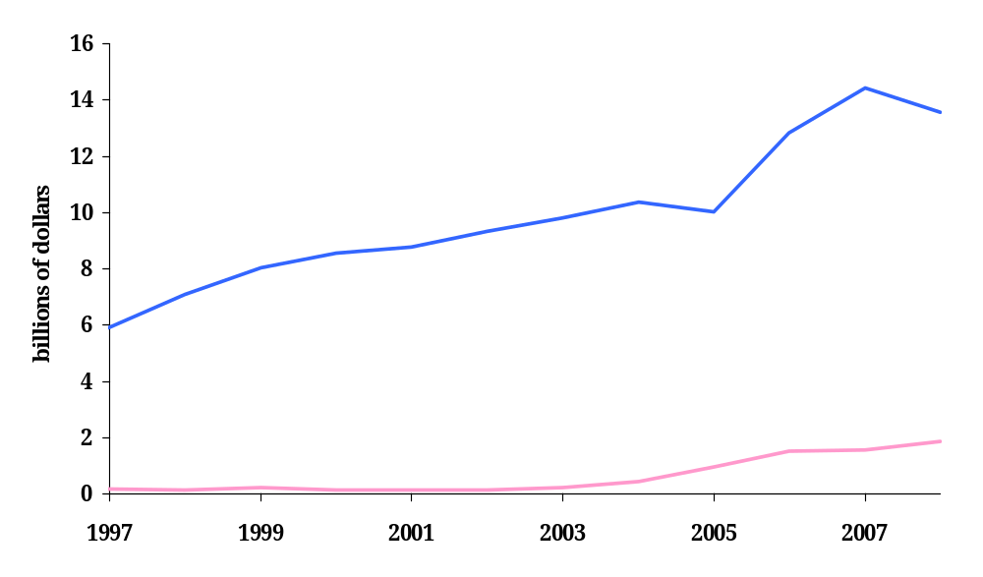
United States service trade
Insourcing of film and television
Outsourcing film and television

Slide 47
Roadmap
In the news: Nobel at Stern!
PS1 Question 4
Trade facts
Ricardo’s model of trade
Distributional aspects of trade
Trade policy

Slide 48
What can go wrong?
Banana producers in U.S. lose their jobs
  We assumed perfect labor markets
  No specific skills
Frictions
  The result of policies
  The result of reality (non-transferable skill)
  Lead to unemployment, underemployment

Slide 49
Distributional effects of trade
A more general model has many inputs
  Capital
  “Skilled” labor
  “Unskilled” labor
And many goods
  Some require a lot of capital
  Some require a lot of unskilled labor
How is the pattern of trade determined?

Slide 50
Comparative advantage, again
Countries produce more of, and export, the goods that are intensive in the factor of production in which they are relatively abundant.
In English
  Countries with more skilled labor (relative to the rest of the world) will export goods that require a lot of skilled labor…and import goods that require a lot of unskilled labor
  Countries with more capital (relative to the rest of the world) will export goods that require a lot of capital…and import goods that require less capital.

Slide 51
Distributional effects, again
With trade
  The demand for the abundant factor increases
    Its return increases
  The demand for the scarce factor decreases
    Its return decreases
In the United States
  Demand for skilled labor increases
  Demand for unskilled labor decreases
Winners win more than losers lose.

Slide 52
Winners and losers
On the whole, still better off: winners win more than losers lose.
How do we make transfers?

Slide 53
Summary
Trade benefits all countries
  Lowers the price of consumption, intermediate goods
  Increases productivity
  Increases real wages
Outsourcing is just another kind of trade
What can go wrong?
  Trade (all of it) creates winners and losers
  Hard to compensate the losers

Slide 54
Trade Reality

Slide 55
If trade is so great…
… why are people against it?
Losses are visible and concentrated
  Loss of entire industries (geographic impact)
  Producers tend to identify with each other, organized
  (Q: Who are you? A: I’m a steel worker)
Gains are less evident and more dispersed
  All consumers pay lower prices for goods
  All firms pay less for inputs
  Consumers tend not to identify with each other
  (Q: Who are you? A: I’m a sugar consumer ?!)

Slide 56
The Negative Railroad
How is trade like technology? Both alter the frontier of production possibilities. Both can displace firms and workers.
Is reducing trade like destroying technology?
“Whatever the protectionists may say, it is no less certain that the basic principle of restriction is the same as the basic principle of breaks in the tracks: the sacrifice of the consumer to the producer….
Frédéric Bastiat, Economic Sophisms, 1845.

Slide 57
Ways to restrict trade
Besides tariffs
  Subsidies to local producers
  Health and safety regulation
  Quotas
  Antidumping law

Slide 58
Subsidies to producers: U.S. sugar
Price supports for sugar require (almost) banning imports of sugar
  Guaranteed prices for sugar (18-22 cents per lb.)
  World price for sugar around 9 cents per lb.
  U.S. expects to pay $2.15 bil. in price supports over 10 years;
  5,980 sugar and sugar beet farms in 2002 census = $351,170 per farm
Restrictions on sugar imports cost U.S. consumers $1.9 billion per year in higher prices
  About $19 per household per year
  Sugar is usually consumed indirectly
Who gains besides sugar producers?
  Corn farmers (HFCS producers)
  Lobbyists, lawyers

Slide 59
Health and safety
EU bans hormone treated meat in 1989
U.S. bans unpasteurized cheese
  Cheese must be made with pasteurized milk, or aged for 60 days
Ban on genetically modified rice
  Only allowed for consumption in U.S., Canada

Slide 60
Quotas
Limit on the amount of a good that can be imported
Voluntary export restraints: quotas imposed by the exporting country
  Most famous: Japanese cars in the 1980s
  Politically more palatable?
WTO says: drop quotas, use tariffs

Slide 61
Antidumping
Antidumping
  Foreign firms using “predatory” pricing
  Domestic firms may file for protection
  Must show foreign firms pricing “unfairly” and that this has caused “injury to domestic firms”
  Unfair pricing: charging less in foreign markets than in home market
  Economic rationale?
Dumping duties (tariffs) imposed on foreign firms
Antidumping is frequently used strategically
More popular as other policy instruments are removed

Slide 62
No more wire hangers!!
One remaining US based hanger producer…
…files petition against Chinese producers
International Trade Commission investigates
  Finds: hangers sold below fair market value
  Duties assessed range from 33% to 165%
  Hanger prices double in US market

Slide 63
Hangers: fallout
Who wins?
  Domestic hanger producers
  Wisconsin hanger plant reopens
Who loses?
  Dry cleaners
  People who use dry cleaners
Unintended consequence
  Hanger recycling

Slide 64
What a mess!
Countries set trade barriers in different ways to different countries
Bargain bilaterally to change barriers
Progress is slow, complicated

Slide 65
The World Trade Organization
1947 General Agreement on Trade and Tariffs
  23 original signers
  Major cornerstone: nondiscrimination
1995 GATT becomes the World Trade Organization
  Enforcement mechanism: none under GATT
  Exemptions: health and safety arguments
Progress
  Tariffs on non-agriculture very low
  General Agreement on Trade in Services (in the works)
  Trade Related Aspects of Intellectual Property Rights (in the works)

Slide 66
WTO principles
Tariff binding
  A negotiated tariff is bound: the tariff can not be increased in the future
Nondiscrimination
  Member grant each other most favored nation status…now called normal trade relations
  NTR: tariff rates are the same for all
  Exceptions: regional trade agreements (e.g. NAFTA)
  Exceptions: “escape clauses” (China and tires)

Slide 67
What have we learned today?
Many ways to restrict trade
  Tariffs, quotas, safety regulations, dumping and countervailing duties
  Protection has a strong political component
In spite of the gains from trade, liberalizing trade is not easy
  Losses are concentrated and visible
  Gains are dispersed and a subtle
  Compensating losers is not an easy task

Slide 68
For the ride home
Foreign “sweatshops”
Pay wages that are low by US standards, but higher than alternatives in that country
Poor working conditions by US standards
What are the issues?
  Is it the responsibility of “rich” nations to intervene by not trading? What is fair?
  Other options?

