Slide 1

The Global Economy Business Cycle Properties

Slide 2
Roadmap
Exam review
Business cycles
What are they?
Terminology
What do they look like?
What makes a good indicator?
Forecasting
Using indicators

Slide 3
Summary Statistics
Mean | 83.1
Standard Dev. | 9.2
Median | 84.0
Top 10% | 93
Top 35% | 87

Slide 4
Question 6
Opportunity cost of producing a car in US is (in tons of wheat):
Opportunity cost of producing a car in Canada is (in tons of wheat):
So Canada exports cars if the price of a car (P_{c}) is such that 0.5<P_{c}<0.75. If P_{c} = 0.8, no country wishes to import cars.

Slide 5
Question 9 Part e
This was a hard question
The answer needs to be argued in terms of borrowing and lending, as the hint implied. Fast growth implies a high return on investment that is relatively attractive to foreign investors. Typically, this implies a deficit on net exports.
“They grew a lot, so they would have exported a lot” is not a great answer. Why? We are interested in net exports, not only exports.

Slide 6
Roadmap
Exam review
Business cycles
What are they?
Terminology
What do they look like?
What makes a good indicator?
Forecasting
Using indicators

Slide 7
Business Cycles: Why people care
How is business cycle analysis used?
Production, employment, investment, and pricing decisions
How would a boom affect each of these?
Does it depend on what you are producing?
Asset management decisions
Is a boom good or bad for equity? Bonds?

Slide 8
What is a business cycle?
Definitions
Short-term economic fluctuations (“high frequency”)
Arthur Burns and Wesley Mitchell: “Business cycles are a type of fluctuation found in the aggregate economic activity of nations.... A cycle consists of expansions occurring at about the same time in many economic activities, followed by similarly general recessions, contractions and revivals which merge into the expansion phases of the next cycle.”
The “official” cycle dates http://www.nber.org/cycles/recessions_faq.html
Business cycles are recurrent, but not periodic

Slide 9
Business cycle terminology
peak
trough
11 months
59 months

Slide 10
US business cycles Duration in months
Average | Contraction (Peak to Trough) | Expansion (Trough to Peak) | Cycle (Trough from Previous Trough) | Cycle (Peak from Previous Peak)
1854-2009 (33 cycles) | 16 | 42 | 56 | 55
1854-1919 (16 cycles) | 22 | 27 | 48 | 49
1919-45 (6 cycles) | 18 | 35 | 53 | 53
1945-2009 (11 cycles) | 11 | 59 | 73 | 66
Great Recession (2007-09) | 18 | 73 | 91 | 81

Slide 11
The Great Depression is still great
 | How Long? | How Deep? |  |  | Unemployment rate
 | Duration in months | Real GDP | Ind. Prod | Employment | High | Change
Great Depression (1933) | 43 | -33% | -53% | -32% | 25% | 22%
Major depressions | 16 | -13 | -32 | -11 | 16 | 10
(1921, 1938)
Sharp recessions | 13 | -3 | -12 | -4 | 8 | 4
(1924, 1949, 1954, 1958, 1975, 1982)
Mild recessions | 9 | -2 | -7 | -2 | 6 | 3
(1927, 1945, 1961, 1970, 1980, 1991, 2001)
Great Recession (2009) | 18 | -5 | -15 | -5 | 10 | 5
Sources: BEA, BLS, Citi, FRB, and Geoffrey Moore.

Slide 12
Describing data
A variable is procyclical if it moves up and down with GDP, countercyclical if it moves in the opposite direction
A variable leads GDP if its ups and downs precede those in GDP, lags if its movements come after
We’ll develop a way to sort out leads and lags

Slide 13
Output Gap
Sources: BEA and CBO. Note: Shaded areas denote NBER recessions.

Slide 14
Correlation
Correlation: the degree to which two indicators vary together
Correlation index ρ where -1 ≤ ρ ≤ 1
If ρ = 1, we say that two indicators are perfectly correlated.
If ρ = -1, we say that two indicators are perfectly negatively correlated.
If ρ = 0, the indicators are not correlated.

Slide 15
Gross domestic product

Slide 16
Deviations from trend GDP

Slide 17
Nondurables consumption
Consumption
GDP

Slide 18
Durables consumption
Consumption
GDP

Slide 19
Nonresidential investment
GDP
Investment

Slide 20
Residential investment
GDP
Investment

Slide 21
Summary: GDP components
 | Std. deviations relative to GDP | Contemporaneous correlation with GDP
GDP | 1.00 | 1.00
Cons. Durables | 2.50 | 0.78
Cons. Nondurables | 0.77 | 0.90
Nonresidential Investment | 3.71 | 0.88
Residential Investment | 5.86 | 0.74
Exports | 2.74 | 0.67
Imports | 7.65 | 0.10

Slide 22
Nonfarm employment
Employment
GDP

Slide 23
Hours worked per worker
Hours worked
GDP

Slide 24
Housing starts
Starts (right axis)
GDP (left axis)

Slide 25
Yield spread
Spread (right axis)
GDP (left axis)
spread = 10 year rate minus 2 year rate

Slide 26
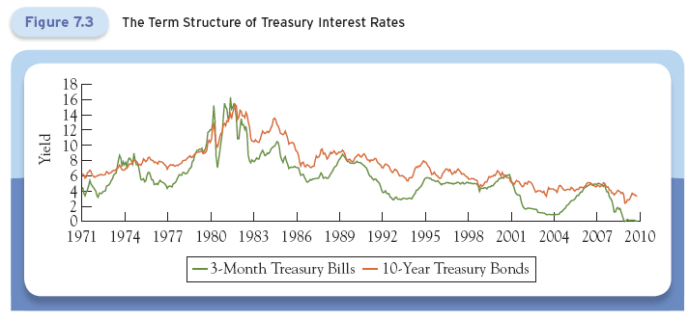
Term Structure of Interest Rates

Slide 27
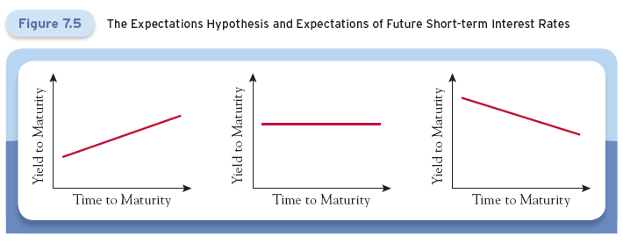
The Expectations Hypothesis

Slide 28
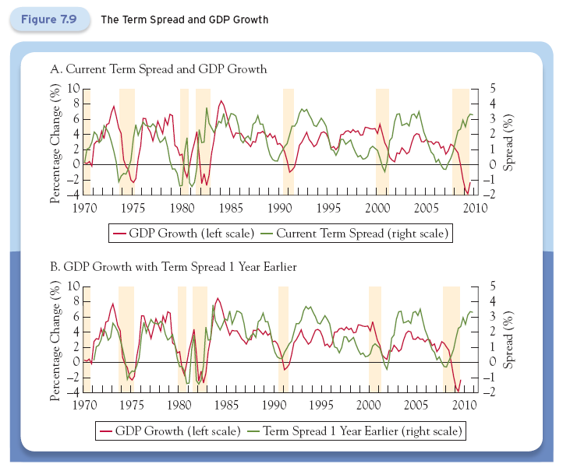
Term Structure of Interest Rates

Slide 29
Summary: other indicators
 | Std. deviations relative to GDP | Contemporaneous correlation with GDP
GDP | 1.00 | 1.00
Employment | 1.01 | 0.87
Hours Worked | 0.56 | 0.60
Yield Spread | 0.55 | -0.16
Housing Starts | 8.69 | 0.53

Slide 30
Identifying good indicators
How do you find good indicators?
Forecasting the future requires indicators that lead what you’re forecasting
Ask friends, read reports, look at ccf (next!)
Cross-correlation function (“ccf”)
Correlations between two variables at different times
ccf(k) = corr(x_{t},y_{t-k})
[plot this against k]
If k<0: x leads y [or y lags x]
If k>0: x lags y [or y leads x]
Easier to analyze than growth rate plots

Slide 31
Cross correlation graphs
Pictures: plot ccf(k) against k
y = IP growth
x = indicator
Does indicator lead or lag IP growth?

Slide 32
Does employment lead or lag?

Slide 33
Contemporaneous correlation
Date | x(t) | y(t)
1 | 2.43 | 8.47
2 | 1.19 | 2.29
3 | 0.13 | 7.36
4 | 0.56 | 6.39
5 | 0.38 | 6.02
6 | 0.96 | 0.22
7 | 1.87 | 3.60
Reminder:
ccf(k) = corr[x(t),y(t-k)]
For k = 0:
ccf(0) = corr[x(t),y(t)]
Use data marked
Red for x
Blue for y

Slide 34
Lagging Indicator
Date | x(t) | y(t)
1 | 2.43 | 8.47
2 | 1.19 | 2.29
3 | 0.13 | 7.36
4 | 0.56 | 6.39
5 | 0.38 | 6.02
6 | 0.96 | 0.22
7 | 1.87 | 3.60
Reminder:
ccf(k) = corr[x(t),y(t-k)]
For k = +1:
ccf(1) = corr[x(t),y(t-1)]
Means: x lags y
Use data marked
Red for x
Blue for y

Slide 35
Leading Indicator
Date | x(t) | y(t)
1 | 2.43 | 8.47
2 | 1.19 | 2.29
3 | 0.13 | 7.36
4 | 0.56 | 6.39
5 | 0.38 | 6.02
6 | 0.96 | 0.22
7 | 1.87 | 3.60
Reminder:
ccf(k) = corr[x(t),y(t-k)]
For k = -1:
ccf(1) = corr[x(t),y(t+1)]
Means: y lags x
Use data marked
Red for x
Blue for y

Slide 36
Unemployment rates

Slide 37
New unemployment claims

Slide 38
Housing starts

Slide 39
Consumer sentiment

Slide 40
S&P 500

Slide 41
Yield spread

Slide 42
Business cycle indicators
Leading indicators
Stock market returns
Consumer sentiment
Hours worked
Durable goods orders
Housing starts, building permits
New claims for unemployment insurance
Lagging indicators
Employment, unemployment rate

Slide 43
Summary
GDP growth is volatile
Information about fluctuations useful for
Production, employment, investment, and pricing
Asset management
Indicators differ in
Volatility
Cyclicality (pro or counter)
Lead and lag

Slide 44
The Global Economy Forecasting

Slide 45
What’s a good indicator?
Correlated with the variable of interest
Leads the variable
Timely: available quickly
Stable: not subject to significant revision that would make in-sample assessment unrealistic

Slide 46
What to forecast?
Forecast industrial production (IP)
A proxy for GDP
Available monthly, rather than quarterly
Covers mining, manufacturing, and utilities
More volatile than GDP

Slide 47
The Evolution of the Reported GDP Growth Rate for 3Q 1990
Source: FRB Philadelphia.

Slide 48
Industrial production
Industrial Production
GDP

Slide 49
What to forecast?
γ_{t,t+k} = k-period growth rate of IP
Monthly data at annual rate
This is a forward-looking growth rate. It is different than our usual growth rate!
!

Slide 50
Forecasting
Use historical patterns to predict future
Date | New unemployment claims (growth rate) | 12 month forward growth rate of IP
November 2007 | -1.5 | 2
November 2008 | 2.0 | -1
November 2009 | 0 | 1.5
November 2010 | -1 | ??

Slide 51
What is IP growth 2010-2011?
Nov 2007
Nov. 2009
Nov. 2008

Slide 52
What is IP growth 2010-2011?
Nov 2007
Nov. 2009
Nov. 2008

Slide 53
Forecasting
Use historical patterns to predict future
2010-2011 growth rate
1.85=(-0.87)*(-1)+0.98
Date | New unemployment claims (growth rate) | 12 month forward growth rate of IP
November 2007 | -1.5 | 2
November 2008 | 2.0 | -1
November 2009 | 0.0 | 1.5
November 2010 | -1.0 | ??

Slide 54
How to forecast
Using a linear regression
is an indicator, is the residual
Sources of forecast error
Large residual variance (large standard error, low R²)
Uncertainty in estimates of (a,b)
Relation between γ and not stable
Data on γ and not stable
Relationship between γ and not linear

Slide 55
Forecasting
Example:
x_{t} = yield spread
k = 24 months
Assessment
IP available monthly, revisions modest
Spread available immediately, never revised
R² = 0.20: roughly 20% “explained”, 80% not
Standard error = 3.01% (+/– 2 std errors is huge!)
Data stability: IP revised somewhat, spread not
Bottom line: useful information

Slide 56
Interpreting Regression Results
R²: Share of variance of dependent variable that is explained by regression. Adjusted R² accounts for the use of multiple explanatory variables.
Standard error of coefficient: precision of estimate
t-statistic: ratio of coefficient to standard error (for a normal distribution, two standard deviations is significant at a 95% confidence interval)
Standard error of regression: can be used to establish a confidence interval around prediction. For example, plus/minus one standard deviation creates a 68% confidence interval around the forecast (assuming normality).

Slide 57
Flow chart
Compute forward-looking growth rate
Find indicator(s) x_{t}
Estimate a relation using historical data
Output of regression is
Use current indicator x_{t} and estimates to forecast future growth

Slide 58
Questions
How much data should we use?
More is better
But relationships might change
Should we use multiple explanatory variables?
Yes
Lagged IP growth among them

Slide 59
Conference Board Index
Indicator | Weight
Average weekly hours, manufacturing | 0.1946
Average weekly initial claims for unemployment insurance | 0.0268
Manufacturers new orders, consumer goods | 0.0504
Vendor performance, slower deliveries index | 0.0296
Manufacturers new orders, non-defense capital goods | 0.0139
Building permits, new private housing units | 0.0205
Stock prices, 500 common stocks | 0.0309
Money supply, M2 | 0.2775
Interest spread, 10 year T-bond less Federal Funds rate | 0.3364
Index of consumer expectations | 0.0193

Slide 60
Summary
Forecasting
Interest spread works well for GDP/IP growth
Still a lot of unpredictable uncertainty out there
Strategic issue: do you want to base plans on forecast, or build in “feedback” responses to inevitable surprises?
Where can I learn more?
Forecasting course: B90.2302, Deo and Hurvich

Slide 61
For the ride home
Google trends
Data on popularity of search terms
http://www.google.com/insights/search/
Can it be used to make better forecasts?
More at:
http://googleresearch.blogspot.com/2009/04/predicting-present-with-google-trends.html

